Slide 1

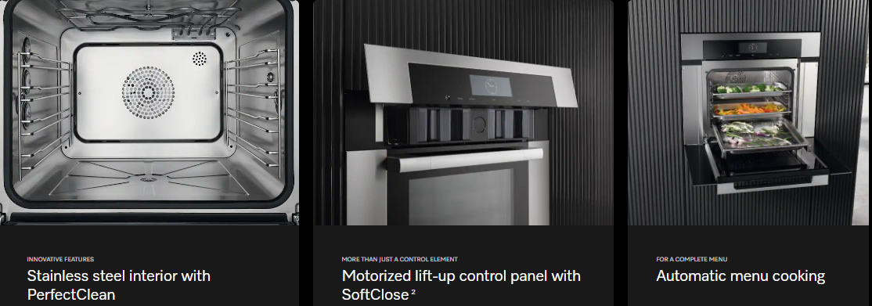
What do you know about Miele Steam Ovens?
Believe it or not – Miele is one of the easiest to use on the market, we use guided cooking, have the most precise steam control, and are the most versatile on the market- here’s why:

Slide 2
True Combination Cooking
  3 in 1 appliance – Steam, Convection Oven, and Combination steam/convection cooking
  Steam veggies, roast meats, bake bread, reheat leftovers, sous-vide, crisp/brown foods
MultiSteam Technology
  Multi steam inlets
  External steam generation
  Even steam distribution throughout the cavity
  Faster heat up times
  More consistent cooking
  Better humidity control
  More multi level cooking
  No flavor transfer!!!!
Ease of Use
  Guided cooking – step by step cooking assistance – great for first time steam oven owners
  Food-specific presets – luxury homeowners want convenience
  No more guessing the humidity – MasterChef automatic settings (this is a big upgrade for any homeowner)
Flexible Installation
  Plumbed models
  Non-plumbed models
  Compact 24 inch
  Larger 30-inch versions

Slide 3
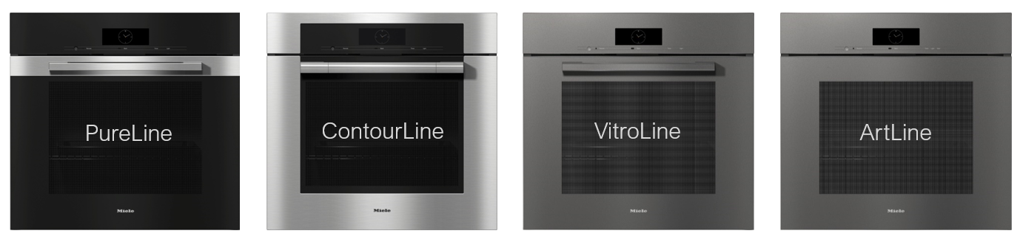
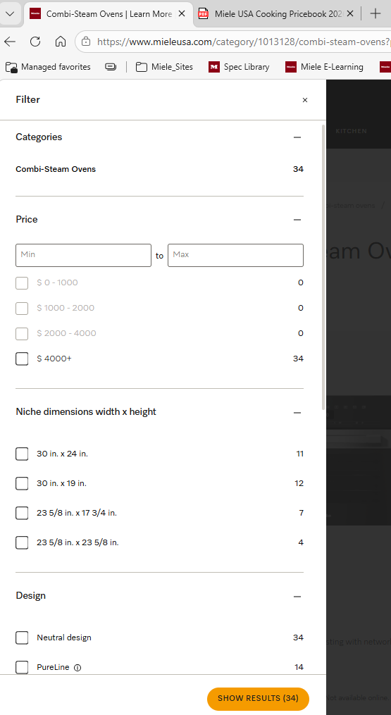
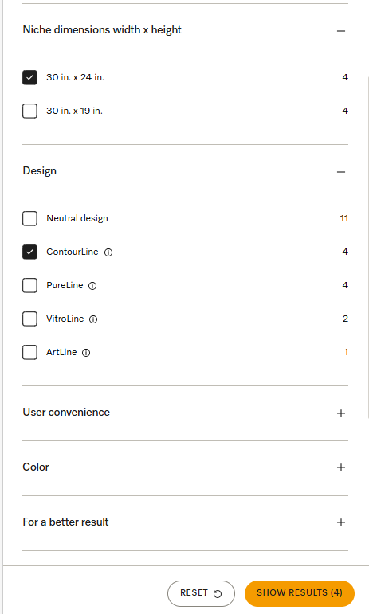
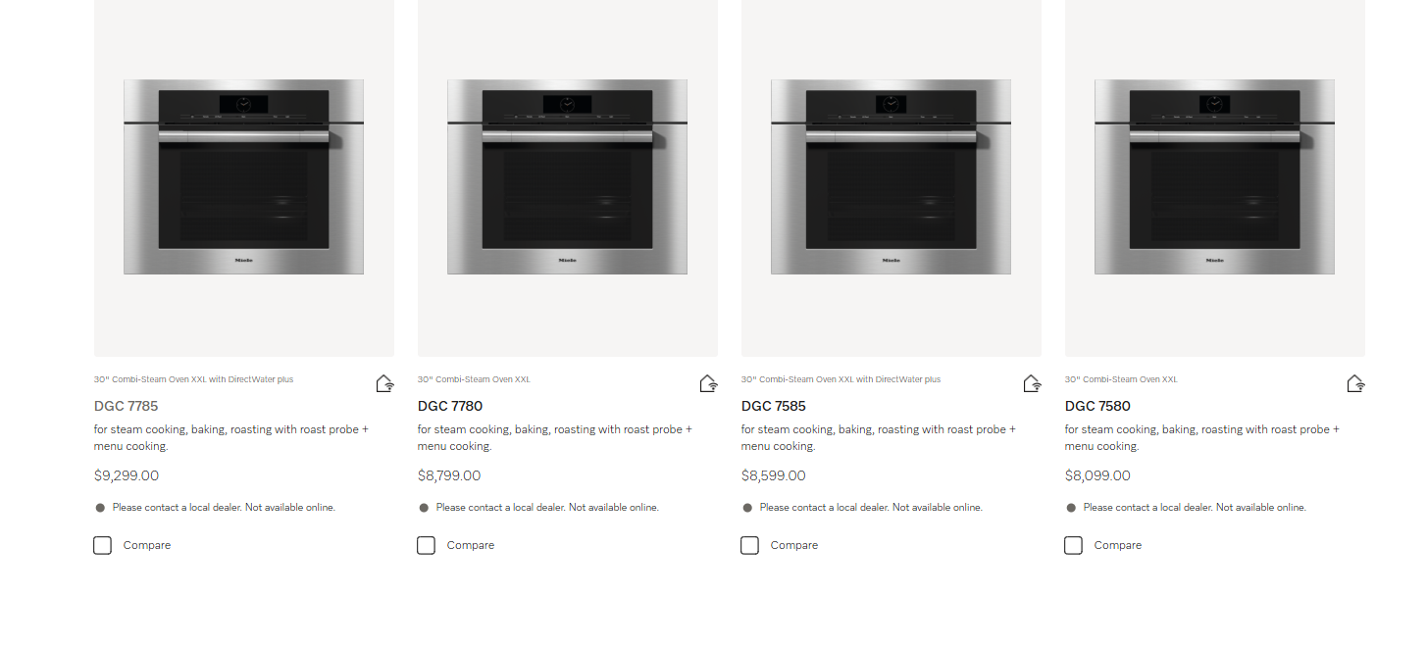
Don’t get caught up in the details! Keep it simple! Yes, we have a ton of options, but once you narrow it down to what the customer is looking for it’s easy!
I went from 34 options to 4 by only picking out my dimension and design on the website – now I just need to pick plumbed or non-plumbed and I basically have it!

