Slide 1

Updates for 2026

Slide 2
2026 updates
2026 pricing effective April 1st, 2026:
3% increase on bathroom, 3.5% increase on architectural hardware
Lav faucet price will not increase.
NL (unlacquered brass) price point has been brought down in line with Polished Nickel (PN).
Single hole freestanding tub fillers across collections have seen a significant price reduction.
New products for 2026
New goose neck shower arms (see slide 6).
New adjustable shower heads (see slide 7).
New cabinet hardware inspired by the LMK bathroom collection (see slides 9-13). Brochure link on slide 9.
Other
Satin Nickel (SN US15) finish code has changed to Brushed Nickel (BN). Same finish, new finish code.
Satin Nickel with Matt Black Chrome accents (SSB) finish code has changed to Brushed Nickel Black (BNB). Same finish, new finish code.
New US Technical Support
Philip Procter
philip.procter@samuel-heath.com
(929) 263 2751
Hours: 8am – 4pm EST

Slide 3
Tub filler price reduction

Slide 4
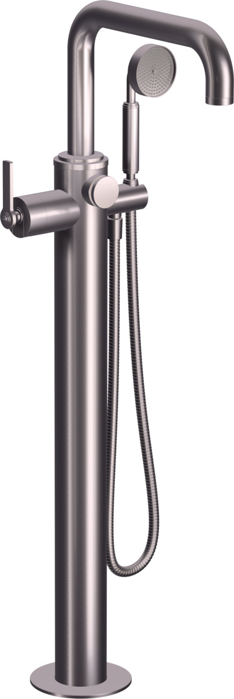
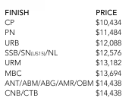
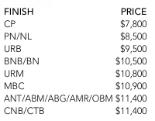
Single hole tub filler price reduction across collections
LMK Pure – V7K36LF
2025 list prices
2026 list prices
Note: V736-AIS tub filler rough has reduced from $2,590 in 2025 to $1,600 in 2026

Slide 5
New shower arms/heads

Slide 6
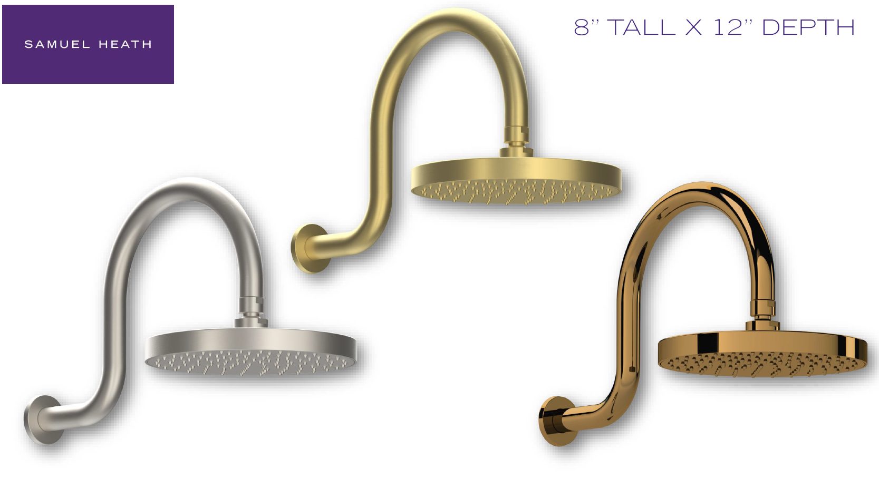
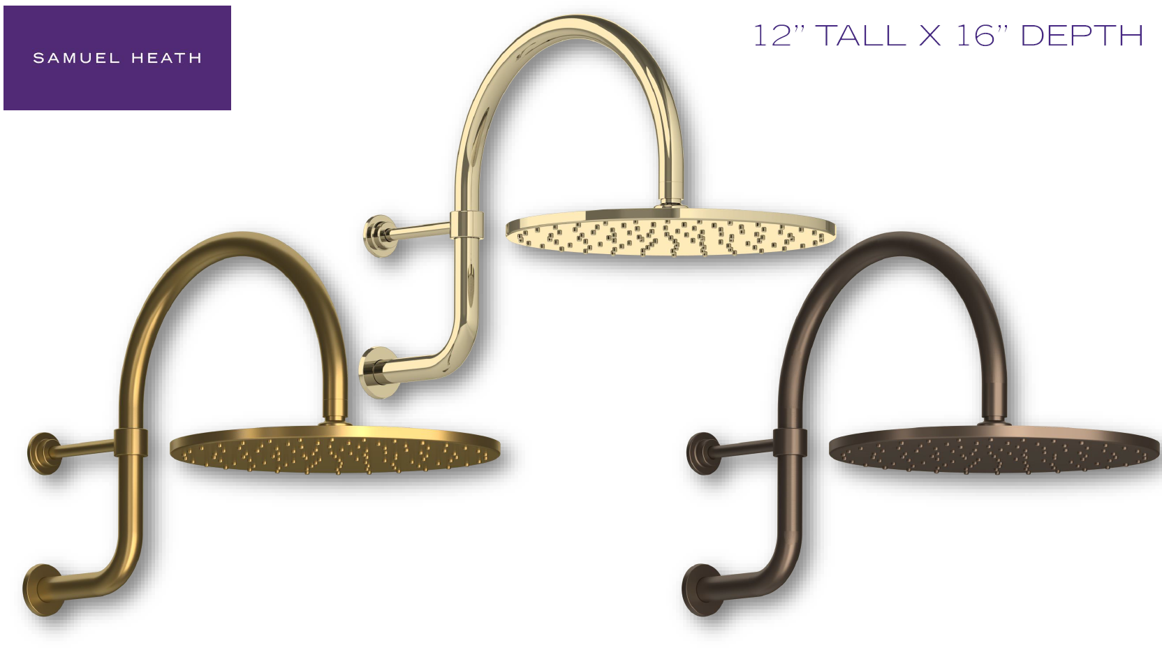
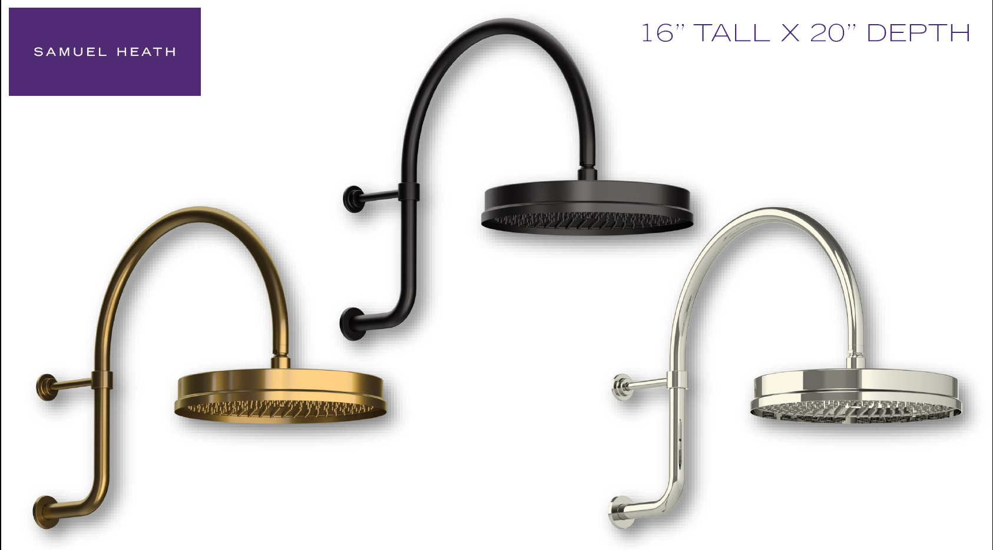
New shower arms

Slide 7
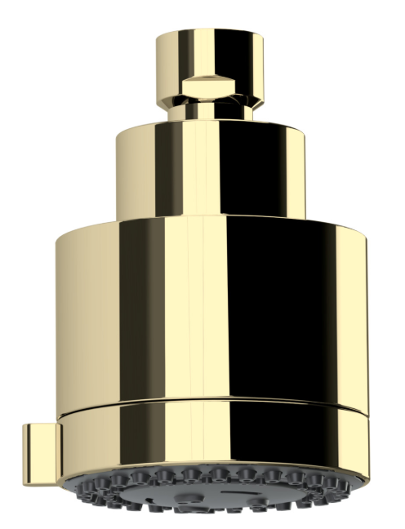
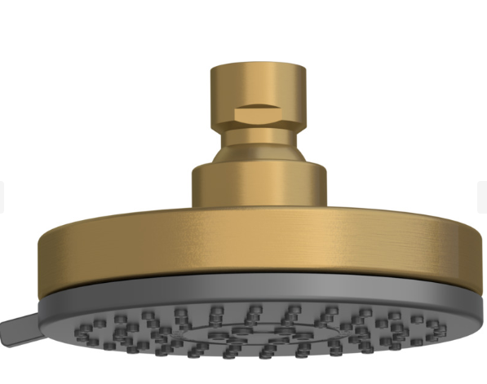
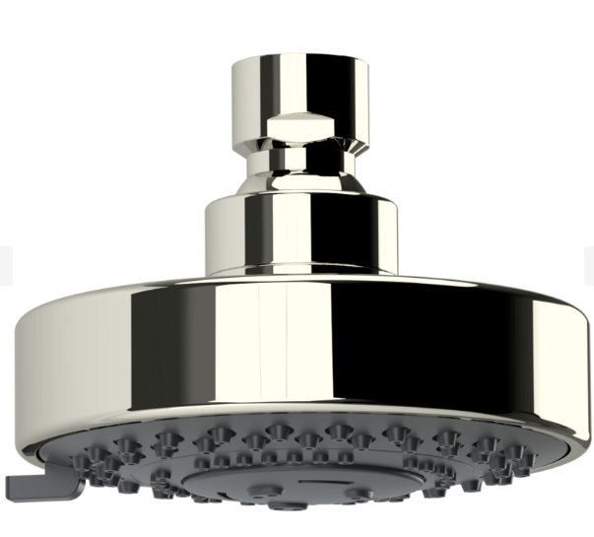
New shower heads
V784 V785 V786

Slide 8
Cabinet Hardware

Slide 9
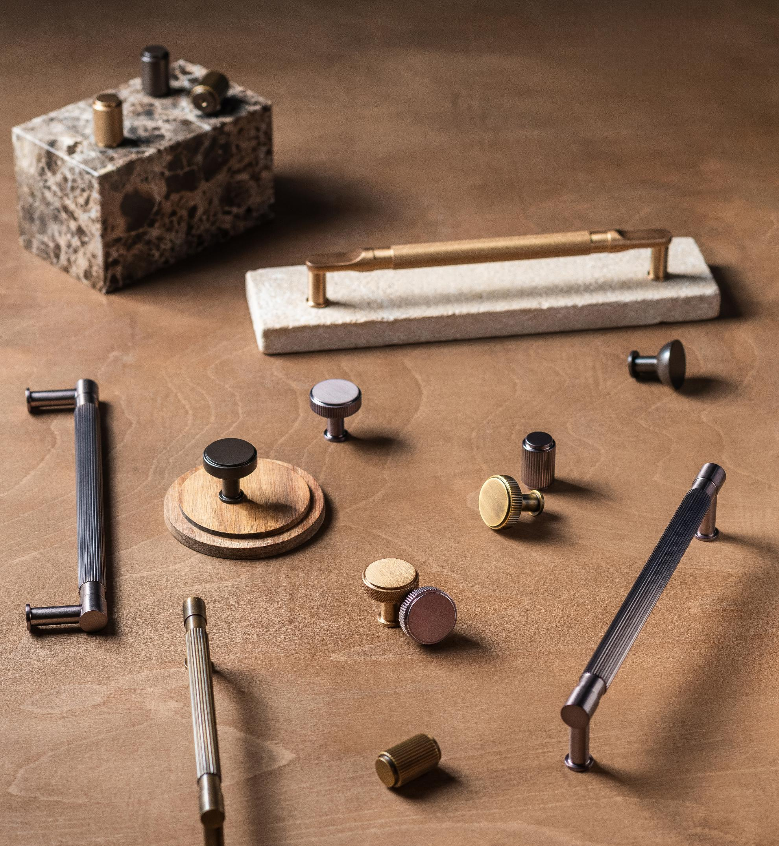
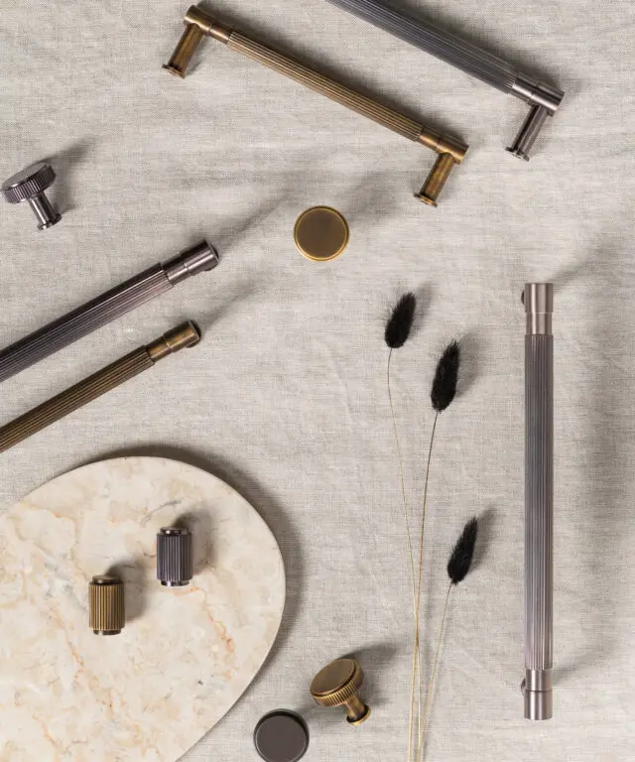
Samuel Heath Cabinet Hardware.pdf

Slide 10
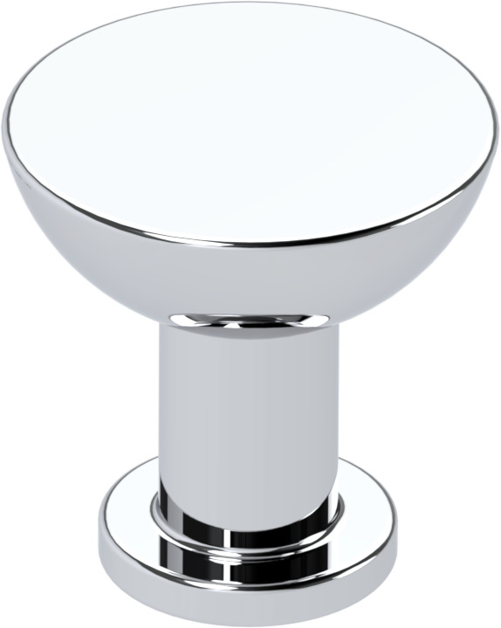

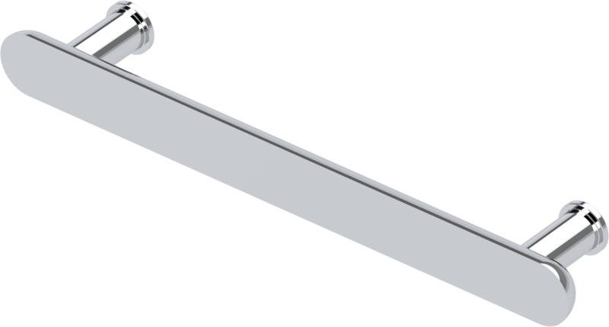
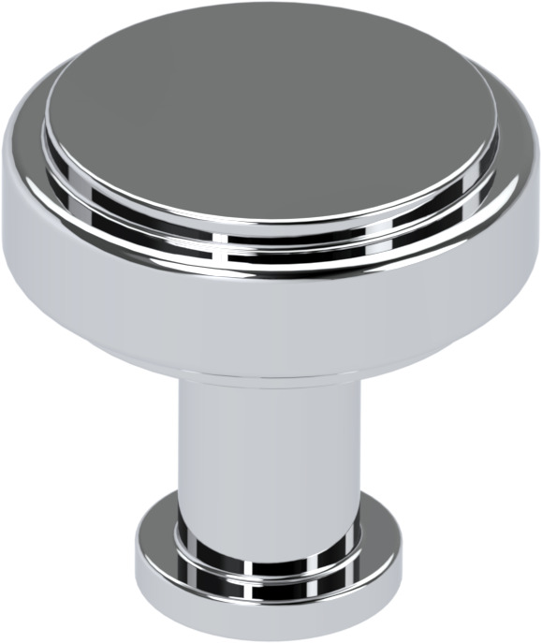
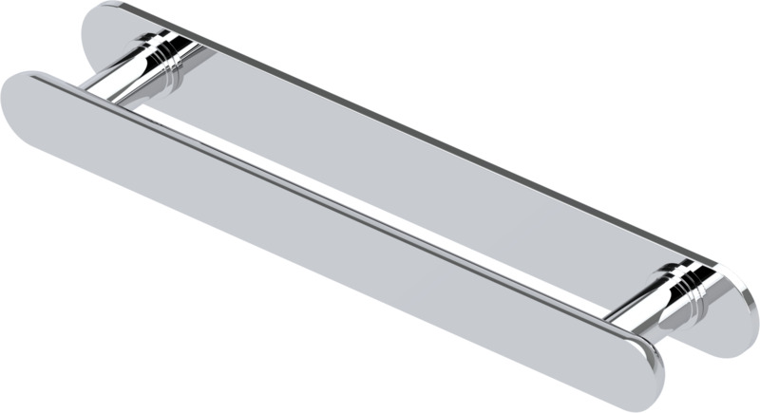
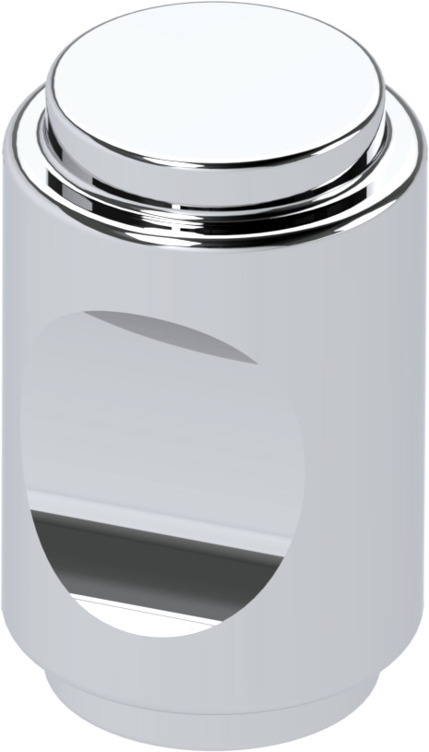
Cabinet knobs/pulls – Bauhaus (LMK Pure)
P801-A or B
Knobs
A size – 1”
B size – 1 ¼”
P8257-A-D sizes
P8252-A-D sizes
P799F-A or B
Cabinet Pulls
A size – 5 1/6” centers
B size – 6 5/16” centers
C size – 8 13/16” centers
D size – 11 5/16” centers
Appliance pulls
E size – 15 1/8” centers
F size – 23 15/16” centers
PK8257P-A-D sizes
P800F-A or B

Slide 11

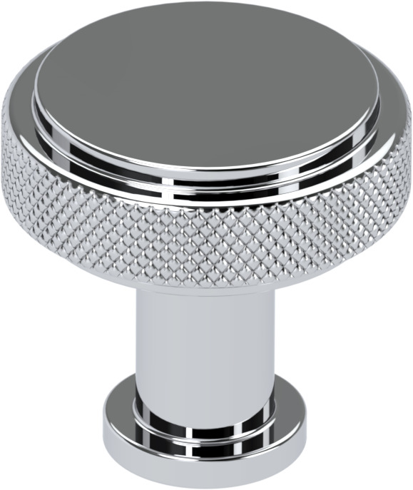
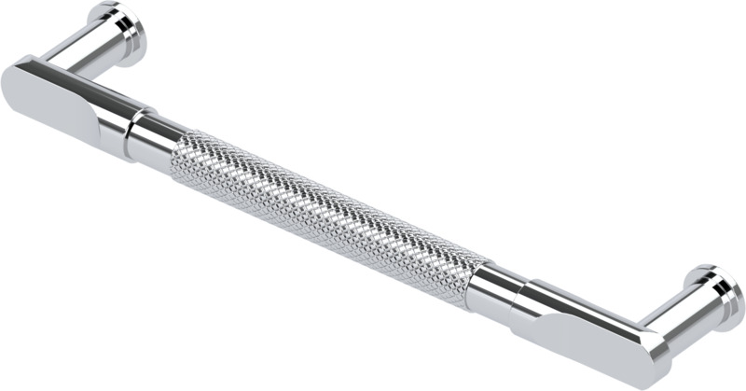
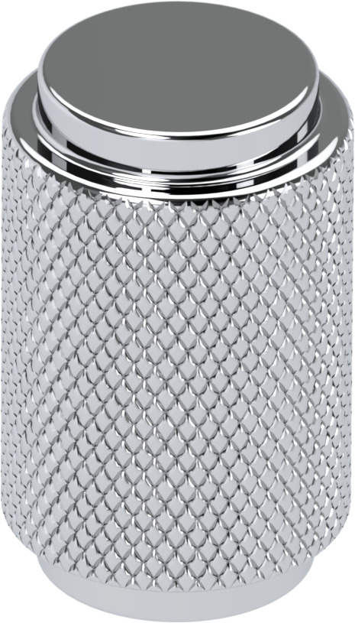
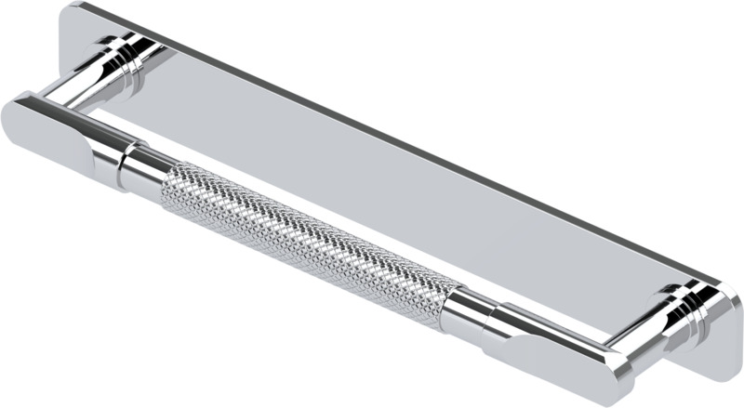
Cabinet knobs/pulls – LMK (LMK Industrial)
Knobs
A size – 1”
B size – 1 ¼”
P799K-A or B
P8256K-A-D sizes
P8250-A-D sizes
Cabinet Pulls
A size – 5 1/6” centers
B size – 6 5/16” centers
C size – 8 13/16” centers
D size – 11 5/16” centers
Appliance pulls
E size – 15 1/8” centers
F size – 23 15/16” centers
P800K-A or B
PK8256P-A-D sizes

Slide 12
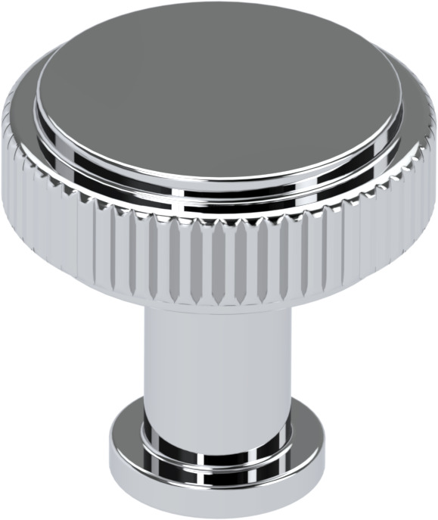

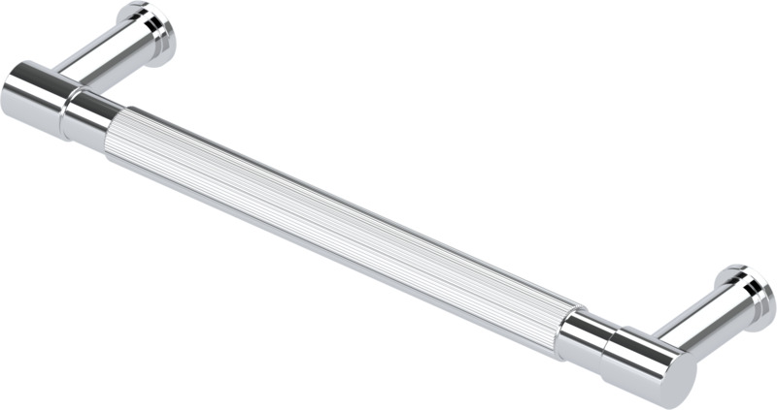
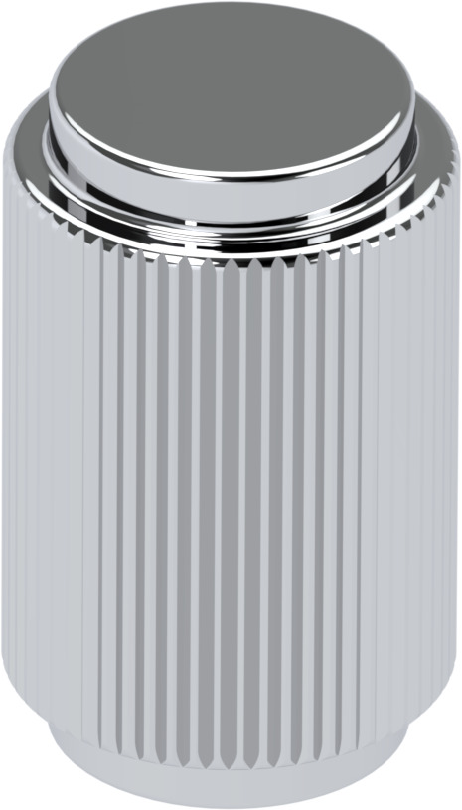
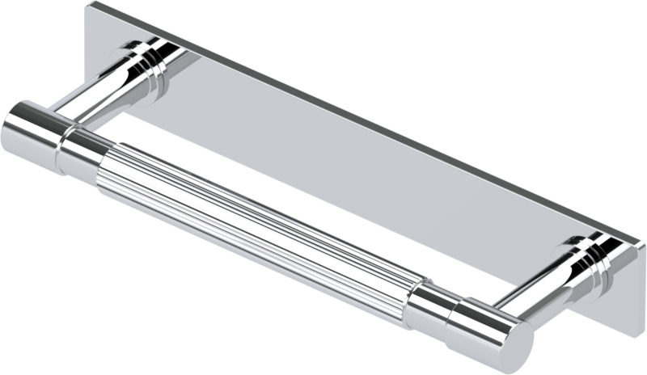
Cabinet knobs/pulls – Reeded (LMK Industrial)
Knobs
A size – 1”
B size – 1 ¼”
P799L-A or B
P8258-A-D sizes
P8254-A-D sizes
Cabinet Pulls
A size – 5 1/6” centers
B size – 6 5/16” centers
C size – 8 13/16” centers
D size – 11 5/16” centers
Appliance pulls
E size – 15 1/8” centers
F size – 23 15/16” centers
P800L-A or B
PK8258P-A-D sizes

Slide 13
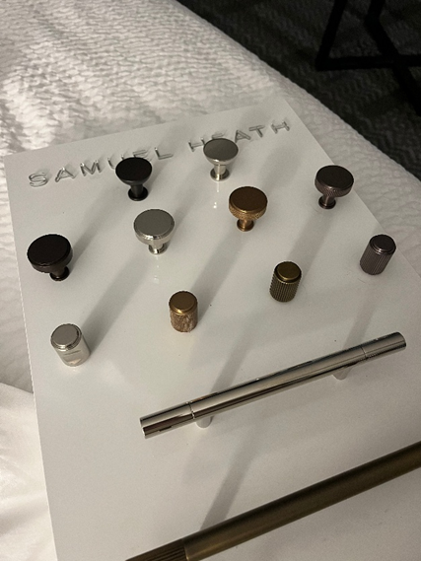
Display board option
High gloss white
– 20” H x 12”W x 2” D

