Slide 1
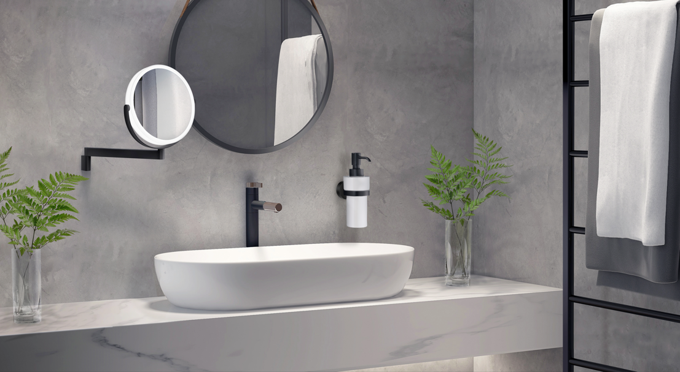

NEW FALL PRODUCTS 2025

Slide 2
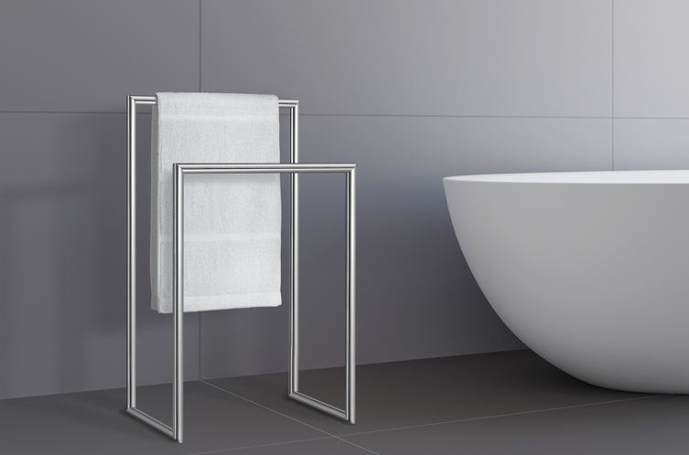
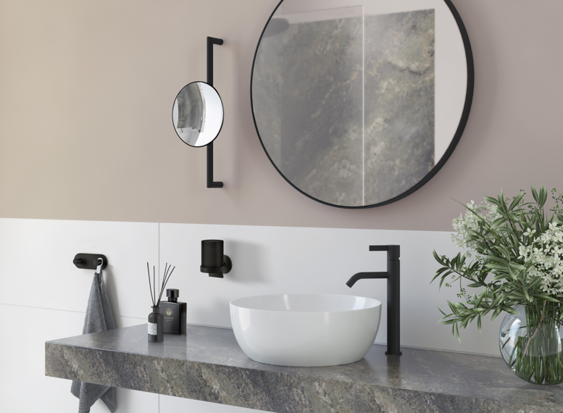
SMEDBO LAUNCHING Q4 2025
10 YEARS
WARRANTY
FREESTANDING
MAKE UP MIRRORS
We are designers. Visionaries. Masters of details.

Slide 3


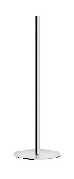


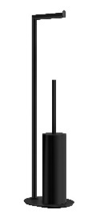
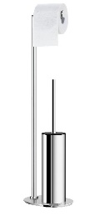
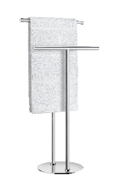
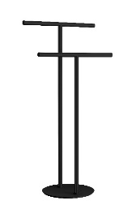
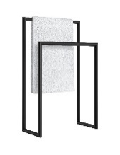
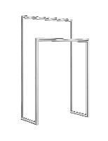
LAUNCHING SMEDBO Q4
FREESTANDING BATHROOM ASSESSORIES
Ola Giertz, our Head of Design, shares the thoughts behind the new range:
After years of development, we’re proud to present our new freestanding bathroom range at Smedbo.
From the first sketches, it’s been an exciting journey to create a concept that shows how timeless, graphic design can transform your bathroom into a spacious and inviting space.
As the bathroom has evolved into a place for wellness and relaxation, our team focused on blending aesthetics with smart functionality. The result is a clean, minimal design – free from unnecessary details – that reflects our Scandinavian heritage and design DNA.
A clean minimalistic design and smart functionality.

Slide 4
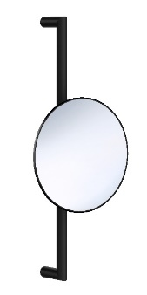
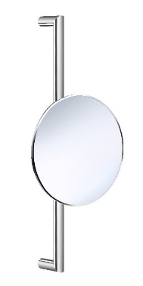
LAUNCHING SMEDBO
NEW MIRROR
Ola Giertz, our Head of Design, shares the thoughts behind the new mirror:
” At Smedbo we have many years of expertise in the world of wall mounted and freestanding mirrors. Our collection includes a wide range with different models suitable for different environments such as bathroom, hallway or dressing rooms. We are now proud to expand this category with a new fresh model with our functional and minimalist approach.
Our design team have paid much attention to the details and tried to merge that with our Nordic aesthetics. Early in the design process we focused on how we can combine the technology and integrated functionality with the simplicity, since the timeless elegance is important for our brand. When created the first sketches, we used our knowledge and toolkit to focus on the people’s needs, in this way we were can develop these innovative and aesthetical mirrors for every home.
Our Scandinavian mirror collection is sprung from our passion for design, and we proudly present our newest model 493 for the world”
Timeless elegance, where Scandinavian simplicity meets smart innovation.

Slide 5
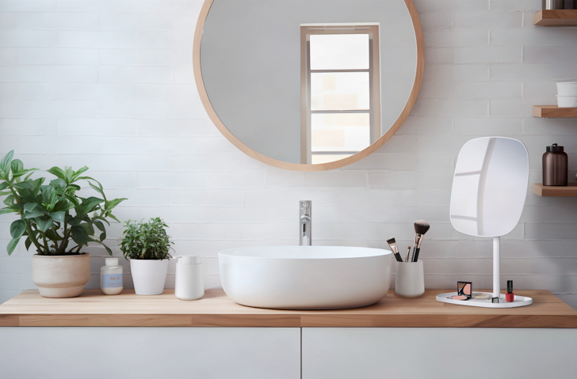
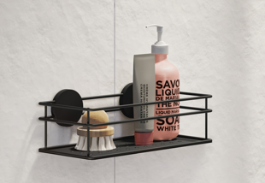
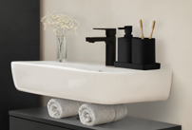
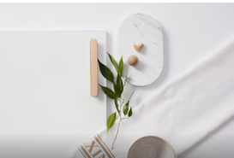

BB BATH LAUNCHING Q4
5 YEARS
WARRANTY
MAKE UP MIRRORS
SHOWER BASKETS
FREESTANDING BATH SATIN SQUARE & WAVE
DRAWERS,KNOBS, HOOKS, HOOKRAILS
UNIQUE USP FOR BB – STAINLESS STEEL
At Beslagsboden, we choose stainless steel for many of our products –ESSENCIAL FOR THE SHOWER!
Stainless steel - a material known for its strength, durability, and refined look.
Resistant to scratches, impacts, and daily use –while ensuring your products stay beautiful over time.

Slide 6
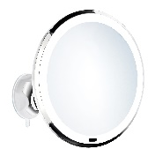
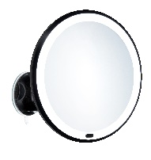
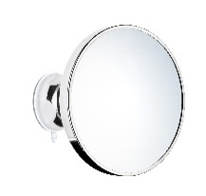
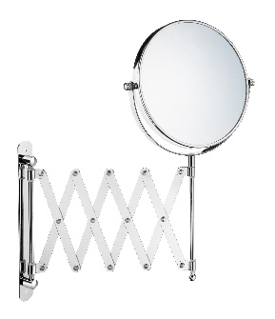
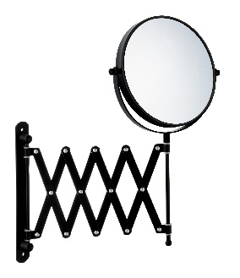
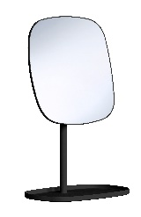
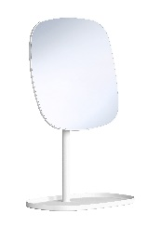
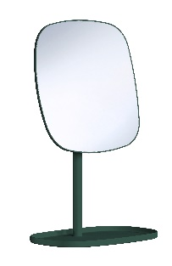
LAUNCHING BB BATH
BB BATH Mirrors :
New mirrors from Beslagsboden – stylish looks for every home.
At Beslagsboden, we create affordable mirrors designed for every home. Our new collection includes both wall-mounted and freestanding models in a variety of shapes, colors, and functions. From modern LED mirrors to timeless classics with a vintage touch – you can find the perfect piece to complement and elevate your interior.
Perfect match to the Satin Range.
Smart, stylish, and accessible – mirrors that bring personality and function to any room.

Slide 7
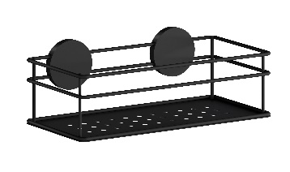
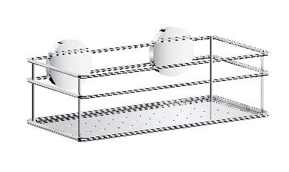
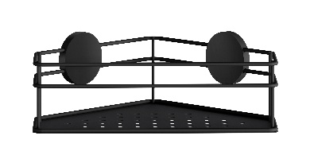
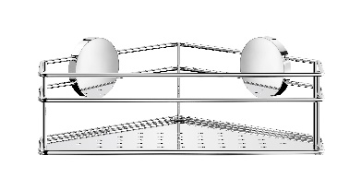
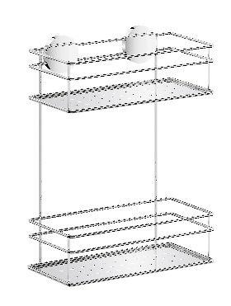
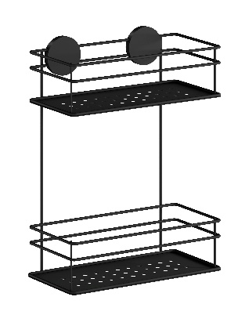
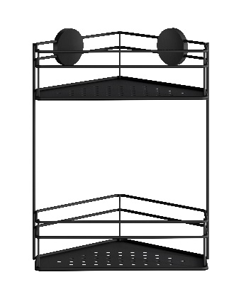
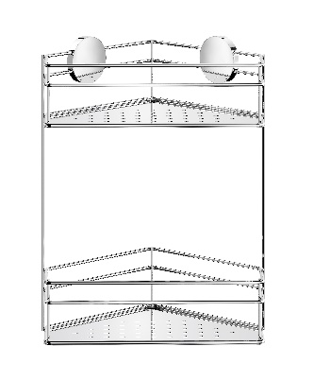
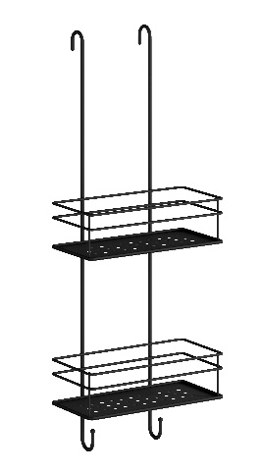
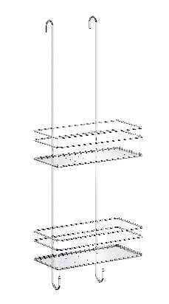
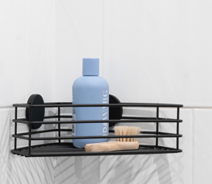
LAUNCHING BB BATH
BB BATH SHOWER BASKETS:
We are designers – let everybody know!
Ola Giertz, our Head of Design, shares the thoughts behind the new basket range:
” In a time when many wire thread baskets look similar, we are proud of now updating our successful assortment of wire baskets to be even more practical with a more luxurious look that stands out.
We have added 10 new baskets in our range, with solid bottom plates that keeps the shower products organized in a more practical way. The plate in stainless steel creates efficient storage and this new selection of baskets can fit into any bathroom style.
In these baskets we have reduced the amount of horizontal wire thread, which create an airier and more transparent look. The clean and graphic expression is important for this new family of baskets, in our try to be the leading Scandinavian supplier of high-end baskets.”
Designed to complement the modern home – crafted in stainless steel for long-lasting quality with a playful and functional edge.

Slide 8
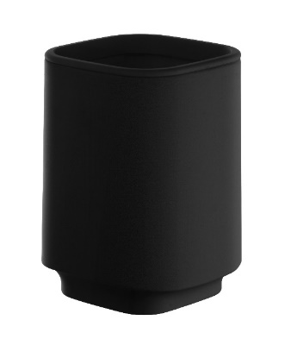
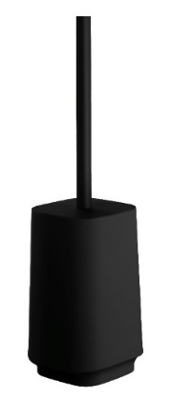
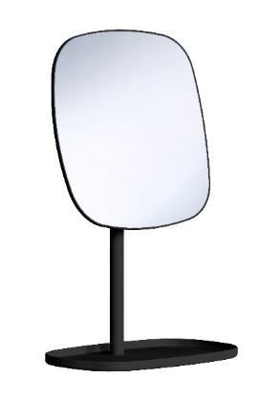
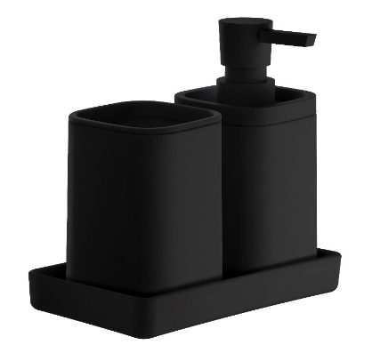
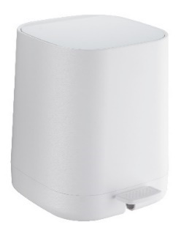
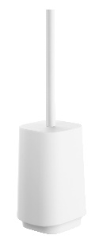
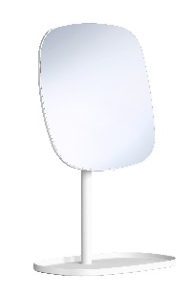
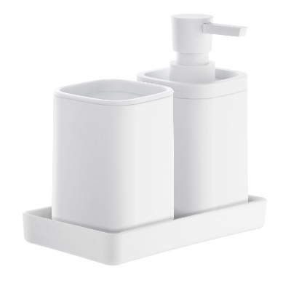
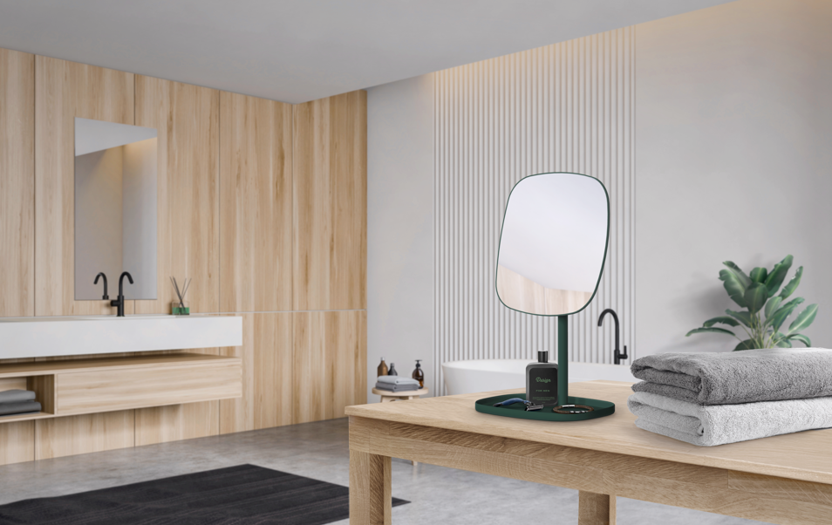
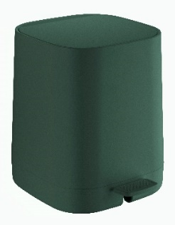
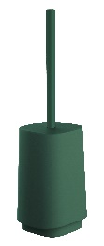
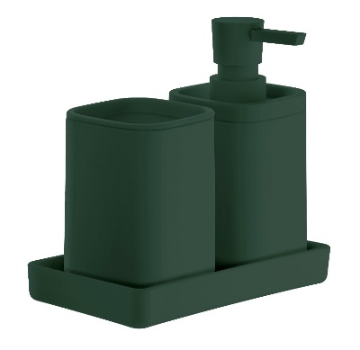
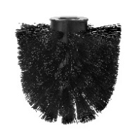
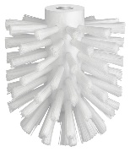
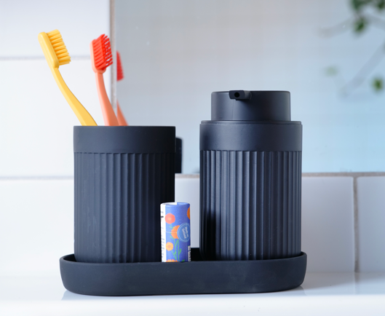




LAUNCHING BB BATH
BB BATH SATIN SQUARE
Discover the latest addition to BB BATH – a freestanding collection in Satin Square that brings a modern, trendy look to the bathroom. With its sleek square design, it offers the perfect mix of style and function. Now available in black, white, and deep green.
BB BATH WAVE

Slide 9

THANK YOU☺

