Slide 1
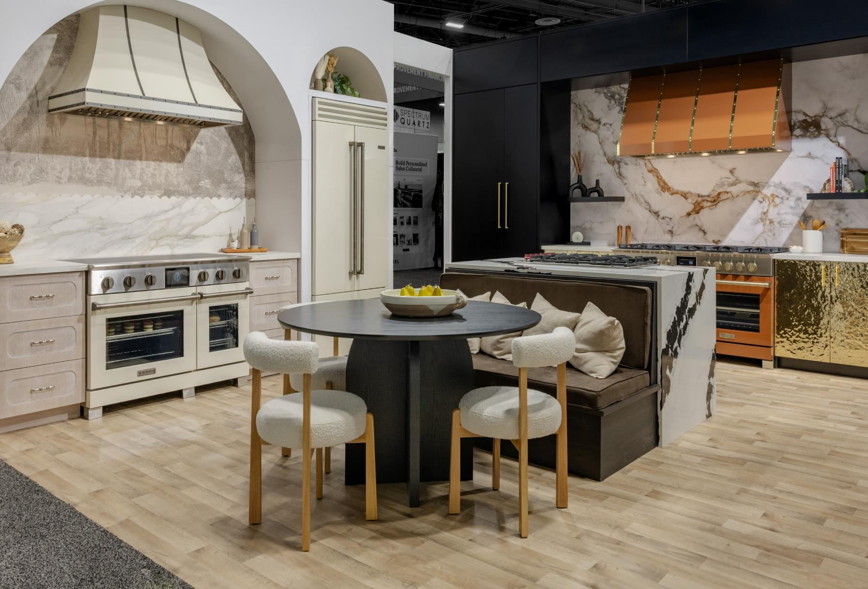
SPRING 2025

Slide 2
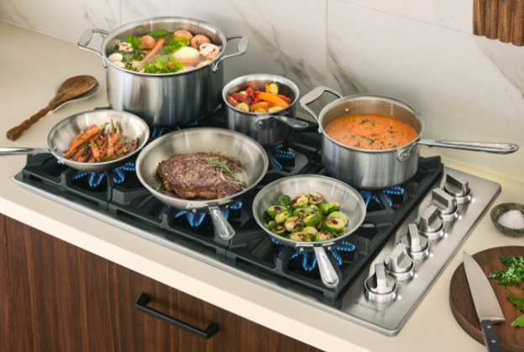
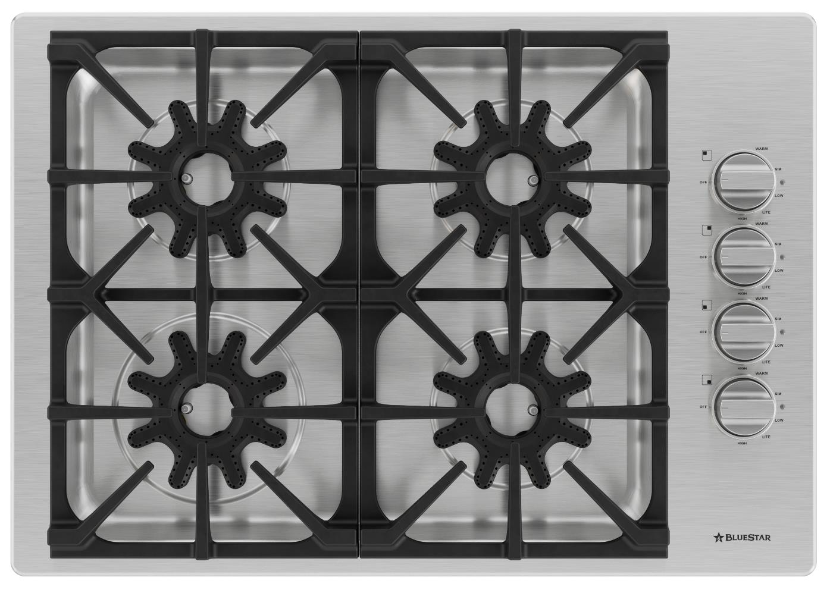
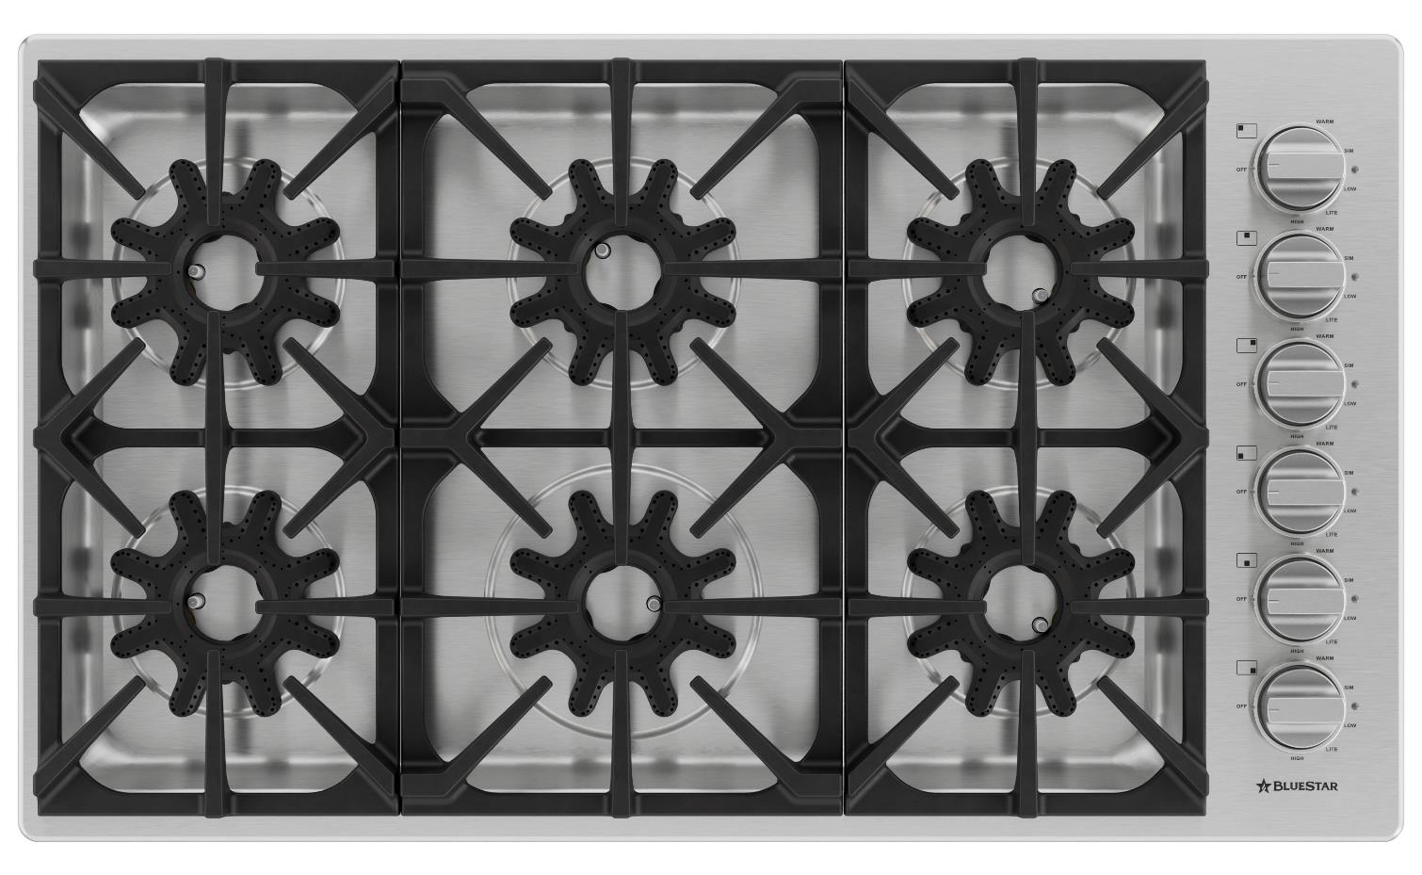

NEW PRODUCT NEWS
THE X-8™ GAS COOKTOP - Coming Soon!
      CHEF INSPIRED PERFORMANCE
Most powerful gas cooktop with a total of 95,000 BTUs*
Six X-8™ sealed burners with full-spectrum power, performance, and versatility from EVERY burner
  One 25,000 BTU power burner
  Five 14,000 BTU burners
Low 500 BTU setting on every single burner
Professional-grade cast iron grates
Handcrafted in Pennsylvania since 1880
      Customization options
Customize with 190 painted knob colors and several metal trims options
3O” cOOKTOP
MODEL#BSDCTX8304B
Starting at $2,195 UMRP
36”* cOOKTOP
MODEL#BSDCTX8366B
Starting at $2,745 UMRP

Slide 3

CURRENT PROMOTION
LEARN MORE
Take advantage of this promotion – which has been extended until the end of the year! Customers can save by bundling premium products from BlueStar®. Promotion now ends December 31, 2025.
Extended Until
12.31.25

Slide 4
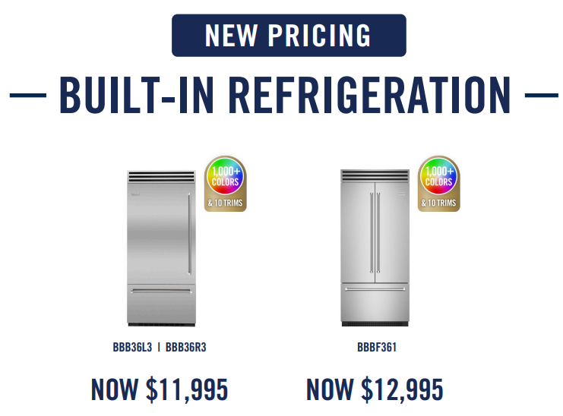
REDUCED PRICING
PRO Built-In Refrigeration
BlueStar® reduced pricing on PRO Built-In Refrigeration Line earlier this year – be sure to take advantage of this incredible pricing for a premium product.

Slide 5
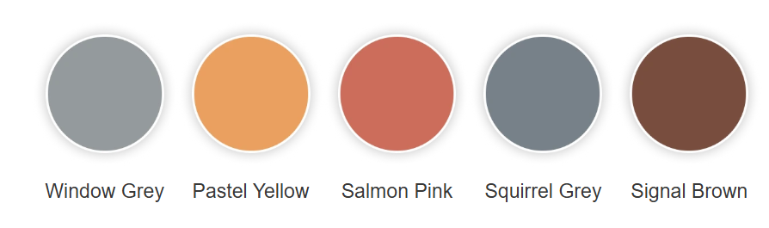


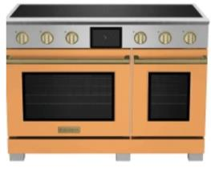


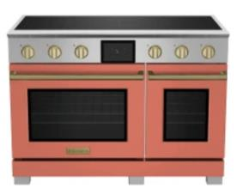

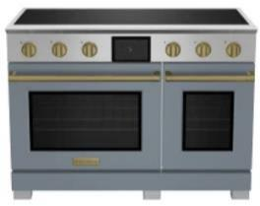

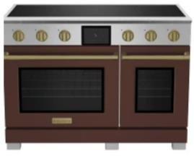

SUMMER COLOR COLLECTION
Calm and Elegant
LEARN MORE
This palette blends a mix of soft warmth and muted neutrals, creating a sophisticated and inviting seasonal look.
In home décor, these colors create a cozy, yet airy summer look, great for beachy or minimal interiors. This refined, sun-kissed aesthetic balances soft warmth with earthy depth - perfect for a modern, understated summer palette that feels both calm and elegant.
Window Grey
RAL 7040
Pastel Yellow
RAL 1034
Salmon Pink
RAL 3022
Squirrel Grey
RAL 7000
Signal Brown
RAL 8002

Slide 6

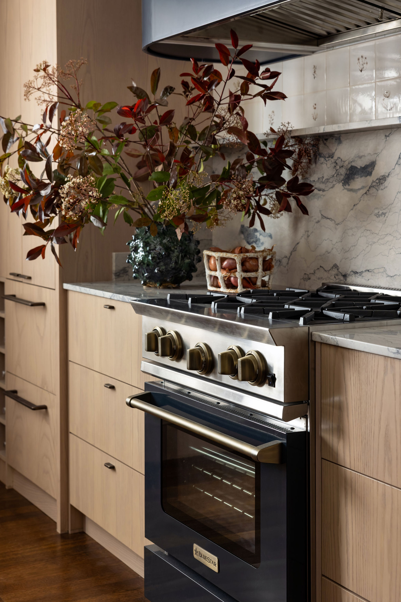
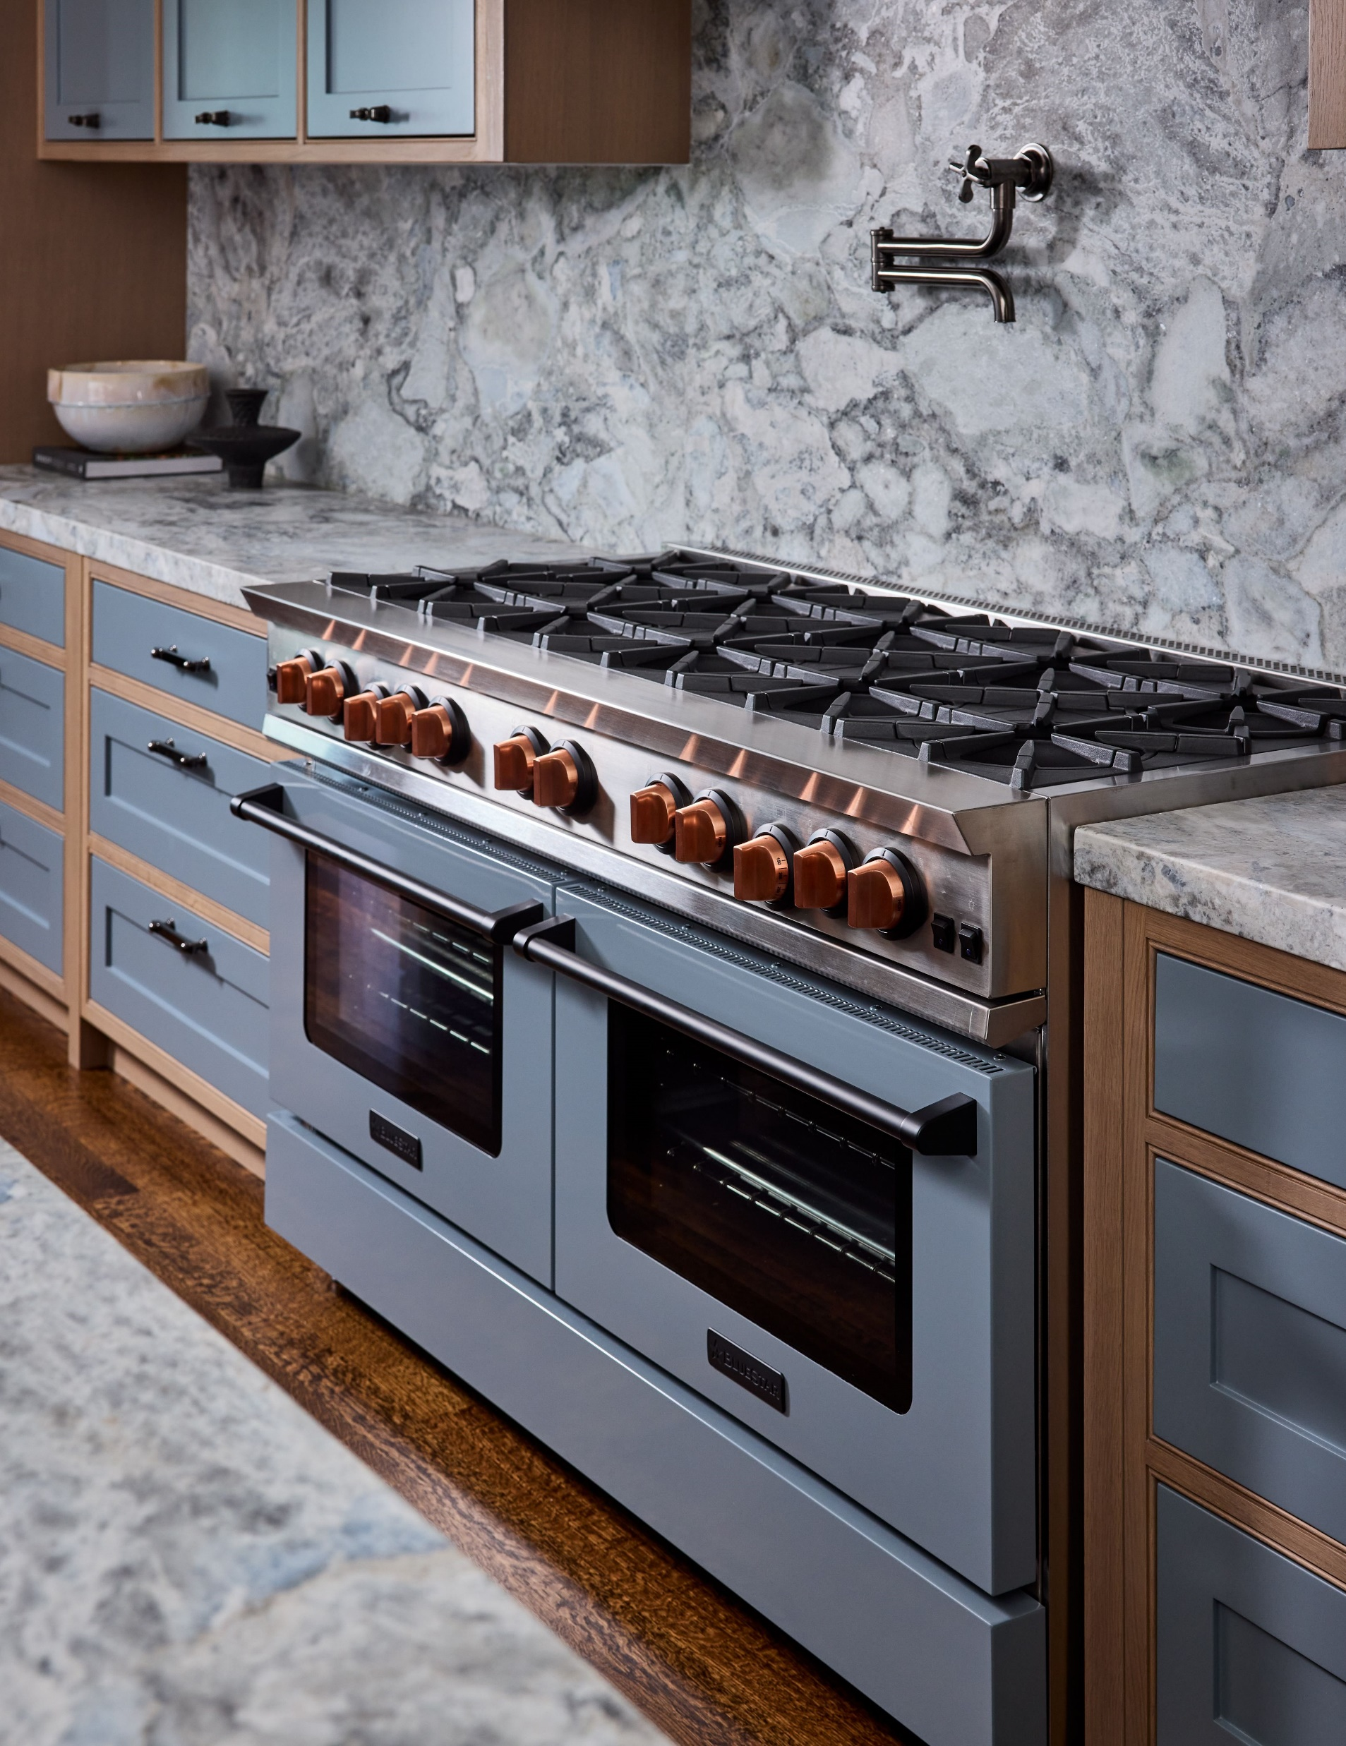
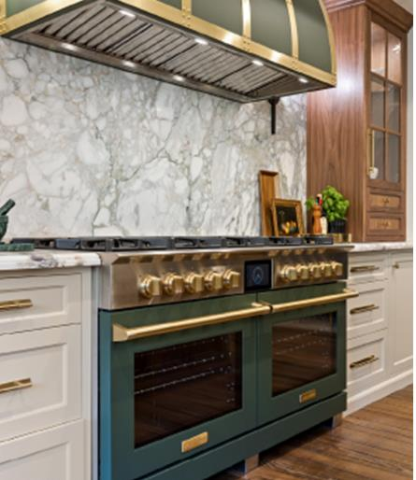

SHOWCASE DESIGN HOMES FEATURE BLUESTAR®
TAKE THE TOUR
Photo: John Merkl
Photo: Stephanie Russo
Photo: Lacey Wood
The 2025 San Francisco Decorator Showcase Home’s main kitchen shines with BlueStar’s 60" Nova Series Gas Range.
Designed by Kelly Hohla Interiors, the range is shown in Squirrel Grey (RAL 7000)
with matte black trim and brushed copper knobs.
Additionally, BlueStar was featured in the cozy and elegant
Garden Apartment. Designed by Katie Monkhouse, the
BlueStar 30" Nova Series Gas Range
is shown in Grey Blue (RAL 5008) with antique brass trim and knobs.
At this year's Pasadena Showcase House of Design, interior designer
Rachel Duarte brings her refined aesthetic to the kitchen with BlueStar’s 60" Dual Fuel Range and 60" Atlas Hood.
Blending timeless materials with functional elegance, her vision redefines the heart of the home with warmth and sophistication.
Both the range and hood are shown in Sunset Forest, with brushed brass trim and knobs, part of our curated
Alison Victoria color collection.

Slide 7

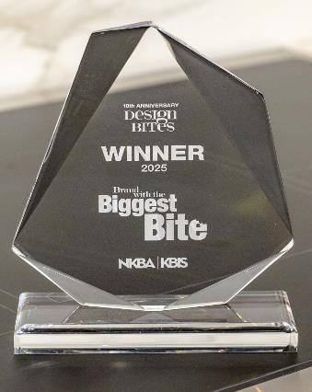







KBIS AWARDS AND MEDIA HIGHLIGHTS
BlueStar® garnered significant media attention and received multiple awards
at KBIS 2025 in Las Vegas.
Awards Summary
Design Bites – Brand with the Biggest Bite Winner
Design Hounds “Favorite Finds”
Designers Today Magazine Gold Award
Media Coverage Summary
642,398,319 Total Impressions
  Highest Impression Stories: Forbes,
  Martha Stewart, Houzz
  38 Press Placements
    11 Consumer Stories
    27 Trade Stories

Slide 8
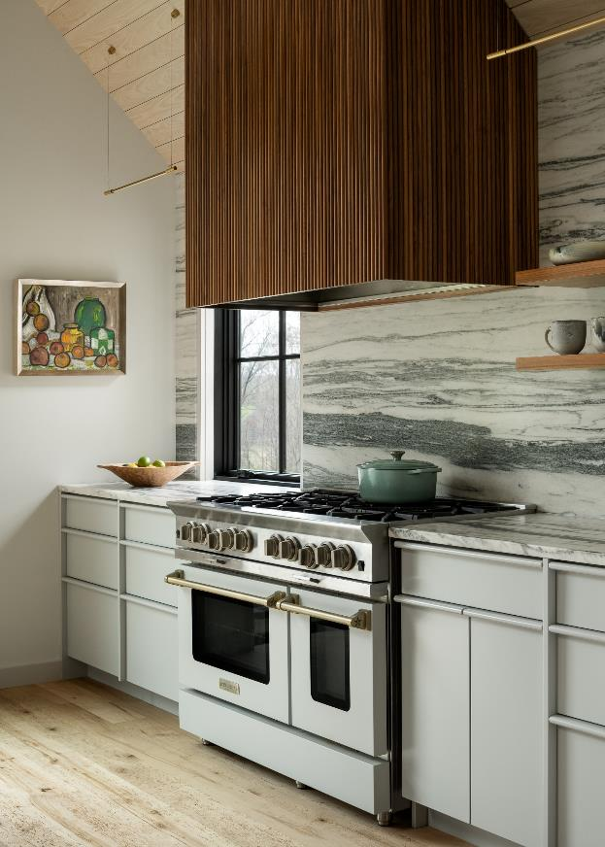
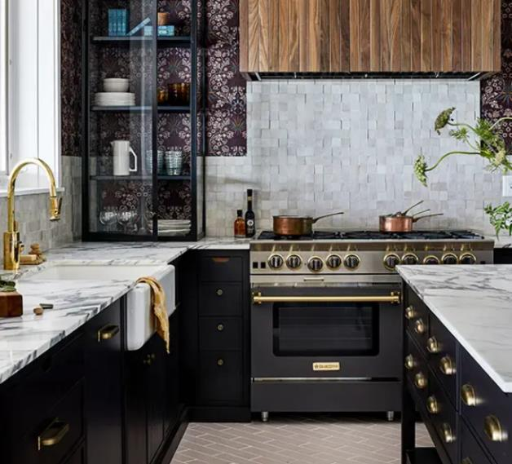
KITCHEN DESIGN CONTEST
LEARN MORE
Entry DEADLINE is May 21, 2025
If you have a designer that created an amazing kitchen with BlueStar® appliances, please encourage them to enter for a chance to win $20,000 in BlueStar® appliances and national recognition. The entry deadline is May 21, 2025.
Two of the Regional Winners from the 2024 BlueStar® Kitchen Design Contest

Slide 9
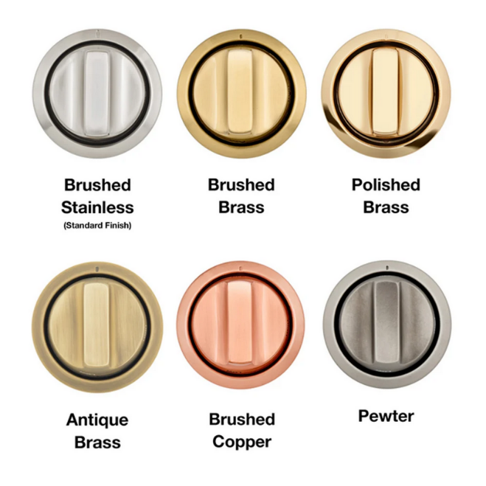
current plated trim offering
Brushed Stainless
Brushed Brass
Polished Brass
Antique Brass
Brushed Copper
Pewter

Slide 10
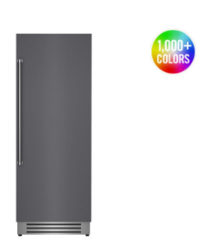



QUICK SHIP APPLIANCES
Customized Appliances with FAST Lead Times
LEARN MORE
Complete kitchen projects with ease! These BlueStar® appliances are available to ship in stainless in three weeks and with color in only four weeks!
Nova Series Rangetops
select sizes
Column Refrigeration
36” Counter Depth Refrigeration
Note: Add one week for either painted units, painted knobs or LP fuel type. Please allow 10-14 days for shipments to the West Coast.

