Slide 1
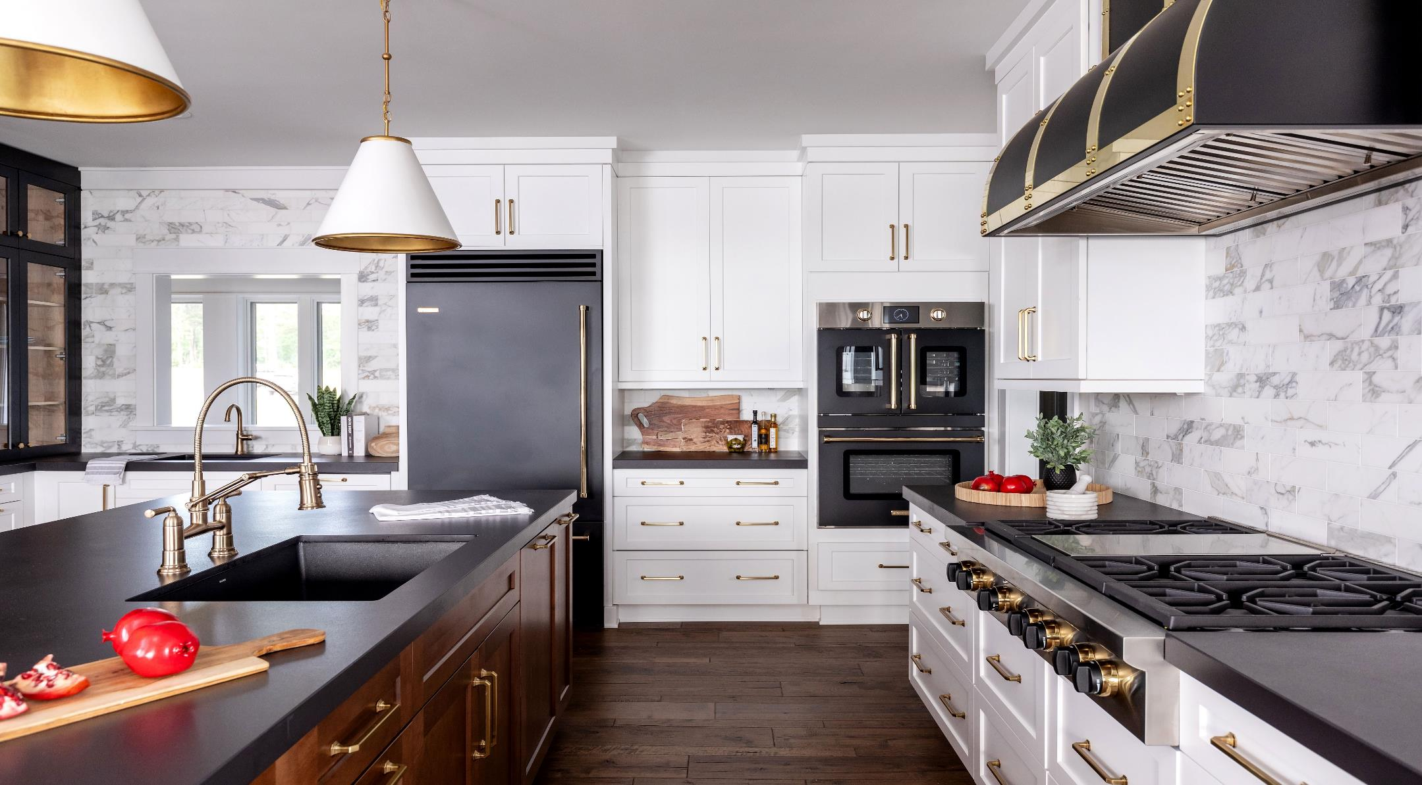
Winter 2025

Slide 2
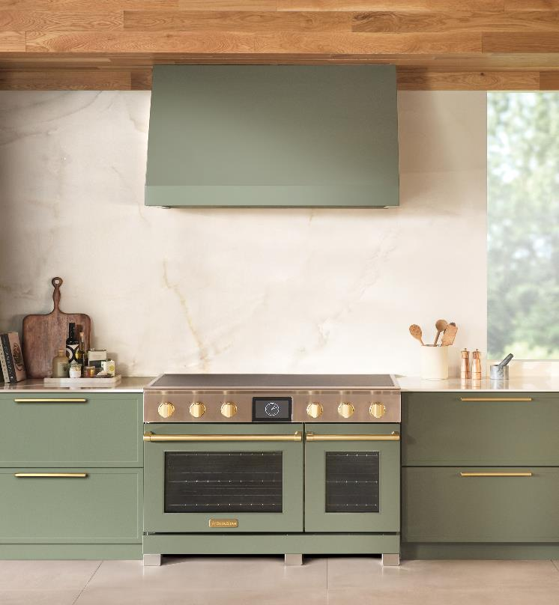

NEW PRODUCT NEWS
BLUESTAR® 48” INDUCTION RANGE: Now Shipping!
LEARN MORE
Bringing PRO to Induction
      Power and precision
Largest cooking surface, including two center 11" zones
The most powerful zone on the market with a searing 7,400 Watts
Versatile cooking surface features six oversized individual cooking zones and two bridge functions
Instant response and precise control on each cooking zone with nine levels of heat, plus simmer and keep warm options
Oversized True Convection electric ovens offer even heat and consistent multi-rack cooking results
      Innovation
Industry first: matte finish, durable scratch & stain resistant surface
Patent-pending power-level indicator light on each zone
Power Optimization System for uninterrupted cooking
      Unmatched customization
1,000+ colors and 10 metal trim options
BSPIR486Z
Starting at $15,995 UMRP
NOW SHIPPING!

Slide 3
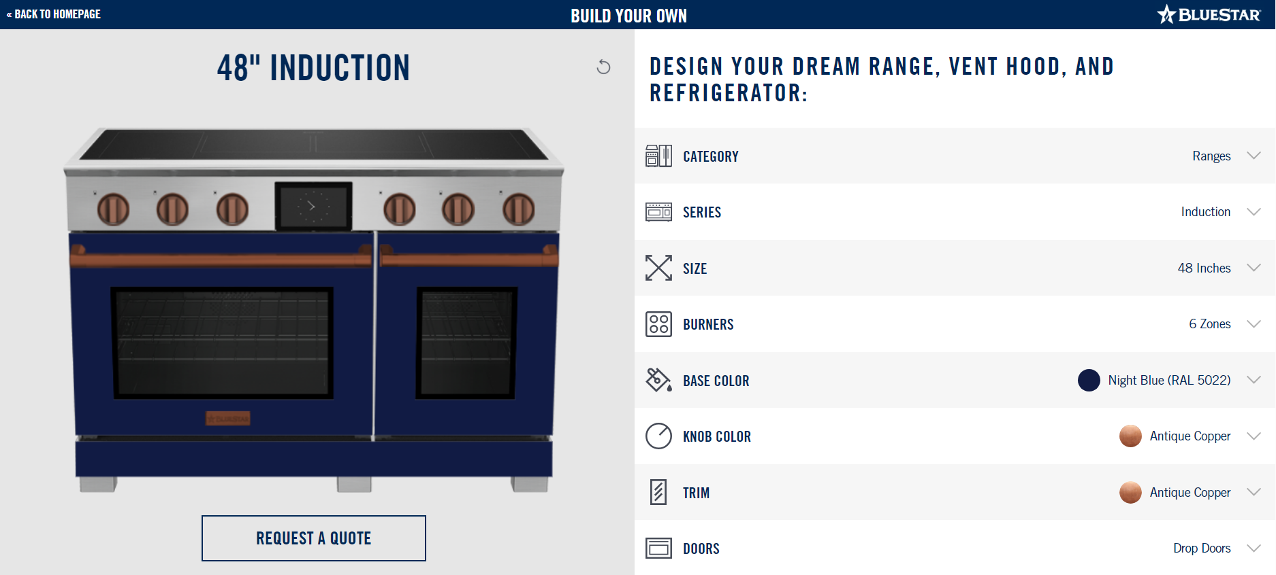
BLUESTAR® 48” INDUCTION RANGE
LEARN MORE
Customize Your Own
Now live on bluestarcooking.com, you can customize our new 48” Induction range. Customize with over 1,000+ standard colors & finishes or custom color match to your exact specifications.

Slide 4

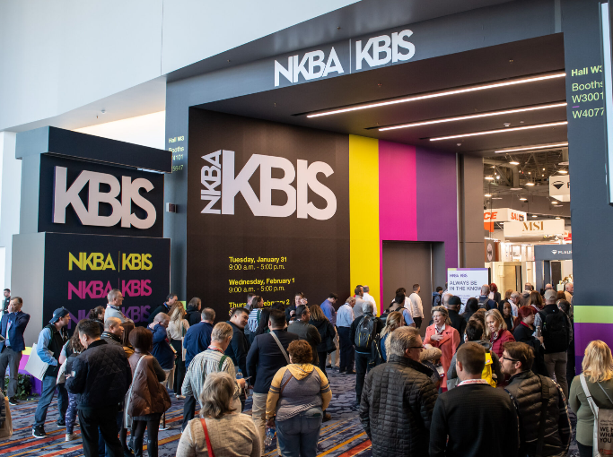
VISIT BLUESTAR AT KBIS
February 25-27 in Las Vegas, NV
Visit BlueStar at KBIS this year in the West Hall where we will showcase innovative new products and breathtaking designs. Explore an elegant space that perfectly blends top-tier performance with unparalleled customization options.
The following will be on display:
• NEW 48” Platinum Induction Range
• NEW X-8™ Drop-In Cooktop
• 60” Dual Fuel Range & our best-selling Nova Series gas range
• Built-In & Column Refrigeration
• An array of Custom Vent Hoods
• PLUS, our 2025 Color of the Year, Signal Brown
Please make an appointment with your Territory Sales Manager so we can provide you with a detailed tour of the booth.
BlueStar
Booth#W1877
2025 KBIS - Event Map

Slide 5

CURRENT PROMOTION
LEARN MORE
Customers can save by bundling premium products from BlueStar® this year.
This promotion runs from February 1-June 30, 2025.

Slide 6
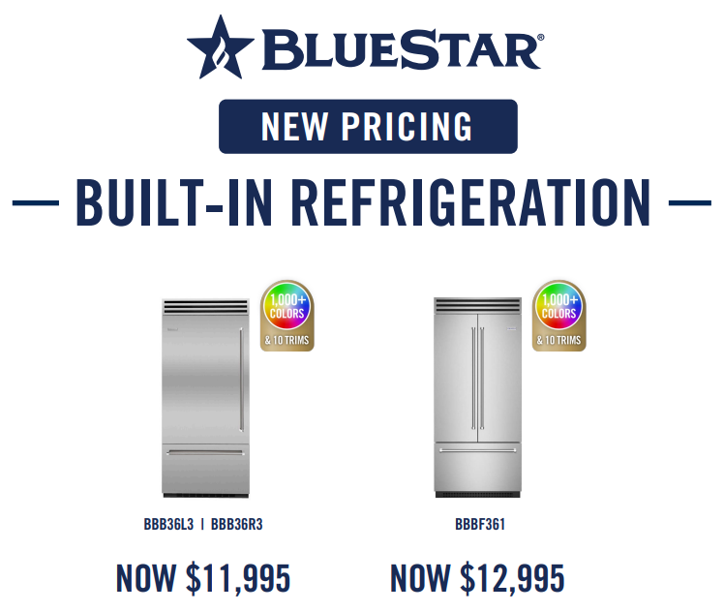
NEW PRICING
PRO Built-In Refrigeration
BlueStar just reduced pricing on PRO Built-In Refrigeration Line!

Slide 7

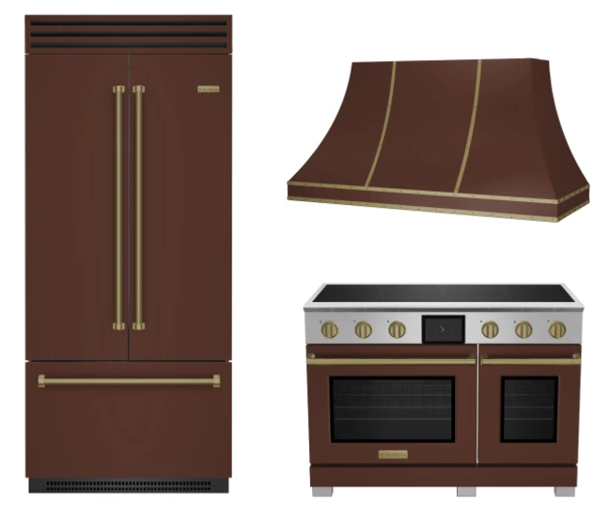

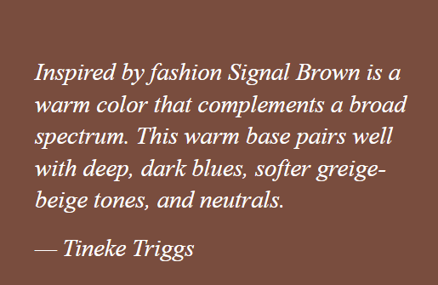

COLOR OF THE YEAR
LEARN MORE
BlueStar® Introduces our 2025 Color of the Year, Signal Brown
BlueStar® is proud to introduce its 2025 Color of the Year, Signal Brown.
The warmness of Signal Brown works well as a foundation and complements a broad spectrum of colors, like deep dark blues, softer beige tones, and neutrals.
The color was handpicked by San Francisco interior designer Tineke Triggs, a seasoned expert with six San Francisco Decorator Showcases to her name.
Her award-winning designs have graced the pages of Architectural Digest, Elle Decor, Dwell, Luxe, Modern Luxury Interiors and more.

Slide 8







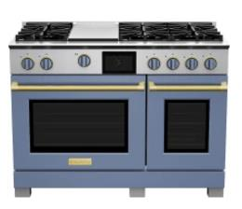
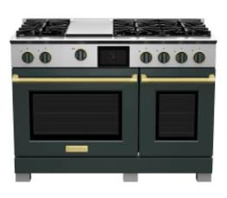
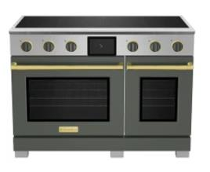
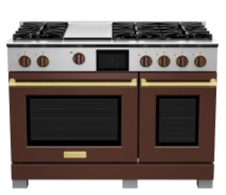
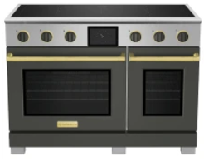
WINTER COLOR COLLECTION
Warm and Inviting
LEARN MORE
The curated palette features five colors—the green, grey, and brown hues offer a grounded feel reminiscent of earthy landscapes, while the blues layer in feelings of calmness and tranquility. Together, these colors create a harmonious winter offering featuring deep hues balanced with soft, subdued colors.

Slide 9
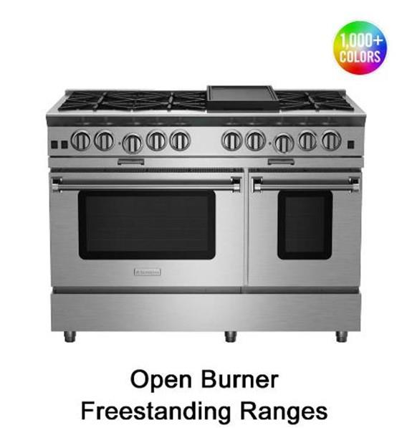
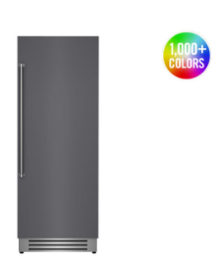
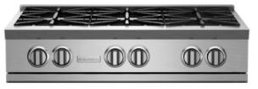
QUICK SHIP APPLIANCES
Customized Appliances with FAST Lead Times
LEARN MORE
Complete kitchen projects with ease! These BlueStar appliances are available to ship in stainless in three weeks and with color in only four weeks!
Column Refrigeration
Nova Series Rangetops-select sizes
Note: Add one week for either painted units, painted knobs or LP fuel type. Please allow 10-14 days for shipments to the West Coast.

