Slide 1
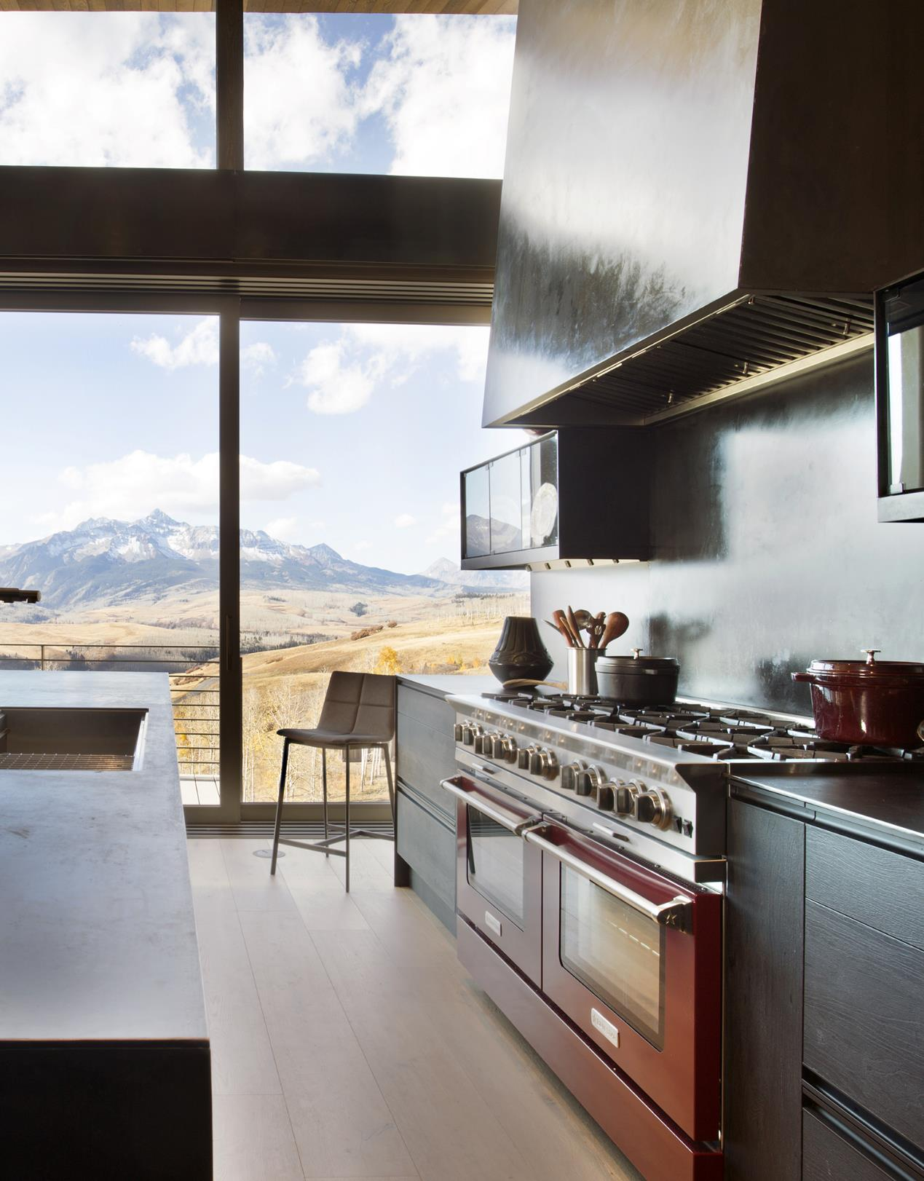
FALL NEWS
Updated
October 2024

Slide 2


NEW PROMOTIONS
LEARN MORE
Customers can save big on premium products from BlueStar this Fall. Both the Platinum series ranges, and Pro Built-In refrigeration products have a limited time special savings offer.
These promotions run from October 1 through December 2, so be sure to take advantage now and get customers into their dream kitchens for an incredible value.

Slide 3
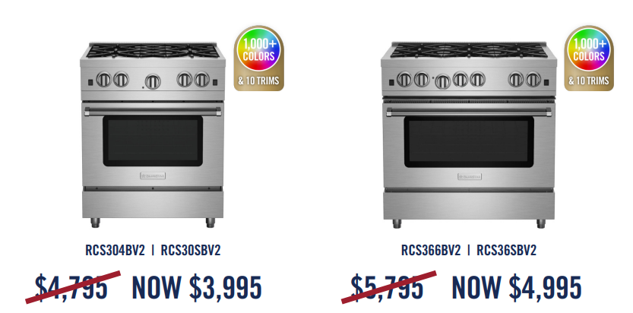
NEW REDUCED PRICING
Culinary Series Ranges
The 30” and 36” Culinary Series Ranges (RCS) now have an everyday price that has been reduced by $800.
This applies to both open and sealed burner ranges.

Slide 4

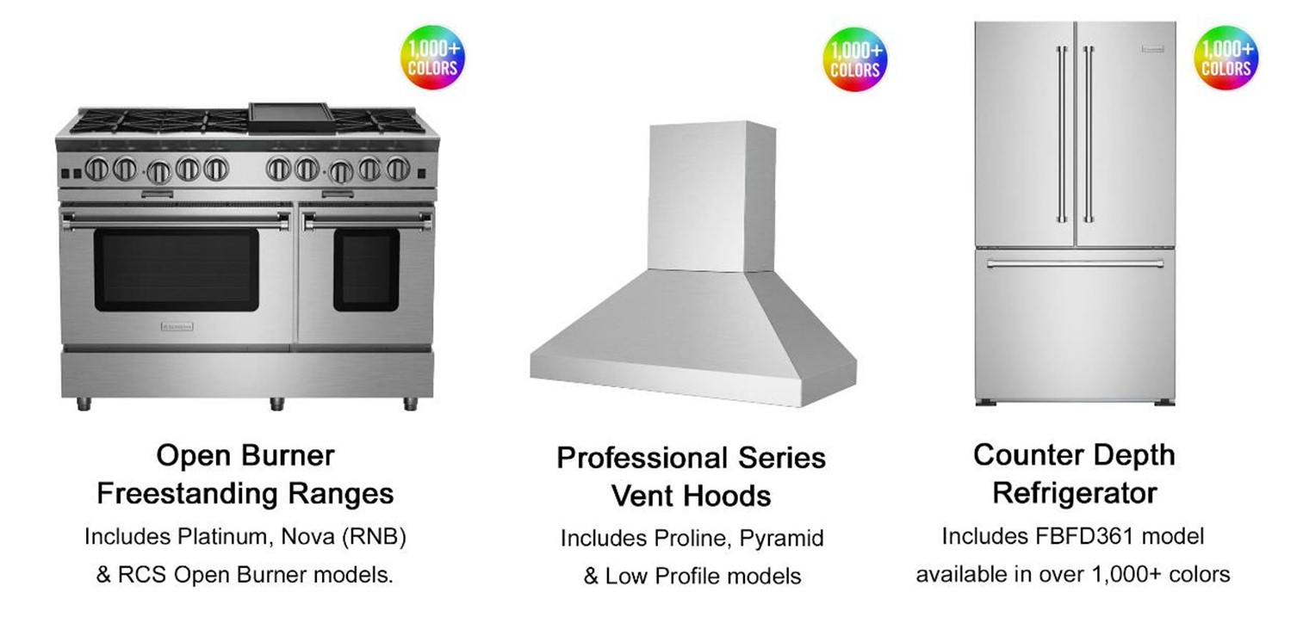
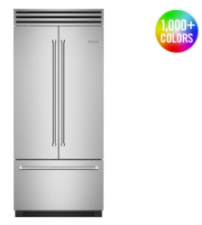
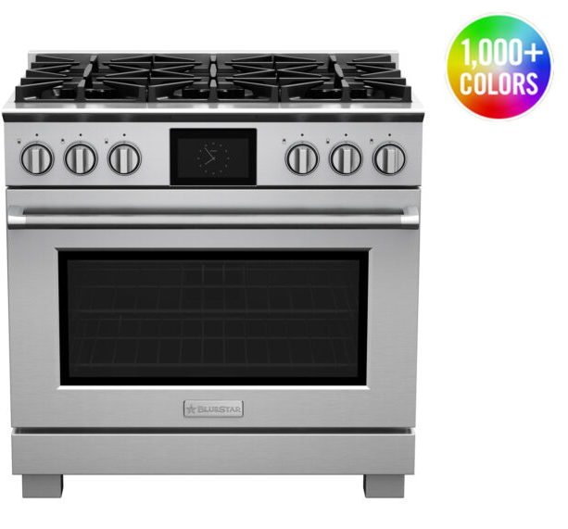
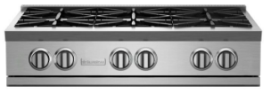
QUICK SHIP APPLIANCES
Customized Appliances with FAST Lead Times
LEARN MORE
Ensure your customer are ready for holiday cooking!
These BlueStar appliances are available to ship in stainless in three weeks and with color in only four weeks!
Dual Fuel Ranges
Pro Built-In Refrigeration
Column Refrigeration
Nova Series Rangetops
Note: Add one week for either painted units, painted knobs or LP fuel type. Please allow 10-14 days for shipments to the West Coast.

Slide 5
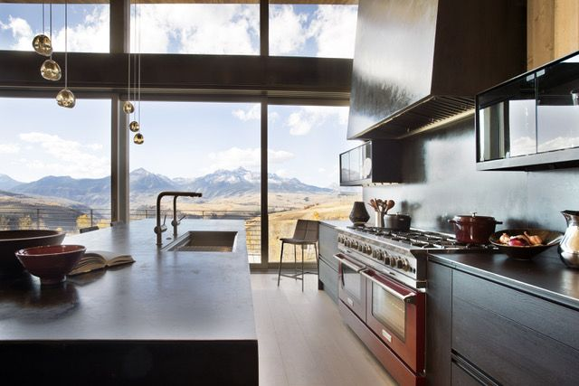
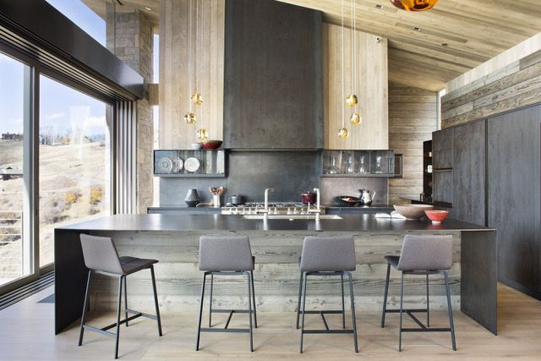
TRADE NEWS
Kitchen Design Contest – Grand Prize Winner
LEARN MORE
We are honored to recognize the talented designers who created exceptional kitchens using BlueStar appliances. This year's winners showcase the endless customization options BlueStar offers.
GRAND PRIZE WINNER
Brian Anderson
Thurston Kitchen & Bath
Telluride, CO

Slide 6

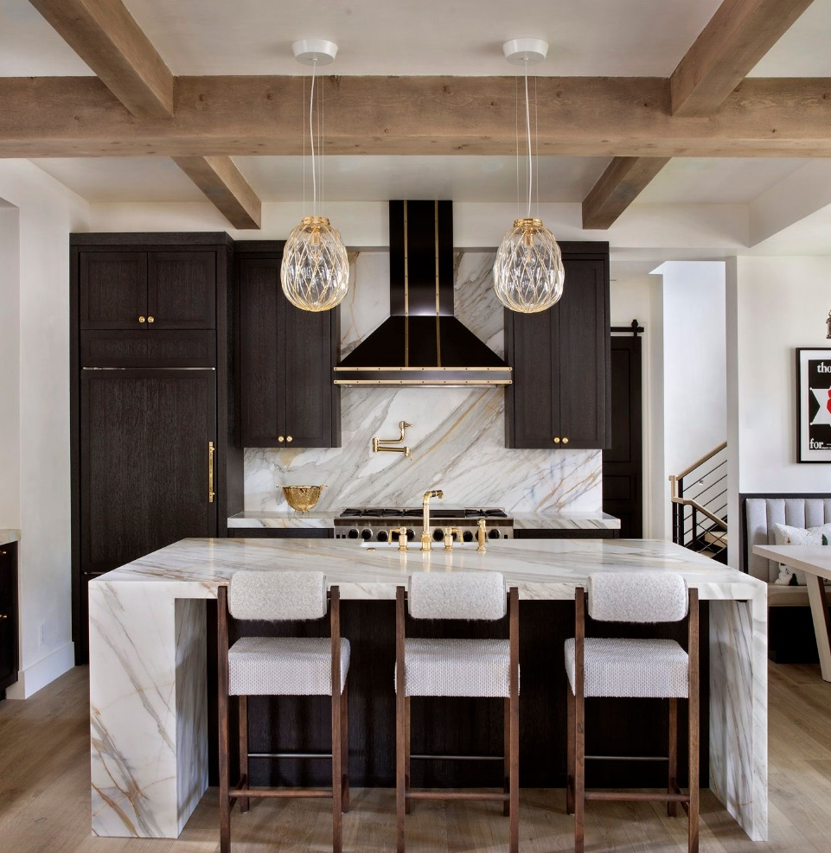
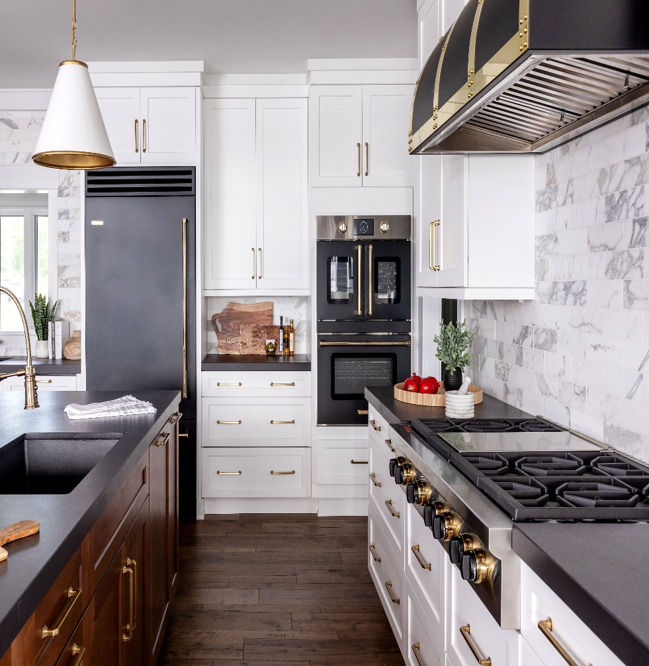
TRADE NEWS
Kitchen Design Contest Regional Winners
REGIONAL WINNER
Jennifer Koch
Jennifer Austin Interiors
Long Beach, CA
REGIONAL WINNER
Sarah Jones
Sarah Jones Design
Aspen, CO
REGIONAL WINNER
Michelle Murphy
Demi Ryan
Smith Mountain Lake, VA

Slide 7
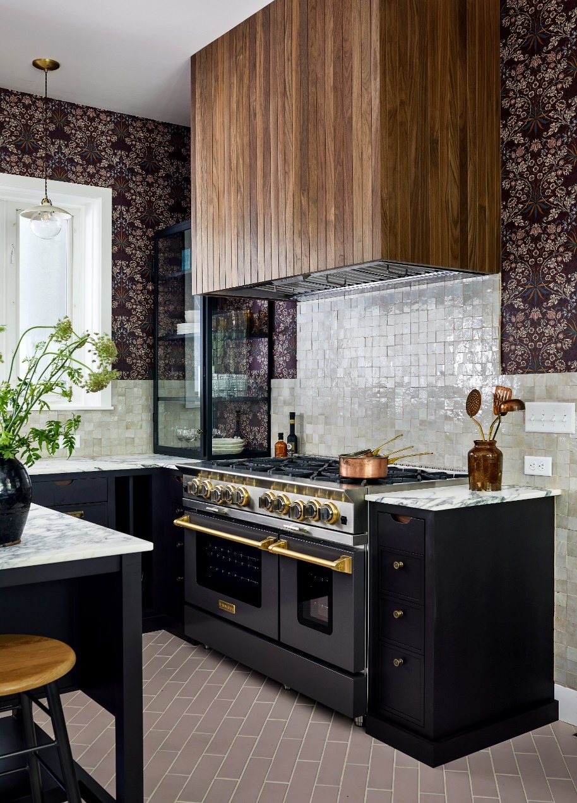
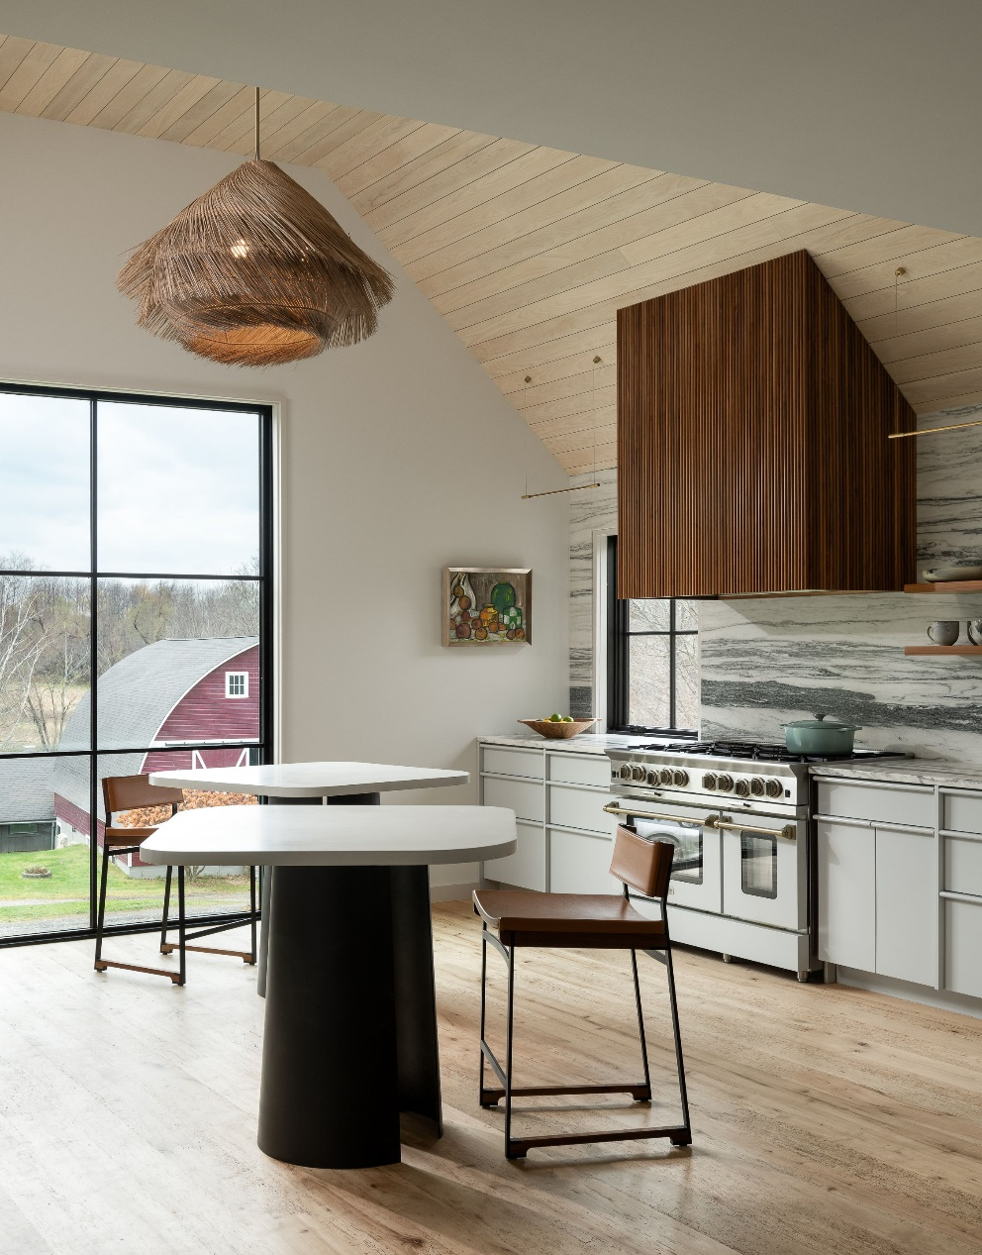
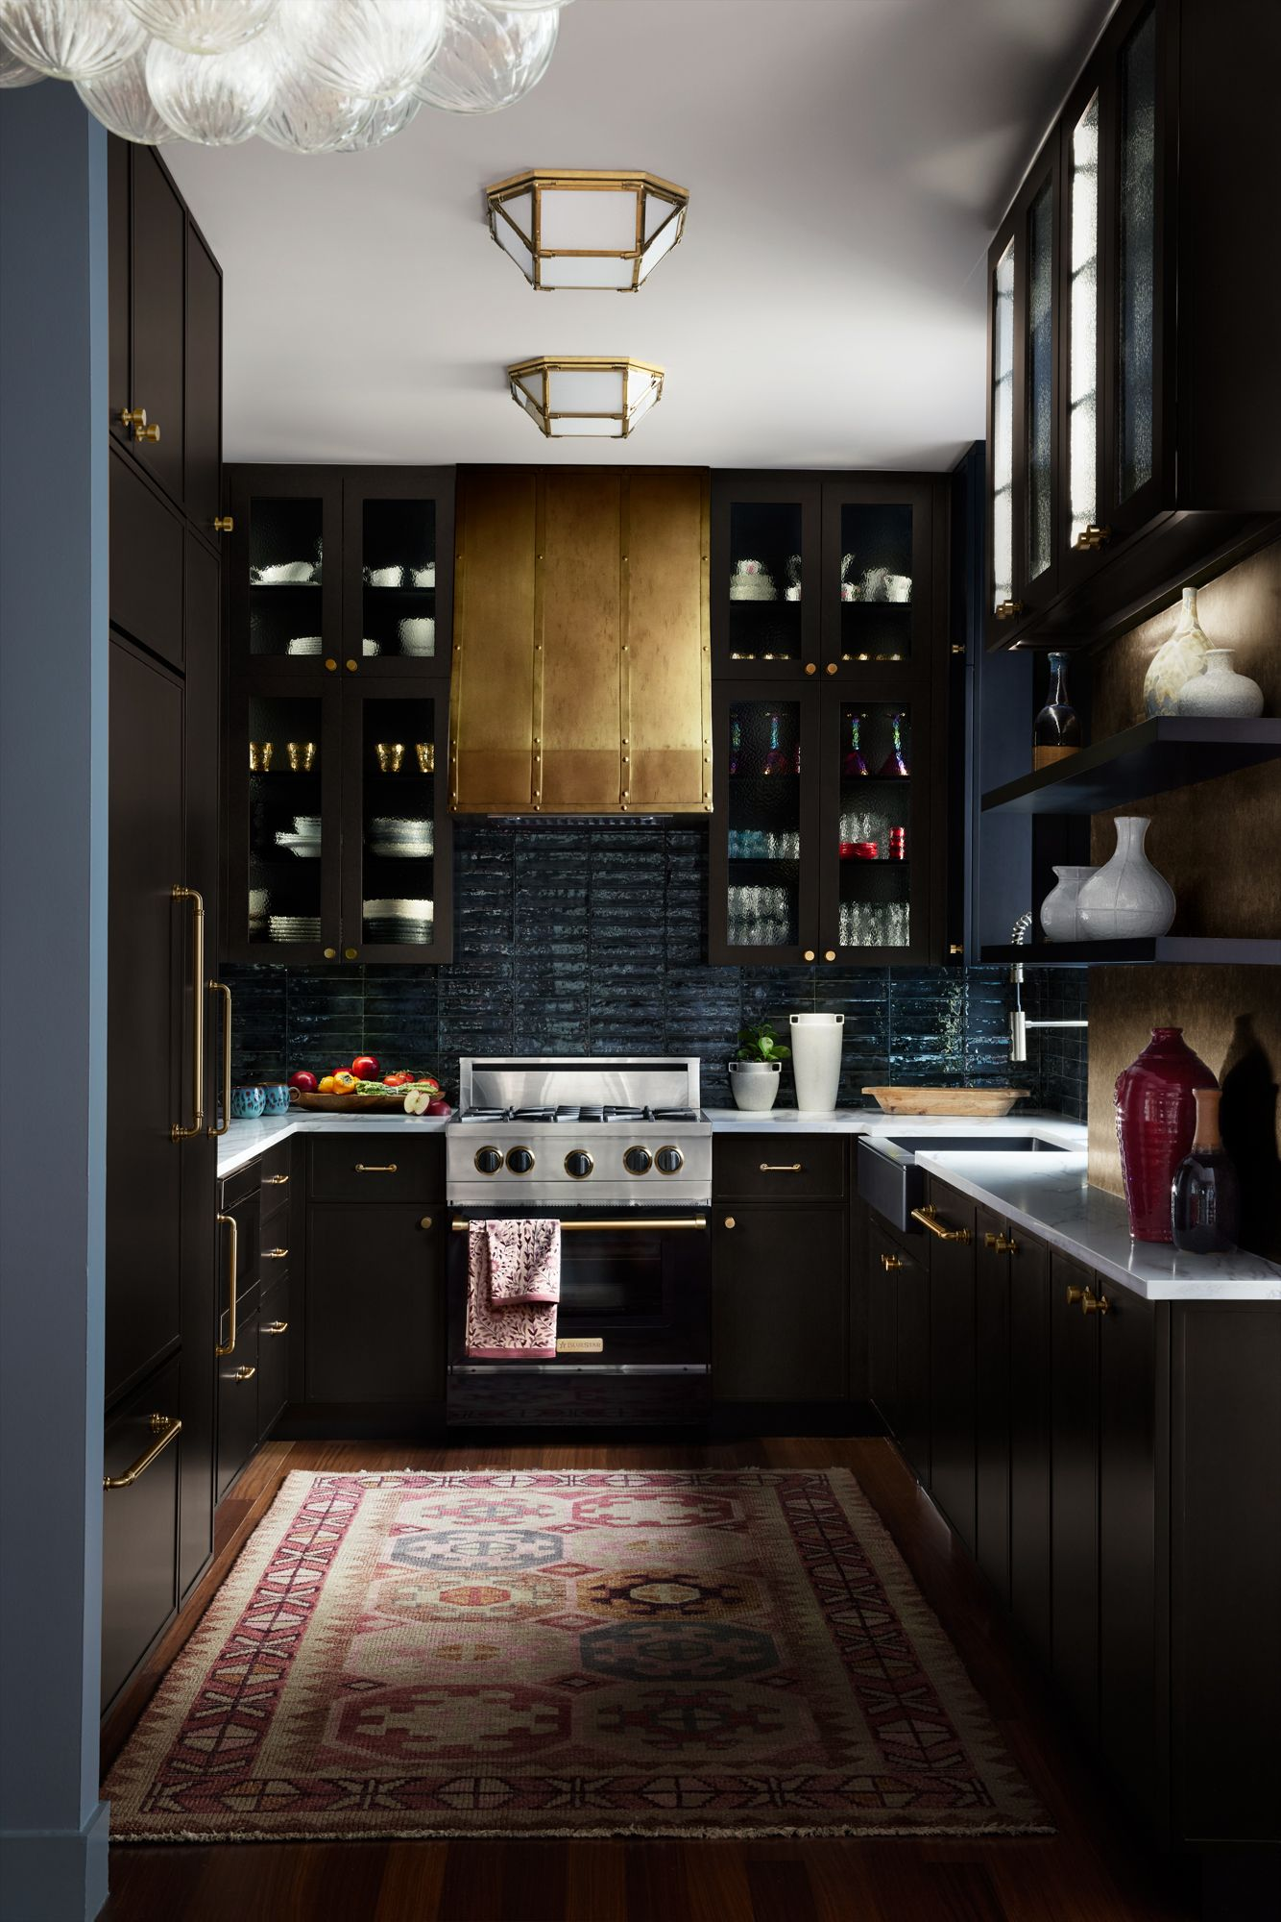
TRADE NEWS
Kitchen Design Contest Regional Winners
REGIONAL WINNER
Amanda Chando
Details and Design
Stevensville, MD
REGIONAL WINNER
Mika Frechette
Stoneledge Farm & Home
Bennington, VT
REGIONAL WINNER
Vivian Hung
Global Home Interiors
New York, NY

Slide 8

NEW PRODUCT NEWS: Taking Orders NOW!
BlueStar 48” Induction Range
Revolutionizing the Electric Kitchen
      Power and precision
Largest surface cooking surface, including two 11" zones
Features most powerful zone on the market with 7,400 Watts
The most versatile cooking surface six oversized individual zones and with two bridge functions
Instant response and precise control on each cooking zone with 9 levels of heat, plus simmer and keep warm options
Oversized True Convection electric ovens offer even and consistent multi-rack cooking
      Innovation
Industry first: matte finish, durable scratch & stain resistant cooking surface
Patent-pending power-level indicator light on each zone
Power Optimization System for uninterrupted cooking
      Unmatched customization
1,000+ colors and 10 metal trim options
BSPIR486Z
Starting at $15,995 UMRP
Shipping Q4 2024

Slide 9

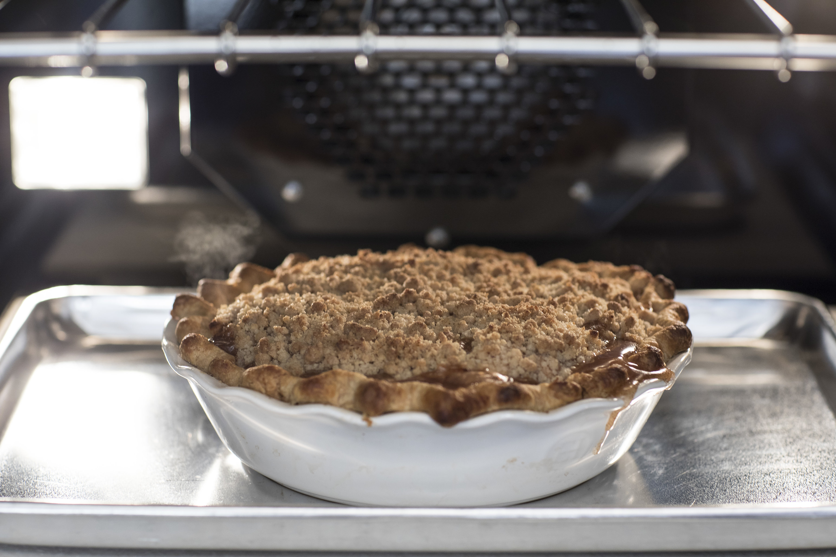
CHEF’S CORNER
Fall Recipe: The Best Apple Pie
From the Kitchen of
BlueStar All-Star Chef
Zoë Francois
With summer coming to a close, it’s time to get ready for Fall and all the delicious flavors of the season!
And why not get a head start on Holiday baking with a delicious Apple Pie?
Right from the kitchen of our All-Star Chef, Zoë Francois, this pie is sure to be a family favorite and one you’ll want to make again and again!
Her secret to success is using six different varieties of apples since they are all in season and add to the flavor.
Full Recipe

Slide 10
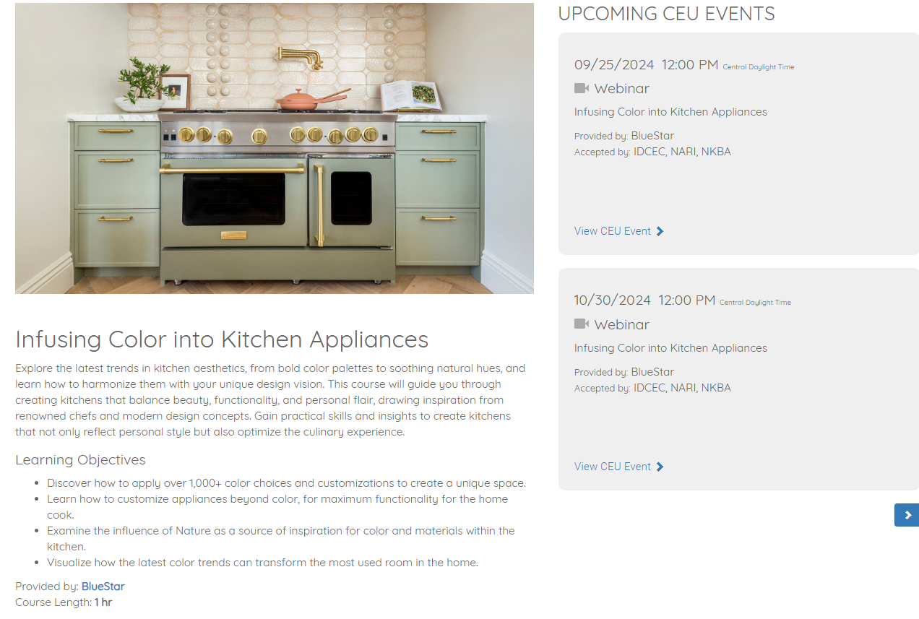
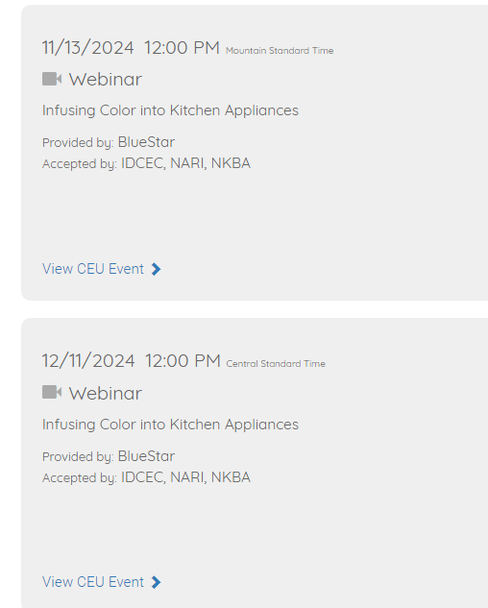
REGISTER FOR CEU VIRTUAL COURSES
LEARN MORE

