Slide 1
Thermador Cooking SKU Optimization
BU Cooking
September 2024

Slide 2
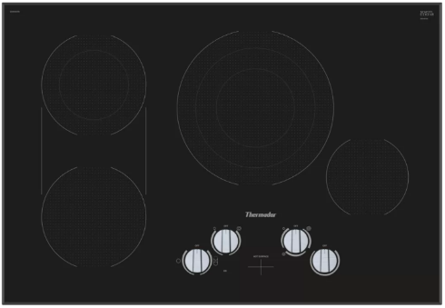
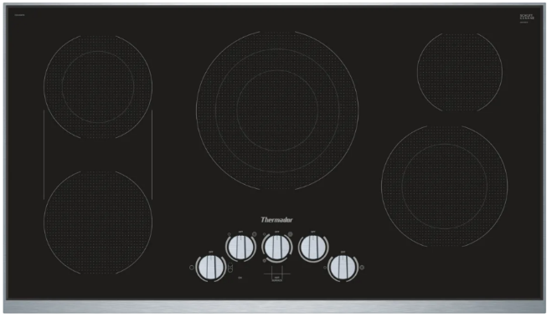
Cooktops - Electric
Note: removing all SKUs with KNOBS
DISCONTINUING SKU​ | RECOMMENDED TRANSITION SKU​
​ | ​CET305YB - 30" Electric Cooktop, Touch Control, Frameless Design CIT304YB - 30" Induction Cooktop, 11" Round Element, Black, Frameless
​ | ​CET366YB - 36" Electric Cooktop, Touch Control, Stainless Steel Frame CIT365YB - 36" Induction Cooktop, 13" Round Element, Black, Frameless
CEM305TB
30" Electric Cooktop, Knob Control, Frameless Design
DISCONTINUING: 9/30/24
CEM366TB
36" Electric Cooktop, Knob Control, Stainless Steel Frame
DISCONTINUING: 9/30/24

Slide 3
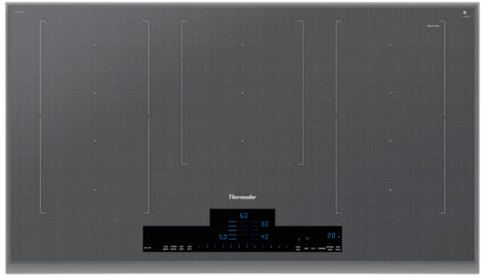
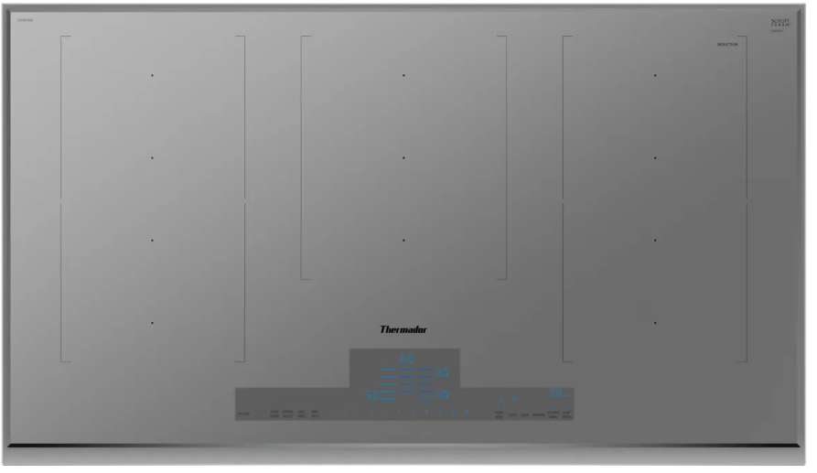
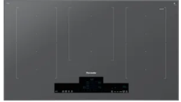
Cooktops – Liberty Induction
Note: removing FRAMED cooktops
DISCONTINUING SKU​ | RECOMMENDED TRANSITION SKU​
​ | ​CIT367YG - 36" Liberty Induction Cooktop, Titanium Gray, Frameless
​ | ​CIT367YG - 36" Liberty Induction Cooktop, Titanium Gray, Frameless
​ | ​CIT367YG - 36" Liberty Induction Cooktop, Titanium Gray, Frameless
CIT367YMS
36" Liberty Induction Cooktop, Silver Mirror, Frame
DISCONTINUING: 3/31/2025
CIT367YGS
36" Liberty Induction Cooktop, Titanium Gray, Frame
DISCONTINUING: 3/31/2025
CIT367YM
36" Liberty Induction Cooktop, Silver Mirror, Frame
DISCONTINUING: 3/31/2025

Slide 4
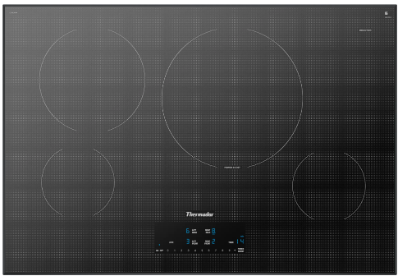
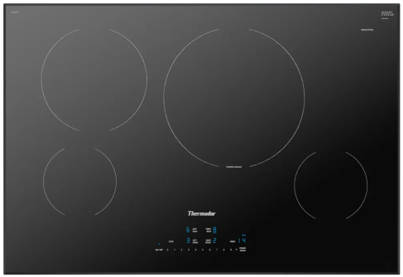
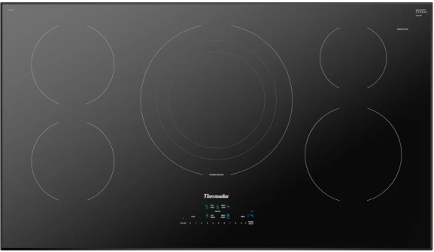
Cooktops – Heritage Induction
Note: removing SILVER MIRROR cooktops & transition frameless to a new generation
DISCONTINUING SKU​ | RECOMMENDED TRANSITION SKU​
 | CIT304BB – 30” Heritage Induction Cooktop Next Generation w/ Enhanced Digital Features. SOS April 2025
​ | CIT304BB – 30” Heritage Induction Cooktop Next Generation w/ Enhanced Digital Features. SOS April 2025
 | CIT365BB – 36” Heritage Induction Cooktop Next Generation w/ Enhanced Digital Features. SOS April 2025
CIT304YM
30” Heritage® Induction Cooktop Silver Mirror, Without Frame
DISCONTINUING: 3/31/2025
CIT304YB
30” Heritage® Induction Cooktop Black, Without Frame
DISCONTINUING: 3/31/2025
CIT365YB
36” Heritage® Induction Cooktop Black, Without Frame
DISCONTINUING: 3/31/2025

Slide 5
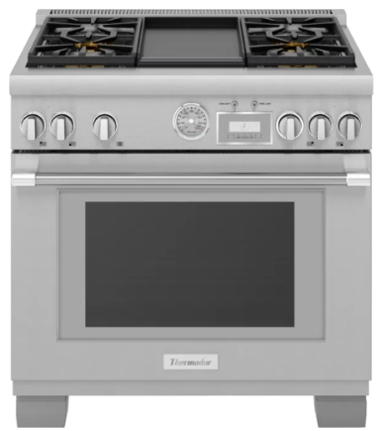
Pro Range
Note: Phase-out low volume SKUs to optimize the portfolio
DISCONTINUING SKU​ | RECOMMENDED TRANSITION SKU​
​ | ​Transition from Pro Grand to Pro Harmony Model PRG364WDH - Pro-Harm 36" Gas Range 4 BRNR Griddle
PRG364WDG
Pro-Grand 36" Gas Range 4 BRNR Griddle
DISCONTINUING: 11/30/2024

Slide 6
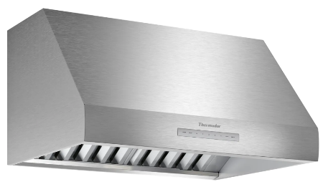
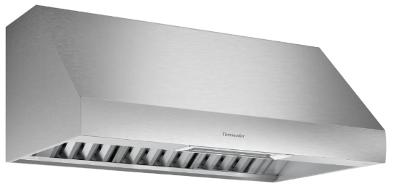
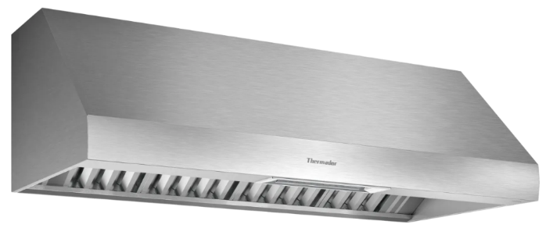
Ventilation – Wall Hood
Note: Phase-out low volume SKUs to optimize the portfolio
DISCONTINUING SKU​ | RECOMMENDED TRANSITION SKU​
​ | Paired with 30” Pro Range (all fuels) ​HMDW30WS - 30" Masterpiece® Under Cabinet Drawer Wall Hood, 600 CFM HMCB30WS - 30" Masterpiece® Pyramid Chimney Wall Hood, 600 CFM HDDB30WS - 30" Masterpiece® Drawer Chimney Wall Hood, 600 CFM Paired with 30” Pro Range Induction Range Only VCIB30ZS - 30" Masterpiece Series Custom Insert, 300 CFM
 | VCIN42GWS - 42" Professional Custom Insert, Optional Blower PH36GWS - 36" Pro Grand® Wall Hood, Optional Blower PH36HWS - 36" Pro Harmony® Wall Hood, Optional Blower HMWB361WS - 36" Masterpiece® Low-Profile Wall Hood, 1000 CFM HMWB36WS - 36" Masterpiece® Low-Profile Wall Hood, 600 CFM
 | VCIN54GWS - 54" Professional Custom Insert, Optional Blower PH48GWS - 48" Pro Grand® Wall Hood, Optional Blower PH48HWS - 48" Pro Harmony® Wall Hood, Optional Blower HMWB481WS - 48" Masterpiece® Low-Profile Wall Hood, 1000 CFM HPCN48W - 48" Professional® Chimney Wall Hood, Optional Blower
PH30HWS
Pro 24" Depth Wall Hood, 30" Wide
DISCONTINUING: 11/30/2024
PH42GWS
42" PRO-GRAND HOOD WALL
DISCONTINUING: 11/30/2024
PH54GWS
54in PRO GRAND HOOD WALL
DISCONTINUING: 11/30/2024

Slide 7
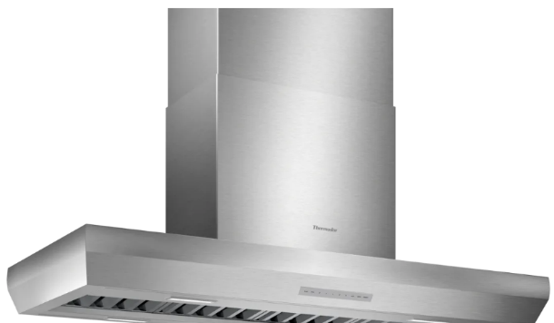
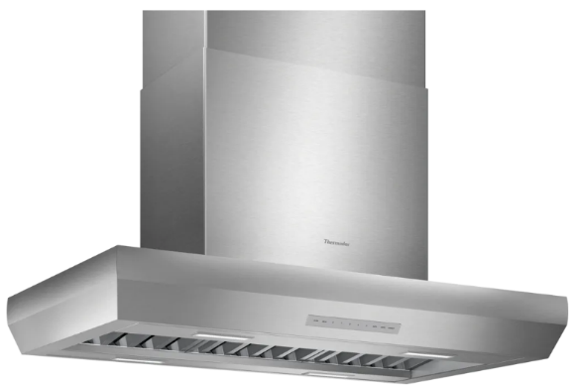
Ventilation – Island Hood
Note: Phase-out low volume SKUs to optimize the portfolio
DISCONTINUING SKU​ | RECOMMENDED TRANSITION SKU​
​ | VCIN54GWS - 54" Professional Custom Insert, Optional Blower
 | HMIB42WS - 42" Masterpiece® Box Island Hood, 600 CFM VCIN42GWS - 42" Professional Custom Insert, Optional Blower
HPIN54WS
54" Professional® Island Hood, Optional Blower
DISCONTINUING: 11/30/2024
HPIN42WS
42" Professional® Island Hood, Optional Blower
DISCONTINUING: 11/30/2024

Slide 8
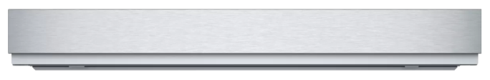
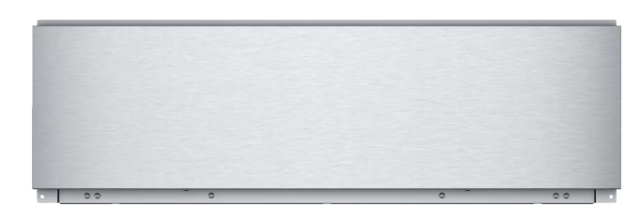
Storage Drawer
Note: Phase-out low volume SKUs to optimize the portfolio
DISCONTINUING SKU​ | RECOMMENDED TRANSITION SKU​
​ | ​Continue sales until the existing inventory is depleted around December 2026
 | Continue sales until the existing inventory is depleted around June 2025
SDS30WC
30-Inch Short Storage Drawer, Stainless Steel
END OF PRODUCTION: Q4 2024
SD30WC
30-Inch Storage Drawer, Stainless Steel
END OF PRODUCTION: Q4 2024

