Slide 1
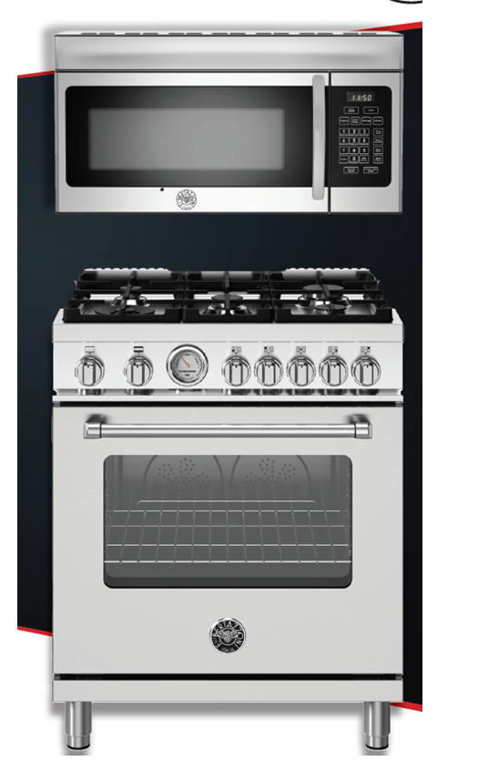
Bertazzoni KOTR30X
Now $250 Suggested Sell Price
**
FREE After Rebate by mail when purchased with qualifying cooking

Slide 2
KOTR30X Details
Milestone has made a special purchase from Bertazzoni on about KOTR30X OTRs that have been discontinued. Since this model is discontinued, no UMRP applies.
Normal deal margin applies.
Previous UMRP was $469
Effective today, the Suggested Price on the KOTR30X will reduce to $250. That means when bought with a BZ range after mail-in rebate, the OTR is FREE.
So a consumer can get a 30” GAS or DFM range and an OTR for as low as $2999 (after rebates by mail.)

Slide 3
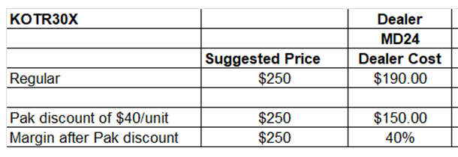
Buy Program
purchase 10 units of 30”ranges and 10 units of KOTR30X in one purchase order of available 30” range models, they will get an extra $40/unit off the OTR. That is another 16 points of margin on the OTR if they sell at $250.

Slide 4
Notes
Full spiffs on the KOTR30X
The KOTR30X counts in the promotion ($250 Rebate by mail when purchased with qualifying cooking)
While supplies last of the KOTR30X – no substitutions
Also qualifies for Milestone Preferred Partner Program and Builder Instant rebate program (in lieu of rebate by mail)

Slide 5
