Slide 1
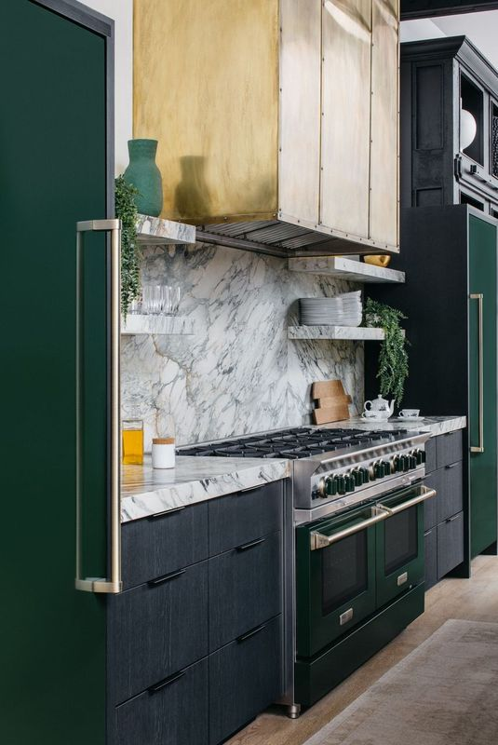
SUMMER NEWSLETTER
2024

Slide 2

NEW!
INSTANT SAVINGS
OFFER
LEARN MORE
BlueStar® is thrilled to announce our new Ultra Premium Offer to help make kitchen dreams a reality for your customers. Purchase any size Dual Fuel or Platinum range, add a pro Built-In Refrigerator and get $1,500 off; add a Designer hood to the package and receive another $500 off for a total instant savings of $2,000.
This offer is available until September 30, 2024.

Slide 3


CURRENT PROMOTIONS
LEARN MORE
BlueStar® has more special offers right now. We are offering discounted pricing on the BlueStar free standing refrigeration in our most popular colors and combinations, as well as instant savings on our incredible Culinary Series (RCS) ranges. These offers are available through September 30, 2024.

Slide 4
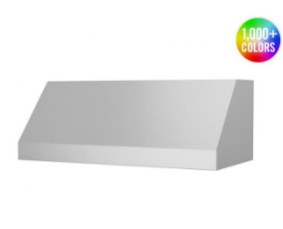
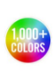
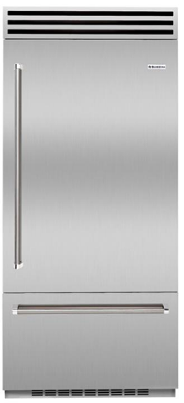
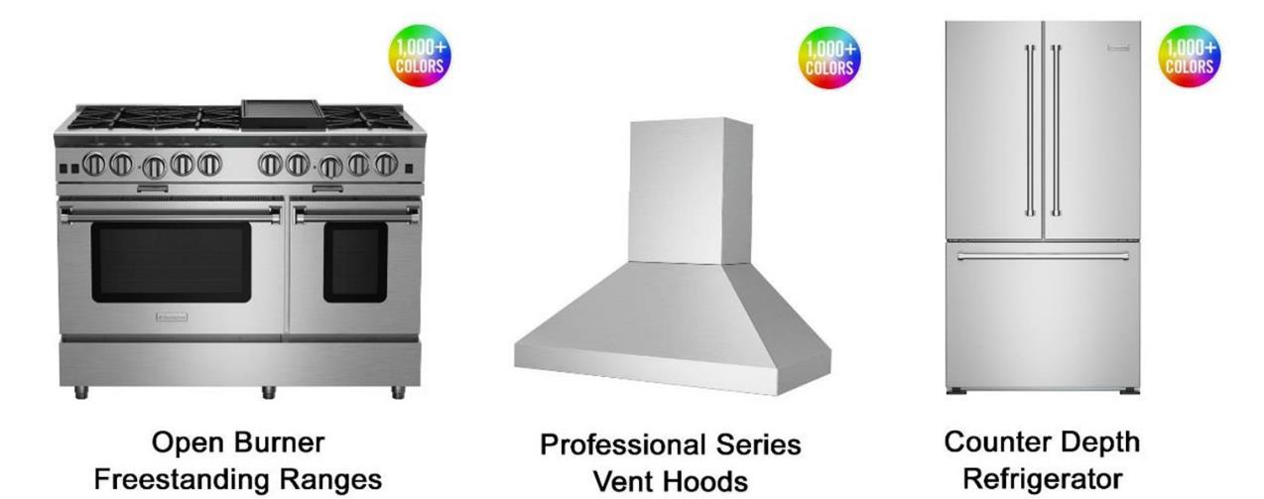
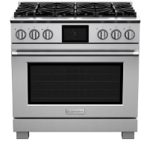
QUICK SHIP APPLIANCES
LEARN MORE
Complete kitchen projects quickly. BlueStar® has many appliances that are available to ship in 2-3 weeks. All Dual Fuel ranges, Built-In refrigerators, open burner gas ranges, and professional series hoods are ready to ship for immediate customer needs.
Review the Quick Ship section of our website for details on models and sizes.
Dual Fuel Ranges
*All Sizes*
All 36” Built-In Refrigeration
Open Burner
Freestanding All Gas Ranges
*All Sizes*
Professional Series
Vent Hoods
Note: Add one week for either painted units, painted knobs or LP fuel type. Please allow 10-14 days for shipments to the West Coast.

Slide 5
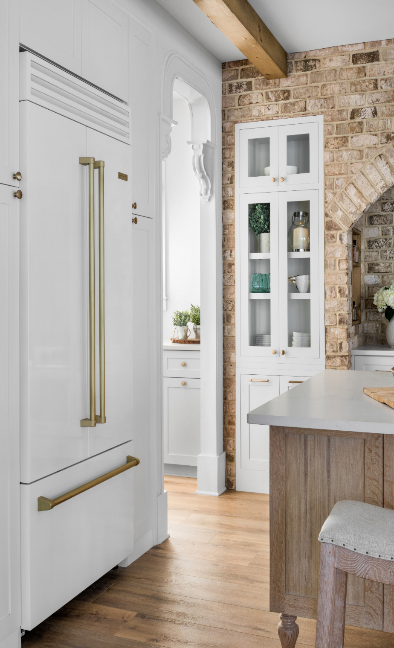
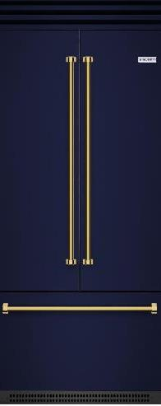
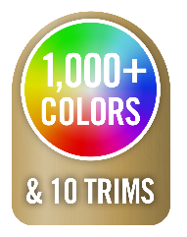

FEATURED PRODUCT
PRO BUILT-IN REFRIGERATION
LEARN MORE
The chef-inspired BlueStar® Built-In Refrigeration line features commercial-style design and performance, as well as advanced food preservation capabilities, with durable stainless steel and glass interiors featuring bright LED lighting.
Available in 36” single swing door and French Door with oversized capacity and unmatched customization options, this product is sure to make a statement in any kitchen.
36” Single Swing Door in Stainless Steel
36” French Door with Color & Plated Trim
Available TO SHIP IN 2-3 WEEKS

Slide 6
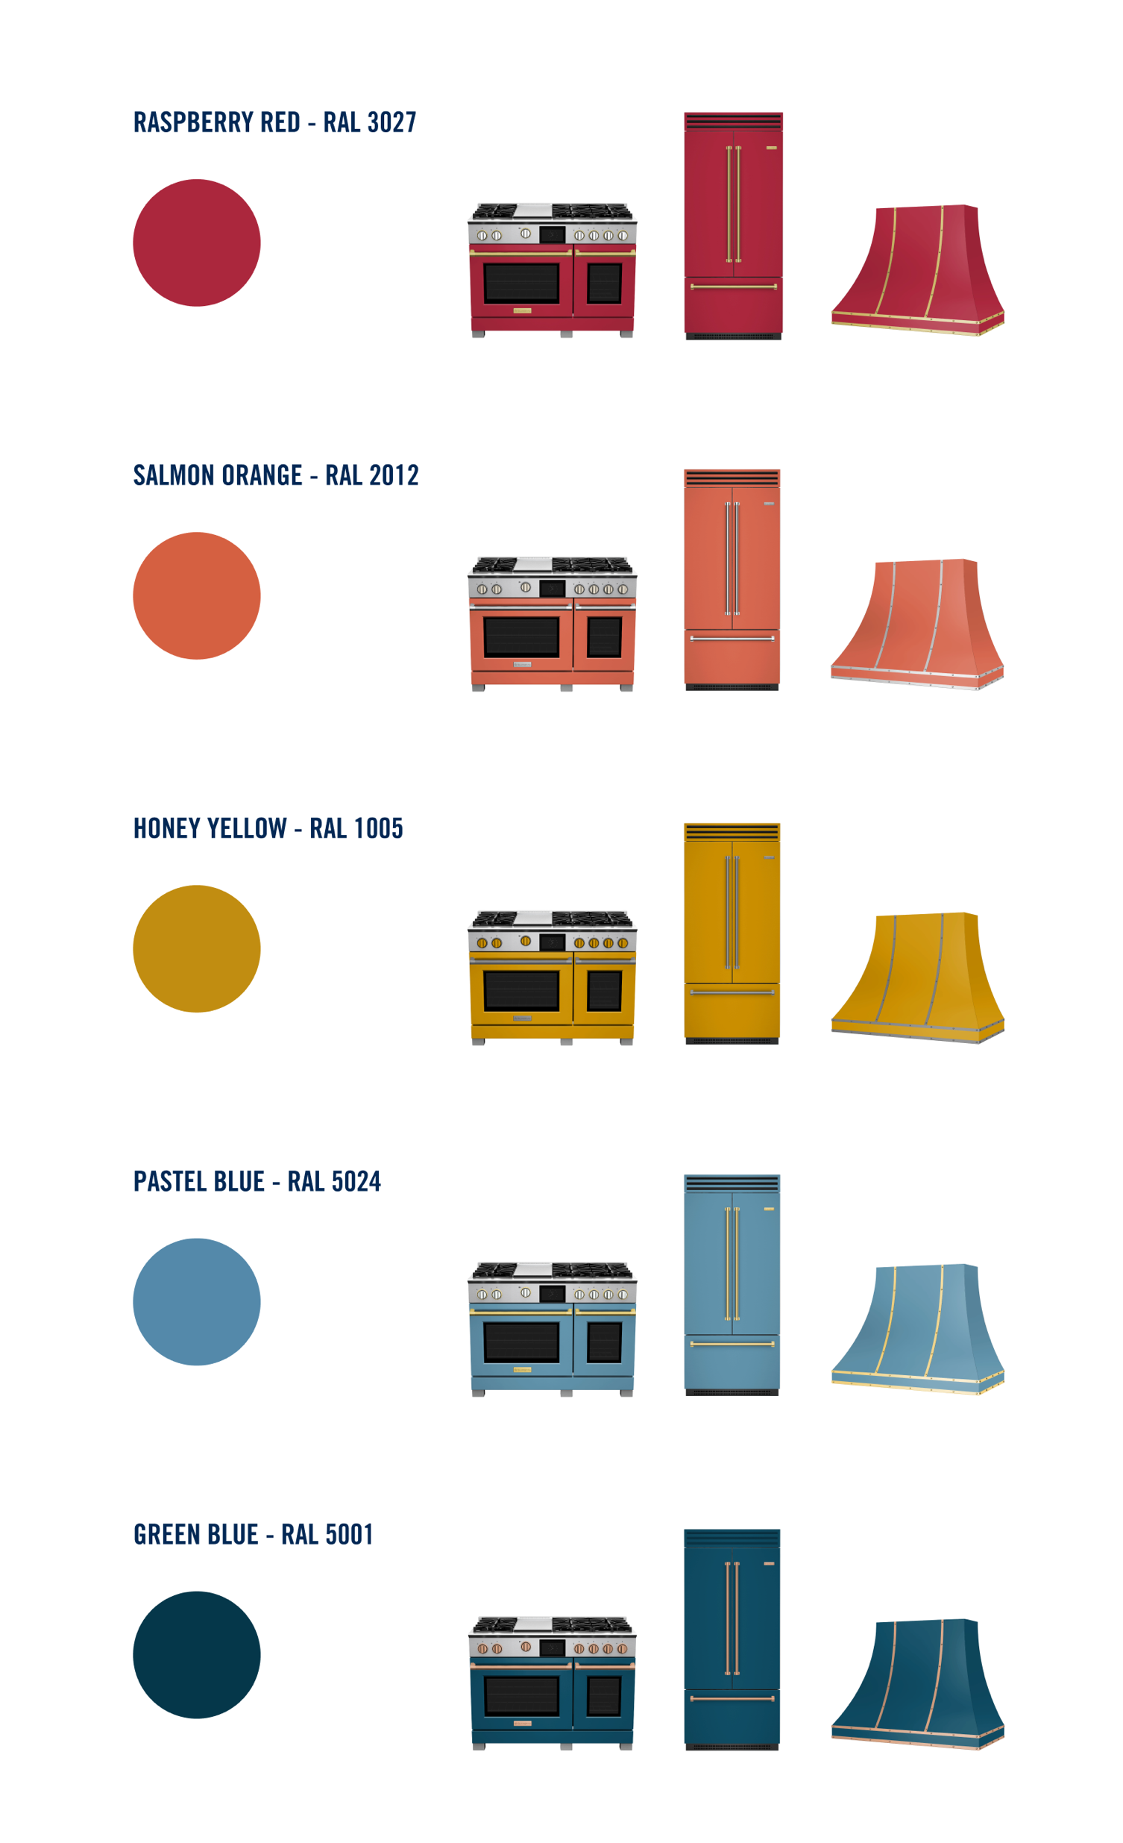

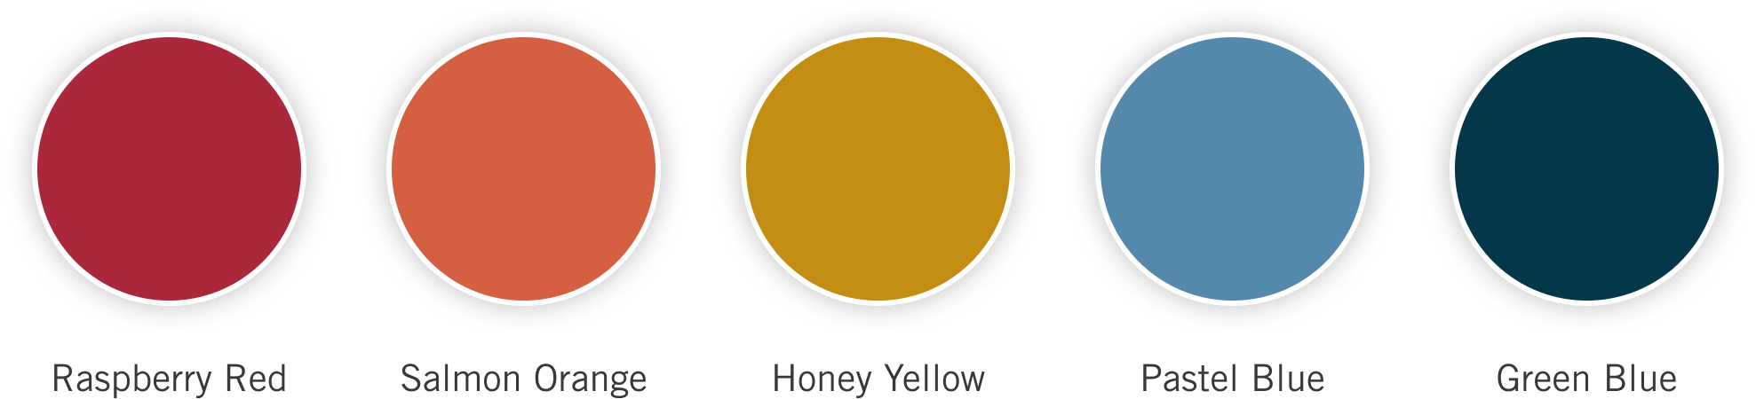
SUMMER COLOR COLLECTION
Feel the Warmth
As leaders in color and customization, BlueStar® is thrilled to announce our latest seasonal color collection. Summer is a bright and vibrant season full of stunning sunsets with an array of colors over calming blue waters. This palette has been designed with warm and bold colors to bring the feeling of summer into your design.

Slide 7
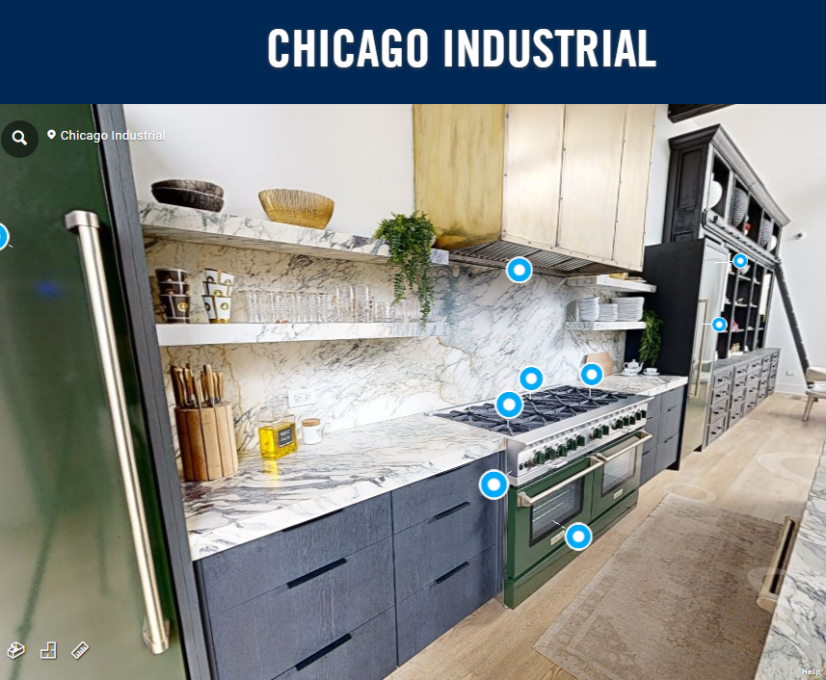
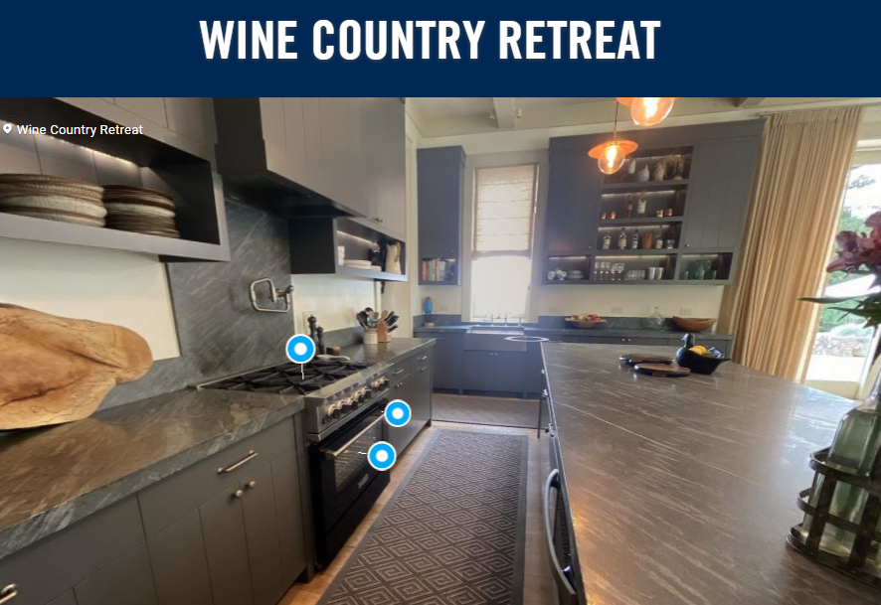
360° KITCHEN TOURS
LEARN MORE
See the latest 360° kitchen tours on our website for inspiration, complete with product and design details.
Our most recent additions include an Industrial style loft in Chicago highlighting elegant greens from our Alison Victoria Color Collection with brass accents, and a charming California Wine Country Retreat.

