Slide 1
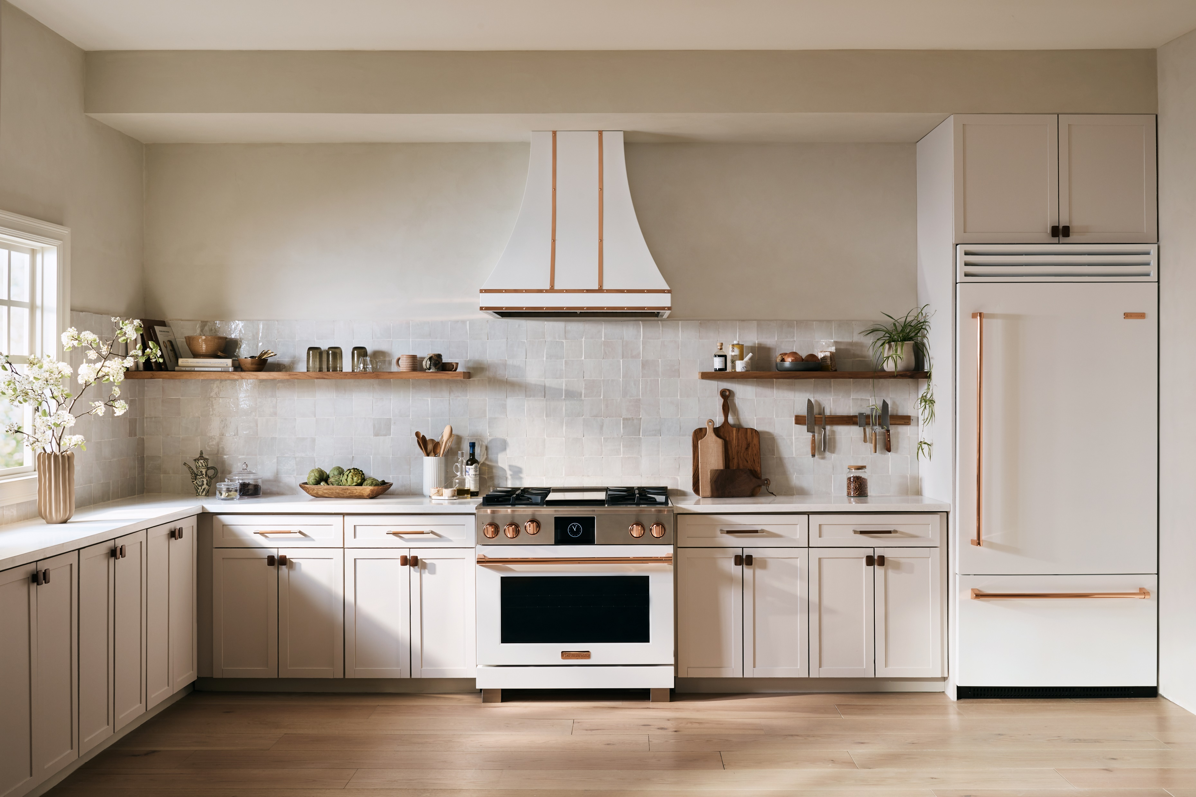
SUMMER NEWS
2023

Slide 2
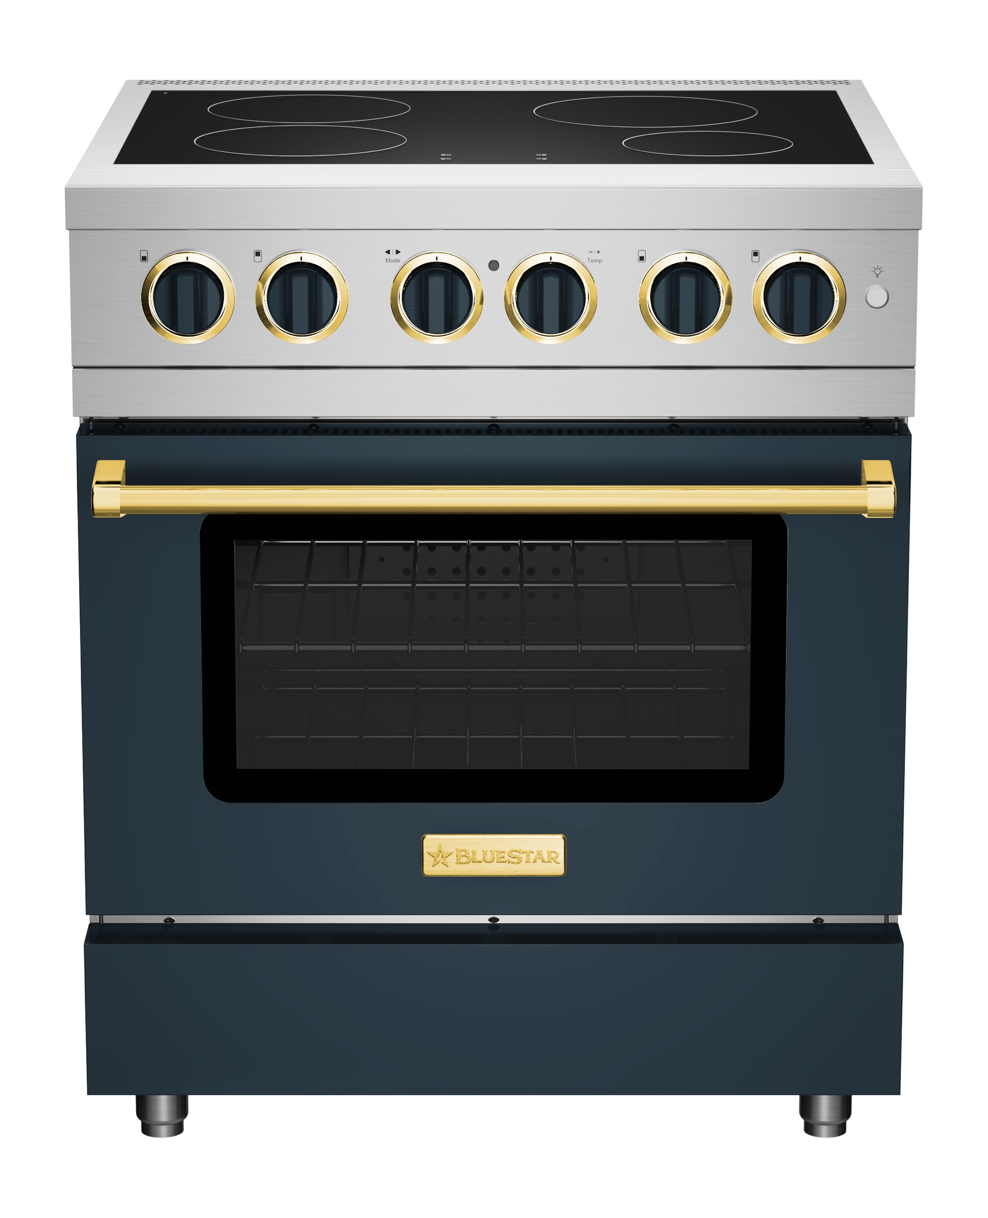
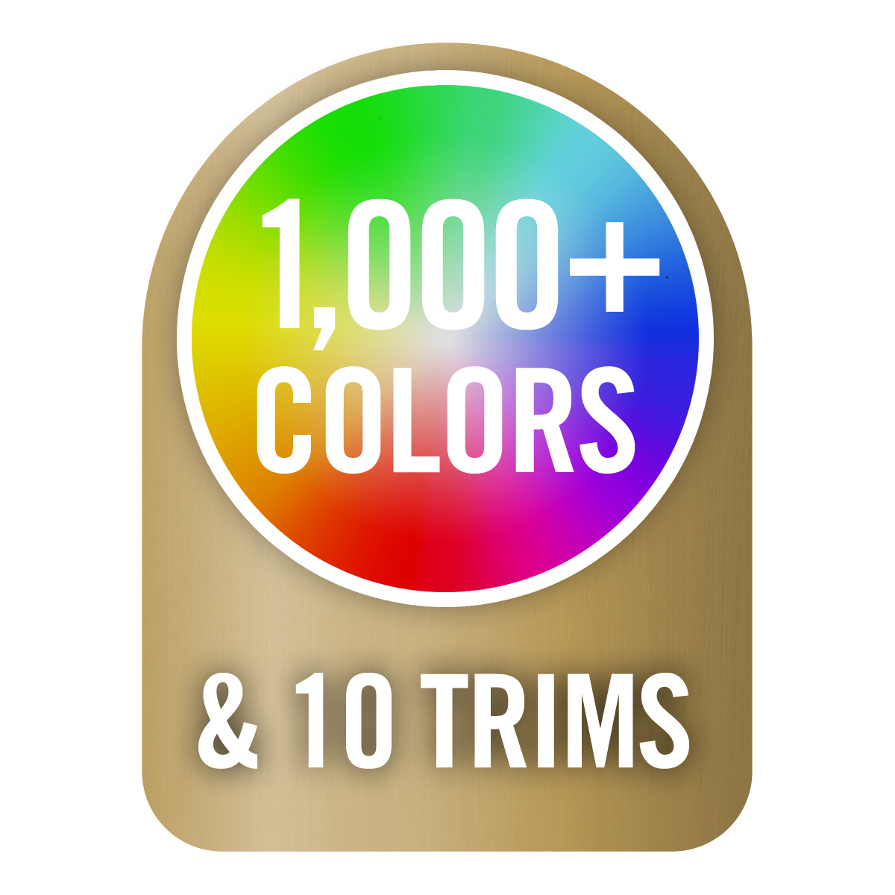
NEW PRODUCT NEWS
Induct Style Into Your Kitchen
BlueStar® is thrilled to introduce our first induction range. Induction Performance, now for the first time with endless customization. Style with 1,000+ colors and 10 Metal Trim options.
4 cooking zones automatically adjust to the size of your cookware
9 heat levels on each zone for exceptional control and a power boost for rapid boils.
Oversized Electric Convection Oven accommodates 18”x26” commercial baking sheet
5 oven modes including Bake, Convection Bake, Broil, Convection Broil and Fast Preheat.
Culinary Series
30” Induction Range
BSIR30 $6,995
Launching JULY 2023

Slide 3

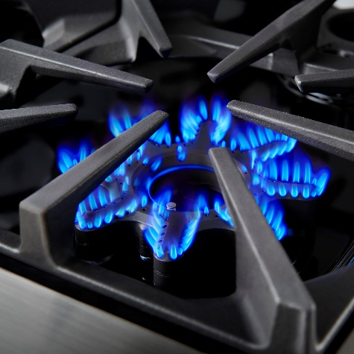
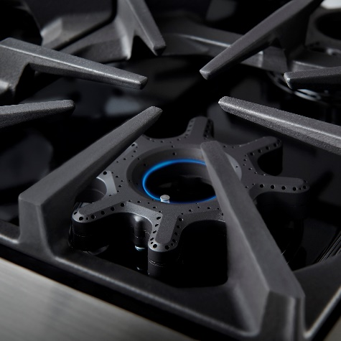
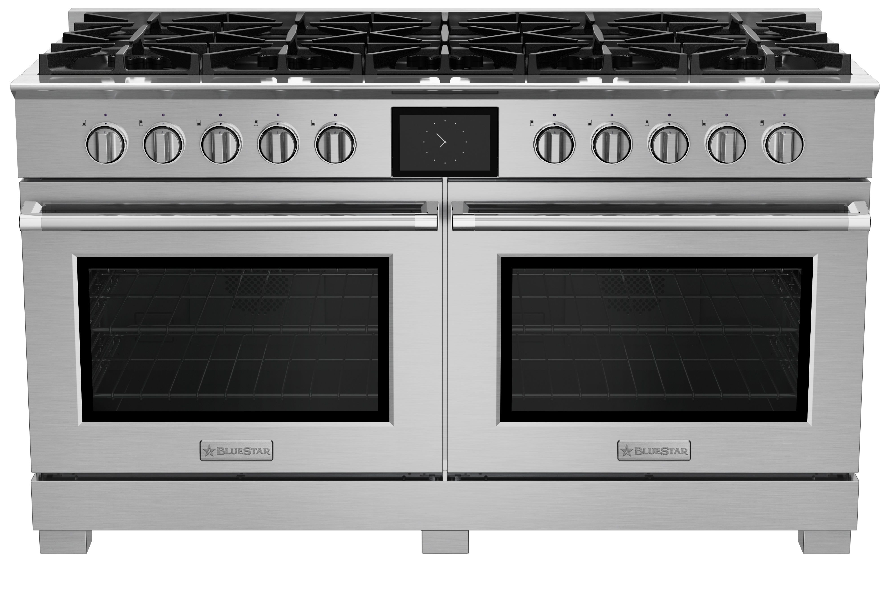
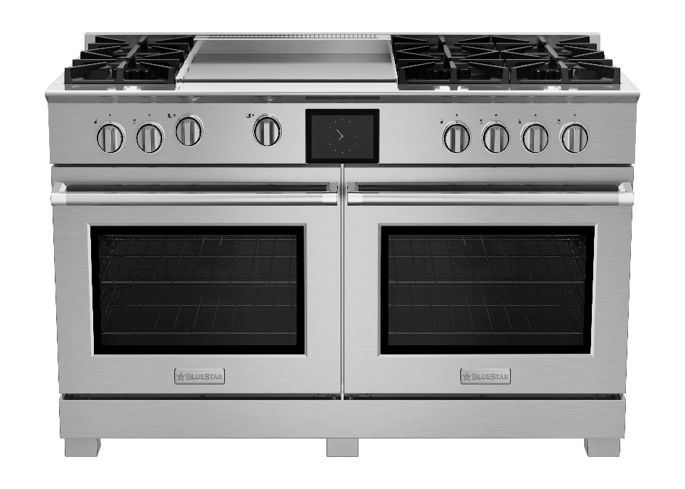
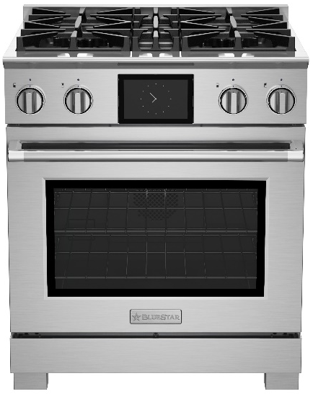
NEW PRODUCT NEWS
LEARN MORE
Dual Fuel Line Extension - 30” & 60”
The Award-Winning Dual Fuel Line is expanding!
The new X-8™ burner delivers full-spectrum power, performance, and versatility from a high 25,000 BTUs down to 500 BTUs on every burner on your cooktop.
The true convection oven was designed for perfectly even cooking and baking, with 8 cooking modes controlled but a 7” full-color touchscreen.
High
25,000 BTUs
Warm
500 BTUs
BSDF6010B $20,495
Launching
JULY 2023
BSDF606G $21,495
Launching
JULY 2023
BSDF8304B $8,295
Launching
JULY 2023

Slide 4
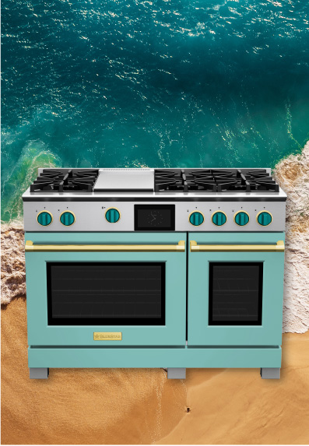
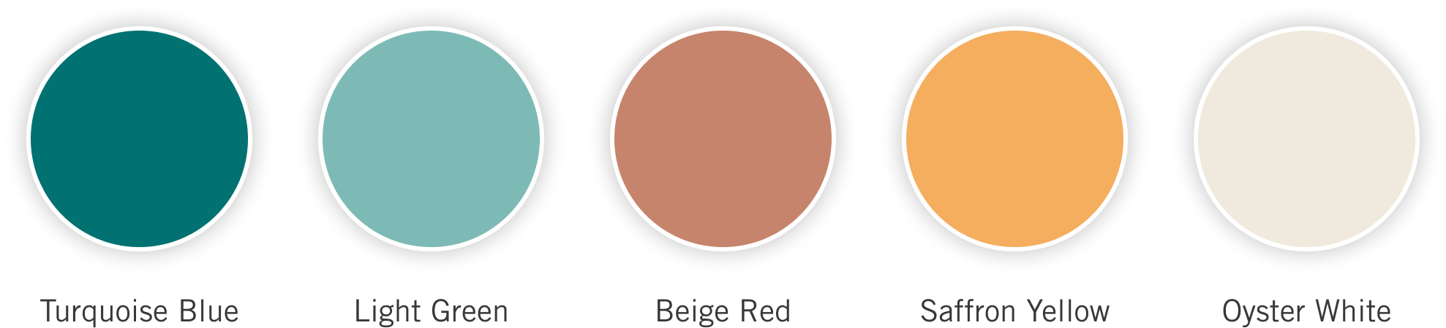
SUMMER COLOR COLLECTION
Splash Into Summer!
Summer is undoubtedly everyone’s favorite season. But how can we carry the shades of summer into our home throughout the year? Summer brings the tranquility of ocean waves, feet sinking into the sand and endless sunshine extending every day.
This season, we return to earthy neutrals that continue to breathe life into design. This palette is refreshing, rich and energetic – evoking the very essence of summer.
LEARN MORE

Slide 5
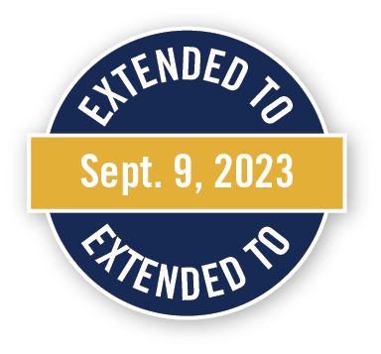


CURRENT PROMOTIONS
LEARN MORE

Slide 6
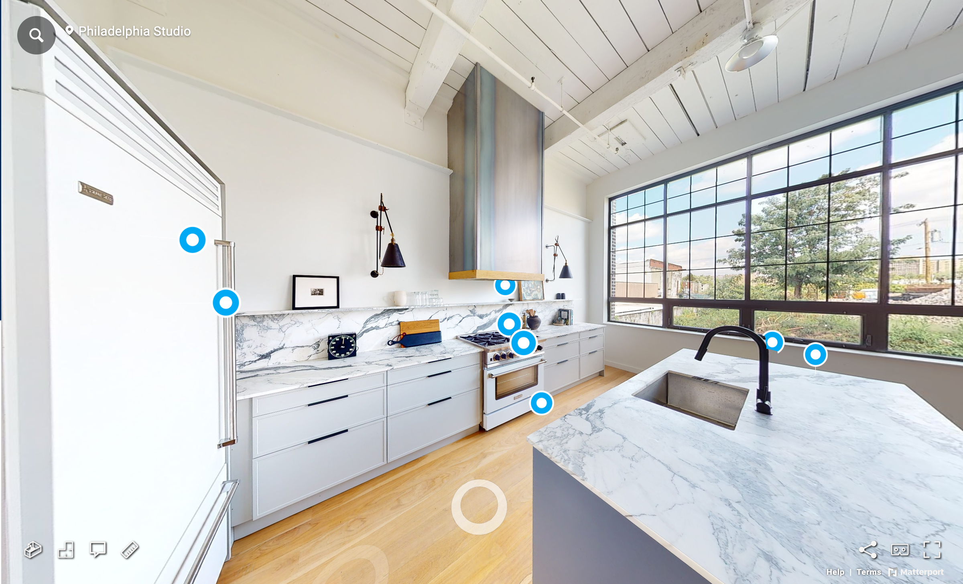
NEW 360° KITCHEN TOURS
LEARN MORE
Take inspiration for kitchen design to the next level with full 360° kitchen tours, complete with product and design details. New additions for more design options being added regularly.

Slide 7
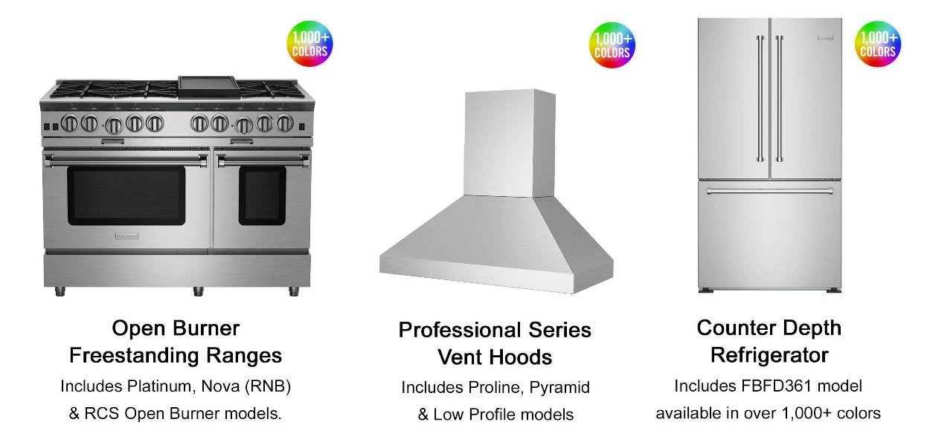
QUICK SHIP APPLIANCES – 3 WEEKS OR LESS
LEARN MORE
Choose from Stainless Steel or 1,000+ Colors and 10 Metal Trims on Most Products
BlueStar is ready to complete kitchens! Use this feature to shop our line of customizable appliances available to ship in less than 3 weeks.
Note: Add one week for either painted units, painted knobs or LP fuel type. Please allow 10-14 days for shipments to the West Coast.

Slide 8

LET’S SCHEDULE AN EVENT
Earn FREE Painted Knobs for your Customers
Choose from any of the following options and contact your BlueStar® Territory Manager to coordinate and organize the event. Book an event, earn FREE Color knobs for your customers. Up to $1,380 value!
Dual Fuel Product Trainings
Ask the Expert with your local Territory Manager
2023 Color Trends Presentation
CEU: Discovering Custom Kitchen Appliances
Trade Event Lunch and Learn
Culinary Demonstration
Intro to BlueStar Sales Trainings for New Staff

