Slide 1
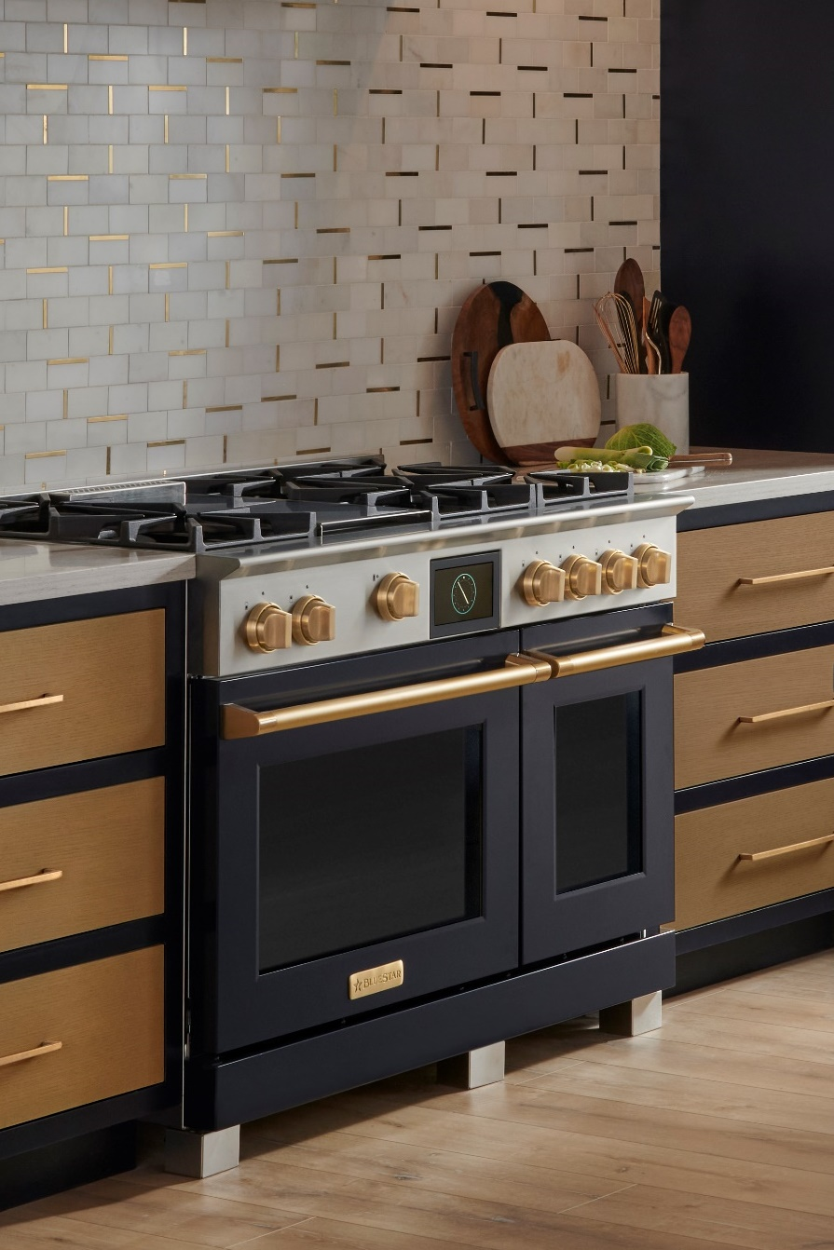

Meet our rising star
Dual fuel
The all new dual fuel range

Slide 2
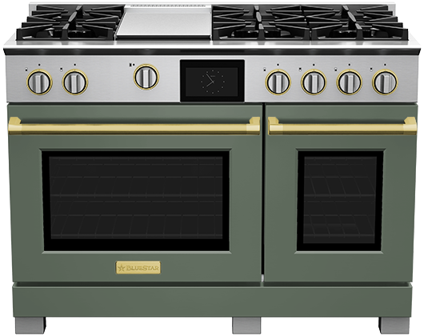


INTRODUCING BLUESTAR’S AWARD WINNING DUAL FUEL
      CHEF INSPIRED PERFORMANCE
The new X-8™ sealed burner delivers full-spectrum power, performance, and versatility from EVERY burner
Over-sized true convection oven with 8 cooking modes, designed for precise baking and even results
      STYLE AS UNIQUE AS YOURS
Create a custom kitchen with 1,000+ colors and 10 metal trim finishes
Handcrafted in Pennsylvania

Slide 3
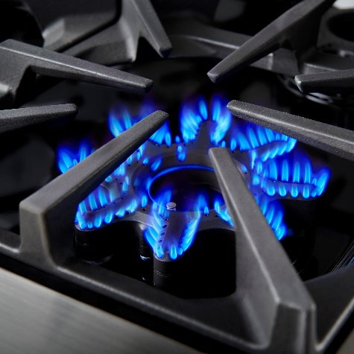
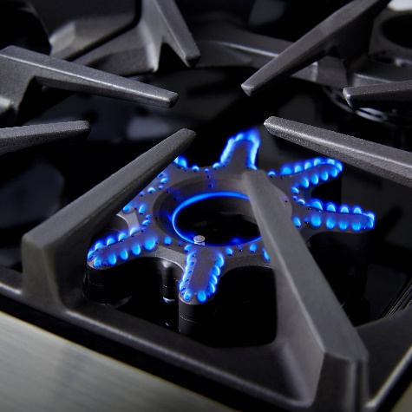
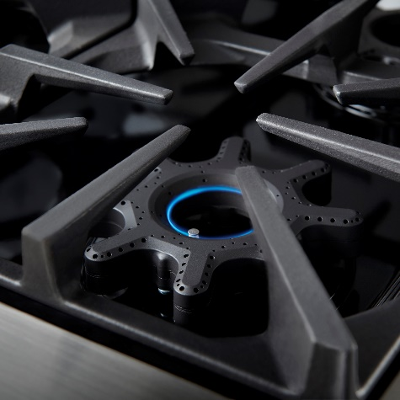
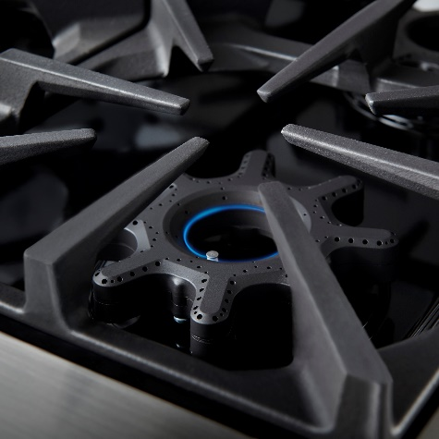
      INTRODUCING THE
      X-8™ BURNER
      HAVE IT ALL
      DO IT ALL
      WITH EVERY. SINGLE. BURNER.
The new X-8™ burner delivers
full-spectrum power, performance,
and versatility from HIGH (25K BTUS) to LOW to SIM to WARM (500 BTUs) on EVERY burner. No exceptions.
8-Point Star Shaped design maximizes even performance and efficiency in an easy to clean sealed burner format.
High
25,000 BTUs
Low
Simmer
Warm
500 BTUs

Slide 4
Superior Design Delivers Superior Performance
The X-8™ shines with more control, easy cleaning and the expansive 8-point heat coverage of our iconic open burners in a modern sealed design.
25,000
BTUs
152
500
BTUs
8-point design and 20” circumference for even heating across any size or style of cookware
Largest range of BTUs – extra-high sear to
ultra-low warm
152 precision-control heat ports for 3x the flame distribution of any other sealed burner

Slide 5
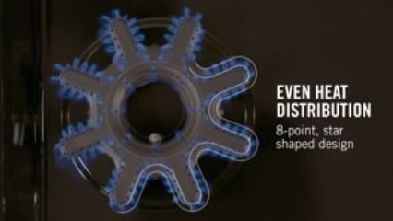
STAR POWER
TIMES EIGHT
5

Slide 6
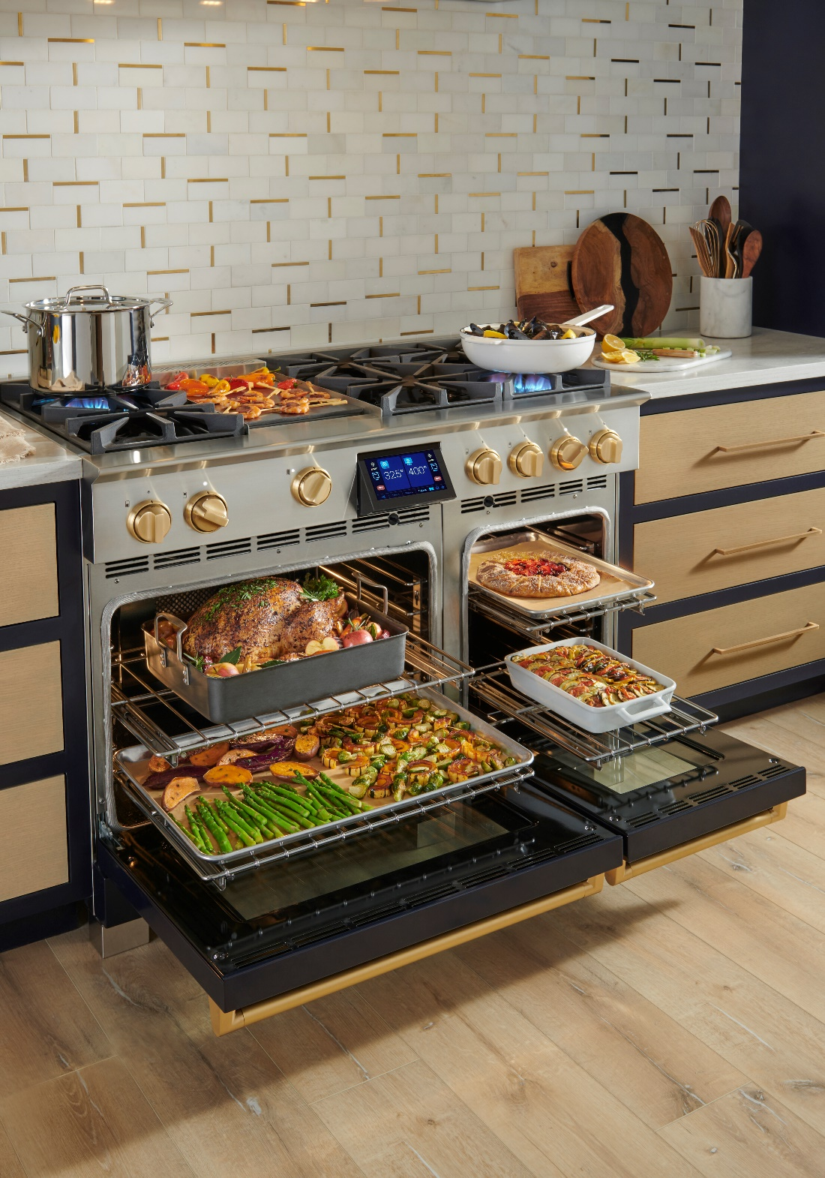
Featuring
NEW Oversized Ovens
True European Convection Ovens for even multi-rack cooking and baking
8 Cooking Modes - Convect, Bake, Convect Bake, Broil, Roast, Convect Roast, Proof and Dehydrate
Extra Large Capacity - fits 18” X 26” full-size commercial baking sheet in large oven (and half size sheet tray in small oven on 48”)
Precise Temperature Probe with default internal temperatures for proteins
Powerful 8-pass Broiler with intense 5000-watt element
Notes:
30” - 5.1 cu. Ft.
18” – 2.7 cu. Ft.

Slide 7
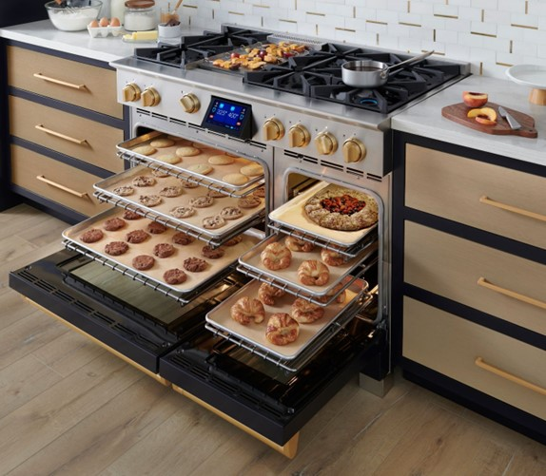
bluestar
True Convection system
2800 Watt double wrapped element around the convection fan
Features Reverse Airflow System
  Convection Fan draws air from the oven cavity and forces it through the heated element
  The intensely heated air is then pushed into the cavity on both sides through a finely tuned baffle
  System uniformly distributes heated air to the entire oven cavity – top to bottom; left to right; front to back – for perfect multi-rack cooking and baking
Preheat: 14-16 minutes to 350°
True Convection fans in large and small ovens in the 48”
Notes:
We have done testing against our target competition as Wolf & Miele and we believe ours is superior
Why not 2 fans? Our testing has shown that 2 fans leave a cold spot in the center in the oven and difficult to get uniformity
We also have reverse air flow
Verses our EWO – back heat assist is not hot enough to operate on its own – only 1800 watts – needs the lower element to preform

Slide 8
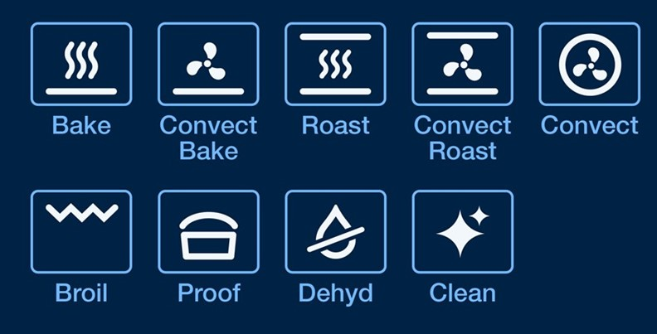
OVEN MODES
Cooking icons highlight heating elements in each mode
Delayed Start Option, Preheat Bypass, plus Sabbath Setting available in select modes

Slide 9
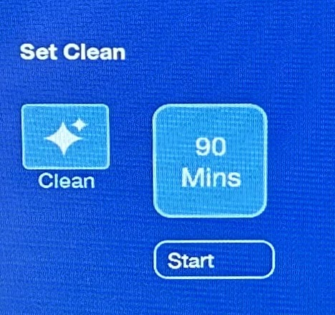
Environmentally friendly
Cleaning mode
PLUS Continu clean™
Environmentally friendly, gentle 90-minute express Cleaning Cycle
  Runs at 550° for 90 minutes – 50 mins to get to temp, then maintains for 40 mins
  All 3 heating elements alternate so dirtiest surfaces (top, bottom, rear walls) are exposed to higher temps to burn off residual greases and oils
  Reduced cycle time pulls less energy and reduces excess heat on electronic controls
  Oven air is circulated through the catalytic elements to remove smoke and odors
  Racks can stay in ovens during cycle, saving time
  Continu Clean™ technology eliminates smoke and odors from oven and kitchen air
  A catalytic element is used to continuously scrub the heated air eliminating smoke and odors during normal cooking
  Located at the top of the oven, behind the broiler
  Passive element only activated above 250° – so will not cycle during proof/dehydrate
Notes:
48” Small oven offers Clean Mode too. One of the easiest ways to damage electronic controllers is pyrolytic self clean – our system does not have that.

Slide 10
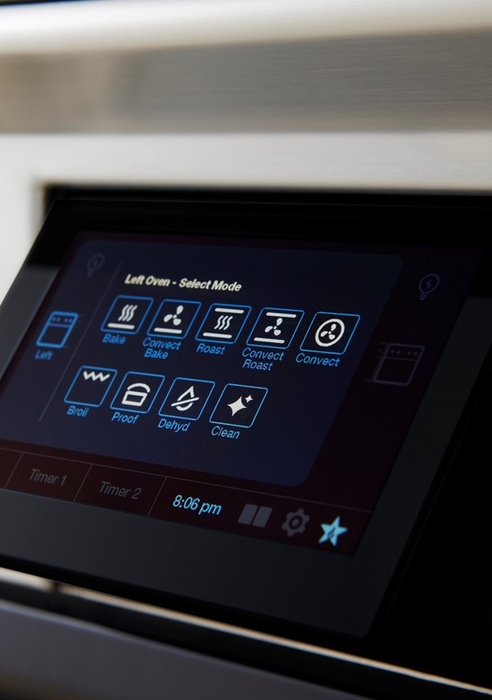
Intuitive Touchscreen With Ergonomic Tilt Display
Full-color, tilt out 7” screen offers clear visibility and a user-friendly interface
Quick Start™ cooking in three easy touches
All modes, external kitchen timers, clock and oven activity viewable on single screen
Customizable clock designs & sound levels

Slide 11
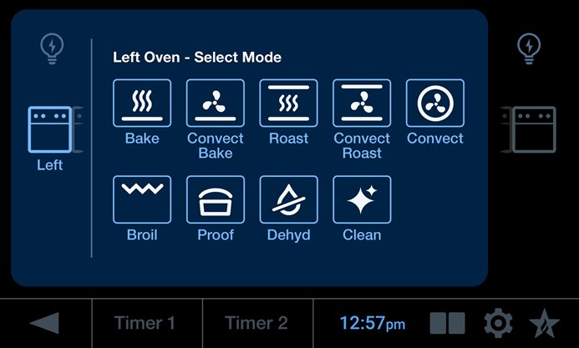
Main screen
Large screen conveniently displays all oven actions at the same time.
Large Oven Light
Small
Oven Light
Large Oven
SmallOven
Previous
Screen
2 independent
Kitchen Timers
Clock
Split Screen
Idle Display
Settings

Slide 12

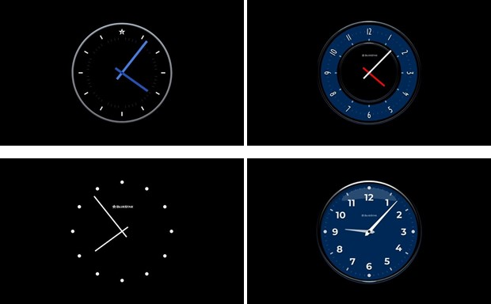
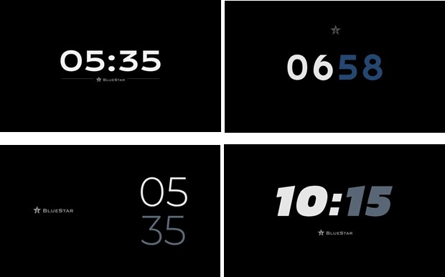
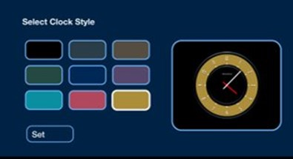
CLOCK CUSTOMIZATION
Choose from 8 different idle clock display screens plus 9 color options depending on personal style.
Analog Clocks
Digital Clocks

Slide 13
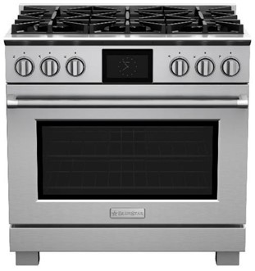
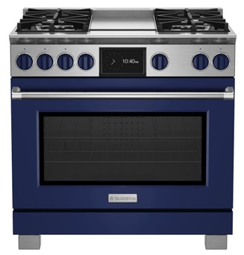
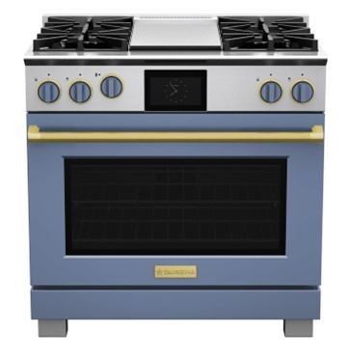
UNMATCHED
COLOR & CUSTOMIZATION
Infinitely customizable ranges as unique as the home chefs who use them.
Create a custom kitchen with 1,000+ colors and 10 metal trim finishes.
Classic Stainless
1,000+ Colors
(Body and Knobs)
1,000+ Colors
(Body and Knobs)
+ 10 Metal Trims

Slide 14
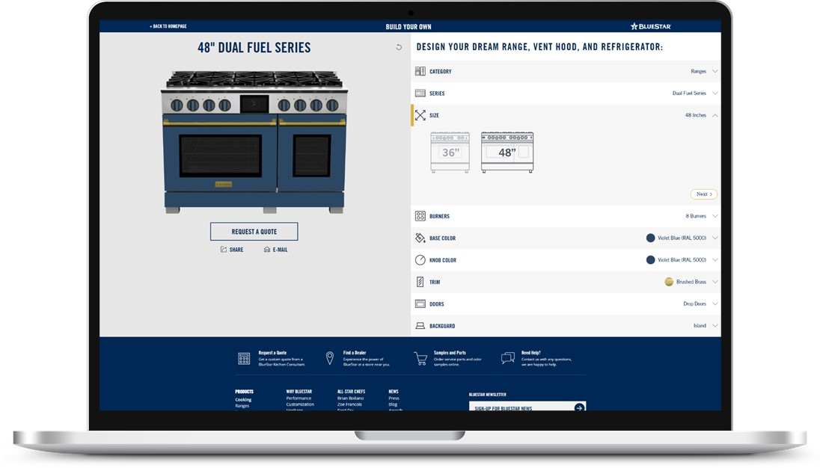
Build Your Own ToDAY
Design your own custom dual fuel range at www.bluestarcooking.com

Slide 15
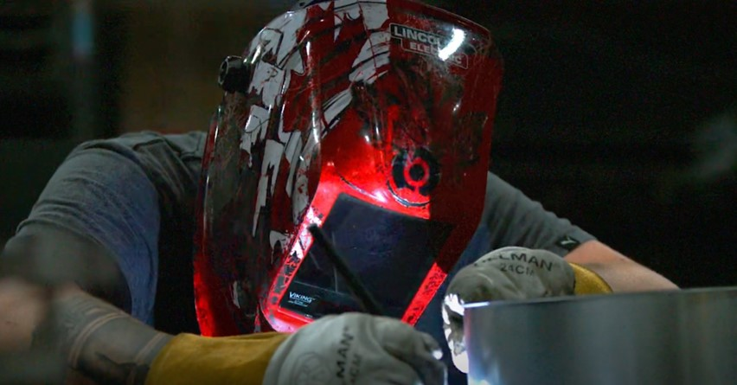
Stars Aren’t Born, They Are Handmade
Like all BlueStar® Appliances, our new line of Dual Fuel products is handcrafted in our Pennsylvania factory with commercial-grade materials

Slide 16
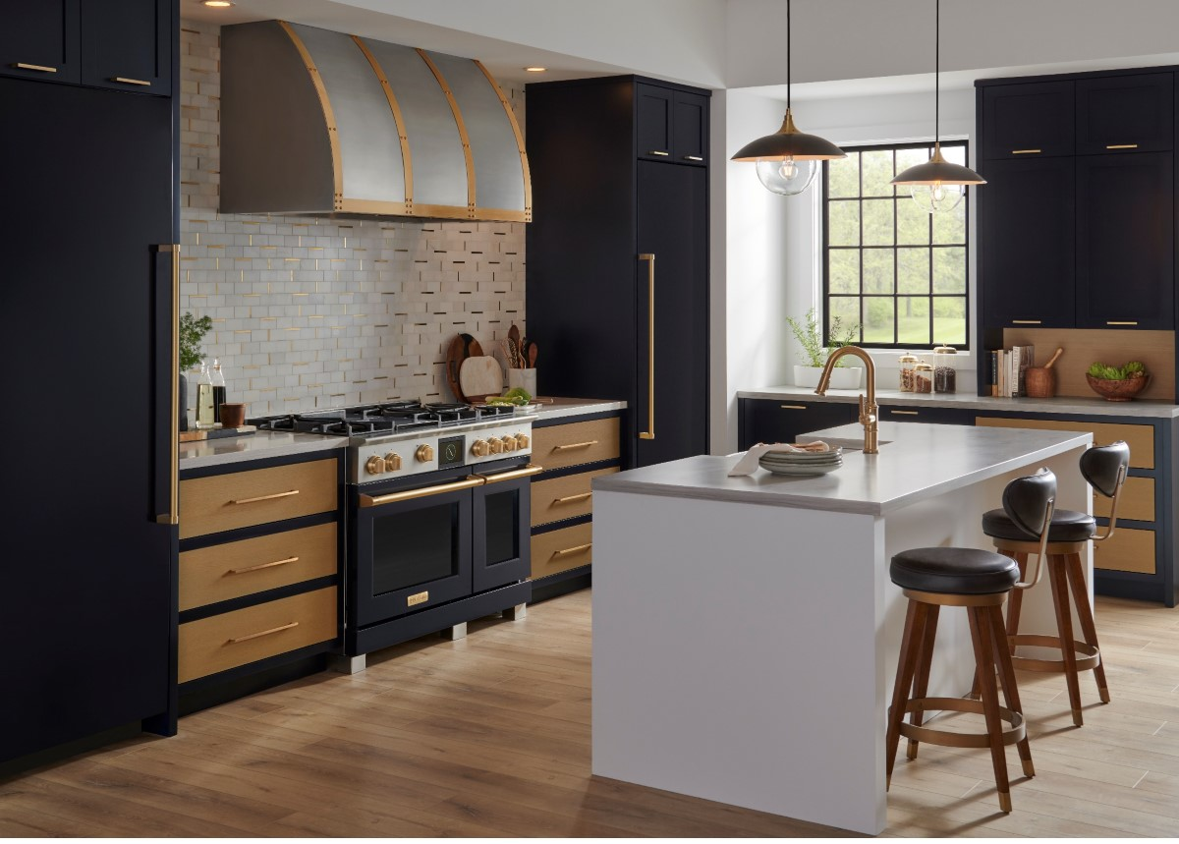
Complete Your Kitchen – What else is in the package?
Designer Hood
Column Refrigerator
Column Freezer

Slide 17
Why BlueStar® Dual Fuel?
      Have it all and do it all on Every Single Burner.
X-8™ Burners deliver full-spectrum power, performance, and versatility
No other Dual Fuel offers a constant warm 500 BTU setting on every single burner or the incredible highs of 25,000 BTUs
The power and performance of our iconic open burner in modern sealed design
      Extraordinary extra-Large true convection oven
True convection oven for even heat distribution and consistent multi-rack baking results
Eight cooking modes and precise temperature probe
User friendly, ergonomic touchscreen control
      Handcrafted in Pennsylvania since 1880
Quality craftsmanship and professional grade materials designed to withstand the rigors of the most demanding home kitchens.
      Unmatched customization
The most customizable Dual Fuel Range in the industry with 1,000+ Colors and 10 metal trim options.

Slide 18
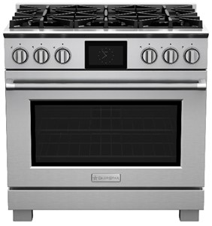
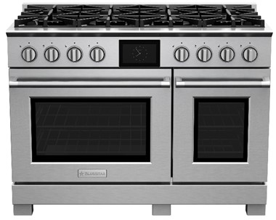
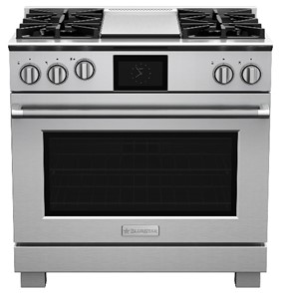
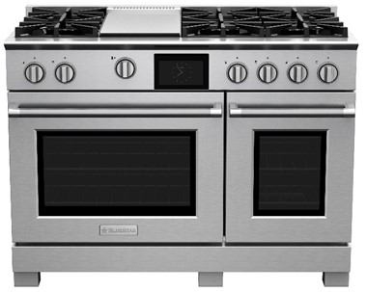
US Pricing
BSDF366B
Starting at $11,995
BSDF488B
Starting at $15,995
BSDF364G
Starting at $12,995
BSDF486G
Starting at $16,995

Slide 19
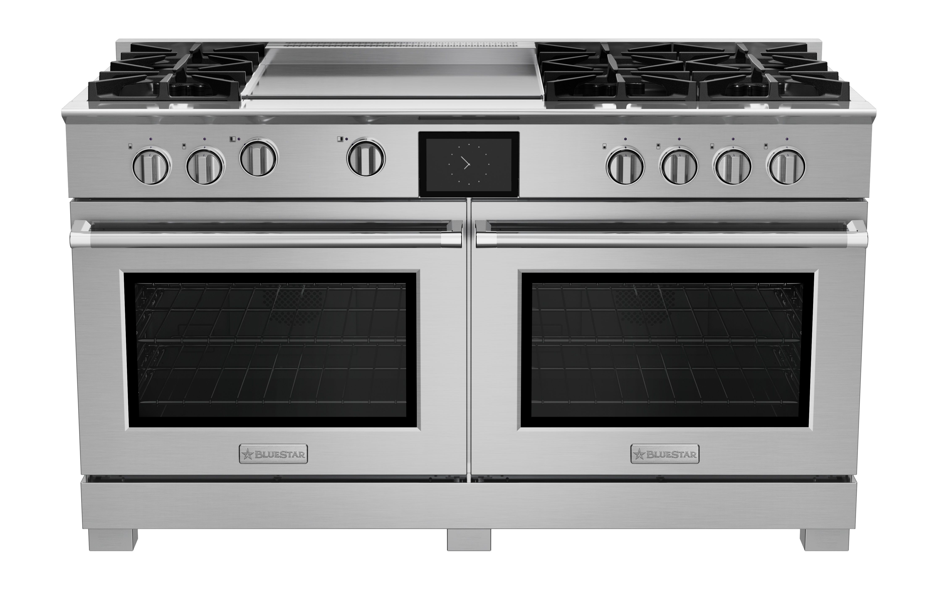
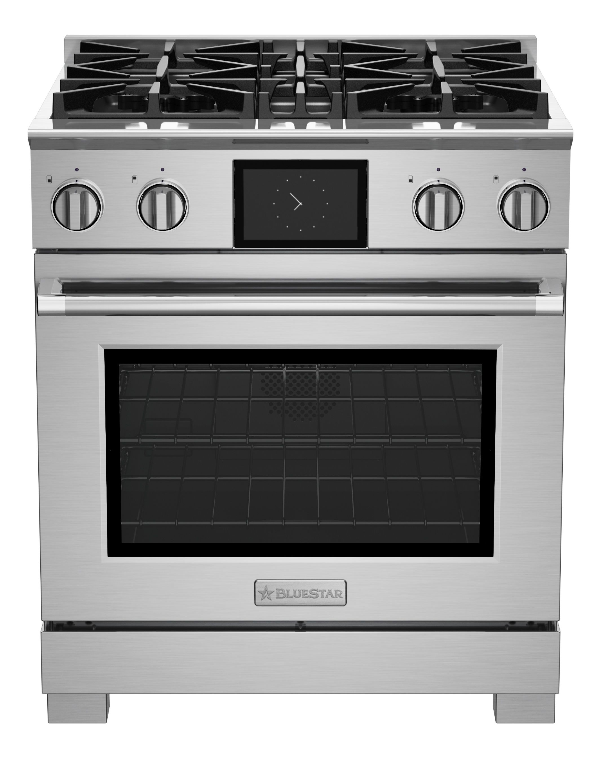
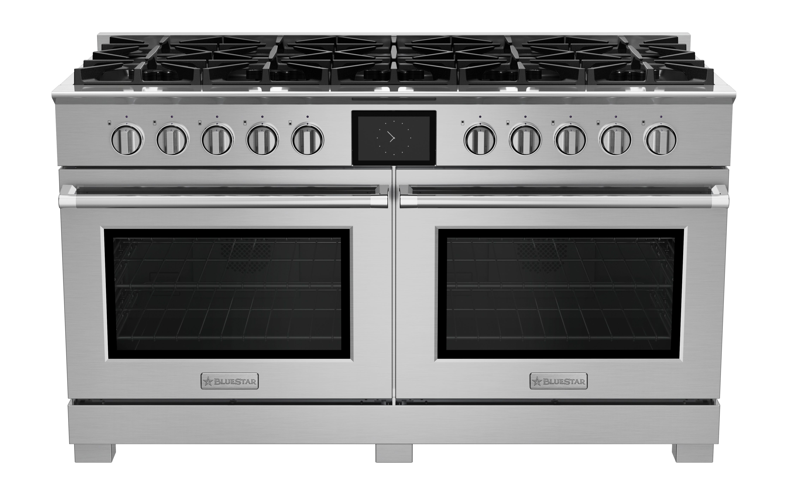
Coming
Soon
30” & 60”
Launching Summer 2023
BSDF606g
Starting at $21,495
BSDF304b
Starting at $8,295
BSDF6010B
Starting at $20,495

Slide 20
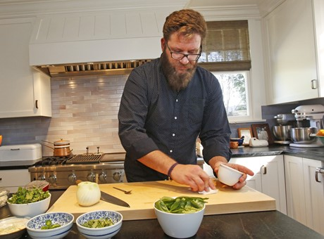
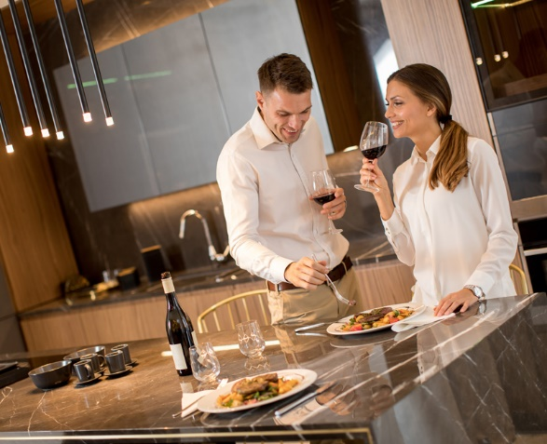
The Bluestar consumer target continues to expand
The Serious Home Cook
Where They Meet
The House Proud Cook
Characteristics:
Favor simplicity
Hands-on, research-oriented
Comfortable with embracing the messiness of the process
How they viewing cooking:
Cooking is enjoyable, relaxing (recipes optional)
Value performance over technology
Strong cooking foundation (basics are effortless)
Will try new techniques at home: wok, sous vide
Cooking References:
Food blogs / Apps like NYT Cooking
Cookbooks
Characteristics:
Values speed, efficiency and convenience
Look for added bells/whistles, even at a higher cost
Appreciate simplicity in terms of cleaning
How they view cooking:
Prefer to use recipes
Wants direct feedback via screen, timers, temperatures, probes
Craves control over the process
Baking is a family hobby
Cooking References:
Ina Garten Fans
Pinterest / Instagram
Enjoys family & entertaining friends with food at the core
Has a diverse palette
Buys Local & Seasonal
Values American craftmanship
Loves to customize
Notes:
Reminder that the person coming in to buy the Dual Fuel is walking in to buy Wolf, Thermador Miele range. They may not even know the BlueStar brand.

Slide 21
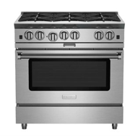
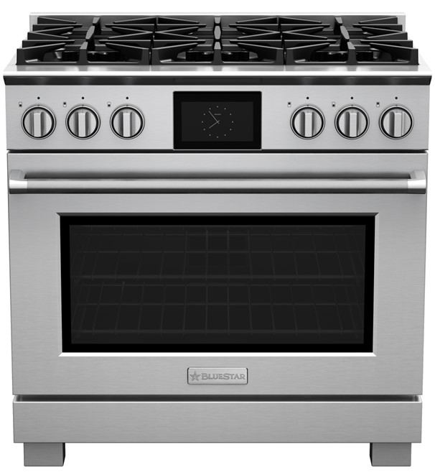
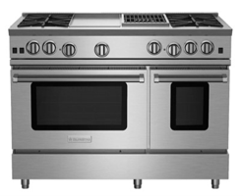
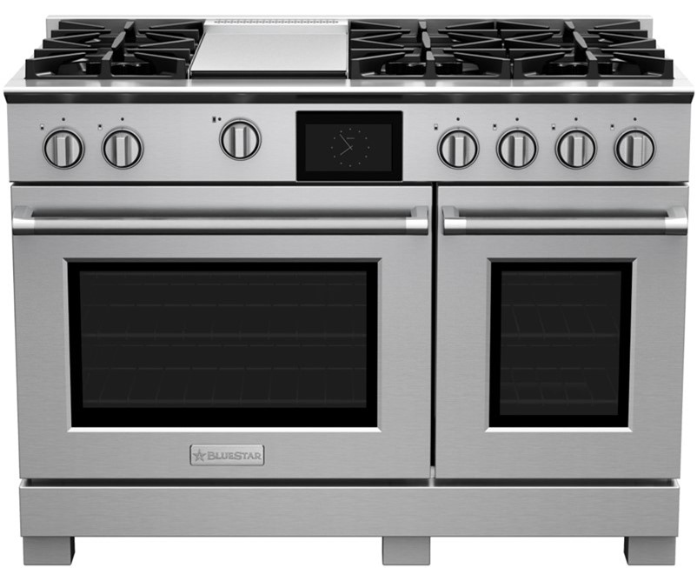
Products they love
The Serious Home Cook
The House Proud Cook
Open Burner - All Gas
Dual Fuel
Notes:
Electric Oven– more precision, better on coloration for baked goods
Gas Oven- moist heat, better for roasting meats and vegetables

Slide 22
BlueStar® consumer target IS BROAD
The House
Proud Cook
Serious Home Cooks
Serious Home Cooks
yesterday
today

Slide 23
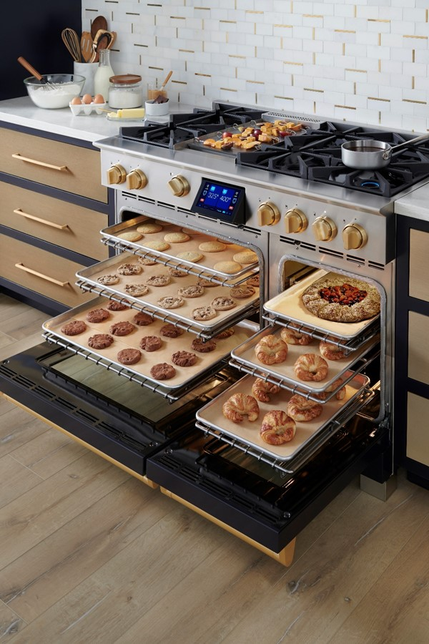
Thank you

Slide 24
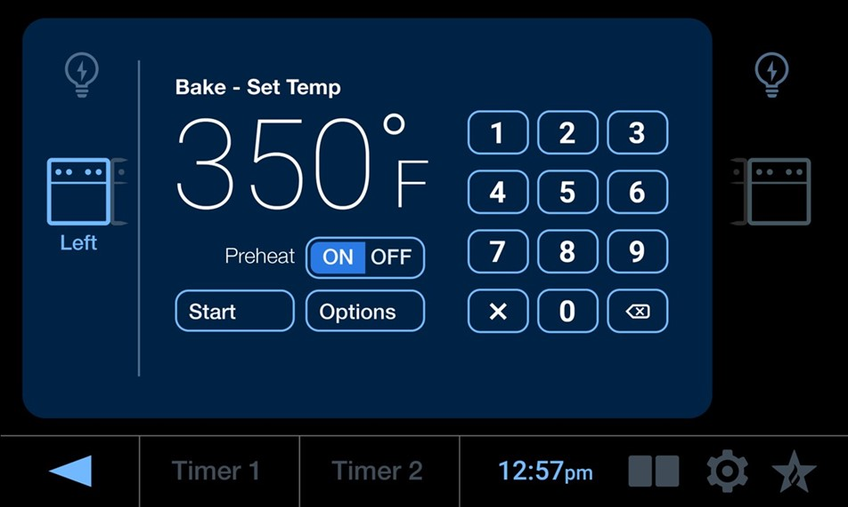
BYPASS PREHEAT

Slide 25
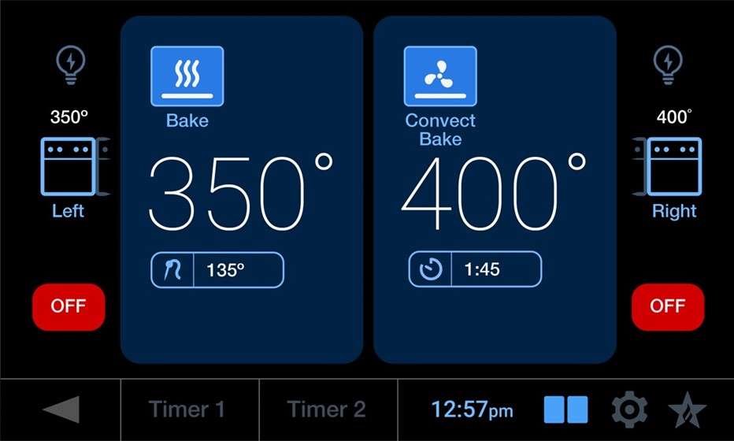
SPLIT SCREEN – Available on 48” & 60” Models

Slide 26
BlueStar® Dual Fuel Oven Heating Elements – 30” & 36” Ovens
Heating elements in use during preheat and oven cycle (as it continues to maintain temperature).
 | PREHEAT |  |  |  | DURING CYCLE
 | Top/ Broil | Rear / Convect | Bottom/ Bake | Fan | Top/ Broil | Rear / Convect | Bottom/Bake | Fan
Bake | X | X | X | X |  |  | X
Convect Bake | X | X | X | X |  |  | X | X
Roast | X | X | X | X | X |  | X
Convect Roast | X | X | X | X | X |  | X | X
Convect | X | X | X | X |  | X |  | X
Broil | X | X | X | X | X
Proof | X | X | X | X |  |  | X
Dehydrate | X | X | X | X | X | X | X | X
Clean | X | X | X |  | X | X | X
Toggle switch button below the temperature readout states: PREHEAT ON OFF
It defaults to ON for most cooking modes. Toggle to OFF.

Slide 27
BlueStar® Dual Fuel Oven Heating Elements – 18” Ovens
Heating elements in use during preheat and oven cycle (as it continues to maintain temperature).
 | PREHEAT |  |  | DURING CYCLE
 | Rear / Convect | Bottom/ Bake | Fan | Rear / Convect | Bottom/ Bake | Fan
Bake | X | X | X |  | X
Conv Bake | X | X | X |  | X | X
Convect | X | X | X | X |  | X
Proof | X | X | X |  | X
Dehydrate | X | X | X | X | X | X
Clean | X | X | X | X | X | X

Slide 28
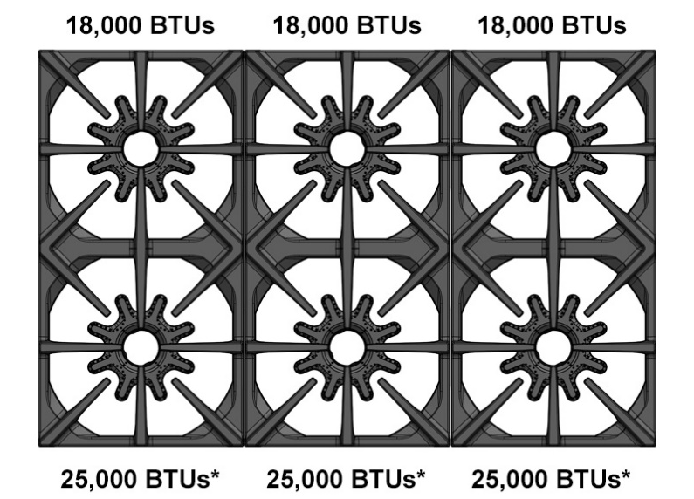
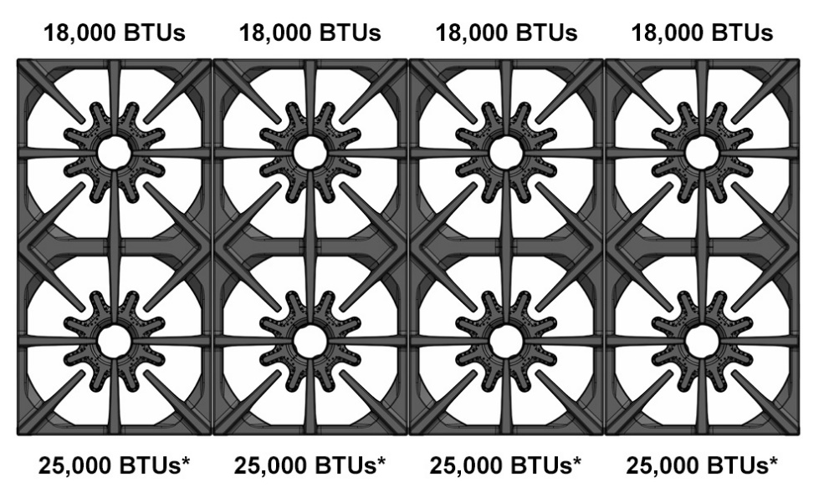
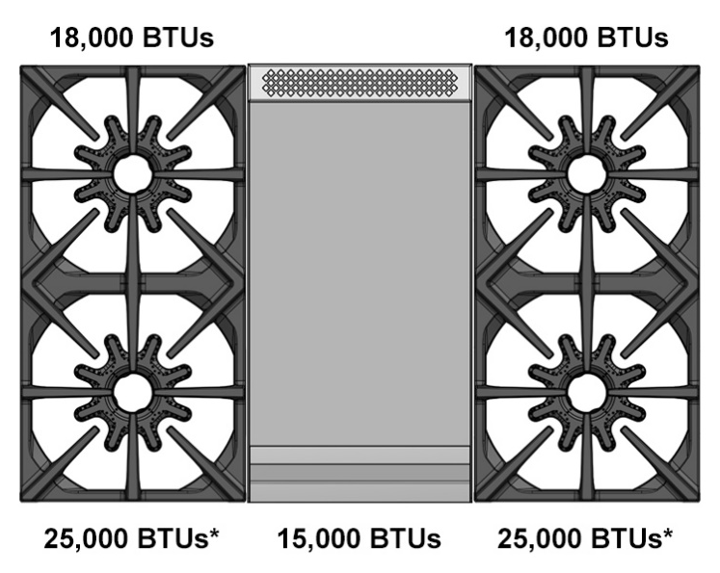
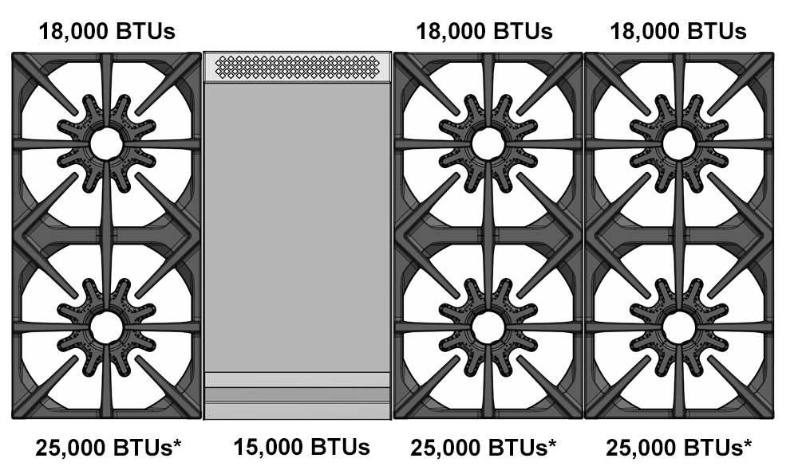
Burner Configurations
BSDF366B
BSDF488B
BSDF364G
BSDF486G

Slide 29

QUALIFYING THE CUSTOMER
Feature | The Serious Home Cook Open Burners – All Gas | The House Proud Cook Sealed Burners – Gas / DF
High Heat | steaks, searing, wok cooking | boiling
Low Simmer | hollandaise, glazes, chocolate | pasta sauce, canned soup
Variability | risotto, reducing sauces | pasta
Griddle / Charbroiler | steaks, fresh seafood | pancakes, grilled cheese
Wok Cooking | fresh stir fry | frozen, premixed stir fry
Broiling | steaks & fish | garlic bread, cheese bread
Roasting | duck or lamb | turkey, chicken – always with probe
Overall Oven | finishing needs / from scratch baking | boxed cookies/cakes/brownies
Baking – Baked Goods | crème brulee | soufflé
Baking – Bread/Pizza | fresh dough | frozen/store bought dough
Cleaning | it can wait, quick wipe down | right away, deep clean

Slide 30
Who is our dual fuel customer?
The House Proud Cook
Behavioral/Psychographics:
Comfortable with using technology for its convenience
Cleaning is important, goes to bed with a clean space
They see the value of paying for enhanced performance features, even if they do not use it – like to “trade up”
Look for the maximum advantages, even at a higher cost
How they cook in the kitchen:
Can/do make delicious meals, but everything is recipe-based
Wants direct feedback on cooking actions via: screen, timers, temperatures, probes
Craves control over the cooking process
Cooks daily, but will prioritize family time over cooking time
Has the same meals every week
Bakes year round; oven used as much as stovetop
Values speed & efficiency
Follows recipes/cooking modes to compensate for minimal skills
Uses meal kit/delivery companies
Does not substitute ingredients, less confident cooking on the fly
Appliances should reflect their home & kitchen décor
Always does a thorough clean after each meal

Slide 31
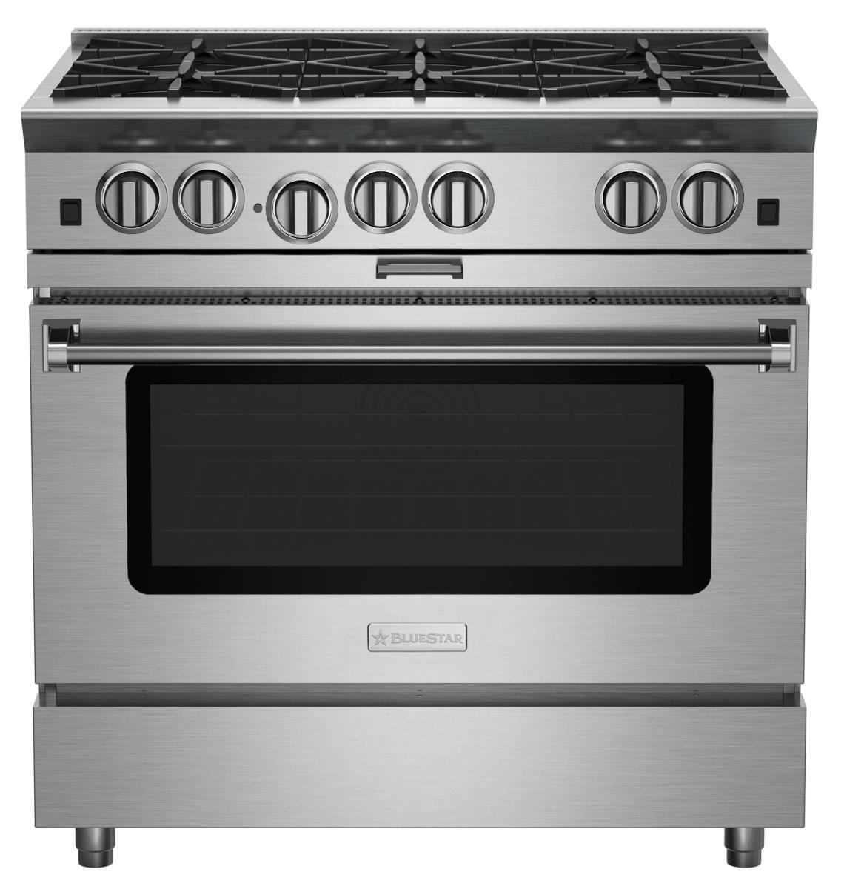
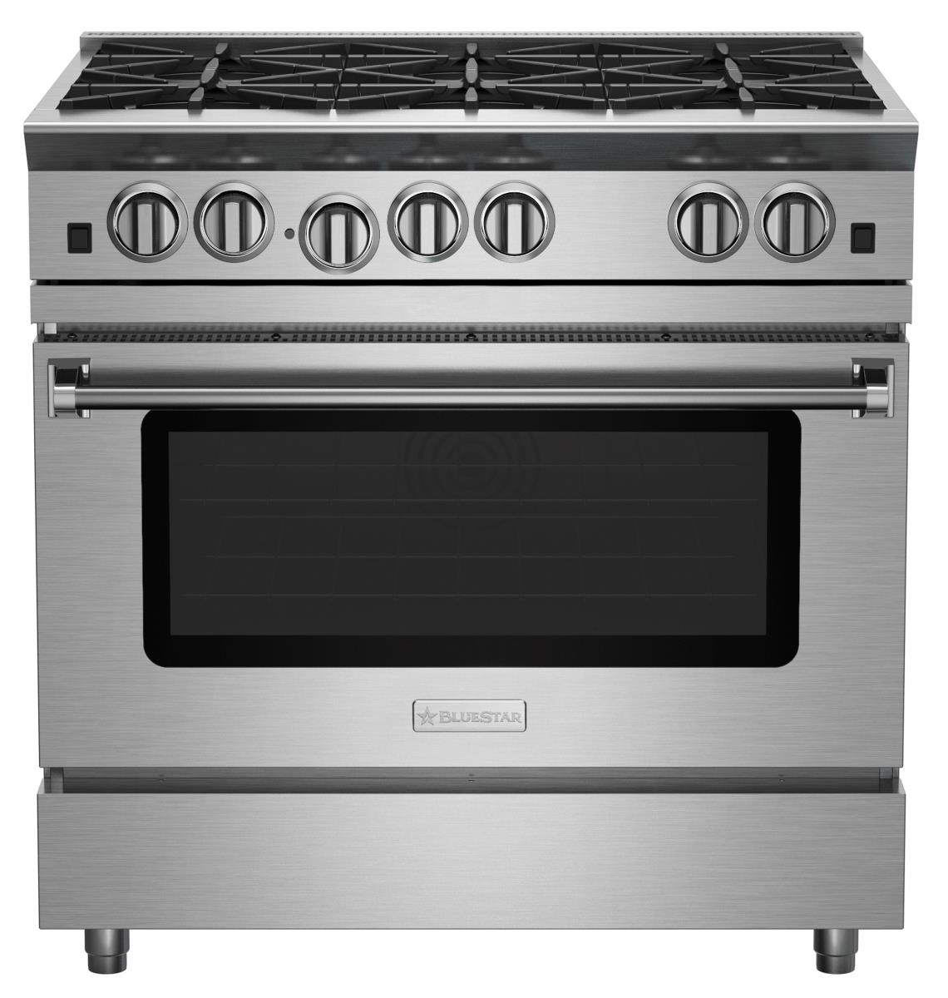
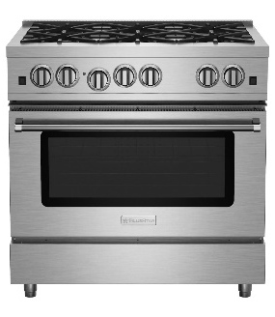
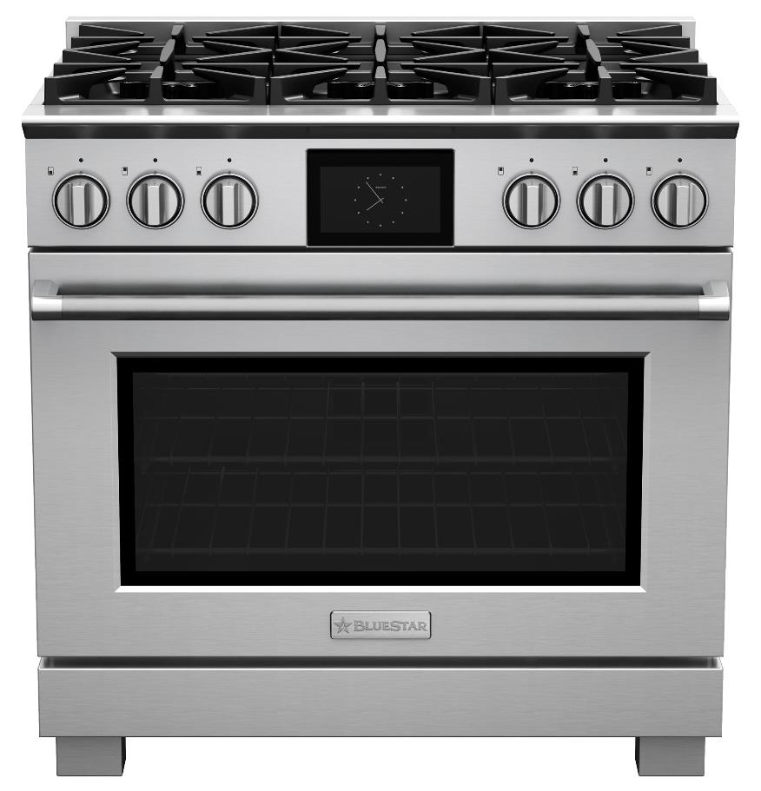

BlueStar Range Burner Data
Platinum & RNB
Gas Type | High Rate (BTUs) | Min. Simmer (BTUs)
NG | 25,000 | 2,691
NG | 22,000 | 2,444
NG | 18,000 | 1,929
NG | 15,000 | 1,902
NG | Simmer (9,500) | 1,307
RCS
Gas Type | High Rate (BTUs) | Min. Simmer (BTUs)
NG | 21,000 | 2,402
NG | 18,000 | 2,680
NG | 15,000 | 2,242
NG | 10,000 | 1,632
NG | Simmer (5K) | 516
Dual Fuel
Gas Type | High Rate (BTUs) | Low (BTUs) | Simmer (BTUs) | Warm (BTUs)
NG | 25,000 | 2,700 | 800 | 500
NG | 18,000 | 2,700 | 800 | 500
TEMP | 12-13 min. to boil | 150° | 130° | 115°

Slide 32
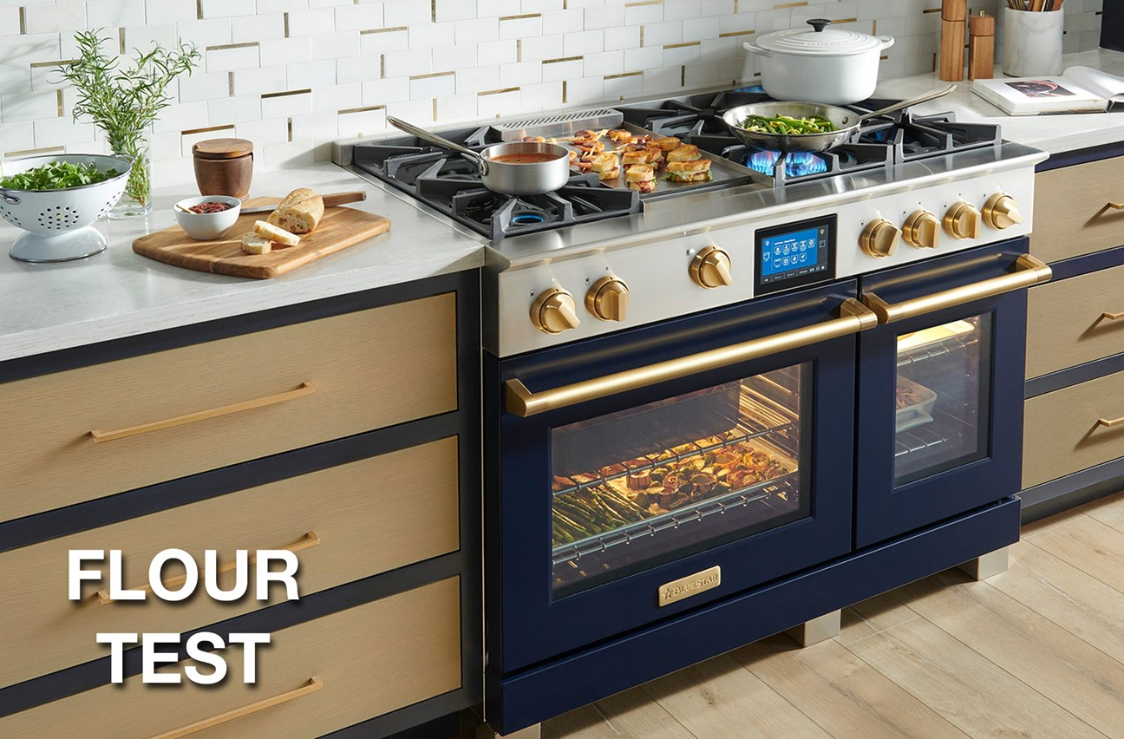

Insert video link

Slide 33
What are they cooking
The House Proud Cook
Feature | The House Proud Cook
High Heat | boiling
Low Simmer | pasta sauce, canned soup
Variability | pasta
Griddle / Charbroiler | pancakes, grilled cheese
Wok Cooking | frozen, premixed stir fry
Broiling | garlic bread, cheese bread
Roasting | turkey, chicken – always with probe
Overall Oven | boxed cookies/cakes/brownies
Baking – Baked Goods | soufflé
Baking – Bread/Pizza | frozen/store bought dough
Cleaning | right away, deep clean

Slide 34
OVEN BOTTOM
BlueStar Dual Fuel ranges feature an easy-to-clean robust ceramic glass bottom on all oven cavities. The surface can be wiped down after each use and even scraped when necessary for tough stains. Its unique and energy efficient material can withstand extreme conditions and provides an excellent heat transfer for faster pre-heat and cooking cycles. And service will be easier as hidden bake element can be accessed without needing to take apart the entire oven cavity.

