Slide 1
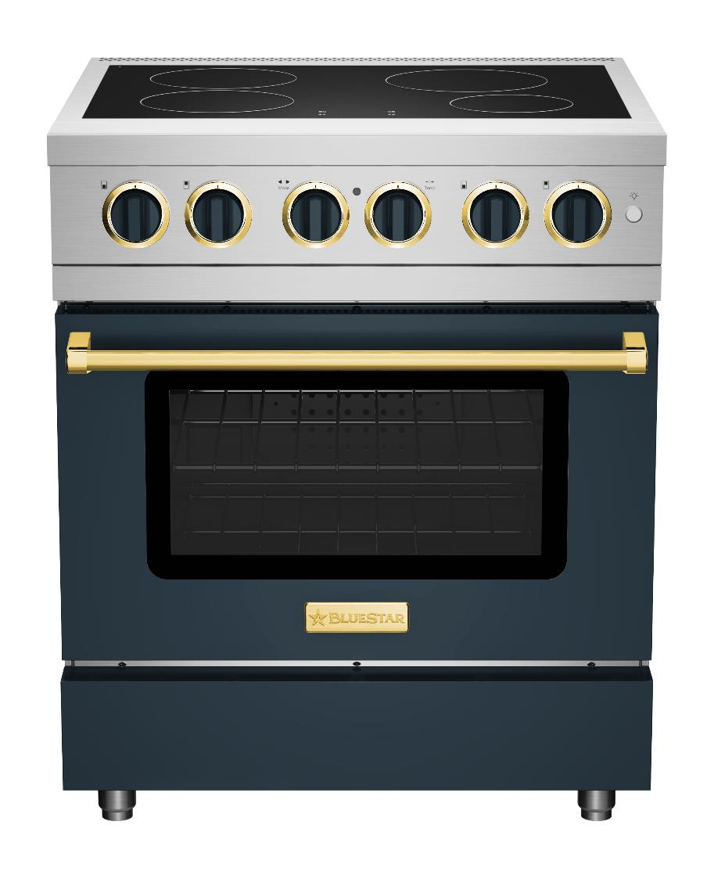
INDUCT STYLE INTO THE KITCHEN WITH bLUEsTAR’S
Newest range

Slide 2
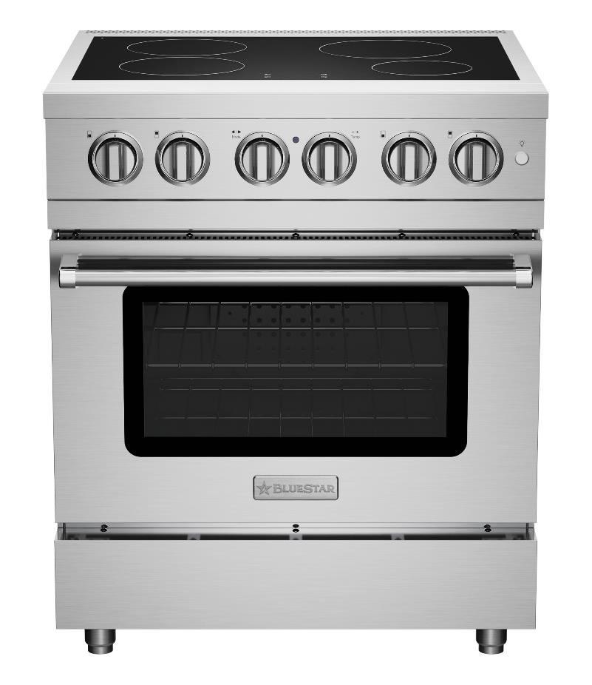
INTRODUCING THE BLUESTAR® 30” CULINARY SERIES INDUCTION RANGE
BlueStar® is thrilled to welcome the first induction range into our lineup of professional-grade cooking appliances. Induction Performance, now for the first time with endless customization. Style with 1,000+ colors and 10 metal trim options.
Nine heat levels for each cooking zone
Four cooking zones efficiently transfer heat to cookware and instantaneously respond to burner adjustments
Oversized Electric Convection Oven accommodates 18” x 26” commercial baking sheet
5 oven modes including Bake, Convection Bake, Broil, Convection Broil and Fast Preheat
BSIR30
$6,995 UMRP

Slide 3
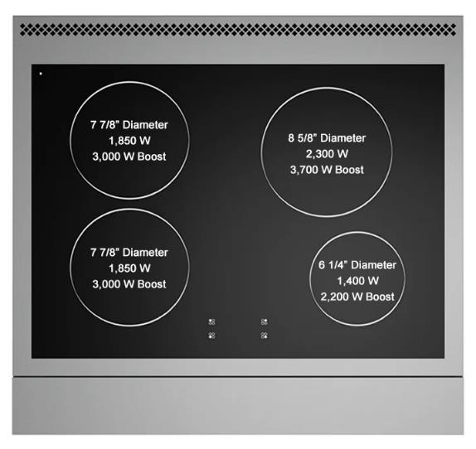
SEAMLSS INDUCTION
COOKTOP
Nine heat levels for each cooking zone, controlled by knobs that provide precise control and flexibility
Four cooking zones efficiently transfer heat to cookware and instantaneously respond to burner adjustments
Highly responsive 3,700 Watt power boost allows for a rapid boil and intense sear
Gentle keep warm function maintains low and even heat on each zone
Optimized safety features include automatic pan detection, a quick to cool surface, hot-surface indicator lights and child-safety lock
Durable ceramic cooktop surface and seamless backguard cleans quickly & easily, simply wipe down

Slide 4
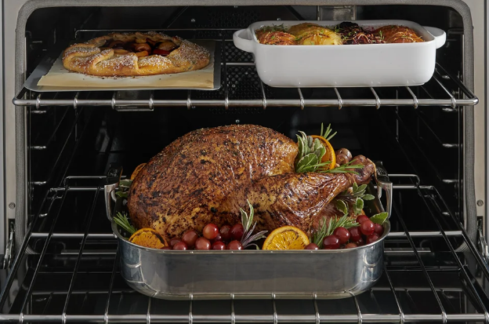
OVERSIZED ELECTRIC
CONVECTION OVEN
Oversized electric convection oven ideal for holiday cooking and entertaining
Oven accommodates 18” x 26” commercial baking sheet
5 oven modes including Bake, Convection Bake, Broil, Convection Broil and Fast Preheat
Powerful 2,500W Broiler
One full-extension glide rack + 2 standard racks included

Slide 5
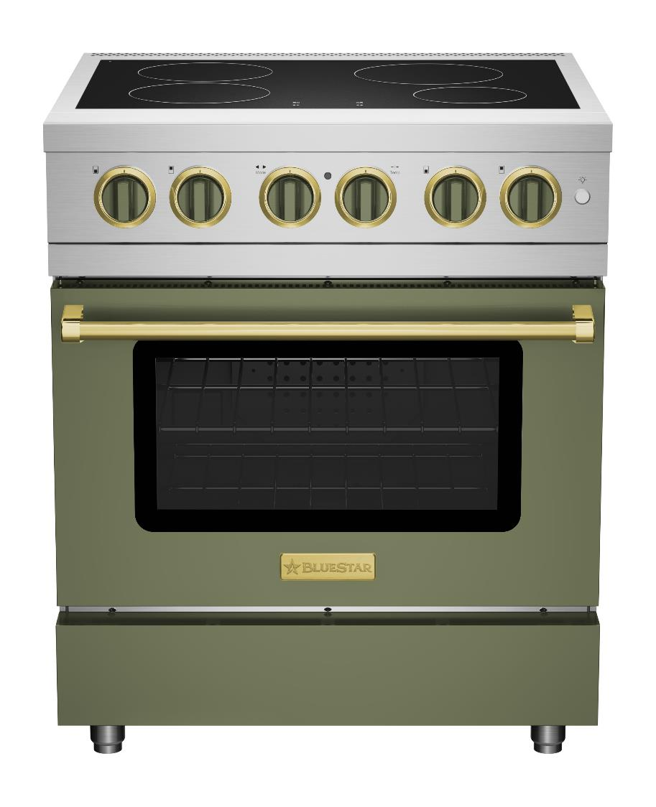
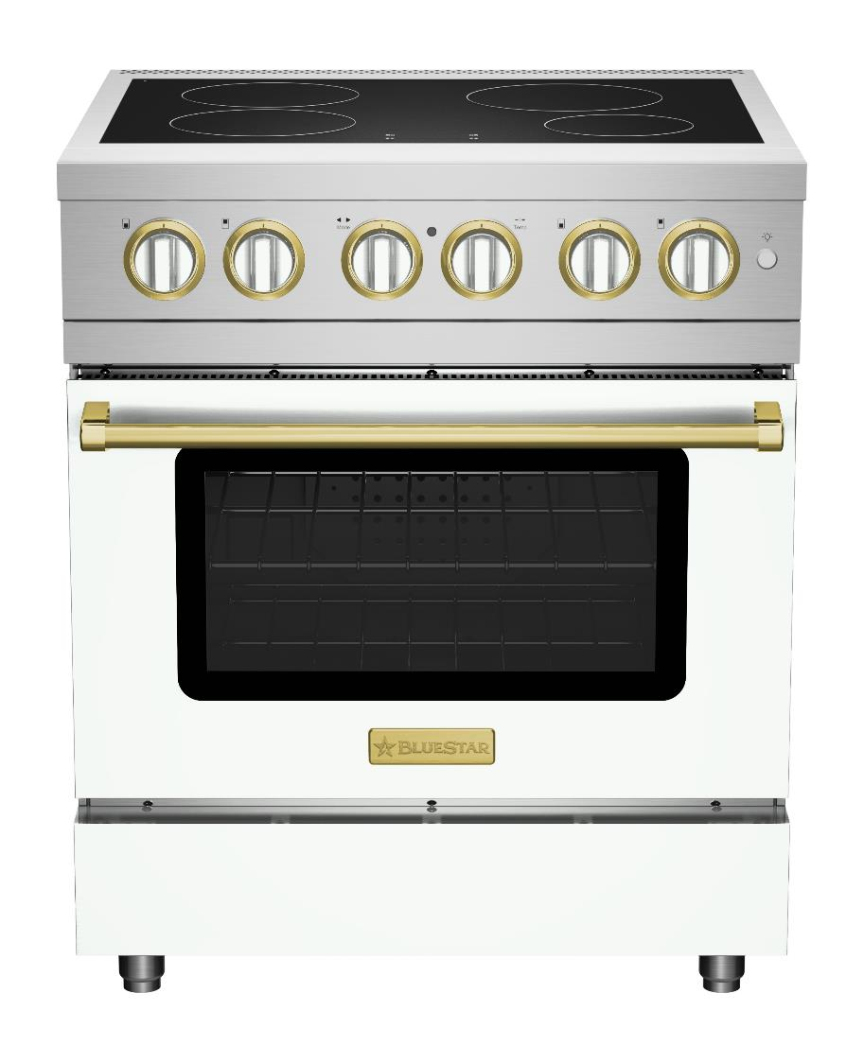
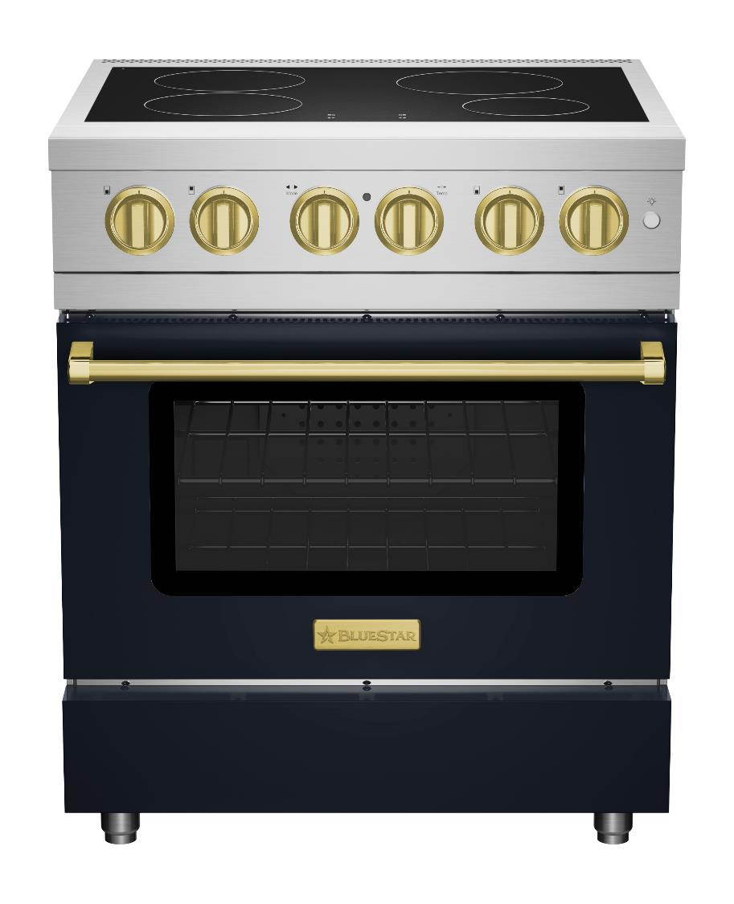
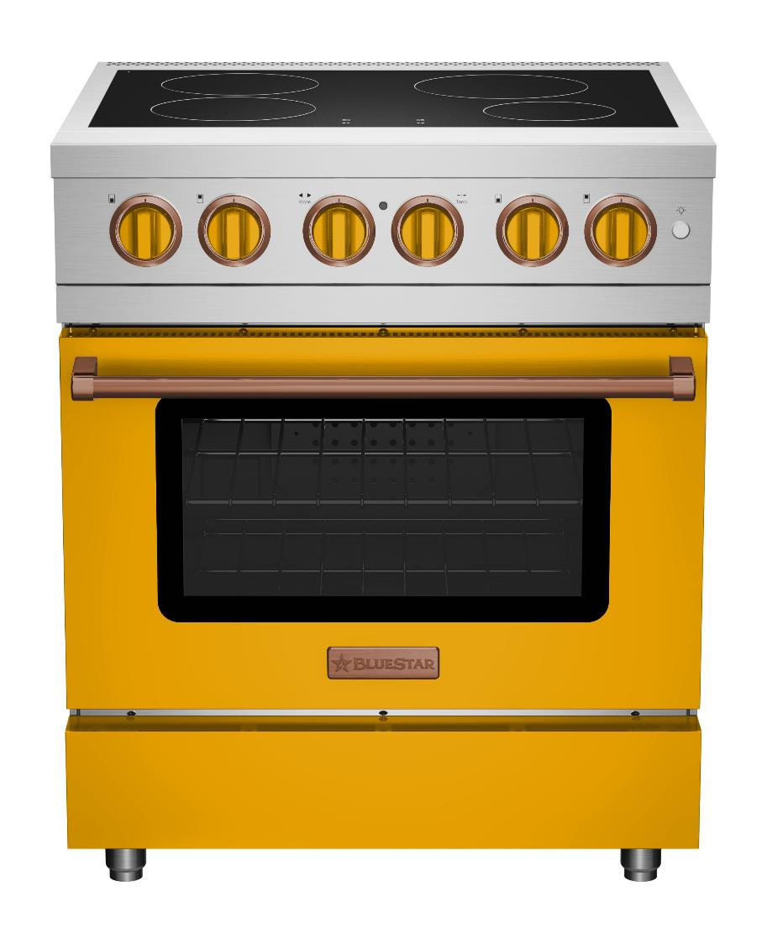
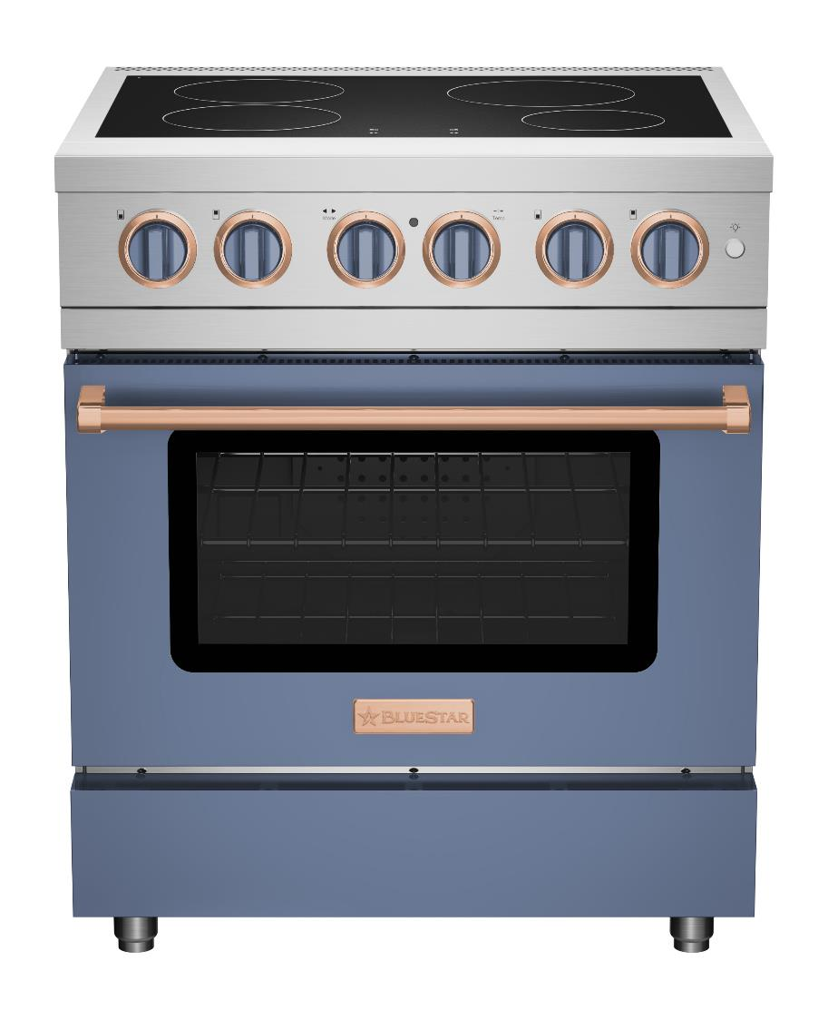
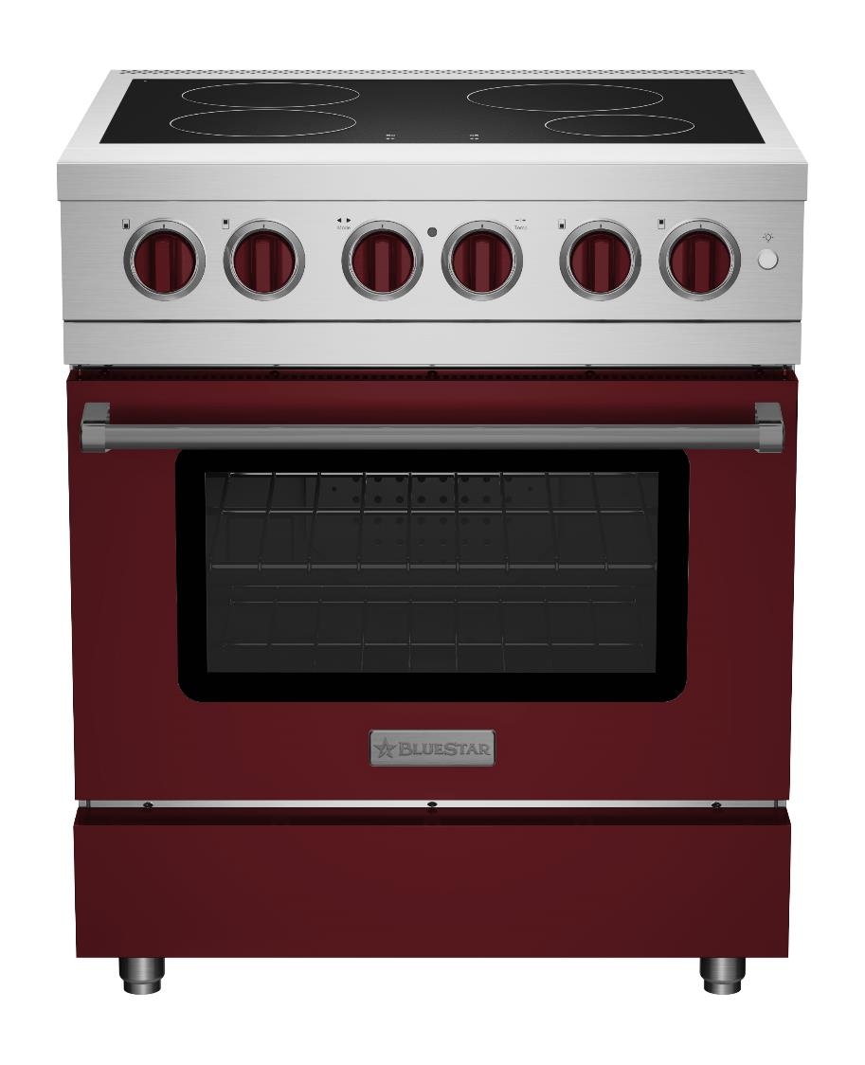
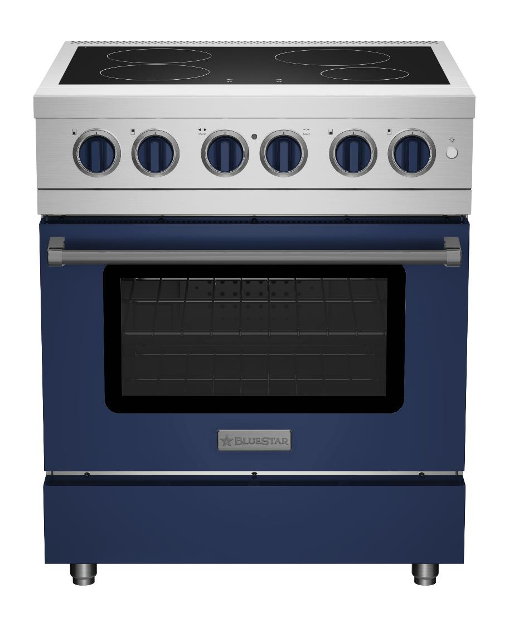
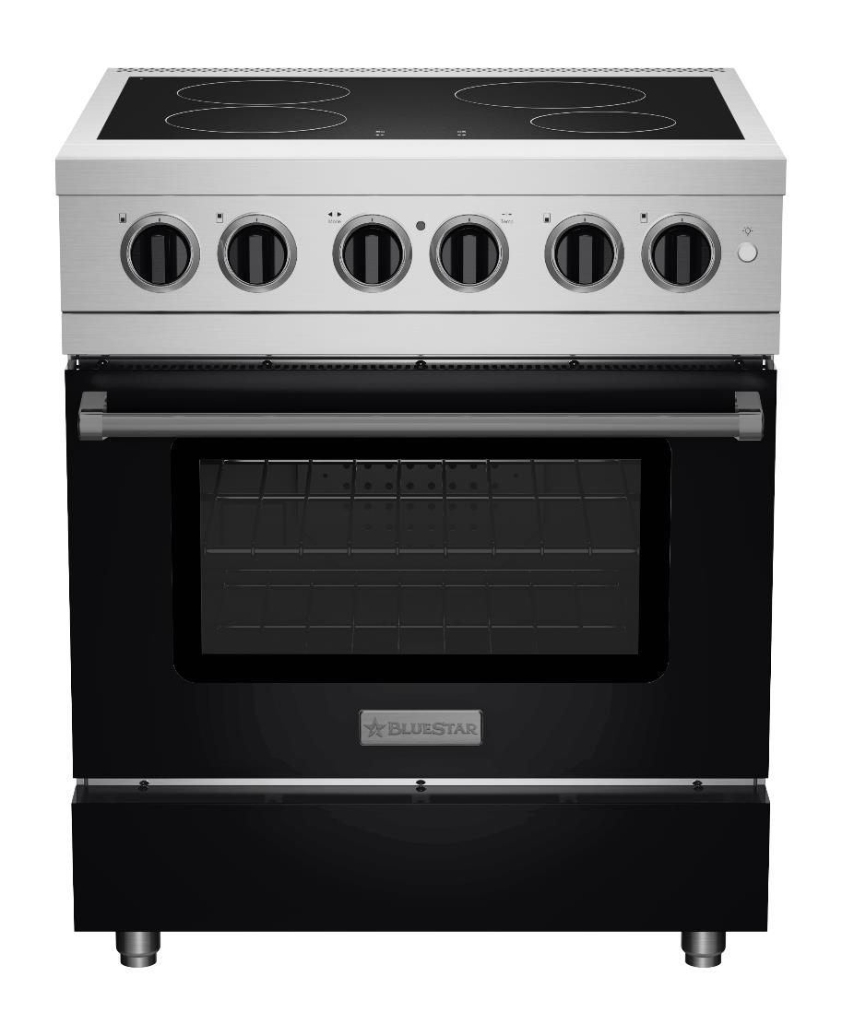
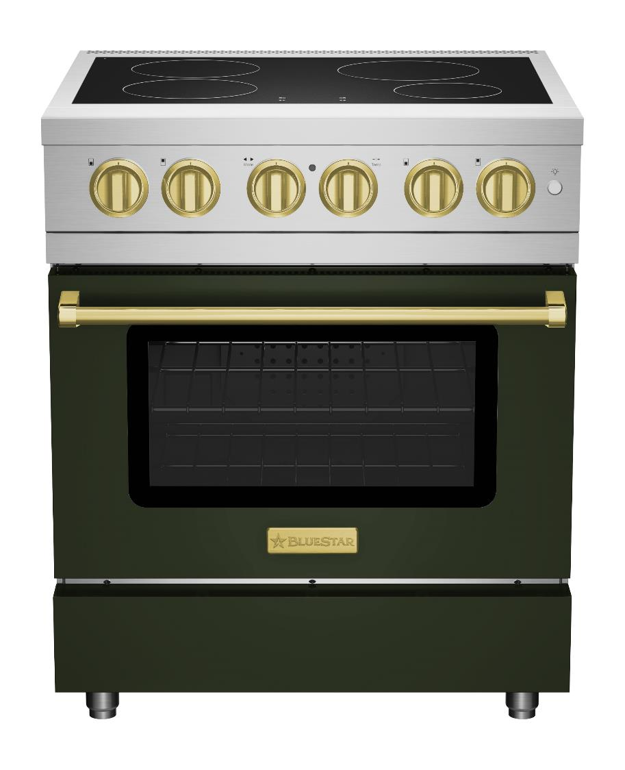
ENDLESS CUSTOMIZATION
THE MOST CUSTOMIZABLE INDUCTION RANGE
1,000+ COLORS | 10 METAL TRIMS | CUSTOM COLOR MATCH | COLOR & PLATED KNOB OPTIONS

Slide 6
WHY INDUCTION? WHY BLUESTAR?
Why Induction?
Fastest & Most efficient (by 50%) fuel source
Precise control, flexibility & even heating
Optimal safety features: no flames, lock function, pan detection
Easiest to clean cooktop surface
Environmentally friendly (does not release combustion gases)
Why BlueStar Induction?
Most customization options in category – 1,000+ colors, plus 10 metal trim options
Superior Oven Capacity – fits full-size sheet pans
Easy-to-use knob controls
Designed and built with commercial-grade materials for lasting performance & durability
Handcrafted in Pennsylvania

Slide 7
BACK UP

Slide 8
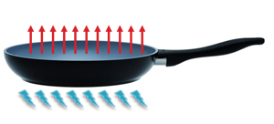
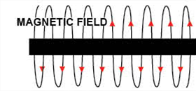
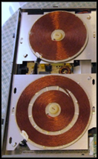
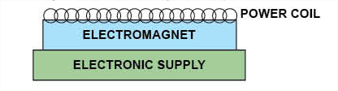
What is Induction Cooking & How Does it Work?
Induction burners create a magnetic field that directly heats the pan and not the surface to provide consistent temperature and instant response.
Currents create heat while running into the bottom of the pot.
The magnetic fields inducts currents into the utensil.
Copper coils create a strong rotating magnetic field.

Slide 9
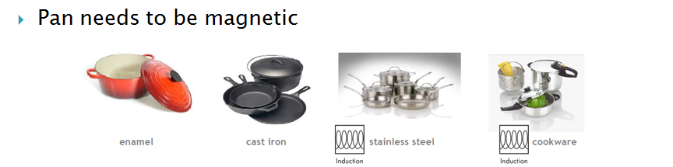


COOKWARE
No Cookware = No Heat
Pan Needs to be Magnetic

Slide 10
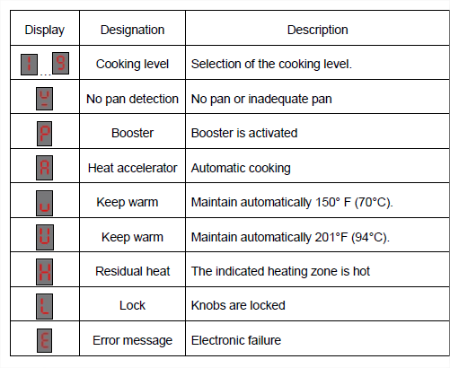
BLUESTAR INDUCTION
SPECIFICATION & FEATURES
Display Area
Each activated function is displayed onto the display area.

Slide 11
BLUESTAR INDUCTION
SPECIFICATION & FEATURES
COOKTOP
Zone Location | Diameter | Nominal Power | Power Boost | Minimum Detection Diameter
Front Left | 7 7/8” | 1,850 W | 3,000 kW | 3 15/16”
Rear Left | 7 7/8” | 1,850 W | 3,000 kW | 3 15/16”
Front Right | 6 1/4” | 1,400 W | 2,200 kW | 3 3/16”
Rear Right | 8 5/8” | 2,300 W | 3,700 kW | 4 3/8”
Total Power: 7400 W

Slide 12
FAQS
Does this unit have a bridge?
No
Does this unit have a temperature probe?
No
Is this oven the same at the electric wall oven?
No it is a different electric cavity
Are there backguard options?
No
Why can it not detect my pan?
Pan needs to be magnetic (enamel, cast iron or induction compatible cookware) - Copper, glass or aluminum are not compatible with induction
Pan needs to be at least 4” minimum - If it’s too small it will not work
Pan needs to have a flat bottom - For better efficiency and function, utensil should always have a flat bottom
What is the “Buzzing” Noise that I am hearing?
Induction cooking involves strong magnetic fields. Pots/pans and the coils inside can make a vibrating or “buzzing” noise when they are placed on the induction cooktop. These noises are random and depend on many parameters. It is normal and does not harm the unit, the cookware or the performance of the cooktop.
Some pans are noisier than others. Quality and weight of the pot/pan is key
When used at high power the noise can become louder
A nearly empty pot/pan will make more noise than a full one
What is the “Fan” Noise that I can hear?
The cooling system is fully automatic. The cooling fan starts at a low speed when the heat generated by the electronic system reaches a certain level. The cooling fan increases to high-speed when the cooktop is intensively used. The cooling fan reduces its speed and stops automatically when the electronic circuit has cooled down enough.
Cooking for a short period of time at a high power might create less noise than cooking for a longer period of time.
After the unit is turned off the fan may continue to run until the cooktop has sufficiently cooled.

Slide 13
COMPETITVE OVERVIEW
Brand | Miele | Wolf | Viking | Fulgor-Milano | Hestan
Model | HR16223I | IR30450/S/T or IR30450/S/P | VIR5302 | F6PIR304S1 | KRI30BK
Price | $9,299 | $8,245 | $9,819 | $6,499 | $9,909
Induction Zones | 4 Zones | 4 Zones | 4 Zones | 4 Zones | 4 Zones
Heat Levels | 9 | 10 | 6 | 9 | 9
Bridge Element | NO | YES | NO | NO | YES
Color/Trim | Stainless Steel | Stainless Steel | Yes-15 colors | Yes-6 Colors And you can create your personalized nameplate for the oven door | Yes-11 Colors

