Slide 1
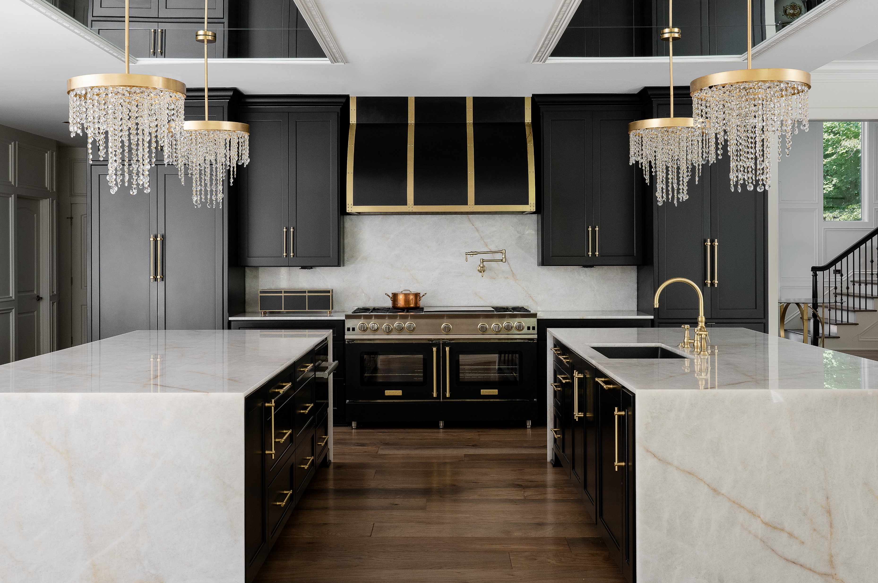
BLUESTAR® NEWS
Q2 2023

Slide 2
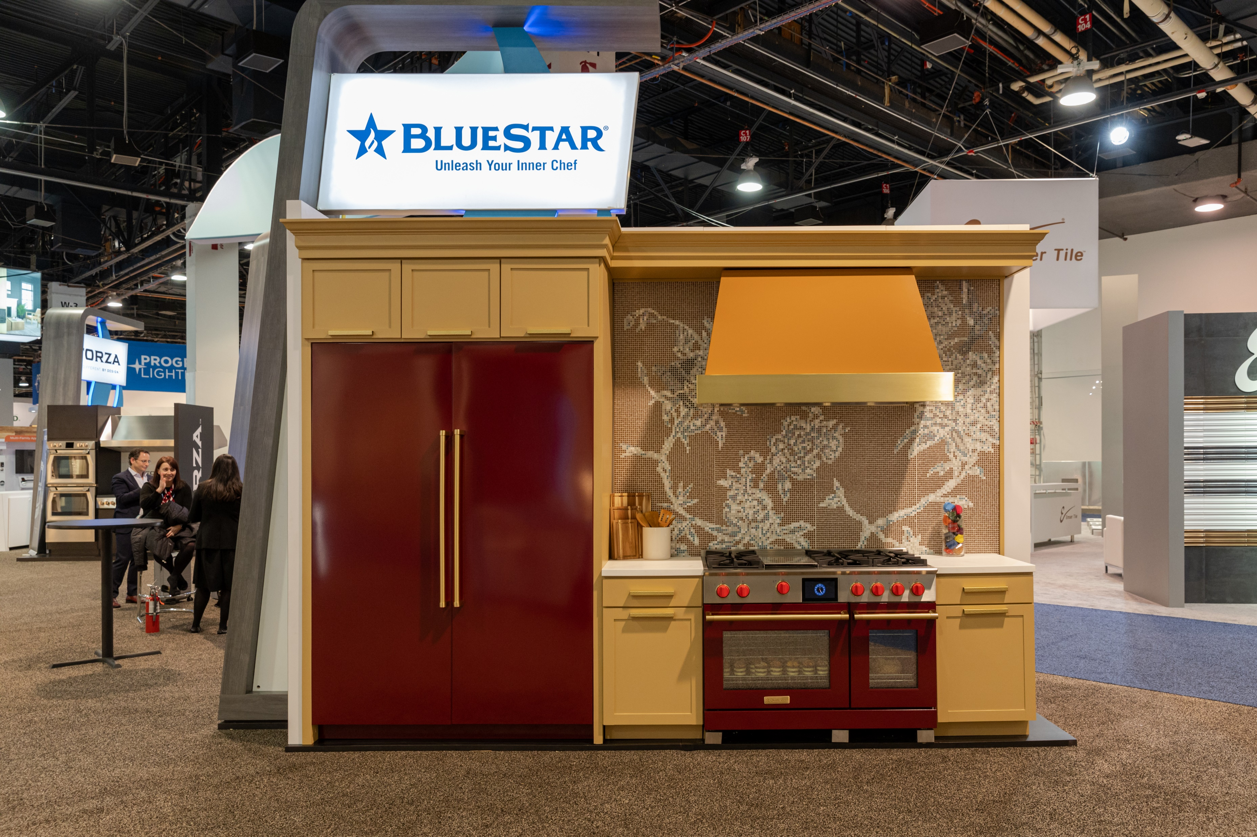
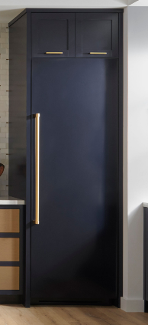
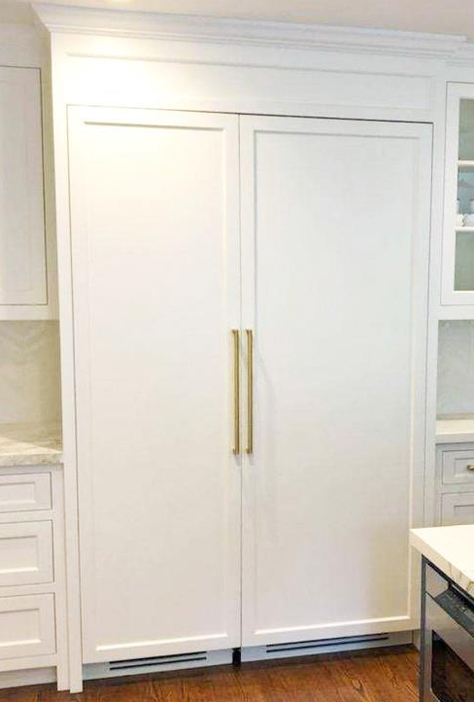

Refrigeration News
The Ultimate in Customization - BlueStar® Columns
BlueStar® columns offer the ultimate in kitchen design flexibility.
Order PANEL READY Units, then customize with a panel accessory
  Choose from pro-style stainless steel, or 1,000+ colors plus 10 metal trim options
Available in 24” and 30” refrigerators, 18”, 24” and 30” freezers
Refrigerator and Freezer Columns (30”) with Painted Panels in our Wine Red Color of the Year and Brushed Brass Handles
Paired Beautifully with our 48” Dual Fuel Range
Stainless Steel or 1,000+ Color Panels
10 Metal Trim Options
*Order Panels Separately*
Seamless Integration
Custom Panel and Hardware

Slide 3

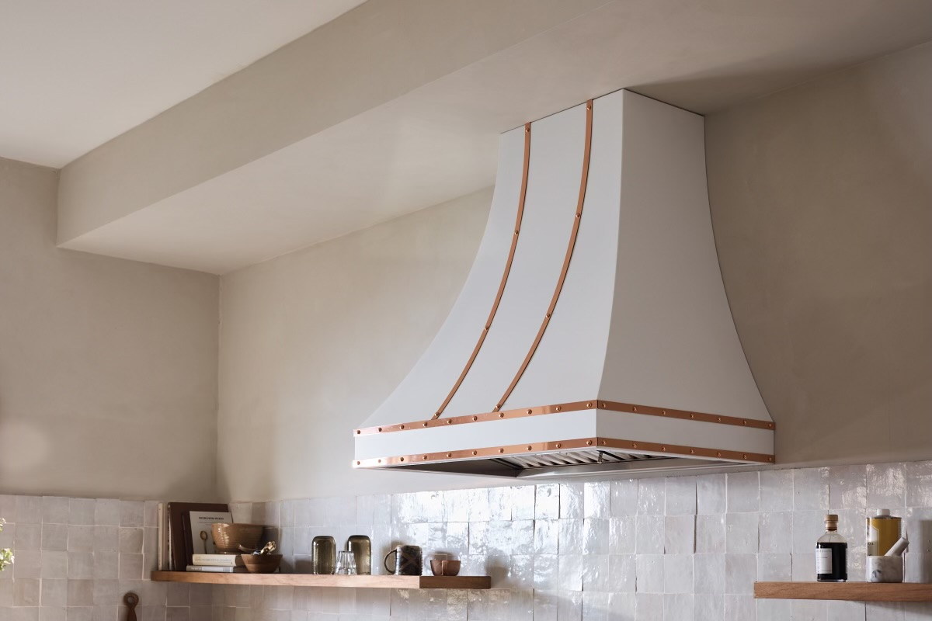
Ventilation News
Introducing the Ridgeline!
Previewed at IBS 2023, the Rigeline is here.
BlueStar’s first 36” high hood, and our most requested custom hood! Aligns perfectly with a 9’ ceiling, with no additional duct required.
Stunning wraps on both sides and can be customized in any of our 10 metal trim options.
Choose from 1,000+ color selections to make a statement in any kitchen.
Available now in 30”, 36”, 42”, 48”, 54” and 60” widths.

Slide 4
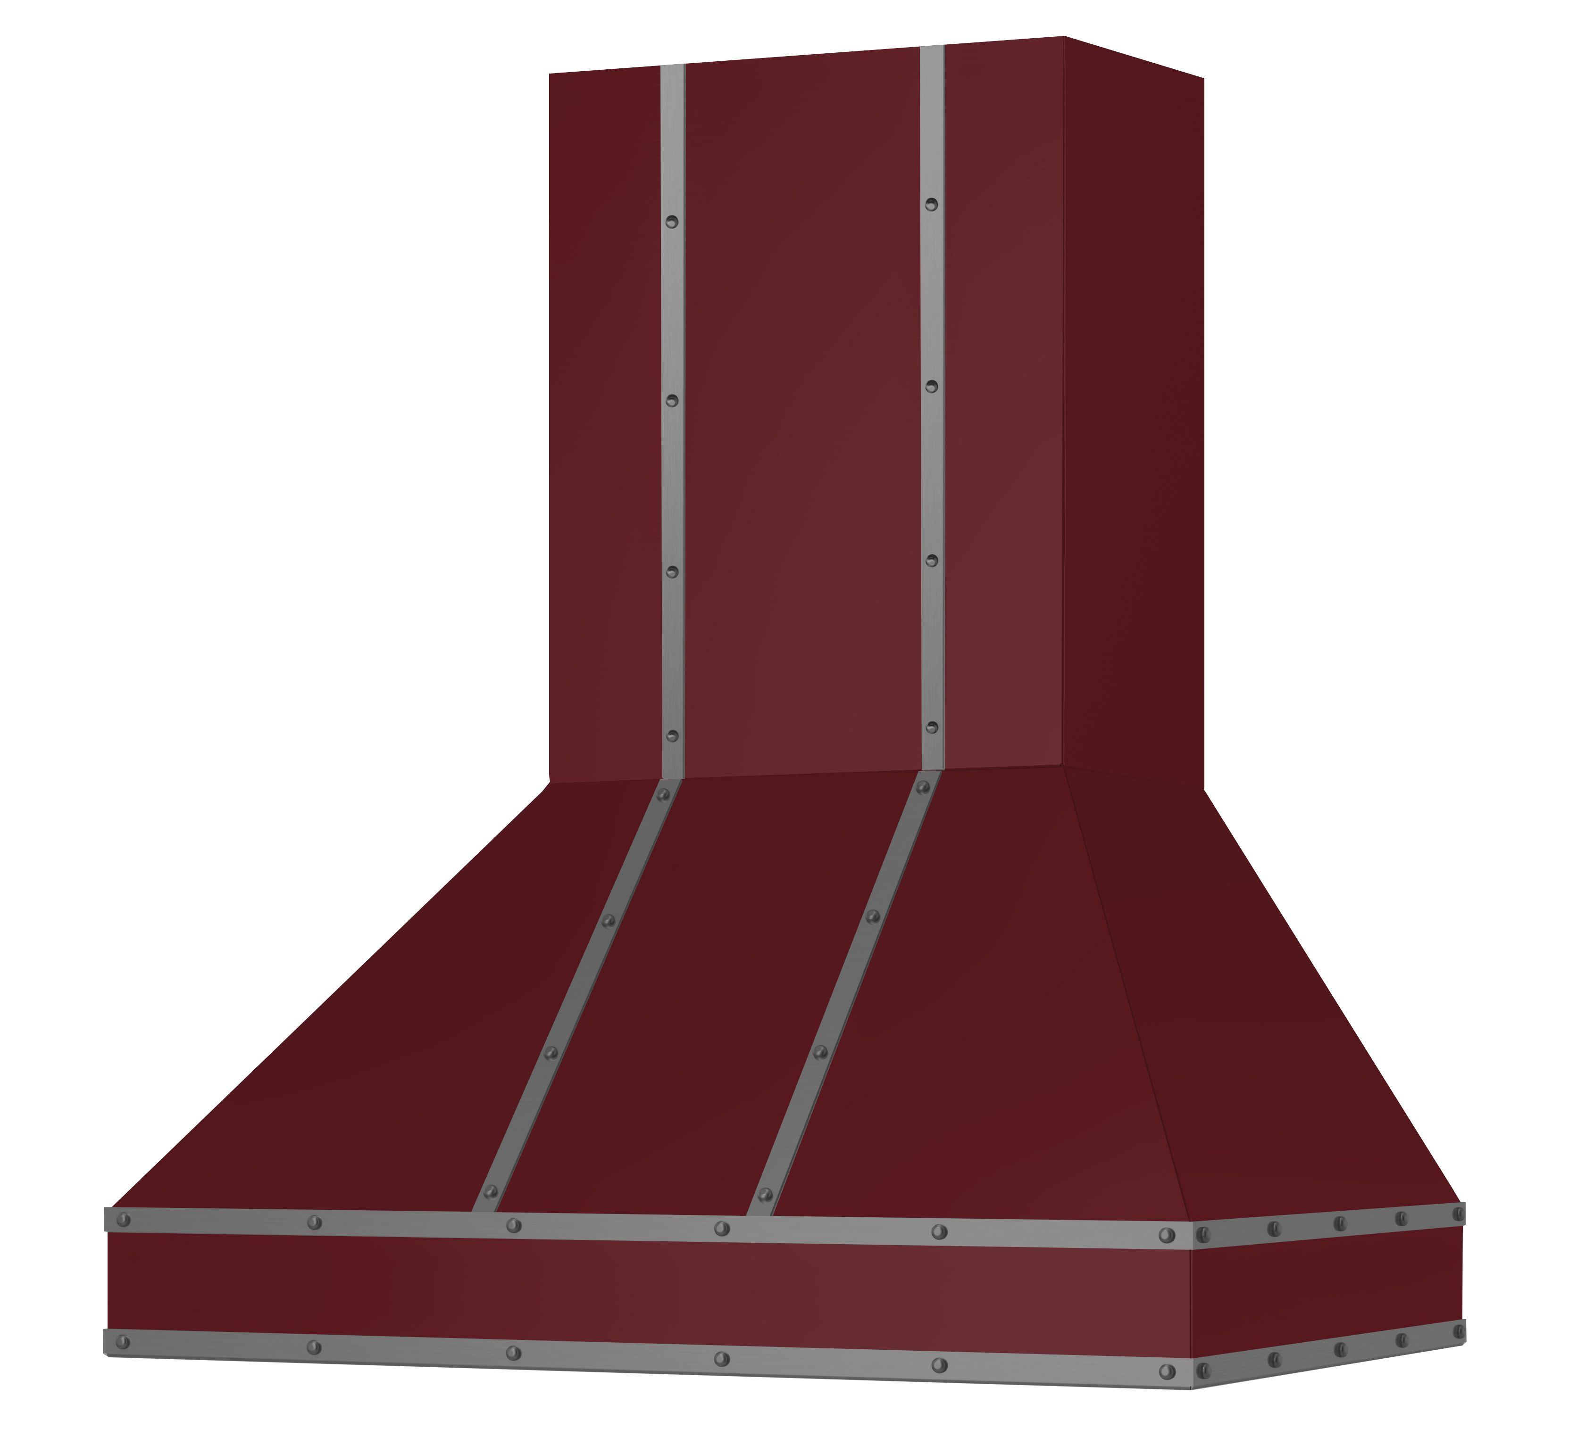
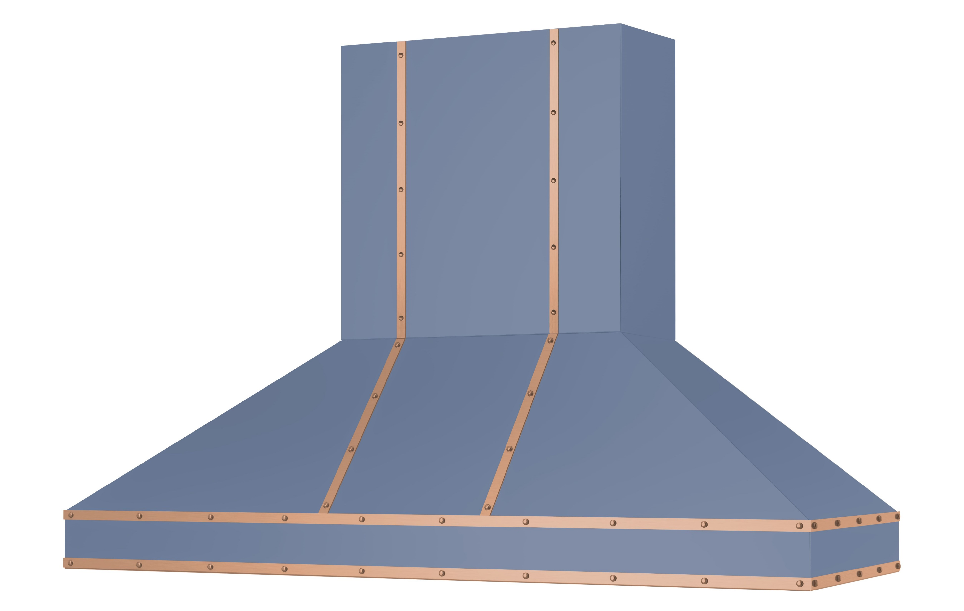
Ventilation News
The Upgraded Hampton!
The Hampton is one of our most popular hoods and now includes stunning strapping for a beautiful design.
This professional-grade performance hood features three exhaust settings and Boost, plus a whisper quiet operation. Dimmable LED lighting and easy to use push controls provide a great customer experience.
Standard duct covers are available at no additional charge for up to 11 ft ceilings.
Heavy duty construction paired with seamless design offers durability and style.
Choose from 1,000+ colors plus with a choice of 10 different metal trim options.
Available now in 30”, 36”, 42”, 48”, 54” and 60” widths.

Slide 5
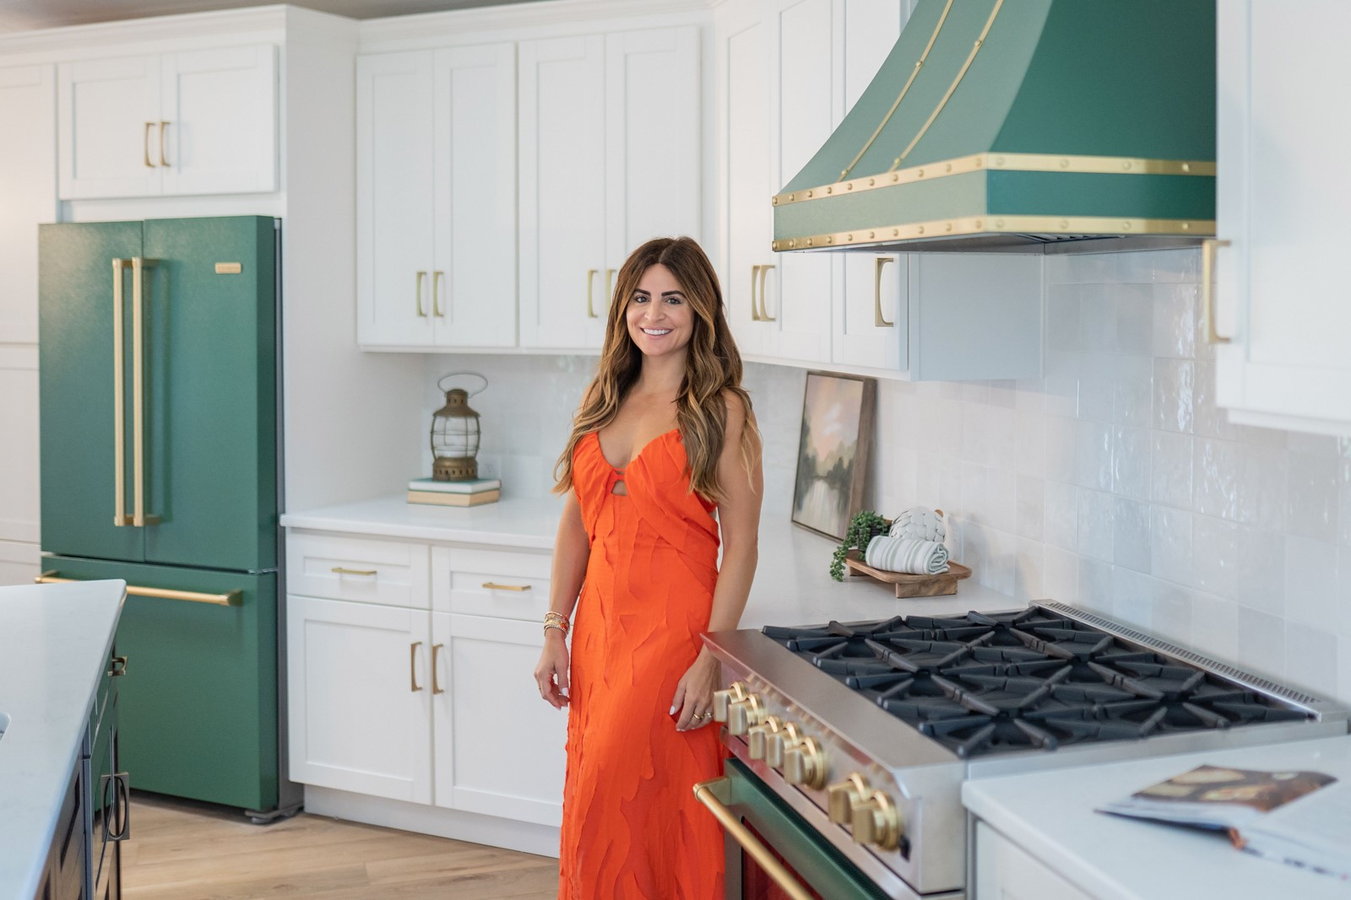
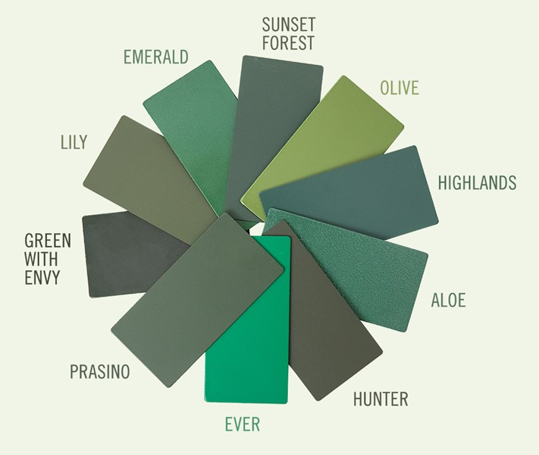
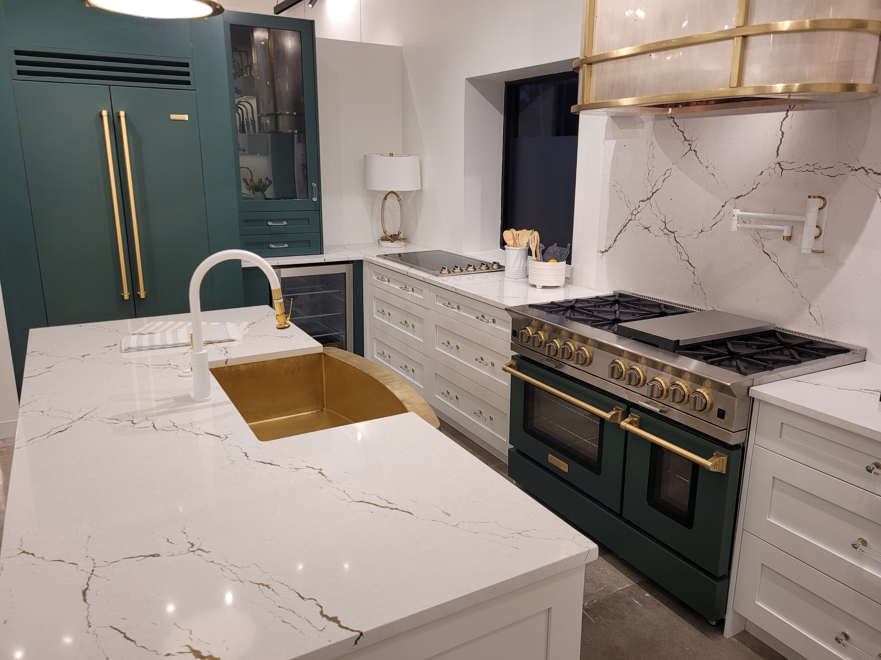
Alison Victoria x BlueStar®
Green is Here to Stay! - Click Here
This collection of 10 dynamic green hues is rooted in nature, fashion and everyday life. Alison drew inspiration for the custom line from a favorite handbag, personal journal, treasured emerald ring and countless travel. BlueStar® was able to precisely match the palette, creating a one-of-kind color collection than can be adapted to any kitchen.
“Green is essentially a new neutral that pairs well with wood tones, crisp or creamy whites or bolder tones like deep blues, creating an optimistic, fresh space.”
- Alison Victoria
Click here to order samples

Slide 6
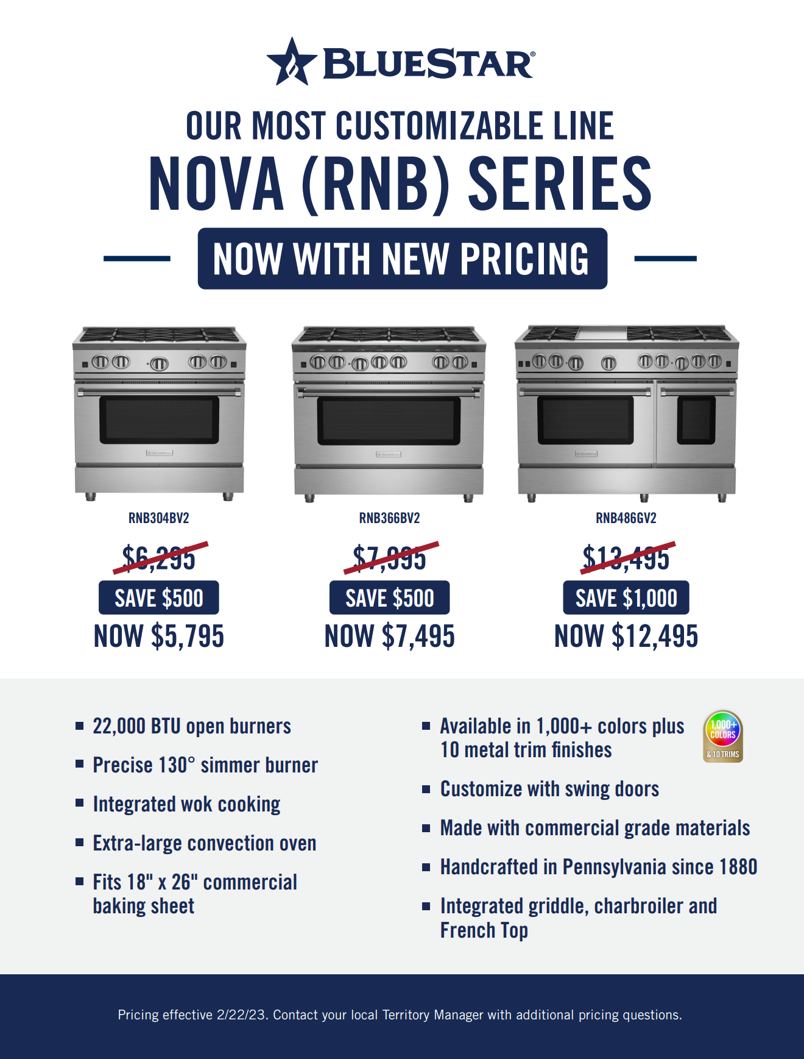
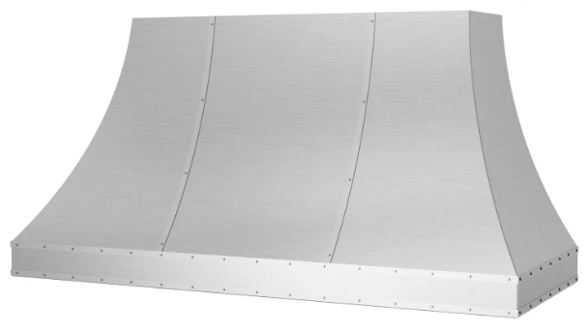
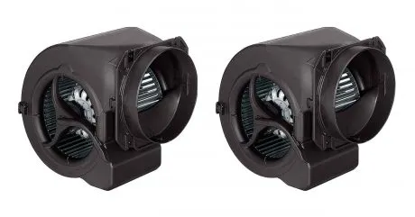
Pricing Update
We recently implemented a pricing change at BlueStar® that included a reduction on our best-selling Nova Series ranges, including 24”, 30”, 36” and 48”.
  In ventilation, a price reduction was taken on the on the following products.:
  Sahara Curved Sides Hood (48” & 54”)
  Up to $1500 Savings!
  Int 1200cfm blower
  Nearly $400 Savings

Slide 7

Promotions – Click Here
The Buy More, Save More Rebate runs through June 30! Maximize savings on a BlueStar® appliance package.

Slide 8

Promotions – Click Here
Save on winning customization refrigeration options through June 30. COMBINE with our Buy More, Save More for maximum savings.

Slide 9
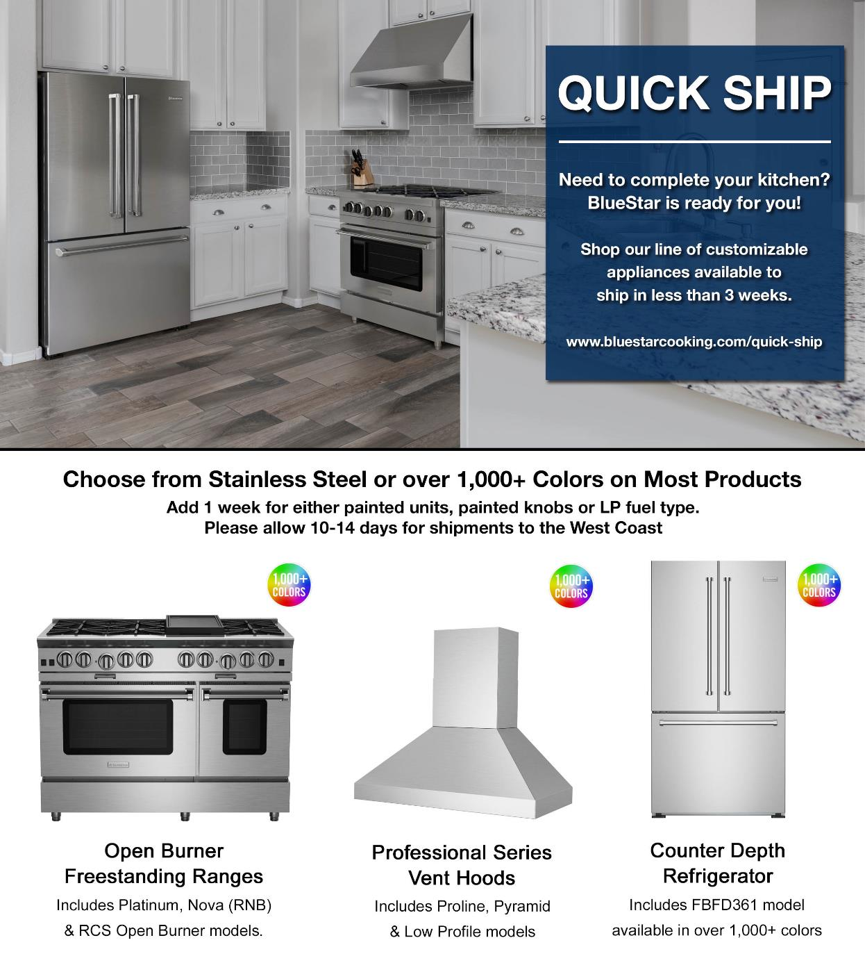
QUICK SHIP Appliances – Click Here
Full suite of kitchen appliances available in to ship in 3 weeks!

Slide 10
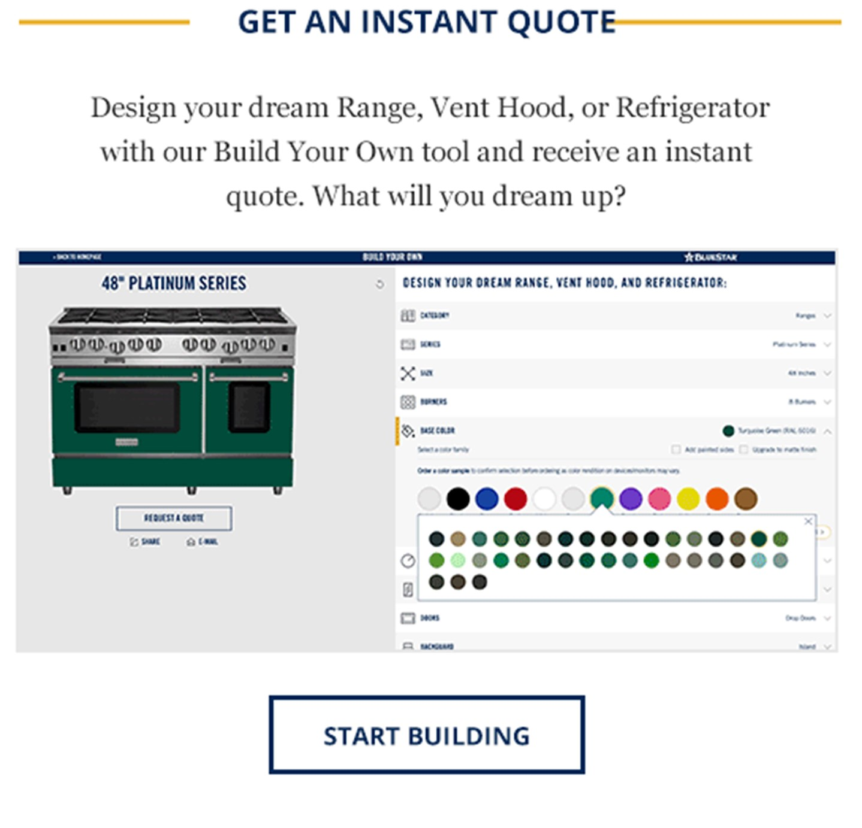
Build Your Own Dream Kitchen – Click Here
Our Build Your Own Tool offers instant pricing to consumers on even the most customized appliances, eliminating the need to quote! Your customers can build their dream kitchen today.

Slide 11

Let’s Schedule an Event!
Earn FREE Color Knobs for your Customers
Book an event, earn FREE Color knobs for your customers.
Up to $1,380 value!
Choose from any of the following options and contact your BlueStar® Territory Manager to coordinate and organize the event.
Dual Fuel Sales Trainings
Ask the Expert with your Local Territory Manager
2023 Color Trends Presentation
CEU: Discovering Custom Kitchen Appliances
Sponsor a Trade Event
Culinary Demonstration
Intro to BlueStar Sales Trainings for New Staff

Slide 12
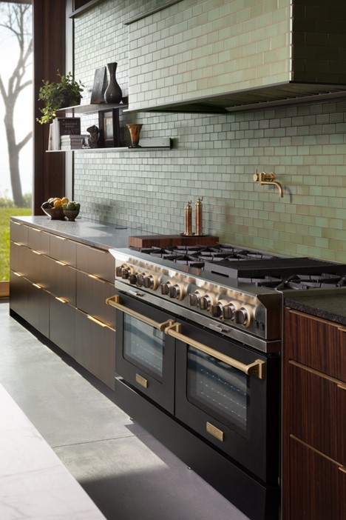
Trade News
Kitchen Design Contest is Open for Entry - Click Here
We recently kicked off the annual BlueStar® Kitchen Design Contest, a program that honors design professionals who incorporate BlueStar® products into innovative, beautiful kitchen designs. It provides designers an opportunity to receive recognition and prizes for their work.
The entry process is simple. Everything is completed online through our website, and we don’t require professional photography. Deadline for entries is June 30 and the winner will be informed no later than August 1.
One designer will be awarded the Grand Prize, 2023 BlueStar® Kitchen Designer of the Year, plus there will be five regional winners selected.
Please be sure to share the contest information with your network of designers to help them get recognized for their amazing kitchen creations highlighting BlueStar appliances and our incredible customization.
2022 Kitchen Design Contest Grand Prize Winner
Vetter Architects/Milwaukee, WI

