Slide 1
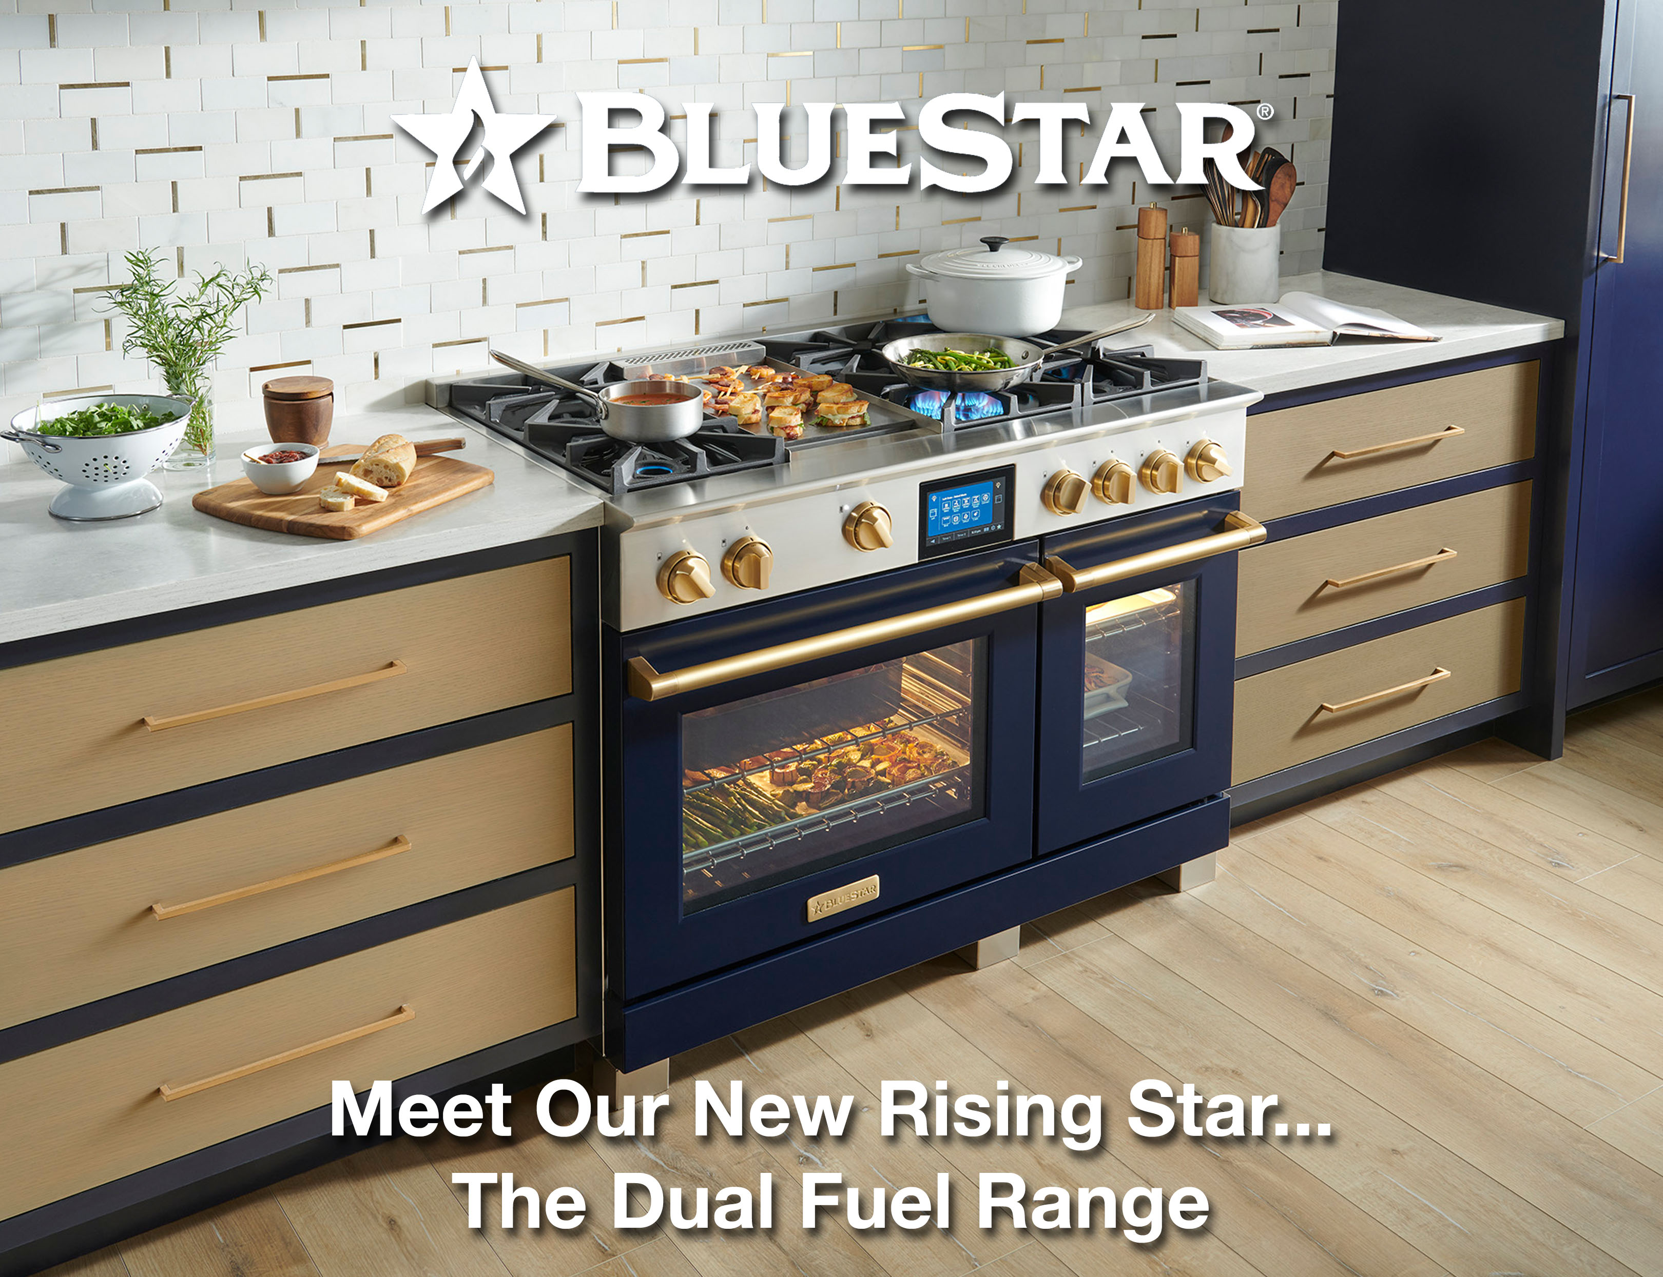

Slide 2

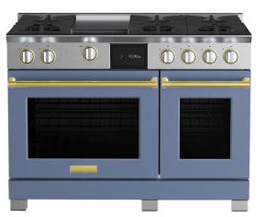

Bringing BlueStar® Power to Dual Fuel
Introducing BlueStar’s first-ever dual range featuring a fresh take on our 8-point star shaped burners paired with a precision true convection oven.
CHEF INSPIRED PERFORMANCE
The new X8™ burner delivers full-spectrum power, performance, and versatility from every burner on your cooktop. No exceptions.
Over-sized True convection oven with 8 cooking modes is designed for precise baking and even results
STYLE AS UNIQUE AS YOURS
Infinitely customizable ranges as unique as the home chefs who use them
Create a custom kitchen with 1,000+ colors and 10 metal trim finishes
Handcrafted in Pennsylvania

Slide 3
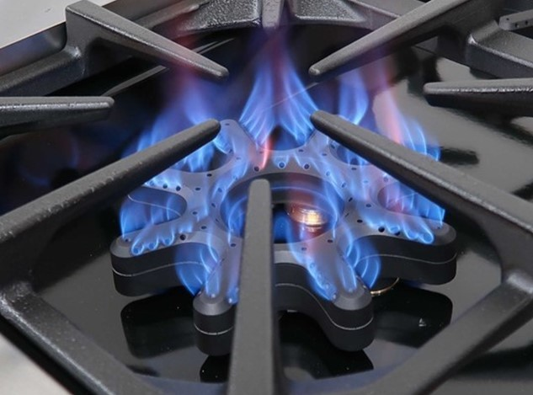
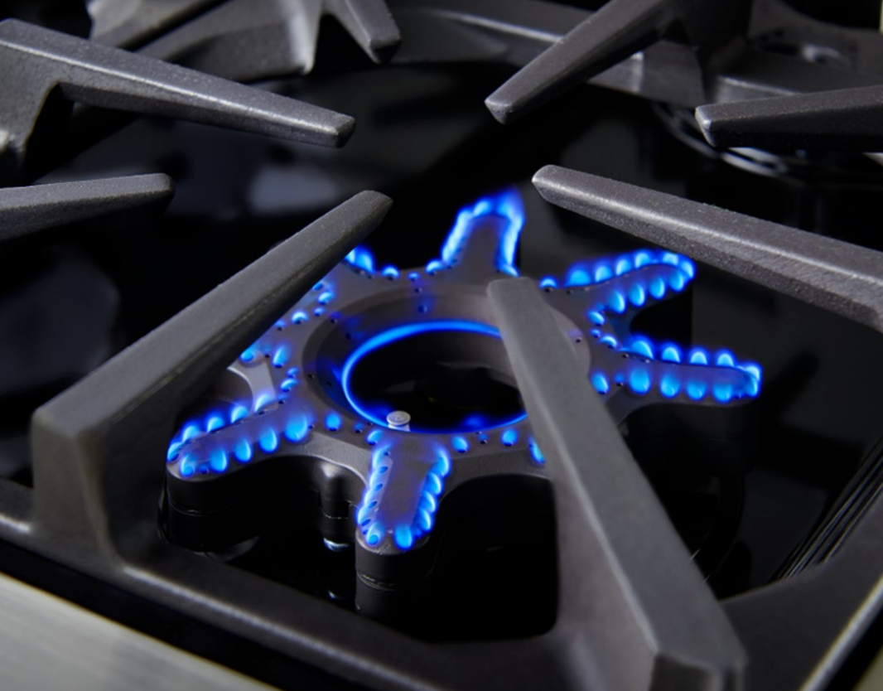
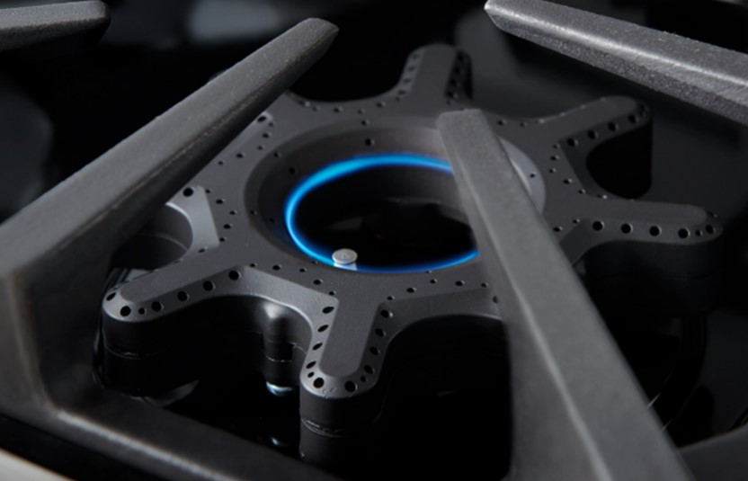
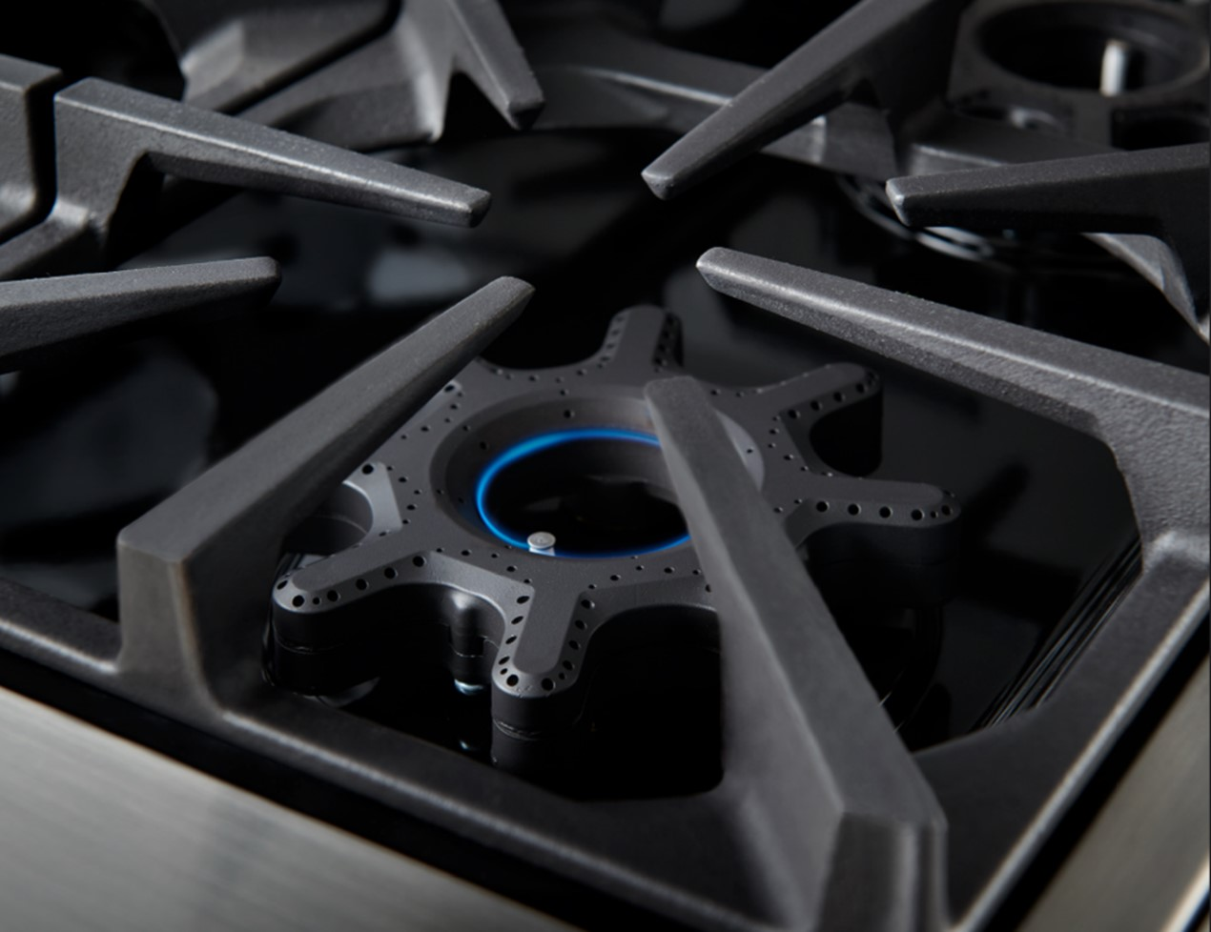
BlueStar Power Times Eight
Have it all and do it all with every. single. burner.
The new exclusive star shaped X8™ burner delivers full-spectrum power, performance, and versatility from HIGH to LOW to SIM to WARM on every burner on your cooktop. No exceptions.
High 25,000 BTUs
Low
Sim
500 BTU Warm

Slide 4
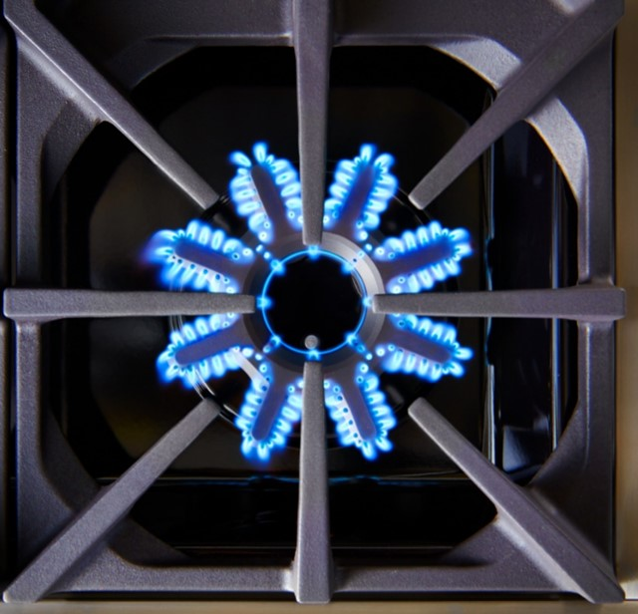
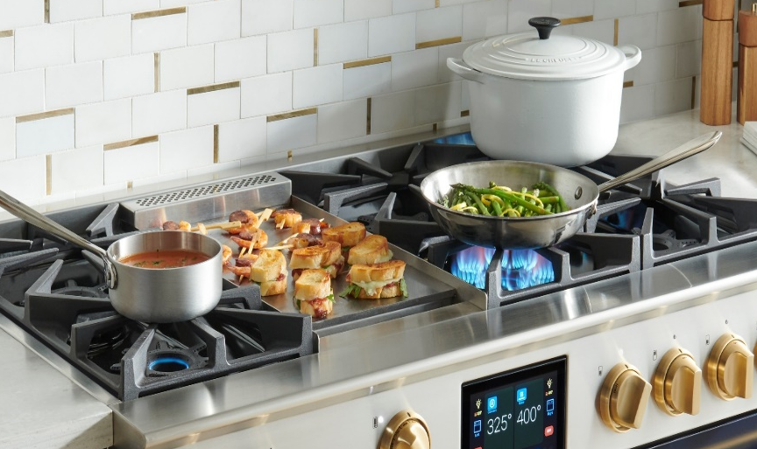
Overview Specifications – Surface Cooking
Extra-High Sear – up to 25,000 BTUs
  All Front Burners = 25K
  Rear Burners = 18K
Ultra-low CONSTANT warm of 500 BTUs on all burners
Dual valves on every burner for seamless transition from high to simmer to warm –precise control
5 positions: OFF, HIGH, LOW, SIM, WARM
Automatic re-ignition
Burner indicator lights on control panel
Heavy-duty, continuous platform cast-iron grates
Seamless, one-piece easy to clean porcelain spill tray
Commercial Grade Steel griddle with precise temperature control – 15,000 BTUs
  Griddle cover included

Slide 5
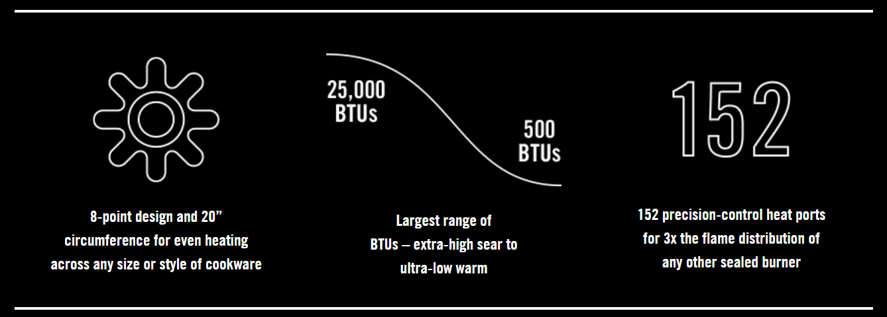
Superior Design Delivers Superior Performance
The X8™ shines with more control, easy cleaning and the expansive 8-point heat coverage of our iconic open burners in a modern sealed design.

Slide 6
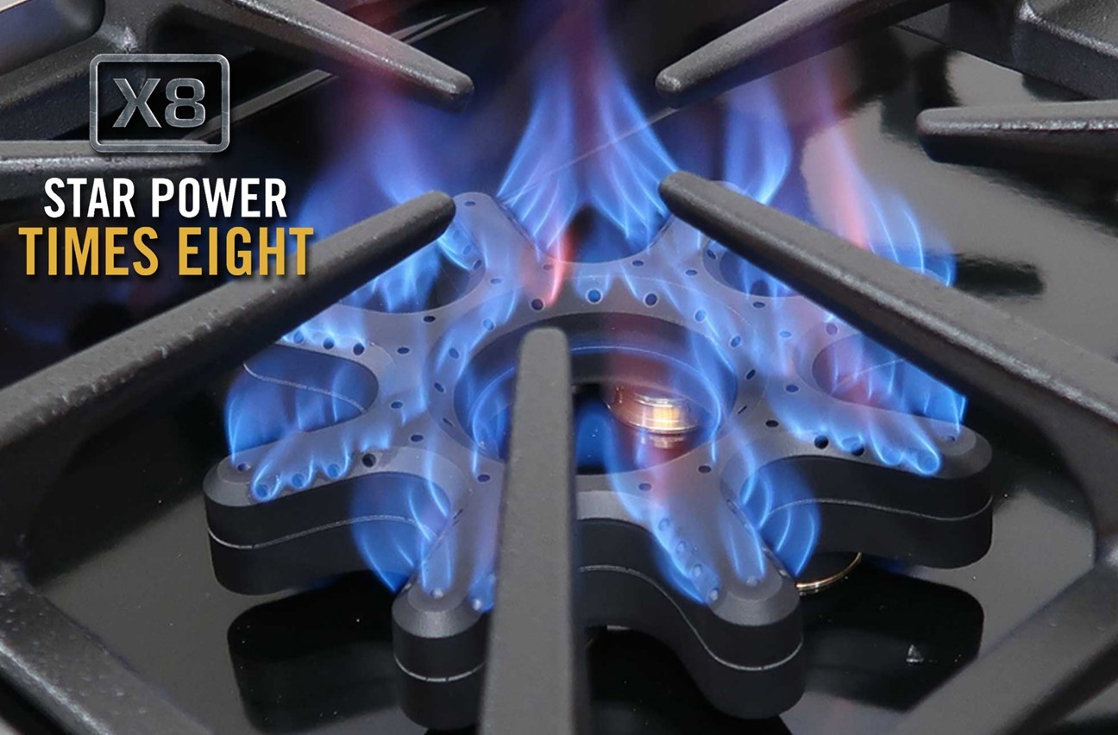

Insert video link

Slide 7
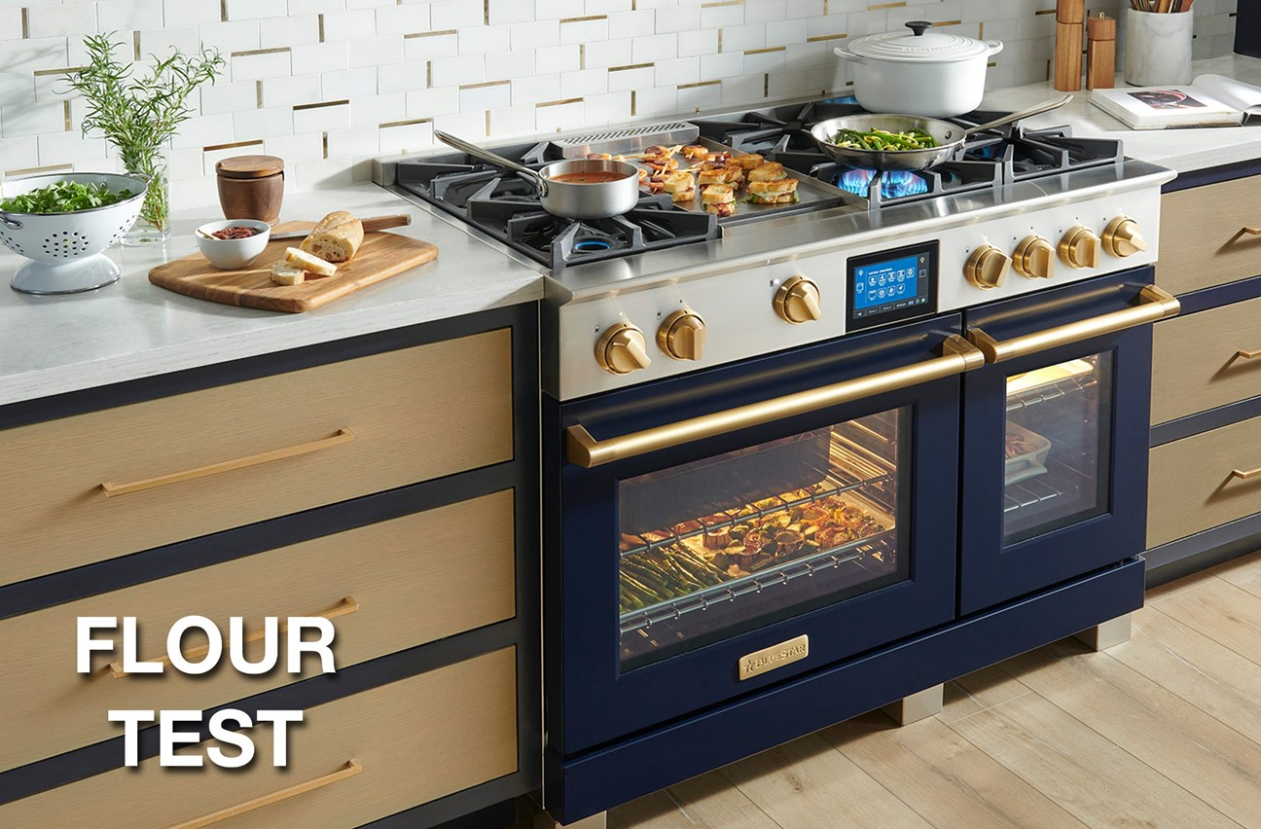
Insert video link

Slide 8
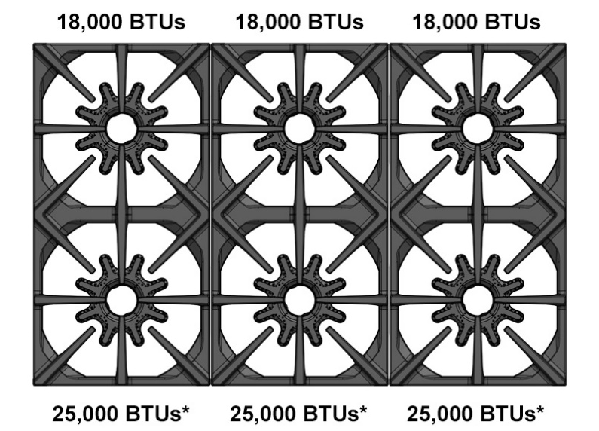
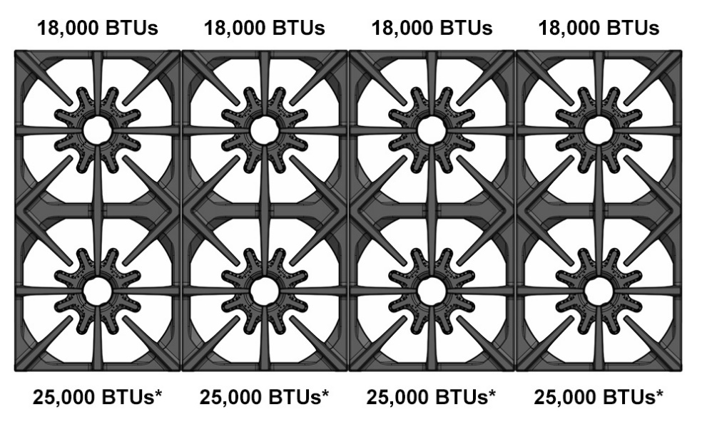
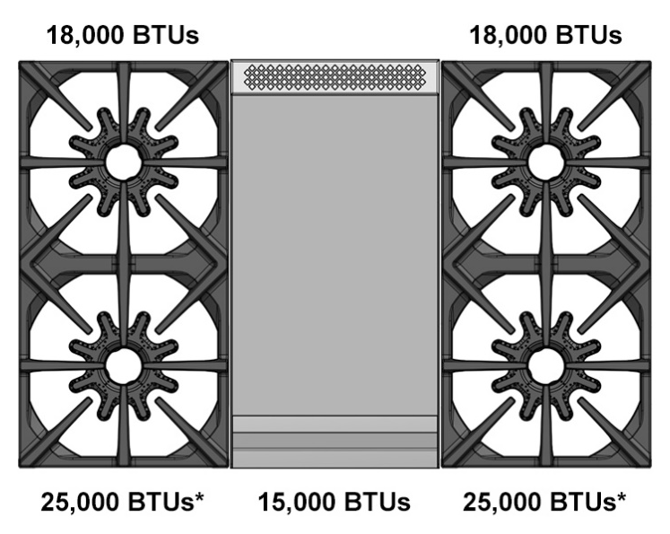
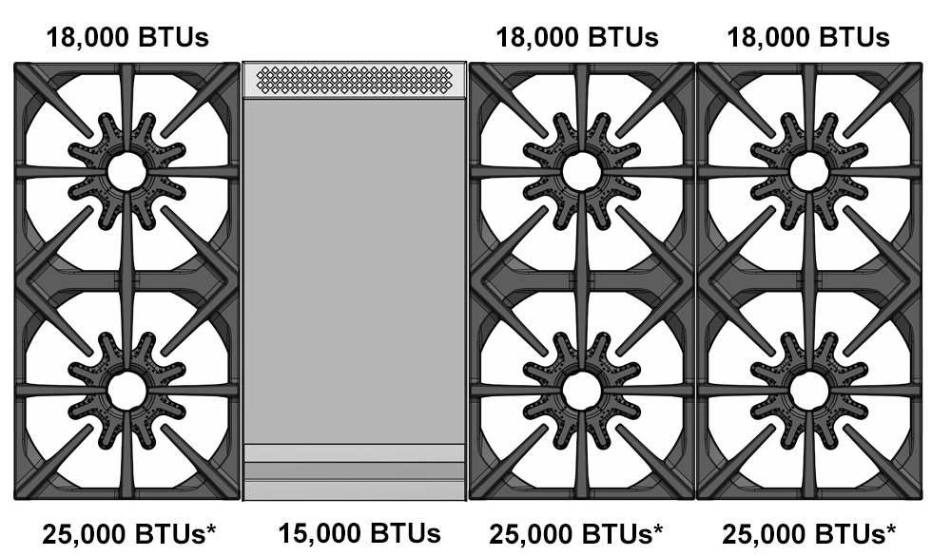
Burner Configurations
BSDF366B
BSDF488B
BSDF364G
BSDF486G

Slide 9
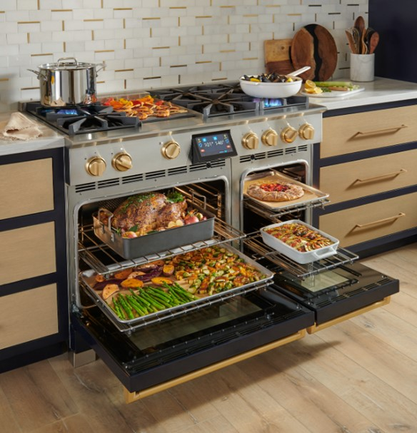
Overview Specifications – True Convection Oven
Industry leading oven capacity – fits full-size commercial baking sheets
8 Cooking Modes
Temperature probe delivers precise results
Unique Glass Bottom Oven for optimal heat in oven and easy clean up after each use
Full-extension Glide Racks for easy access (ships with 2)
Sabbath mode
Environmentally friendly, gentle 90-minute express cleaning mode plus Continu CleanTM
2-year full parts & labor warranty

Slide 10
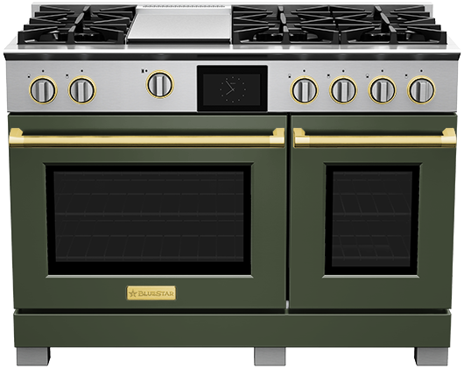
BlueStar® Dual Fuel Range - Oven Features
Intuitive Touchscreen:
Oversized, full-color 7” display panel operates eight cooking modes plus ergonomic tilt up display. Quick Start™ cooking in 2 easy touches
Powerful Broiler:
5,000 Watts
Extra Large Capacity:
5.1 cu. Ft.
Fits full-size commercial sheet pans
Unmatched Customization:
Choose from stainless steel or +1,000 colors and 10 metal trim options
True Convection Oven:
Designed for precise cooking and baking with eight modes include convect, bake, convect bake, broil, roast, convect roast, proof and dehydrate
Optimized Small Oven:
Convection
2.7 cu. Ft.
Full-extension racks can accommodate 9” x 13” sheet pan

Slide 11
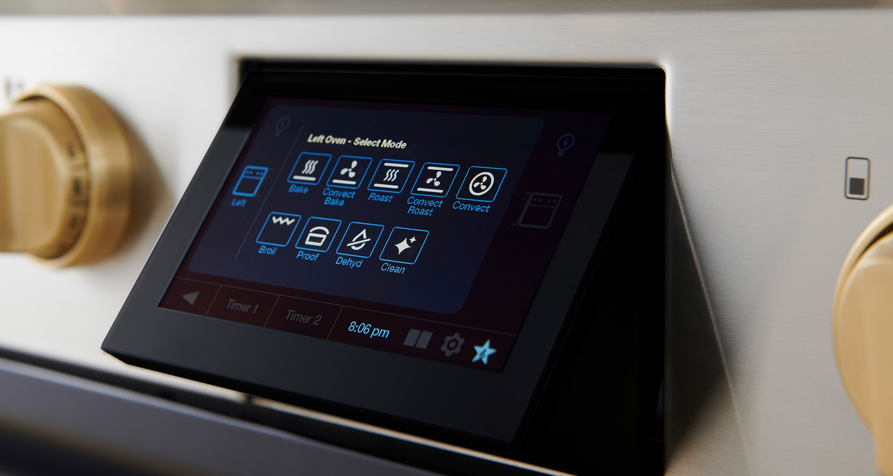
Ergonomic Tilt Display
One-touch tilt display for easy usage and viewing

Slide 12
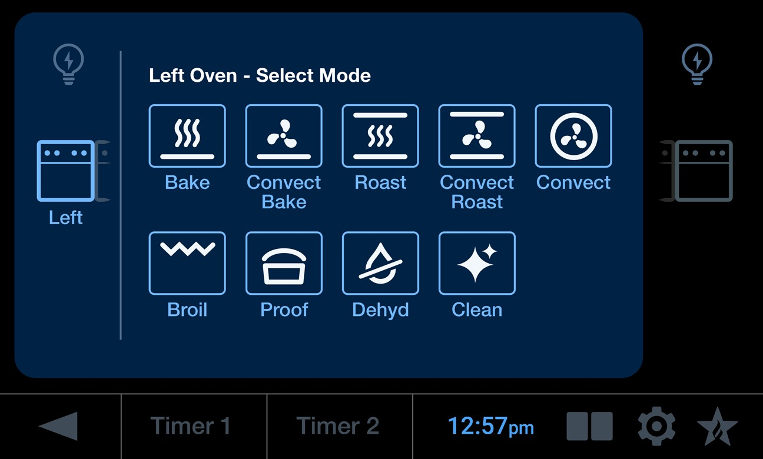

Intuitive Touchscreen
Full-color 7” screen offers clear visibility, with high resolution and a user-friendly interface
8 cook modes + Sabbath + Precise Temperature Probe
Quick StartTM cooking in three easy touches
All modes, external kitchen timers, clock and oven activity viewable on single screen
Large Oven Light
Small
Oven Light
Large Oven
SmallOven
Previous
Kitchen Timers
Clock
Split Screen
Idle Display
Settings

Slide 13
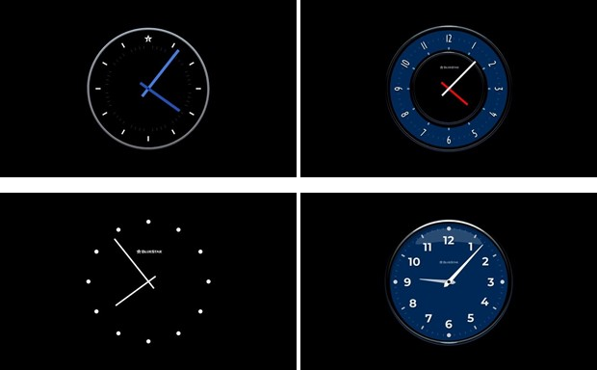
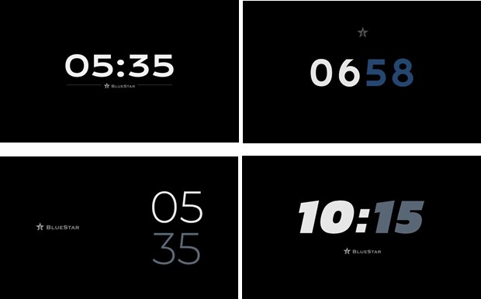
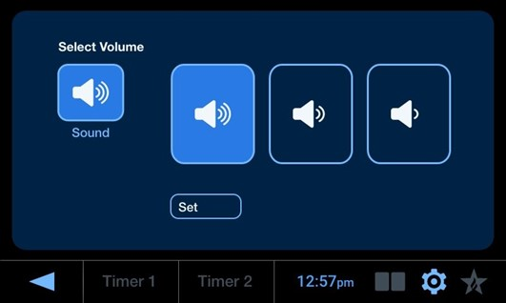
Controller Customization
Choose from 8 different idle clock display screens and 3 sound settings depending on personal preference.
Analog Clocks
Digital Clocks
Sound Selection

Slide 14

Oven Cleaning Mode
Environmentally friendly, gentle 90-minute express cleaning mode plus Continu Clean™ technology
Cycle Runs at 550° for 90 minutes
  Set to 550° – takes about 50 to get to temp, then retains the temp for another 40 minutes
  Heating elements alternate so dirtiest surfaces are expose to higher temps
Catalytic element eliminates smoke and odors
Reduced cycle time, pulls less energy and reduces excess heat, smoke and odors in your household

Slide 15
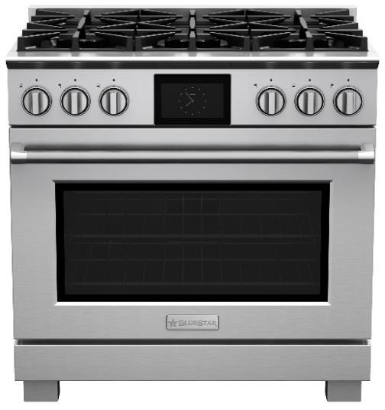
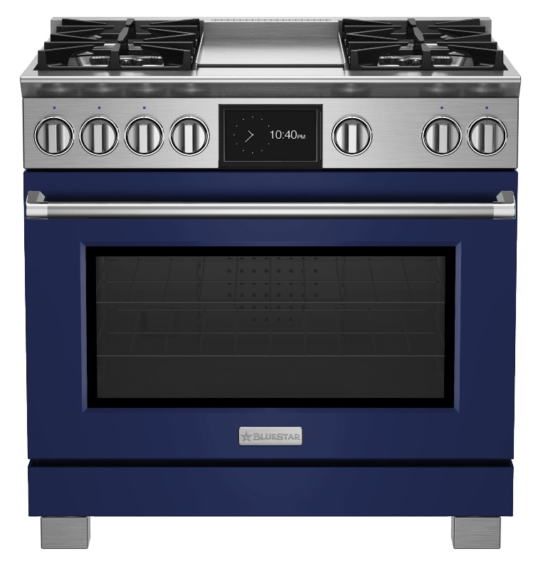
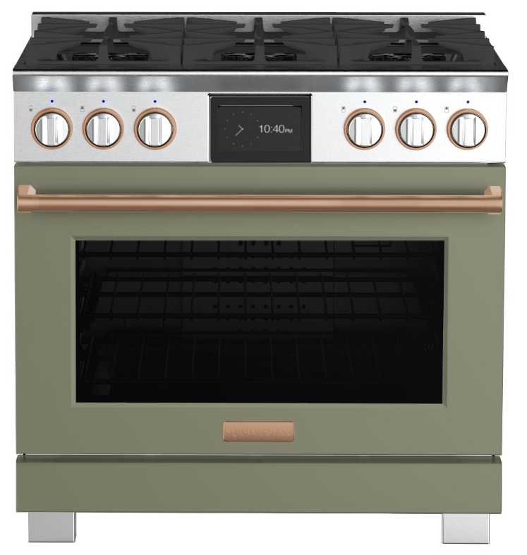
BlueStar® is the MARKET LEADER in COLOR & CUSTOMIZATION
Infinitely customizable ranges as unique as the home chefs who use them. Create a custom kitchen with 1,000+ colors and 10 metal trim finishes.
1,000+ Colors
+ 10 Metal Trims
Classic Stainless
1,000+ Colors

Slide 16
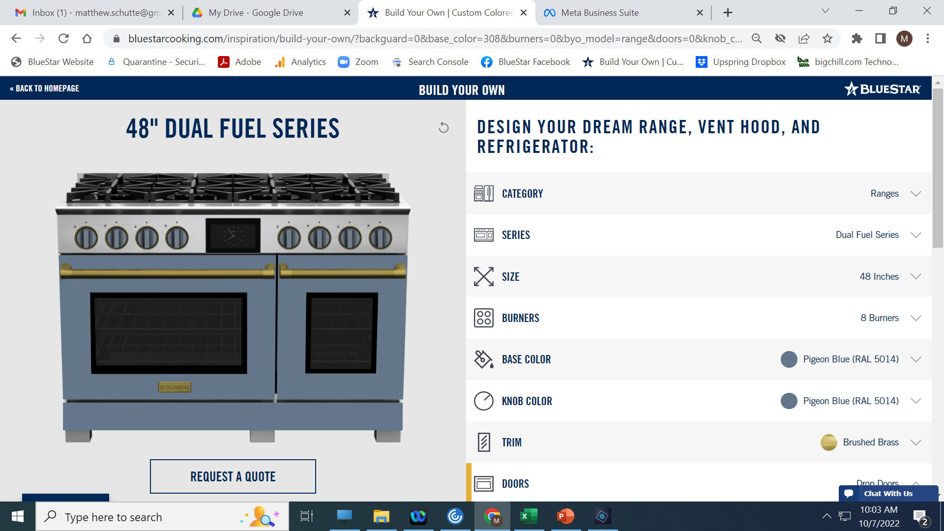
Design Yours Today
The new line raises the level of design sophistication with exciting options for personalization, including 1,000+ colors, custom colors and 10 metal trims, to fully style the luxury home kitchen.

Slide 17
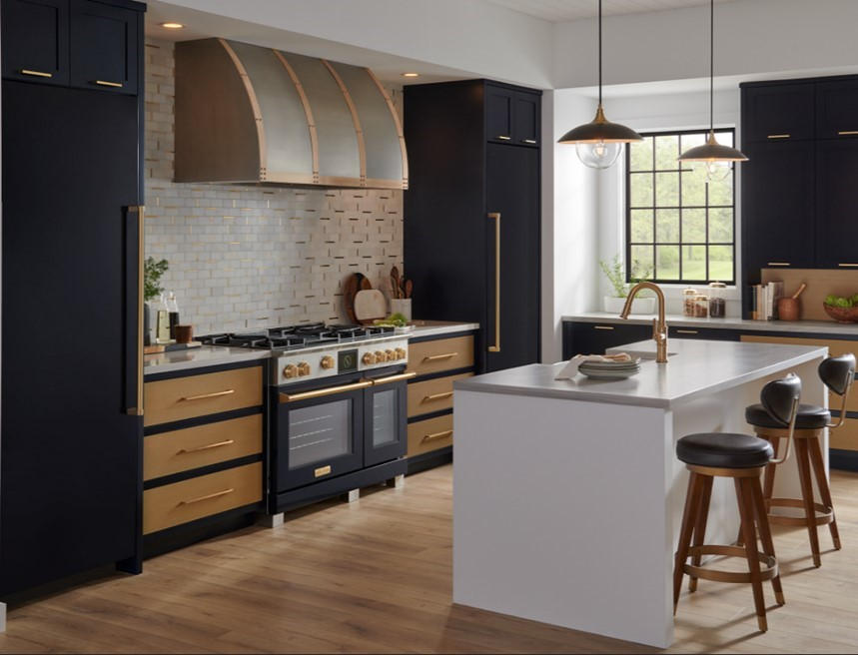
Complete Your Kitchen – What else is in the package?
Designer Hood
Column
Freezer
Column Refrigerator

Slide 18
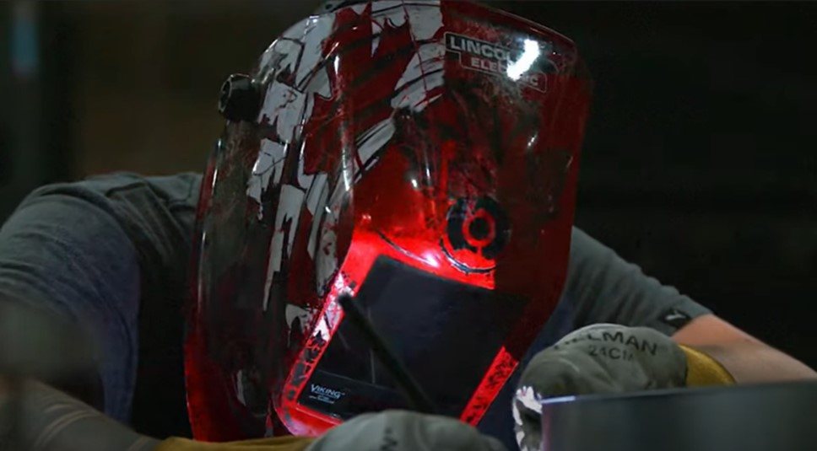
Stars Aren’t Born, They Are Handmade
Like all BlueStar® Appliances, our new line of Dual Fuel products is
handcrafted in our Pennsylvania factory

Slide 19
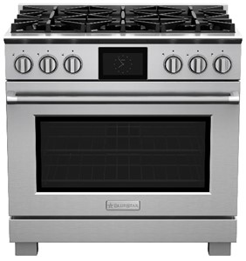
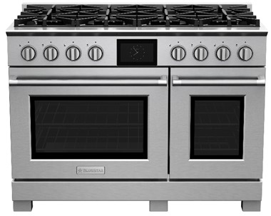
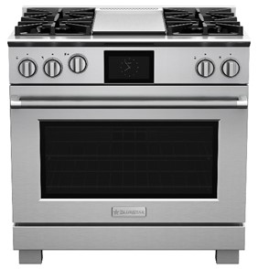
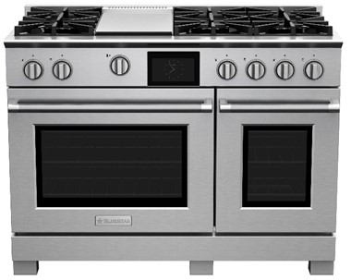
US Pricing
BSDF366B
Starting at $11,995
BSDF488B
Starting at $15,995
BSDF364G
Starting at $12,995
BSDF486G
Starting at $16,995

Slide 20
Why BlueStar Dual Fuel?
Have it all and do it all on Every Single Burner.
  X8™ Burners deliver full-spectrum power, performance, and versatility
  No other Dual Fuel offers a constant warm 500 BTU setting on every single burner or the incredible highs of 25,000 BTUs
Incredible commercial heritage meets modern sealed burner design with true convection electric oven and convenient touch screen control
Design by You
  BlueStar® performance plus unmatched customization. Dual Fuel has never shined like this.
Handcrafted in Pennsylvania since 1880

Slide 21
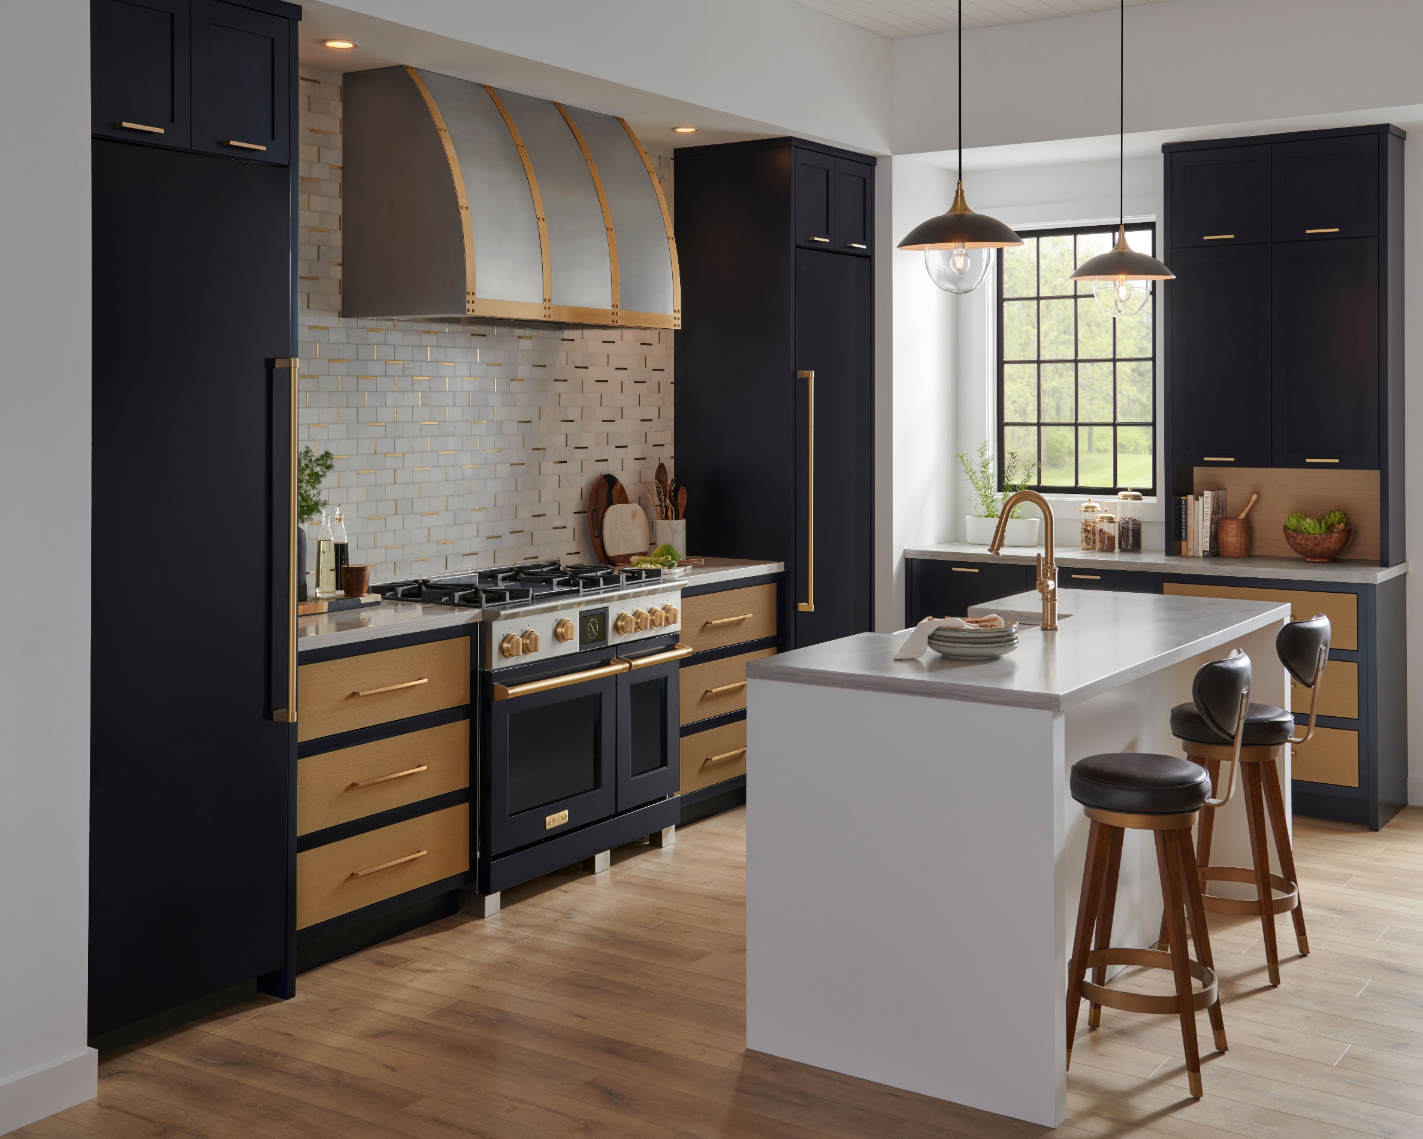
Thank You

