Slide 1
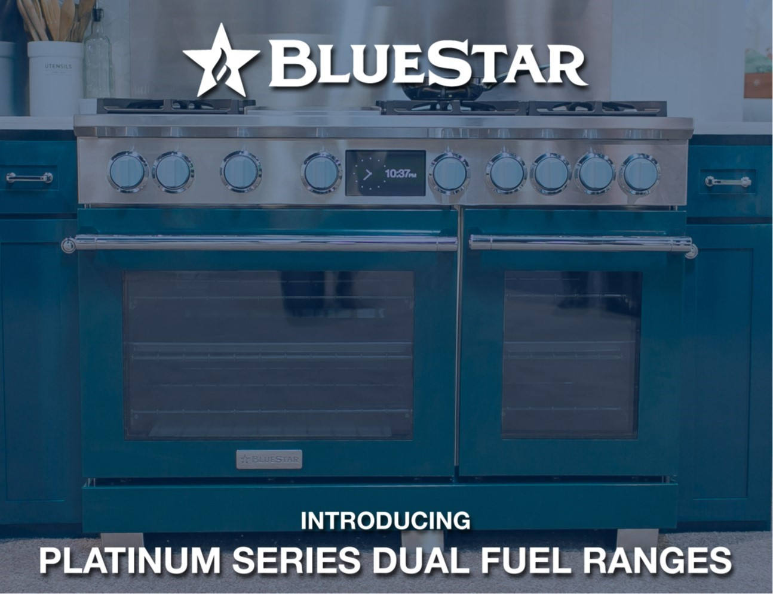
Meet Our New Rising Star …
The Dual Fuel Range

Slide 2

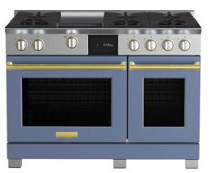

Bringing BlueStar® Power to Dual Fuel
Only BlueStar® Dual Fuel features our 8-point star shaped burners, now in a show-stopping sealed format, for restaurant-level heat and control.
CHEF INSPIRED PERFORMANCE
The new X8™ burner delivers full-spectrum power, performance, and versatility from every burner on your cooktop. No exceptions.
Extra Large oven designed for precise baking and even results
STYLE AS UNIQUE AS YOURS
Infinitely customizable ranges as unique as the home chefs who use them.
Create a custom kitchen with 1,000+ colors and 10 metal trim finishes

Slide 3
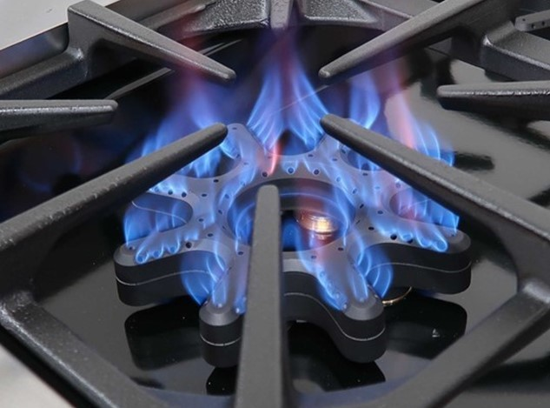
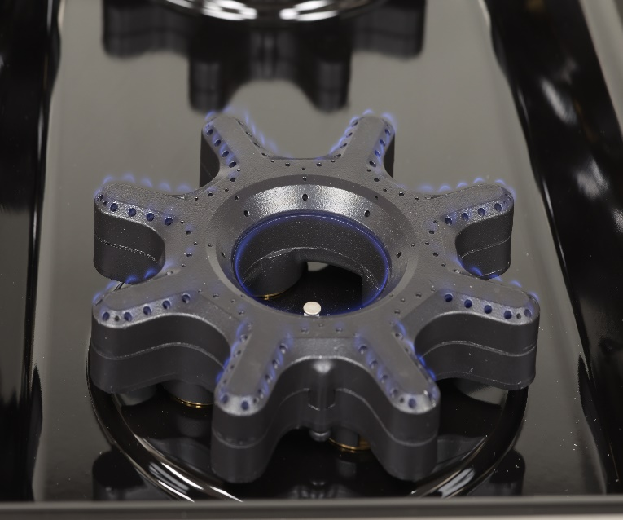
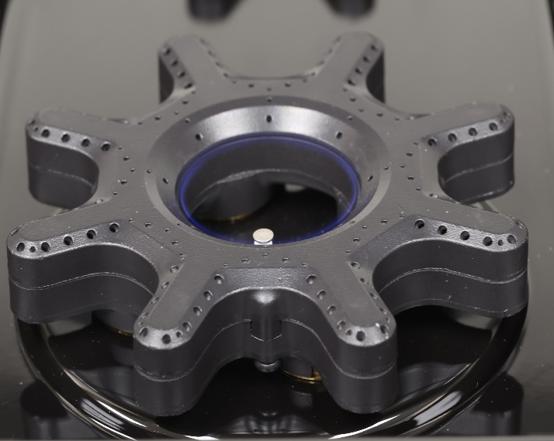
BLUESTAR POWER TIMES EIGHT
Have it all and do it all with every. single. burner.
The new X8™ burner delivers full-spectrum power, performance, and versatility from every burner on your cooktop. No exceptions. The X8™ shines with more control, easy cleaning and the expansive 8-point heat coverage of our iconic open burners in a modern sealed design.
8-point design and 20” circumference for even heating across any size or style of cookware
Largest range of BTUs – extra-high sear to ultra-low warm
152 precision-control heat ports for 3x the flame distribution of any other sealed burner
High 25,000 BTUs
Low
Ultra-Low Inner Ring
500 BTU Warm

Slide 4
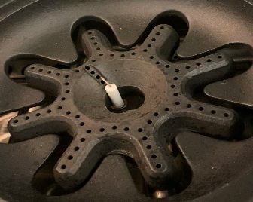
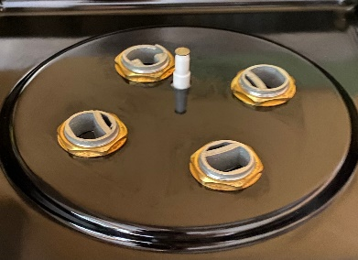
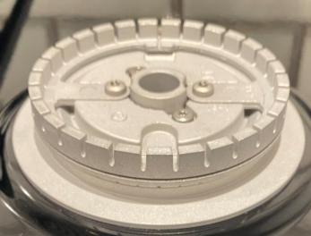
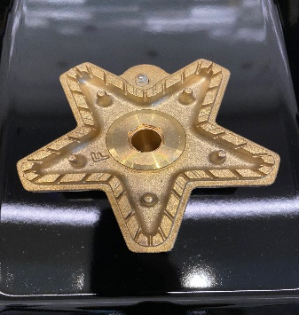
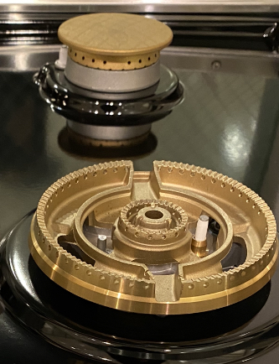
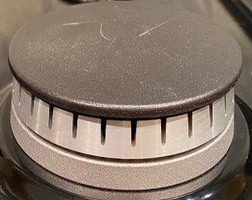
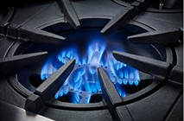
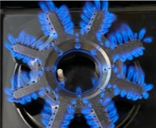
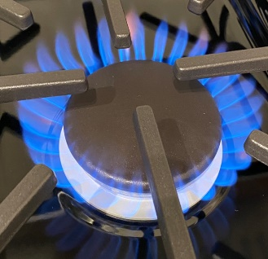
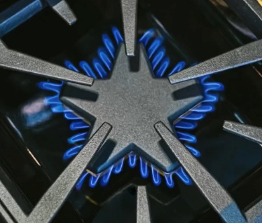
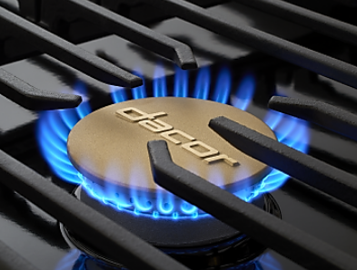
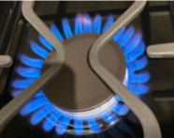
Burner Matrix
Comp Burner Review | Current BlueStar Open Burner | New BlueStar X8 Burner | Wolf | Thermador | Dacor | Miele
Max BTUs | 25,000 | 25,000 | 20,000 | 22,000 | 22,000 | 19,500
Min BTUs | 1,000 | 500 (on every single burner) | 300 (on one burner only) & 700 | 375 | 750 | 700
Max Ports | 107 | 152 | Approx. 30 | 50 | Approx. 30 | Approx. 30
Shape | 8-point star | 8-point star | Circle w/Cap | 5-point star w/cap | Circle w/cap | Circle w/cap
Circumference / Surface Area | ? | 20” | 11 ¾” | 15 ½” | 16 ½” | 12”

Slide 5
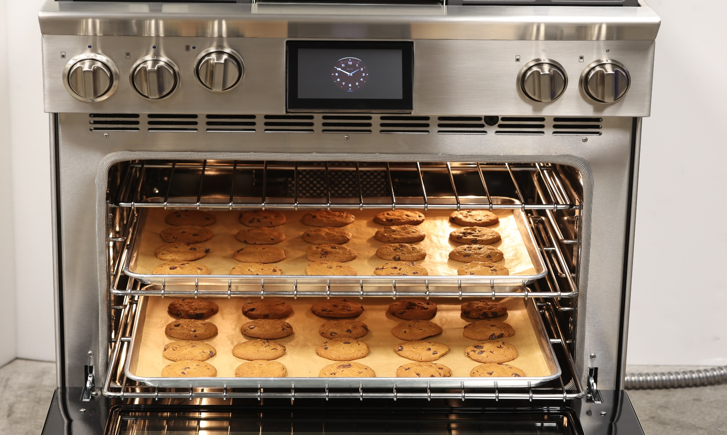
EXTRA LARGE. ELECTRIC. EXTRAORDINARY.
Designed for precise cooking and even baking.
7-inch full-color touchscreen with QUICK START™ cooking
True convection oven with 8 cooking modes
Oversized capacity fits 18” x 26” baking sheets
Temperature Probe delivers precise results
Powerful Broiler with intense 5000-watt element
Unique Glass Bottom Oven for optimal heat in oven and easy clean up after each use
Full-extension Glide Racks for easy access

Slide 6
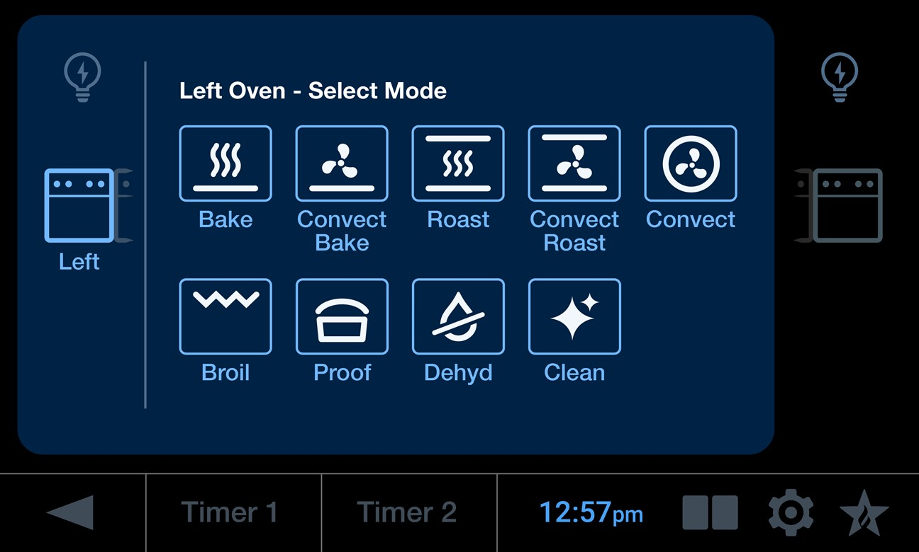

Intuitive Touchscreen
Full-color 7” screen offers clear visibility, with high resolution and a user-friendly interface
Easy 2-touch panel to initiate cooking
Customizable clock options available
All modes, external kitchen timers, clock and oven activity viewable on single screen.
Large Oven Light
Small
Oven Light
Large Oven
SmallOven
Previous
Kitchen Timers
Clock
Split Screen
Idle Display
Settings

Slide 7
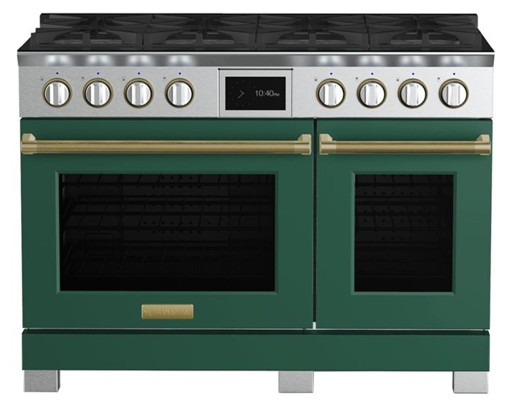
BlueStar Dual Fuel Range Features
Intuitive Touchscreen:
Oversized, full-color 7” display panel operates eight cooking modes plus ergonomic tilt up display. Quick Start™ cooking in 2 easy touches
Powerful Broiler:
5,000 Watts
Extra Large Capacity:
5.1 cu. Ft.
Fits full-size commercial sheet pans
Unmatched Customization:
Choose from stainless steel or +1,000 colors and 10 metal trim options
True Convection Oven:
Designed for precise cooking and baking with eight modes include convect, bake, convect bake, broil, roast, convect roast, proof and dehydrate
Optimized Small Oven:
Convection
2.7 cu. Ft.
Full-extension racks can accommodate 9” x 13” sheet pan

Slide 8
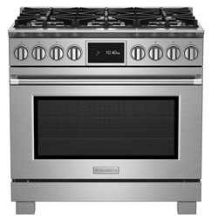
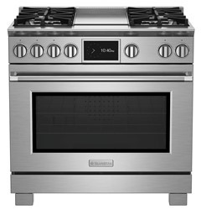
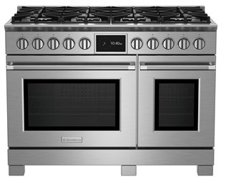
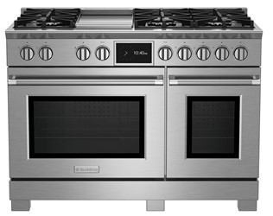
US Pricing
US Model # | Description | UMRP
BSDF366B / BSDF366BL | Dual Fuel 36" Range, 6 Burner, NG / LP | $ 11,995
BSDF364G / BSDF364GL | Dual Fuel 36" Range, 4 Burner + Griddle, NG / LP | $ 12,995
BSDF488B / BSDF488BL | Dual Fuel 48" Range, 8 Burner, NG / LP | $ 15,995
BSDF486G / BSDF486GL | Dual Fuel 48" Range, 6 Burner + Griddle, NG / LP | $ 16,995

Slide 9
Canada Pricing
Canada Model # | Description | MSP
BSDF366BW / BSDF366BLW | Dual Fuel 36" Range, 6 Burner, NG / LP | $ 15,595
BSDF364GW / BSDF364GLW | Dual Fuel 36" Range, 4 Burner + Griddle, NG / LP | $ 16,895
BSDF488BW / BSDF488BLW | Dual Fuel 48" Range, 8 Burner, NG / LP | $ 20,795
BSDF486GW / BSDF486GLW | Dual Fuel 48" Range, 6 Burner + Griddle, NG / LP | $ 22,095
Canadian models include 4-foot power cord.
Cord rated at 220/240 VAC, 50 amps

Slide 10
Why BlueStar Dual Fuel?
Have it all and do it all on Every Single Burner.
  X8™ Burners deliver full-spectrum power, performance, and versatility
  No other Dual Fuel offers the low 500 BTU/115-degree setting on every single burner like BlueStar or the incredible range in power
Incredible Commercial Heritage Meets Modern Sealed Burner Design with True Convection Electric Oven and Convenient Touch Control Panel
The Best of Both Worlds
  BlueStar® performance plus total and unmatched customization. Dual Fuel has never shined like this.

