Slide 1

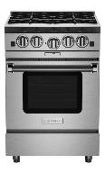
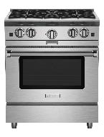
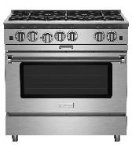
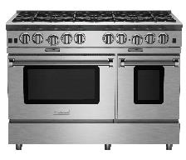
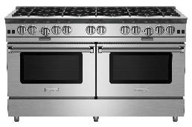
Gas Ranges: Platinum Series Availability – Updated 6/13/2022
Model | Available Inventory | Lead Time | C/CF Colors | Custom Match Finish | Designer Trim
BSP244B | 0 | 2 weeks | 3 weeks | 10 weeks | 4 weeks
BSP244BL | 0 | 3 weeks | 4 weeks | 11 weeks | 5 weeks
BSP304B | 1 | 2 weeks | 3 weeks | 10 weeks | 4 weeks
BSP304BL | 2 | 3 weeks | 4 weeks | 11 weeks | 5 weeks
BSP366B | 3 | 2 weeks | 3 weeks | 10 weeks | 4 weeks
BSP366BL | 0 | 3 weeks | 4 weeks | 11 weeks | 5 weeks
BSP488B | 2 | 2 weeks | 3 weeks | 10 weeks | 4 weeks
BSP488BL | 0 | 3 weeks | 4 weeks | 11 weeks | 5 weeks
BSP6010B | 1 | 2 weeks | 3 weeks | 10 weeks | 5 weeks
BSP6010BL | 0 | 3 weeks | 4 weeks | 11 weeks | 5 weeks
L: Denotes LP/Propane model. No additional charges apply
BSP244B – UMRP $6,395
BSP304B – UMRP $7,295
Features: Platinum Series
25,000 BTU PrimaNova™ open burners
All burners, plus innovative Interchangeable Griddle/Charbroiler
Gentle 130° simmer burner
Integrated wok cooking
Oven accommodates 18" x 26" baking sheet
PowR Oven™ for 40% faster preheating & 1850° infrared broiler
Available in 1,000+ colors and finishes
BSP366B – UMRP $9,995
BSP488B – UMRP $13,595
BSP6010B – UMRP $17,495

Slide 2
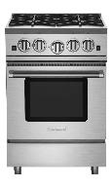
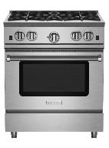
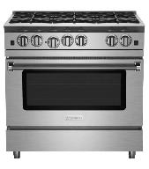
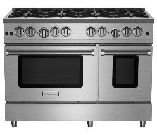
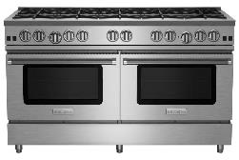
Gas Ranges: Nova Series Availability
Model | Available Inventory | Lead Time | C/CF Color | Custom Color | Designer Trim
RNB244BV2 | 0 | 2 weeks | 3 weeks | 10 weeks | 4 weeks
RNB244BV2L | 0 | 3 weeks | 4 weeks | 11 weeks | 5 weeks
RNB304BV2 | 1 | 2 weeks | 3 weeks | 10 weeks | 4 weeks
RNB304BV2L | 0 | 3 weeks | 4 weeks | 11 weeks | 5 weeks
RNB366BV2 | 3 | 2 weeks | 3 weeks | 10 weeks | 4 weeks
RNB366BV2L | 0 | 3 weeks | 4 weeks | 11 weeks | 5 weeks
RNB488BV2 | 1 | 2 weeks | 3 weeks | 10 weeks | 4 weeks
RNB488BV2L | 0 | 3 weeks | 4 weeks | 11 weeks | 5 weeks
RNB486GV2 (12” Griddle) | 1 | 2 weeks | 3 weeks | 10 weeks | 4 weeks
RNB486GV2L (12” Griddle) | 0 | 3 weeks | 4 weeks | 11 weeks | 5 weeks
RNB6010BV2 | 0 | 2 weeks | 3 weeks | 10 weeks | 4 weeks
RNB6010BV2L | 0 | 3 weeks | 4 weeks | 11 weeks | 5 weeks
L: Denotes LP/Propane model. No additional charges apply
RNB244BV2 – UMRP $5,395
RNB304BV2 – UMRP $5,795
RNB366BV2 – UMRP $7,495
RNB488BV2 – UMRP $11,195
RNB486GV2 – UMRP $12,195
Features: Nova (RNB) Series
22,000 BTU UltraNova™ open burners
Precise 130° simmer burner
Choose from all burners or add integrated griddle, charbroiler or French Top
Integrated wok cooking
Extra-large convection oven - fits 18" x 26" commercial baking sheet and 1850° infrared broiler
Available in 1,000+ colors & finishes plus swing doors
RNB6010BV2 – UMRP $17,895

Slide 3
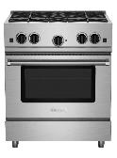
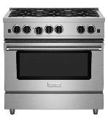
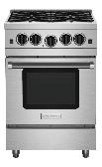
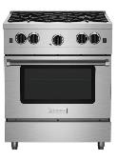
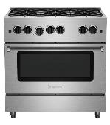
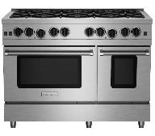
Gas Ranges: RCS Series Availability
Model | Available Inventory | Lead Time | C/CF Color | Custom Color | Designer Trim
RCS304BV2 | 4 | 2 weeks | 3 weeks | 10 weeks | 4 weeks
RCS304BV2L | 2 | 3 weeks | 4 weeks | 11 weeks | 5 weeks
RCS366BV2 | 0 | 2 weeks | 3 weeks | 10 weeks | 4 weeks
RCS366BV2L | 2 | 3 weeks | 4 weeks | 11 weeks | 5 weeks
RCS24SBV2 | 0 | 2 weeks | 3 weeks | 10 weeks | 4 weeks
RCS24SBV2L | 0 | 3 weeks | 4 weeks | 11 weeks | 5 weeks
RCS30SBV2 | 6 | 6 weeks | 7 weeks | 16 weeks | 8 weeks
RCS30SBV2L | 4 | 7 weeks | 8 weeks | 17 weeks | 9 weeks
RCS36SBV2 | 0 | 6 weeks | 7 weeks | 16 weeks | 8 weeks
RCS36SBV2L | 0 | 7 weeks | 8 weeks | 17 weeks | 9 weeks
RCS48SBV2 | 0 | 12 week | 13 week | 20 week | 7 week
RCS48SBV2L | 1 | 13 week | 14 week | 21 week | 8 week
L: Denotes LP/Propane model. No additional charges apply
RCS304BV2 – UMRP $4,295
Open Burner | Stainless Steel Only
RCS366BV2 – UMRP $5,195
Open Burner | Stainless Steel Only
RCS24SBV2 – UMRP $3,995
Sealed Burner | 1,000+ Colors
RCS30SBV2 – UMRP $4,295
Sealed Burner | 1,000+ Colors
Features: Culinary (RCS) Series Open Burner
Restaurant style 15,000 BTU Nova™ open burners
Integrated wok cooking - no wok ring needed
Extra-large convection oven with 1850° infrared broiler that accommodates a full size 18" x 26" commercial baking sheet
Features: Culinary (RCS) Series Sealed Burner
6 sealed burners for maximum cooking area
Powerful 21,000* BTU burners
Convection oven fits commercial size sheet pans
1850° commercial-grade infrared broiler
RCS36SBV2 – UMRP $5,195
Sealed Burner | 1,000+ Colors
RCS48SBV2 – UMRP $8,995
Sealed Burner | 1,000+ Colors

Slide 4





Rangetops: Platinum Series Availability
Model | Available Inventory | Lead Time | Designer Trim
BSPRT244B | 0 | 2 weeks | 3 weeks
BSPRT244BL | 0 | 3 weeks | 4 weeks
BSPRT304B | 0 | 2 weeks | 3 weeks
BSPRT304BL | 0 | 3 weeks | 4 weeks
BSPRT366B | 0 | 2 weeks | 3 weeks
BSPRT366BL | 0 | 3 weeks | 4 weeks
BSPRT488B | 0 | 2 weeks | 3 weeks
BSPRT488BL | 0 | 3 weeks | 4 weeks
BSPRT6010B | 2 | 2 weeks | 3 weeks
BSPRT6010BL | 0 | 3 weeks | 4 weeks
L: Denotes LP/Propane model. No additional charges apply
BSPRT244B – UMRP $5,195
BSPRT304B – UMRP $5,395
BSPRT366B – UMRP $5,995
Features: Platinum Series
25,000 BTU PrimaNova™ open burners
All burners, plus innovative Interchangeable Griddle/Charbroiler
Gentle 130° simmer burner
Integrated wok cooking
BSPRT488B – UMRP $6,995
BSPRT6010B – UMRP $10,295

Slide 5




Rangetops: Nova Series Availability
Model | Available Inventory | Lead Time | Designer Trim
RGTNB244BV2 | 0 | 2 weeks | 3 weeks
RGTNB244BV2L | 0 | 3 weeks | 4 weeks
RGTNB304BV2 | 0 | 2 weeks | 3 weeks
RGTNB304BV2L | 0 | 3 weeks | 4 weeks
RGTNB366BV2 | 0 | 2 weeks | 3 weeks
RGTNB366BV2L | 0 | 3 weeks | 4 weeks
RGTNB488BV2 | 0 | 2 weeks | 3 weeks
RGTNB488BV2L | 0 | 3 weeks | 4 weeks
RGTNB486GV2 (12” Griddle) | 0 | 2 weeks | 3 weeks
RGTNB486GV2L (12” Griddle) | 0 | 3 weeks | 4 weeks
RGTNB6010BV2 | 0 | 2 weeks | 3 weeks
RGTNB6010BV2L | 0 | 3 weeks | 4 weeks
L: Denotes LP/Propane model. No additional charges apply
RGTNB244BV2 – UMRP $4,395
RGTNB304BV2 – UMRP $4,495
RGTNB366BV2 – UMRP $4,795
RGTNB488BV2 – UMRP $5,995
RGTNB486GV2 – UMRP $6,195
Features: Nova (RNB) Series
22,000 BTU UltraNova™ open burners
Precise 130° simmer burner
Choose from all burners or add integrated griddle, charbroiler or French Top
Integrated wok cooking
RGTNB6010BV2 – UMRP $9,595

Slide 6
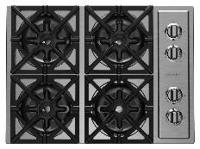
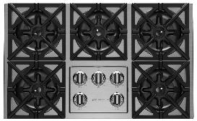
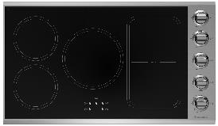
Cooktops: RBCT & Induction Series Availability
Available Inventory | Lead Time | Available Inventory | Designer Trim
RBCT304BSSV2 | 0 | 2 weeks | 3 weeks
RBCT304BSSV2L | 0 | 3 weeks | 4 weeks
RBCT365BSSV2 | 0 | 2 weeks | 3 weeks
RBCT365BSSV2L | 0 | 3 weeks | 4 weeks
L: Denotes LP/Propane model. No additional charges apply
RBCT304BSSV2 – UMRP $2,395
RBCT365BSSV2 – UMRP $2,995
Features: RBCT Series
Restaurant style 22,000 BTU UltraNova™ open burners
Precise 130° simmer burner
Full motion grates
Stainless steel knobs and available customization
Available in Natural or LP gas
Enhanced compatibility with BlueStar Electric Wall Oven
Available Inventory | Lead Time | Available Inventory | Designer Trim
BSP36INDCKT | 0 | 15 weeks | 16 weeks
Features: Induction Series
Features a searing 5,500 Watt burner
Rapid Heat Accelerator technology for no-wait cooking, heats 50% faster than gas
Exceptional temperature control with 12 cooking settings
Maximum cooking surface fits up to 5 pots or pans
Seamless 2-burner bridging technology, perfect for grilling or searing with the Cast Iron Dual Zone Griddle (sold separately)
BSP36INDCKT – UMRP $3,895

Slide 7
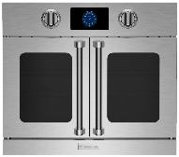
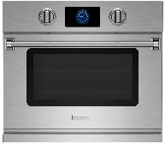
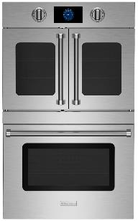
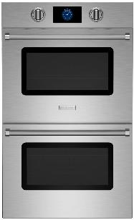
Wall Ovens: Single & Double Electric Availability
Model | Available Inventory | Lead Time | C/CF Color | Custom Color | Designer Trim
BSEWO30SDV3 | 0 | 6 weeks | 7 weeks | 15 weeks | 8 weeks
BSEWO30DDV3 | 0 | 6 weeks | 7 weeks | 15 weeks | 8 weeks
Features: Single Electric Wall Oven Series
New oversized, intuitive, full-color touchscreen with unique customization capabilities
Extra-large oven capacity, overall capacity of 4.6 cu ft & industry leading usable capacity of 3.5 cu ft
Built-in, temperature-controlled bake stone for perfect artisan breads & pizzas
BSEWO30SDV3 – UMRP $6,295
BSEWODDV3 – UMRP $5,795
Model | Available Inventory | Lead Time | C/CF Color | Custom Color | Designer Trim
BSDEWO30SDV3 | 0 | 15 week | 16 week | 23 week | 17 week
BSDEWO30DDV3 | 0 | 15 week | 16 week | 23 week | 18 week
Features: Double Electric Wall Oven Series
New oversized, intuitive, full-color touchscreen with unique customization capabilities
Extra-large oven capacity, overall capacity of 9.2 cu ft & industry leading usable capacity of 7.1 cu ft
Built-in, temperature-controlled bake stone for perfect artisan breads & pizzas
BSDEWO30SDV3 – UMRP $9,595
BSDEWO30DDV3 – UMRP $8,995

Slide 8
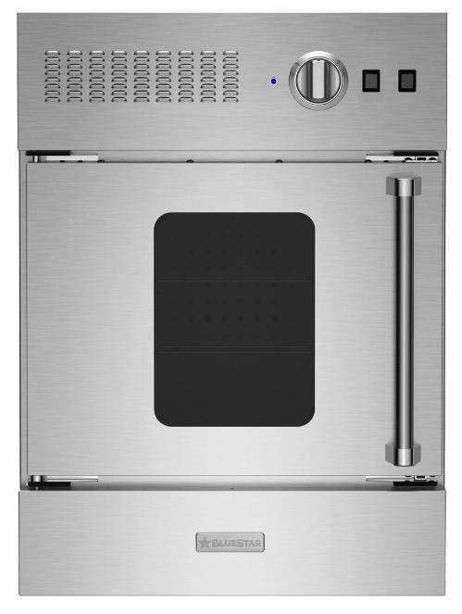
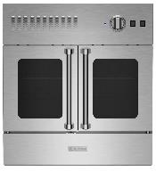
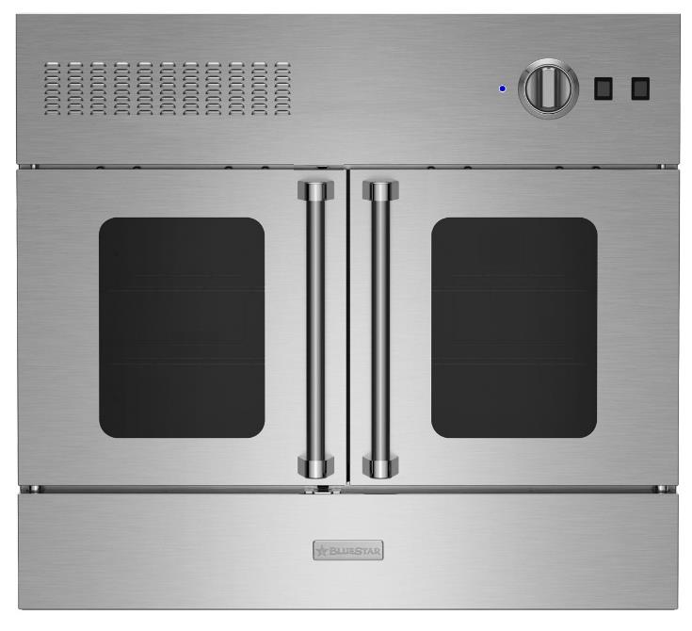
Wall Ovens: Gas Wall Ovens
Model | Available Inventory | Lead Time | Standard RAL | Specialty Finish | Designer Trim
BWO24AGSV2 | 0 | 15 week | 16 week | 24 week | 17 week
BWO24AGSV2L | 0 | 15 week | 16 week | 24 week | 17 week
BWO30AGSV2 | 0 | 15 week | 16 week | 24 week | 17 week
BWO30AGSV2L | 0 | 15 week | 16 week | 24 week | 17 week
BWO36AGSV2 | 0 | 15 week | 16 week | 24 week | 17 week
BWO36AGSV2L | 0 | 15 week | 16 week | 24 week | 17 week
BWO24AGSV2 - $4,695 UMRP
BWO30AGSV2 - $6,195 UMRP
Features: Built-in Gas Wall Ovens
Powerful 25,000 BTU burner with 1850° infrared broiler
30” and 36” models accommodate a full size 18” x 26” commercial baking sheet
24” depth for compatibility with standard kitchen cabinetry
Available as single ovens or two single ovens double stacked
Available in 1,000+ colors and finishes
BWO36AGSV2 - $7,395 UMRP

Slide 9
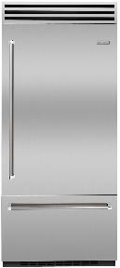
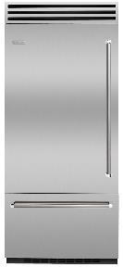
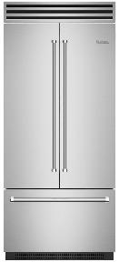
Refrigeration: PRO Built-In Availability
Model | Available Inventory | Lead Time | C/CF Color | Custom Color | Designer Trim
BBB36R2 | 0 | 9 weeks | 10 weeks | 17 weeks | 8 weeks
BBB36L2 | 0 | 9 weeks | 10 weeks | 17 weeks | 8 weeks
Features: PRO Built-In Refrigerator
Stainless Steel Interiors
Dual Compressors
Oversized 22.4 cu. ft. Capacity
Fit Commercial Size Sheet Tray: Refrigerator/Freezer
Fully Extending Self Close Tray
Heavy Duty Construction
Ramp-on LED Lighting
BBB36R2 – UMRP $12,795
BBB36L2 – UMRP $12,795
Model | Available Inventory | Lead Time | C/CF Color | Custom Color | Designer Trim
BBF361 | 0 | 9 week | 10 week | 17 week | 8 week
Features: PRO Built-In French Door Refrigerator
Stainless Steel Interiors
Dual Compressors
Oversized 22.2 cu. ft. Capacity
Fit Commercial Size Sheet Tray: Refrigerator/Freezer
Fully Extending Self Close Tray
Heavy Duty Construction
Ramp-on LED Lighting
BBF361 – UMRP $13,295

Slide 10
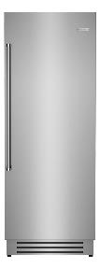
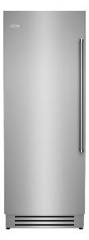
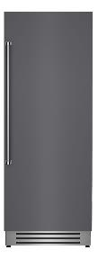
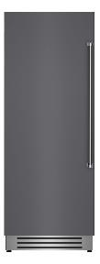




Refrigeration: Column Refrigerator Availability
Model | Available Inventory | Lead Time | C/CF Color | Custom Color | Designer Trim
BIR30R0 | 1 | 13 week | 14 weeks | 22 Weeks | 15 weeks
BIR30L0 | 0 | 13 week | 14 week | 22 week | 15 week
BIRP30R0 (Panel Ready) | 0 | 2 week | N/A | N/A | N/A
BIRP30L0 (Panel Ready) | 0 | 15 week | N/A | N/A | N/A
Features: 30” Integrated Column Refrigerator
Stainless Steel interior
Industry-leading 17.44 cu. ft. capacity for optimum food storage
Flush installation for seamless look
Soft close slide-out tray that fits sheet pan
Advanced, lateral airflow provides consistent temperature control for longer food preservation
BIR30R0
UMRP $8,495
BIR30L0
UMRP $8,495
BIRP30R0
UMRP $7,795
BIRP30L0
UMRP $7,795
Model | Available Inventory | Lead Time | C/CF Color | Custom Color | Designer Trim
BIR24R0 | 0 | 9 week | 10 week | 18 week | 11 week
BIR24L0 | 0 | 11 week | 12 week | 20 week | 13 week
BIRP24R0 (Panel Ready) | 0 | 13 week | N/A | N/A | N/A
BIRP24L0 (Panel Ready) | 0 | 11 week | N/A | N/A | N/A
Features: 24” Integrated Column Refrigerator
Stainless Steel interior
Industry-leading 12.99 cu. ft. capacity for optimum food storage
Flush installation for seamless look
Soft close slide-out tray that fits sheet pan
Advanced, lateral airflow provides consistent temperature control for longer food preservation
BIR24R0
UMRP $7,895
BIR24L0
UMRP $7,895
BIRP24R0
UMRP $7,295
BIRP24L0
UMRP $7,295

Slide 11
Refrigeration: Column Freezer Availability
Model | Available Inventory | Lead Time | C/CF Color | Custom Color | Designer Trim
BIF30R0 | 0 | 19 week | 20 week | 28 week | 21 week
BIF30L0 | 0 | 15 week | 16 week | 24 week | 17 week
BIFP30R0 (Panel Ready) | 0 | 19 week | N/A | N/A | N/A
BIFP30L0 (Panel Ready) | 0 | 15 week | N/A | N/A | N/A
Features: 30” Integrated Column Freezer
Stainless Steel interior
Industry-leading 16.84 cu. ft. capacity for optimum food storage
Flush installation for seamless look
Automatic ice maker with Super Ice function to temporarily increase ice production as needed
BIF30R0
UMRP $8,595
BIF30L0
UMRP $8,595
BIFP30R0
UMRP $7,895
BIFP30L0
UMRP $7,895
Model | Available Inventory | Lead Time | C/CF Color | Custom Color | Designer Trim
BIF24R0 | 0 | 15 week | 16 week | 24 week | 17 week
BIF24L0 | 0 | 22 week | 23 week | 31 week | 24 week
BIFP24R0 (Panel Ready) | 0 | 13 week | N/A | N/A | N/A
BIFP24L0 (Panel Ready) | 0 | 11 week | N/A | N/A | N/A
Features: 24” Integrated Column Freezer
Stainless Steel interior
Industry-leading 12.64 cu. ft. capacity for optimum food storage
Flush installation for seamless look
Automatic ice maker with Super Ice function to temporarily increase ice production as needed
BIF24R0
UMRP $7,995
BIF24L0
UMRP $7,995
BIFP24R0
UMRP $7,395
BIFP24L0
UMRP $7,395

Slide 12



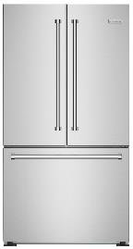
Refrigeration: 18” Freezer / 36” Freestanding Refrigerator
Availability
Model | Available Inventory | Lead Time | C/CF Color | Custom Color | Designer Trim
BIF18R0 | 0 | 2 week | 3 week | 11 week | 4 week
BIF18L0 | 2 | 13 week | 14 week | 22 week | 15 week
BIFP18R0 (Panel Ready) | 0 | 25 week | N/A | N/A | N/A
BIFP18L0 (Panel Ready) | 0 | 2 week | N/A | N/A | N/A
Features: 18” Integrated Column Freezer
Stainless Steel interior
Industry-leading 8.22 cu. ft. capacity for optimum food storage
Flush installation for seamless look
Automatic ice maker with Super Ice function to temporarily increase ice production as needed
BIF18R0
UMRP $7,595
BIF18L0
UMRP $7,595
BIFP18R0
UMRP $6,995
BIFP18L0
UMRP $6,995
Model | Available Inventory | Lead Time | C/CF Color | Custom Color | Designer Trim
FBDF361 | 1 | 1 week | 2 weeks | 9 weeks | 3 weeks
Features: 36” Freestanding French Door Refrigerator
Counter depth design
19.9 cu. ft. capacity
Large capacity drawers
French doors perfect for tighter kitchen spaces
Adjustable glass shelving
LED lighting & Digital display
FBDF361
UMRP $3,975

Slide 13
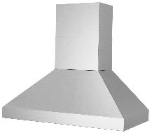
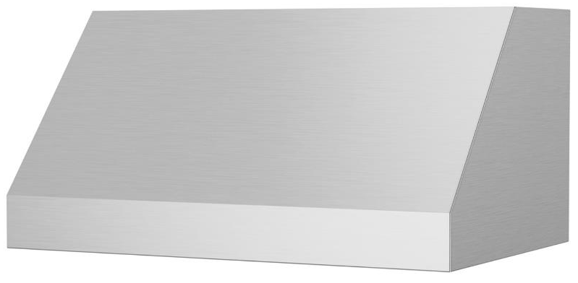
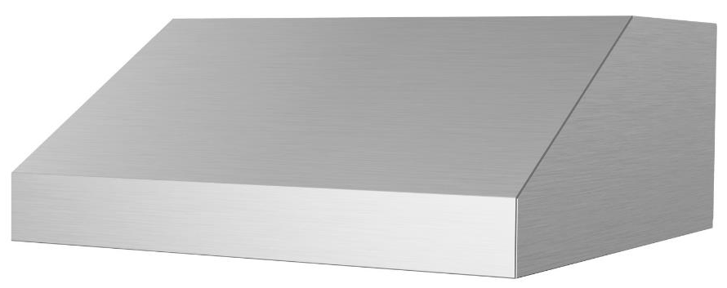
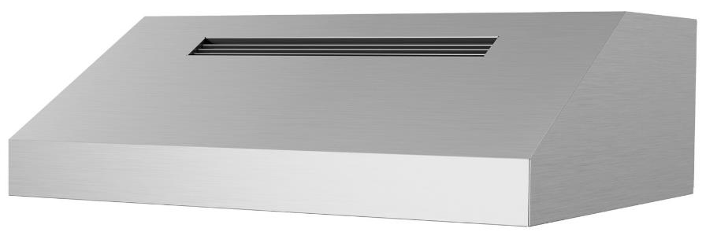
Ventilation: Professional Series Hoods
Availability
Model | Available Inventory | Lead Time | C/CF Color | Custom Color
PL030ML | 0 | 2 weeks | 7 weeks | 14 weeks
PL036ML | 0 | 2 weeks | 7 weeks | 14 weeks
PL042ML | 0 | 2 weeks | 7 weeks | 14 weeks
PL048ML | 0 | 2 weeks | 7 weeks | 14 weeks
PL054ML | 0 | 2 weeks | 7 weeks | 14 weeks
PL060ML | 0 | 2 weeks | 7 weeks | 14 weeks
PL066ML | 0 | 2 weeks | 7 weeks | 14 weeks
PY030ML | 0 | 2 weeks | 7 weeks | 14 weeks
PY036ML | 0 | 2 weeks | 7 weeks | 14 weeks
PY042ML | 0 | 2 weeks | 7 weeks | 14 weeks
PY048ML | 0 | 2 weeks | 7 weeks | 14 weeks
PY054ML | 0 | 2 weeks | 7 weeks | 14 weeks
PY060ML | 0 | 2 weeks | 7 weeks | 14 weeks
PY066ML | 0 | 2 weeks | 7 weeks | 14 weeks
LP030LP | 0 | 2 weeks | 7 weeks | 14 weeks
LP036LP | 0 | 2 weeks | 7 weeks | 14 weeks
LR030LP | 0 | 2 weeks | 7 weeks | 14 weeks
LR036LP | 0 | 2 weeks | 7 weeks | 14 weeks
Proline Series
PL030ML - $2,455
PL036ML - $2,575
PL042ML - $2,825
PL048ML - $3,070
PL054ML - $3,190
PL060ML - $3,440
PL066ML - $3,685
Pyramid Series
PY030ML - $2,575
PY036ML - $3,190
PY042ML - $3,320
PY048ML - $3,440
PY054ML - $3,685
PY060ML - $4,420
PY066ML - $4,775
Low Profile
LP030LP - $1,960
LP036LP - $2,145
Low Profile Recirculating
LR030LP - $2,085
LR036LP - $2,210

Slide 14
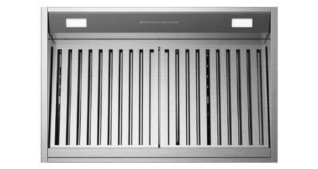
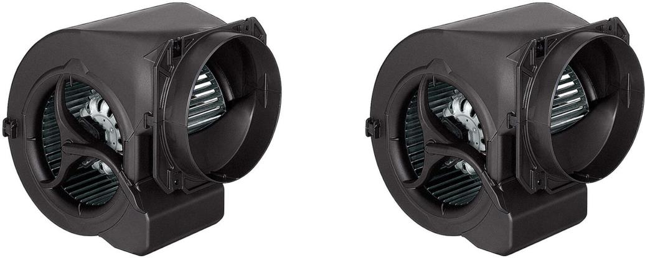
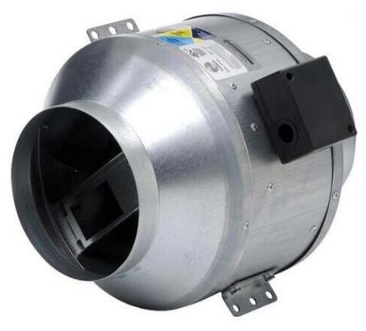
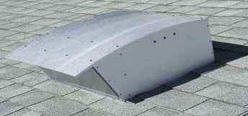
Ventilation: Liners
Availability
Model | Available Inventory | Lead Time
PM028ML | 0 | 2 weeks
PM034ML | 0 | 2 weeks
PM040ML | 0 | 2 weeks
PM046ML | 0 | 2 weeks
PM052ML | 0 | 2 weeks
PM058ML | 0 | 2 weeks
PM064ML | 0 | 2 weeks
PM070ML | 0 | 2 weeks
Model | Available Inventory | Lead Time
BS-CFM-600-IN6 | 0 | 2 weeks
BS-CFM-1200-IN12 | 0 | 2 weeks
ATEX-0.8 | 1 | 6 weeks
ATEX-1.2 | 0 | 6 weeks
HYEX-1.0-GA | 0 | 11 week
HYEX-1.4-GA | 0 | 11 week
Liner Series
PM028ML - $1,545
PM034ML - $1,545
PM040ML - $1,545
PM046ML - $1,680
PM052ML - $1,805
PM058ML - $1,875
PM064ML - $2,060
PM070ML - $2,315
BS-CFM-600-IN6 - $965 UMRP
BS-CFM-1200-IN12 - $1,385 UMRP
ATEX-0.8 - $1,260 UMRP
ATEX-1.2 - $1,510 UMRP
HYEX-1.0-GA - $1,385 UMRP
HYEX-1.4-GA - $1,640 UMRP

Slide 15
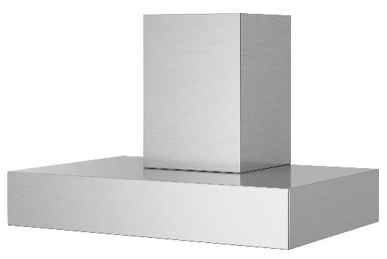
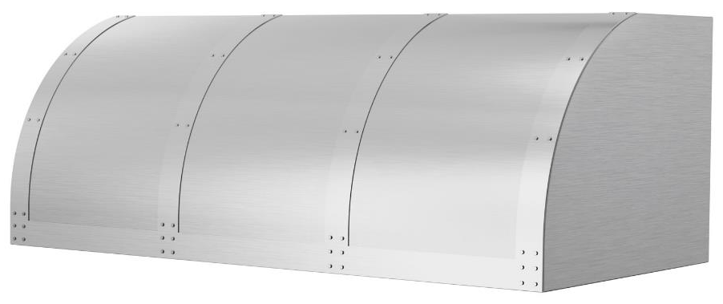
Ventilation: Designer Series Hoods
Availability
Model | Available Inventory | Lead Time | C/CF Color | Custom Color | Designer Trim
HA030ML | 0 | 6 weeks | 7 weeks | 15 weeks | Not Available on this Model Custom Quote Only
HA036ML | 0 | 6 weeks | 7 weeks | 15 weeks
HA042ML | 0 | 6 weeks | 7 weeks | 15 weeks
HA048ML | 0 | 6 weeks | 7 weeks | 15 weeks
HA054ML | 0 | 6 weeks | 7 weeks | 15 weeks
HA060ML | 0 | 7 weeks | 8 weeks | 16 weeks
HA066ML | 0 | 7 weeks | 8 weeks | 16 weeks
MH030MA | 0 | 6 weeks | 7 weeks | 15 weeks | Not Available on this Model Custom Quote Only
MH036MA | 0 | 6 weeks | 7 weeks | 15 weeks
MH042MA | 0 | 6 weeks | 7 weeks | 15 weeks
MH048MA | 0 | 6 weeks | 7 weeks | 15 weeks
MH054MA | 0 | 6 weeks | 7 weeks | 15 weeks
MH060MA | 0 | 7 weeks | 8 weeks | 16 weeks
MH066MA | 0 | 7 weeks | 8 weeks | 16 weeks
BZ030MLPLT | 0 | 6 weeks | 7 weeks | 15 weeks | 8 weeks
BZ036MLPLT | 0 | 6 weeks | 7 weeks | 15 weeks | 8 weeks
BZ042MLPLT | 0 | 6 weeks | 7 weeks | 15 weeks | 8 weeks
BZ048MLPLT | 0 | 6 weeks | 7 weeks | 15 weeks | 8 weeks
BZ054MLPLT | 0 | 6 weeks | 7 weeks | 15 weeks | 8 weeks
BZ060MLPLT | 0 | 7 weeks | 8 weeks | 16 weeks | 9 weeks
BZ066MLPLT | 0 | 7 weeks | 8 weeks | 16 weeks | 9 weeks
Hampton Series
HA030ML - $2,890
HA036ML - $3,375
HA042ML - $4,100
HA048ML - $4,220
HA054ML - $4,340
HA060ML - $4,585
HA066ML - $4,705
Manhattan Series
MH030MA - $2,890
MH036MA - $3,375
MH042MA - $3,615
MH048MA - $3,860
MH054MA - $5,065
MH060MA - $5,430
MH066MA - $5,550
Bonanza Series
BZ030MLPLT - $4,460
BZ036MLPLT - $4,825
BZ042MLPLT - $5,550
BZ048MLPLT - $6,030
BZ054MLPLT - $6,155
BZ060MLPLT - $6,635
BZ066MLPLT - $6,755

Slide 16
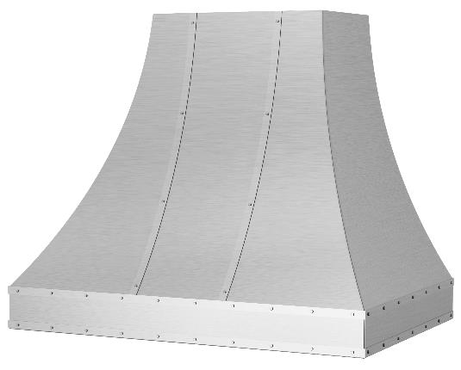
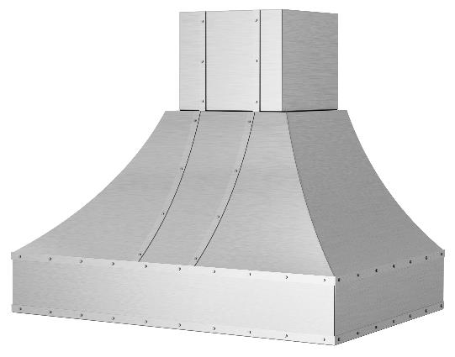
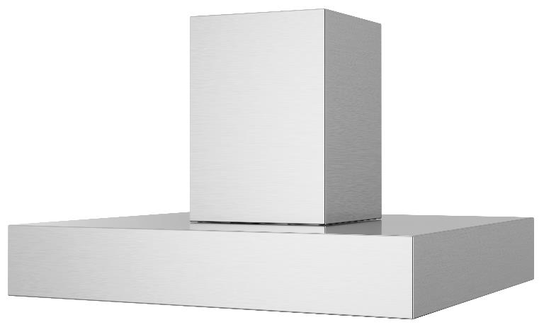
Ventilation: Designer Series Hoods
Availability
Model | Available Inventory | Lead Time | C/CF Color | Custom Color | Designer Trim
SC030MLPLT | 0 | 6 weeks | 7 weeks | 15 weeks | 8 weeks
SC036MLPLT | 0 | 6 weeks | 7 weeks | 15 weeks | 8 weeks
SC042MLPLT | 0 | 6 weeks | 7 weeks | 15 weeks | 8 weeks
SC048MLPLT | 0 | 6 weeks | 7 weeks | 15 weeks | 8 weeks
SC054MLPLT | 0 | 6 weeks | 7 weeks | 15 weeks | 8 weeks
SC060MLPLT | 0 | 7 weeks | 8 weeks | 16 weeks | 9 weeks
WR030MLPLT | 0 | 6 weeks | 7 weeks | 16 weeks | 9 weeks
WR036MLPLT | 0 | 6 weeks | 7 weeks | 15 weeks | 8 weeks
WR042MLPLT | 0 | 6 weeks | 7 weeks | 15 weeks | 8 weeks
WR048MLPLT | 0 | 6 weeks | 7 weeks | 15 weeks | 8 weeks
WR054MLPLT | 0 | 6 weeks | 7 weeks | 15 weeks | 8 weeks
WR060MLPLT | 0 | 7 weeks | 8 weeks | 16 weeks | 9 weeks
WR066MLPLT | 0 | 7 weeks | 8 weeks | 16 weeks | 9 weeks
BS-MANH-I-36-SS | 0 | 6 weeks | 7 weeks | 15 weeks | Not Available on this Model Custom Quote Only
BS-MANH-I-42-SS | 0 | 6 weeks | 7 weeks | 15 weeks
BS-MANH-I-48-SS | 0 | 6 weeks | 7 weeks | 15 weeks
BS-MANH-I-54-SS | 0 | 6 weeks | 7 weeks | 15 weeks
BS-MANH-I-60-SS | 0 | 7 weeks | 8 weeks | 16 weeks
BS-MANH-I-66-SS | 0 | 7 weeks | 8 weeks | 16 weeks
Sahara Curved Series
SC030MLPLT - $6,030
SC036MLPLT - $6,635
SC042MLPLT - $6,875
SC048MLPLT - $8,810
SC054MLPLT - $9,170
SC060MLPLT - $10,620
Wrangler Series
WR030MLPLT - $7,600
WR036MLPLT - $7,845
WR042MLPLT - $7,965
WR048MLPLT - $8,085
WR054MLPLT - $8,205
WR060MLPLT - $8,325
WR066MLPLT - $8,445
Ventilation: Island Series Hoods
Manhattan Island Series
BS-MANH-I-36-SS - $4,170
BS-MANH-I-42-SS - $4,675
BS-MANH-I-48-SS - $4,800
BS-MANH-I-54-SS - $4,930
BS-MANH-I-60-SS - $6,320
BS-MANH-I-66-SS - $6,570

Slide 17
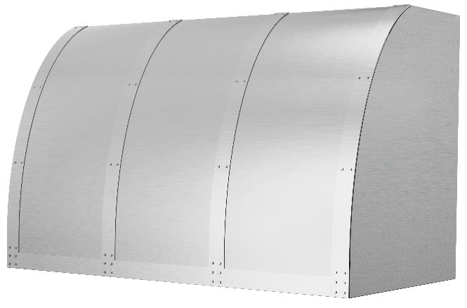
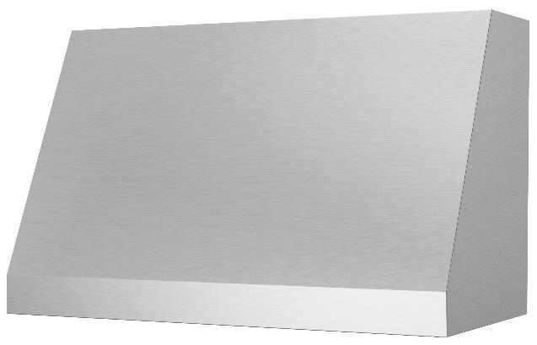
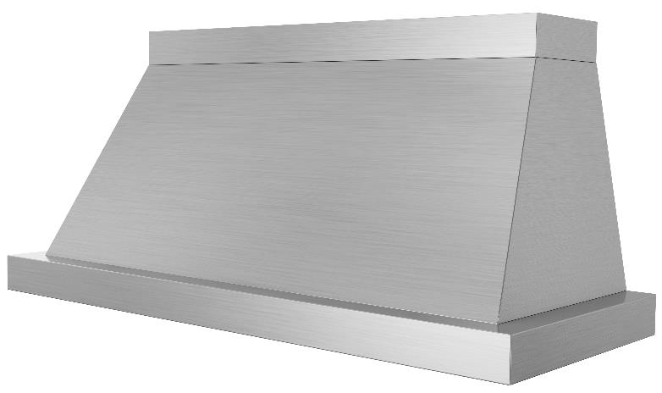
Ventilation: Abbaka Series Hoods
Availability – Updated 11/10/2021
Model | Available Inventory | Lead Time | C/CF Color | Custom Color | Designer Trim
AT030MLPLT | 0 | 6 weeks | 7 weeks | 15 weeks | 8 weeks
AT036MLPLT | 0 | 6 weeks | 7 weeks | 15 weeks | 8 weeks
AT042MLPLT | 0 | 6 weeks | 7 weeks | 15 weeks | 8 weeks
AT054MLPLT | 0 | 6 weeks | 7 weeks | 15 weeks | 8 weeks
AT060MLPLT | 0 | 7 weeks | 8 weeks | 16 weeks | 9 weeks
AT066MLPLT | 0 | 7 weeks | 8 weeks | 16 weeks | 9 weeks
ME030ML | 0 | 6 weeks | 7 weeks | 15 weeks | Not Available on this Model Custom Quote Only
ME036ML | 0 | 6 weeks | 7 weeks | 15 weeks
ME042ML | 0 | 6 weeks | 7 weeks | 15 weeks
ME048ML | 0 | 6 weeks | 7 weeks | 15 weeks
ME054ML | 0 | 6 weeks | 7 weeks | 15 weeks
ME060ML | 0 | 7 weeks | 8 weeks | 16 weeks
ME066ML | 0 | 7 weeks | 8 weeks | 16 weeks
NR036ML | 0 | 6 weeks | 7 weeks | 15 weeks | Custom Quote Only
NR042ML | 0 | 6 weeks | 7 weeks | 15 weeks
NR048ML | 0 | 6 weeks | 7 weeks | 15 weeks
NR054ML | 0 | 6 weeks | 7 weeks | 15 weeks
NR060ML | 0 | 7 weeks | 8 weeks | 16 weeks
NR066ML | 0 | 7 weeks | 8 weeks | 16 weeks
Atlas Series
AT030MLPLT - $5,650
AT036MLPLT - $5,900
AT042MLPLT - $6,515
AT048MLPLT - $6,760
AT054MLPLT - $7,010
AT060MLPLT - $7,375
AT066MLPLT - $7,995
Mesa Series
ME030ML - $3,685
ME036ML - $3,805
ME042ML - $4,055
ME048ML - $4,300
ME054ML - $4,420
ME060ML - $4,670
ME066ML - $4,915
Normandy Series
NL036ML - $6,145
NR042ML - $6,515
NR048ML - $8,610
NR054ML - $9,100
NR060ML - $9,840
NR066ML - $10,455

