Slide 1

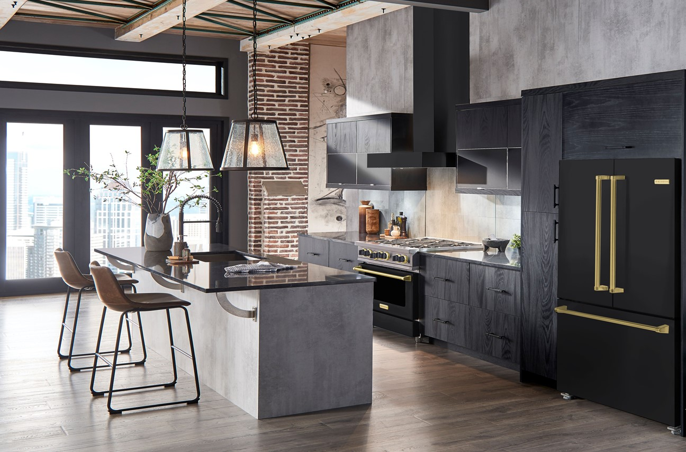

BlueStar®
36” Counter Depth Refrigerator
Now in COLOR (& Trim)!

Slide 2
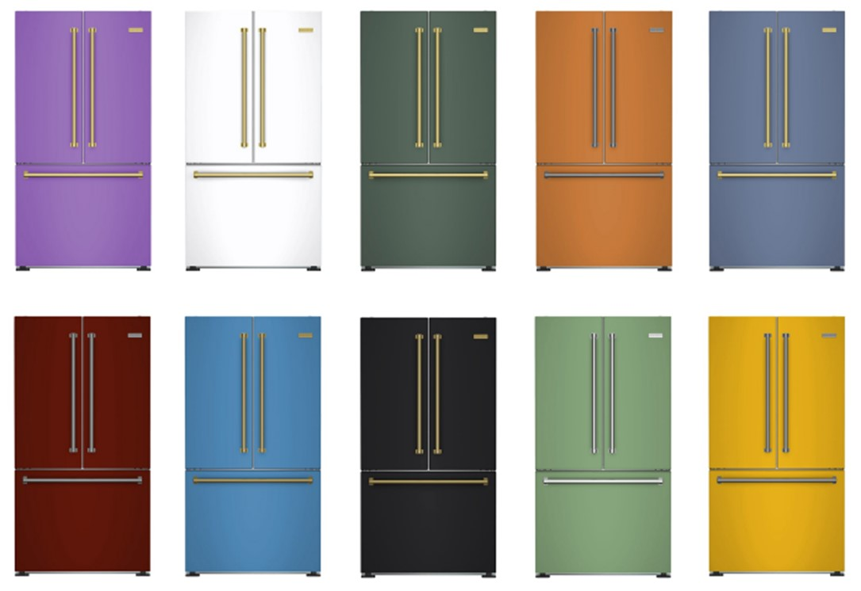
The BlueStar® Counter Depth Refrigerator is getting an UPGRADE!
Choose from any of our 1,000+ Colors & 10 Metal Trims

Slide 3
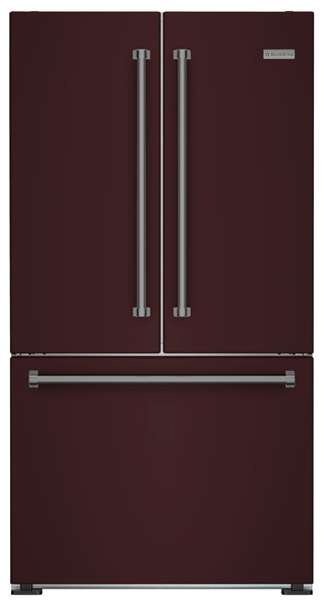
36” Counter Depth Refrigerator
19.9 cu. ft. capacity with large capacity drawers
Counter-depth design for seamless, built-in look
Advanced Cooling System works to eliminate odors
Adjustable glass shelving
LED Theater-Style lighting
Digital Display
Internal filtered water dispenser
Automatic Ice Maker
ENERGY STAR certified
French Doors perfect for tighter kitchen spaces
Pair with any BlueStar® Cooking & Ventilation Products
Available in 1,000+ Colors & 10 Metal Trims

Slide 4
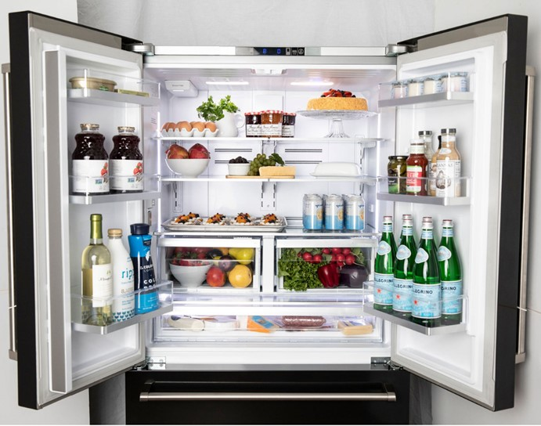
36” Counter Depth Refrigerator
Advanced Cooling System provides optimal food preservation
Digital Display:
Bright, intuitive display controls temperature & Sabbath mode
Unmatched Customization:
Shelves can easily be changed to fit any need. 1,000+ colors and 10 metal trim finishes.
Oversized Capacity:
Features 19.9 cu ft of capacity
Adjustable Glass Shelving:
Shifts to accommodate all groceries
Internal Water:
Discreet dispenser for cold water
Fits Half Size Sheet Pan:
Accommodates 9” x 13” sheet pans for easy meal prep
LED Lighting:
Beautiful theater-style lighting
Extra-large Door Buckets:
Fits full-size bottles of wine, plus all your favorite condiments.
Large Capacity Drawers:
Fits all your meats, cheese, veggies and fruits

Slide 5
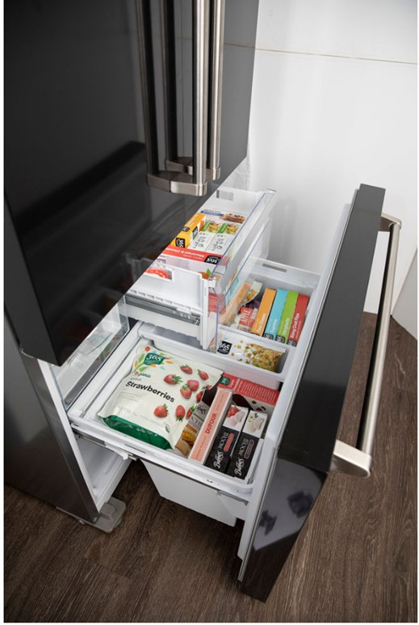
Bottom Mount Freezer
  Automatic ice maker

Slide 6

SAVE BIG with Our Most Popular Color Combinations!
Offer Valid Until 9/30/22!
Notes:
Black & White
Glossy and Matte with SS trim $4995
Glossy and Matte with BB trim $5995

Slide 7
Promotion Specifics
Model # | UMRP Price | Savings | Descriptor
 |  |  | Stainless Trim +
FBFD361PW | $ 4,995 | $ (795) | Gloss Signal White (RAL 9003)
FBFD361PB | $ 4,995 | $ (795) | Gloss Signal Black (RAL 9004)
FBFD361PMW | $ 4,995 | $ (1,295) | Matte White
FBFD361PMB | $ 4,995 | $ (1,295) | Matte Black
 |  |  | Brushed Brass Trim +
FBFD361PWPLT | $ 5,995 | $ (1,290) | Gloss Signal White (RAL 9003)
FBFD361PBPLT | $ 5,995 | $ (1,290) | Gloss Signal Black (RAL 9004)
FBFD361PMWPLT | $ 5,995 | $ (1,790) | Matte White
FBFD361PMBPLT | $ 5,995 | $ (1,790) | Matte Black
FINE PRINT: Offer valid on all new qualifying purchases made between March 21, 2022 – September 30, 2022. Must purchase BlueStar® FBFD36 model number. Valid on Gloss Signal White RAL 9003, Gloss Signal Black RAL 9004, Matte White and Matte Black only. Offer excludes all other standard RAL colors, Specialty Finish (CF) colors and custom colors (CC). Offer valid on stainless steel and brushed brass trim options, excludes all other trim finishes.

Slide 8
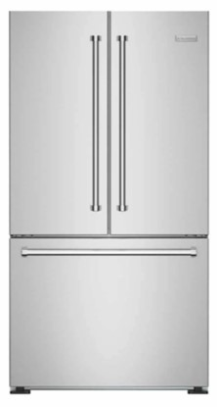
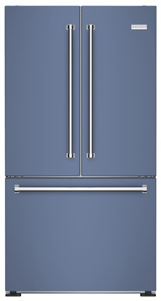
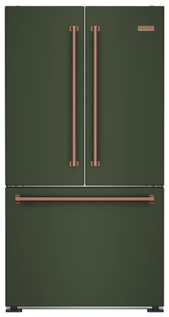
Standard Model Numbers
Lead time:
2-4 weeks!
Model # | UMRP Price | Descriptor
FBFD361 | $ 4,295 | Stainless, no panel
FBFD361PC | $ 5,790 | RAL + Stainless trim
FBFD361PCPLT | $ 7,285 | RAL + Any trim
FBFD361PCF | $ 6,290 | CF Color + Stainless trim
FBFD361PCFPLT | $ 7,785 | CF Color + Any trim
FBFD361PCC | $ 7,490 | Custom color + Stainless trim
FBFD361PCCPLT | $ 8,985 | Custom color + Any trim

Slide 9
Backup

Slide 10
All Model Numbers
Promotion
Model # | UMRP Price | Descriptor
FBFD361 | $ 4,295 | Stainless, no panel
FBFD361PC | $ 5,790 | RAL + Stainless trim
FBFD361PCPLT | $ 7,285 | RAL + Any trim
FBFD361PCF | $ 6,290 | CF Color + Stainless trim
FBFD361PCFPLT | $ 7,785 | CF Color + Any trim
FBFD361PCC | $ 7,490 | Custom color + Stainless trim
FBFD361PCCPLT | $ 8,985 | Custom color + Any trim
Standard Models
Model # | UMRP Price | Savings | Descriptor
 |  |  | Stainless Trim +
FBFD361PW | $ 4,995 | $ (795) | Gloss Signal White (RAL 9003)
FBFD361PB | $ 4,995 | $ (795) | Gloss Signal Black (RAL 9004)
FBFD361PMW | $ 4,995 | $ (1,295) | Matte White
FBFD361PMB | $ 4,995 | $ (1,295) | Matte Black
 |  |  | Brushed Brass Trim +
FBFD361PWPLT | $ 5,995 | $ (1,290) | Gloss Signal White (RAL 9003)
FBFD361PBPLT | $ 5,995 | $ (1,290) | Gloss Signal Black (RAL 9004)
FBFD361PMWPLT | $ 5,995 | $ (1,790) | Matte White
FBFD361PMBPLT | $ 5,995 | $ (1,790) | Matte Black

