Slide 1

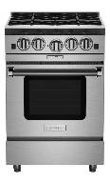
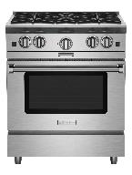
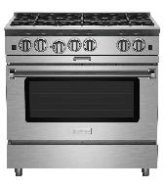
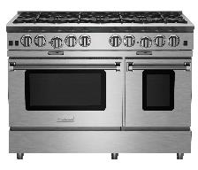
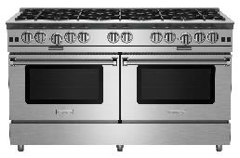
Gas Ranges: Platinum Series Availability – Updated 11/12/2021
***Stock is first come/first serve. Stock numbers are not garunteed***
Model | Available Inventory | Current Lead Time
BSP244B | 1 | 6 weeks
BSP244BL |  | 7 weeks
BSP304B |  | 6 weeks
BSP304BL | 2 | 7 weeks
BSP366B | 7 | 6 weeks
BSP366BL | 1 | 7 weeks
BSP488B |  | 6 weeks
BSP488BL | 2 | 7 weeks
BSP6010B | 1 | 6 weeks
BSP6010BL |  | 7 weeks
L: Denotes LP/Propane model. No additional charges apply
BSP244B – UMRP $6,395
BSP304B – UMRP $7,295
Features: Platinum Series
25,000 BTU PrimaNova™ open burners
All burners, plus innovative Interchangeable Griddle/Charbroiler
Gentle 130° simmer burner
Integrated wok cooking
Oven accommodates 18" x 26" baking sheet
PowR Oven™ for 40% faster preheating & 1850° infrared broiler
Available in 1,000+ colors and finishes
BSP366B – UMRP $9,995
BSP488B – UMRP $13,595
BSP6010B – UMRP $17,495

Slide 2
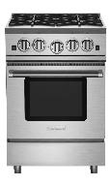
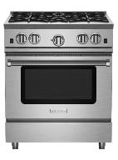
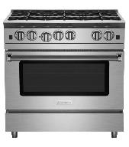
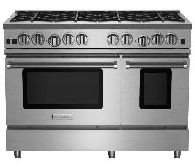
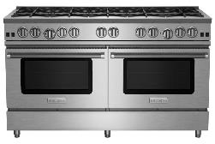
Gas Ranges: Nova Series Availability – Updated 11/12/2021
***Stock is first come/first serve. Stock numbers are not garunteed***
Model | Available Inventory | Current Lead Time
RNB244BV2 |  | 6 weekw
RNB244BV2L |  | 7 weeks
RNB304BV2 | 2 | 6 weeks
RNB304BV2L |  | 7 weeks
RNB366BV2 | 2 | 6 weeks
RNB366BV2L |  | 7 weeks
RNB488BV2 | 3 | 6 weeks
RNB488BV2L |  | 7 weeks
RNB486GV2 (12” Griddle) |  | 6 weeks
RNB486GV2L (12” Griddle) |  | 7 weeks
RNB6010BV2 |  | 6 weeks
RNB6010BV2L |  | 7 weeks
L: Denotes LP/Propane model. No additional charges apply
RNB244BV2 – UMRP $5,395
RNB304BV2 – UMRP $5,795
RNB366BV2 – UMRP $7,495
RNB488BV2 – UMRP $11,195
RNB486GV2 – UMRP $12,195
Features: Nova (RNB) Series
22,000 BTU UltraNova™ open burners
Precise 130° simmer burner
Choose from all burners or add integrated griddle, charbroiler or French Top
Integrated wok cooking
Extra-large convection oven - fits 18" x 26" commercial baking sheet and 1850° infrared broiler
Available in 1,000+ colors & finishes plus swing doors
RNB6010BV2 – UMRP $17,895

Slide 3
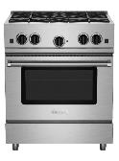
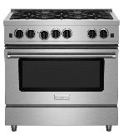
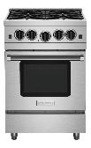
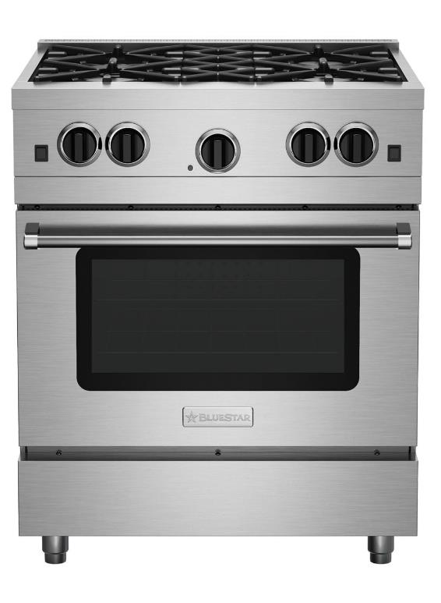
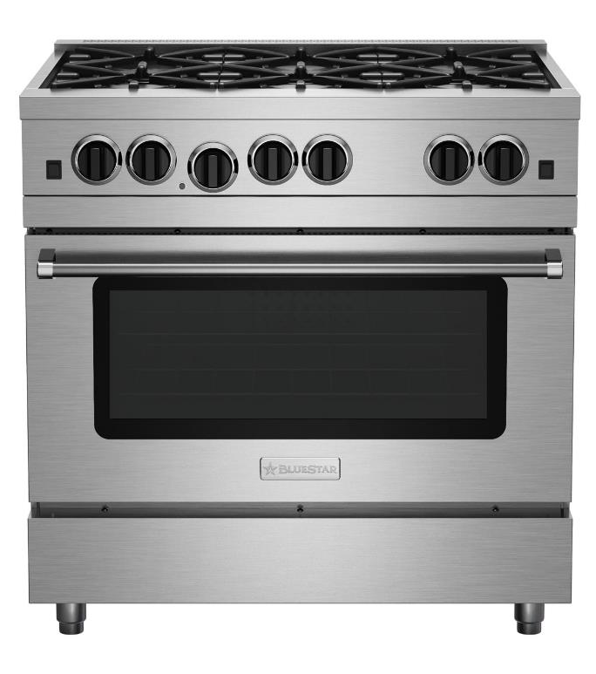
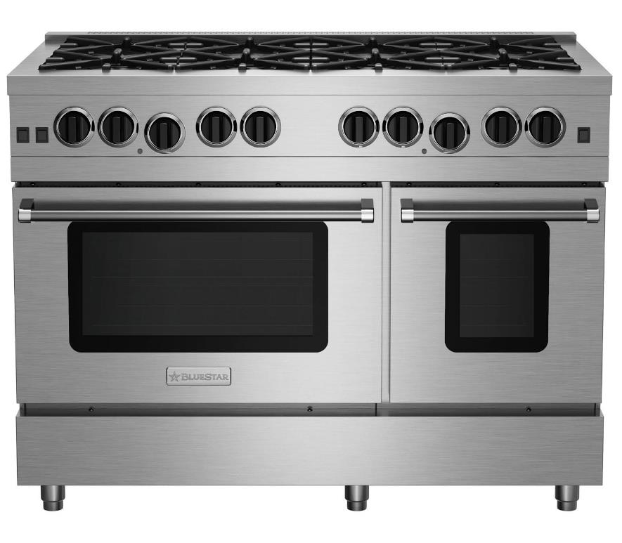
Gas Ranges: RCS Series Availability – Updated 11/12/2021
***Stock is first come/first serve. Stock numbers are not garunteed***
Model | Available Inventory | Current Lead Time
RCS304BV2 | 1 | 6 weeks
RCS304BV2L | 2 | 7 weeks
RCS366BV2 | 2 | 6 weeks
RCS366BV2L | 2 | 7 weeks
RCS24SBV2 |  | 6 weeks
RCS24SBV2L |  | 7 weeks
RCS30SBV2 | 1 | 10 weeks
RCS30SBV2L |  | 10 weeks
RCS36SBV2 |  | 13 weeks
RCS36SBV2L |  | 13 weeks
RCS48SBV2 | 2 | 6 weeks
RCS48SBV2L |  | 7 weeks
L: Denotes LP/Propane model. No additional charges apply
RCS304BV2 – UMRP $4,295
Open Burner | Stainless Steel Only
RCS366BV2 – UMRP $5,195
Open Burner | Stainless Steel Only
RCS24SBV2 – UMRP $3,995
Sealed Burner | 1,000+ Colors
RCS30SBV2 – UMRP $4,295
Sealed Burner | 1,000+ Colors
Features: Culinary (RCS) Series Open Burner
Restaurant style 15,000 BTU Nova™ open burners
Integrated wok cooking - no wok ring needed
Extra-large convection oven with 1850° infrared broiler that accommodates a full size 18" x 26" commercial baking sheet
Features: Culinary (RCS) Series Sealed Burner
6 sealed burners for maximum cooking area
Powerful 21,000* BTU burners
Convection oven fits commercial size sheet pans
1850° commercial-grade infrared broiler
RCS36SBV2 – UMRP $5,195
Sealed Burner | 1,000+ Colors
RCS48SBV2 – UMRP $8,995
Sealed Burner | 1,000+ Colors

Slide 4





Rangetops: Platinum Series Availability – Updated 11/12/2021
***Stock is first come/first serve. Stock numbers are not garunteed***
Model | Available Inventory | Current Lead Time
BSPRT244B |  | 3 weeks
BSPRT244BL |  | 4 weeks
BSPRT304B |  | 3 weeks
BSPRT304BL |  | 4 weeks
BSPRT366B |  | 3 weeks
BSPRT366BL |  | 4 weeks
BSPRT488B |  | 3 weeks
BSPRT488BL |  | 4 weeks
BSPRT6010B |  | 3 weeks
BSPRT6010BL |  | 4 weeks
L: Denotes LP/Propane model. No additional charges apply
BSPRT244B – UMRP $5,195
BSPRT304B – UMRP $5,395
BSPRT366B – UMRP $5,995
Features: Platinum Series
25,000 BTU PrimaNova™ open burners
All burners, plus innovative Interchangeable Griddle/Charbroiler
Gentle 130° simmer burner
Integrated wok cooking
BSPRT488B – UMRP $6,995
BSPRT6010B – UMRP $10,295

Slide 5




Rangetops: Nova Series Availability – Updated 11/12/2021
***Stock is first come/first serve. Stock numbers are not garunteed***
Model | Available Inventory | Current Lead Time
RGTNB244BV2 | 1 | 3 weeks
RGTNB244BV2L |  | 4 weeks
RGTNB304BV2 |  | 3 weeks
RGTNB304BV2L |  | 4 weeks
RGTNB366BV2 | 1 | 3 weeks
RGTNB366BV2L | 1 | 4 weeks
RGTNB488BV2 |  | 3 weeks
RGTNB488BV2L |  | 4 weeks
RGTNB486GV2 (12” Griddle) |  | 6 weeks
RGTNB486GV2L (12” Griddle) |  | 6 weeks
RGTNB6010BV2 |  | 3 weeks
RGTNB6010BV2L |  | 6 weeks
L: Denotes LP/Propane model. No additional charges apply
RGTNB244BV2 – UMRP $4,395
RGTNB304BV2 – UMRP $4,495
RGTNB366BV2 – UMRP $4,795
RGTNB488BV2 – UMRP $5,995
RGTNB486GV2 – UMRP $6,195
Features: Nova (RNB) Series
22,000 BTU UltraNova™ open burners
Precise 130° simmer burner
Choose from all burners or add integrated griddle, charbroiler or French Top
Integrated wok cooking
RGTNB6010BV2 – UMRP $9,595

Slide 6
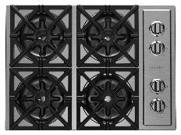
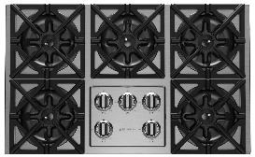
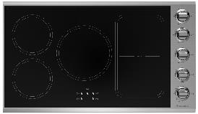
Cooktops: RBCT & Induction Series Availability – Updated 11/12/2021
***Stock is first come/first serve. Stock numbers are not garunteed***
Model | Available Inventory | Current Lead Time
RBCT304BSSV2 |  | 9 weeks
RBCT304BSSV2L |  | 9 weeks
RBCT365BSSV2 |  | 9 weeks
RBCT365BSSV2L |  | 9 weeks
L: Denotes LP/Propane model. No additional charges apply
RBCT304BSSV2 – UMRP $2,395
RBCT365BSSV2 – UMRP $2,995
Features: RBCT Series
Restaurant style 22,000 BTU UltraNova™ open burners
Precise 130° simmer burner
Full motion grates
Stainless steel knobs and available customization
Available in Natural or LP gas
Enhanced compatibility with BlueStar Electric Wall Oven
Model | Available Inventory | Current Lead Time
BSP36INDCKT |  | 30 weeks
Features: Induction Series
Features a searing 5,500 Watt burner
Rapid Heat Accelerator technology for no-wait cooking, heats 50% faster than gas
Exceptional temperature control with 12 cooking settings
Maximum cooking surface fits up to 5 pots or pans
Seamless 2-burner bridging technology, perfect for grilling or searing with the Cast Iron Dual Zone Griddle (sold separately)
BSP36INDCKT – UMRP $3,895

Slide 7
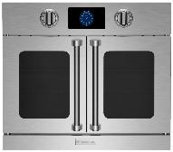
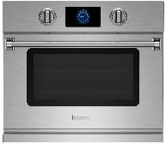
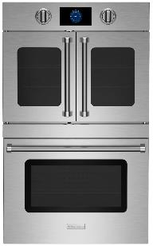
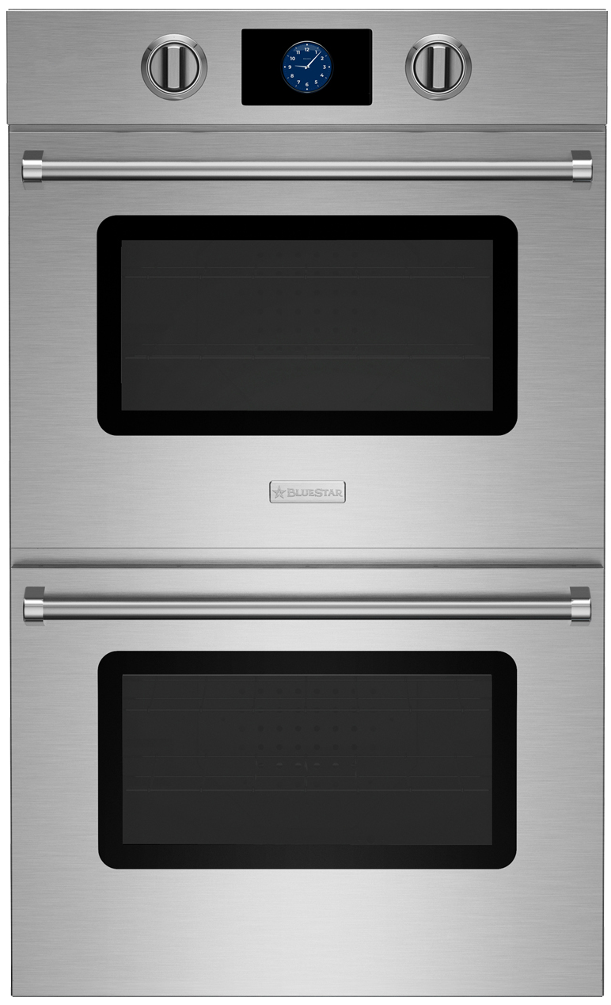
Wall Ovens: Single & Double Electric Availability – Updated 11/12/2021
***Stock is first come/first serve. Stock numbers are not garunteed***
Model | Available Inventory | Current Lead Time
BSEWO30SDV3 | 1 | 12 weeks
BSEWO30DDV3 | 1 | 12 weeks
Features: Single Electric Wall Oven Series
New oversized, intuitive, full-color touchscreen with unique customization capabilities
Extra-large oven capacity, overall capacity of 4.6 cu ft & industry leading usable capacity of 3.5 cu ft
Built-in, temperature-controlled bake stone for perfect artisan breads & pizzas
BSEWO30SDV3 – UMRP $6,295
BSEWODDV3 – UMRP $5,795
Model | Available Inventory | Current Lead Time
BSDEWO30SDV3 | 1 | 12 weeks
BSDEWO30DDV3 |  | 12 weeks
Features: Double Electric Wall Oven Series
New oversized, intuitive, full-color touchscreen with unique customization capabilities
Extra-large oven capacity, overall capacity of 9.2 cu ft & industry leading usable capacity of 7.1 cu ft
Built-in, temperature-controlled bake stone for perfect artisan breads & pizzas
BSDEWO30SDV3 – UMRP $9,595
BSDEWO30DDV3 – UMRP $8,995

Slide 8
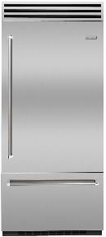
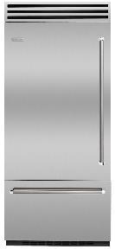
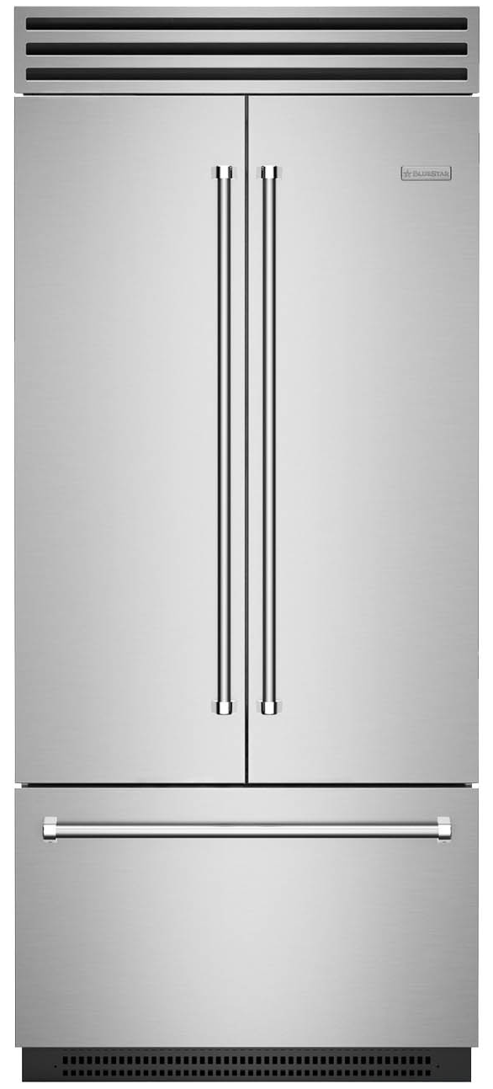
Refrigeration: PRO Built-In Availability – Updated 11/12/2021
***Stock is first come/first serve. Stock numbers are not garunteed***
Model | Available Inventory | Current Lead Time
BBB36R2 | 2 | 6 weeks
BBB36L2 |  | 6 weeks
Features: PRO Built-In Refrigerator
Stainless Steel Interiors
Dual Compressors
Oversized 22.4 cu. ft. Capacity
Fit Commercial Size Sheet Tray: Refrigerator/Freezer
Fully Extending Self Close Tray
Heavy Duty Construction
Ramp-on LED Lighting
BBB36R2 – UMRP $12,795
BBB36L2 – UMRP $12,795
Model | Available Inventory | Current Lead Time
BBF361 |  | 6 weeks
Features: PRO Built-In French Door Refrigerator
Stainless Steel Interiors
Dual Compressors
Oversized 22.2 cu. ft. Capacity
Fit Commercial Size Sheet Tray: Refrigerator/Freezer
Fully Extending Self Close Tray
Heavy Duty Construction
Ramp-on LED Lighting
BBF361 – UMRP $13,295

Slide 9
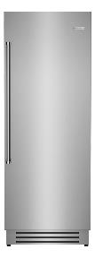
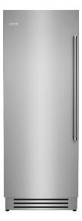
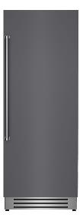
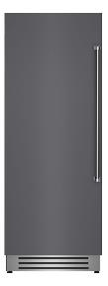




Refrigeration: Column Refrigerator Availability – Updated 11/12/2021
***Stock is first come/first serve. Stock numbers are not garunteed***
Model | Available Inventory | Current Lead Time
BIR30R0 |  | 2 to 4 weeks
BIR30L0 |  | 17 to 19 weeks
BIRP30R0 (Panel Ready) |  | 2 to 4 weeks
BIRP30L0 (Panel Ready) |  | 17 to 19 weeks
Features: 30” Integrated Column Refrigerator
Stainless Steel interior
Industry-leading 17.44 cu. ft. capacity for optimum food storage
Flush installation for seamless look
Soft close slide-out tray that fits sheet pan
Advanced, lateral airflow provides consistent temperature control for longer food preservation
BIR30R0
UMRP $8,495
BIR30L0
UMRP $8,495
BIRP30R0
UMRP $7,795
BIRP30L0
UMRP $7,795
Model | Available Inventory | Current Lead Time
BIR24R0 |  | 17 to 19 weeks
BIR24L0 |  | 17 to 19 weeks
BIRP24R0 (Panel Ready) |  | 17 to 19 weeks
BIRP24L0 (Panel Ready) |  | 17 to 19 weeks
Features: 24” Integrated Column Refrigerator
Stainless Steel interior
Industry-leading 12.99 cu. ft. capacity for optimum food storage
Flush installation for seamless look
Soft close slide-out tray that fits sheet pan
Advanced, lateral airflow provides consistent temperature control for longer food preservation
BIR24R0
UMRP $7,895
BIR24L0
UMRP $7,895
BIRP24R0
UMRP $7,295
BIRP24L0
UMRP $7,295

Slide 10
Refrigeration: Column Freezer Availability – Updated 11/12/2021
***Stock is first come/first serve. Stock numbers are not garunteed***
Model | Available Inventory | Current Lead Time
BIF30R0 |  | 17 to 19 weeks
BIF30L0 |  | 17 to 19 weeks
BIFP30R0 (Panel Ready) |  | 17 to 19 weeks
BIFP30L0 (Panel Ready) |  | 17 to 19 weeks
Features: 30” Integrated Column Freezer
Stainless Steel interior
Industry-leading 16.84 cu. ft. capacity for optimum food storage
Flush installation for seamless look
Automatic ice maker with Super Ice function to temporarily increase ice production as needed
BIF30R0
UMRP $8,595
BIF30L0
UMRP $8,595
BIFP30R0
UMRP $7,895
BIFP30L0
UMRP $7,895
Model | Available Inventory | Current Lead Time
BIF24R0 |  | 17 to 19 weeks
BIF24L0 |  | 17 to 19 weeks
BIFP24R0 (Panel Ready) |  | 17 to 19 weeks
BIFP24L0 (Panel Ready) |  | 17 to 19 weeks
Features: 24” Integrated Column Freezer
Stainless Steel interior
Industry-leading 12.64 cu. ft. capacity for optimum food storage
Flush installation for seamless look
Automatic ice maker with Super Ice function to temporarily increase ice production as needed
BIF24R0
UMRP $7,995
BIF24L0
UMRP $7,995
BIFP24R0
UMRP $7,395
BIFP24L0
UMRP $7,395

Slide 11
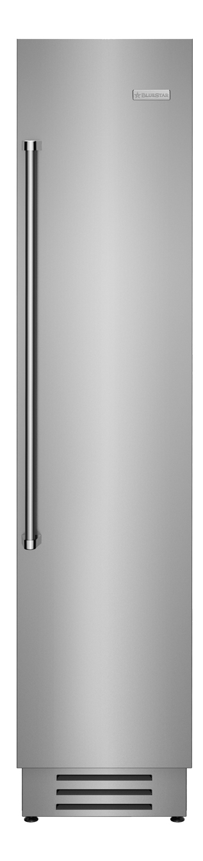


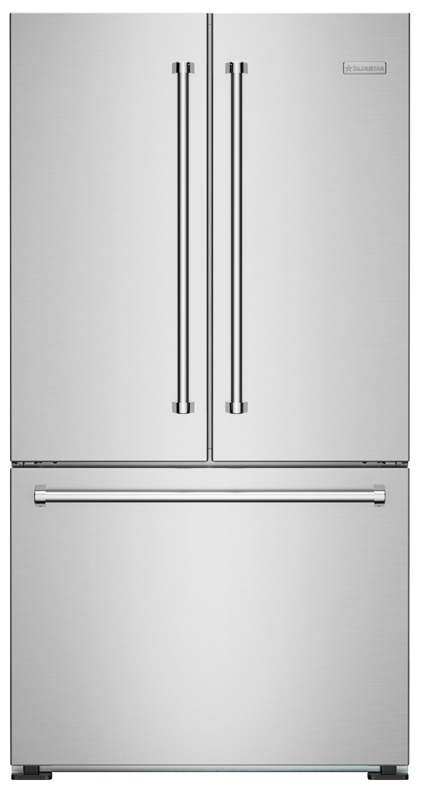
Refrigeration: 18” Freezer / 36” Freestanding Refrigerator
Availability – Updated 11/12/2021
***Stock is first come/first serve. Stock numbers are not garunteed***
Model | Available Inventory | Current Lead Time
BIF18R0 |  | 17 to 19 weeks
BIF18L0 |  | 2 to 4 weeks
BIFP18R0 (Panel Ready) |  | 17 to 19 weeks
BIFP18L0 (Panel Ready) |  | 2 to 4 weeks
Features: 18” Integrated Column Freezer
Stainless Steel interior
Industry-leading 8.22 cu. ft. capacity for optimum food storage
Flush installation for seamless look
Automatic ice maker with Super Ice function to temporarily increase ice production as needed
BIF18R0
UMRP $7,595
BIF18L0
UMRP $7,595
BIFP18R0
UMRP $6,995
BIFP18L0
UMRP $6,995
Model | Available Inventory | Current Lead Time
FBDF361 | 11 | 3 weeks
Features: 36” Freestanding French Door Refrigerator
Counter depth design
19.9 cu. ft. capacity
Large capacity drawers
French doors perfect for tighter kitchen spaces
Adjustable glass shelving
LED lighting & Digital display
FBDF361
UMRP $3,975

