Slide 1

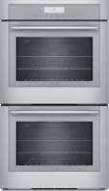
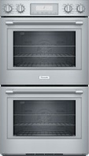
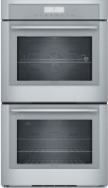
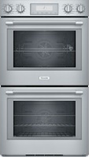
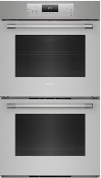
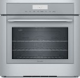
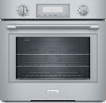
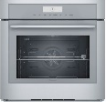
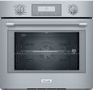
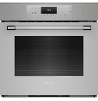

Cooking Modes for Thermador Convection Ovens
SINGLE & UPPER OVEN Cooking Modes | ME301WS POD301W | MED301WS POD301W | ME301YP
Bake
Conv. Bake
Broil
Conv. Broil
Max Broil
Max Conv. Broil
Variable Broil
Roast
Conv. Roast
Proof
Warm
Pizza
True Convection
Dehydrate
Speed Convection
Slow Roast
Rotisserie
Fast Preheat
LOWER OVEN (doubles) Cooking Mode | ME302WS POD302W | MED302WS POD302W | ME302YP
Bake
Conv. Bake
Broil
Conv. Broil
Max Broil
Max Conv. Broil
Variable Broil
Roast
Conv. Roast
Proof
Warm
Pizza
True Convection
Dehydrate
Speed Convection
Slow Roast
Rotisserie
Fast Preheat

