Slide 1
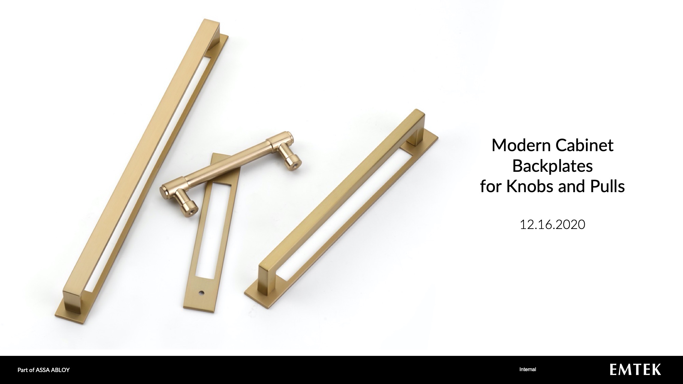

Slide 2
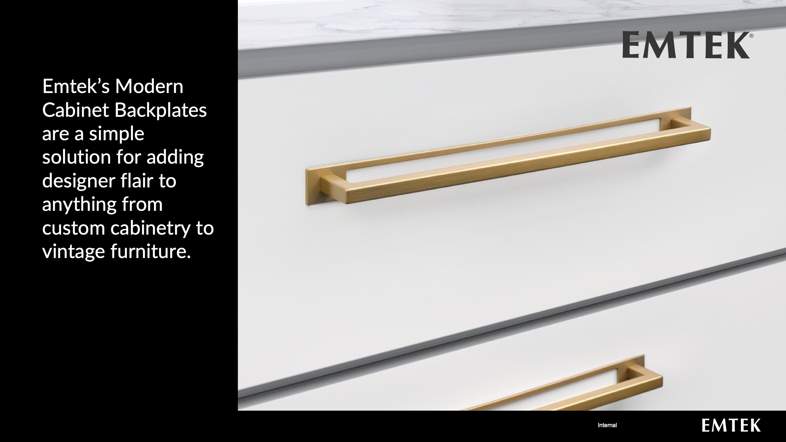

Slide 3
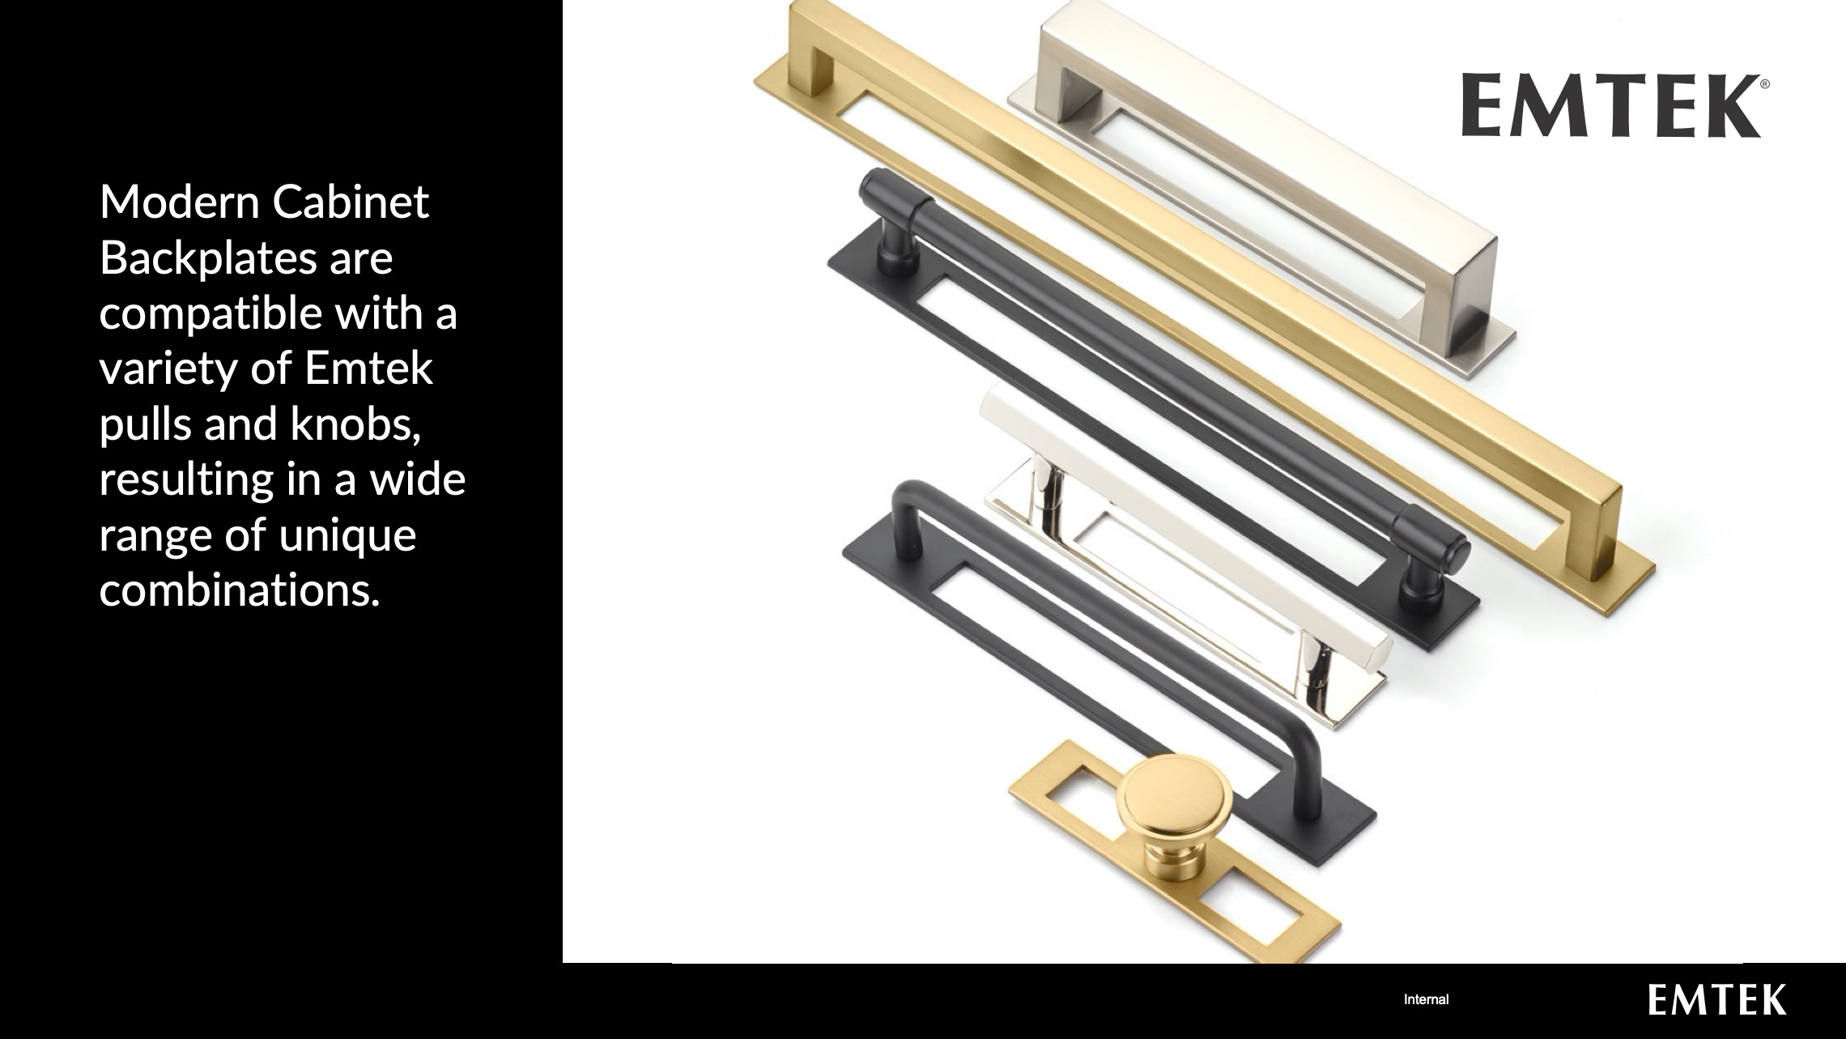

Slide 4
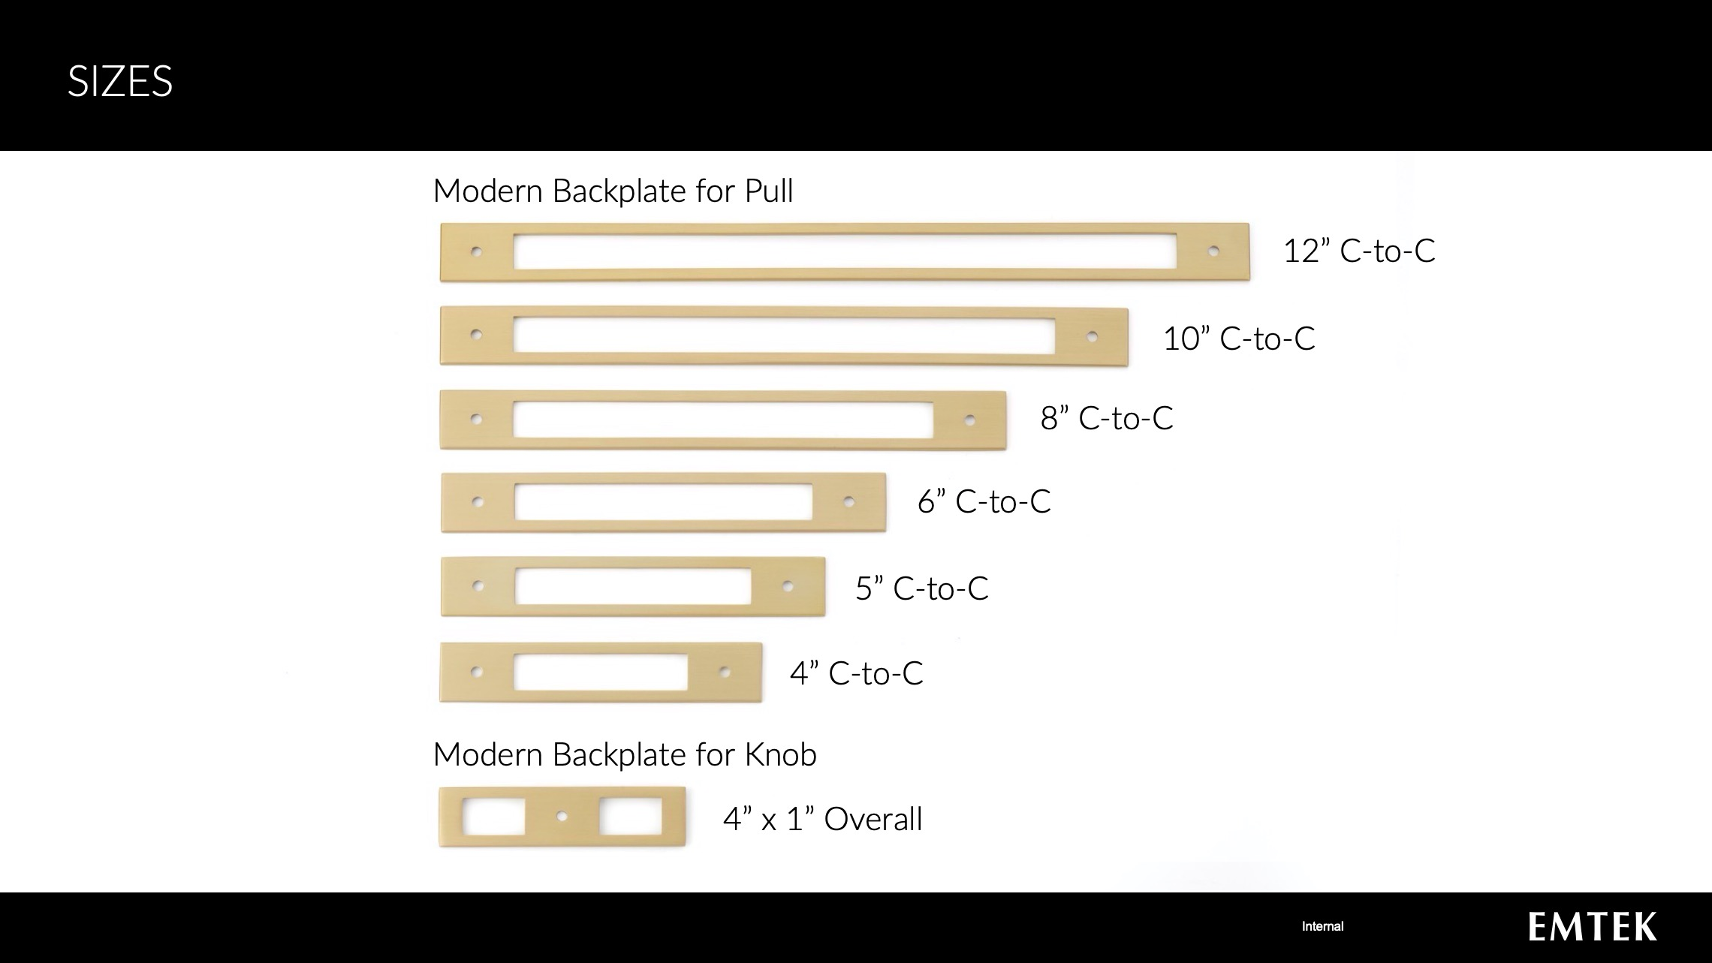

Slide 5
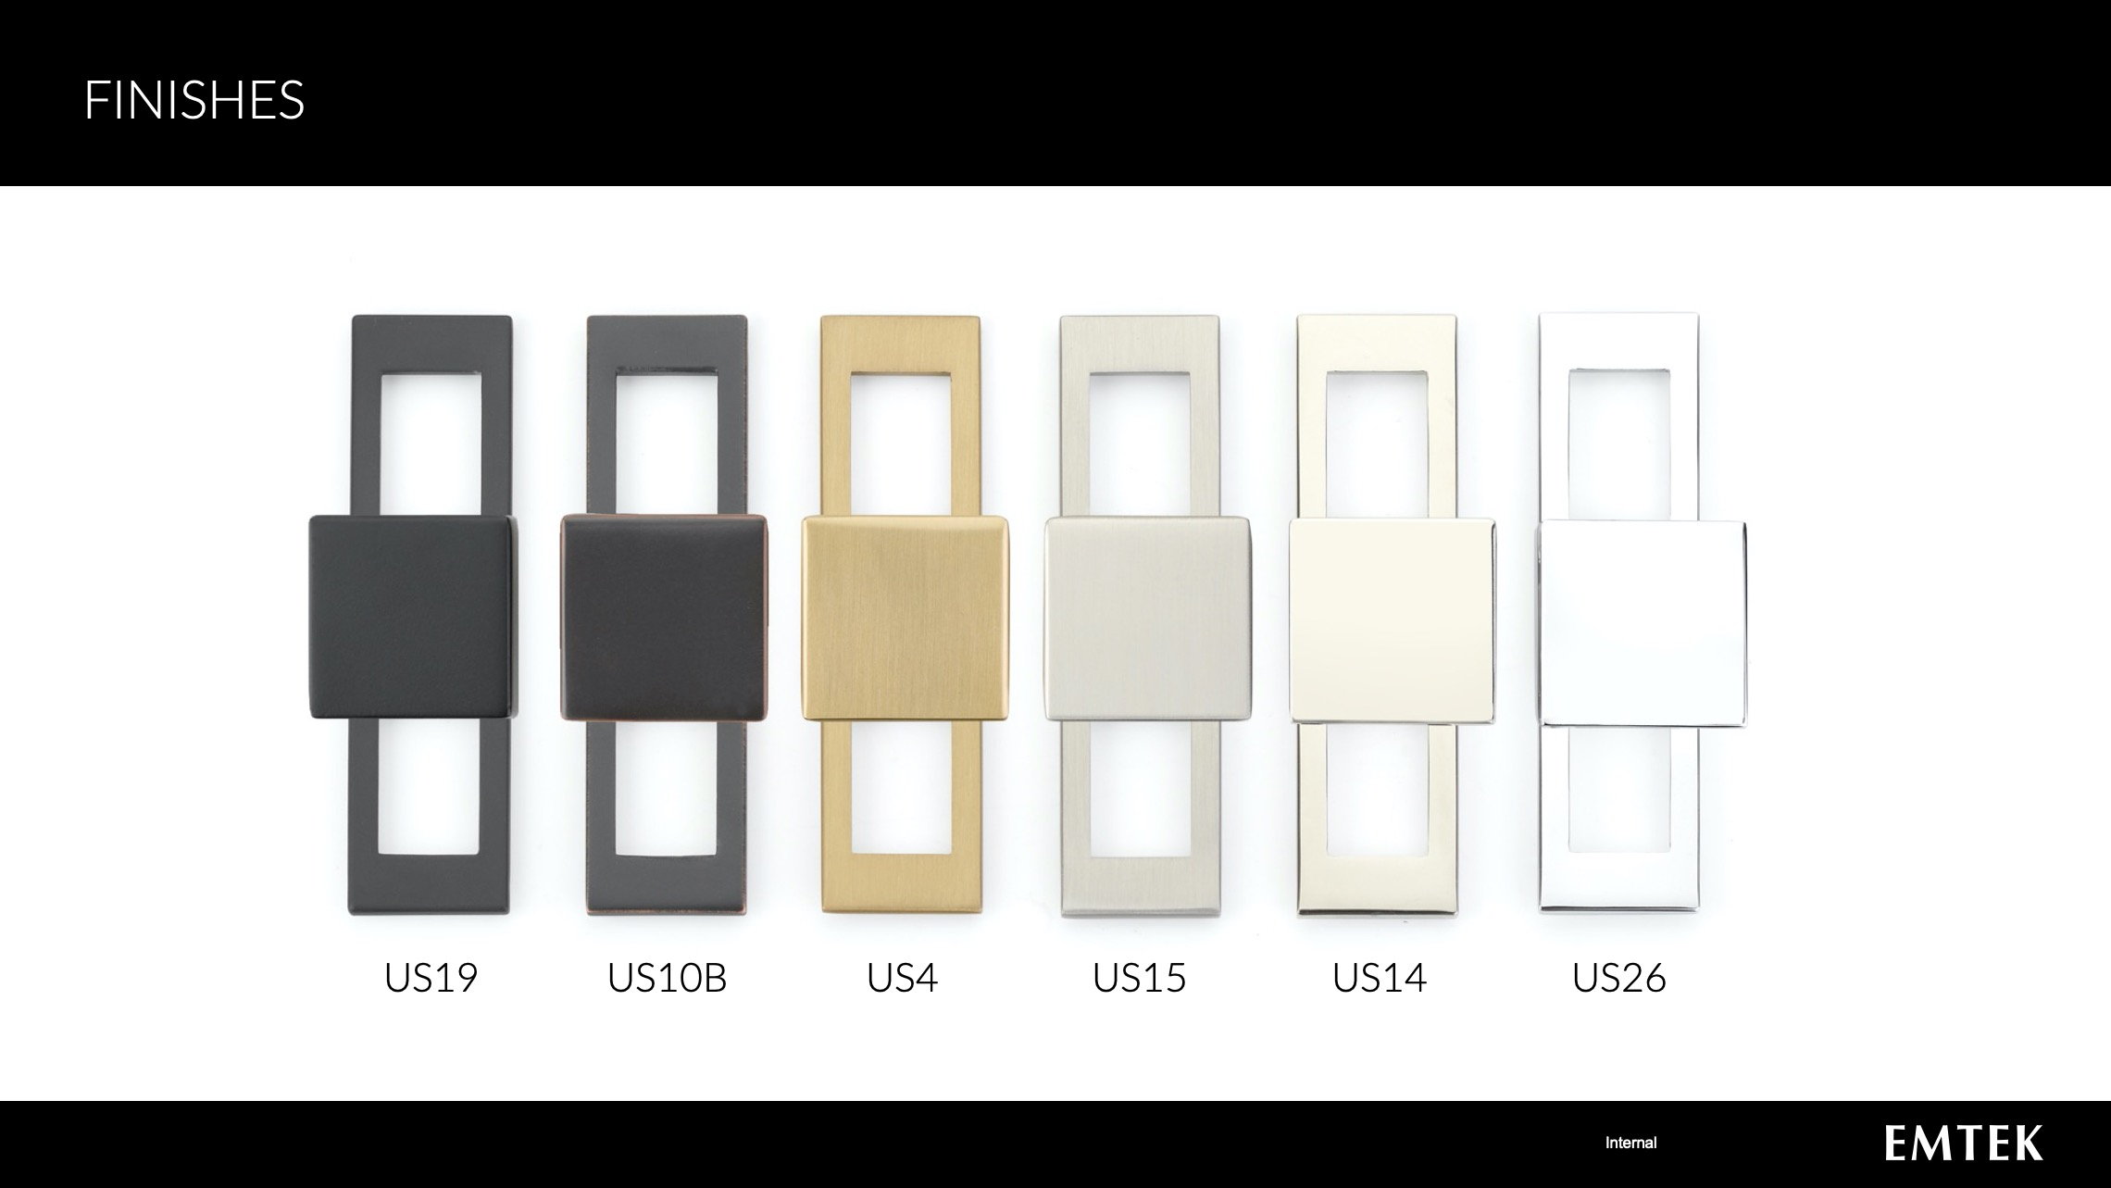

Slide 6
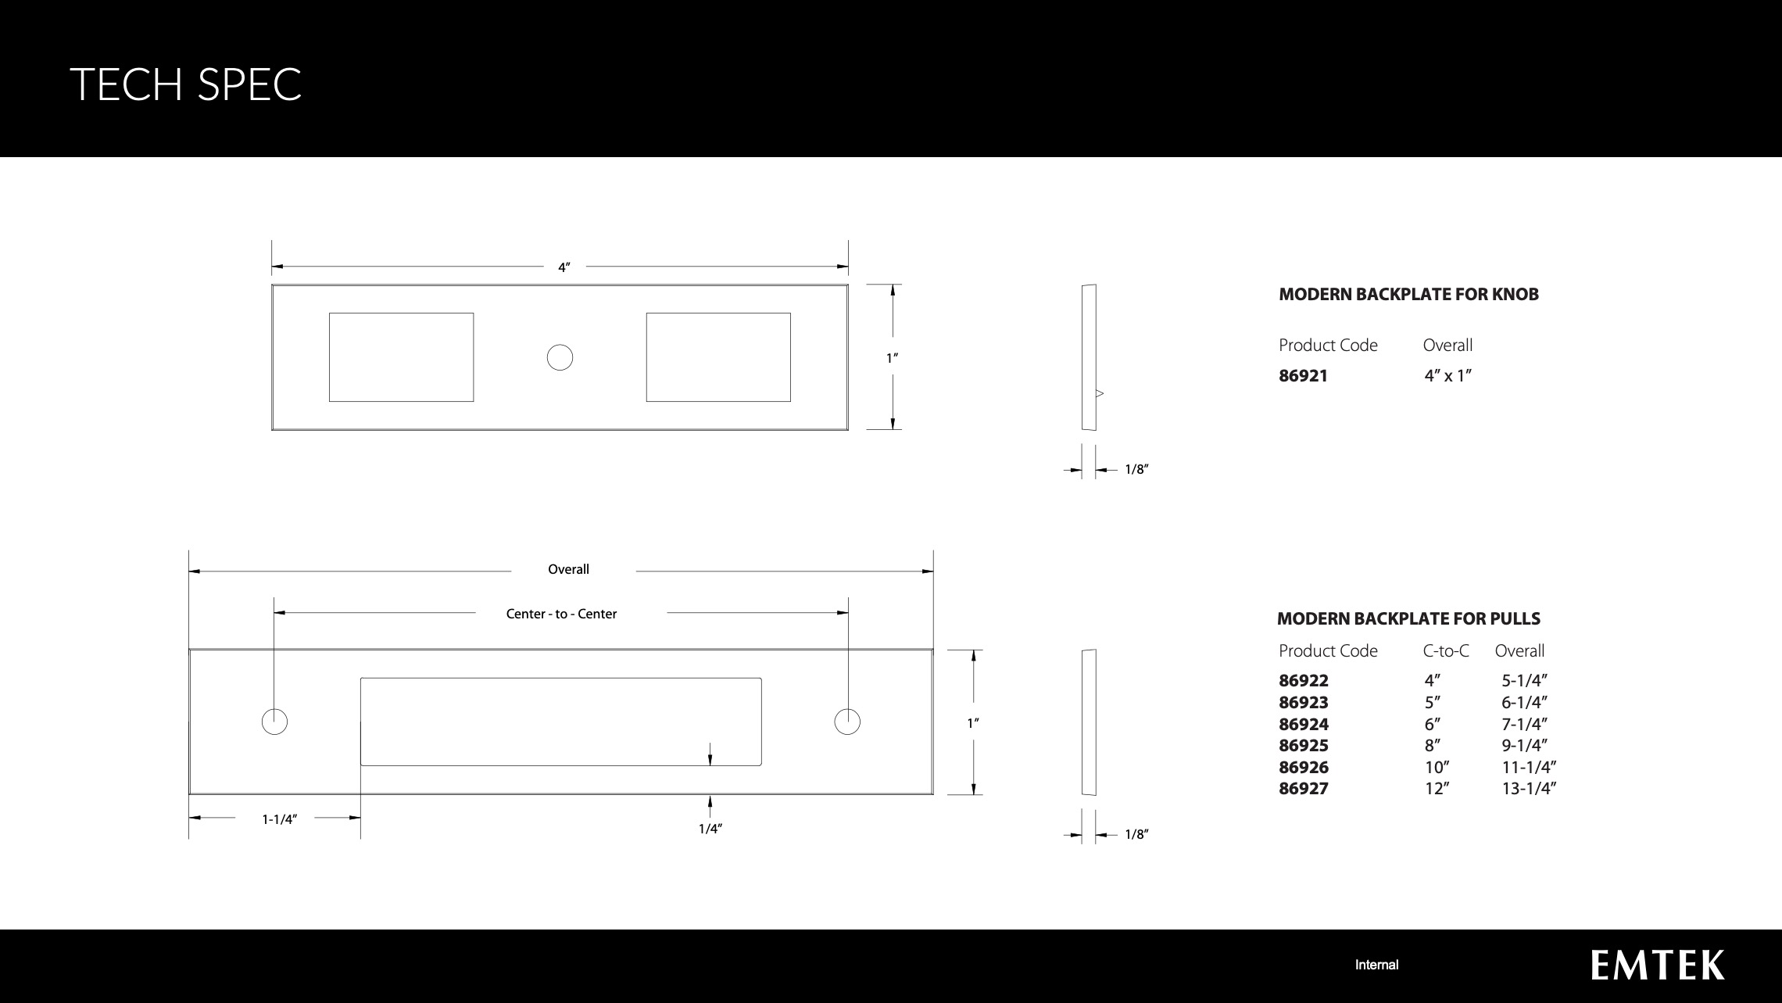

Slide 7
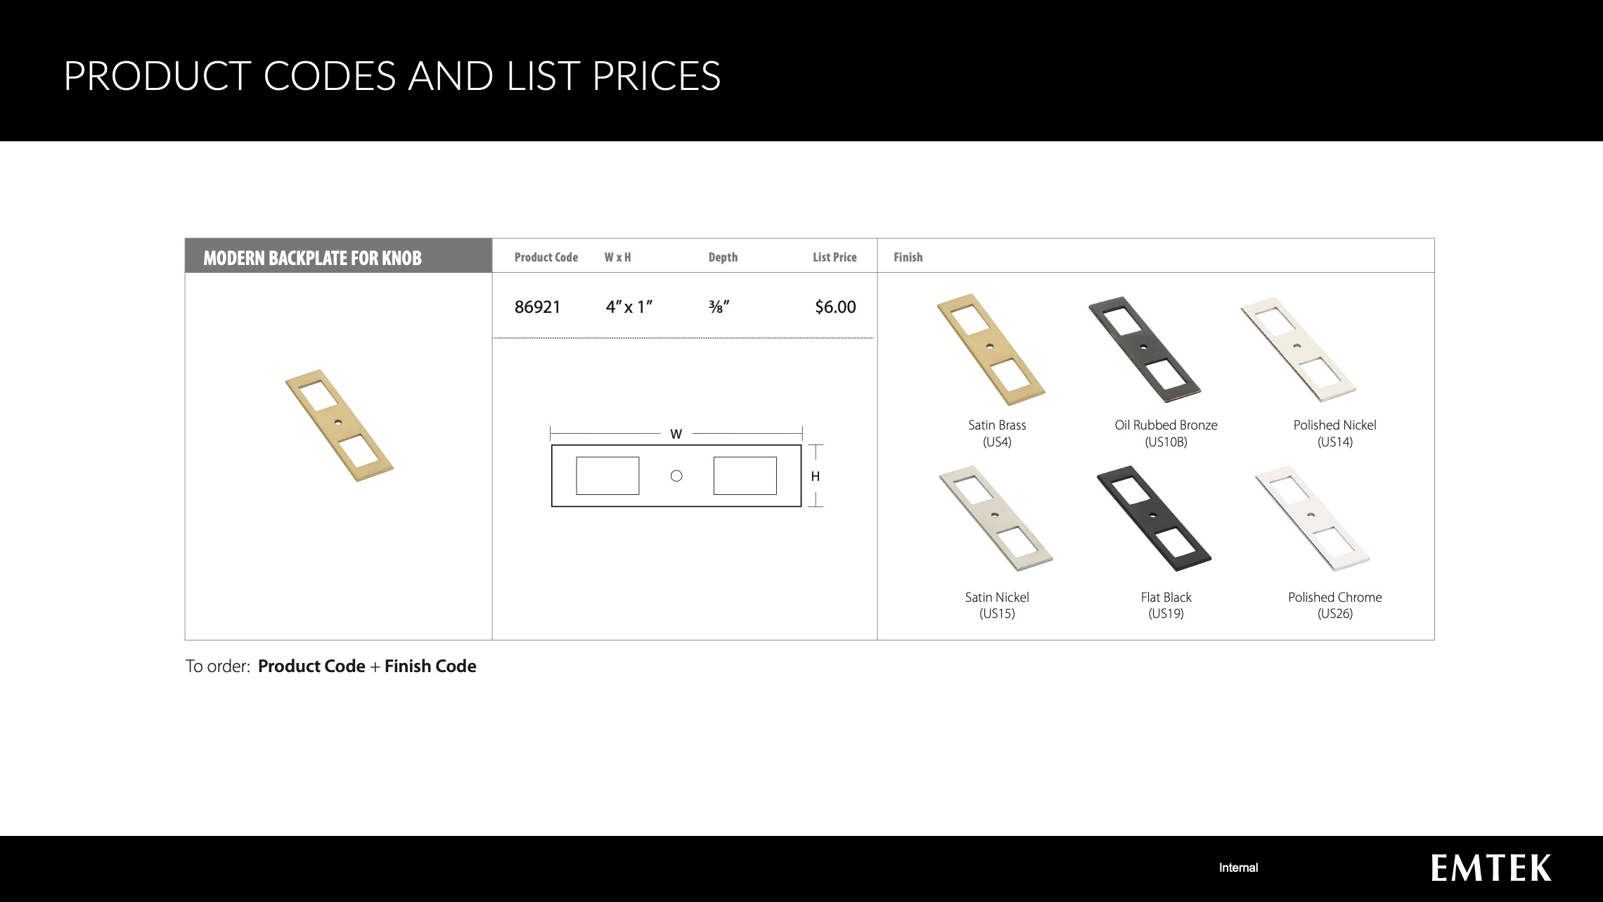

Slide 8
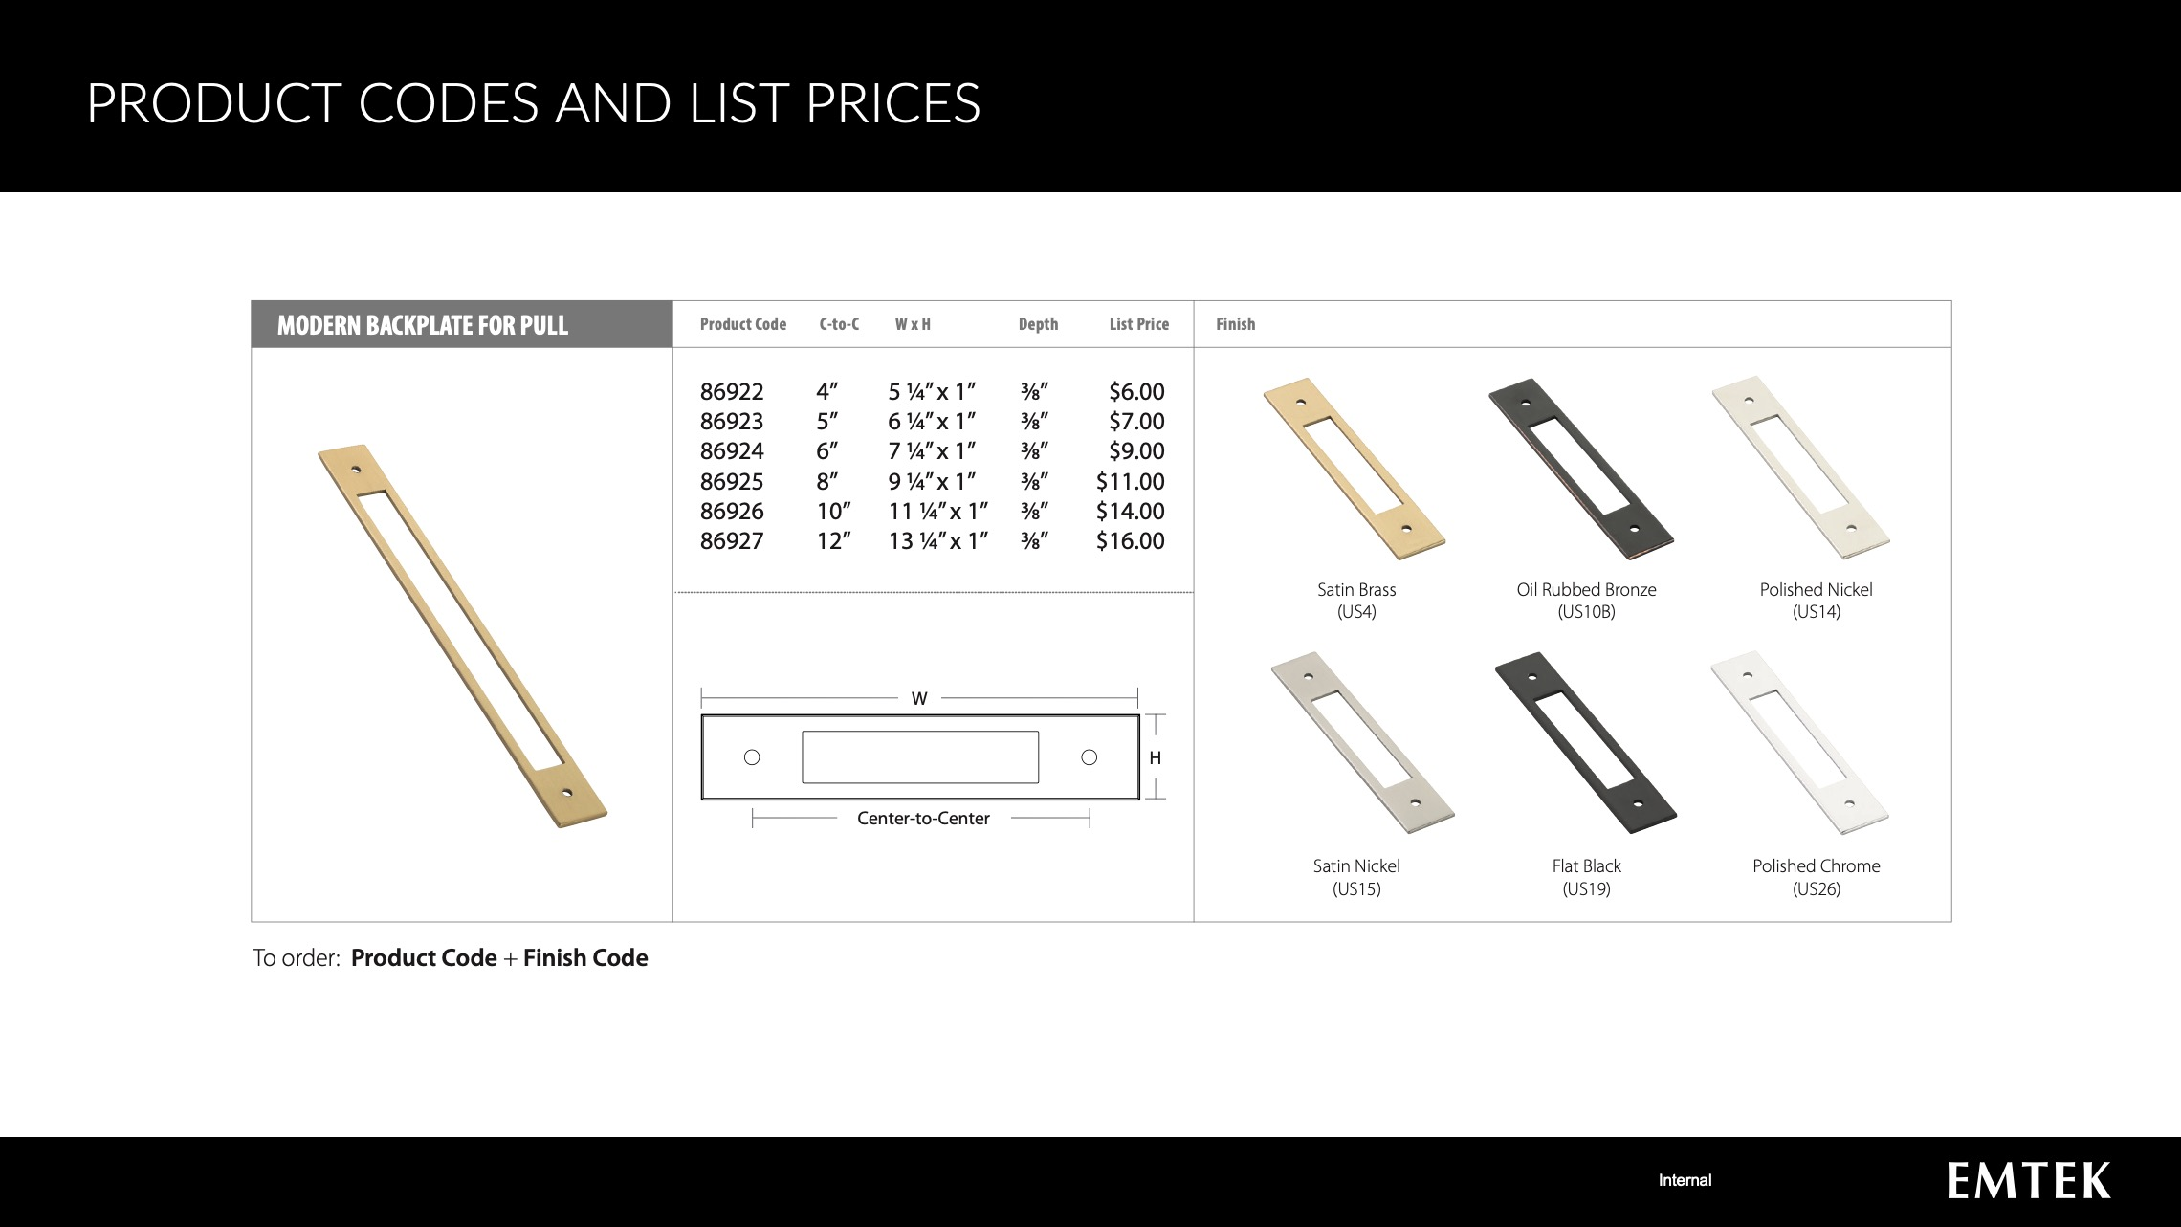

Slide 9
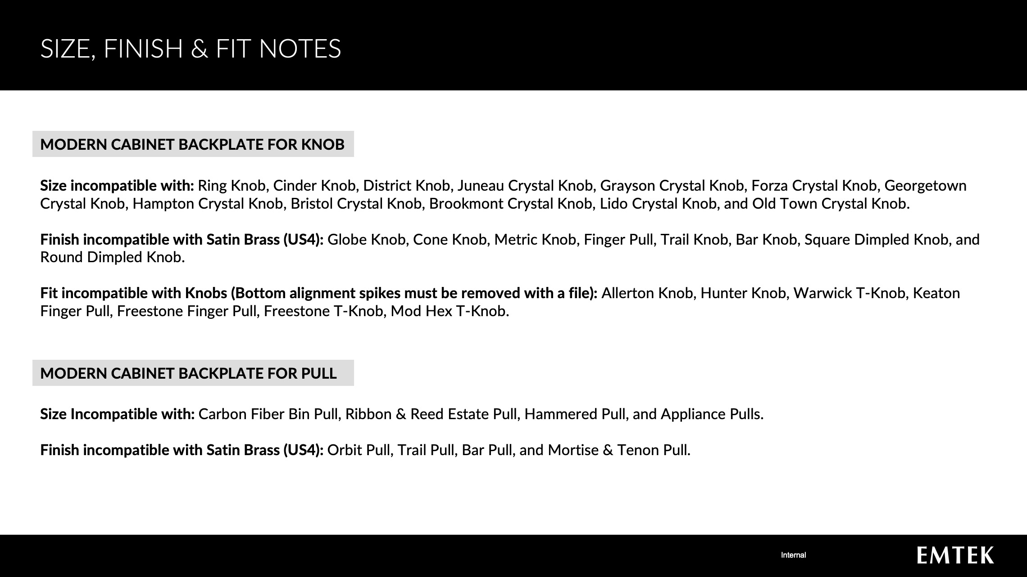

Slide 10
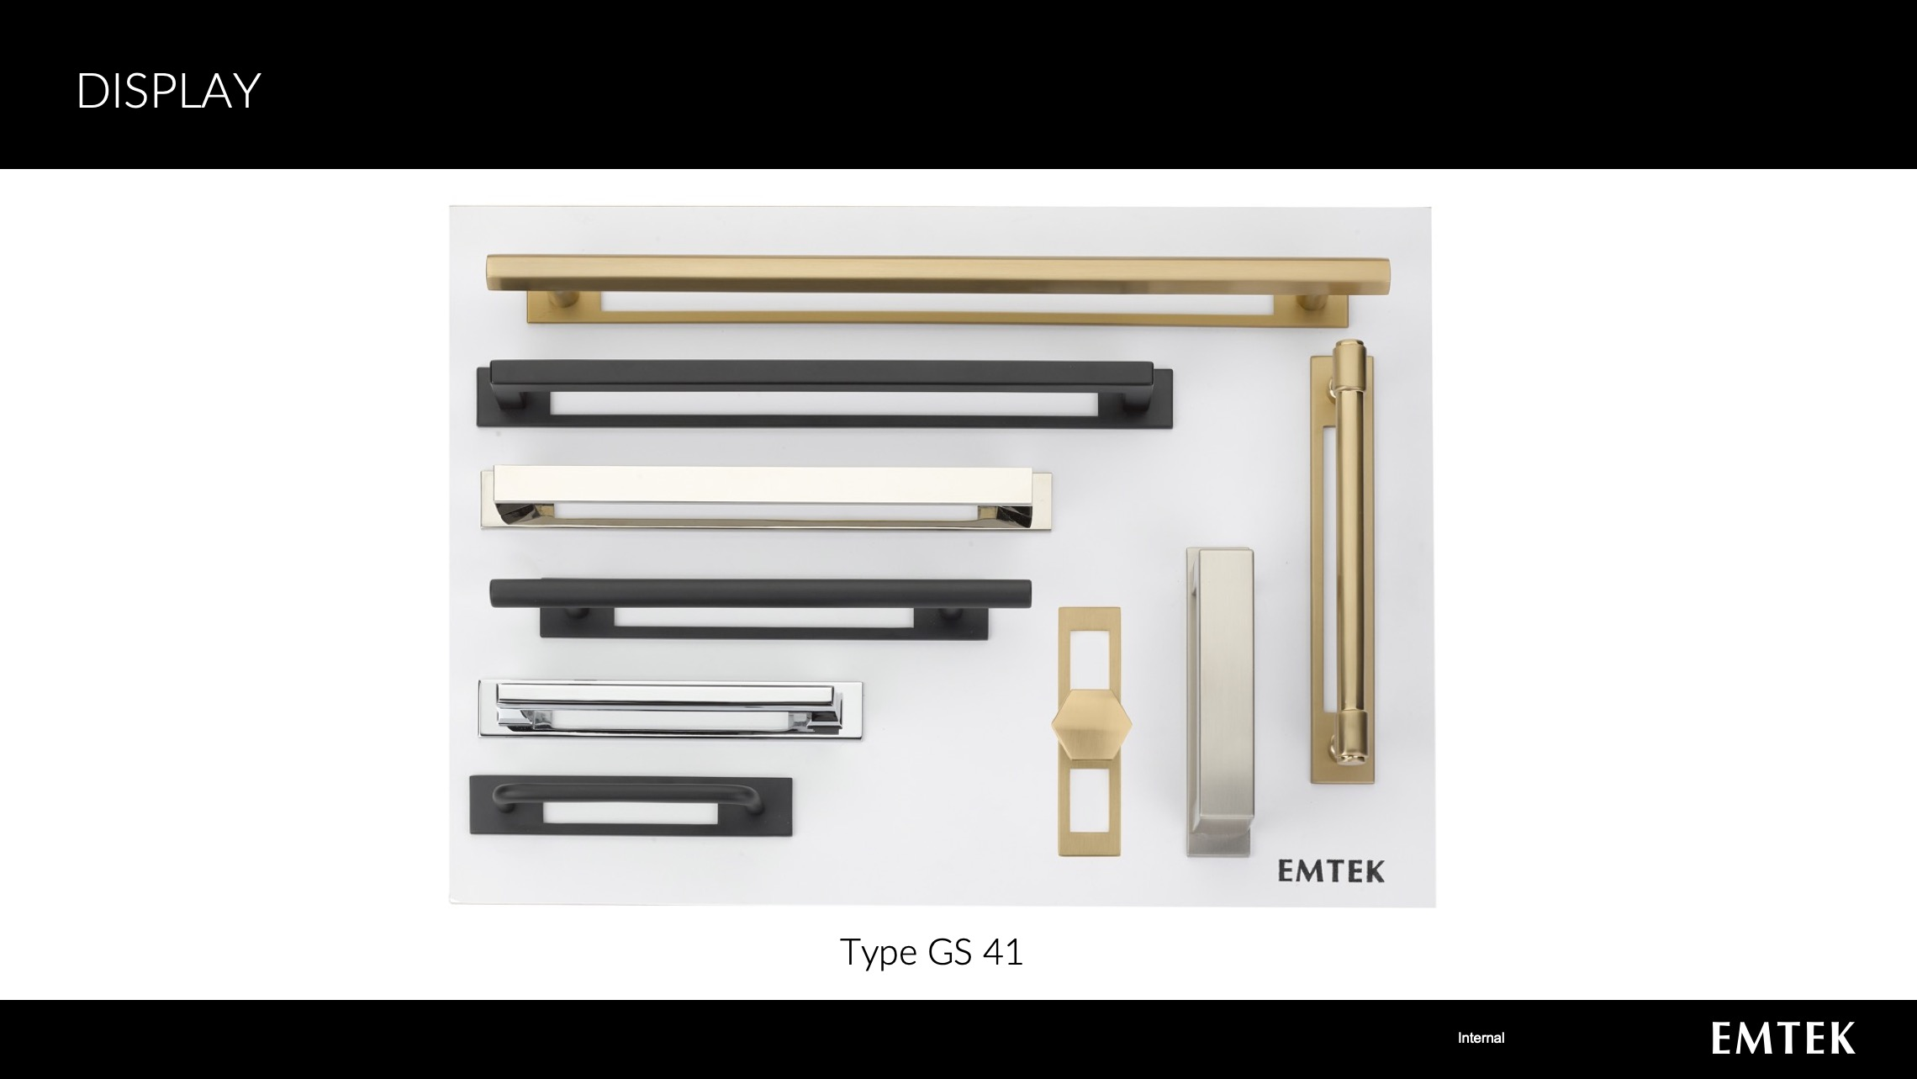

Slide 11
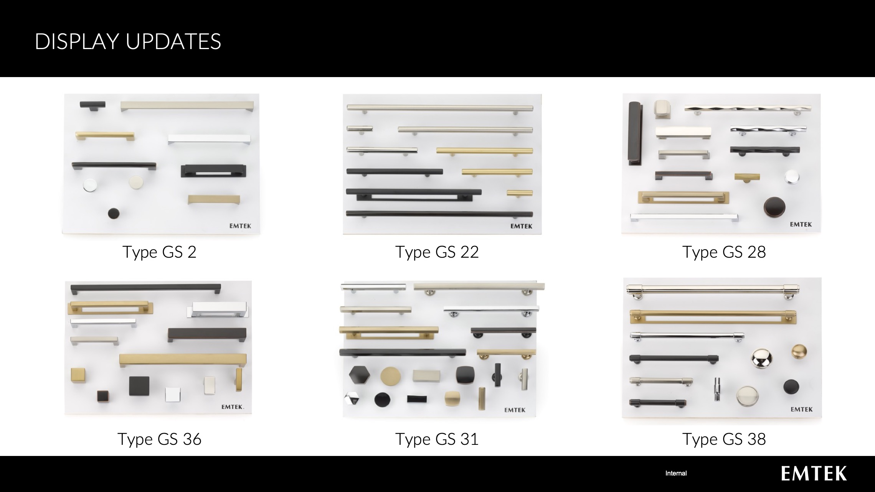

Slide 12
LINKS
Addendum
https://emtek.com/pdf/addendums/2020_EMTEK_Addendum_L_Modern_Cabinet_Backplate.pdf
Website
https://emtek.com/cabinet-knobs/modern-backplate-for-knob
https://emtek.com/cabinet-pulls/modern-backplate-for-pull
Tech Spec
https://emtek.com/technical-spec/TS_CH_Modern_Cabinet_Backplates_Tech_Spec.pdf
Price List
https://assaabloy.box.com/s/puf8gcn4jmssirotpzjye49x41rqyz68
Marketing Kit
https://assaabloy.box.com/v/Emtek-Marketing-Kit
Web links will be available December 14, 2020

