Slide 1
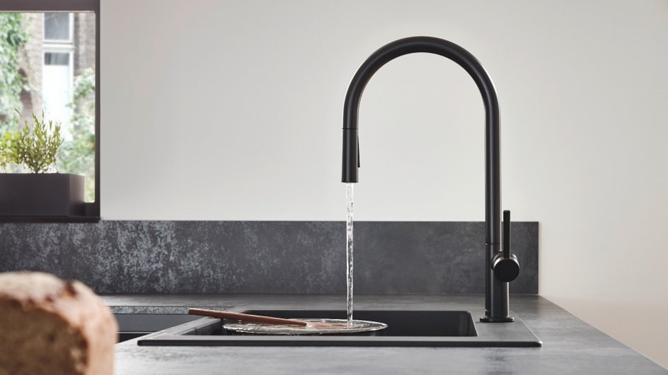

Talis N
Minimalism In An Industrial Inspired Style

Slide 2
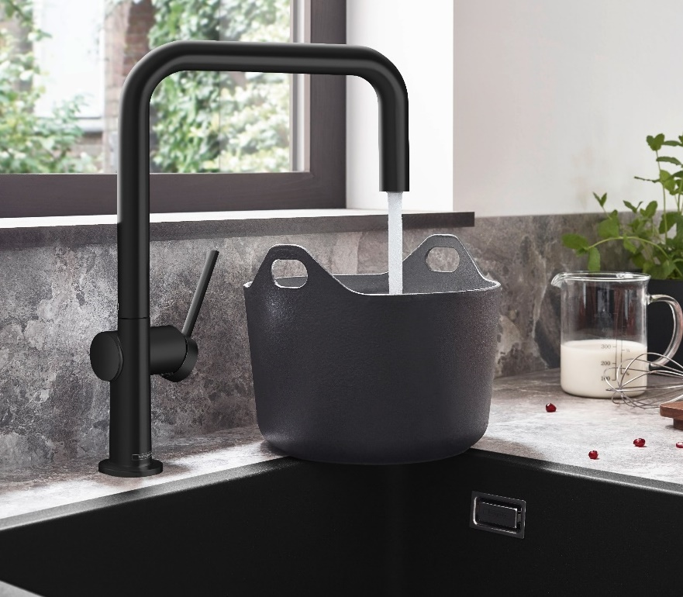

Design
Beautiful, ultra-slim design with clean lines compliment the space without taking over or appearing bulky
3 shape options available for various customer needs:
O-Style A-Style U-Style
Stocked in Chrome, Matte Black, Steel Optic, and Polished Nickel with matching soap dispenser line (Talis)
Notes:
Beautiful, ultra-slim design with clean lines compliment the space without taking over or appearing bulky
3 shape options available for various customer needs:
O-Style A-Style U-Style
Stocked in Chrome, Matte Black, Steel Optic, and Polished Nickel with matching soap dispenser line (Talis)

Slide 3
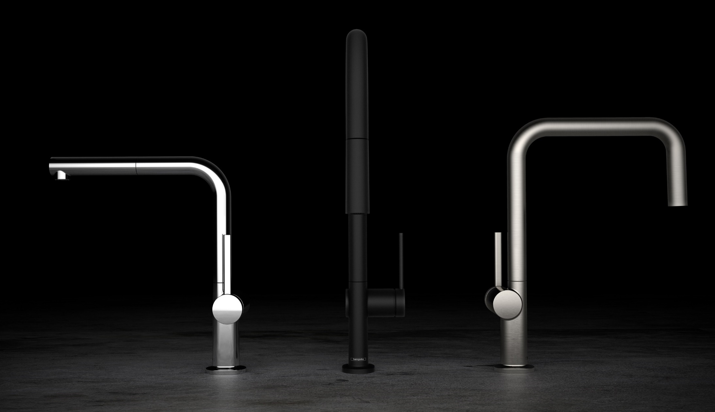


Design

Slide 4
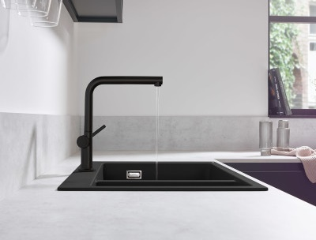

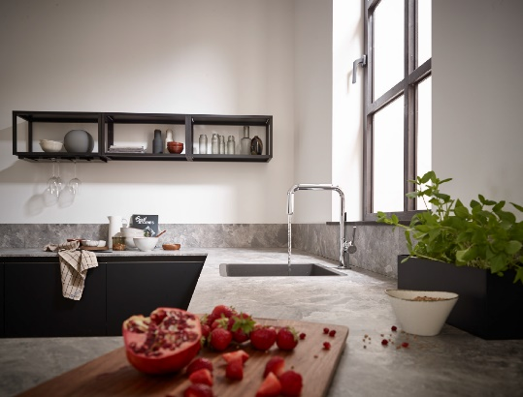
Design
Options for all spaces
Versatile Use
Eco-conscious
Ergonomic:
horizontally extendable spout, laminar spray
Ergonomic: laminar and shower spray,
flat diverter button, lockable spray modes
Economical: laminar spray (1.75 gpm)
Notes:
Options for all spaces
Ergonomic:
horizontally extendable spout, laminar spray
Versatile Use
Ergonomic: laminar and shower spray,
flat diverter button, lockable spray modes
Eco-conscious
Economical: laminar spray (1.75 gpm)

Slide 5
Assortment
Description | Finish | Part No. | List Price
Talis N HighArc Kitchen Faucet, O-Style 2-Spray Pull‑Down, 1.75 GPM | Chrome | 72800001 | $550
Talis N HighArc Kitchen Faucet, O-Style 2-Spray Pull‑Down, 1.75 GPM | Matte Black | 72800671 | $699
Talis N HighArc Kitchen Faucet, O-Style 2-Spray Pull‑Down, 1.75 GPM | Steel Optic | 72800801 | $699
Talis N HighArc Kitchen Faucet, O-Style 2-Spray Pull‑Down, 1.75 GPM | Polished Nickel | 72800831 | $671
Talis N HighArc Kitchen Faucet, O-Style 2-Spray Pull‑Down, 1.75 GPM w/sBox | Chrome | 72801001 | $633
Talis N HighArc Kitchen Faucet, O-Style 2-Spray Pull‑Down, 1.75 GPM w/sBox | Matte Black | 72801671 | $804
Talis N HighArc Kitchen Faucet, O-Style 2-Spray Pull‑Down, 1.75 GPM w/sBox | Steel Optic | 72801801 | $804
Talis N HighArc Kitchen Faucet, O-Style 2-Spray Pull‑Down, 1.75 GPM w/sBox | Polished Nickel | 72801831 | $772
Talis N HighArc Kitchen Faucet, A-Style 2-Spray Pull‑Down, 1.75 GPM | Chrome | 72846001 | $500
Talis N HighArc Kitchen Faucet, A-Style 2-Spray Pull‑Down, 1.75 GPM | Matte Black | 72846671 | $635
Talis N HighArc Kitchen Faucet, A-Style 2-Spray Pull‑Down, 1.75 GPM | Steel Optic | 72846801 | $635
Talis N HighArc Kitchen Faucet, A-Style 2-Spray Pull‑Down, 1.75 GPM | Polished Nickel | 72846831 | $610
Talis N HighArc Kitchen Faucet, A-Style 2-Spray Pull‑Down, 1.75 GPM w/sBox | Chrome | 72850001 | $575
Talis N HighArc Kitchen Faucet, A-Style 2-Spray Pull‑Down, 1.75 GPM w/sBox | Matte Black | 72850671 | $730
Talis N HighArc Kitchen Faucet, A-Style 2-Spray Pull‑Down, 1.75 GPM w/sBox | Steel Optic | 72850801 | $730
Talis N HighArc Kitchen Faucet, A-Style 2-Spray Pull‑Down, 1.75 GPM w/sBox | Polished Nickel | 72850831 | $702
Talis N HighArc Kitchen Faucet, U-Style 1-Spray Pull‑Down, 1.75 GPM | Chrome | 72806001 | $400
Talis N HighArc Kitchen Faucet, U-Style 1-Spray Pull‑Down, 1.75 GPM | Matte Black | 72806671 | $508
Talis N HighArc Kitchen Faucet, U-Style 1-Spray Pull‑Down, 1.75 GPM | Steel Optic | 72806801 | $508
Talis N HighArc Kitchen Faucet, U-Style 1-Spray Pull‑Down, 1.75 GPM | Polished Nickel | 72806831 | $488

Slide 6

Aquno Select
Experience Water In A Brand New Way

Slide 7

Can You Relate?
Now more then ever we are eating healthier and preparing food at home.
The need to have clean fresh produce and the ability to clean the containers we store it in is growing everyday.
This process however is not always easy.
Notes:
Now more then ever we are eating healthier and preparing food at home.
The need to have clean fresh produce and the ability to clean the containers we store it in is growing everyday.
This process however is not always easy.

Slide 8
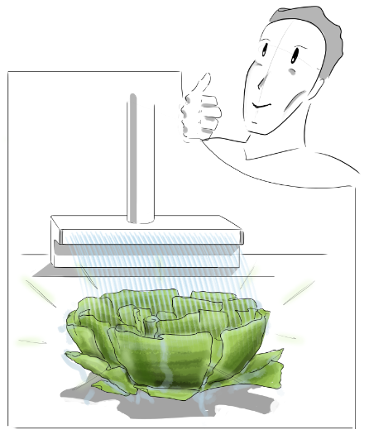
Can You Relate?
Satin Flow Spray
Less splash while cleaning fruits, vegetables, and dishes
Easy conversion from pull down spray to Satin Flow spray with Select button
Great for hand washing
A new way to experience water in the kitchen and a design that will become the focal point of the room.
Notes:
Satin Flow Spray
Less splash while cleaning fruits, vegetables, and dishes
Easy conversion from pull down spray to Satin Flow spray with Select button
Great for hand washing
A new way to experience water in the kitchen and a design that will become the focal point of the room.

Slide 9
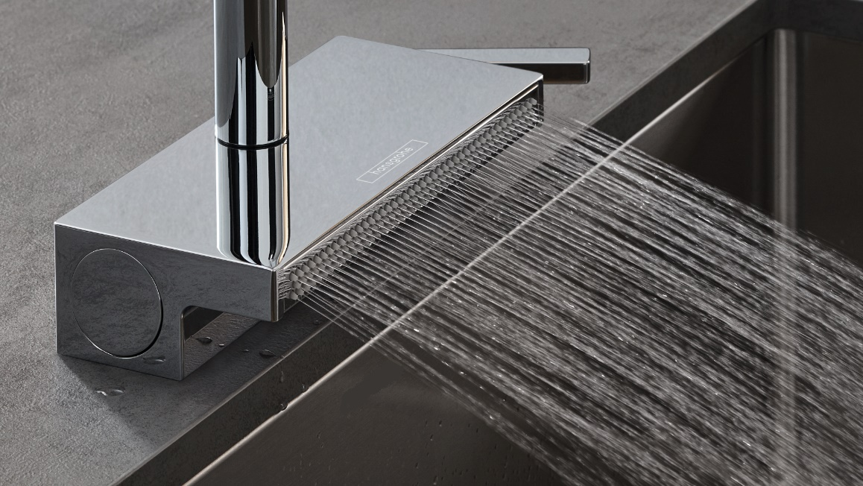
SatinFlow
Experience Water In A Brand New Way

Slide 10
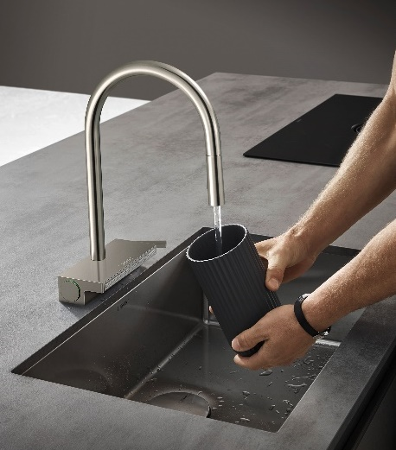
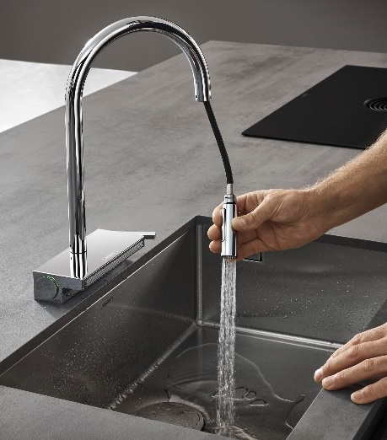
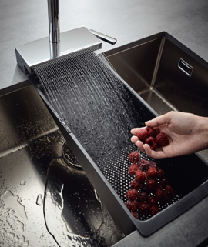
Functionality
NEW
Laminar spray
Shower spray
SatinFlow wide spray
1.75gpm
1.75gpm
1.75gpm
Crystal clear water stream without aeration
An intense shower spray to clean dishes or water plants
Ultra-fine, splash-free spray pattern with more than 130 jets.
Notes:
Laminar spray
Crystal clear water stream without aeration
Shower spray
An intense shower spray to clean dishes or water plants
SatinFlow wide spray
Ultra-fine, splash-free spray pattern with more than 130 jets.

Slide 11
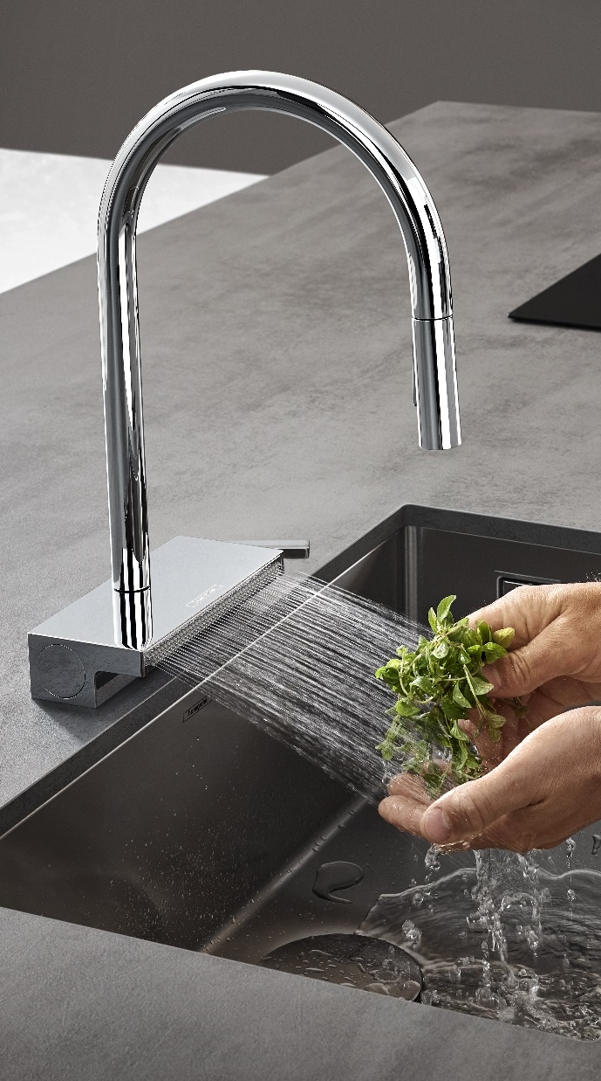
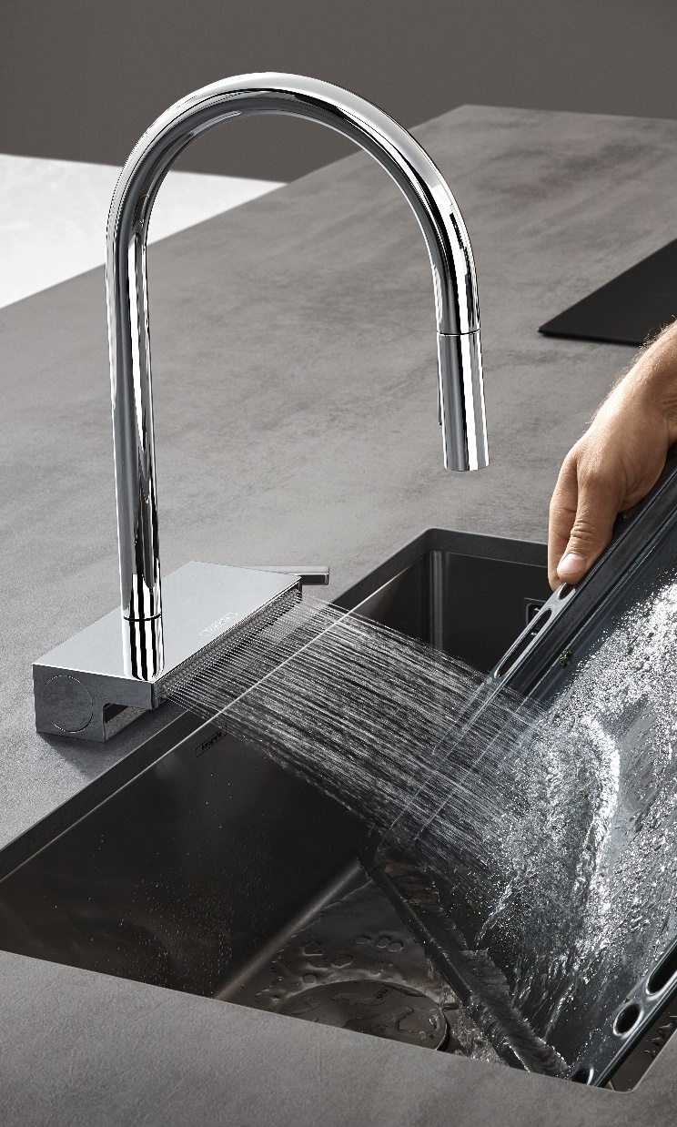
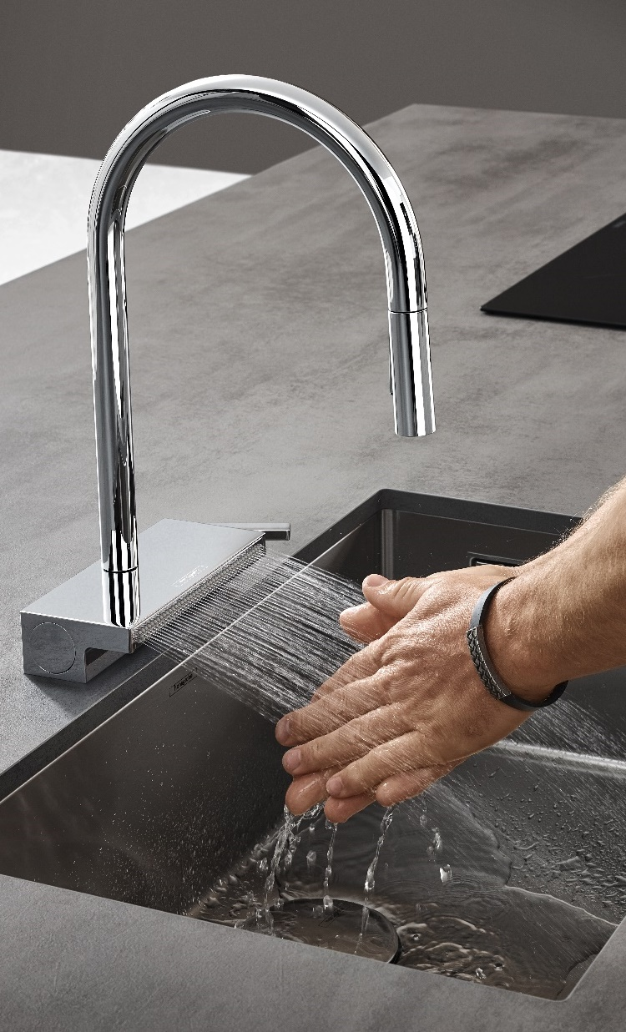
Gentle rinsing of
sensitive foods
Fast cleaning of large objects
Resource-saving hand washing
Notes:
Gentle rinsing of sensitive foods
Fast cleaning of large objects
Resource-saving hand washing

Slide 12
Assortment
Description | Finish | Part No. | List Price
Aquno Select HighArc Kitchen Faucet, 3-Spray Pull-Down, 1.75 GPM | Chrome | 73837001 | $850
Aquno Select HighArc Kitchen Faucet, 3-Spray Pull-Down, 1.75 GPM | Matte Black | 73837671 | $1,080
Aquno Select HighArc Kitchen Faucet, 3-Spray Pull-Down, 1.75 GPM | Steel Optic | 73837801 | $1,080
Aquno Select HighArc Kitchen Faucet, 3-Spray Pull-Down, 1.75 GPM w/sBox | Chrome | 73831001 | $935
Aquno Select HighArc Kitchen Faucet, 3-Spray Pull-Down, 1.75 GPM w/sBox | Matte Black | 73831671 | $1,187
Aquno Select HighArc Kitchen Faucet, 3-Spray Pull-Down, 1.75 GPM w/sBox | Steel Optic | 73831801 | $1,187
Aquno Select HighArc Kitchen Faucet, 3-Spray Pull-Out, 1.75 GPM | Chrome | 73836001 | $760
Aquno Select HighArc Kitchen Faucet, 3-Spray Pull-Out, 1.75 GPM | Matte Black | 73836671 | $965
Aquno Select HighArc Kitchen Faucet, 3-Spray Pull-Out, 1.75 GPM | Steel Optic | 73836801 | $965
Aquno Select HighArc Kitchen Faucet, 3-Spray Pull-Out, 1.75 GPM w/sBox | Chrome | 73830001 | $845
Aquno Select HighArc Kitchen Faucet, 3-Spray Pull-Out, 1.75 GPM w/sBox | Matte Black | 73830671 | $1,073
Aquno Select HighArc Kitchen Faucet, 3-Spray Pull-Out, 1.75 GPM w/sBox | Steel Optic | 73830801 | $1,073

