Slide 1


HT-400 LITTLE BUTLER HEATING TANK
PRODUCT TRAINING
Notes:
I’m excited to be able to finally introduce our new HT-400 heating tank today! This is the 4th generation of our Little Butler heating tanks, and today, I’m going to share with you why I think it’s going to be the best! I see this launch as the foundation, the starting point for us to completely revamp our entire filtration portfolio. I hope after today, you’ll be as excited about this product as I am.
Before we begin, I want to let you know what we’re going to cover
basic info about the tank
The customer needs and value proposition of the tank
The features and benefits
The technical info
AND finally, we’ll look at how we stack up against the competition
It’s a lot to cover in 30 minutes, so I’m going to move pretty quick, but I’ll ask you guys to let me get through all this first, and then if I still haven’t answered all your questions about the product, we’ll open the floor up for discussion
Sound good?

Slide 2
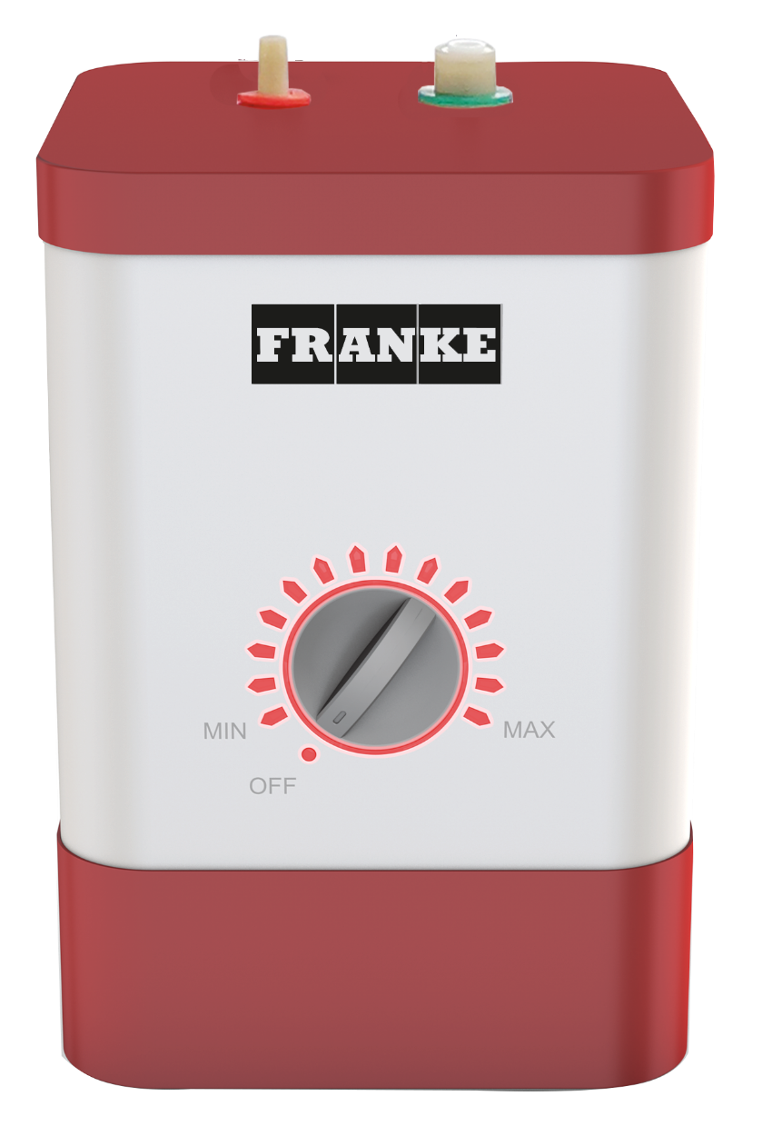
HT-400
LITTLE BUTLER HEATING TANK
$420 list price
Replaces
  HT-100
  HT-250
  HT-300
5 year warranty
Available 7/15/2020
Notes:
Touch on the basics first:
HT100/250/300 are on promo until we use those up
When I say Available 7/15 – that is our official launch date. In reality, they are already in STOCK now!
7/15 is the day the launch packet will go out, which will contain the product brochure and the spec sheet.

Slide 3


CUSTOMER NEEDS & VALUE PROPOSTION

Slide 4
CUSTOMER NEEDS
Cost Savings
Simplify Tasks
Energy Efficient
Convenience
Save time when they interact with your product.
Enable me to save money.
Eliminate energy waste. Use less energy to perform the same task.
Make everyday tasks easier.
Notes:
These are the 4 areas that were identified as the most important consumer needs for a point of use heating tank:
Adding convenience and simplifying everyday tasks fall right in line with Franke’s core product approach to make products that really help out in the kitchen.
Having a product that was also energy efficient, and helps to save money were 2 additional areas that we felt were important to add value for our customers.
Here’s how the tank meets each of these important customer concerns.

Slide 5

CONVENIENCE

Slide 6

CONVENIENCE
Provides almost boiling water coming out of your faucet is not only very convenient but time saving. It maintains a consistent and reliable supply of hot water for when you need it.
Notes:
A heating tank provides convenience because you don’t have to pull out a pot, fill it with water and wait for it to heat up. With the HT-400, you have near boiling water, ready whenever you need it, for whatever you need it for.
Pretty easy to see the convenience factor here.

Slide 7

ENERGY EFFICIENT

Slide 8

ENERGY EFFICIENT
The HT-400 5/8 gallon tank produces up to 208°F water instantly. The energy efficient tank uses less energy throughout the day than a light bulb or boiling a kettle 3 times a day.
Notes:
The HT-400 is powerful, but it is efficient in the way it uses it’s energy. For the average user, that means it will consume less energy in a day than a 40 watt light bulb, to keep your water near boiling.

Slide 9

COST SAVINGS

Slide 10
COST SAVINGS
As it takes time to boil water, we usually boil more than we actually need. With the HT-400 Heating Tank you just take the amount of hot water you need, saving on water and energy.
Notes:
Because of it’s efficiency, the HT-400 saves money too because you don’t have to boil more water than you need. When boiling on the stove, we usually boil more than we actually need because it takes so long to get the water up to temp, which is a wasteful practice of both time, energy, and money.

Slide 11

SIMPLIFY TASKS

Slide 12



SIMPLIFY TASKS
Cleaning Tasks
Cooking Tasks
Everyday Tasks
Remove stains
Clean toothbrushes
Clean toys
Clean pet bowls
Rinse food residue
Thaw frozen foods
Prepare instant oatmeal
Kick-start boiling
Make tea or coffee
Warm your favorite syrups
Easily remove labels
Loosen jar lids
Warm baby bottles
Aromatherapy steam
Remove candle wax
Notes:
Lastly, the HT-400 can help simplify a huge amount of tasks around the home. You can’t imagine all the uses these things can give until you have one in your home and start using it.
Here’s a list of just some of the common tasks an HT-400 heating tank can help out with around the house

Slide 13
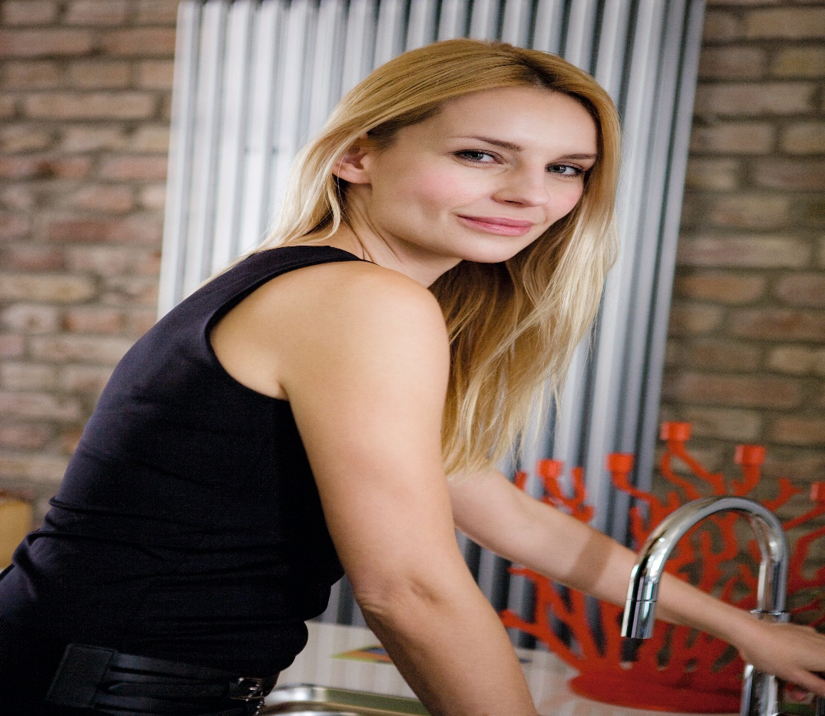
PRODUCT FEATURES
& BENEFITS

Slide 14
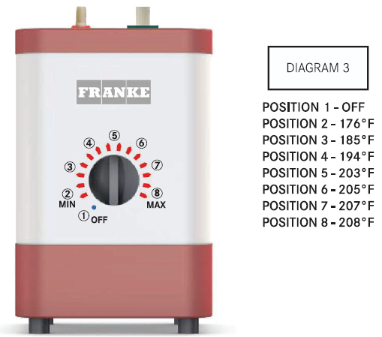
TEMPERATURE CONTROL
Precise, electronic temp control, accurate within 1⁰ F
7 pre-set temperature positions
Backlit temp selection dial and indicator lights
  Displays selected temp setting
  If flashing in sequence around the dial, indicates water is not at set temp and is heating
  If light is solid, indicates the water has reached set temp
  If blue “off” light is flashing, indicates tank is empty. Tank will NOT heat in this condition until tank is filled with water.

Slide 15

DESIGN
Patented internal water management design greatly improves dripping / spitting of tank during heat cycles.
Heating element is encased in it’s own, separate chamber that prevents direct contact with water, preventing buildup of mineral deposits and increasing longevity
Durable, all-metal external housing
304 Stainless Steel tank for RO Compatibility
Compatible with all Franke Little Butler dispensing faucets and filtration systems
Notes:
It has larger inner water passages and a larger chamber for expanding water to help prevent dripping and clogging.
If you’ve ever seen inside a water heating tank, you will appreciate the encased heating element feature – this should greatly reduce the precipitated mineral deposits or “gunk” building up inside the tank.
Another benefit of reduced “gunk” in the tank is that this doesn’t get clogged up in the water ways of the tank, which can create back pressure and cause the expanding water chamber to rupture – an issue that has been seen on our competitors tanks.

Slide 16
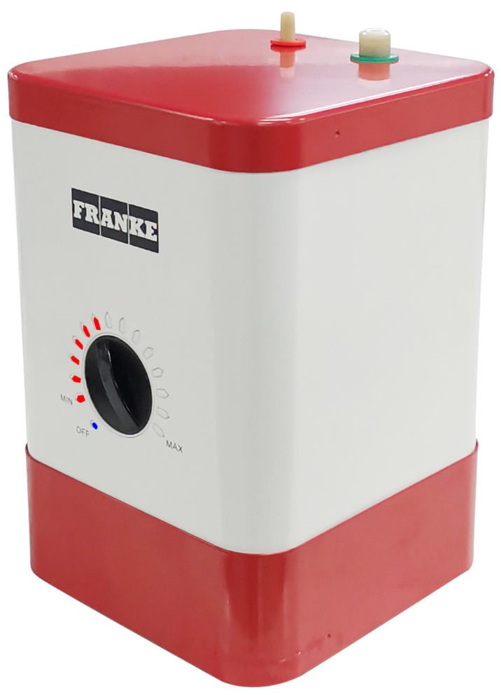
SAFETY & RELIABILTY
Water level sensor and dual temperature sensors prevent dry tank operation
Water management design allows tank to withstand pressure spikes up to 140psi, eliminating need for additional pressure reducing valves
Intertek/ETL certification to UL 499 and CSA C22.2#64
Tank is NOT pressurized to prevent dangerous pressure build-up
Industry leading 5 year warranty
Durability tested to 50,000 heating cycles!
Notes:
50,000 heating cycle test comment:
If the tank cycled 10 times a day, that would be 5,000 days, or almost 14 years of usage!
I wouldn’t expect even the most strenuous user to cycle their tanks more than 10 times a day.

Slide 17
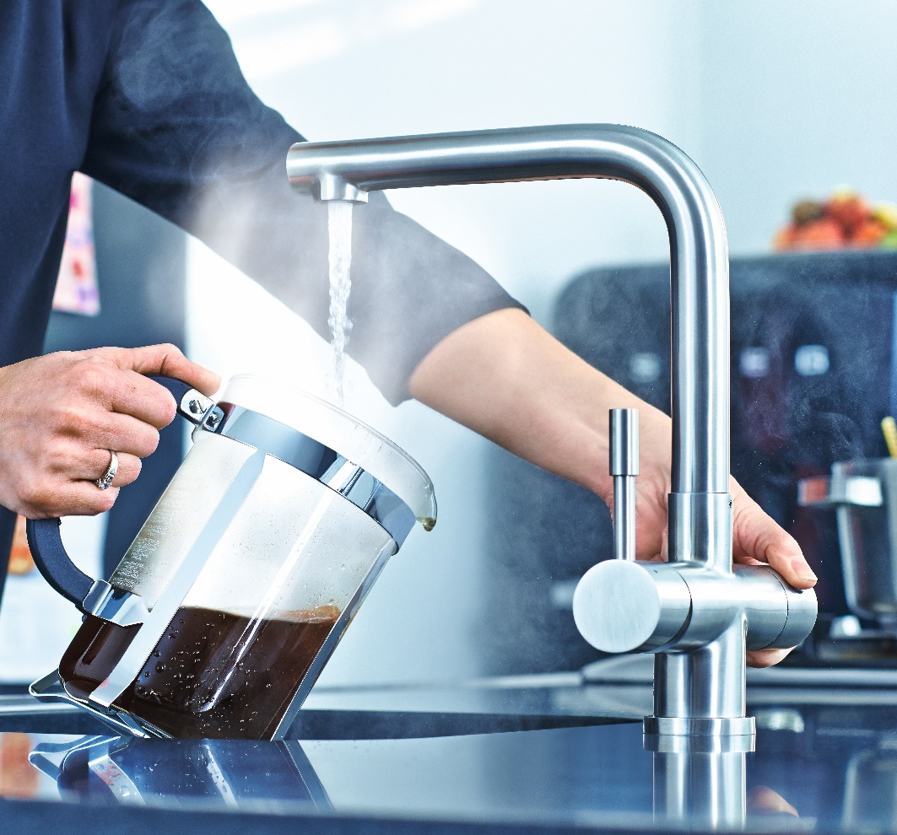
TECHNICAL INFORMATION

Slide 18
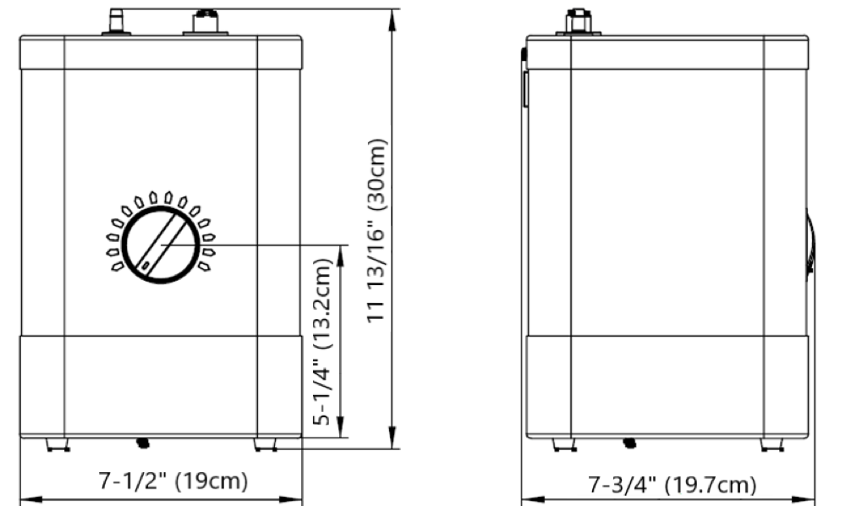
PERFORMANCE
1100 Watt rapid recovery, energy efficient encased heating element
  8-10 minute cold start time
  4-5 minute reheat time
  1 Watt stand-by power usage
60 cups / hr hot water supply rate
2.5 quarts, 5/8 gallon (2.4L) tank capacity
Minimum operating pressure = 15psi
Maximum operating pressure = 140psi
Recommended operating pressure = 60psi
Weight = 8lbs
Notes:
1100 watt heating element – there are more powerful elements on the market, our old Joneca tank used a 1300Watt unit, however, because the element is encased, the heating surface area is increased, so you still have good performance. Our heat times were actually slightly faster for this tank than the more powerful Joneca tank.
Industry standard 60 cup/hr heating capacity and 2.5 quart tank size
The tank will operate at very low pressures – there are a couple of other tanks out there that will operate at 15psi – the BTI tank and the new insinkerator showroom tank
However, this tank will do something they can’t – it will also operate at very high pressures – 140psi is significantly higher than the competition. Also, the patented water management system prevents the need for additional pressure reducing valves like a lot of the other heating tanks require

Slide 19
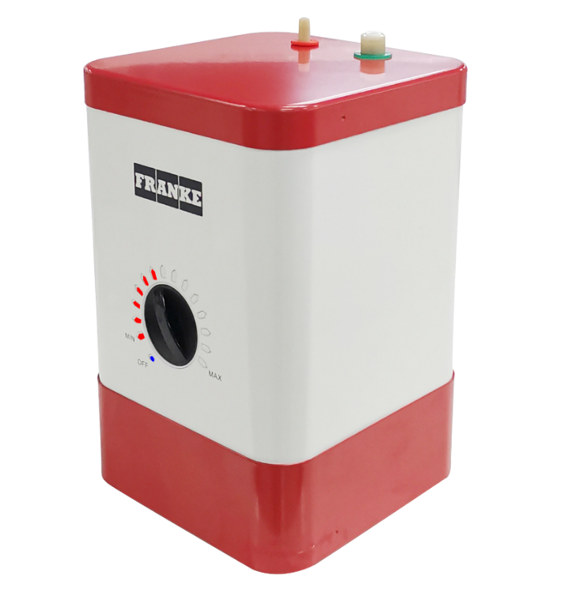
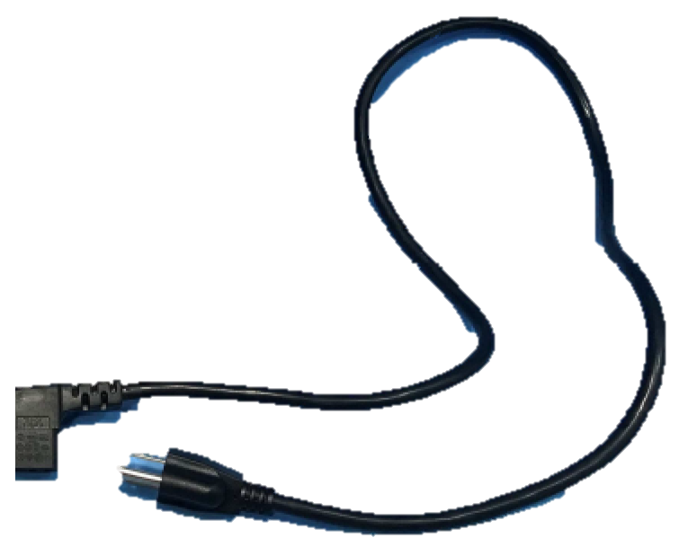
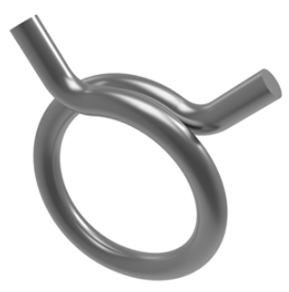
CONTENTS
Tank
Power Cord
Hose Clamp
Notes:
Very simple to connect, no special tools required – if you can’t spread the clamp by hand, then you may need a pair of pliers, that’s it.

Slide 20
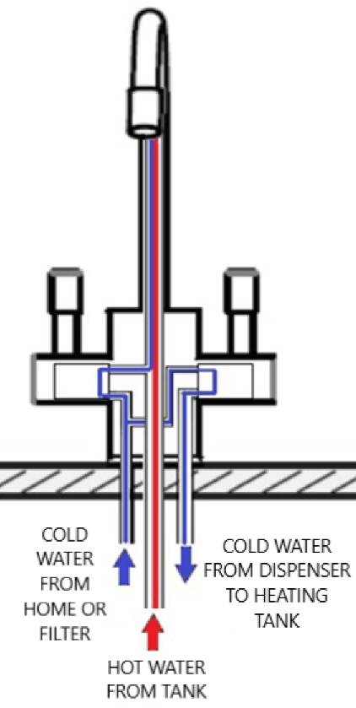
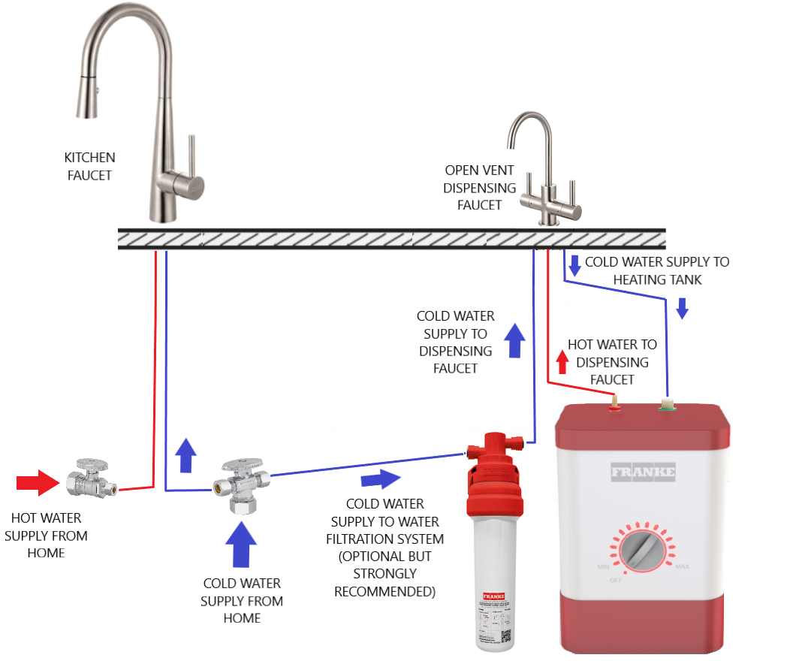
INSTALLATION
The HT-400 Should be compatible with any OPEN VENT style dispensing faucet – Faucets where the water outlet for the heated water is open to the atmosphere; there is no valve between the exit of heated water from the tank and the atmosphere. This creates a “push” system. (see diagram)
Franke only guarantees proper performance when tank is paired with a Franke dispensing faucet.
Notes:
Here is an overview of the installation.
The tank is supplied by cold water from the home or the filtration system.
We recommend using a filtration system to help prolong the life of the tank, and improve water quality, but it isn’t a requirement if you don’t want to use it.
Then the cold water will either go directly out of the spout if the cold water valve is turned on
Or it will divert over to the hot water valve and when the hot water valve is turned on, cold water will be sent to the heating tank
Then the cold water enters the tank and forces the hot water in the tank out of the top of the tank and back to the faucet and out of the spout
Hot/Cold Filter Dispensers - This is the basic setup of an open vent dispensing faucet with 3 tubes. As long as the faucet being used with the tank has the 3 tubes – cold in, cold out, hot in, then it should work, no matter what brand
The important thing is that there can be no valve between the hot water leaving the tank and the spout, otherwise you can build pressure in the tank and it has no where to go.
With an open vent faucet – basically the faucet spout is open all the way to the heating tank, so any expanding water can discharge directly out if that makes sense.
So as I said, any open vent faucet should be compatible with the tank, but we can’t guarantee everyone’s works the same, and we can’t test every brand with our tank, so the only way to be sure it is going to function properly is to pair your tank with a Franke dispensing faucet.
We don’t explicitly state in the warranty that it voids warranty with other brand faucets, but it is highly recommended as we can’t guarantee the function of any other brand, and we should naturally want that additional sale of the faucet too

Slide 21
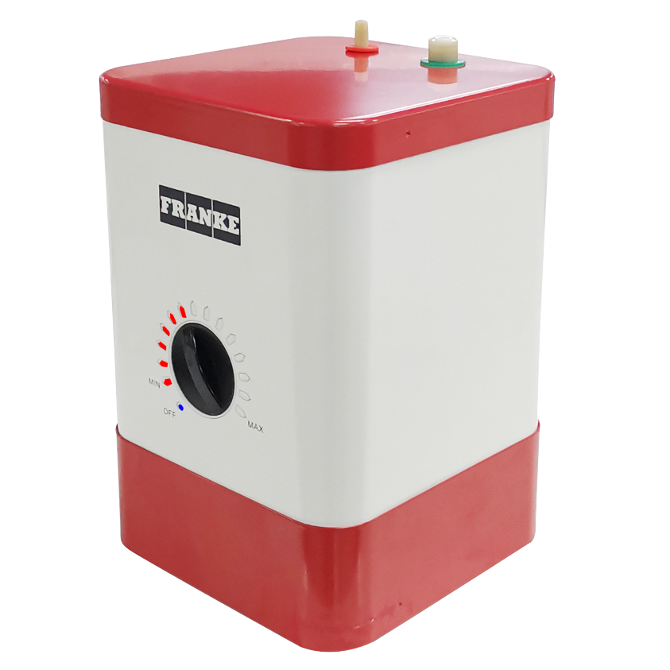
INSTALLATION
Allow 4-6” space around the unit in the cabinet
The tank has feet on the bottom
It must be mounted vertically
Franke recommends using a filtration system for the water entering the tank – it will improve taste, tank performance and prolong tank life
Inlet connection is ¼” push fitting for ¼” poly-tubing – compatible with all Franke Hot Water Dispensing Faucets
Discharge connection is clamp on fitting for silicone discharge tubing – compatible with all Franke Hot Water Dispensing Faucets
Notes:
Push fitting is integrated into the tank, no external fittings to install

Slide 22
PUSH FITTINGS – A CLOSER LOOK
FACTS
Established design that’s been around since the 1980’s. Most push fitting suppliers offer a 25 year warranty!
Push fitting installation is faster than compression fittings or soldered fittings
Push fittings compact design is ideal for tight spaces, like underneath a kitchen cabinet
Push fittings don’t require tools of any kind, minimizing the chance of damage
Compression fittings must be assembled and tightened correctly to create a proper seal. They have more components, so there are more opportunities for errors in installation
Compression fittings can require retightening over time
Soldered joints can develop pin holes if not properly installed.
IMPORTANT TO REMEMBER
Push fittings, like any fitting, must be installed properly in order to function as intended
It’s critical to make sure the tubing being connected is cut square, free of burrs and is not scratched or deformed in any way.
The tubing must be pressed in COMPLETELY, all the way to the fitting stop

Slide 23
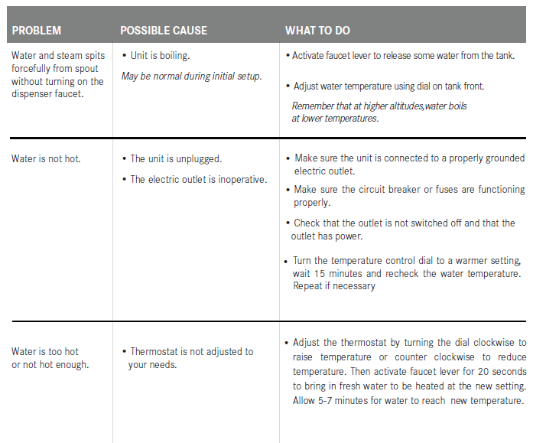
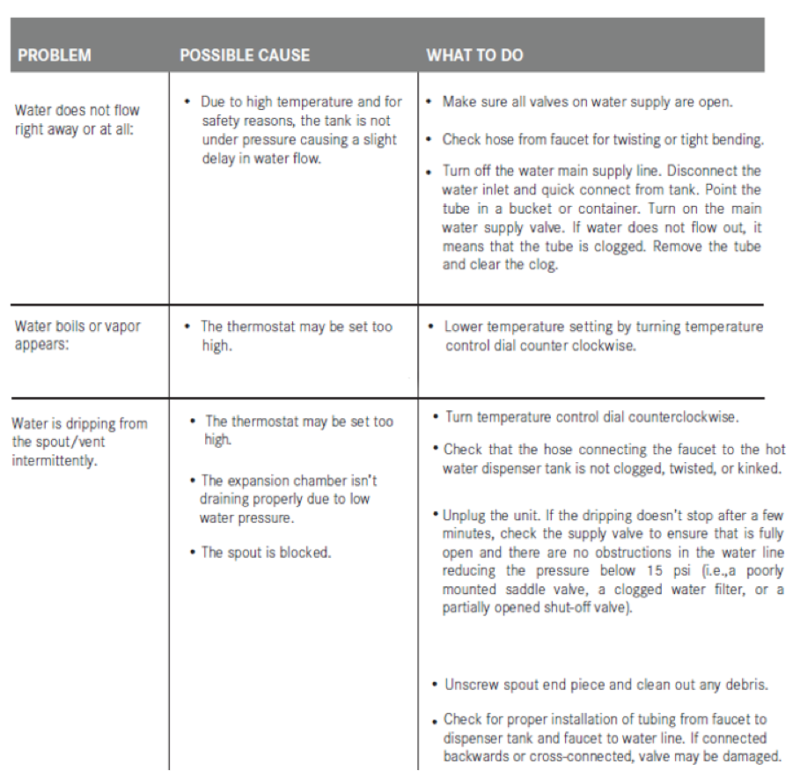
TROUBLE SHOOTING
Notes:
Trouble shooting guidelines are in the manual, they are pretty standard for all heating tanks
Basically if it’s dripping or spewing water, its probably set too hot.
The tank the product team tested, saw a few drips (through the spout) on the initial heat up, which is common to all tanks, but otherwise, didn’t see many drips at all, and couldn’t make it boil at max temp, the instant it reached 208, just before boiling, it shuts off.

Slide 24

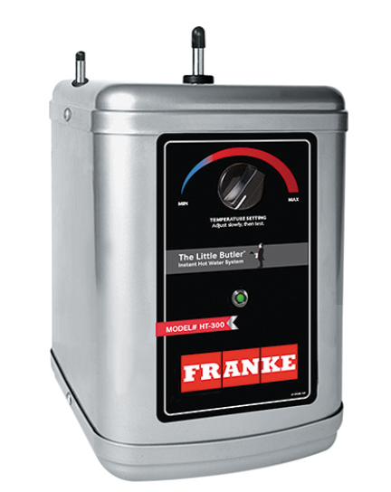
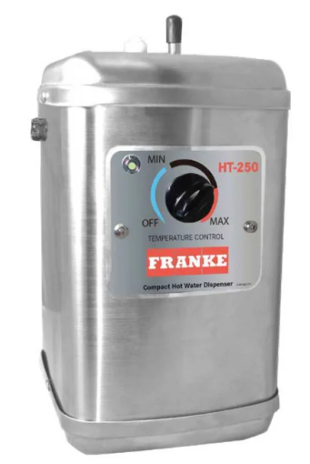
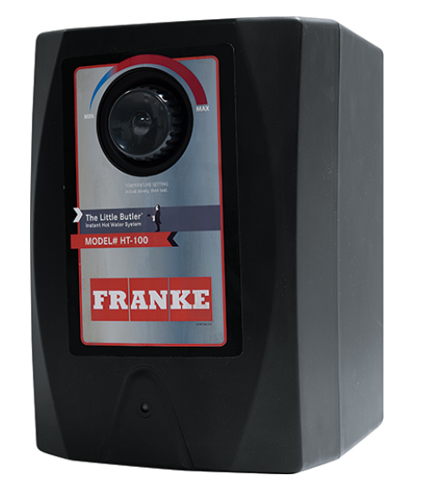
MODEL COMPARISON
Feature | HT-400 | HT-300 | HT-250 | HT-100
List Price | $420 | $450 | $450 | $365
Length | 7-3/4" | 9-3/8" | 6-3/4" | 8-3/4"
Width | 7-1/2" | 7-13/16" | 6-3/8" | 7-7/8"
Height | 11-13/16" | 11-9/16" | 10-3/4" | 11-3/4"
Power | 1100 Watts | 1300 Watts | 1300 Watts | 780 Watts
Max Temp | 208⁰ F | 194⁰ F | 194⁰ F | 190⁰ F
Hot water supply rate | 60 cups / hr | 60 cups / hr | 60 cups / hr | 40 cups / hr
Temperature adjustment | Digital selector | Analog dial | Analog dial | Analog dial
Temperature Accuracy | +/- 1⁰ F | +/- 5⁰ F | +/- 5⁰ F | +/- 5⁰ F
All digital temp control | Yes | No | No | No
Min Pressure | 15 PSI | 20 PSI | 20 PSI | 20 PSI
Max Pressure | 140 PSI | 60 PSI | 60 PSI | 60 PSI
Patented water management system | Yes | No | No | No
Encased heating element | Yes | No | No | No
Integrated push fitting connections | Yes | No | Yes | No
Warranty | 5 years | 3 years | 3 years | 3 years
Notes:
Current tank vs new
The HT-400 is basically superior to the others in every way except the wattage, which we discussed that because of the heating element design, makes this tank punch above it’s weight class so to speak, it heats the water very quickly and requires less energy to do it.
And maybe you could argue the compactness of the HT-250 would be another point where the old Joneca tank might have an advantage since it is smaller than the HT-400, but the HT-400 is more compact than the other 2 standard sized HT100 and HT300 tanks

Slide 25
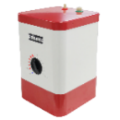
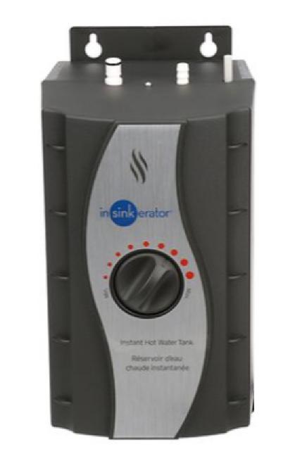
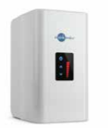
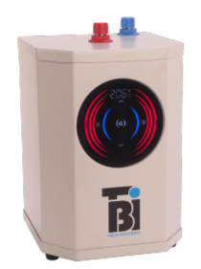
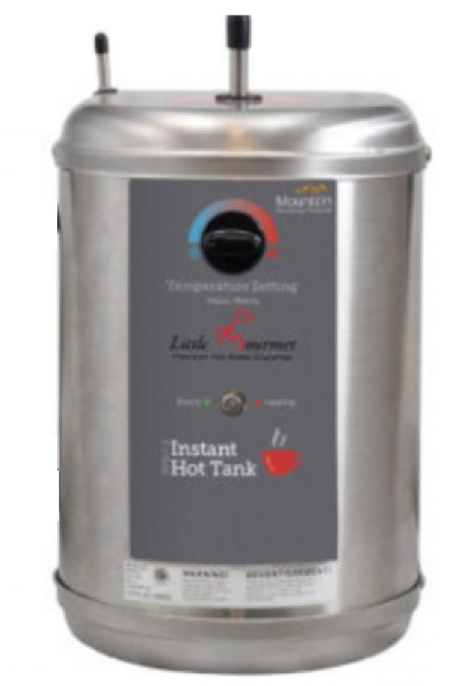
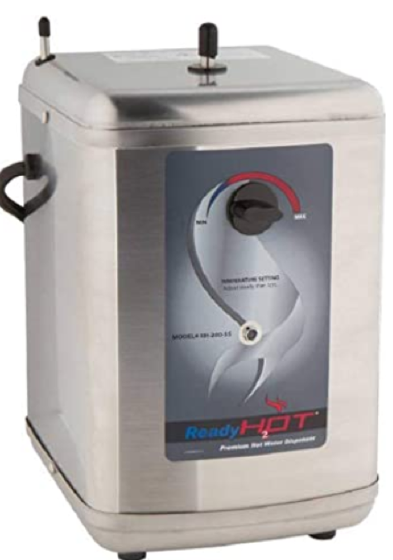
Feature | Franke HT-400 | Insinkerator HWT-00 | Insinkerator HWT300 | BTI Aqua Solutions HT4105 | Mountain Plumbing MT641-3 / California Faucet 9628SS | Newport Brass 5-036
List Price (*references available separately from 3rd party, not listed on manufacturer website) | $420 | $432* | $671* | $639* | $605* / $595* | $491*
Length | 7-3/4" | 6-3/4” | 8-1/8” | 7-1/2” | 8” | 9-3/8"
Width | 7-1/2" | 6-1/8” | 6-1/4” | 7-1/2” | 7-3/4” | 7-13/16"
Height | 11-13/16" | 10-7/8” | 12-1/4” | 10-3/4” | 12” | 11-9/16"
Power | 1100 Watts | 750 Watts | 1300 Watts | 1500 Watts | 1300 Watts | 1300 Watts
Max Temp | 208⁰ F | 210⁰ F | 210⁰ F | 208⁰ F | 190⁰ F | 190⁰ F
Temperature adjustment | Digital selector | Analog selector | Digital touch screen | Digital touch screen | Analog selector | Analog selector
Temperature Accuracy | +/- 1⁰ F | +/- 7.5⁰ F | +/- 1⁰ F | +/- 2⁰ F | +/- 5⁰ F | +/- 5⁰ F
All digital temp control | Yes | No | Yes | Yes | No | No
Min Pressure | 15 PSI | 30 PSI | 15 PSI | 15 psi | 20 PSI | 35 PSI
Max Pressure | 140 PSI | 80 PSI | 80 PSI | 72 psi | 70 PSI | 100 PSI
Patented water management system | Yes | No | No | No | No | No
Encased heating element | Yes | No | No | Yes | No | No
Integrated push fitting connections | Yes | Yes | Yes | No | No | No
Standby power consumption | 1 Watt | 26 Watts | 19 Watts | 1 Watt | Not Listed | Not Listed
Easy no-tool installation | Yes | No | No | No | No | No
Warranty | 5 years | 3 years | 4 years | 5 years* | 3 years | 1 year
COMPETITIVE BENCHMARK
Notes:
Plus we have much more stylish faucet pairings and superior filtration systems, which most of the competition can’t offer all 3

Slide 26

QUESTIONS?
Notes:
Guys – I think we have a great product here that should be very reliable and should really restore credibility in the Little Butler brand and confidence in our heating tanks and give us a leg up on the competition too in terms of features and pricing. It has some things technically that really move it past the older generation tanks and our competition, so I’m excited about the potential we have with this product.
Any other questions/comments?

Slide 27

THANK YOU!!!

