Slide 1

Coming Soon Page - subzerowolfcoveownerappreciationincentive.com

Slide 2
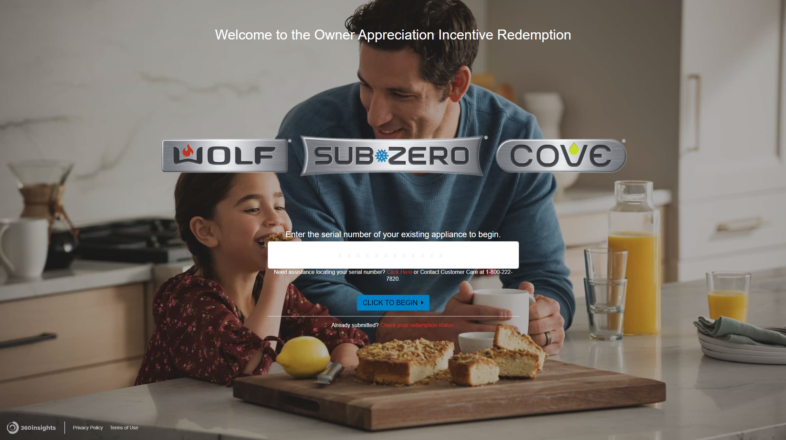
Landing Page

Slide 3
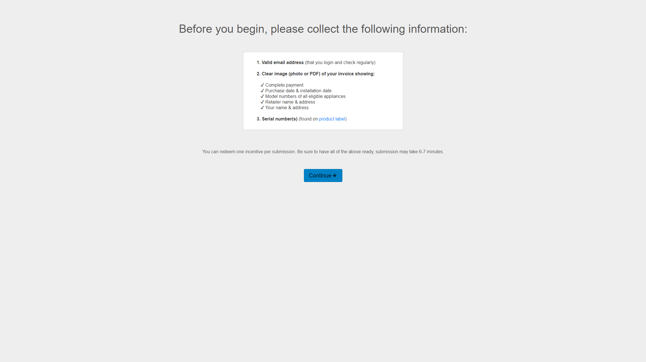
Intro Page

Slide 4
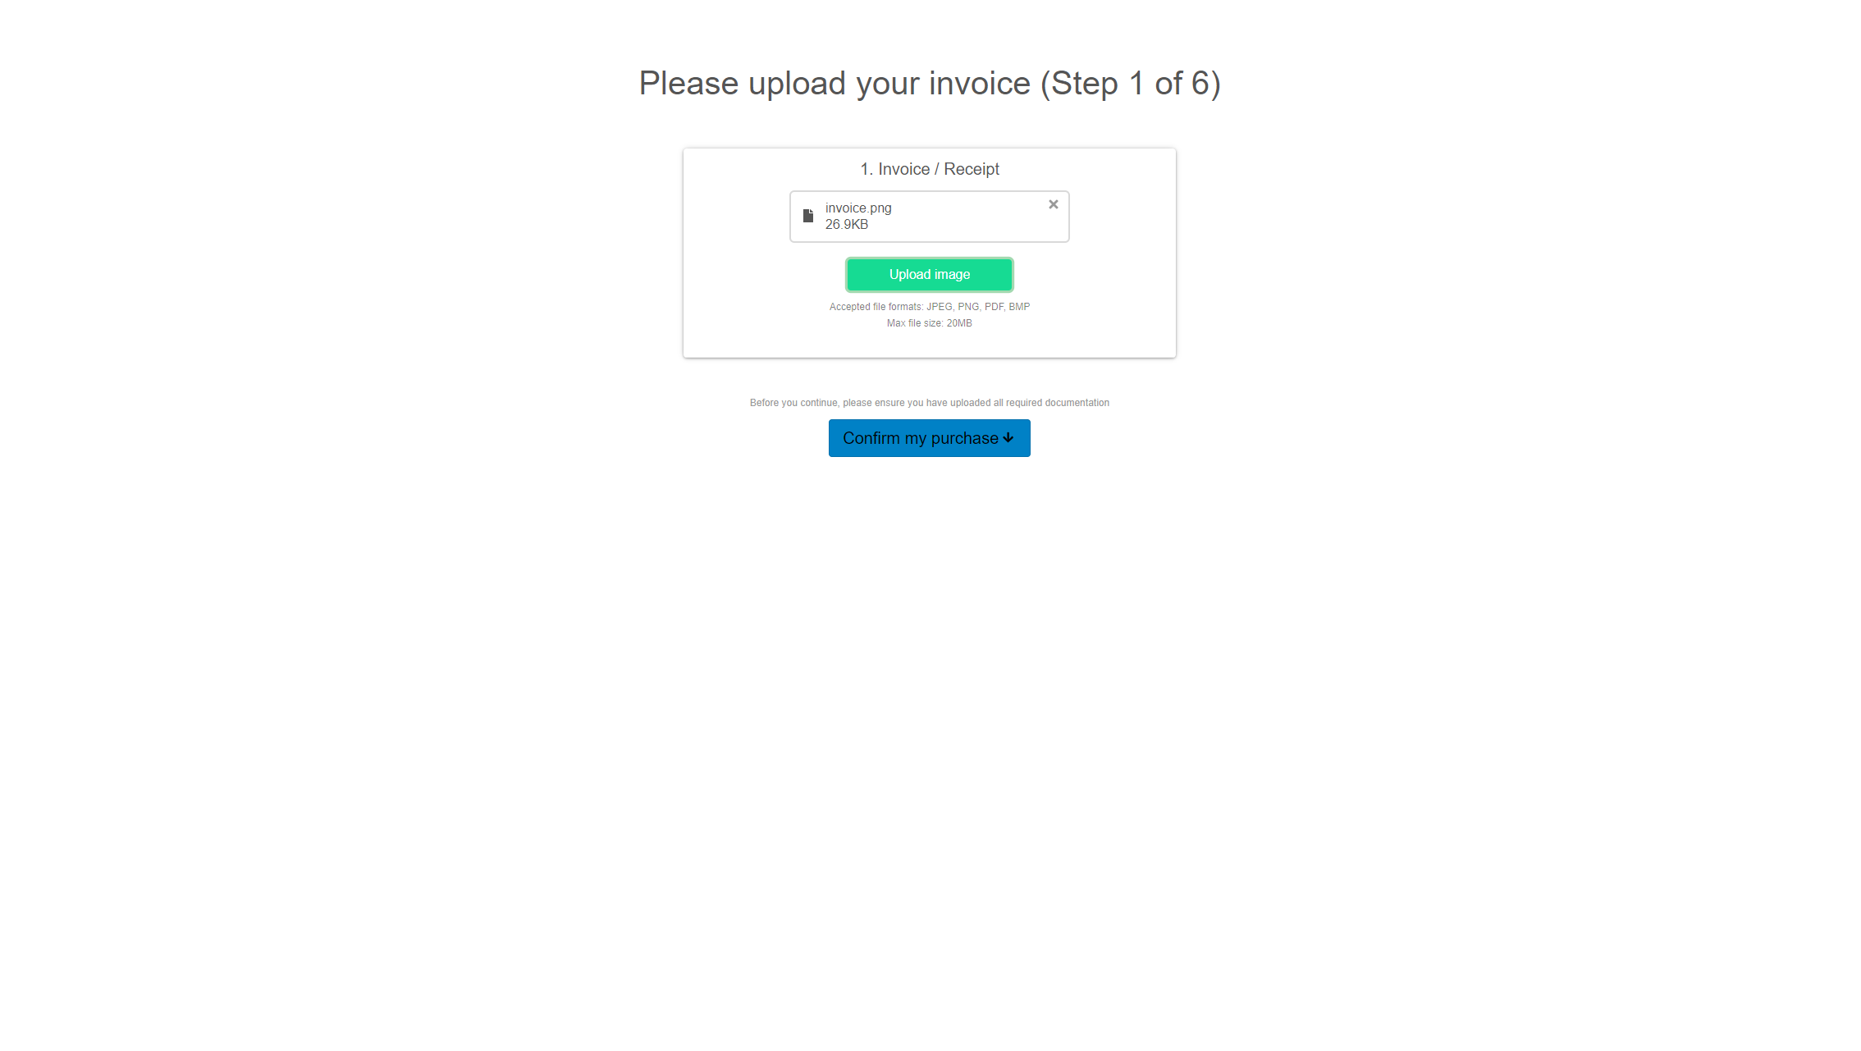
Invoice Upload Page

Slide 5
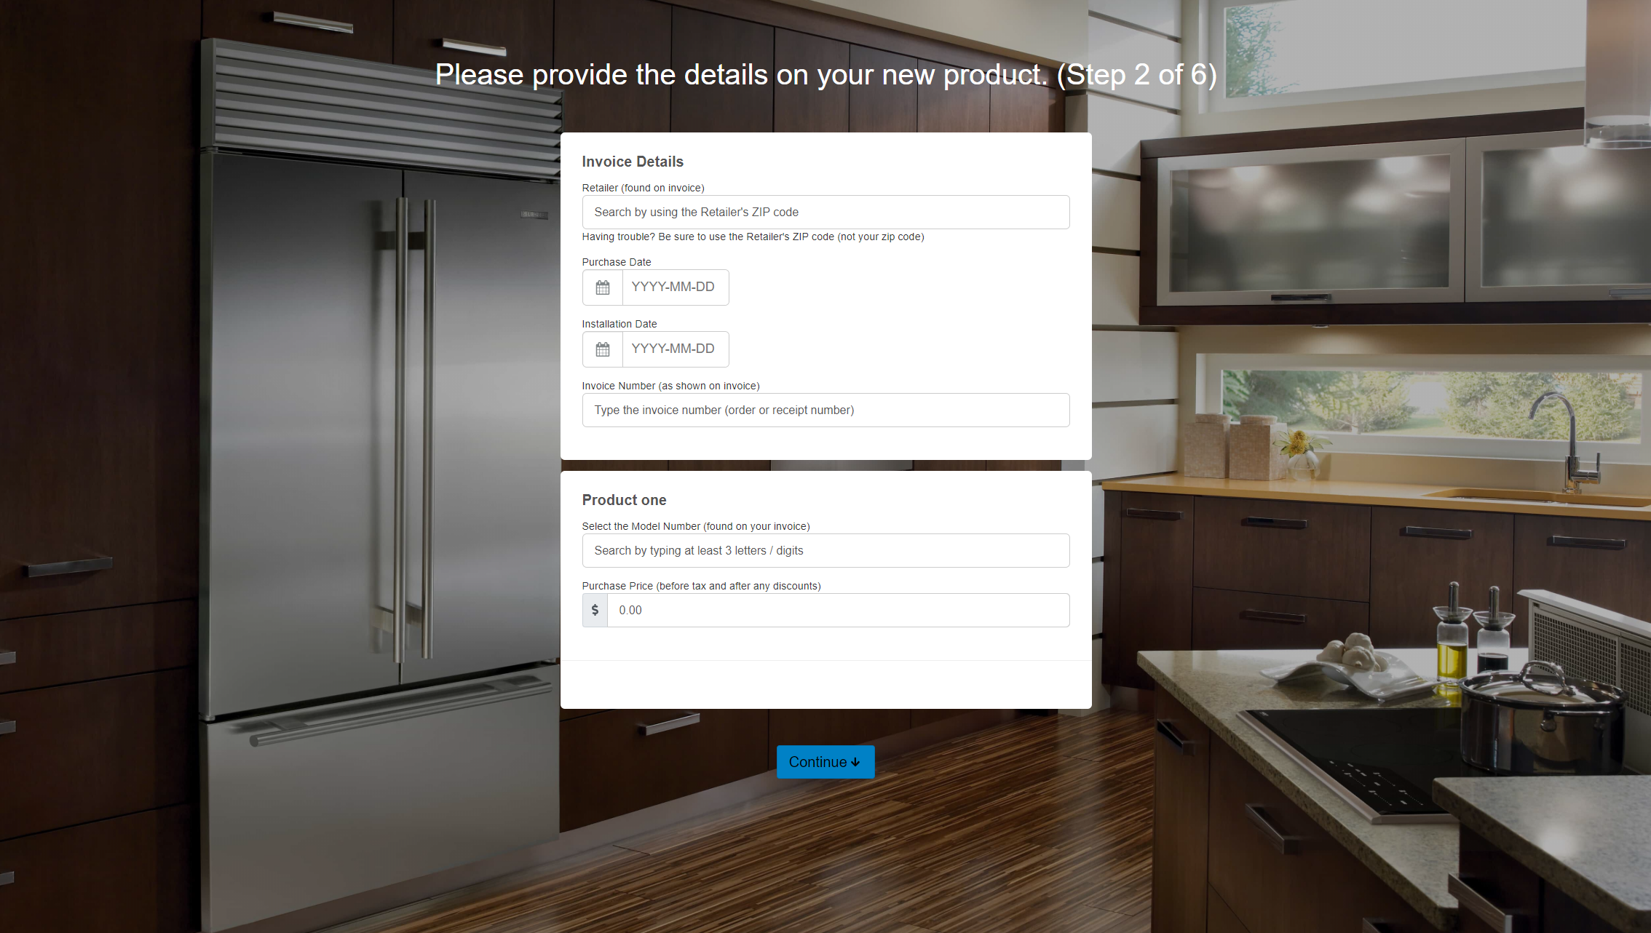
Product Details Entry Page

Slide 6
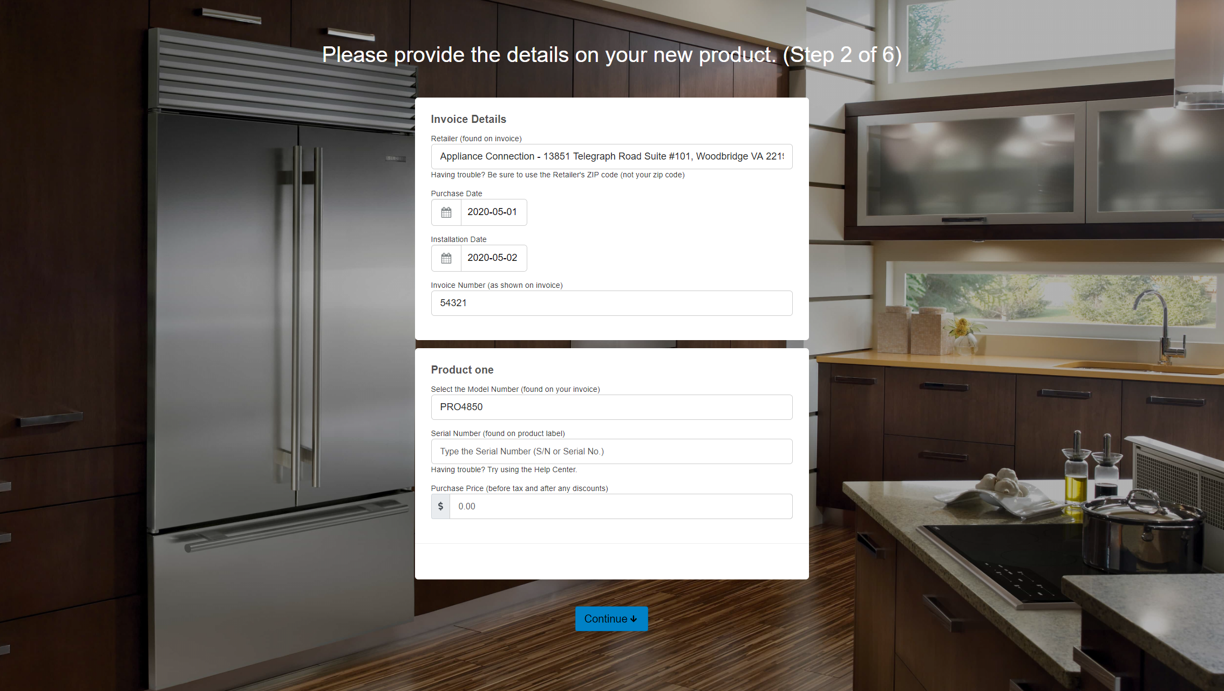
Product Details Entry with Serial

Slide 7
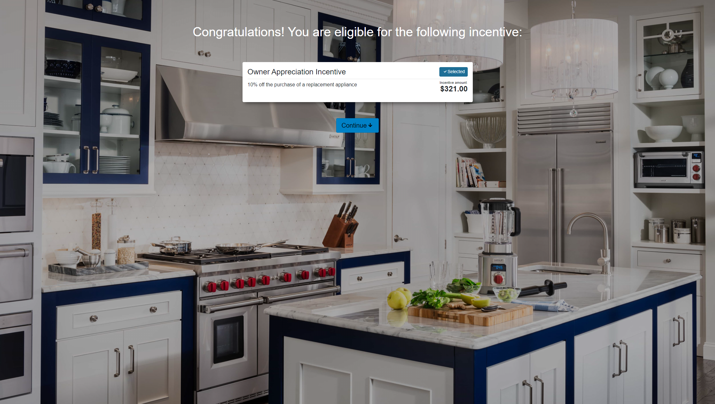
Program Eligibility Page

Slide 8
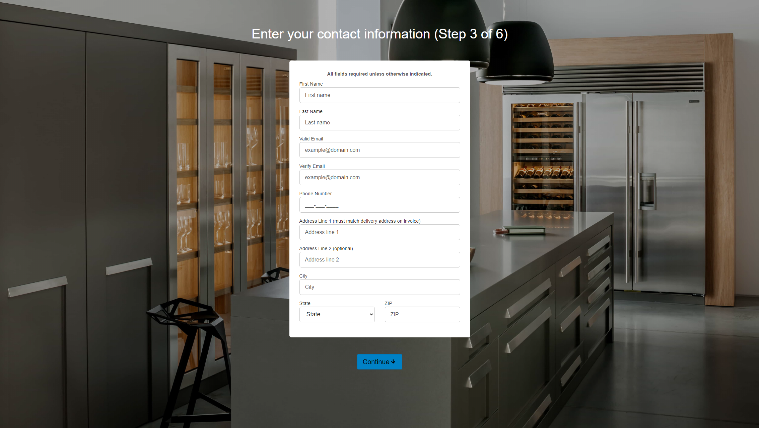
Personal Information Entry Page

Slide 9
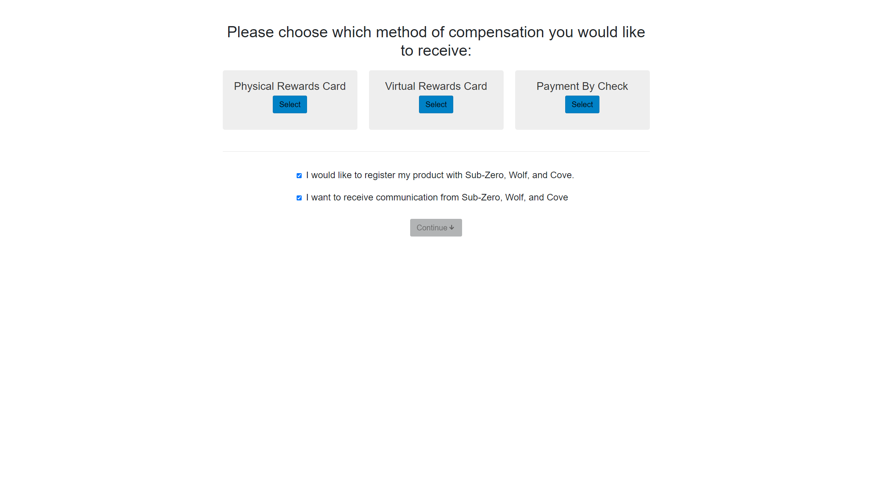
Reward Selection & Registration Page

Slide 10
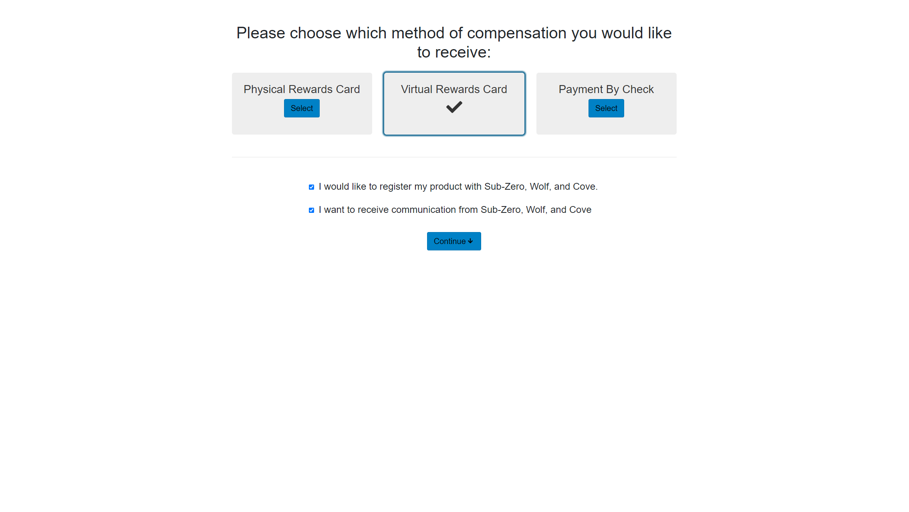
Reward Selection & Registration Page Selected

Slide 11
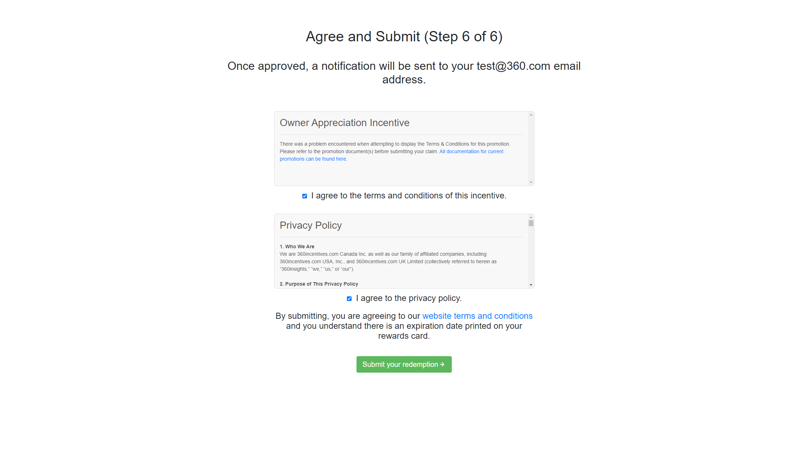
Terms & Conditions Page

Slide 12
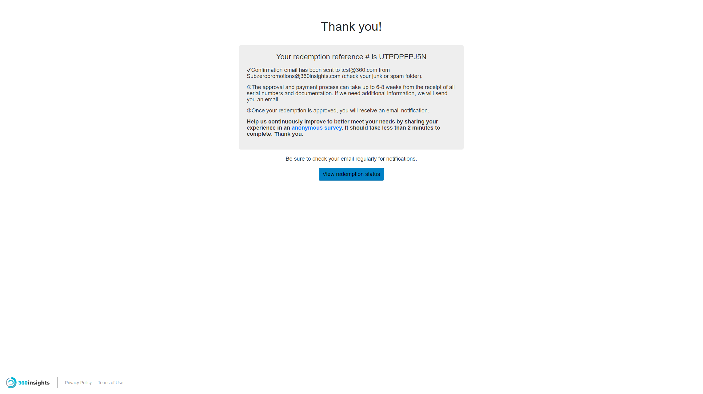
Submission Confirmation Page

Slide 13
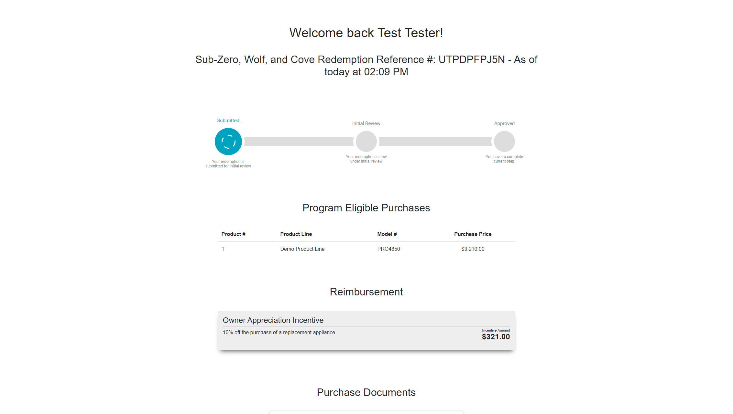
Existing Claim Summary Page

