Slide 1


Slide 2

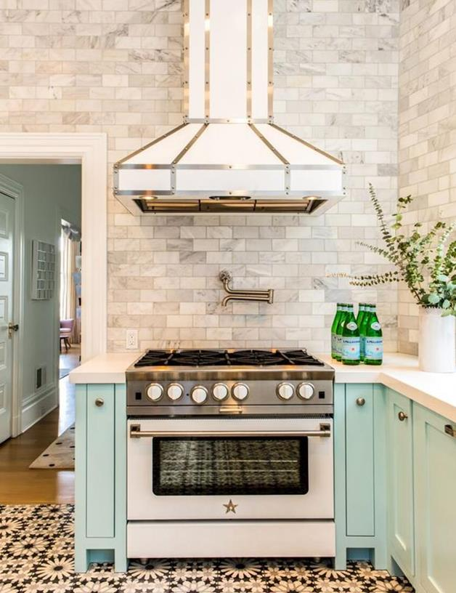

Our Ventilation Line
2006: The BlueStar® brand is born
2012: BlueStar® acquires Independent Hoods and the line is rebranded under Prizer Hoods®
2017: BlueStar® acquires ABBAKA Hoods
2020: BlueStar® becomes the flagship ventilation brand for both Prizer Hoods® and ABBAKA with enhancements & upgrades to the entire line
Notes:
2006: Launched with a line of limited cooking and ventilation products
2009: This acquisition dramatically expands our offerings with many new models, and exciting new customization capabilities with different types of metals, strapping and finishes.
2017: Abbaka is a leader in handcrafted ventilation & the industry leading Hy-Ex remote blower

Slide 3
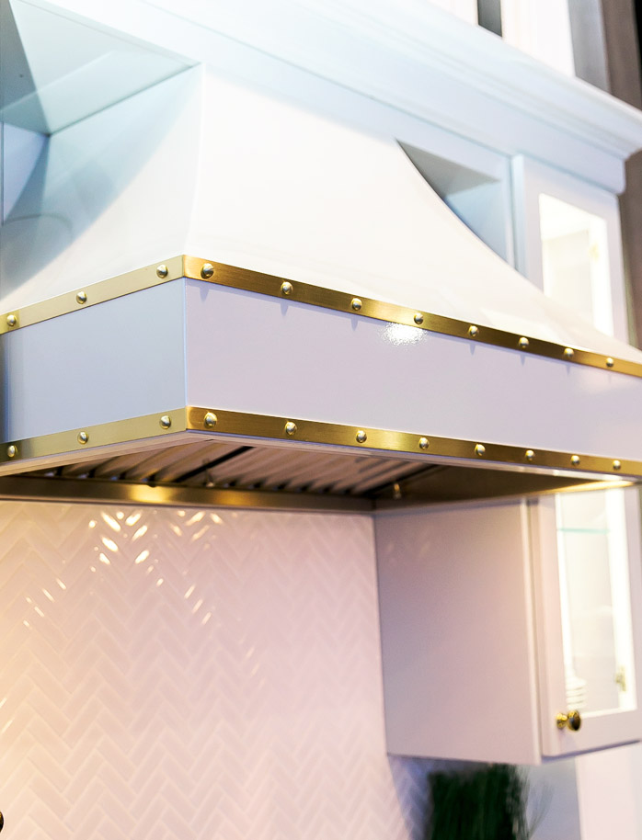
The NEW & Improved BlueStar Ventilation Line
Delivering superior pro-style performance, unsurpassed customization & streamlined product assortment
Offering
Professional-grade smoke removal
3-speed fan with boost mode efficiently clears the air
Innovative 3-stage grease capture system
Enhanced visibility with dimmable LED lighting
Stainless baffle filters seamlessly remove for dishwasher safe cleaning
Easy-to-use push-button controls
Quiet operation does not interfere with conversation while entertaining
Convenient delayed off feature
In-line, in-hood and remote blower compatible
Notes:
Delayed Off feature will run hood for 7 minutes after you’ve finished cooking and shut off automatically.

Slide 4
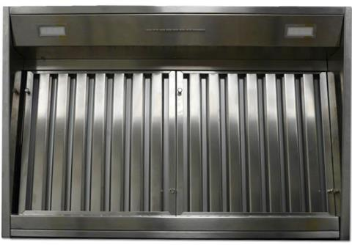
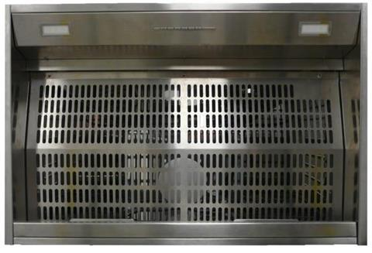
3-Stage Grease Capture System
Phase 1: Baffle Filter Design
Designed for maximum air flow while reducing noise Baffle filters, with smooth rounded edges, are dishwasher safe are for easy cleaning.
Phase 2: Inner Filter Shield
The inner shield is specially designed to distribute air flow evenly across the entire cooking surface while capturing any grease that may come through.
Phase 3: Removable Grease Channel
Removable grease channel located at the base of the filters is designed for maximum grease collection and easy cleaning.
1
2
3

Slide 5
Easy Touch Control Panel
A
B
C
D
E
F
Blower
Controls
Timer
Light
Controls
Additional Controls:
E – Timer
Pressing button during operation will cause blower to run for 5 minutes at its current speed. Blower will automatically shut off.
F – Light On/Off plus Dimming Feature
Press once to turn light on and off. Hold in button to adjust light intensity. Selected intensity will stay in controller memory until changed.
Blower Controls:
A – Blower starts on 1st speed
B – 2nd speed
C – 3rd speed
D – 4th speed (Boost Function)*
After 7 minutes of operation in Boost Mode the blower will automatically move to 3rd speed.

Slide 6
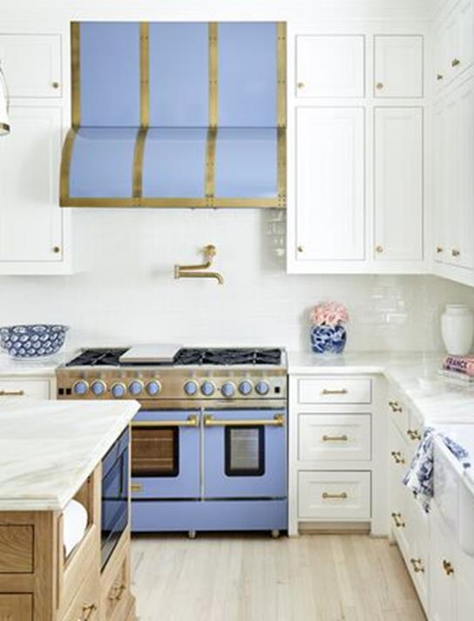
Seamless Cleaning
Filter Cleaning Reminder light will illuminate after a set number of hours of use to remind homeowner to clean filter system.
Remove baffle filters and place in the dishwasher, or gently wash in warm soapy water
Remove and clean grease tray and gently wash in warm soapy water

Slide 7
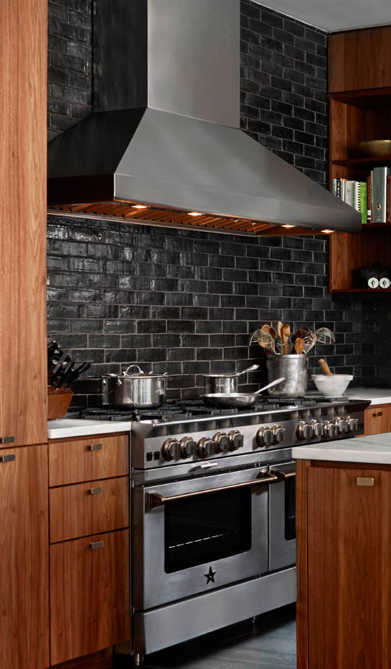
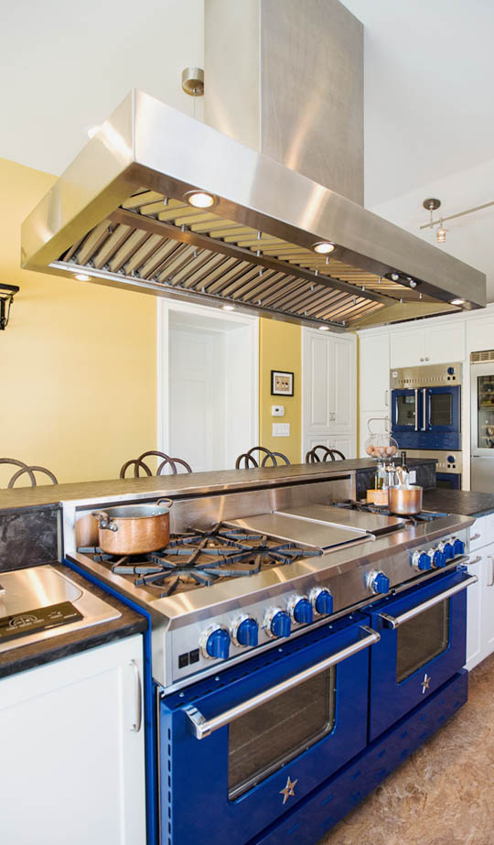
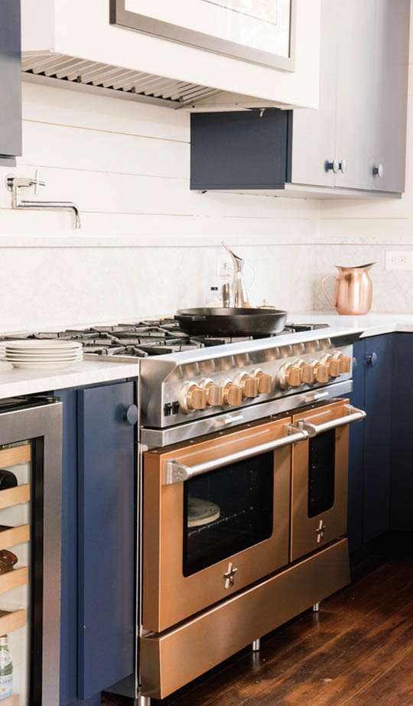
Our Line
Wall Hoods
Island Hoods
Liners
Notes:
Most customers that are purchasing professional-grade appliances think about ventilation options last, when it really is the starting point for a remodel or new build. The location and ability to properly vent can quickly dictate overall kitchen and appliance layout. Although hoods serve a very specific function of pulling out cooking odors, grease and smoke they CAN have a strong design appeal, that will help create a focal point for a kitchen - and be the statement piece that a client anchors around. The ability to customize ventilation is critical when designing for your clients.

Slide 8
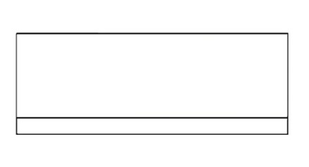
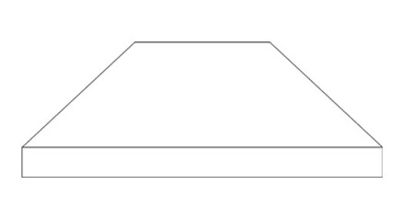
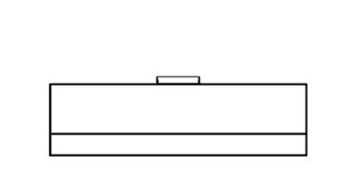
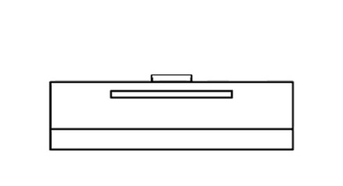
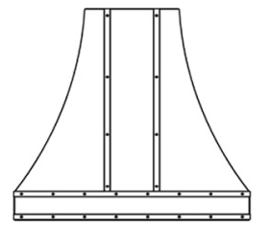
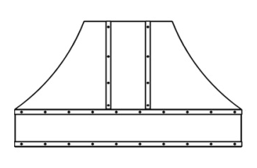
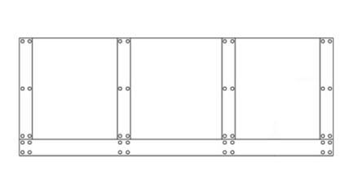
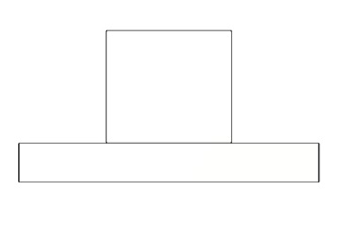
Wall Hoods
Professional Series:
Proline
Pyramid
Low Profile
Low Profile
Recirculating
Designer Series
Bonanza
Hampton
Incline
Manhattan
Sahara Curved
Wrangler
Notes:
What is the Difference Between the Proline/Incline & Pyramid/Hampton?:
The shells and features on these models are identical with the main difference being the customization allowed on them. Proline and Pyramid hoods are available in 1,000+ colors and have limited or telescopic flue options. Specifically the proline has a 12” duct cover option and the Pyramid has a telescopic flue. The Incline and Hampton models are available in 1,000+ colors, designer metals, can have strapping added and include a wider selection of one-piece duct cover from 6” up.
From a design perspective there are three different types of ventilation hoods I want to point out to you. As you know, Wall Hoods are the most common application for kitchens. This type of ventilation hood is directly affixed to the wall and may have a decorative chimney, or soffit, to line up with the top of your cabinets or to "disappear" into your ceiling.

Slide 9
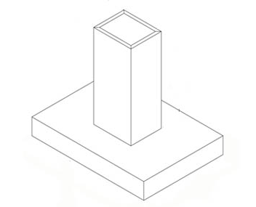
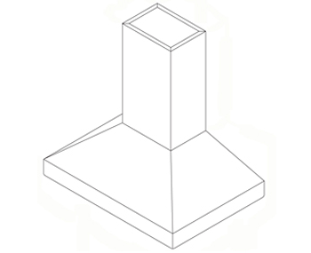
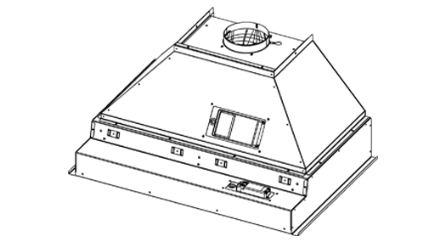
Island Hoods & Liners
Manhattan
Hampton
PMLSS
MLSS
Notes:
Liners are the most custom option you can specify. These power packs contain the "guts" of a hood including the blower, grease traps, lights and controls. They are intended mainly for use in kitchen designs that are using cabinetry or wood shells. They fit into your own creation or into a shell of wood, plaster or metal manufactured by others.
Island Hoods, are popular for those centralizing their cooking appliances and hang from the ceiling over an island or peninsula. It may also hang from the peninsula’s wall cabinets. You may choose to hang it higher to avoid blocking any view and if so, it will need more coverage than it would compared to a wall mount. As a general rule, but especially when you specify the Island Hoods, I would recommend at least an additional 3 inches on either side, so a 30" stove would require a 36" hood. It will also need more CFM to compensate for the extra height and for breezes passing through your kitchen.

Slide 10
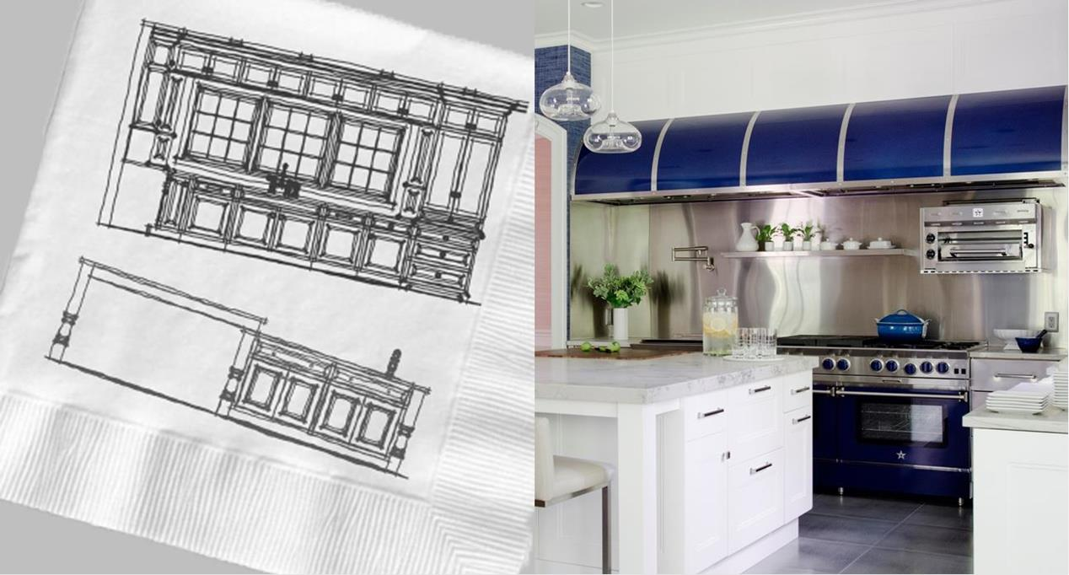
Custom Hoods
Let us work with you to create the statement piece for your kitchen
Notes:
These customized designs can range from bold and daring to subtle to perfectly complement the rest of the room. With over a dozen designer finishes to choose from like brass, copper and pewter the design possibilities are seemingly endless.

Slide 11
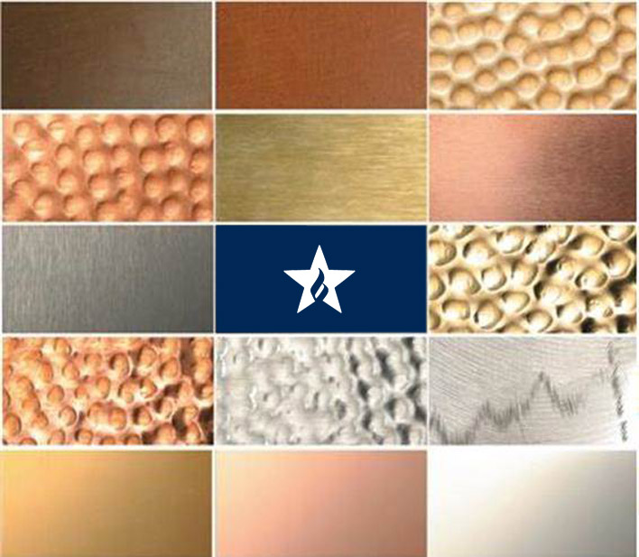

Choose Your Design
After selecting shape and size, pick from 14 custom metals and 1,000 colors & finishes
14 Custom Metals
1,000+ Colors & Finishes
Stainless : Brushed, Polished & Hammered
Brass: Antique, Brushed, Polished & Hammered
Copper: Antique, Brushed, Polished & Hammered
Pewter
Oil Rubbed Bronze
Millennium Disc

Slide 12
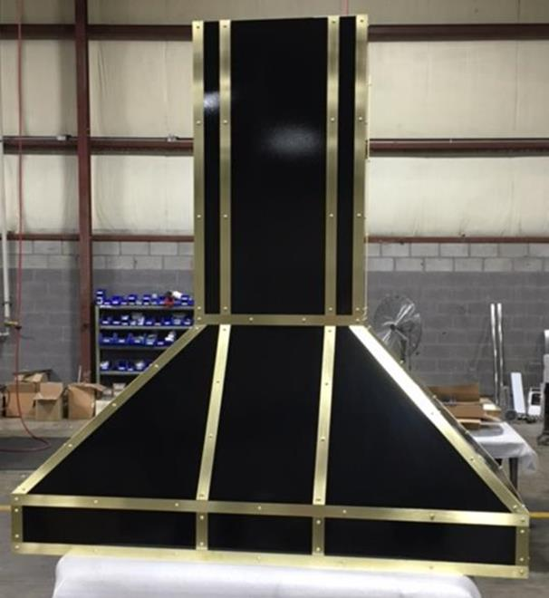
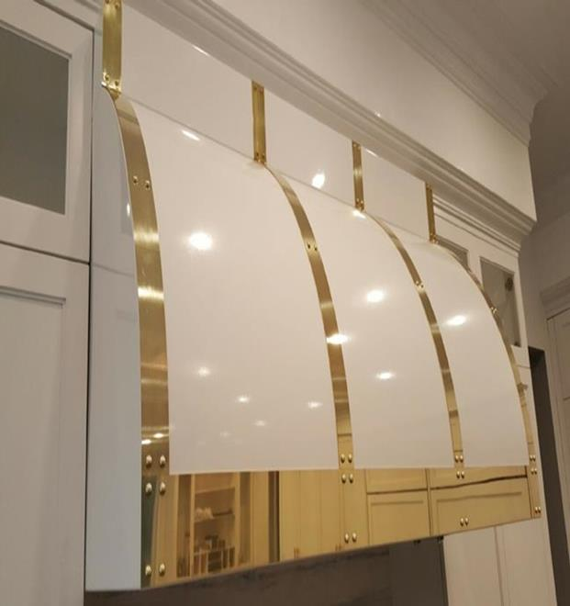
Add Strapping & Rivets
Enhance your ventilation hood design with the addition of custom strapping and rivets to compliment other finishes in your kitchen.

Slide 13
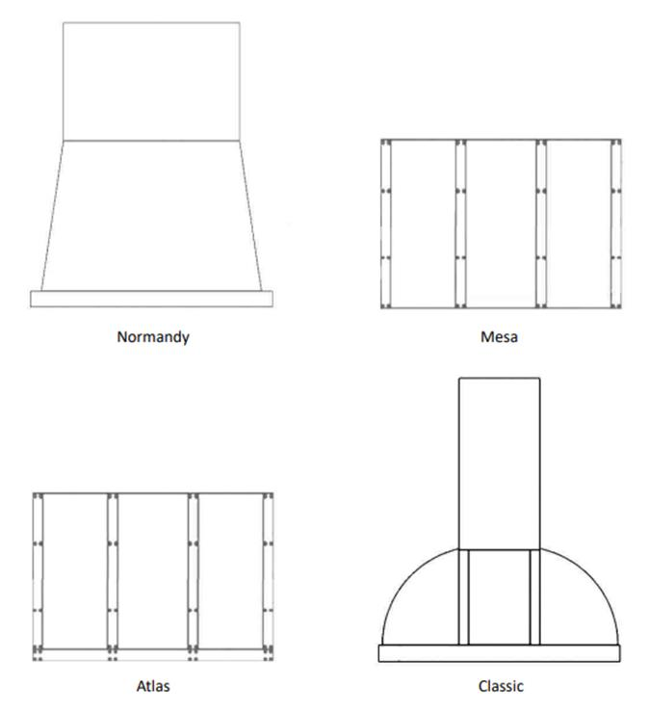
Abbaka Series
Our most premium line of customizable hoods in stunning designs
Normandy
Mesa
Classic
Atlas

Slide 14
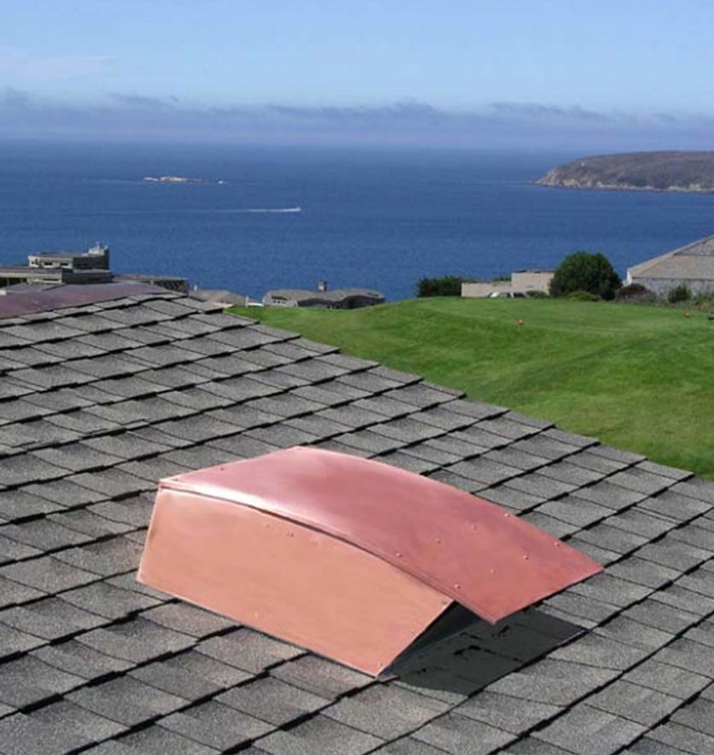
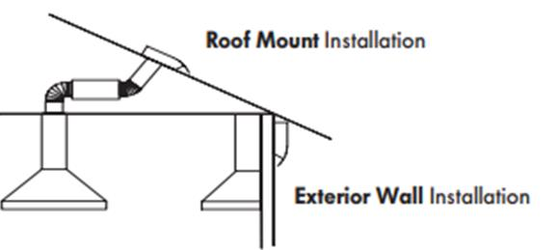
Industry Leading Hy-Ex Remote Blowers
Hyper-quiet—70% quieter than conventional remote ventilators
Restaurant ventilator power
Energy Efficient—high CFM output
3-speed fan control
Galvanized metal exterior, can be painted to match room coloration
Maintenance-free

Slide 15
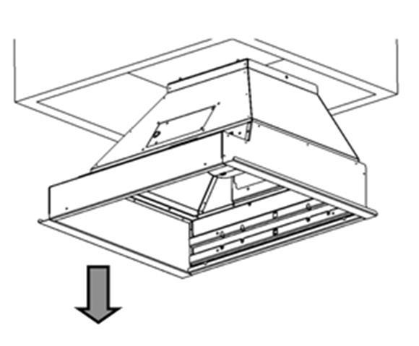
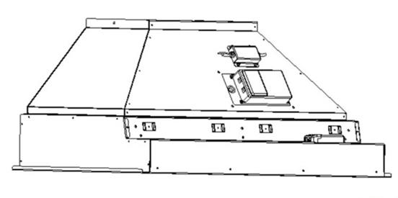
Easy Install & Serviceability
Module design allows for the shell and liner to be installed separately thus reducing the weight and manpower needed.
All electronics are accessible from the front of the hood.
All internal parts are designed for “quick connect” connections for easy removal and replacement.
Improved design places all electronics between liner and shell to reduce exposure to heat and grease for longer life.

Slide 16


Slide 17
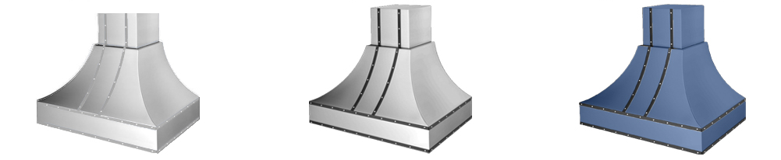
New Model Number Guide
Example Model Number: WR030MLPLTDC
Model Designation
  PL, LP, LR, PY, IN, HA, MH, WR, SC & BZ
Unit Width
  24”, 30”, 36”, 42”, 48”, 54”, 60”, 66”
Liner Type
Plating (Strapping)
  Standard Plating ONLY applies to models WR, SC, & BZ
Plating (Strapping) Designer Metals
  Designer Metals Plating ONLY applies to models WR, SC, & BZ
  Brass, Copper, Antique Brass, Antique Copper, etc.
Color
  C – 190 Standard RAL (Semi-Gloss) Colors
  CF – Specialty Finish (190 RAL Matte, Precious Metals & Textures
  CC – Custom Colors
1 | 2 | 3 | 4 | 5 | 6
WR | 030 | ML | PLT | D | C
WR030MLPLT
Standard Stainless Unit
WR030MLPLTD
+ Plating Designer Metals
WR030MLPLTDC
+ Plating Designer Metals & Color

Slide 18
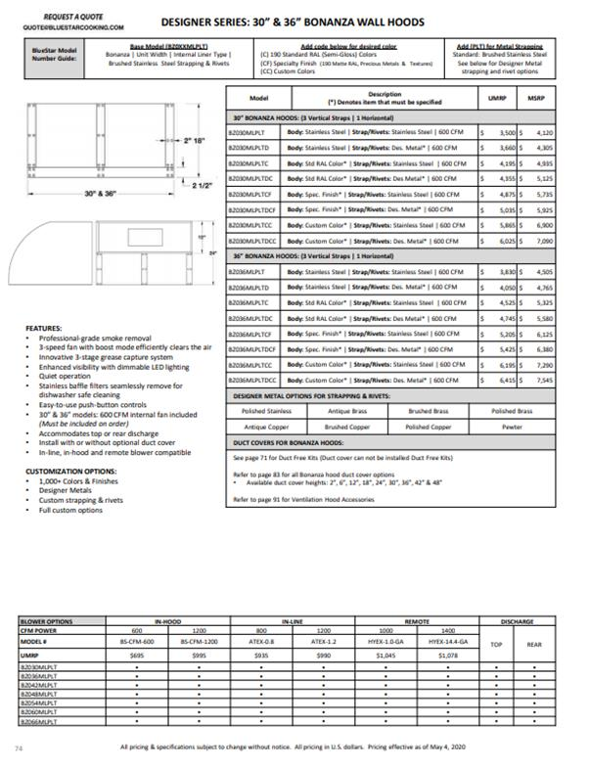
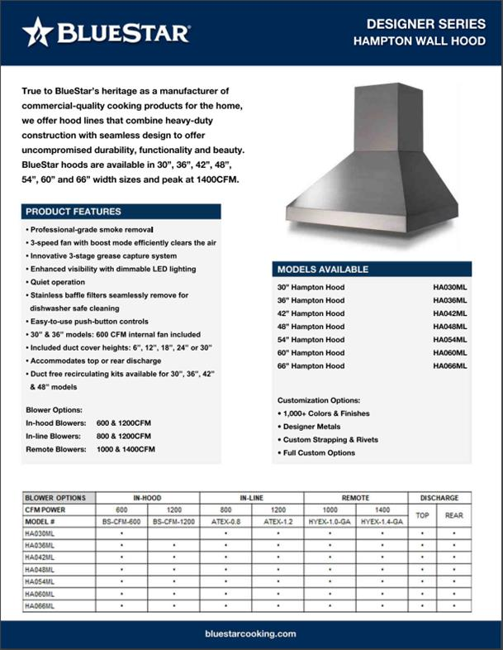

Updated Price List Page & Spec Sheets Available

Slide 19
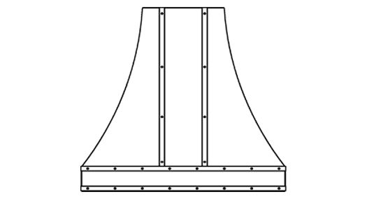
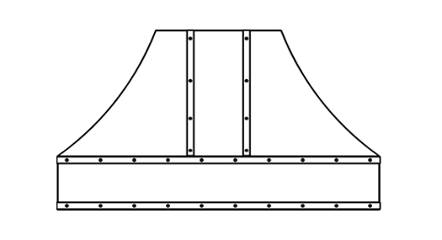

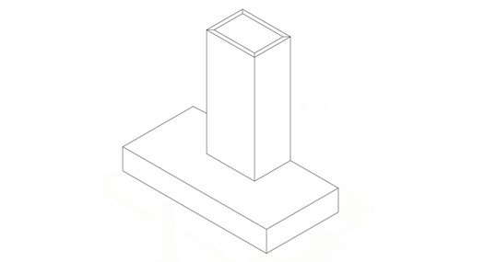
Price Changes
Sahara Curved, Wrangler and Bonanza
Hood pricing now includes strapping standard and on most sizes pricing has been lowered
Pro-Line and Pyramid models have a mix of slight increase and decrease pending on size and model
Many models, typically requiring quote can now be priced with paint and strapping using May 2020 pricing
Manhattan
30% price decrease for sizes 30”, 36”,42”, and 48”
Liners
26% average decrease in pricing
Notes:
Sahara Curved, Wrangler and Bonanza hoods without strapping will have to be custom quoted and assigned a longer lead time.

Slide 20
Next Steps
Use this presentation to virtually train / introduce the dealers
Train on new model numbers
Price List: All hoods not listed in the May 2020 price list will have to be custom quoted at quote@bluestarcooking.com.
Work with dealers to upgrade displays
Future Enhanced Website
  Updated product pages, manuals, spec sheets
  Improved Ventilation Filter Tool
  Improved hood inspiration photo gallery

Slide 21
BACK UP SLIDES

Slide 22
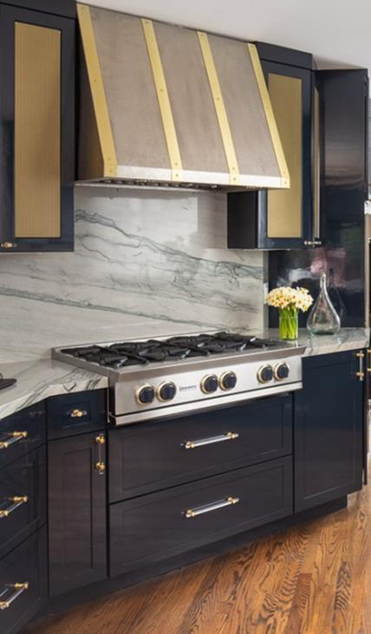
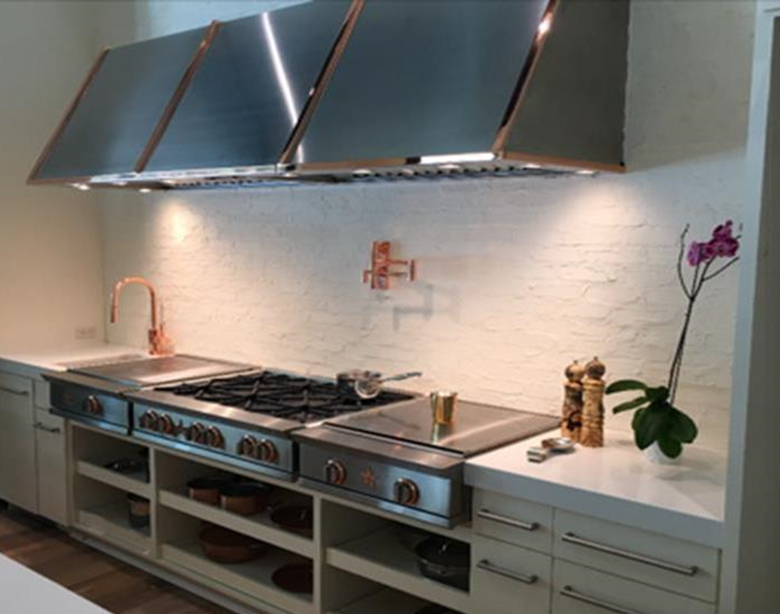

Slide 23
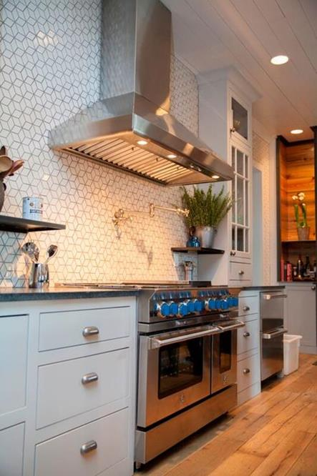
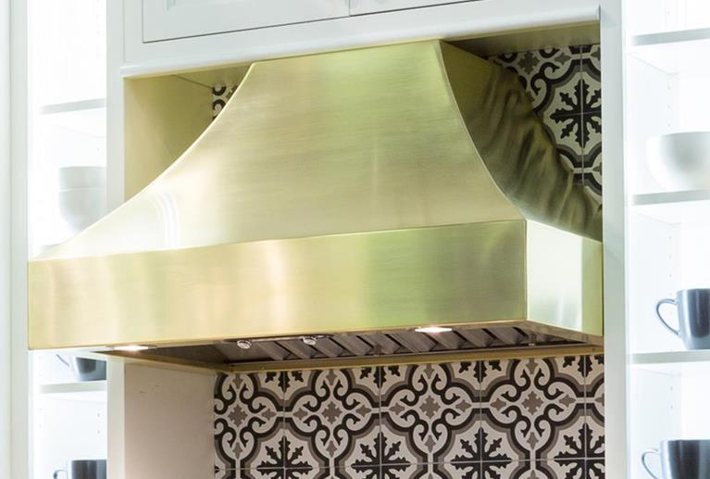

Slide 24
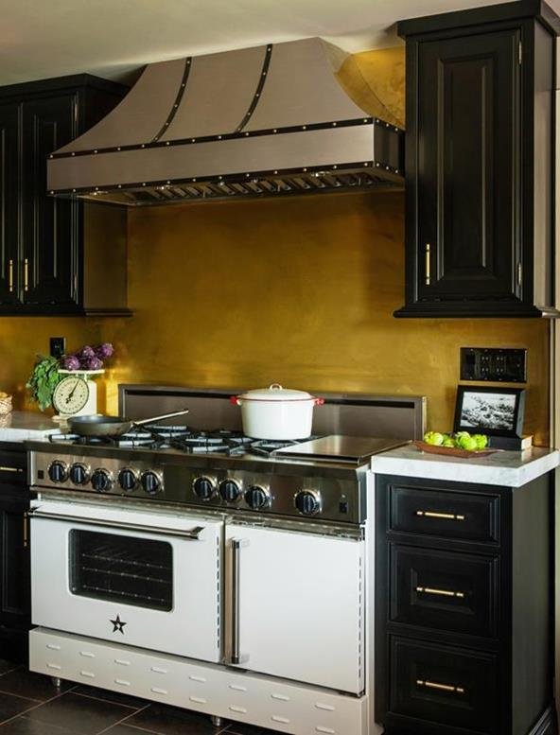
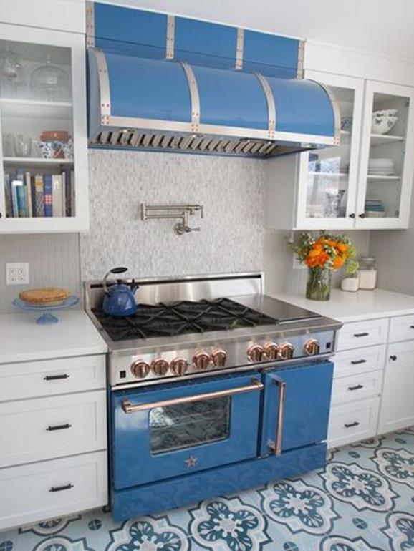

Slide 25
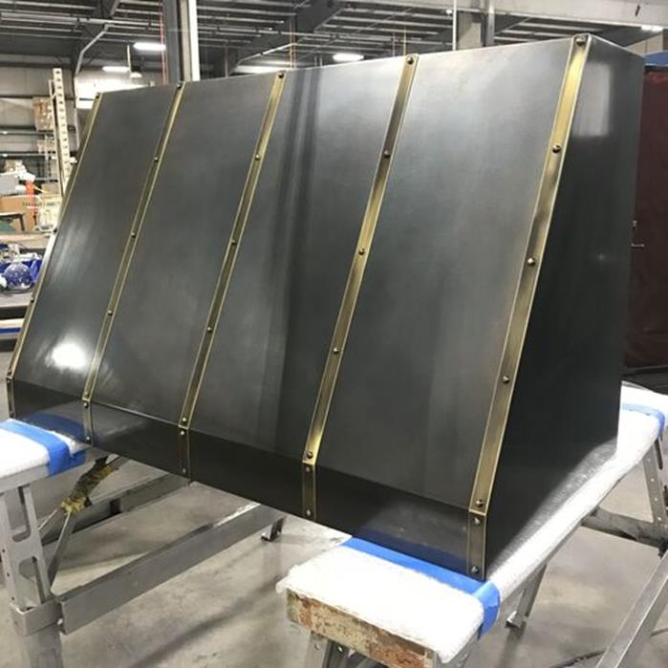
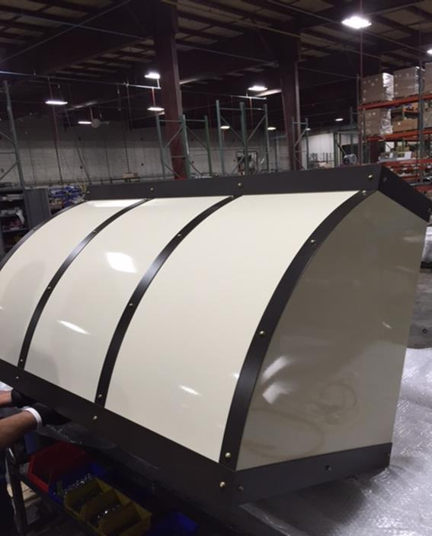

Slide 26
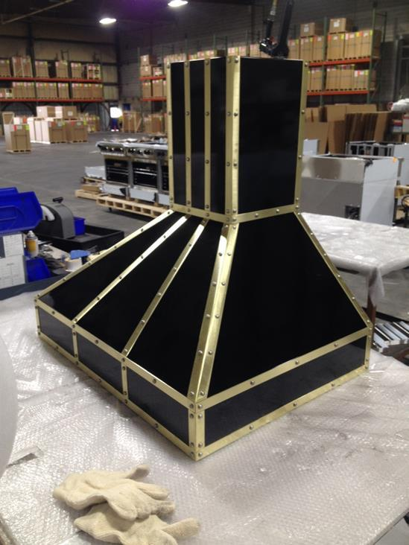
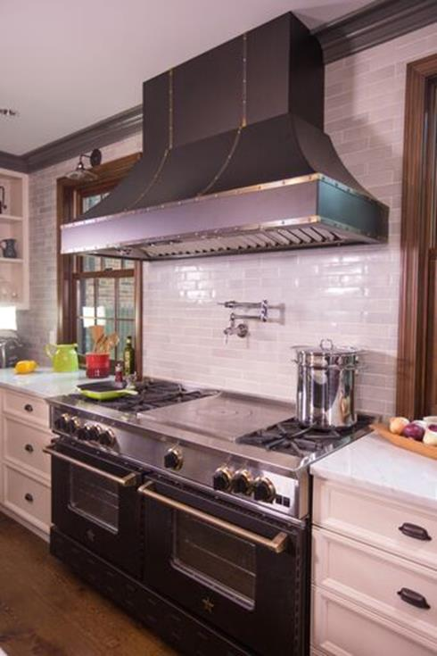

Slide 27
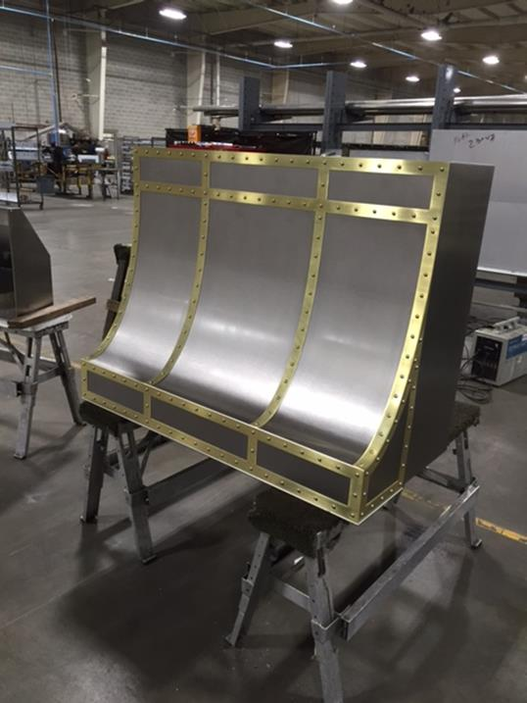
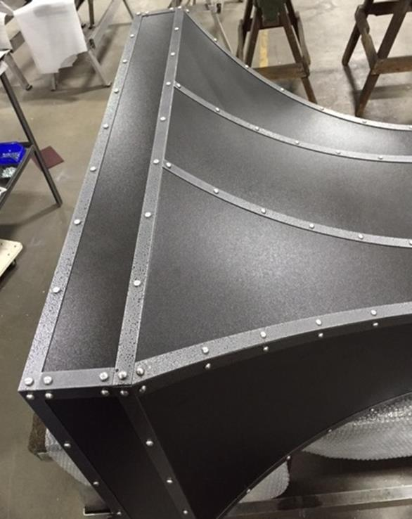

Slide 28
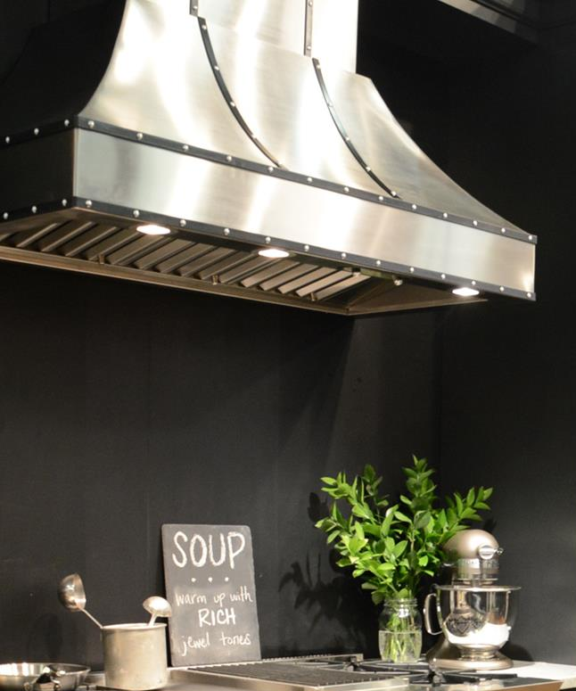
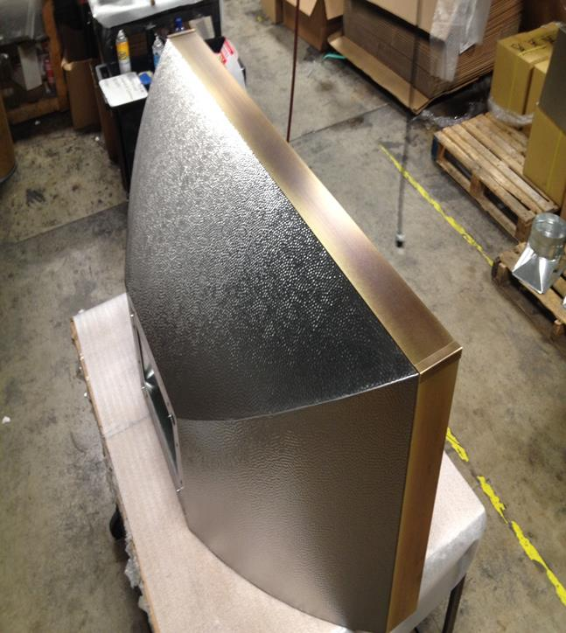

Slide 29
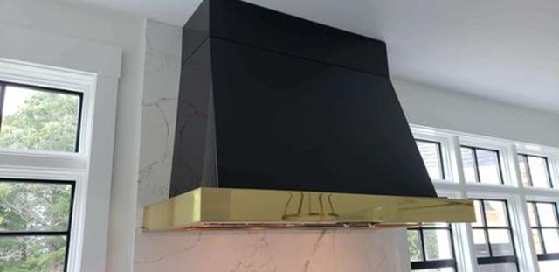
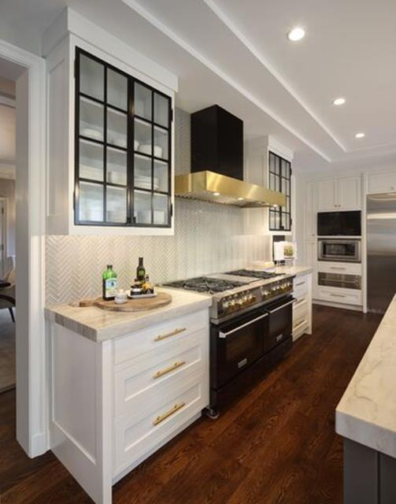


Slide 30

Blowers
Choose from 3 different blower types depending on your duct run
In-line Blower
Located within the duct run
Remote Blower
Located on roof or an
exterior wall
In-hood Blower
Located directly
Inside ventilation
hood

Slide 31

Ventilation 101
What does a ventilation hood remove from the kitchen?:
Heat
Grease laden steam
Cooking Vapors
Particulate matter
Keys to an effective ventilation system:
Capture area (width & depth over cooktop surface)
Adequate CFM’s for BTUs of range or cooktop
Duct size, length of duct run & 90 degree bends
Height of hood over cooktop surface
Make-up air system (if applicable)

Slide 32

Make-up Air
A system that will replace the air being vented from the home to keep the pressure equal.
BlueStar does not have a make-up air system, but our hoods are compatible with and do not require being wired into the switch with any after market system.

Slide 33
Blower Options
In-Hood Blower Options
600 CFM
1200 CFM
In-Line Blower Options
800 CFM
1200 CFM
Remote Blower Options
1000 CFM
1400 CFM

Slide 34

Duct Options
Blower CFMs | Minimum Duct Size | Recommended Duct Size
600 – 800 | 8” | 8” – 10”
801 – 1200 | 10” | 10”
1200+ | 10” | 10” – 12”
Reduced Pressure = Reduced Noise:
Install correct duct size in relation to CFMs of blower
The shorter and straighter the duct run the better
Every 90 degree bend adds pressure & the equivalent of 10’ of duct
Hot air rises so if you can not vent directly out of the home run ducting vertically up

Slide 35
Feature Upgrades
Current Liner | Feature | New Liner
3-Speed | Blower Control | 3-Speed with Boost
Knobs | Controls | Push Button
Halogen | Lighting | Dimmable LED
Baffle filters only | Filtration | 3-Phase Grease Collection
Limited | Field Change Discharge | All
No | 3-Prong Elec. Connection | Yes
No | HY-EX Remote Blowers | Yes
No | ATEX In-line Blowers | Yes

