Slide 1
Lighting Deep Dive

Slide 2

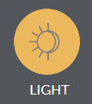

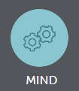
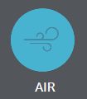
Meeting Consumer Needs
According to the “International Well Being” Institute, a non-governmental organization (NGO), people can be positively affected by their space.
Key elements include:
Light
Comfort
Mind
Air

Slide 3
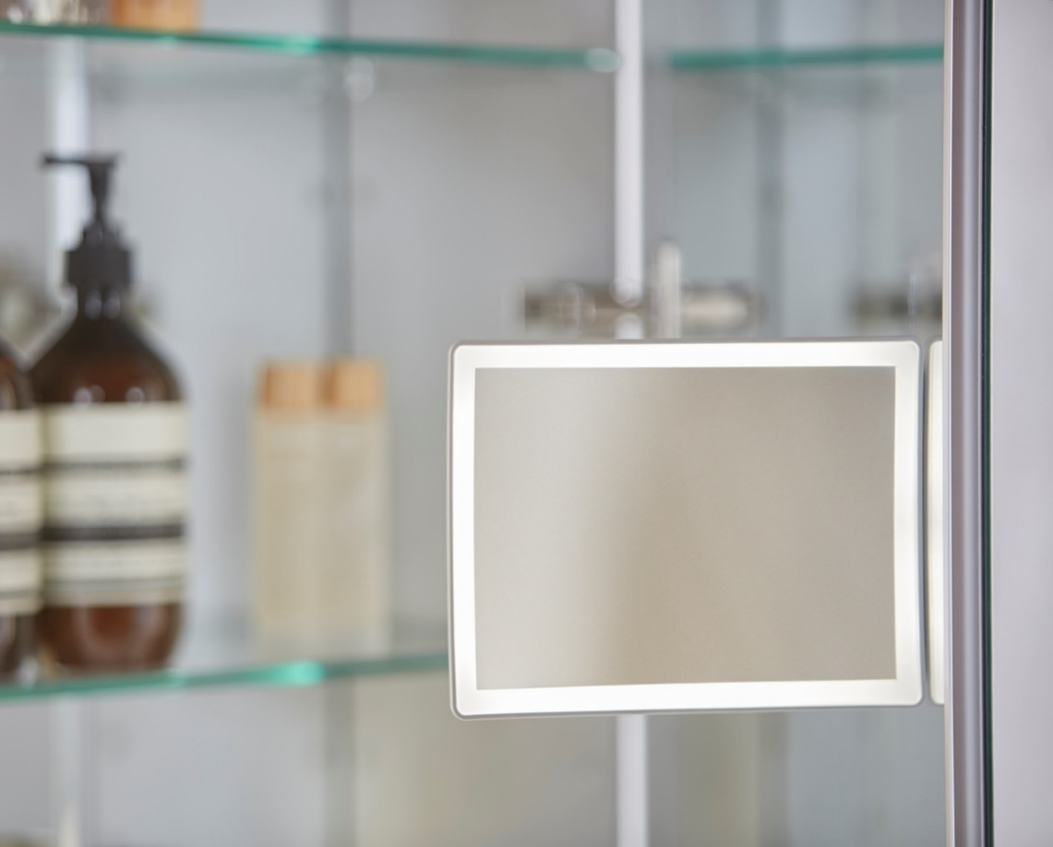
Light
Design a styling space the is appropriately lit for tasks so that you can:
  Properly see your reflection
  Avoid eye strain when grooming
  Simulate the lighting of the day ahead
    Dimming
    Tuning
  Avoids glare
Notes:
Visual Lighting Design
Part 1. Visual Acuity for Focus
Task lighting to provide 300-500 lux
Part 2. Brightness Management Strategies
The manner in which brightness is distributed across ceiling in a given room.
Circadian Lighting Design
Part 1. Melanopic Light Intensity
Light models show at least 250 melanopic lux (mLux) is present for al least 4hrs/day
Task lighting, mLux greater than or equal to lux recommendations in Vertical Targets
Color Quality
Part 1. Color Rendering Index (CRI)
CRI, average of R1-R8 of 80+ CRI, R9of 50+
Electric Light Glare Control
Lamp Shielding (diffusion)
Less than 20,000 cd/m², no shielding required
20,000- 50,000 cd/m², 15°
50,000-500,000 cd/m², 20°
500,000cd/m², 30°

Slide 4
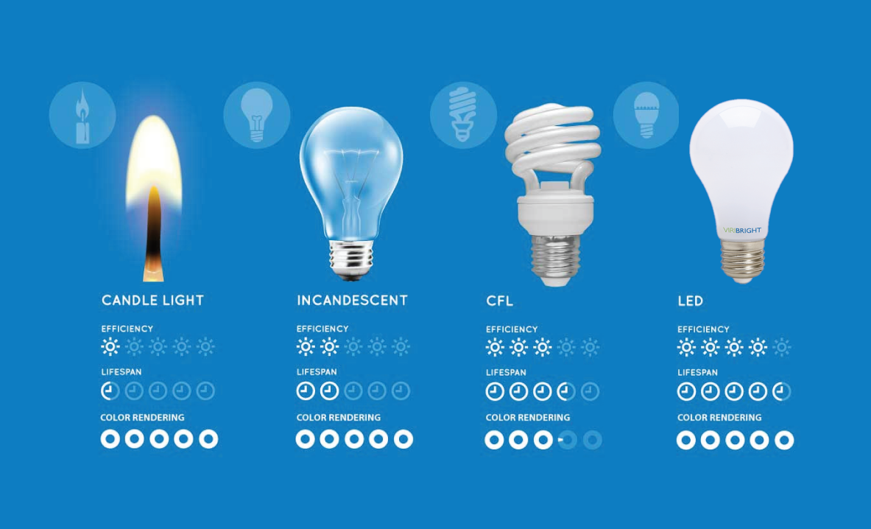
Light Sources
Light-Emitting Diode (LED)
  Brighter
  Energy Efficient
  Long Lasting

Slide 5
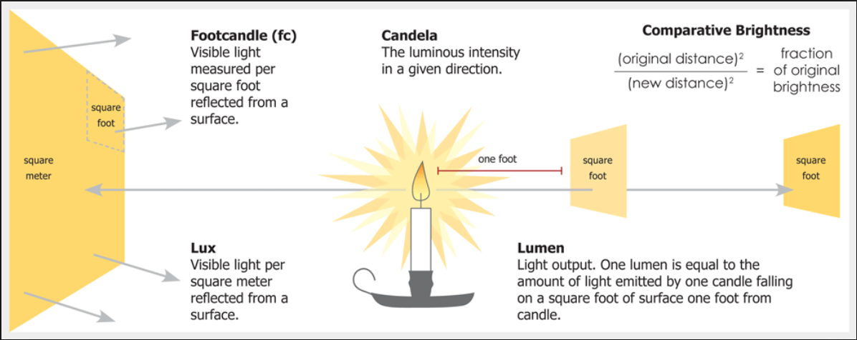
Light Source: Output and Brightness
Candela
Notes:
A measurement of light intensity. More specifically, a footcandle measures how bright* the light is one foot away from the source. (*the amount of visible light falling on a surface)

Slide 6
Light Source: Output and Brightness
Footcandle
Too much light can cause eye strain- highbeams
Mile per gallon – real world scenario
Notes:
A measurement of light intensity. More specifically, a footcandle measures how bright* the light is one foot away from the source. (*the amount of visible light falling on a surface)

Slide 7
Light Source: Output and Brightness
Lux

Slide 8
Light Source: Output and Brightness
Lumens

Slide 9
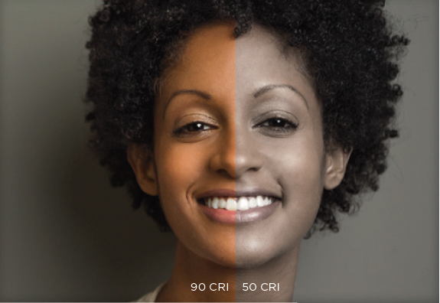
Light Source: Color Rendering
CRI
  Color Rendering Index (CRI) is the current standard metric of a light source’s ability to reveal the colors of objects faithfully in comparison with natural light. It’s the perfect CRI (100) of sunlight that makes it the standard for color rendering to which we compare all artificial light.

Slide 10
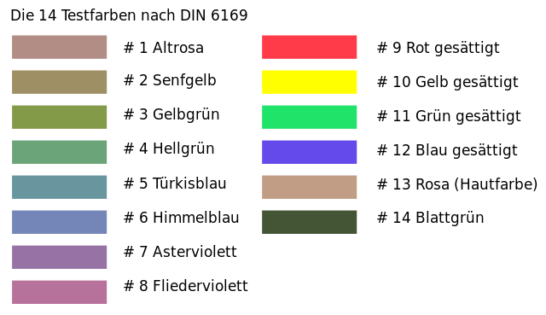

Light Source: Color Rendering
R9 Value
  CRI is not the only factor in light quality because it only contains measurements for R1-R8 values, does not measure red, which is present in skin tones and wood finishes. A light also needs to have solid “R” values that measure how well the light brings out saturated colors. The most popular indicators of high upper “R” values are R9 (red). A low value for these would indicate that a light is showing the color of an object or person to be lacking in color and dull looking.
R1
R6
R11
R2
R7
R12
R3
R8
R13
R4
R9
R14
R5
R10
Notes:
CRI is determined by averaging the color rendering for eight standard color samples drawn from European technical standard DIN 6169 Color Rendering.
CRI averages color rendering for eight color samples (R1 through R8) that are light in saturation. Manufacturers may test another six colors, including R9 through R14, which are saturated colors. These don’t contribute to CRI, though some manufacturers report R9 (saturated red) to demonstrate that their source effectively renders skin tones and wood finishes.
An R9 value of 50+ in conjunction with a CRI of 90+ is needed to accurately render colors, bring out skin tones, and accurately match makeup to skin tone.

Slide 11
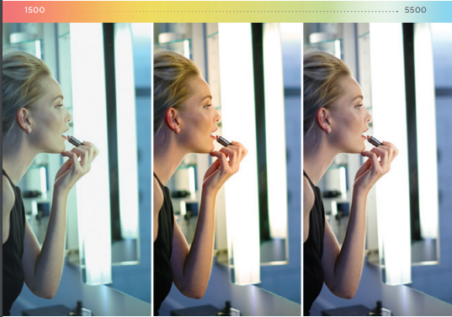
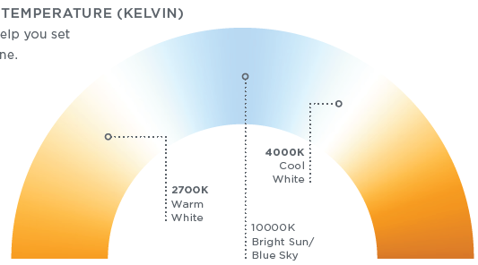
Light Source: Color Temperature
Correlated Color Temperature (CCT)
  Defines the color appearance of white in degrees Kelvin; a warm light is around 2700k, moving to neutral white at around 4000k, and to cool white, at 5000K or more.
  Measured in KELVIN
Notes:
Residential lighting is typically warm (i.e., incandescent) whereas workplace lighting is typically cooler (i.e., fluorescent). Ideally, mirror lighting will provide flexibility to examine one’s appearance under both warm and neutral white CCTs. Traditionally, this would have been addressed with duplicate light fixtures—one set with warm white lamps and one with neutral lamps.
Recent advances in LED lighting technology allow users to change the color temperature of a single fixture. New control methods allow users to easily adjust CCT using a wall controller or smartphone app.

Slide 12
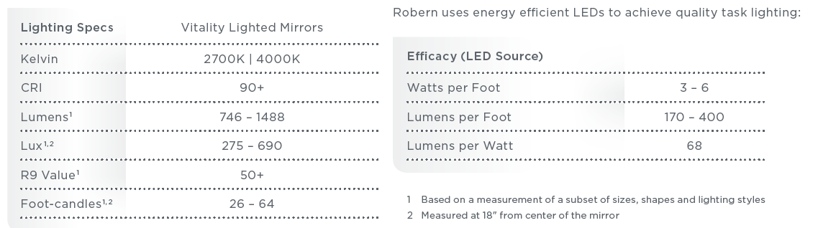

Vitality: Robern Product Specs
746 lumens is the equivalent of 50 incandescent watts.
1488 lumens is the equivalent of 100 incandescent watts.
Measure the intensity of light falling on an area of one square foot.
Measure the intensity of light falling on an area of one square meter.
Measure how well the light brings out saturated colors, in particular red.
Measure the intensity of light – specifically how bright the light is 1 foot away from the source.

Slide 13
Vitality: Robern Product Specs

Slide 14
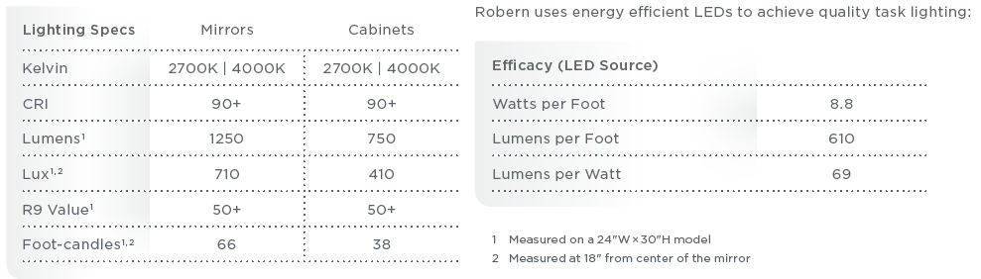
AiO: Robern Product Specs
1250 lumens is the equivalent of 80 incandescent watts.
750 lumens is the equivalent of 50 incandescent watts.
Measure the intensity of light falling on an area of one square foot.
Measure the intensity of light falling on an area of one square meter.
Measure how well the light brings out saturated colors, in particular red.
Measure the intensity of light – specifically how bright the light is 1 foot away from the source.

Slide 15
AiO: Robern Product Specs

Slide 16
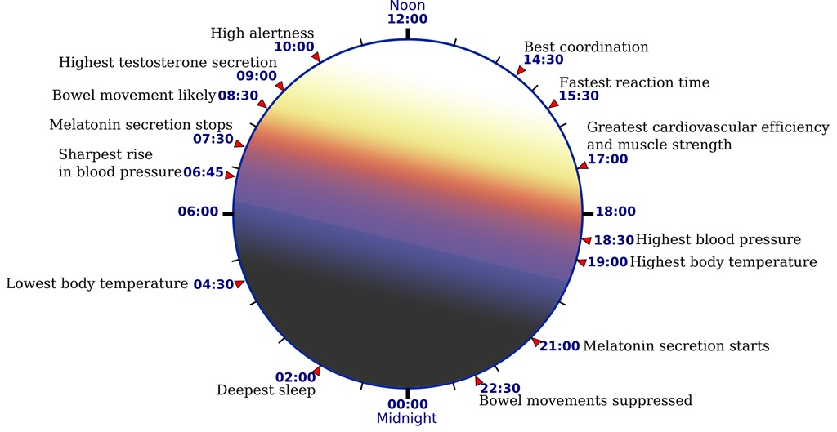
Design: Light Color Temperature
Light Color Temperature
  Circadian Rhythm
Notes:
The body’s natural cycle that produces and regulates bodily functions.
- Ex. Sleep-wake cycle
How does light influence a poor circadian response?
Artificial lighting beyond sunset or before sunrise
Short(blue) wavelengths
- Ex. TV, Mobile Device, Laptops, etc.
- “Blue light blockers”
What happens when the Circadian Rhythm is disrupted?
Effects overall health
Inability to sleep
Loss of cognitive function
Increased risk of elevated blood pressure
Increased risk of elevated cholesterol

Slide 17
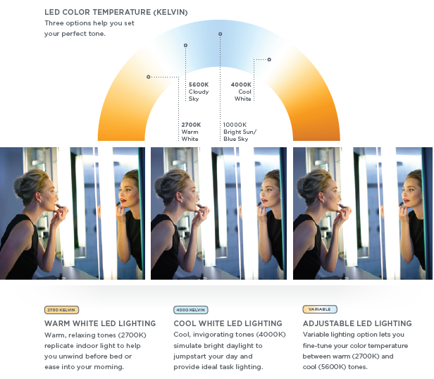
Design: Light Color Temperature
Tuning or CCT Control
  Adjusting the temperature of light between warm and cool tones
Notes:
CCT Controls are the solution to maintaining a healthy Circadian Rhythm

Slide 18
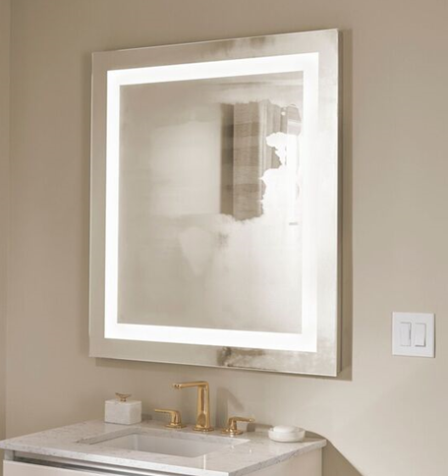

Additional Technology
Defogger

Slide 19
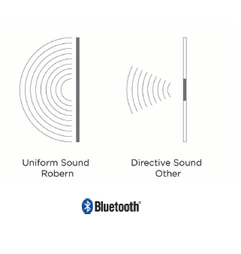
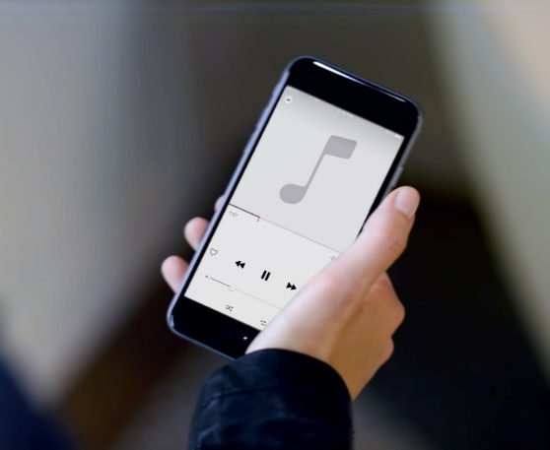
Additional Technology
Audio

Slide 20
Additional Technology
USB Charging

Slide 21
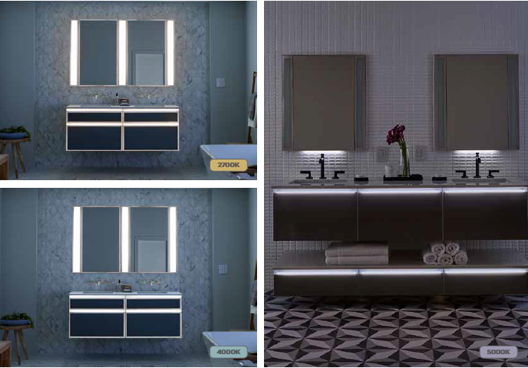
Additional Technology
Nightlight
Notes:
Availble on lighted mirrors custom

Slide 22
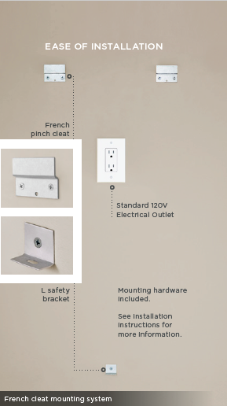
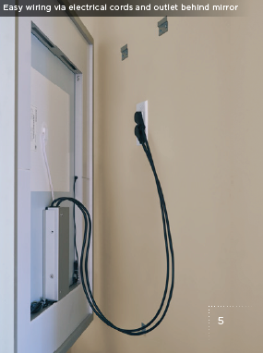
Vitality Lighted Mirror Collection
Easy Installation

Slide 23
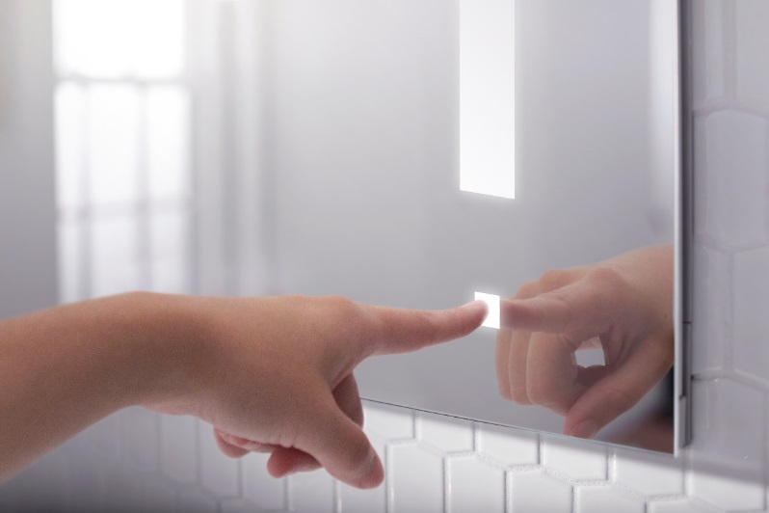
The AiO Collection
LUM_{TM} Lighting – on mirror capacitive touch task lighting that provides smooth continuous dimming with no shimmer, pop on or drop off
Optional OM_{TM} Audio turns your mirror into an audio system with invisible speakers that generate sound into the entire space around you – connect your smart phone via Bluetooth audio
USB Charging
Slim Profile
Electrical Ports (Medicine Cabinet only)
Magnetic Storage (Medicine Cabinet only)
Compact Adjustable Magnification Mirror (Medicine Cabinet only)
Entice (Medicine Cabinet only – Optional)

