Slide 1
Stainless Steel Sinks
Training Slides

Slide 2



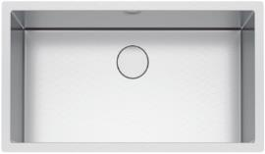
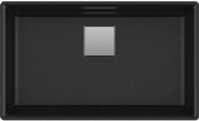
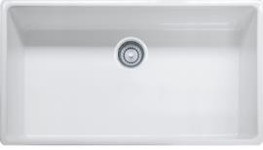
Franke is the leading SINKS producer
9% of sinks in US
FRANKE is GLOBAL #2
Brand new factory in Slovakia
70% of sinks in US
FRANKE is GLOBAL #1
Factories in US, Canada, Switzerland, China, Italy, Netherlands, Finland, Turkey, India, Brazil, Poland, Russia
13% of sinks in US
Partner production
in France, Israel
and Italy
Strong growth trend
6/13/2018

Slide 3




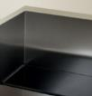
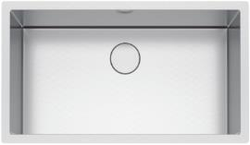

What you need to know about Stainless
Add points about steel quality
304 SS is with higher nickel content
316 is for outdoor use
≤16 gauge
Deep drawn (pressed)
Tight corners
18 gauge
Fabricated (cut, fold, weld)
20 gauge
Wide corners
≥22 gauge
Hybrid (draw, fold, weld)
Rule of thumb:
The lower the gauge, the thicker the steel, the better the quality
Keep in mind:
Hand fabrication depends on the skill of the welder
Don’t forget:
Zero radius looks great but may be harder to clean
6/13/2018
Notes:
Up to what radius can you deep draw?
Talk about cleaning issue

Slide 4
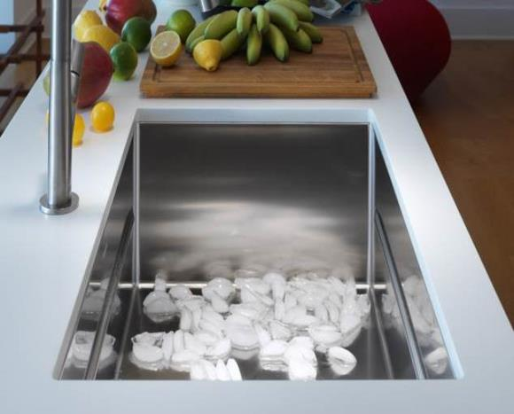
Stainless steel is the #1 choice for sinks
Corrosion-Proof
Premium quality chrome nickel steel makes sinks highly resistant to staining, rust, and corrosion
Self-Regenerating
Stainless steel surfaces develop a passive protective layer that continuously renews so your sink is easy to clean and care for
Timeless
Design that lasts
Pore-Free
Naturally hygienic
Durable
Temperature and acid resistant
Environmentally
Friendly
100% Recyclable
5/15/2018

Slide 5
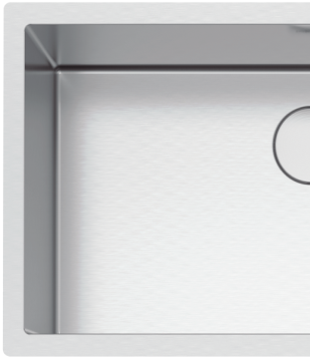
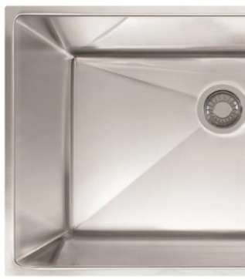



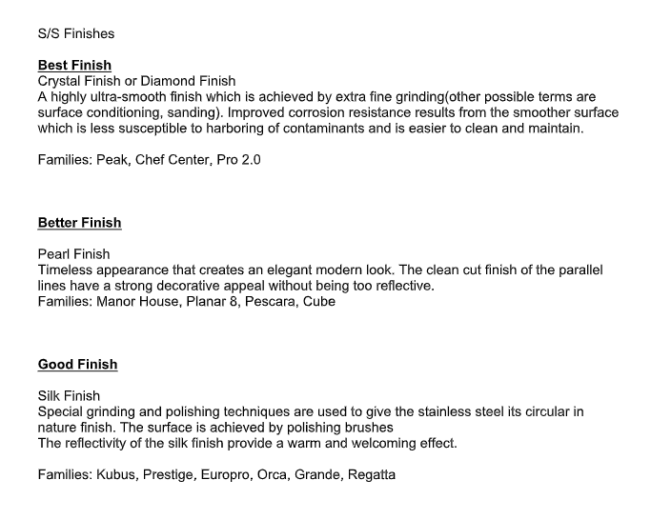
Franke offers three finishes
Our diamond finish creates a shiny, almost flawless, appearance that highlights the sinks elegance and makes it an attractive centerpiece to your kitchen
This Franke exclusive is fingerprint proof and feels warm to the touch
This elegant, easy-to-clean finish is beautifully shiny in appearance and nearly scratch resistant
CulinaryCenter, ChefCenter, PEAK, Crystal, Planar 8
ManorHouse, Pro Outdoor, Pescara, Cube
Kubus, Prestige, Orca 2.0, Regatta, Grande, Rotondo
1/18/2019

Slide 6






17 families of sinks in our collection
Manor House
Chef Center
4
$2’395
$2,599
PEAK
Culinary Center
New
$2,430
$2,295
PROFESSIONAL 2.0
CRYSTAL
$1’655
$1’645
9
PROFESSIONAL OUTDOOR
KUBUS
$875
$1’065
PLANAR 8
PESCARA
$1’475
$1’095
PRESTIGE
ORCA 2.0 / ORCA
$675
$995
New
4
REGATTA
CUBE
$965
$825
GRANDE
ROTONDO
$795
$535
Note: prices indicate list price for an average single bowl in the family
1/17/2019

Slide 7
Franke features by model
Family | 16G | 18 G | 19 G | 20 G | Under | Sound | Finish | Fabricatate | Accessory ledge | Waste | Radius | Depth
 |  |  |  |  | coating | Pads |  |  |  | cover
Peak | ü |  |  |  | ü | ü | Diamond | Handmade | ü | ü | 5 mm | 10”
Culinary |  |  | ü |  |  | ü | Diamond | Handmade |  | ü | 12mm | 9"
Chef Center |  | ü |  |  | ü | ü | Diamond | Handmade | ü | ü | 12 mm | 9”
Pro Series 2 | ü |  |  |  | ü | ü | Diamond | Handmade | Cutout | ü | 8 mm | 10”
Manor house | ü |  |  |  |  | ü | Pearl | Handmade |  |  | 19 mm | 9”
Kubus |  | ü |  |  | ü | ü | Silk | Deep drawn/Cicle weld | ü |  | 25 mm | 9”
Crystal | ü |  |  |  | ü | ü | Diamond | Handmade |  | ü | 0 | 9"
Planar 8 |  | ü |  |  |  | ü | Diamond | Handmade |  |  | 8 mm | 9”
Pescara |  | ü |  |  | ü | ü | Pearl | Handmade | ü | ü | 20 mm | 9”
Orca 2.0 |  | ü |  |  | ü | ü | Silk | Deep drawn/Cicle weld | ü | ü | 30mm | 9"
Orca |  | ü |  |  | ü | ü | Silk | Deep drawn/Cicle weld | ü |  | 70+ mm | 9”
Prestige |  | ü |  |  | ü | ü | Silk | Deep drawn/Cicle weld | ü |  | 83mm | 9"
Cube |  | ü |  |  | ü | ü | Diamond | Handmade |  |  | 12 mm | 9”
Grande |  | ü |  |  | ü | ü | Silk | Deep drawn/Cicle weld |  |  | 50 mm | 9”
Rotondo |  |  |  | ü |  | ü | Silk | Deep drawn/Cicle weld |  |  | N/A | 6"

Slide 8
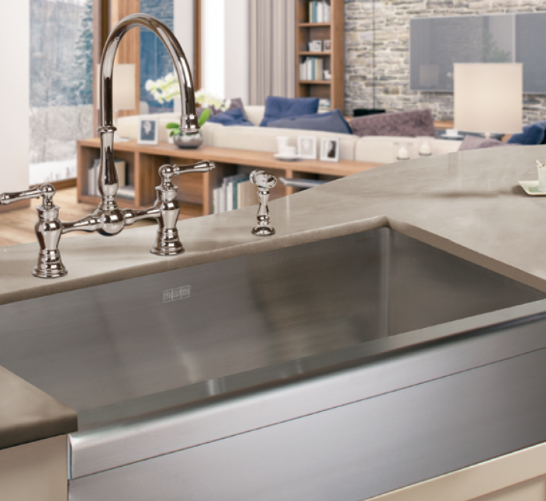
Manor House
Traditional Apron front design
With Apron front sink the face of the sink can be closer to your body making it easier to reach into the sink
19mm corners|9.0625” deep
16 gauge
Satin Finish
Sound pads
Compatible accessories
3 models
30”, 33”, 36”
Hand Fabricated
SINK | STAINLESS | MANOR HOUSE

Slide 9

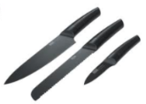
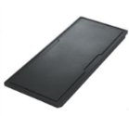
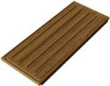
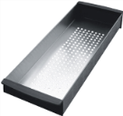
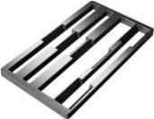
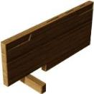
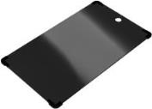
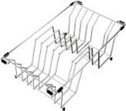
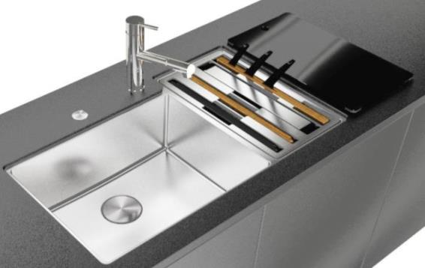
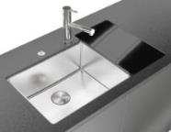

Culinary Center
Innovation meets beauty
Workstation that put everything at your fingertips
9$\frac{3}{16}$” and 8$\frac{1}{16" }$ Bowls
19 Gauge
Diamond Finish
Sound Pads
Accessories Included
Walnut, Plastic, and Glass Cutting boards, Knife Holder with Knives, Colander, Wire Rack, and Frame Cover
SINK | STAINLESS | CULINARY CENTER

Slide 10
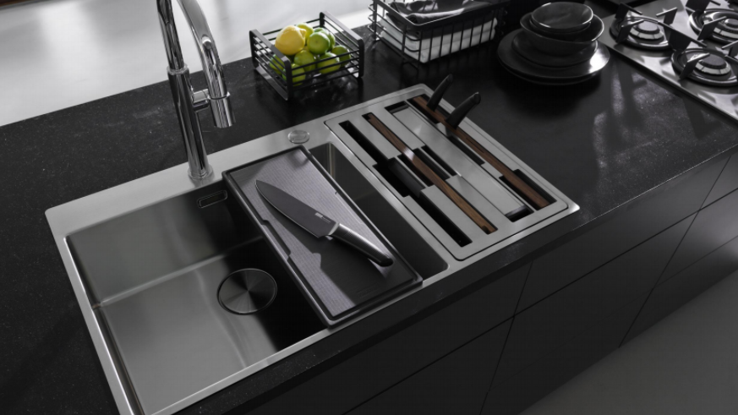
MS/LC

Slide 11
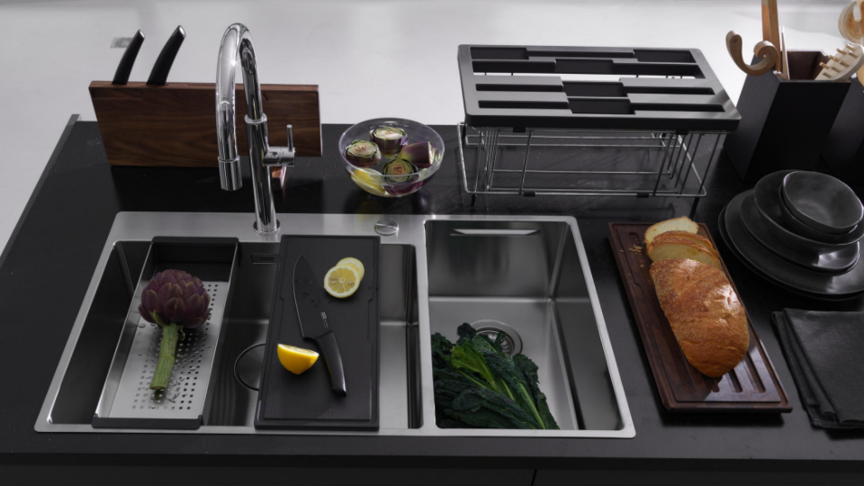
MS/LC

Slide 12
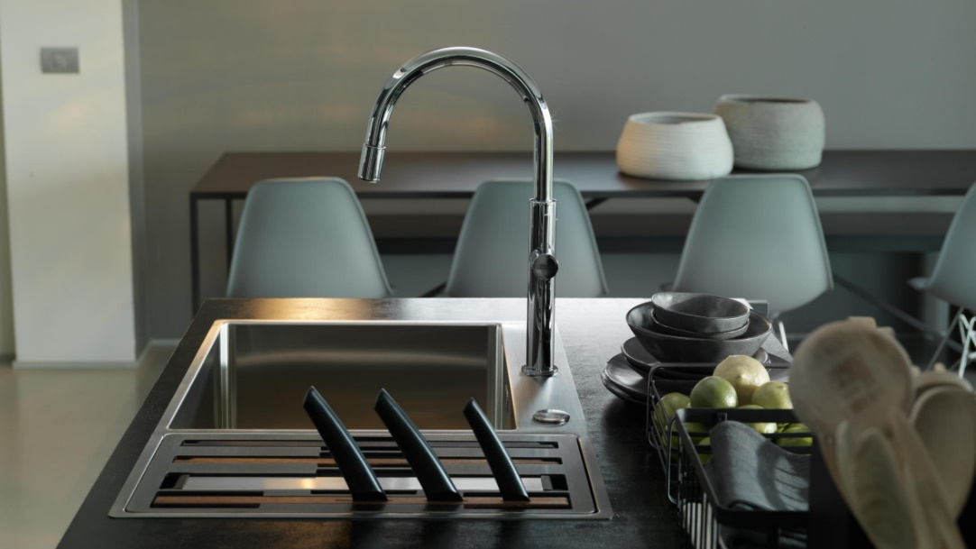
MS/LC

Slide 13
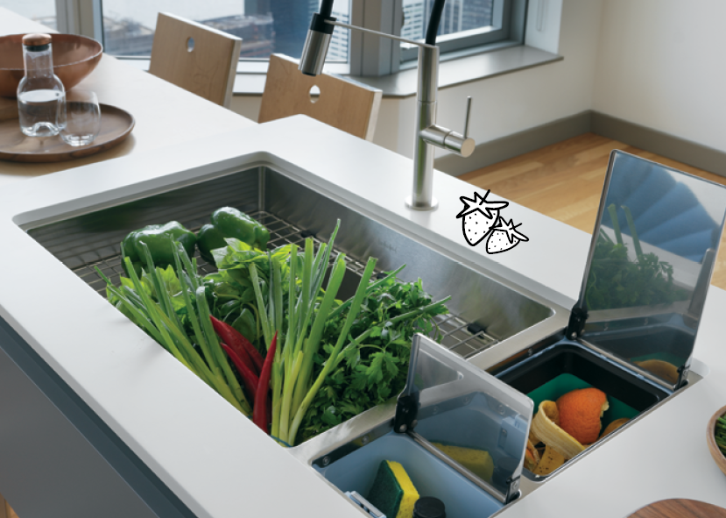
Chef Center
Art of Innovation
Seamless workflow, from prepping to cleaning to entertaining
12mm corners|9” deep
18 gauge
Silk Finish
Sound pad and spray coat
Accessories Included:
Bottom/Shelf Grid, Glass Cutting Board, Cutting Mat, Colander, Roller Mat, and Drain Board
3 models: 33”, 36” & 45”
Hand Fabricated
SINK | STAINLESS | CHEF CENTER

Slide 14
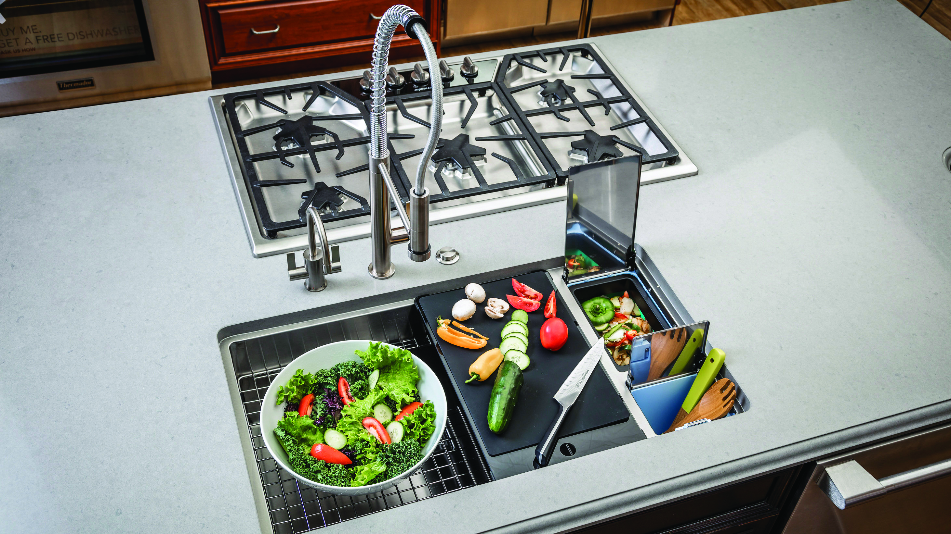

Slide 15
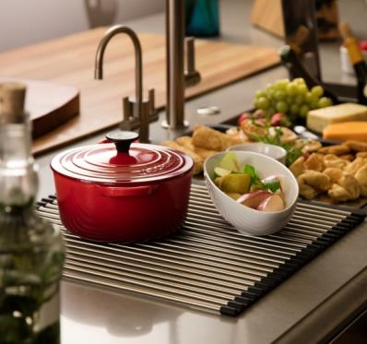


CHEF CENTER is THE HEART OF THE KITCHEN
THE OLD DAYS
TODAY
Guests are entertained
anywhere but in the
kitchen
The kitchen is the
sole resort of
the housewife
Guests are entertained
in the kitchen
Everybody gathers
in the kitchen
The oven is the
pride of the kitchen
The sink is
for cleaning dishes
Chopping, preparing,
arranging are the modern
methods of cooking
The sink is an
entertainment center
37% of homeowners are upgrading to a kitchen island
5/15/2018

Slide 16
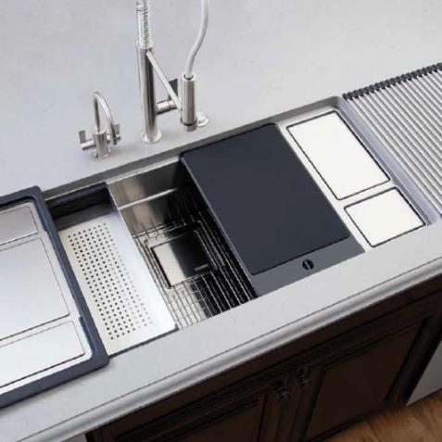












WORK IN three APPLICATIONs
PREPARE
ENTERTAIN
Removable Compost Bin
Colander
Removable Cutting Board
Storage Bin
Glass Serving Board
Ice Bucket & Condiment Bin
Steel Serving Tray
Universal Roller Mat
USP
USP
USP
USP
CLEAN
Drain Board
Roller Mat Dish Rack
Cleaning Tool Storage Bin
Large Single Bowl Sink
USP
5/15/2018

Slide 17
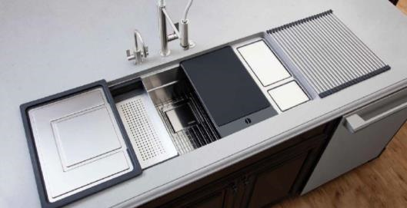
Comes with superior functionality
Universal Roller Mat
Multi-functional accessory acts as a dish drying rack, trivet and is perfect for rinsing vegetables and fruit.
Multi-Level Grid
Creates a higher level ergonomically work space
Removable Composting Bin
Antimicrobial material reduces odors
Ice Cooler
Remove composting bin and self-draining storage area doubles as an ice cooler.
Colander
Integrated to sit on sink ledge
Drain Board
Sloped design directs water back to sink
Serving Tray
Nestles onto ledge of sink
Storage Compartment
Self contained storage bin is perfect for storing prep and cleaning tools.
Large 18 Gauge 9” Deep Single Bowl
Makes washing larger cookware easier. Cookie sheets and roasting pans lay flat.
Cutting Board
Slides easily across sink ledge to move food scraps to composting bin
Glass Serving Tray
Doubles as a serving board or cheese tray
5/15/2018

Slide 18
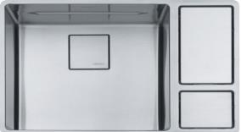
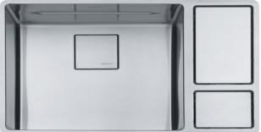
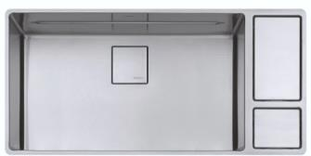
New XL version available
Model # | CUX11018-W | CUX11024-W | CUX11031-W
Overall Sin Size (OD) | 28 1/8” x 18 7/8” | 33 5/8” x 18 7/8” | 41 5/8” x 18 7/8”
Bowl Size (ID) | 18 1/8” x 16 1/8” x 9” | 23 5/8” x 16 1/8” x 9” | 31 5/8” x 16 1/8” x 9”
Bowl Depth (ID) | 9” | 9” | 9”
Sound Coating | Yes | Yes | Yes
Anti Noise Pads | Yes | Yes | Yes
Minimum Cabinet | 33” | 36” | 45”
Installation Type | Undermount
Material | Type 304 / 18 gauge Stainless
Included Accessories | Drain board, roller mat, glass cutting board, sink grid, colander, square drain cover
4/1/2019

Slide 19
MANOR HOUSE
Traditional Apron front design
With an Apron front sink the face of the sink can be closer to your body making it easier to reach
19mm corners|9” deep
16 gauge
Pearl Finish
Sound pads
Compatible accessories
3 models (30”, 33”, 36”)
Hand Fabricated
SINK | STAINLESS | MANOR HOUSE

Slide 20
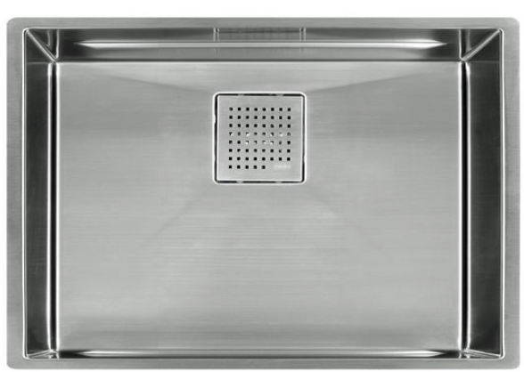
PeAK
Metropolitan Elegance
Tight corners and design symmetry
Ledge System allows optional accessories
Square Drain Covers
5mm corner
9.625” deep
16 gauge
Silk Finish
Sound pad and spray coat
Compatible accessories
8 models
Hand Fabricated
SINK | STAINLESS | PEAK

Slide 21
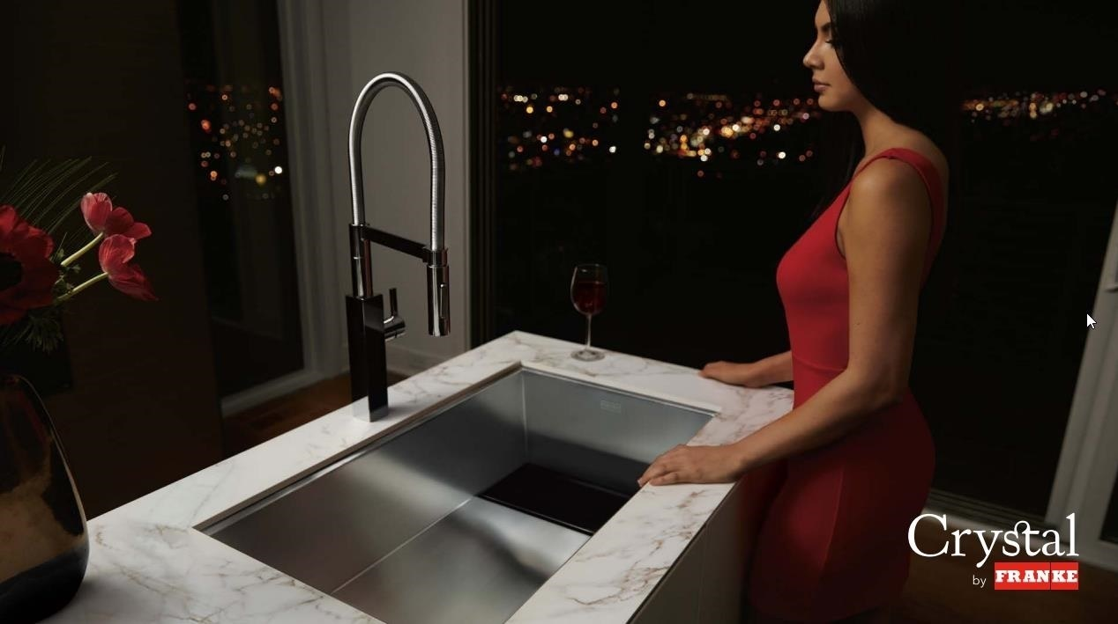
5/15/2018

Slide 22
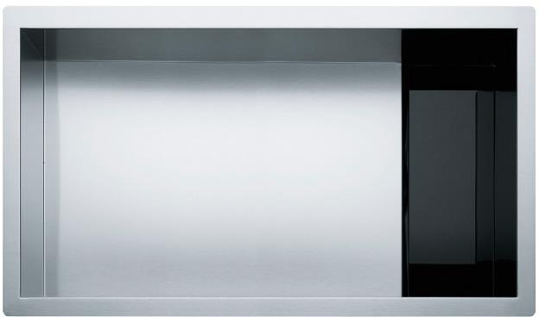
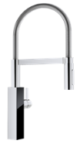
CrYstal
Unique, contemporary design
Hidden Drain with Glass or Stainless Drain Cover
90° corners|9” deep
16 gauge
Sound pad and spray coat
Compatible accessories
4 models including
double bowl
Hand fabricated
Design matching
Crystal Faucet
SINK | STAINLESS | CRYSTAL
1/17/2019

Slide 23


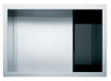
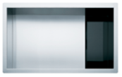
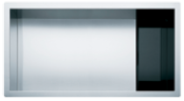
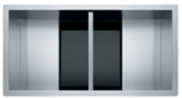



Crystal
SINK | STAINLESS | CRYSTAL
Key Features
Specs
Matching Faucet
Exclusive design for drain cover
Matching CRYSTAL faucet
Contemporary design
16 Gauge
9” deep
90° corners
CRYSTAL
FFPD4600
Models
Accessories
Bottom Grid
Cutting Board
Colander
24½”
CLV110-24
27½”
CLV110-28
30½”
CLV110-31
32½”
CLV120-33
Roller Matt
Drain Cover
Push Button
Strainer Kit
5/15/2018

Slide 24
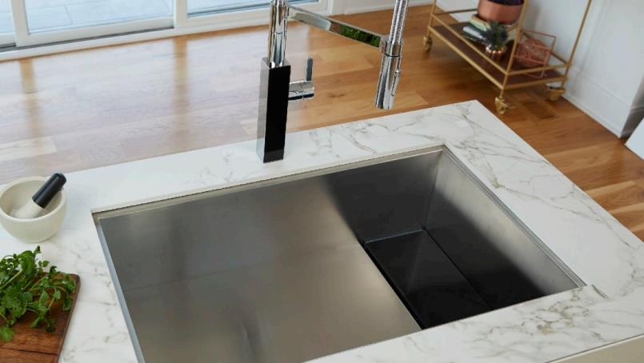
5/15/2018

Slide 25
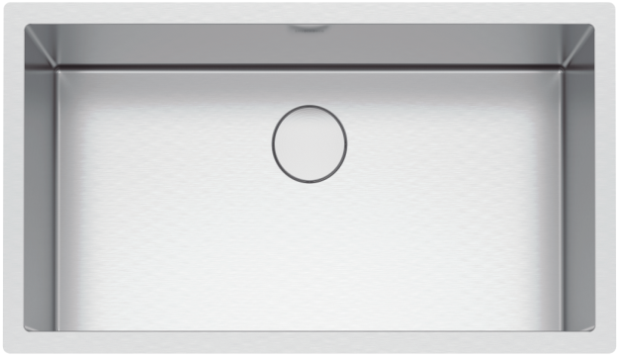
Professional 2.0
Hard-working, commercial-grade
Perfect partner for the serious home chef
Round drain cover
8mm corners|10” deep
16 gauge
Silk finish
Sound pad and
spray coat
Lifetime warranty
12 models
Hybrid (Drawn and welded)
SINK | STAINLESS | PRO 2.0
1/17/2019

Slide 26
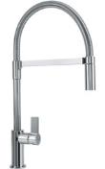














Professional 2.0
SINK | STAINLESS | PRO 2.0
Key Features
Specs
Matching Faucet
Excellent quality of material and craft
Contemporary design and beauty
Silk finish and round drain cover included
Large variety of sizes
16 Gauge
10” deep
8mm corners
PLANAR 8
FF2800
Models
Accessories
Bottom Grid
Cutting Board
Colander
17½”
PS2X110-15
35½”
PS2X110-33
35½”
PS2X120-16-16
Roller Matt
Drain Cover
Strainer basket
5/15/2018

Slide 27
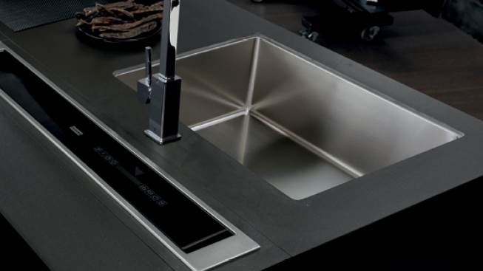
5/15/2018

Slide 28
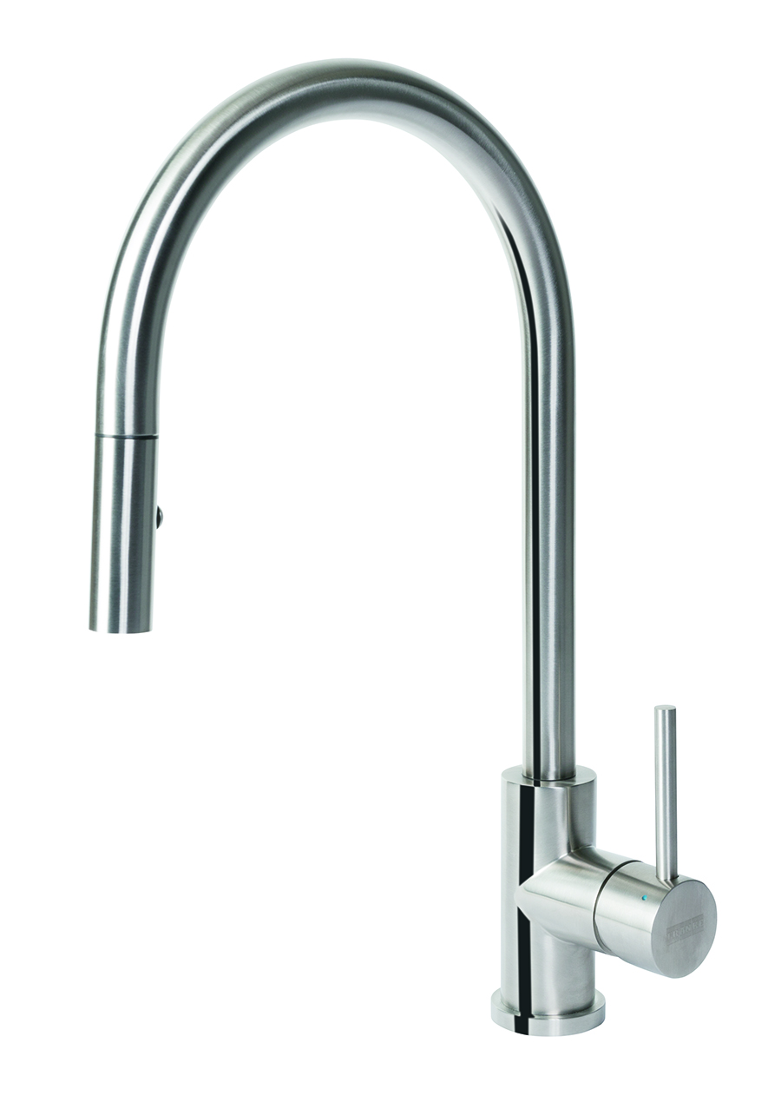
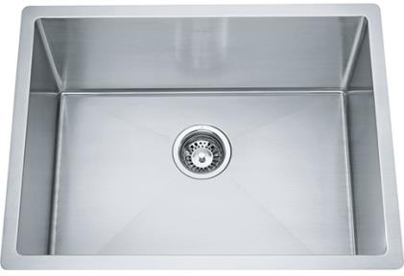
Professional OUTDOOR
Stainless perfection
316 steel used in sink and faucet for perfect outdoor durability
Sink comes in one size (23”) and two depths (10/12”)
18 gauge quality T316
SINK | STAINLESS | OUTDOOR
LRX110-2310-316 Outdoor 23" SS 316 10" Deep $825.00
LRX110-2312-316 Outdoor 23" SS 316 12" Deep $875.00
PS23-36S 23" Bottom Grid $245.00
FF3352 CUBE 316 Steel Faucet $580.00
1/17/2019

Slide 29
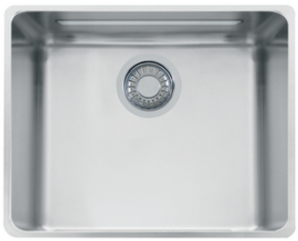
KUBUS
Balanced Beauty
Straight lines create a clean, modern look
Ledge System allows optional accessories
25mm corners|9” deep
18 gauge
Silk Finish
Sound pad and spray coat
9 models including
double bowl
Deep Drawn manufacturing
SINK | STAINLESS | KUBUS

Slide 30
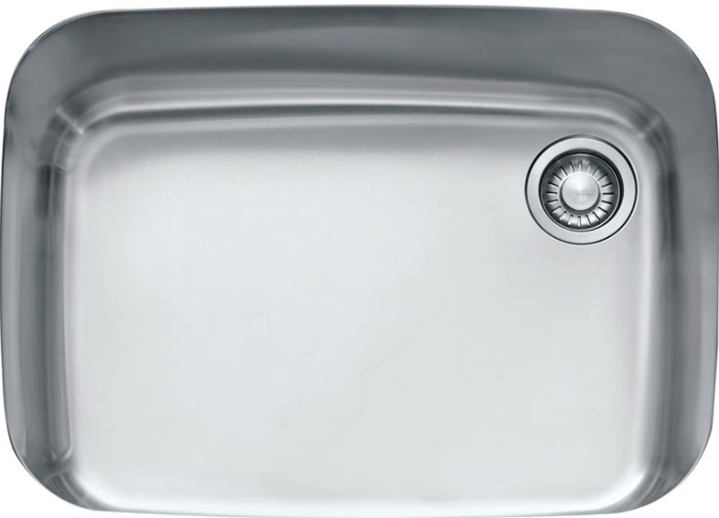
EUROPRO
An Icon Reimagined
Deliver maximum functionality with classic style
99 mm corner
8-11” deep
18 gauge
Silk Finish
Sound pad and spray coat
Compatible accessories
3 models
Deep Drawn Construction
SINK | STAINLESS | EUROPRO

Slide 31

PLANAR 8
Modern Simplicity
Clean lines for the ultimate contemporary urban look
8mm corners|9.5” deep
18 gauge
Diamond Finish
Sound pad and spray coat
Compatible accessories
4 models
Hand Fabricated
SINK | STAINLESS | PLANAR 8

Slide 32
PESCARA
Metropolitan elegance
Tight corners and design symmetry
Ledge System allows optional accessories
Square Drain Covers
5mm corner
9.625” deep
16 gauge
Pearl Finish
Sound pad and spray coat
8 models
Hand Fabricated
SINK | STAINLESS | PESCARA
1/17/2019

Slide 33






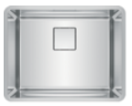
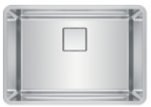
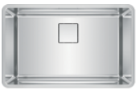



PESCARA
SINK | STAINLESS | PESCARA
Key Features
Specs
Matching Faucet
Great price / quality
Integrated ledge, square drain cover included
Comprehensive accessories
Matching faucet line
18 Gauge
9½” deep
20mm radius
Pescara 360
FF4400
Models
Accessories
Bottom Grid
Cutting Board
Colander
18” cabinet
PTX110-14
30” cabinet
PTX110-25
36” cabinet
PTX110-31
Glass cutting
board with self-
healing mat
Shelf Grid
Strainer basket
1/20/2018

Slide 34

PRestige
Profoundly Versatile
Large deep bowl with traditional style
Ledge System allows shelf grid
D bowl |9.06” deep
18 gauge
Silk Finish
Sound pad and spray coat
Compatible accessories
6 models
Deep Drawn Construction
SINK | STAINLESS | PRESTIGE

Slide 35




ORCA 2.0
Transcending Time
A roomy sink to accommodate large cookware and big taks
Integrated ledge
Compatible accessories
30mm/83.5mm Corners
18 gauge
Silk Finish
Sound pad and spray coat
Deep drawn fabrication
SINK | STAINLESS | ORCA 2.0
Jun

Slide 36

ORCA
Transcending Time
Transitional design that allows you to customize your sink to fit your lifestyle
Integrated ledge
Compatible accessories
83.5mm corner
9.06” deep
18 gauge
Silk Finish
Sound pad and spray coat
Deep Drawn Fabrication
SINK | STAINLESS | ORCA

Slide 37

REGATTA
Timeless Classic
Traditional design double bowl design offers large deep bowls while remaining space conscious
113mm corner
8.87” deep
18 gauge
Silk Finish
Sound pad and spray coat
Compatible accessories
1 model
Deep Drawn Fabrication
SINK | STAINLESS | PEAK

Slide 38

CUBE
Classically Modern
Transitional design with plenty of space for prep or cleanup in the kitchen
8mm corners
9” deep
18 gauge
Diamond Finish
Sound pad and spray coat
Compatible accessories
10 models
Hand Fabricated
SINK | STAINLESS | CUBE

Slide 39

GRANDE
Artistic Style
Traditional design with large flat surface and the convenience of wide corners
50mm corners
9” deep
18 gauge
Silk Finish
Sound pad and spray coat
Compatible accessories
7 models
Deep Drawn Fabrication
SINK | STAINLESS | GRANDE

Slide 40

rotondo
Versatility Defined
Attractive round design
Smaller size that works well in the kitchen, bar, or laundry
6.56” deep
20 gauge
Radiant Silk Finish
Sound pad and spray coat
Compatible accessories
1 model
Deep Drawn Fabricated
SINK | STAINLESS | ROTONDO

Slide 41
Specifications Stainless steel sinks
1. Speed 2. Joint Power
1/18/2019

