Slide 1
Uplift® Tech
Medicine Cabinet

Slide 2
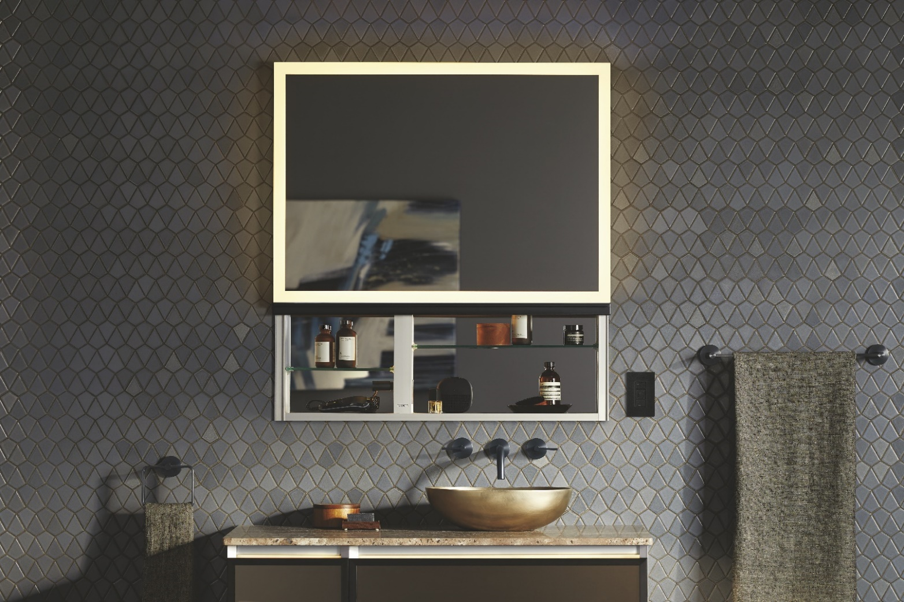
Introducing Uplift® Tech
Raise your expectations for styling space design. Uplift Tech enhances the innovative features of the classic Uplift Medicine Cabinet with state-of-the-art technology, superior task lighting, and luxurious finishes to create a cutting-edge storage solution that is seamlessly functional and beautifully versatile.

Slide 3
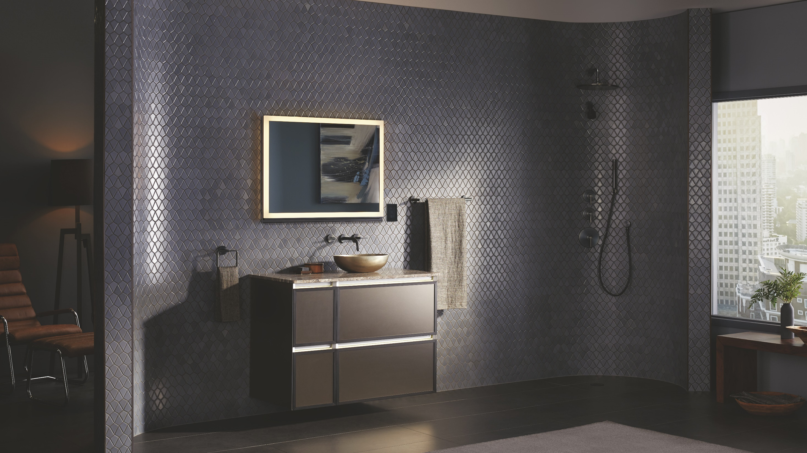

Slide 4
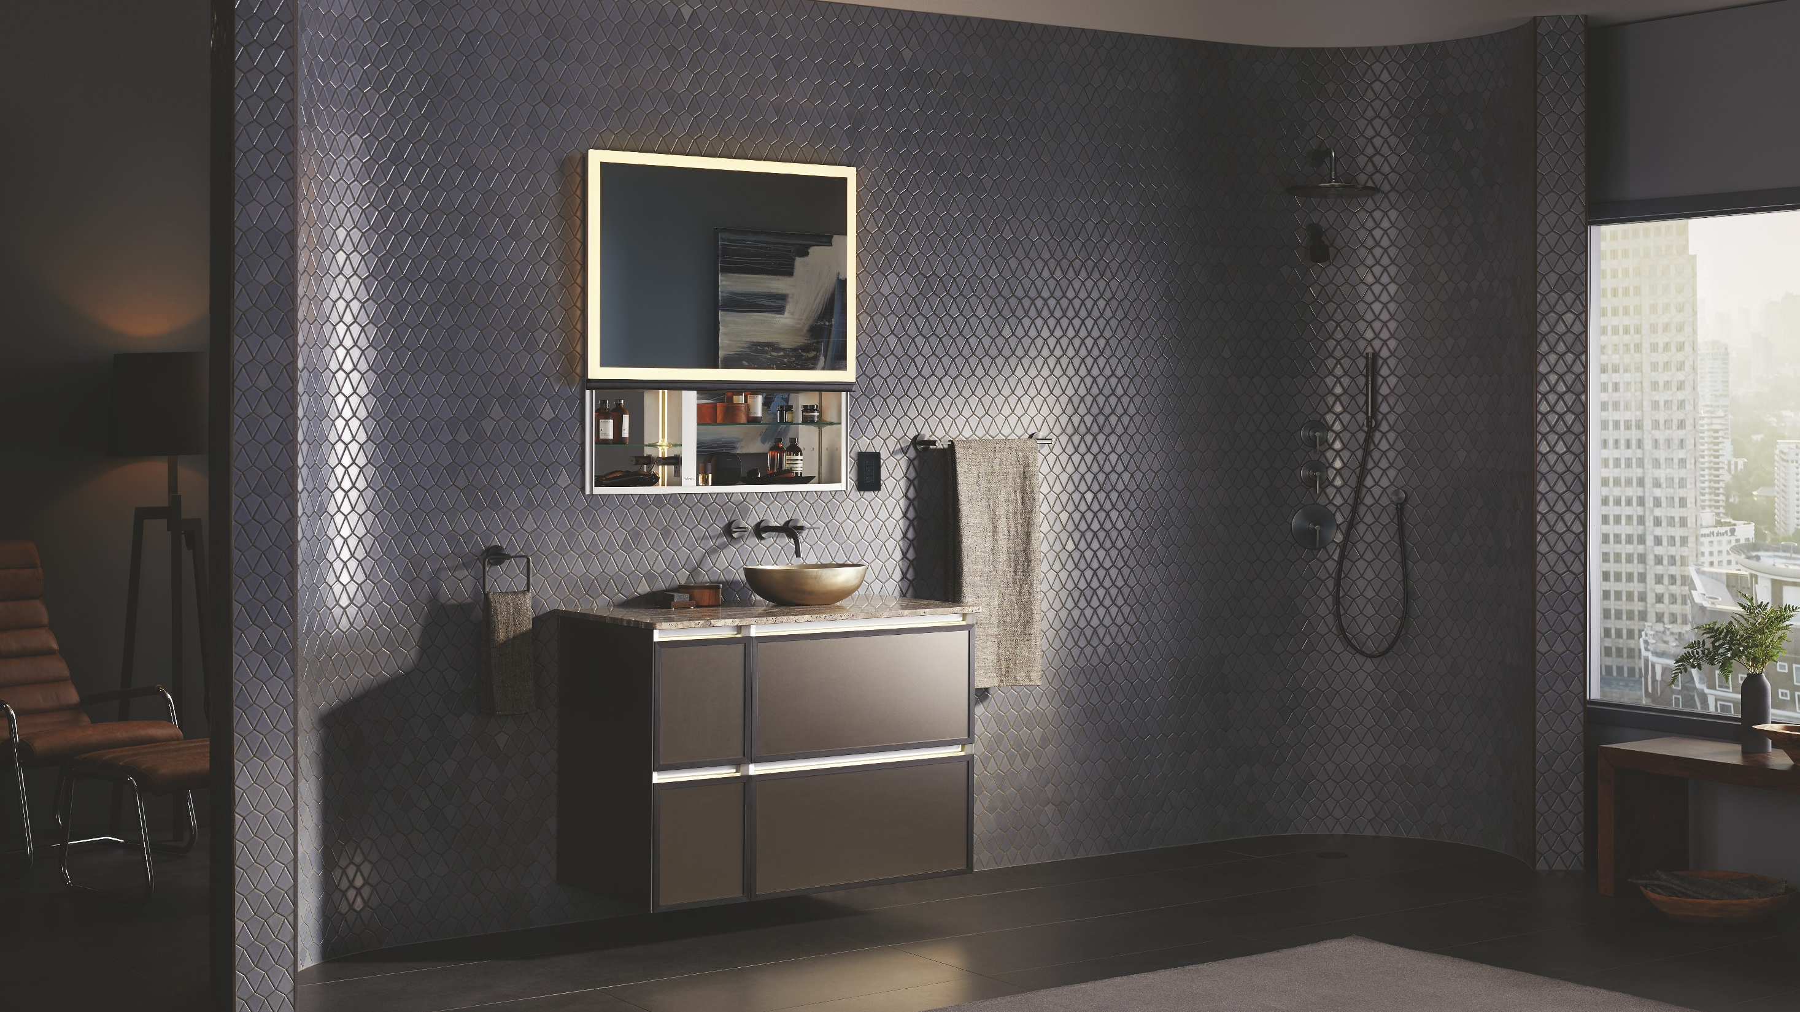

Slide 5
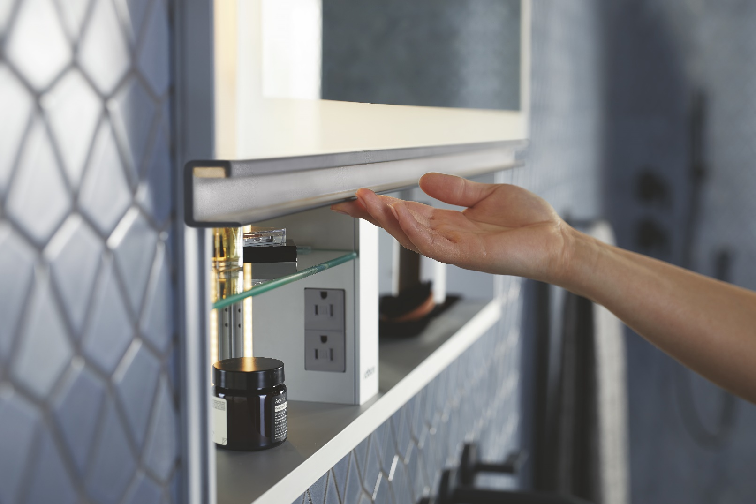
Uplift® Tech – How did it come to be?
Customer Feedback
  Integrated Lighting (like AiO)
  Handle to match faucets
  USB ports (like M Series, AiO)
  24” version – urban markets
Market Data
  Sales in high end medicine cabinets are growing at a higher rate than the overall market
  Functionality – electrical outlets and light fittings inside of product
  Cabinet with clean lines
  Shades of gray

Slide 6
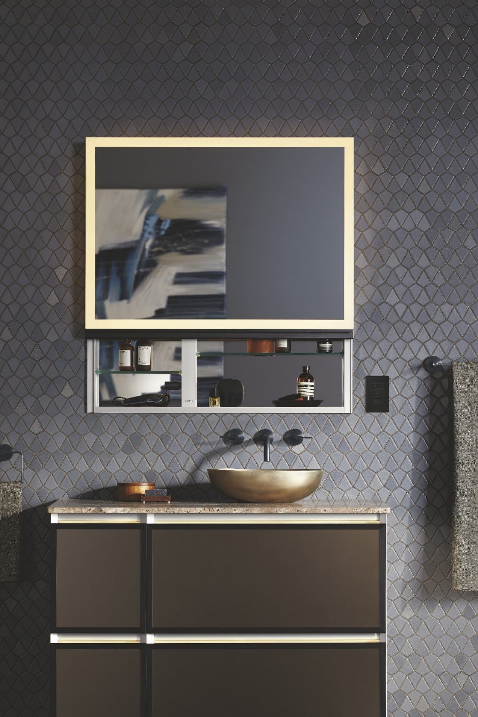
Uplift® Tech – Key Features & Benefits
Streamline your routine with functional features like defogging, night light, integrated electrical outlets, and built-in USB charging.
  Vertically opening doors won’t interfere with tall faucets or hanging light fixtures, allowing for unparalleled design flexibility even in small spaces.
  The Perimeter lighting option illuminates the Uplift Tech with Robern’s industry-leading task lighting.
  Available with upgraded handle options in popular finishes. Choose modern Matte Gold or Matte Black, or timeless Chrome or Polished Nickel, and pair with color-matched Kallista and Kohler finishes for a coordinated look.
  With a wide array of available sizes, Uplift Tech offers a modular solution that seamlessly fits together to meet the unique needs of any space.

Slide 7
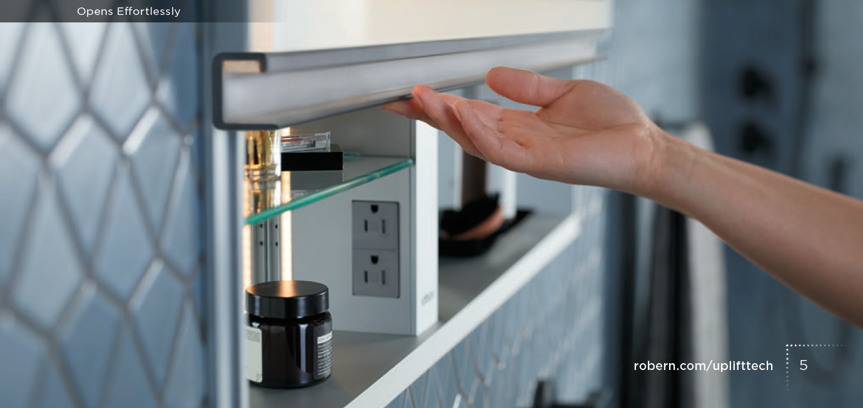
Uplift® Tech – Seamless Ergonomic Design
The handle enables effortless two-finger lifting, allowing for easy access to tools and essentials.
Notes:
NL is shown inside of the handle

Slide 8
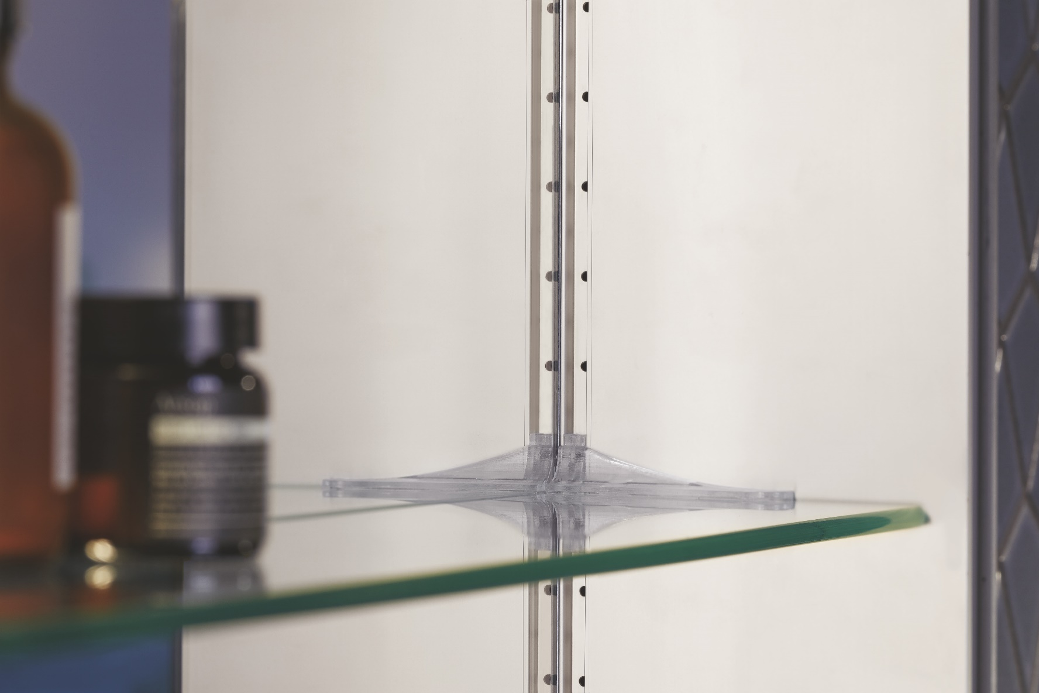
Uplift® Tech – Seamless Ergonomic Design
Adjustable cantilever shelving can be easily placed and repositioned to create a personalized storage solution. Provides a clean interior aesthetic.

Slide 9
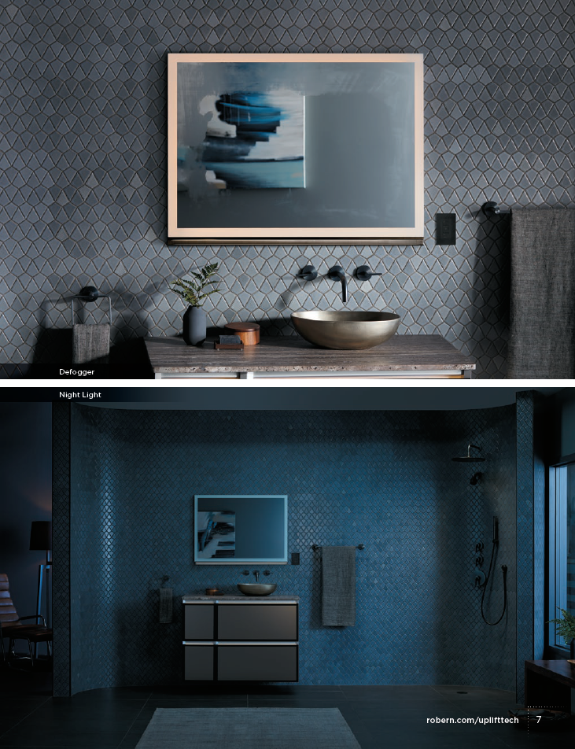
Uplift® Tech – Innovation Technology
Eliminate delays in your daily routine with defogging technology that turns on with the push of a button and is equipped with a 45-minute timer.
The LED night light can be turned on and off using in-cabinet controls or programmed to provide nighttime illumination in 12-hour increments.

Slide 10
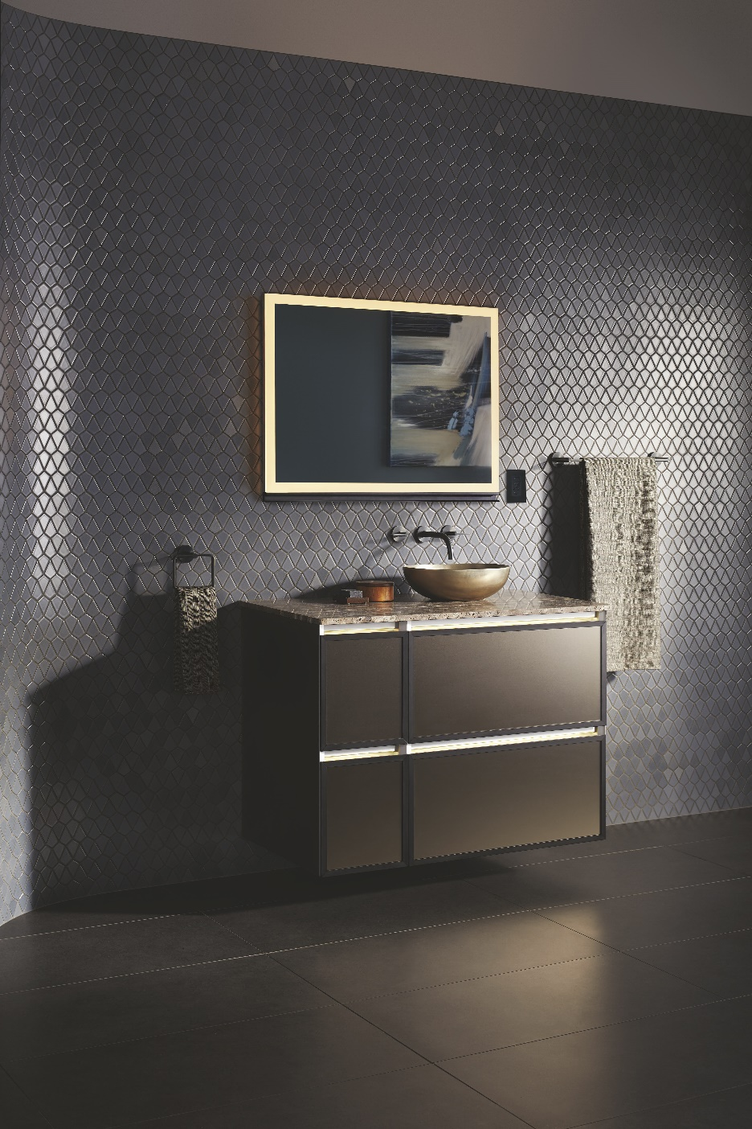
Uplift® Tech – Innovation Technology
Task lighting is integrated into the mirror to provide a high-quality reflection, so you look and feel your best.

Slide 11
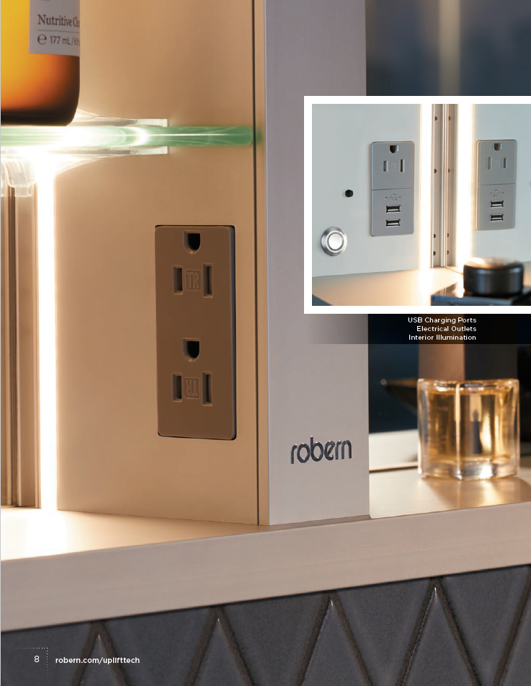
Uplift® Tech – Thoughtful Features
With Uplift Tech, even the smallest details serve a distinct purpose:
Integrated USB ports keep your phone charged and close at hand.
Tamper resistant plugs add convenience and safety.
Interior illumination and adjustable shelving make it easy to access your essentials.

Slide 12
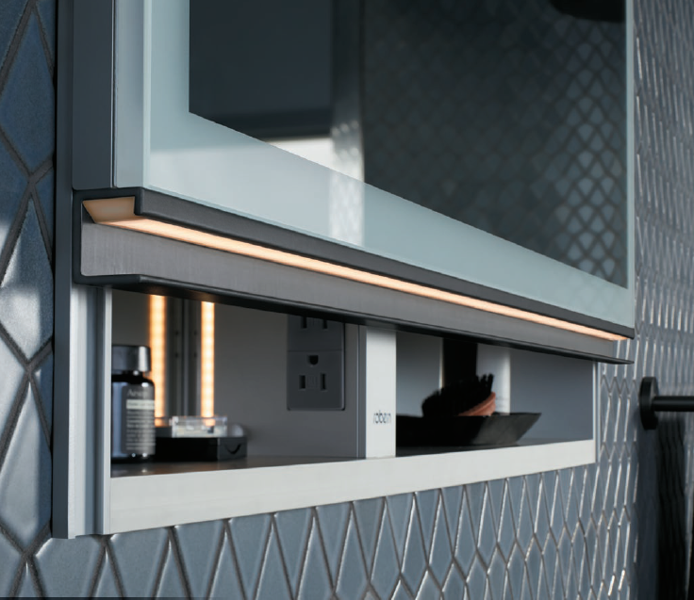
Uplift® Tech – New Handle Design
Uplift® Tech features an anodized aluminum handle, with the option to upgrade to a premium metal finish that pairs with your color palette.
Notes:
Optional handle accessory in Chrome, Polished Nickel, Matte Gold, Matte Black

Slide 13
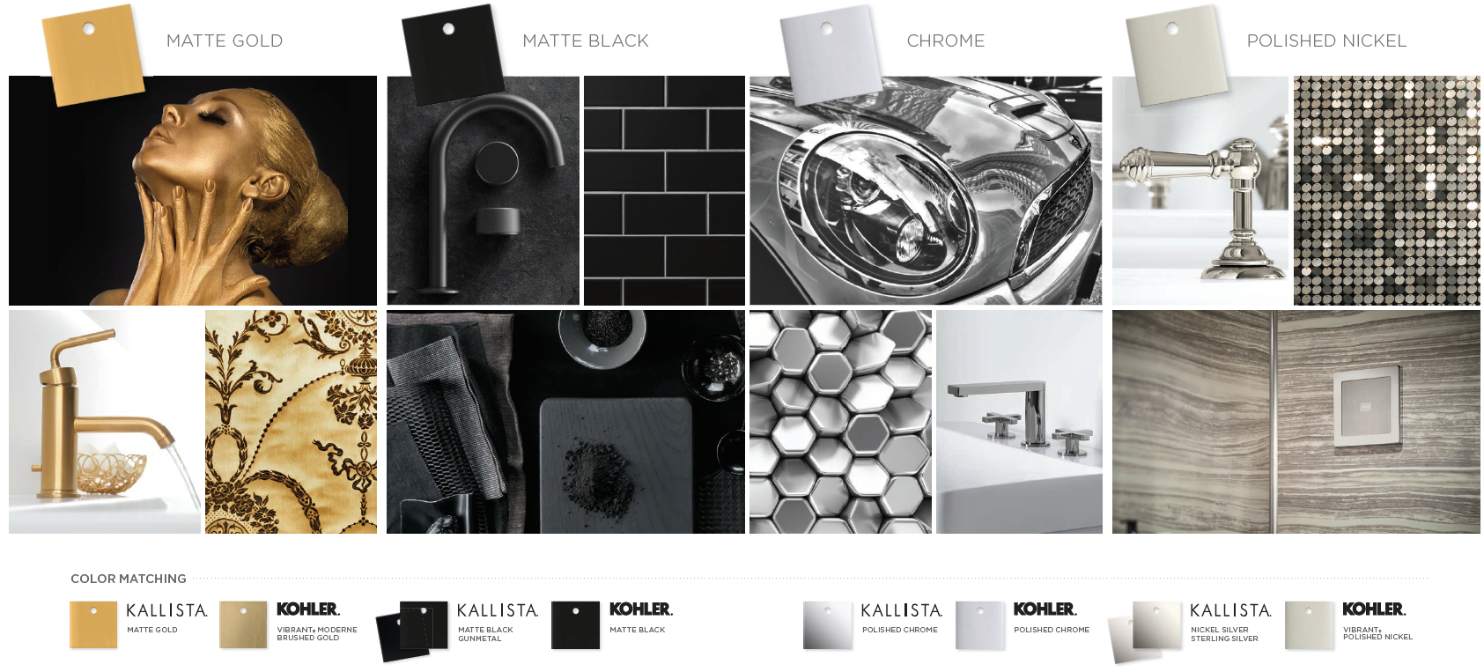
Uplift® Tech – Handle Finishes

Slide 14
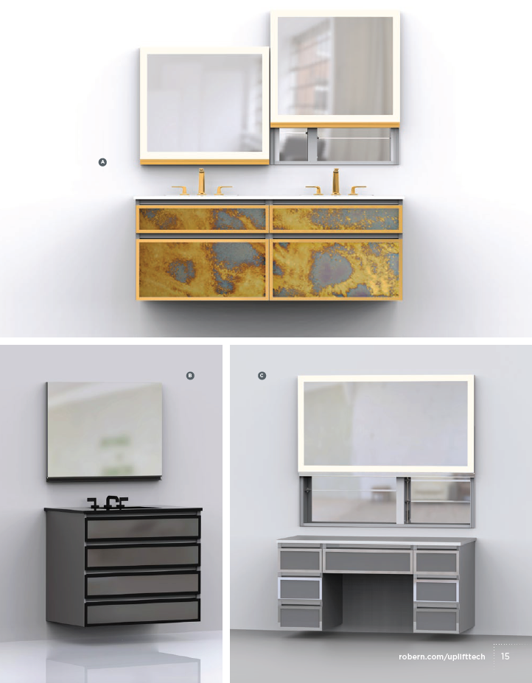
Uplift® Tech – Pairings

Slide 15
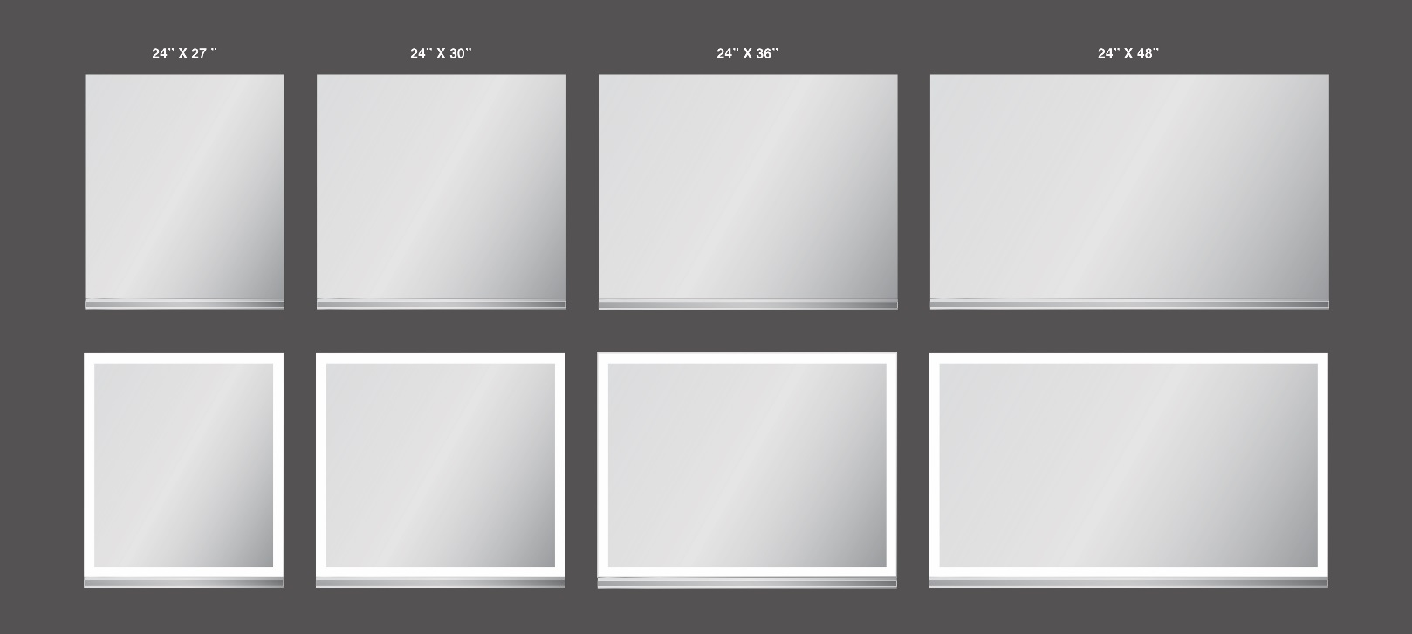
Uplift® Tech – Size Options
24” W x 27” H 30” W x 27” H 36” W x 27” H 48” W x 27” H

Slide 16
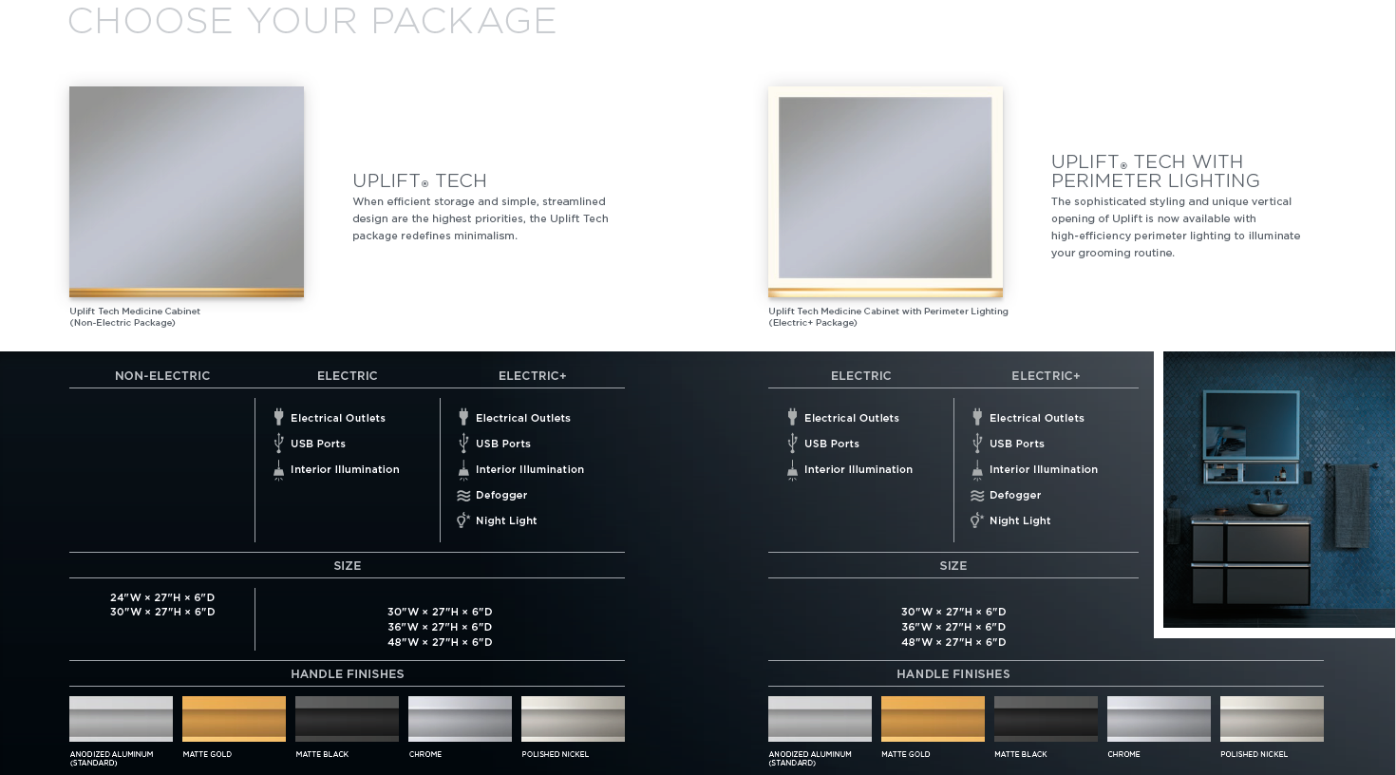
Uplift® Tech – Packages

Slide 17

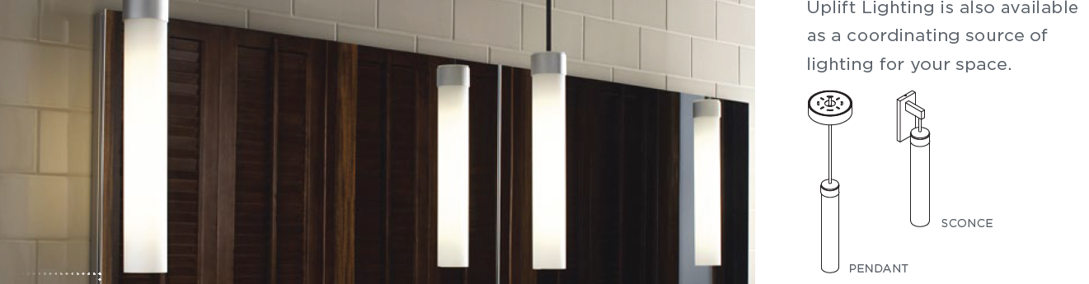
Uplift Tech® Medicine Cabinet – Pricing, Accessories, & Availability
The following packaging are available:
  Non-Electric - $1,999 starting
  Electric - $2,599 starting
  Electric & Perimeter Lighting - $3,099 starting
  Electric+ - $3,099 starting
  Electric+ & Perimeter Lighting - $3,599 starting
Handle upgrade:
  Handle - $329 starting
Additional Accessories:
  Sconce and pendant lights
  Side Kit
  Ganging Kit
  Top/Bottom Kit

Slide 18
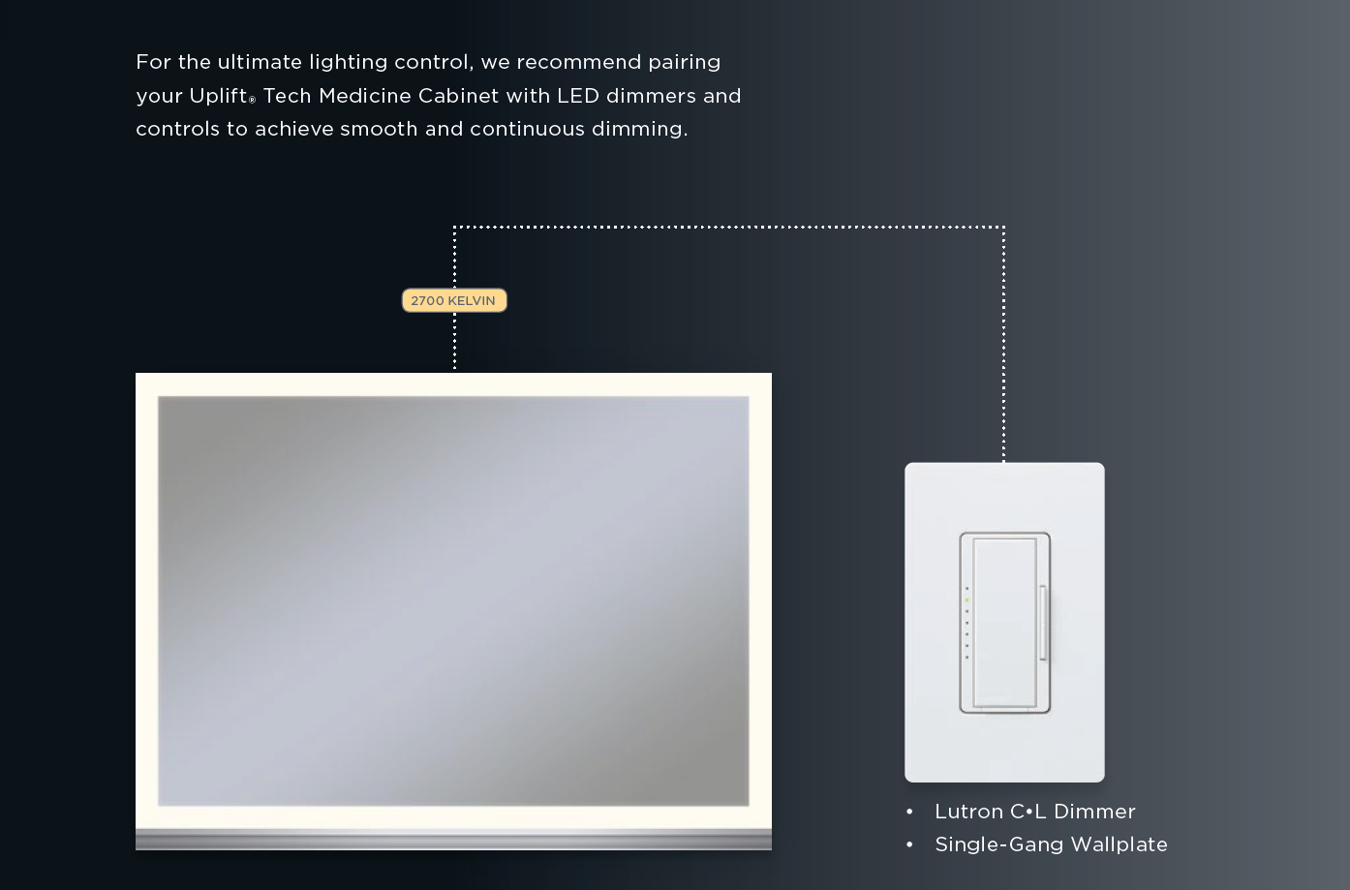
Uplift® Tech – Lighting Control

Slide 19
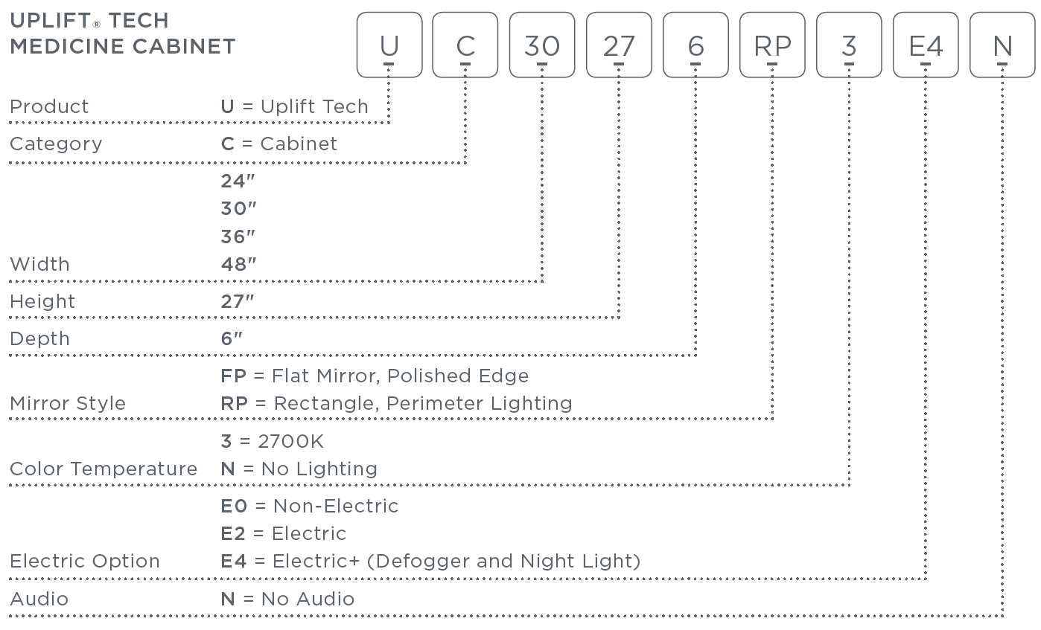
Uplift® Tech – Model Number Key

Slide 20
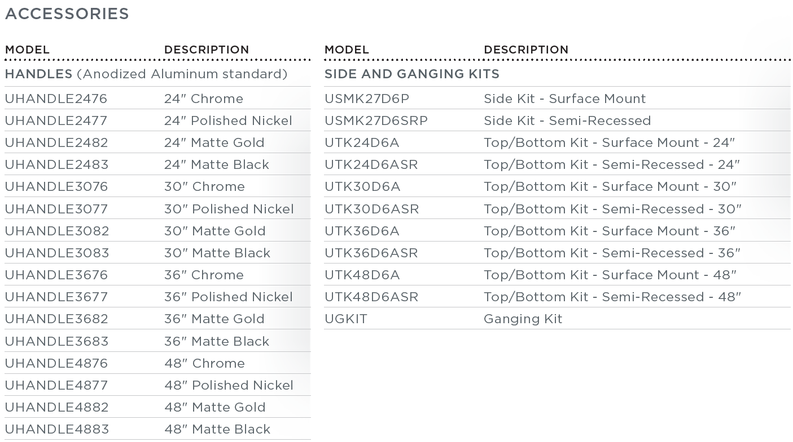
Uplift® Tech – Model Number Key

