Slide 1

2018 CONSUMER PROMOTIONS
[Insert Date]

Slide 2

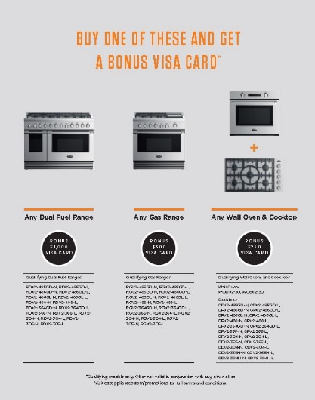
DCS - $1000, $500 or $250 Gift Card for Cooking Products

Slide 3
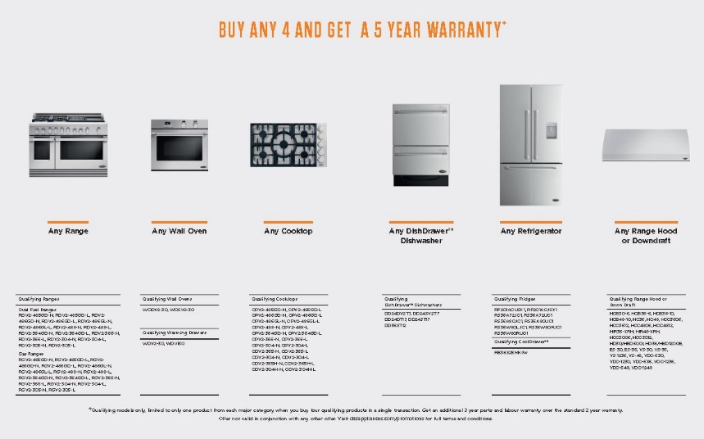
DCS 4 Piece Kitchen Gets 5 Year Warranty

Slide 4

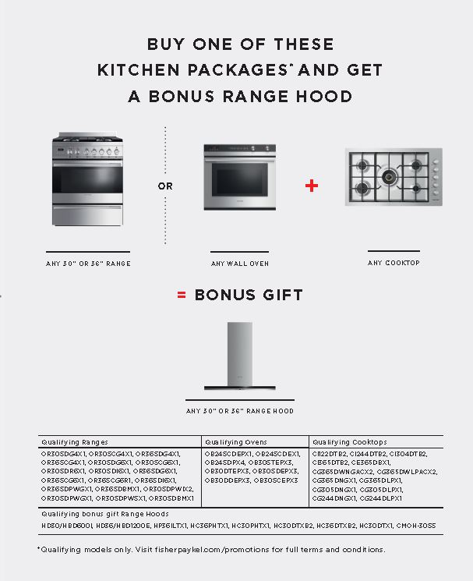
Purchase any 30" or 36" Range or Wall Oven and Cooktop combination and receive a free 30" or 36" Range Hood.

Slide 5

Buy 4 or more appliances and register your products to receive a
Five Year Warranty!

Slide 6
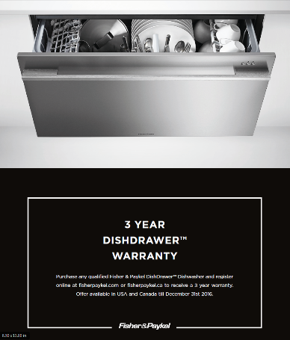

Purchase any qualified Fisher & Paykel DishDrawer™ Dishwasher and register
online to receive a 3 year warranty
Purchase any qualified Fisher & Paykel Top Load Washer and register online to receive an additional 3 year warranty (5 Years Total)

