Slide 1
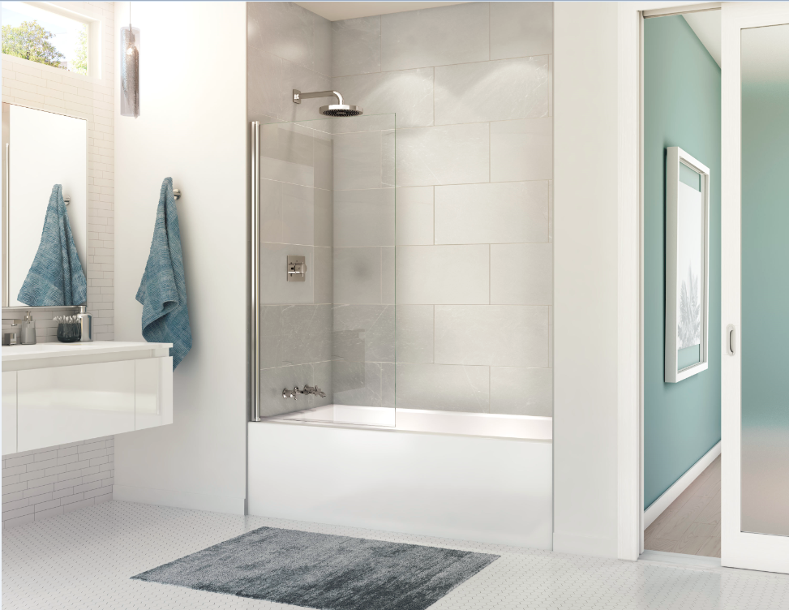
Rubix Access IFS
New addition to the Rubix family

Slide 2
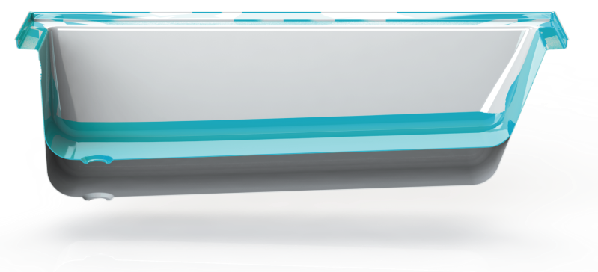
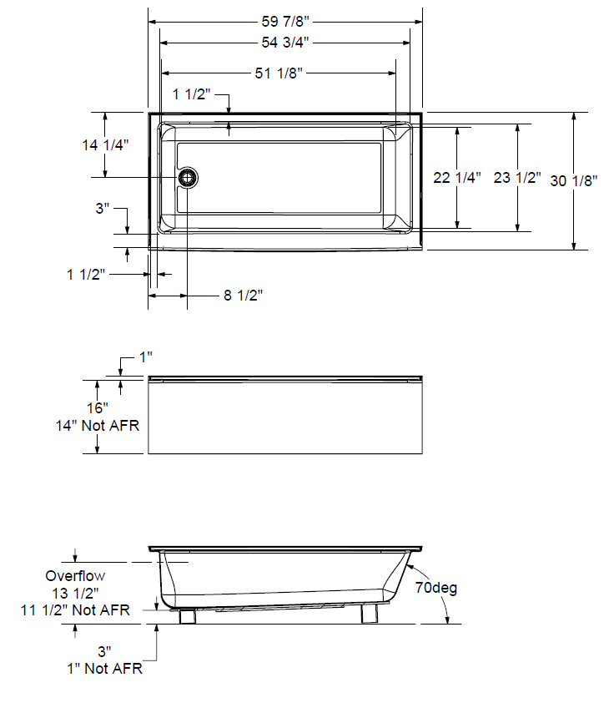
Rubix Access 6030
Product features
Flat apron, Optimized bathing well
Available in AFR 16’’ and Non - AFR 14’’
Room to mount faucets on deck
Design changes from current Rubix
Wider deck for faucet install
  Wider deck : + 0.4’’
  Smaller deck radius : 1/2’’ to 3/8’’
Lower height & bottom : - 4 3/8’’
Overall width : 59 7/8’’
Drain & overflow centered in bathing well
Antislip textured bottom ; Meets ASTM F462
Produced in Sainte-Marie (Québec) plant
Rubix
Rubix Access
Maax.com web link

Slide 3
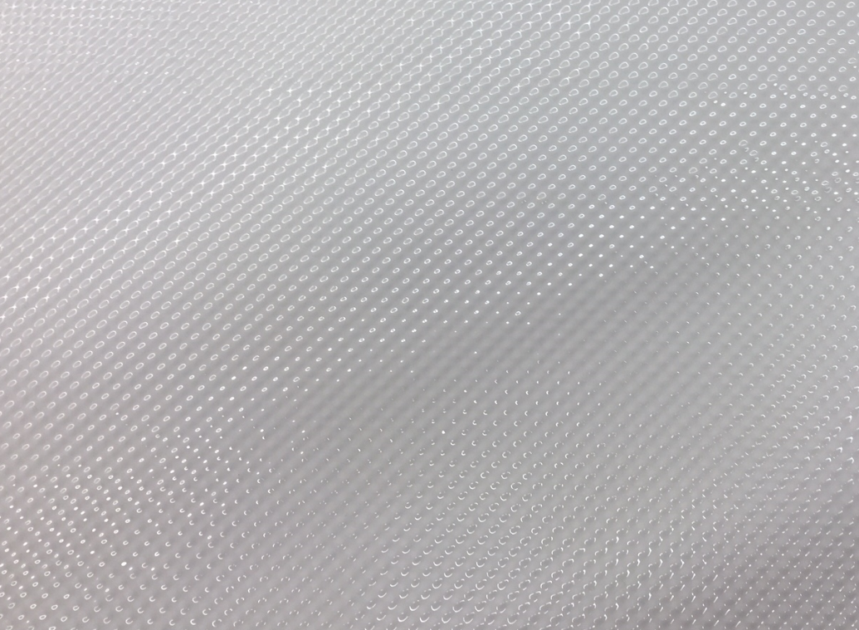
New Antislip Pattern
New antislip texture
A new textured patterns was developed to meet the antislip norm ASTM F462
MAAX is the first manufacturer to offer a certified integrated antislip texture on acrylic product

Slide 4
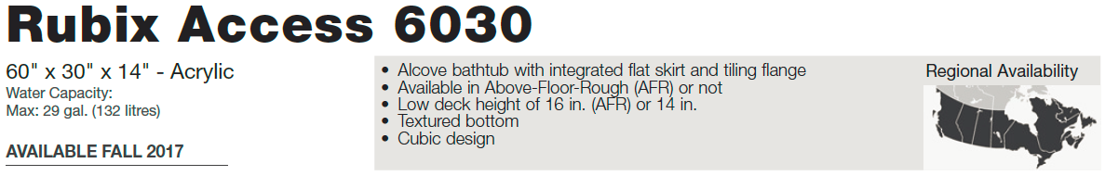
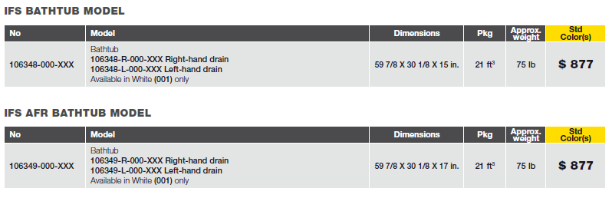
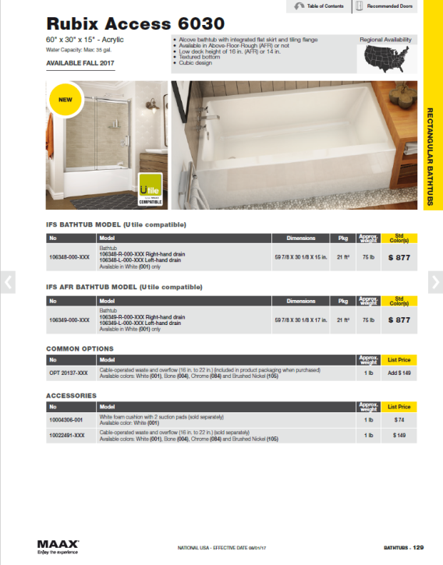
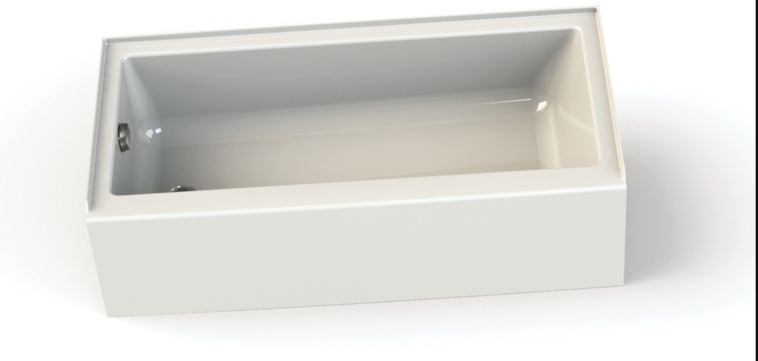
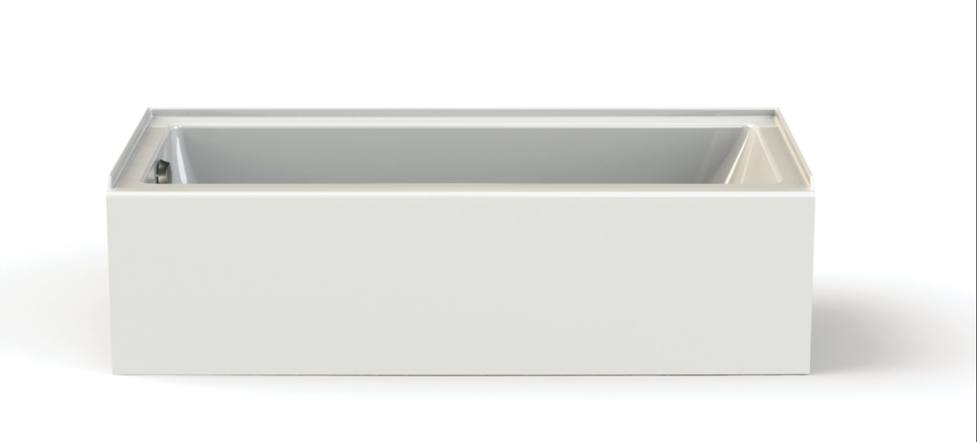
Pricing Structure - US
AVAILABLE NOW
Price lists
Professional US 2017

