Slide 1
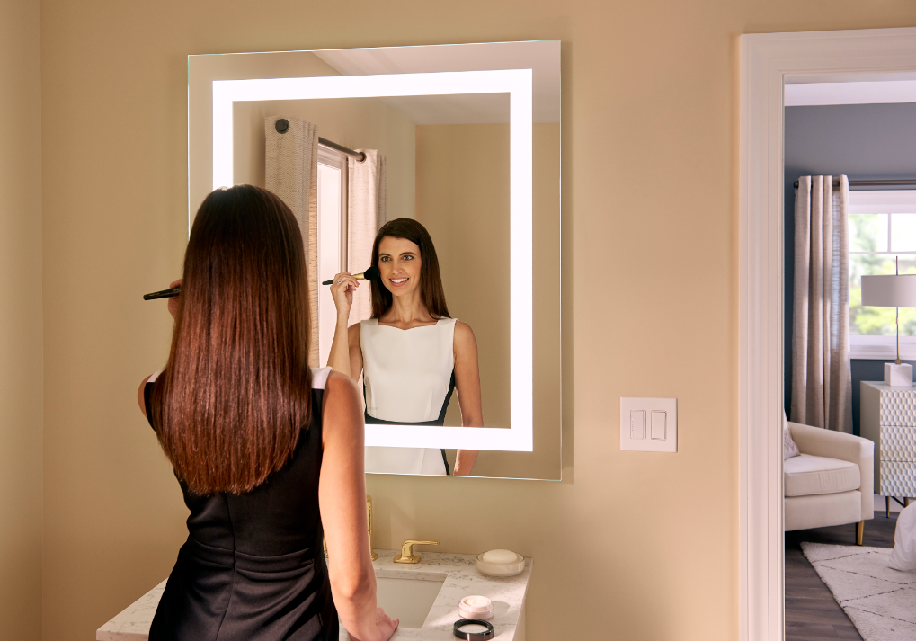
NEW Vitality Lighted Mirror Collection

Slide 2
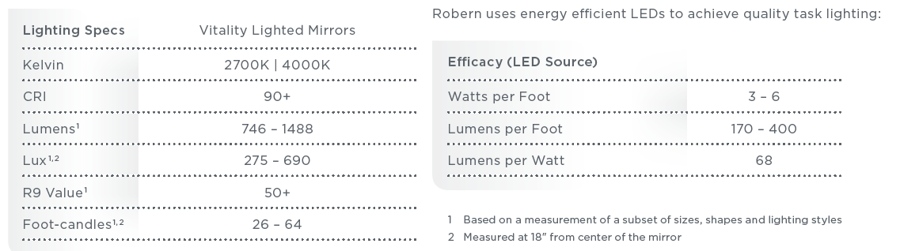

Vitality Lighted Mirror Collection
Quality of Light
746 lumens is the equivalent of 50 incandescent watts.
1488 lumens is the equivalent of 100 incandescent watts.
Measure the intensity of light falling on an area of one square foot.
Measure the intensity of light falling on an area of one square meter.
Measure how well the light brings out saturated colors, in particular red.
Measure the intensity of light – specifically how bright the light is 1 foot away from the source.

Slide 3
Vitality Lighted Mirror Collection
Quality of Light

Slide 4
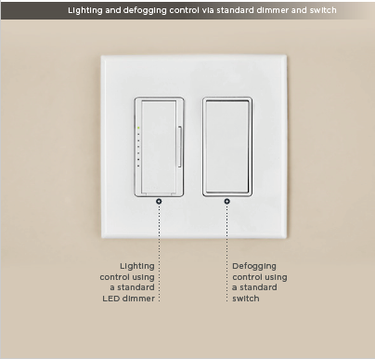
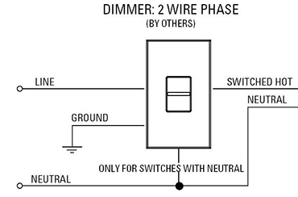
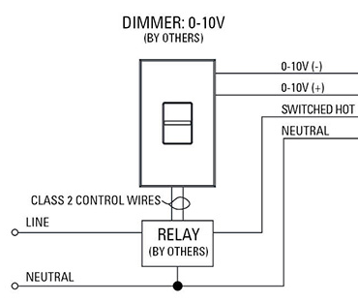
Vitality Lighted Mirror Collection
Smooth and Continuous Dimming & Defogging
Robern wiring (for dimming)
Standard 2 wires for residential!
Others wiring (for dimming)
Commercial grade 4 wires

Slide 5
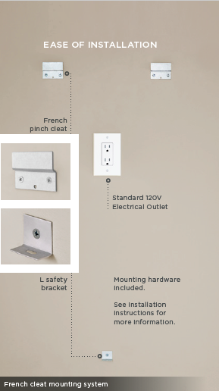
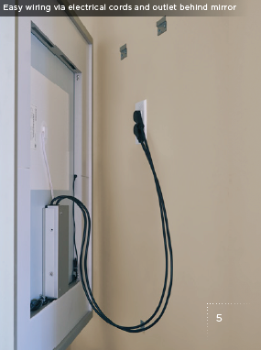
Vitality Lighted Mirror Collection
Easy Installation

Slide 6
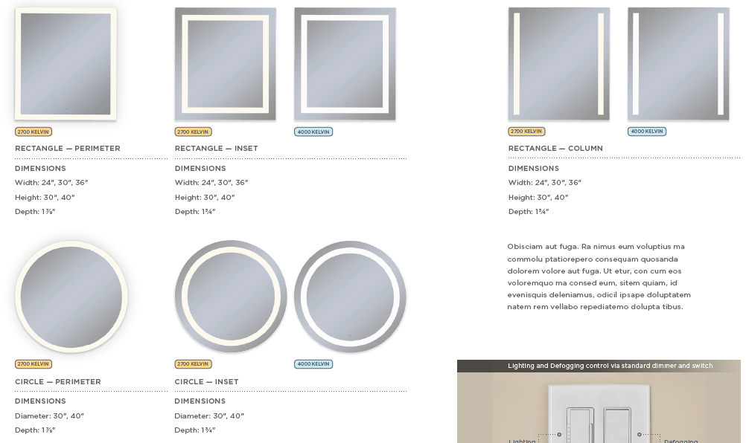
Vitality Lighted Mirror Collection
Options: $499 – $949 USD LIST; $649 - $1249 CAD LIST

Slide 7
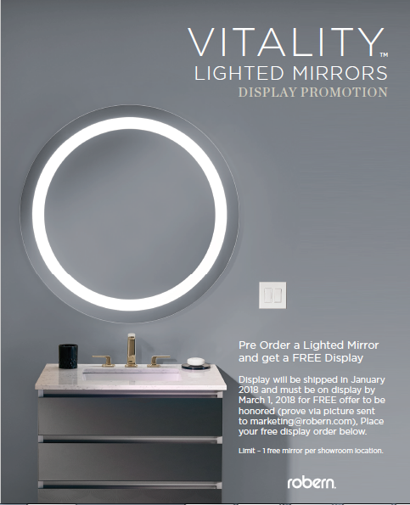
Vitality Lighted Mirror Collection
Display Promotion –
BUY 1, GET 1 FREE
Timing – NOW through 12/31/2017
Pre-Order a Vitality Lighted Mirror at showroom product multiplier (i.e. .405 for Platinum showroom) and get 1 FREE Vitality Lighted Mirror Display*†‡
Pre-Order 1 Vitality Lighted Mirror Display at Display Multiplier and get 1 FREE Vitality Lighted Mirror Display*†‡
*Display will be shipped in January 2018 and must be on display by March 1, 2018 for FREE offer to be honored (prove via picture sent to marketing@robern.com).
†Limit – 1 free mirror per showroom location.
‡Product must be in new Robern space in showroom, not just replacing old Robern product.

Slide 8
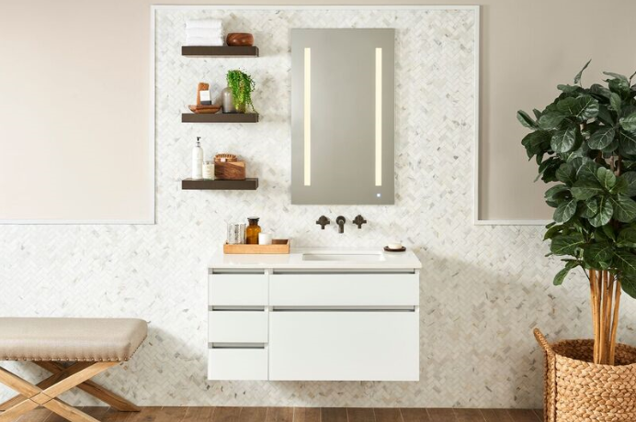
Expanding the AiO Collection
NEW! 2700K
Mirrors
Medicine Cabinets

Slide 9
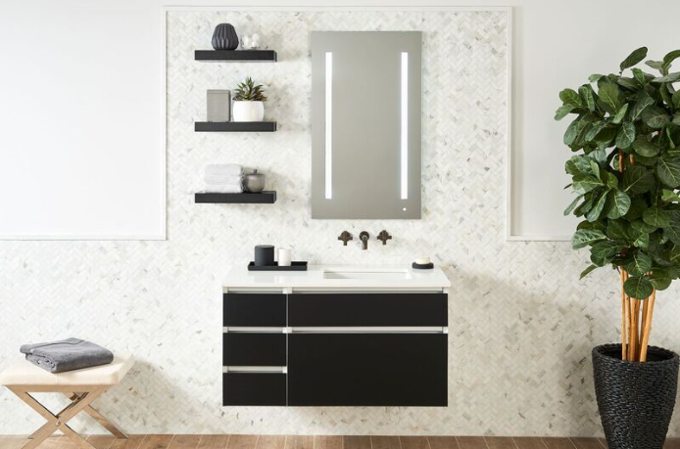
Expanding the AiO Collection
4000K
Mirrors
Medicine Cabinets

Slide 10
Expanding the AiO Collection
Mirror
LIST Price:
Starting at $1279 USD (was $1599) and $1699 CAD
Sizes:
Rectangle:
  24”, 30”, 36” Wide
  30”, 40”, 70” High
Cabinet
LIST Price:
Starting at $1799 USD and $2399 CAD
Sizes:
Rectangle:
  24”, 30”, 36” Wide
  30”, 40” High

Slide 11
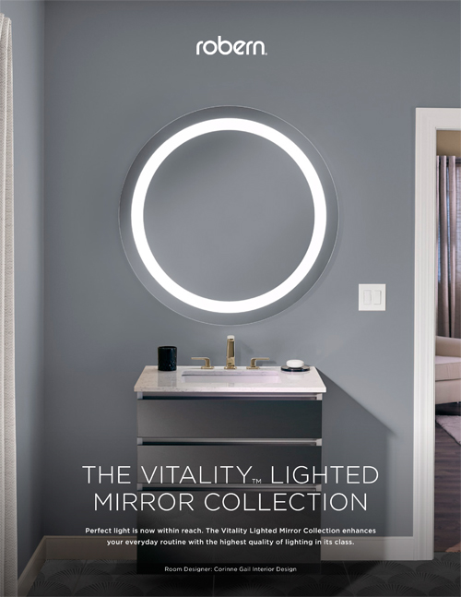
September Launch - Tools
Vitality Collection Sell Sheet
25/Pack and 3-Hole Punched
Availability:
Will receive literature packets by the week of 9/18.
Orderable on 9/12
How to Access:
Literature section on robern.com
Robern Online Store
How to Order:
Robern Online Store

Slide 12
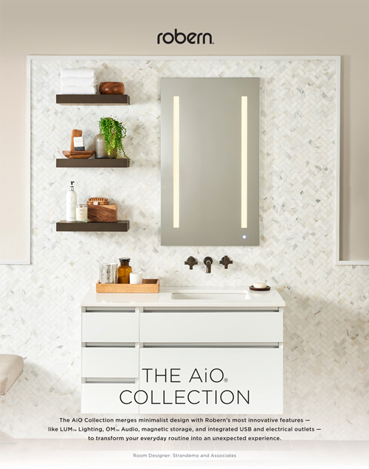
September Launch - Tools
AiO Collection Sell Sheet
25/Pack and 3-Hole Punched
Availability:
Will receive literature packets by the week of 9/18.
Orderable on 9/12
How to Access:
Literature section on robern.com
Robern Online Store
How to Order:
Robern Online Store

Slide 13
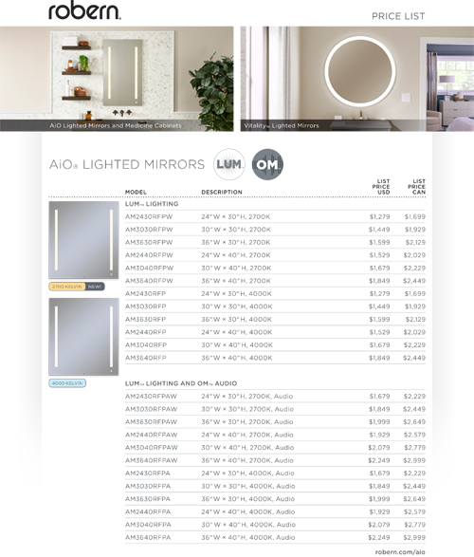
September Launch - Tools
AiO Collection & Vitality Price List
25/Pack and 3-Hole Punched
Availability:
Will receive literature packets by the week of 9/18.
Orderable on 9/12
How to Access:
Literature section on robern.com
Robern Online Store
How to Order:
Robern Online Store

Slide 14
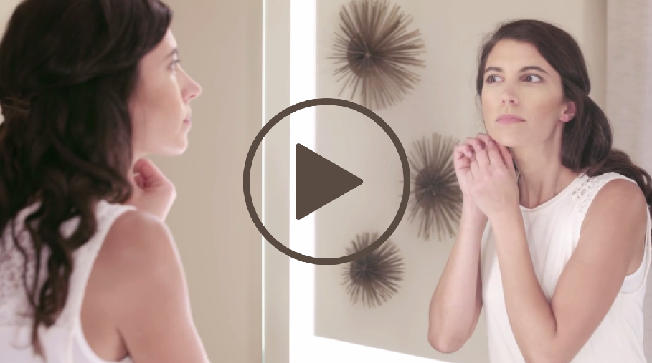
September Launch - Tools
Vitality Video
Availability:
Downloadable the week of 9/18
How to Access:
Available to view on Robern.com
Download on Robern Image Library (Videos)

Slide 15
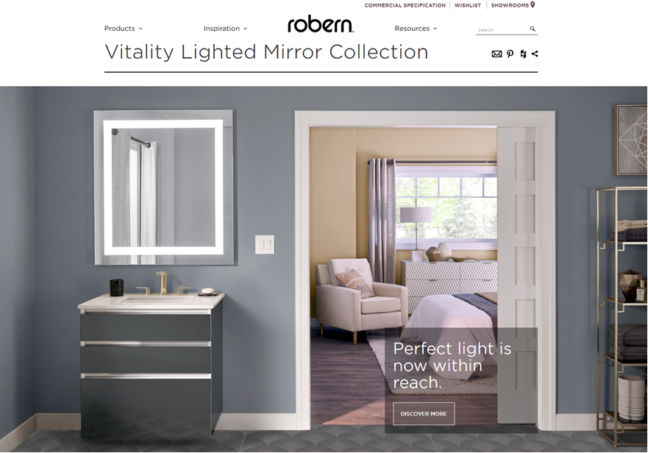
September Launch - Tools
Robern.com
robern.com/vitality
robern.com/aio
Live September 12, 2017
Available:
Spec Sheets
Installation Instructions
CAD Files

