Slide 1
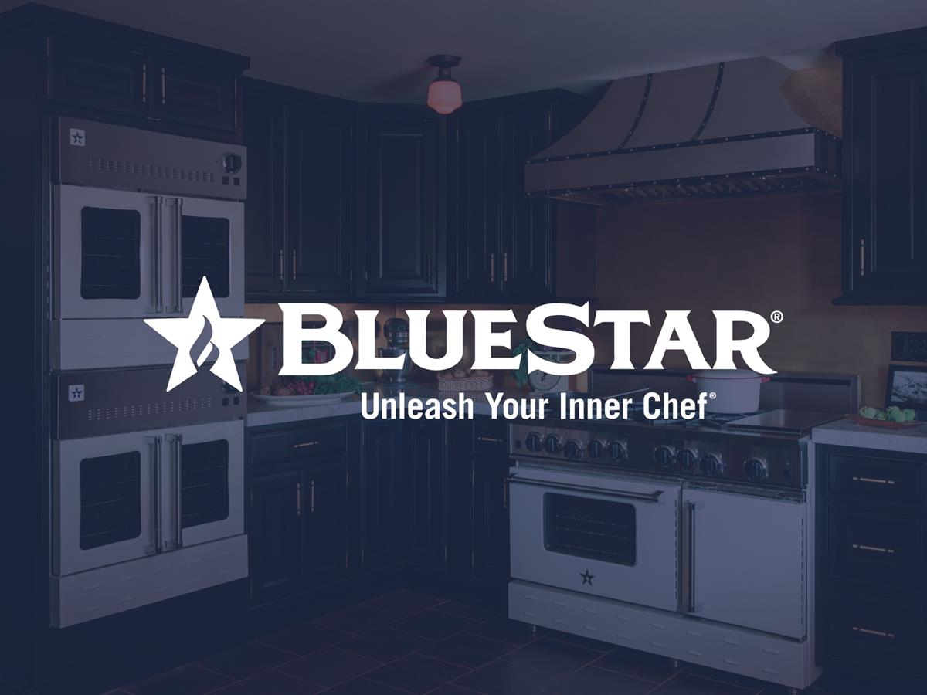
Color Trends
Notes:
Welcome, as you may or may not know BlueStar is color leader within the appliance industry. All of our products are available in 750+ colors and finishes to compliment any home kitchen design. We have been seeing some major trends related to color within the kitchen space. Most of these trends have been influenced by the broader fashion, design, home décor and automotive categories. First let’s see what the color authorities are selecting and then what BlueStar is seeing in the kitchen.

Slide 2
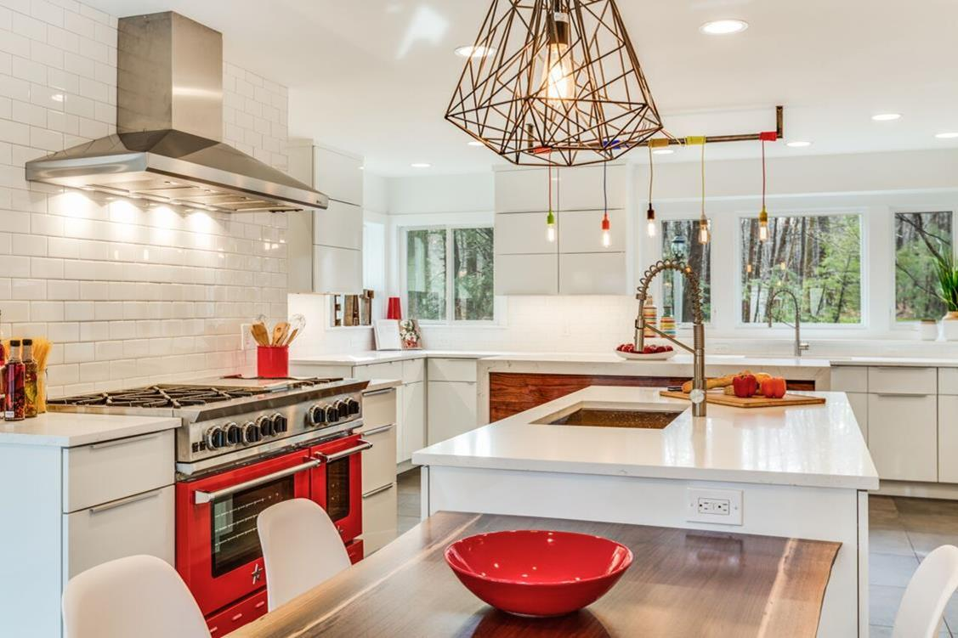
Color in the Kitchen – Here to Stay
Notes:
Color overall is here to stay. People love to personalize their space, make it feel like their own, a true reflection of their style and taste…the kitchen is no exception to that.

Slide 3


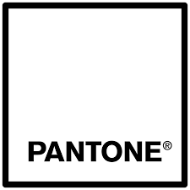
Color Authority Picks
Notes:
This time of year color leaders around the world are announcing complete color pallets and noteworthy colors that we usher in 2018. These colors will dictate many fashion trends and influence home décor. Let see what they have chosen…

Slide 4
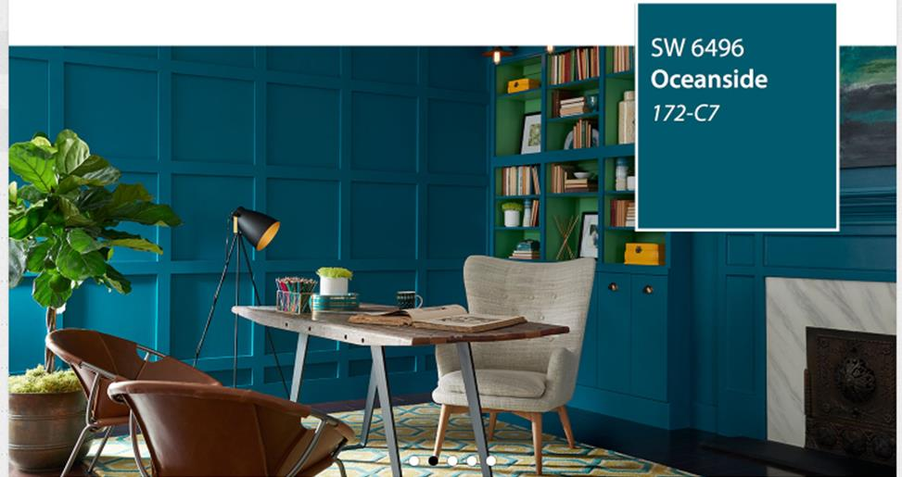
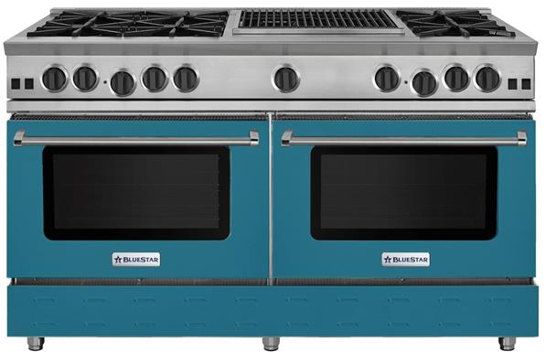
Sherwin-Williams 2018 Color Pick
Notes:
One of our All-Star Designers, Jill Calo predicted this focus on blues – like the newly released Sherwin-Williams Colors of the Year, Oceanside. “We have been seeing azure blues from the fashion runways to weddings to home décor,” said Calo. “This blue can be applied to furnishings, countertops, framed décor and textiles.” “It is an intense color and can be striking in a backsplash which can be backlit for a modern feel. “For a dramatic look, I would pair this blue with black cabinets and copper accents, such as the handles on the appliances,” said Calo.

Slide 5

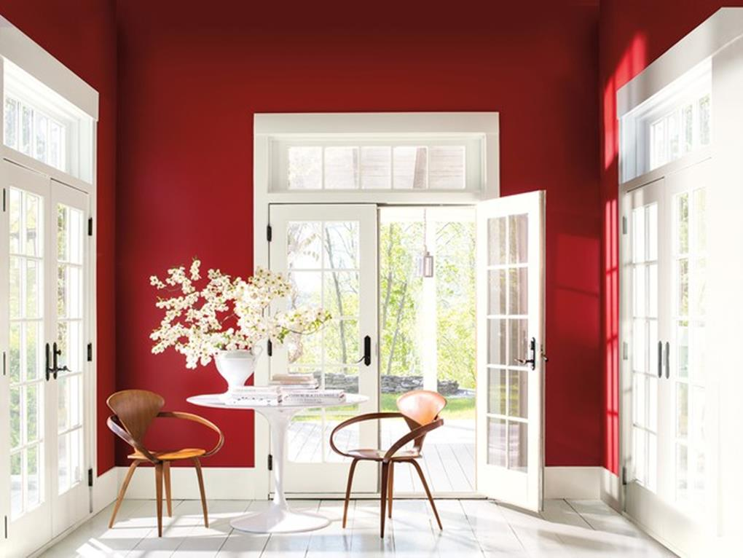
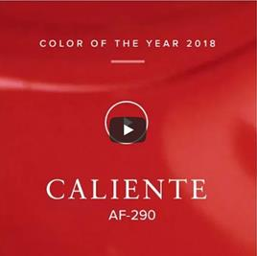

Benjamin Moore 2018 Color Pick
Notes:
Benjamin Moore also announced their 2018 Color Pick – Caliente – a bit of a surprising choice given how bold the hue is. This matches perfectly with our Ruby Red (Ral 3003), which has been and continues to be a top BlueStar color choice for years.

Slide 6
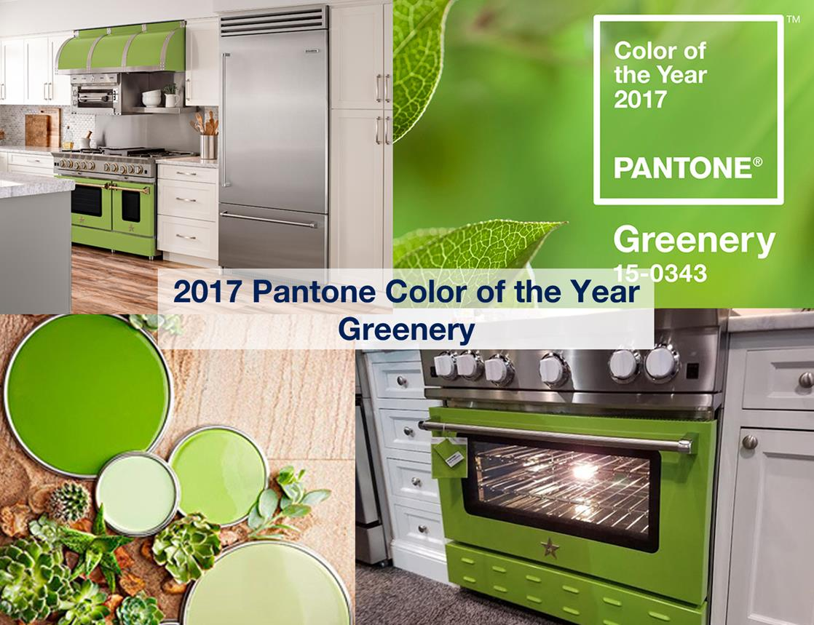

Notes:
According to Pantone, Greenery is nature’s neutral – it was their 2017 Color of the Year. It is a fresh and zesty yellow-green shade that evokes the first days of spring when nature’s greens revive, restore and renew. The fortifying attributes of Greenery signals consumers to take a deep breath, oxygenate and reinvigorate. We will see what Pantone selects as their 2018 Colors of the Year, which they announce every December – we anticipate it to be in the Blue/Purple palette.

Slide 7
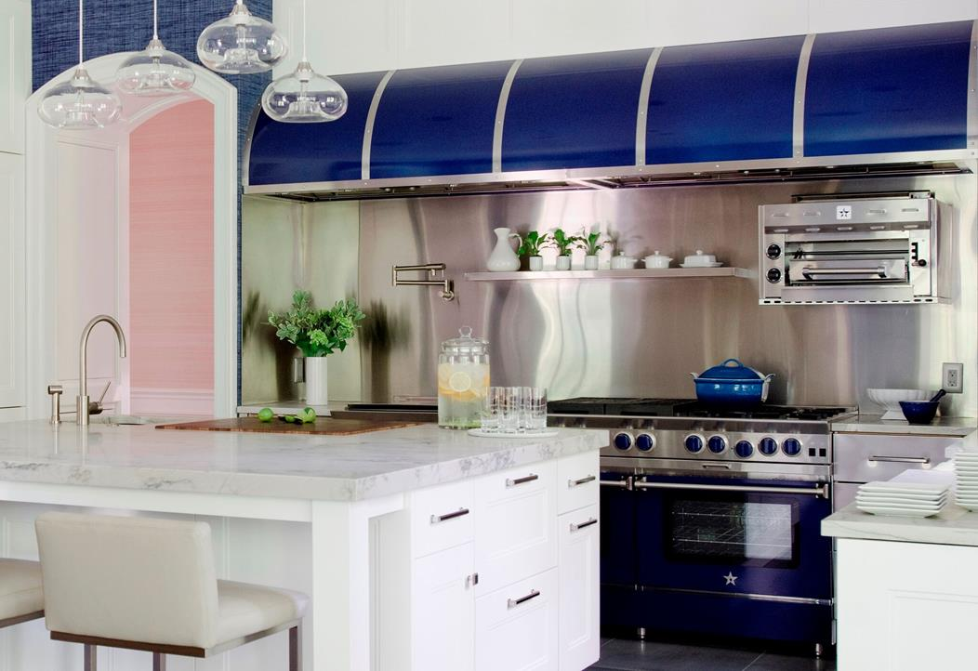
Color in the Kitchen
Trends We See
Notes:
Now let’s focus specifically on the kitchen and trends we are seeing there. This fall and winter is all about rich purples and blues.

Slide 8
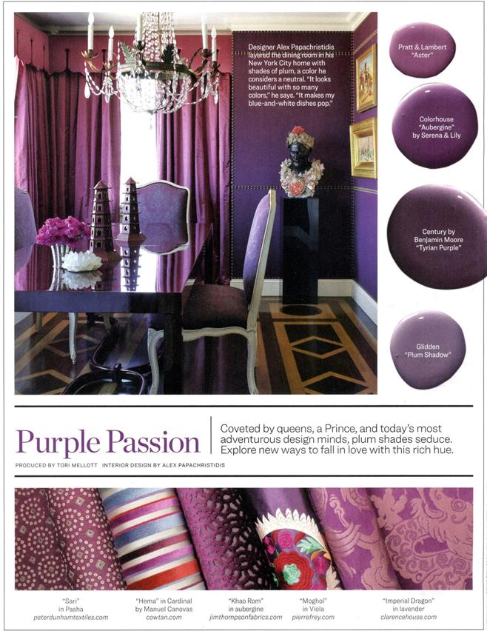
Fall / Winter 2018
Purple Palette and Pattern
Traditional Home Magazine
Oct/Nov 2017
Notes:
Unexpected combinations such as Pastel and Purple Violets and rich Azure Blues are eye-arresting and create an unusual color dichotomy.

Slide 9
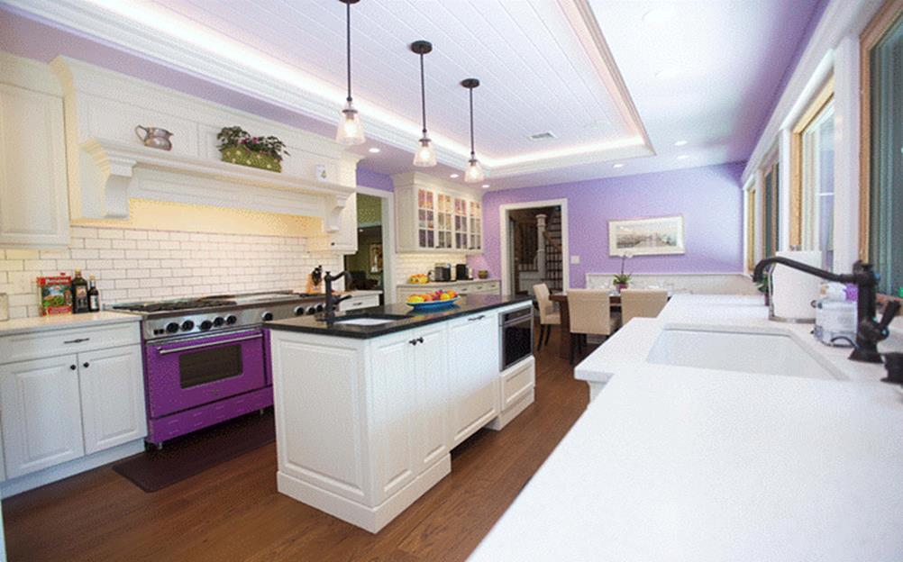
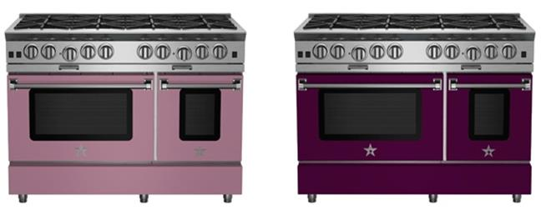
Fall / Winter 2018
Purple Palette and Pattern
Notes:
Purple Violet (RAL 4007) suggests the color of a full-bodied wine and is a perfect accent in a small area, especially when combined with clean white countertops and medium grey cabinets.
**Some may ask about a consumer getting tired of a color over time – remind them on cooking we can swap panels if they want.**

Slide 10
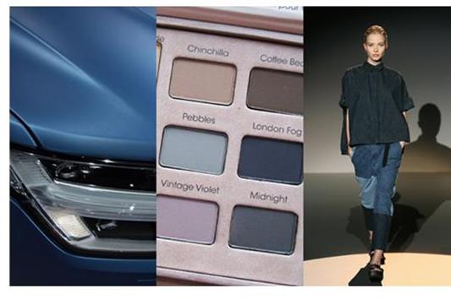
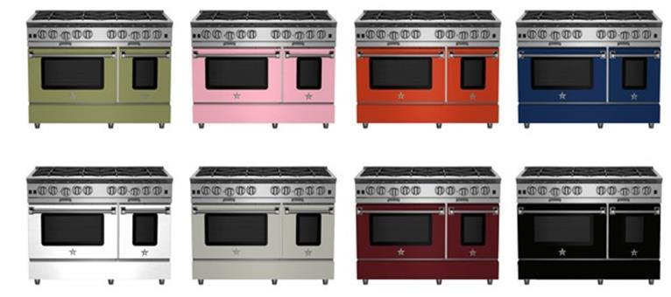
Matte Colors
Notes:
Right now, matte colors are popping up everywhere in trend-forward industries like automotive, make up, and fashion because of their versatility and sophistication. Naturally these colors have moved into the kitchen and when paired with metallics or high-gloss glazes, they create a statement making design for the most important room in the home. The matte option allows design freedom to create a more interesting look. I don’t believe that matte is a ‘trend’ that will ever go away. It is just being used more frequently as design evolves. The BlueStar Matte Collection features a strong mix of layers and contrast to make a kitchen special. Each of these colors brings a unique design concept that can be utilized as a mild pop of color or a more neutral feel.
Another trend for matte recently is honed counter tops.

Slide 11
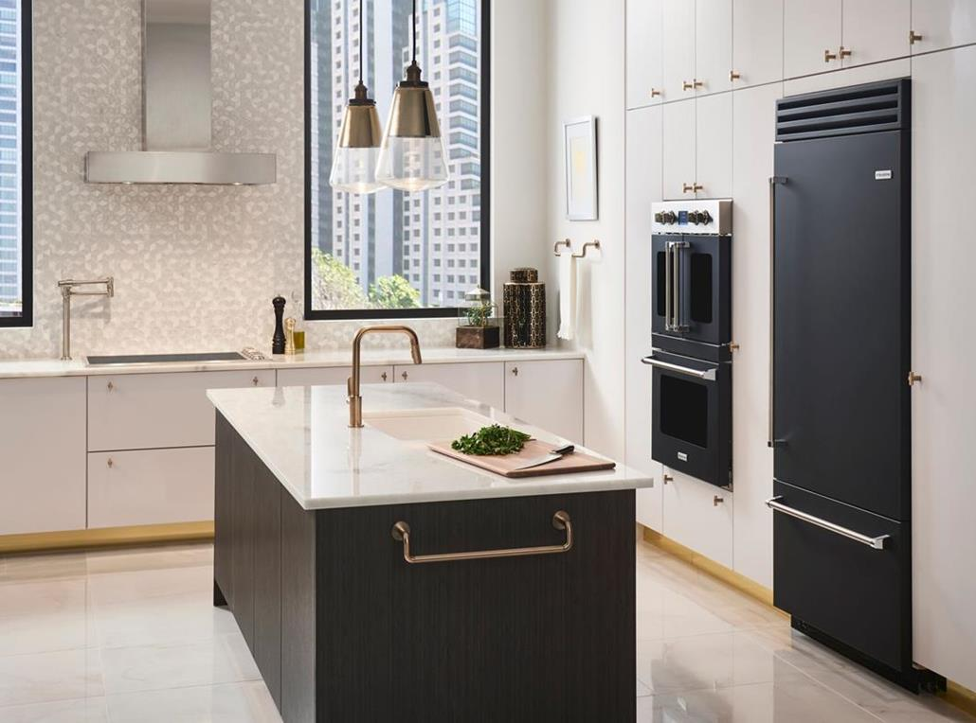
Matte Black
Notes:
The most popular matte hue that we see today is Black. Both the fridge and the double wall ovens here are painted matte black and look stunning with the white cabinetry and Brizo brass hardware accents.

Slide 12
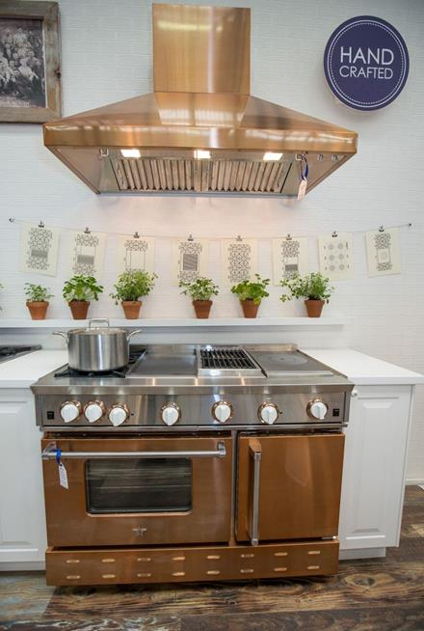
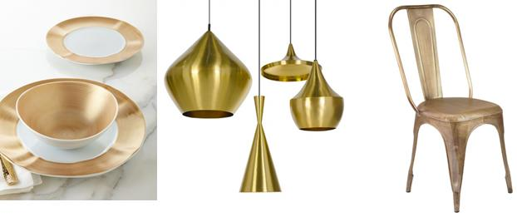
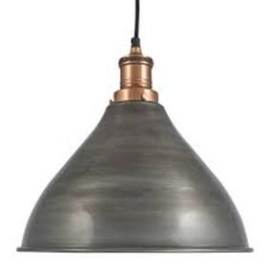
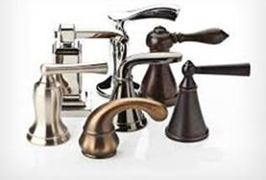
Trending Metals
Notes:
Metallics continue to be huge in overall home décor today. Consumers are able to choose from a wide variety of metals across furniture, fixtures, plumbing, hardware and lighting. The most recent lead horse in metallics is Pewter.

Slide 13
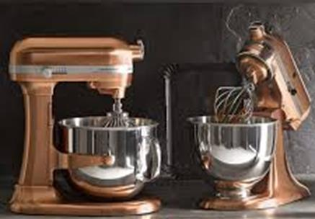
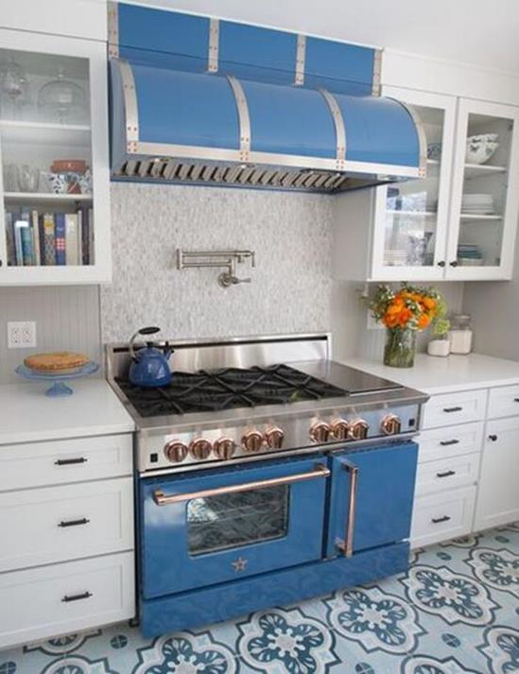
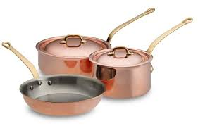
Metal Accents
Notes:
Metals in the kitchen are no exception, consumers are blending large and small appliances with pots/pans and other hardware accents. With trim on ranges and hoods to pull the overall look together.

Slide 14
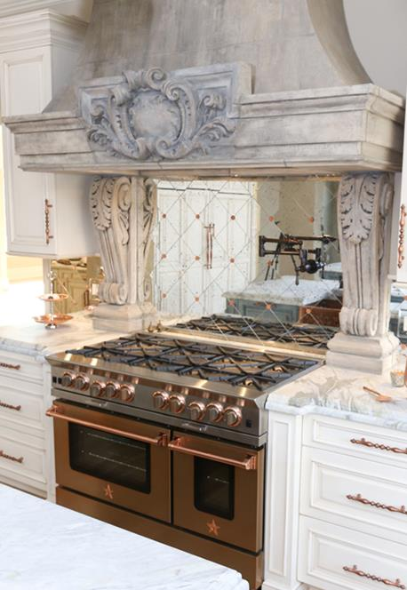
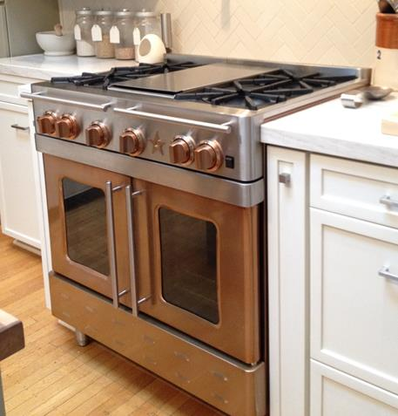
Infused Copper
Notes:
The leading metal that we are seeing used is copper. BlueStar’s infused copper is now one of our top colors.

Slide 15
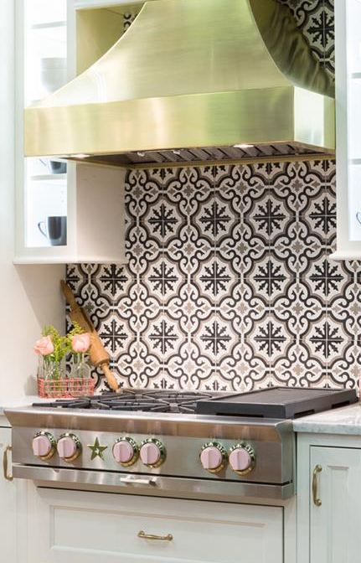
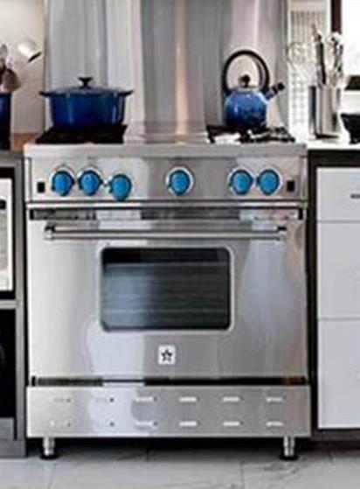
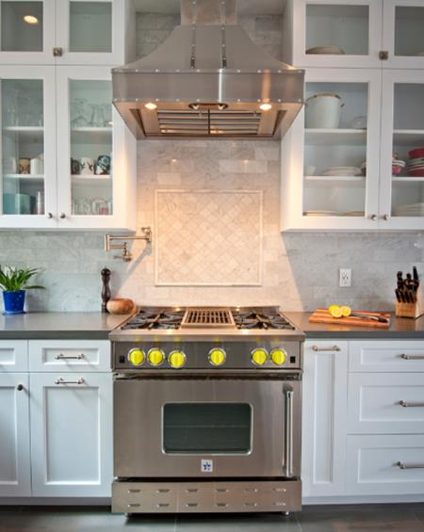
Pops of Color – Accent with Painted Knobs
Notes:
For consumers who are shyer about color, they find an easy way to add a pop is with painted knobs. They create a subtle tie to a specific color that is being used in other parts of the kitchen – such as a le crueset pot, kitchenaid standing mixer, backsplash or tile.
**Some may ask about the cost and be shocked by the price for painted knobs, remind them they can upgrade for FREE if they attend an event.**

Slide 16
Black Is Back
Notes:
Black kitchens are stylish, sophisticated and undeniably cool. Black works with any kitchen style - you’re not limited to an ultra modern or minimalist look.

Slide 17
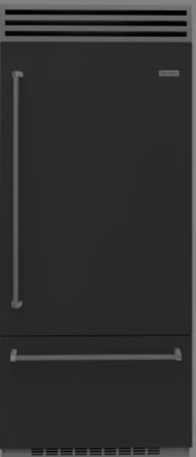
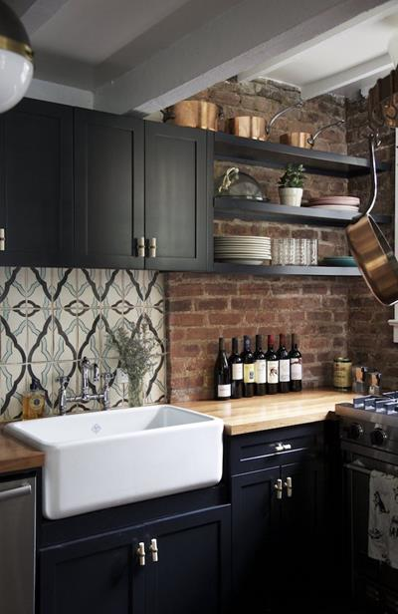
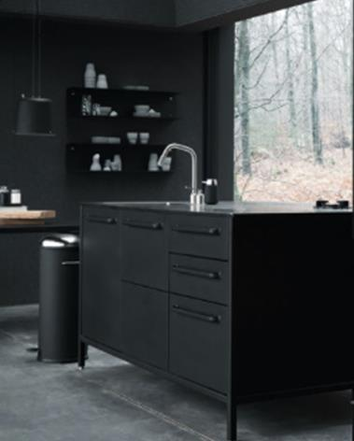
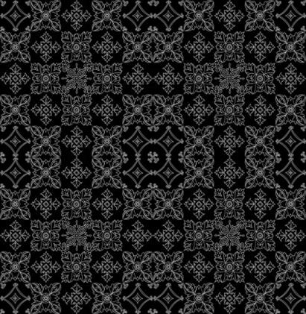
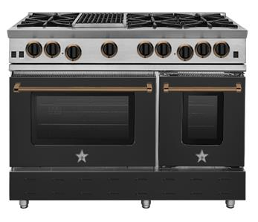
Statement Making Black Kitchens
Notes:
As you can see, cabinets, flooring, appliances, painted walls and backsplashes all in black are coming together to make stunning kitchen designs.

Slide 18
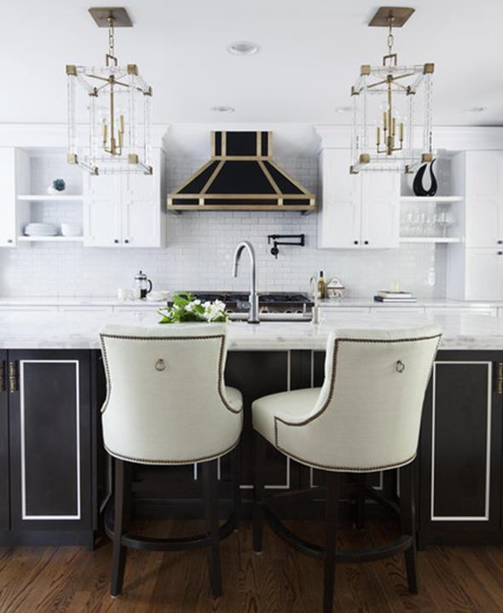
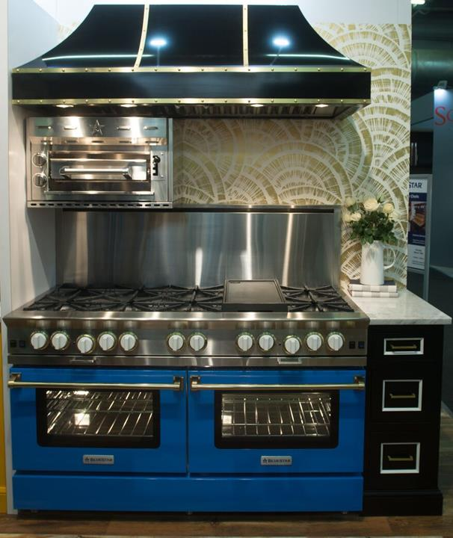
Hollywood Regency
Notes:
Another form of black kitchens can be seen with this Hollywood Regency style. The 1930s Design Style from Hollywood’s Golden age is no longer a relic of the past. The over-the-top style is not just for the rich and famous; a modern version is surging in popularity. As you can see cabinets in black and white and pops of blue hues plus gold/brass accents are the anchor of the design.

Slide 19
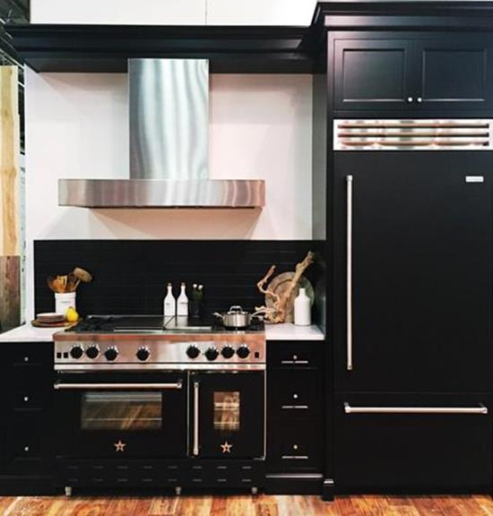
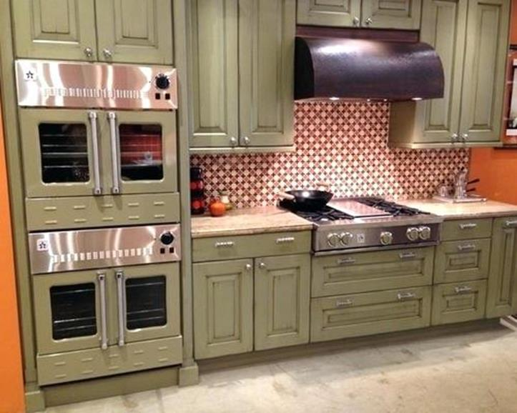
Matching Appliances to Cabinetry
Notes:
Also trending is matching appliances to cabinets – but not to the extreme of paneling appliances – which had been the focus historically. Consumers want their appliances to accent their cabinetry. You can see 2 stunning kitchens here, one in black, and the other in green – matching with the surrounding cabinetry.

Slide 20
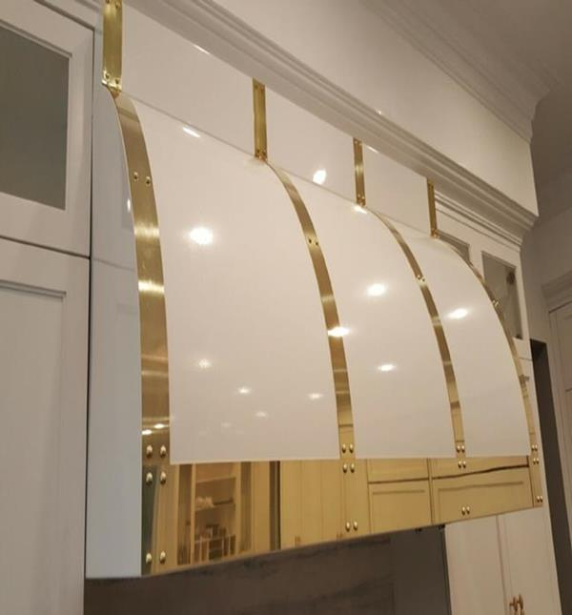
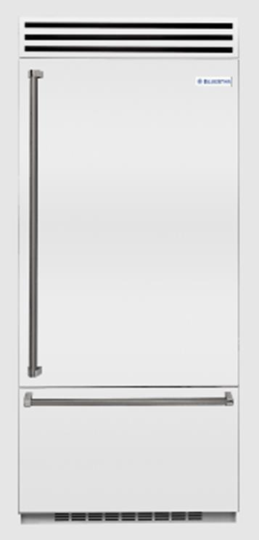
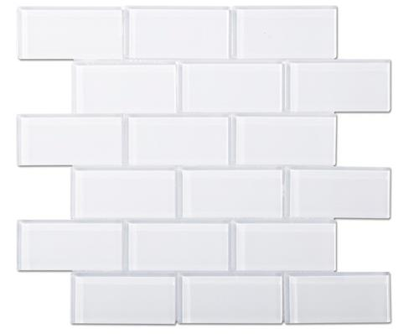
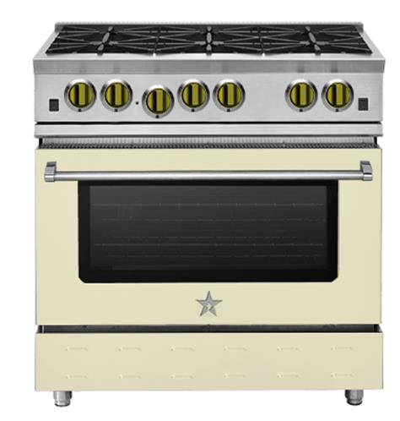
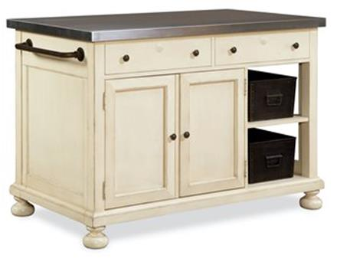
Timeless Kitchen Color: White
Notes:
Although many designers are tired of white, consumers are not willing to let it go just yet. Traditional white, and neighboring creams can still be an anchor for a kitchen design and in many cases help to amplify and bolder colors.

Slide 21
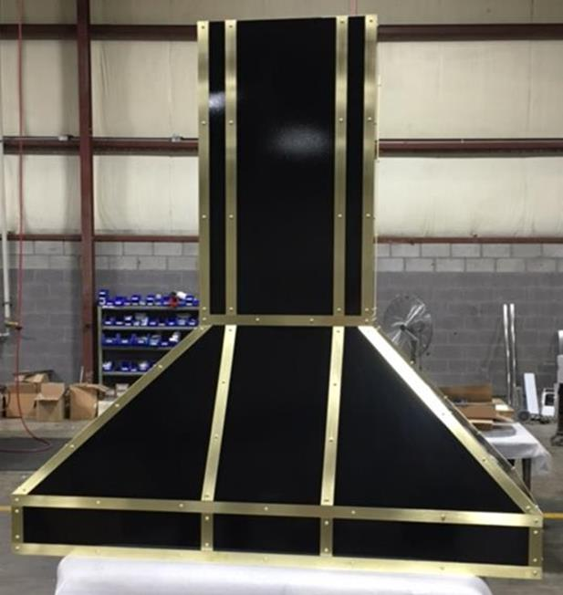
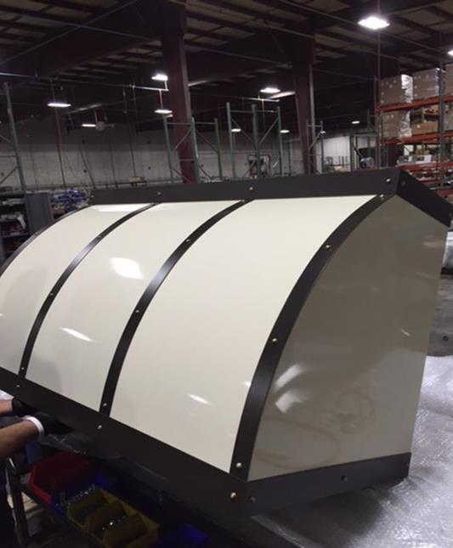
Focal Point Ventilation – Combining Color & Metals
Notes:
Custom ventilation continues to be a growing trend – as consumers try to make a focal point in their kitchens – and broader living spaces. With the rise of open floor plans and the kitchen being visible from the multiple rooms, the need to make a stunning center pieces has increased. As you can see, ventilation that used to be hidden within cabinetry is a thing of past - large, elaborate, painted hoods are becoming a standard in high-end kitchens. Plus it continues to give consumers the opportunity to customize to meet their own style.

Slide 22
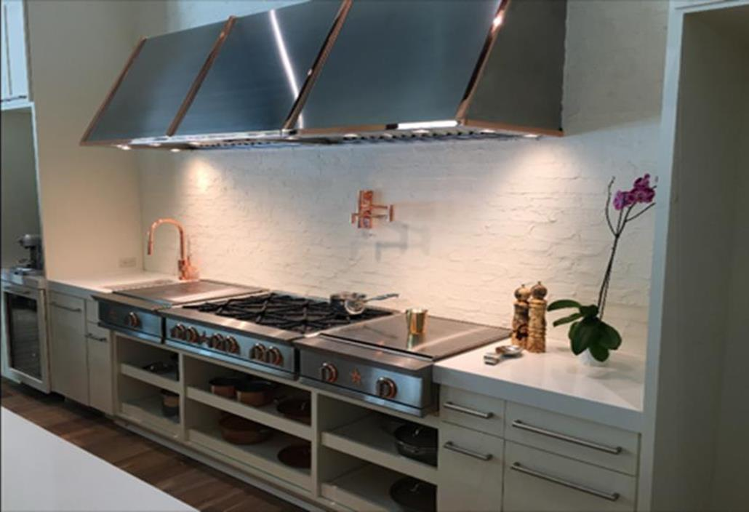
Focal Point Ventilation – Combining Color & Metals
Notes:
Custom ventilation continues to be a growing trend – as consumers try to make a focal point in their kitchens – and broader living spaces. With the rise of open floor plans and the kitchen being visible from the multiple rooms, the need to make a stunning center pieces has increased. As you can see, ventilation that used to be hidden within cabinetry is a thing of past - large, elaborate, painted hoods are becoming a standard in high-end kitchens. Plus it continues to give consumers the opportunity to customize to meet their own style.

Slide 23
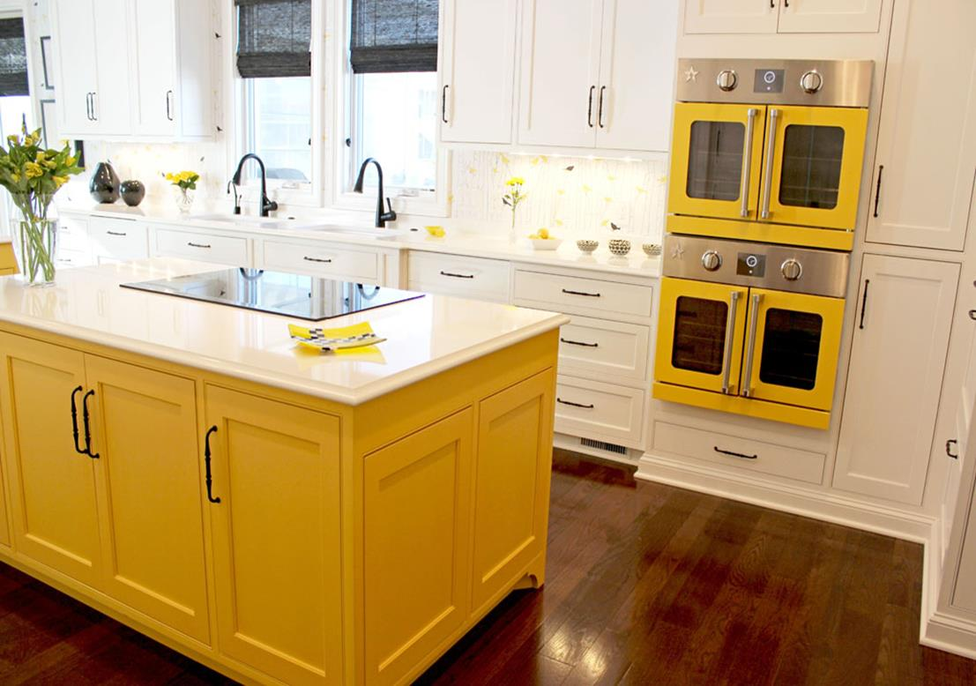
BlueStar Offers Unmatched Customization
Notes:
BlueStar has been the appliance leader in color for years, but the customization options do not stop there.

Slide 24
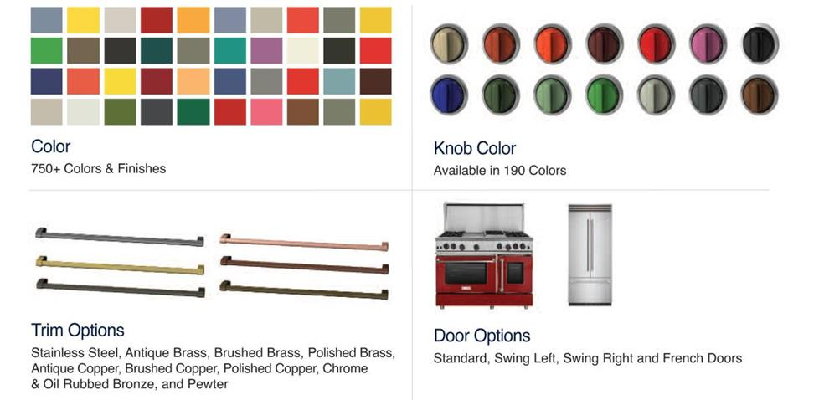
Designers Choice
Notes:
Both professional designers and consumers can choose from over 750+ colors & finishes, plus 10 trim options, and painted accents like knobs/grills/strapping across cooking, ventilation and refrigeration appliances.

Slide 25
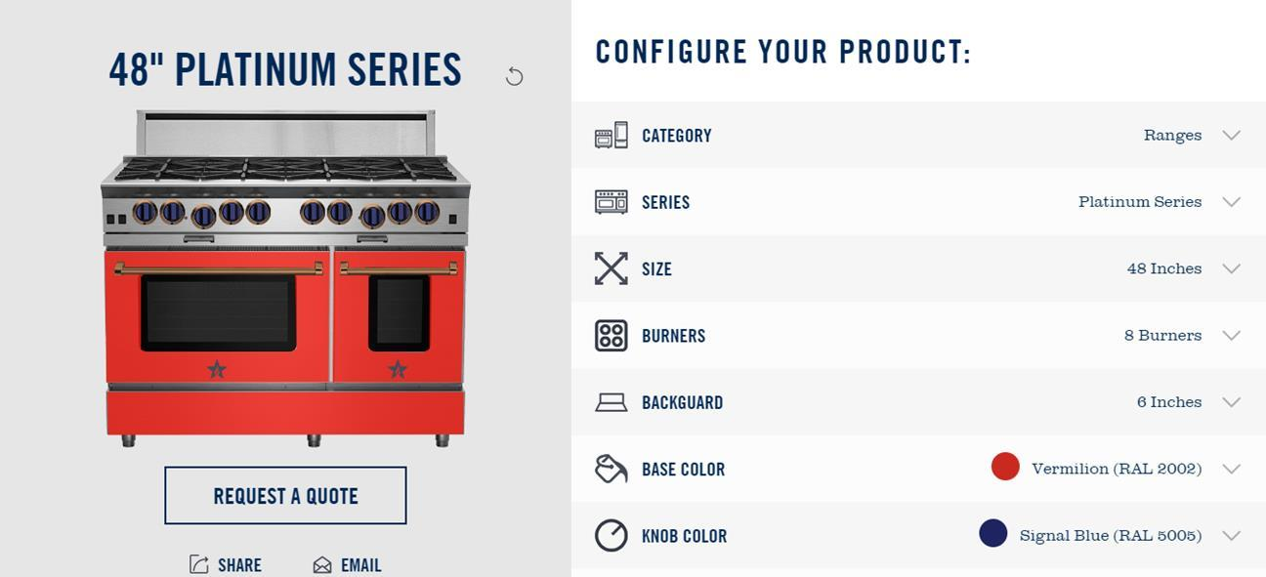
Try it all with our Build Your Own BlueStar® Tool
ADD URL
Notes:
You can play with color and customization on our BYO tool at bluestarcooking.com. Choose from 190 colors, painted knobs and trim options plus more.

Slide 26

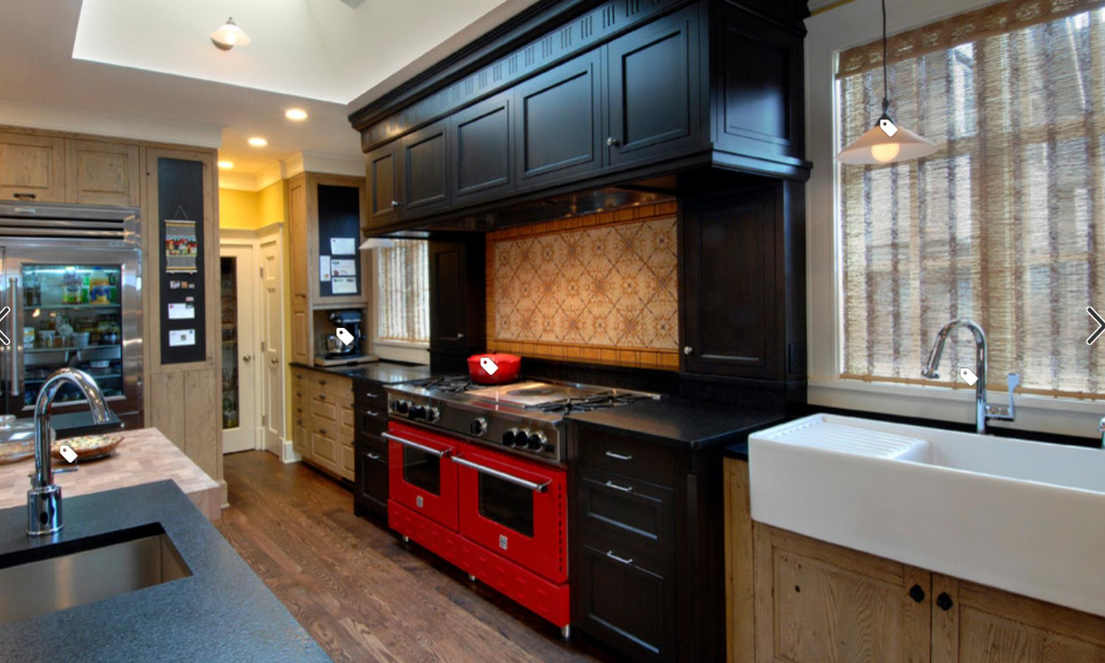
Notes:
For more inspiration on incorporating color in the kitchen you can check out our profile on Houzz.

Slide 27


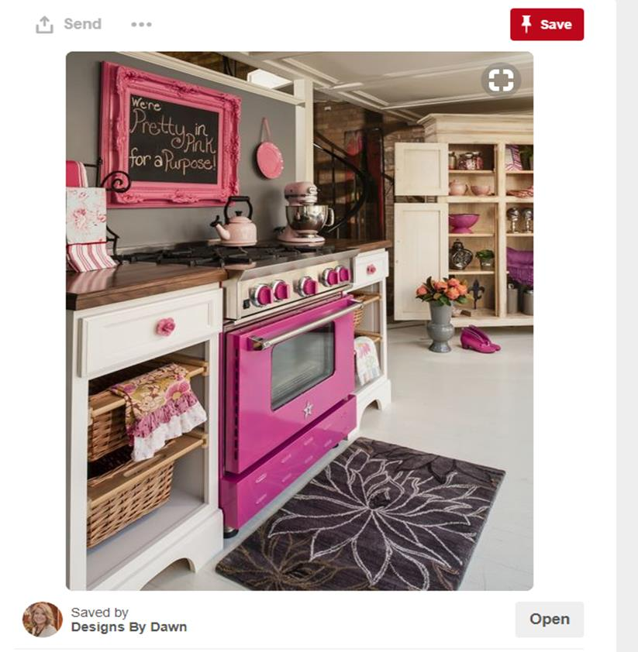
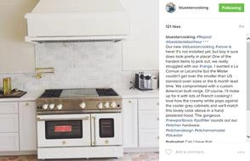
@BlueStarCooking
Notes:
Or get new ideas by following us on Instagram or Pinterest - @bluestarcooking

Slide 28

Trade Support – Specifier Rewards Program
NEW! Trade Cash Rewards for Specifying BlueStar®
Open to all builders, designers and architects
Cash spiffs paid for specifying select BlueStar products
Sign up at bluestarcooking.com/resources
Notes:
If you are specing a BlueStar kitchen for a client we would like to reward you. Sign up for specifier rewards program to receive cash on each qualifying appliance.

Slide 29



Annual Kitchen Design Contest
Win the title of BlueStar® Kitchen Designer of the Year
The Grand Prize Winner: up to $15,000 in BlueStar® Products
Six Regional Winners: PR and advertising through our website and social media channels
Notes:
Once you have completed a kitchen with BlueStar equipment submit it to our Kitchen Design Contest for a chance to win up to $15,000 in product.

