Slide 1


Slide 2
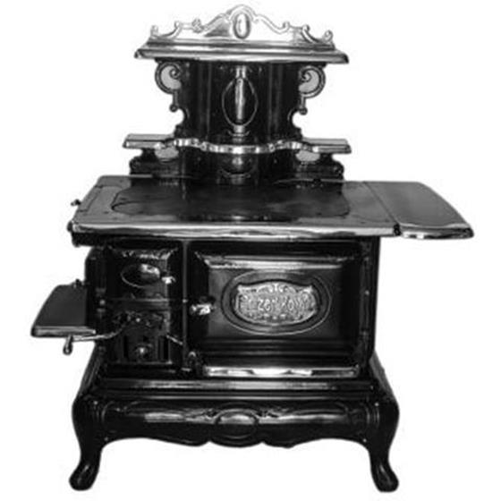
BlueStar Legacy: Handcrafted with pride since 1880
In 1880, Prizer-Painter Stove Works began manufacturing a full line of residential and commercial coal ranges, hot water heaters, furnaces, and heating stoves in Reading, PA.

Slide 3
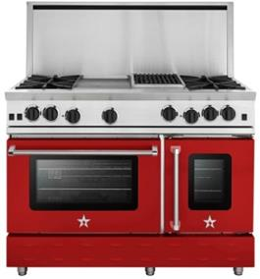
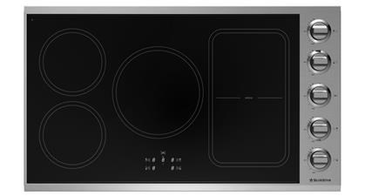
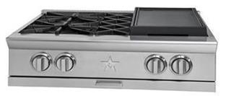
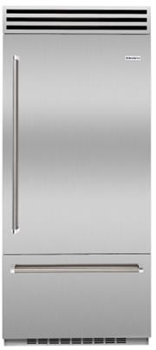
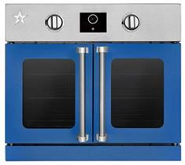
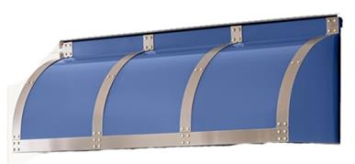
BlueStar Today: Complete Line for the Serious Home Chef
Cooktops
(Gas / Induction)
Rangetops
Ranges
Built-In
Refrigeration
(*launched Q1 2017)
Wall Ovens (Gas / Electric)
Ventilation (Standard, Designer and Custom)

Slide 4
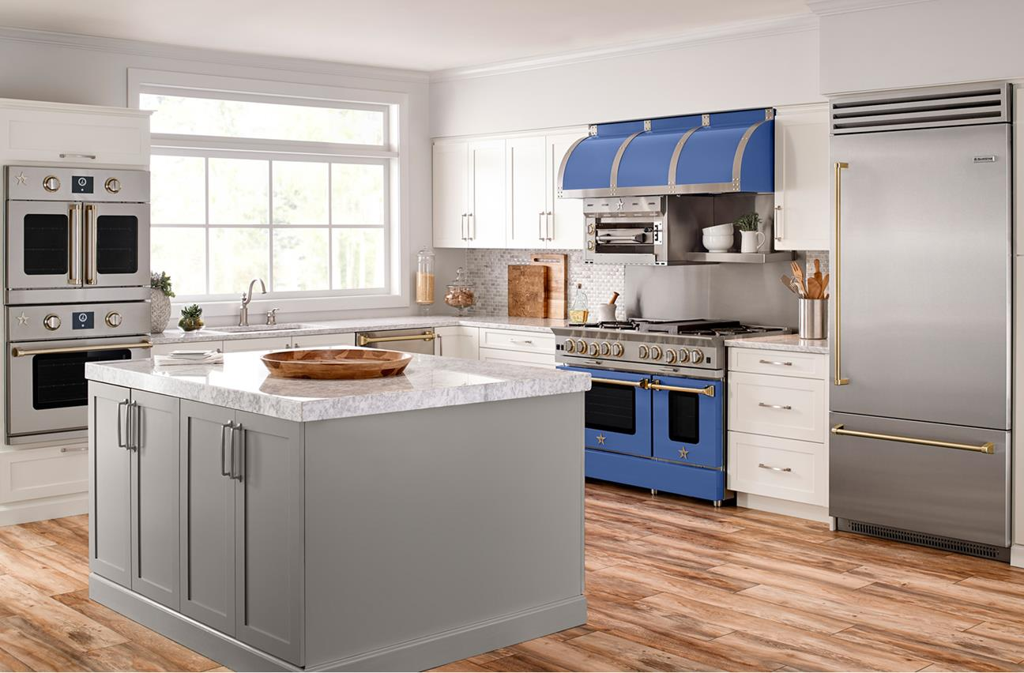
BlueStar Today – The Ultimate Chef’s Kitchen at Home

Slide 5


Our Target Customers
The Inspired Home Chef
Kitchen Remodelers & Designers

Slide 6
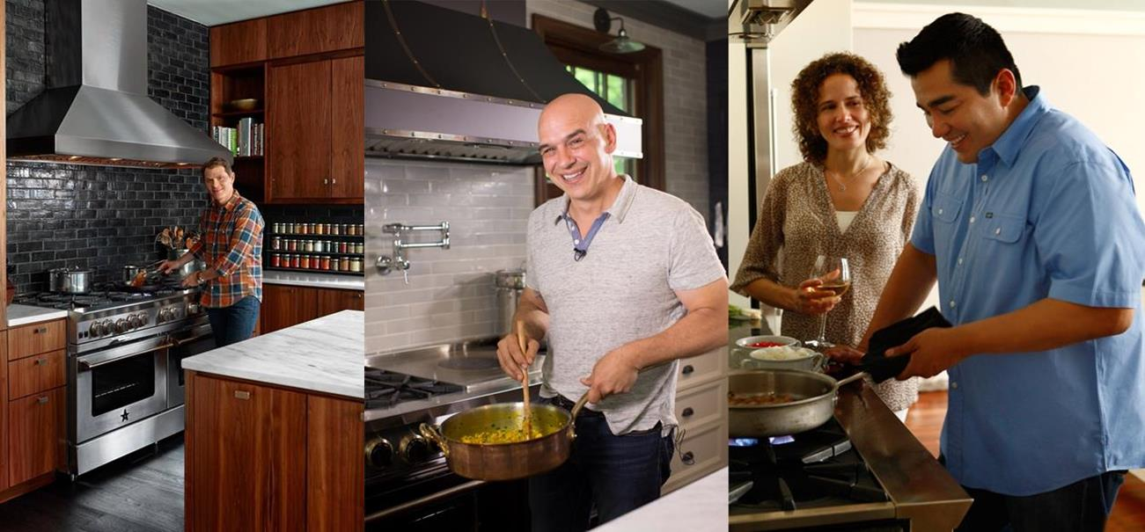
Choice of America’s Top Chefs at Home
Bobby Flay
New York, NY
Michael Symon
Cleveland, OH
Jose Garces
Philadelphia, PA

Slide 7
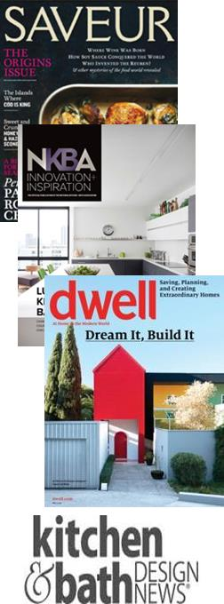


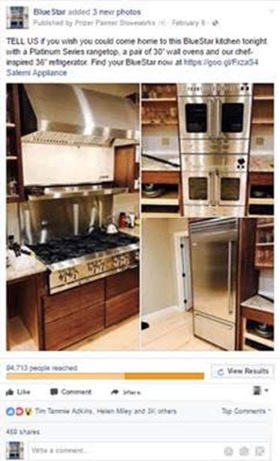
Vibrant, Lifestyle Brand
Diverse Editorial Coverage
Large & Engaged Social Media Following

Slide 8
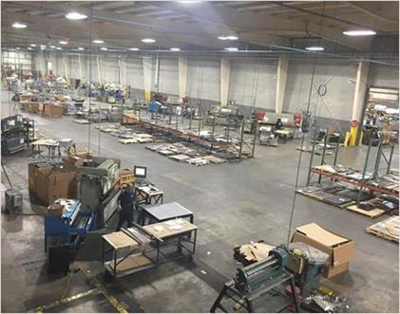

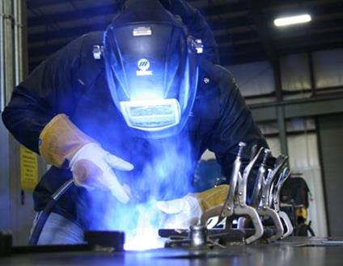
Exciting New Changes: Foundation for Expansion
Manufacturing Facility
Management
Quality Focus
New, state-of-the-art 350,000+ sq. ft. manufacturing facility
New management team
Robust QA Program

Slide 9
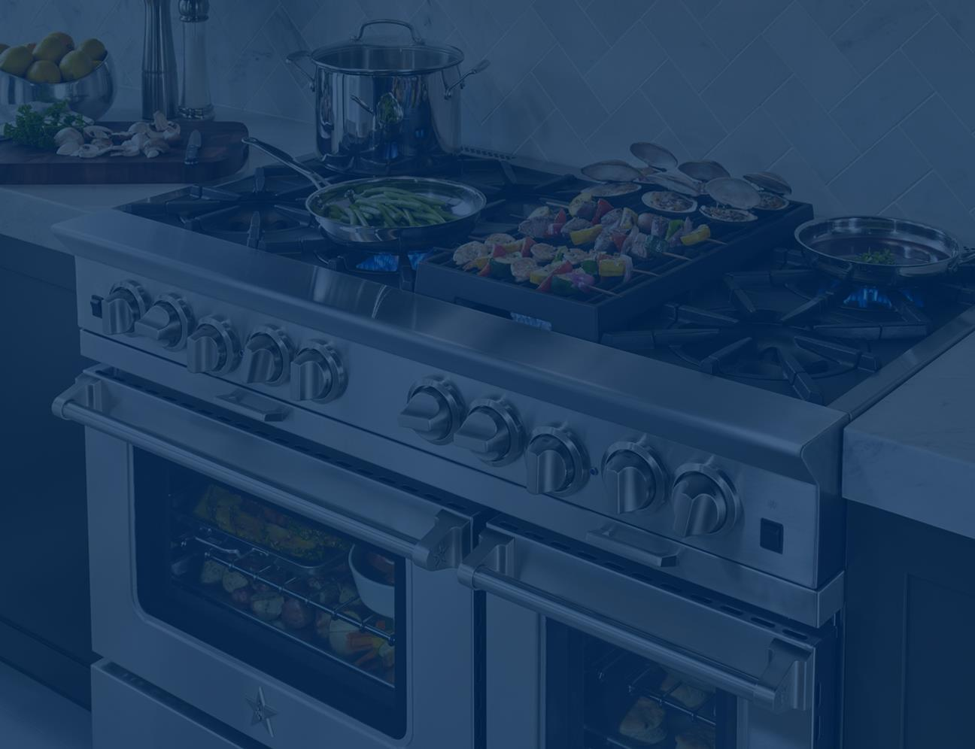
What Sets Us Apart

Slide 10
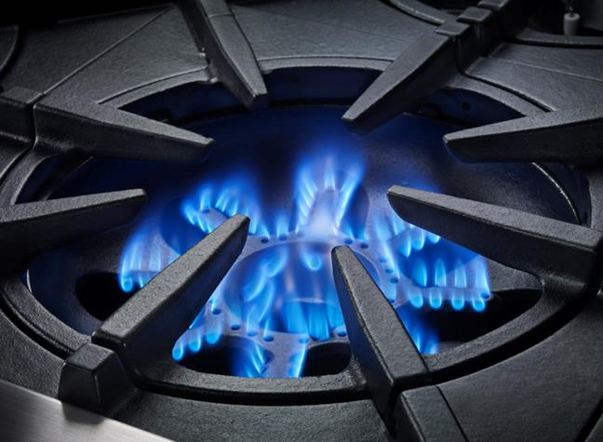
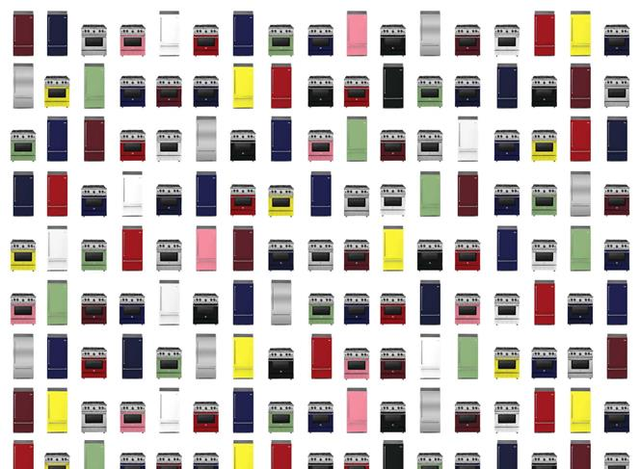
Chef-Inspired Performance & Features
Unsurpassed Customization
Handcrafted Quality

Slide 11
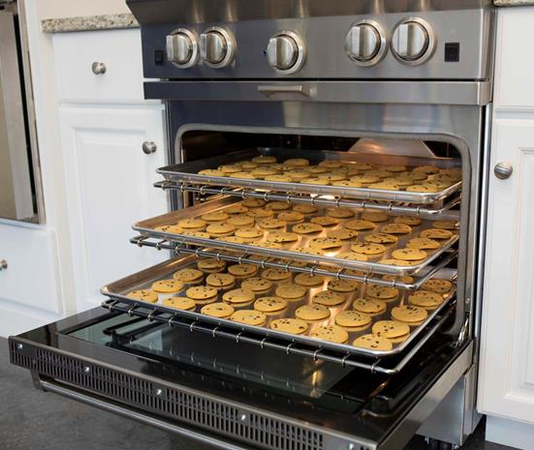
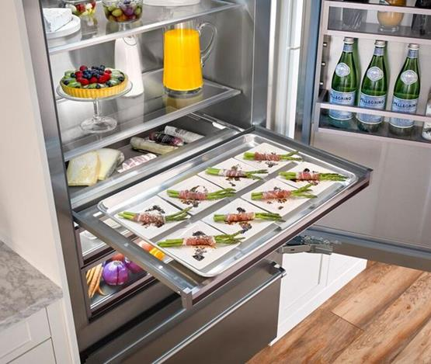
Chef-Inspired Performance & Features
BlueStar® is focused on bringing restaurant quality results to discerning home chefs.
With leading capacity in booth cooking & refrigeration, plus commercial-grade features BlueStar® appliances are designed and tested for the ultimate in performance.

Slide 12
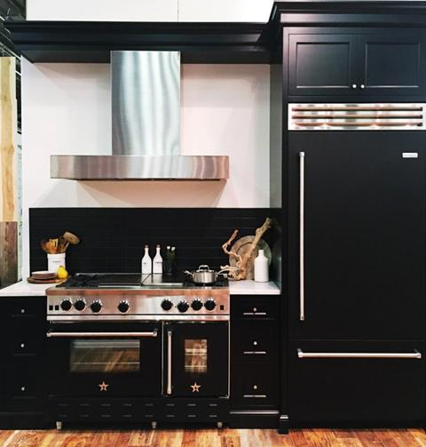
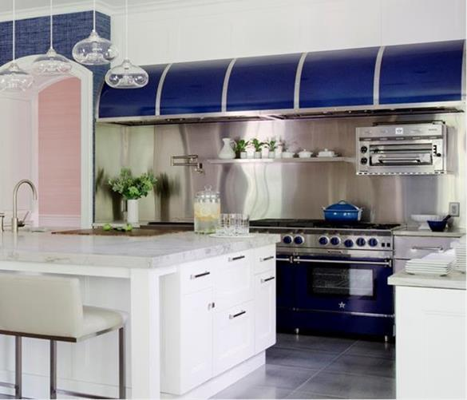

Unsurpassed Customization
Customize cooking, refrigeration and ventilation appliances with over 750+ standard colors & finishes or custom color match to your exact specifications. Plus 10 metal trim options.

Slide 13
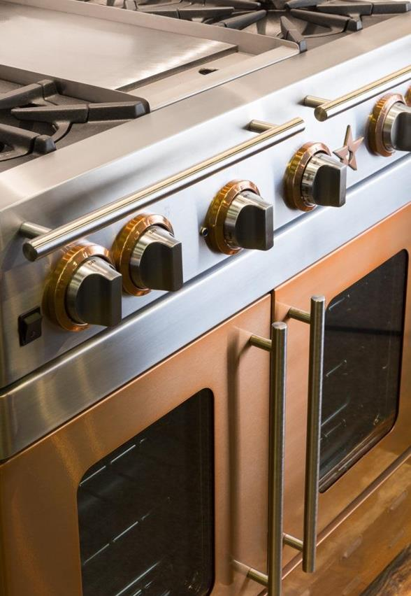
Handcrafted, Durable Construction
Handcrafted in our factory in PA using superior-quality, commercial grade stainless steel, our products are designed to withstand the rigors of the busiest home kitchens.

Slide 14
Cooking Overview

Slide 15

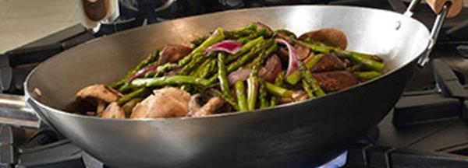

Powerful and Precise Open Burners
Up to 25,000 BTUs, perfect for achieving a rapid boil, high-heat sear, or the perfect sauté.
Place the wok directly in the open flame for even, high-heat authentic wok cooking.
Gentle 130ºF simmer is perfect for gently warming delicate soups and sauces.

Slide 16
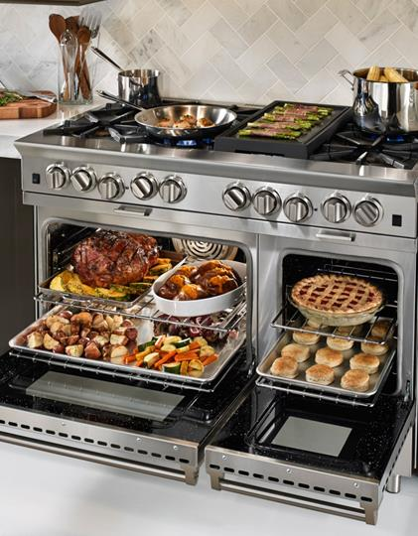
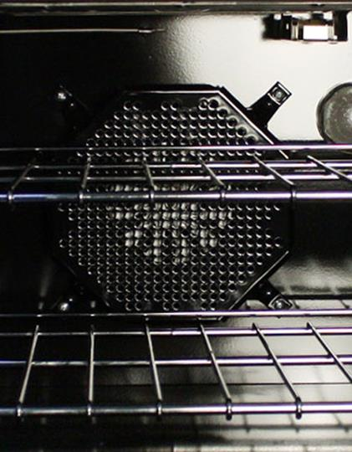
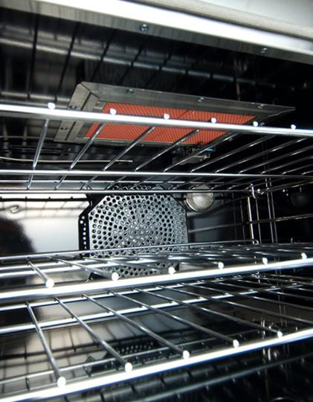
Commercial-Grade Ovens
Extra-large oven capacity accommodates 18” x 26” commercial baking sheet.
Unique oven baffle design and convection fan system result in even heat distribution for precise, accurate baking.
This 15,000 BTU broiler produces 1850 degrees of intense searing heat.

Slide 17
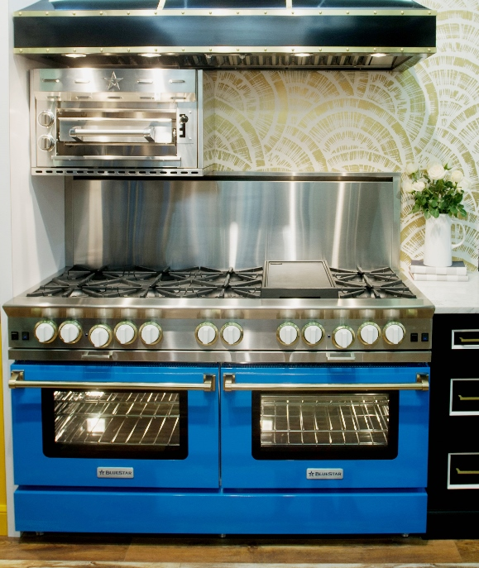
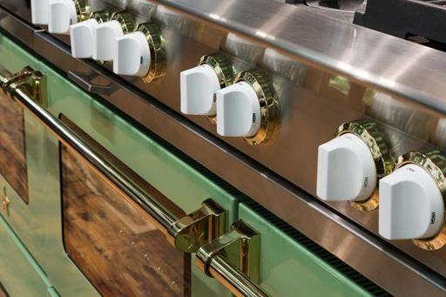
Customize with Color & Trim
Color in the kitchen continues to grow in popularity.
Choose from 750+ colors & finishes and 10 trim options for a unique kitchen design.

Slide 18

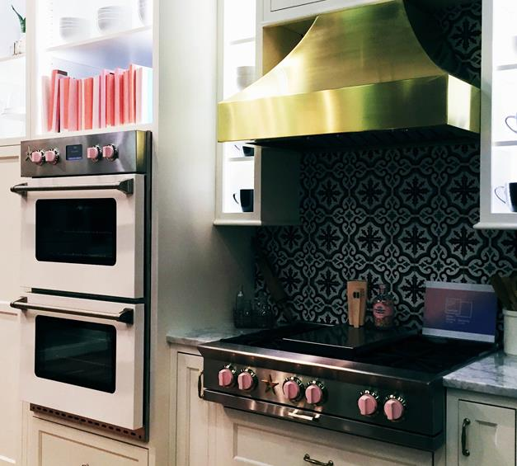
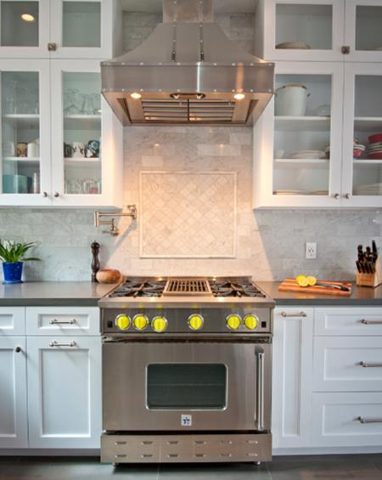

Customize with Painted Knobs
Add a pop of color to the kitchen ties any color scheme, choose from 190+ colors

Slide 19
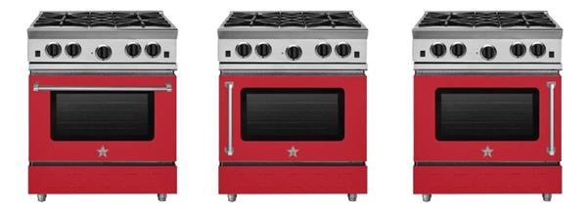
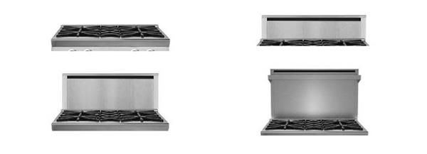
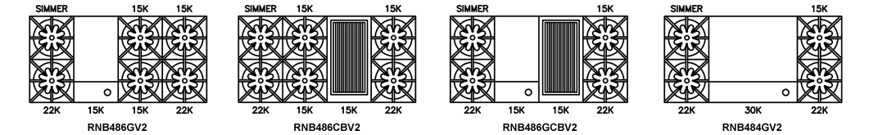
Near Unlimited Configuration Options
Door Options:
Right, Left Hinge, Drop, Swing
Backguard Options: Island, 6”, 17”, 24”
Cooking Configurations:
Burners, Griddle, Charbroiler, French Top

Slide 20
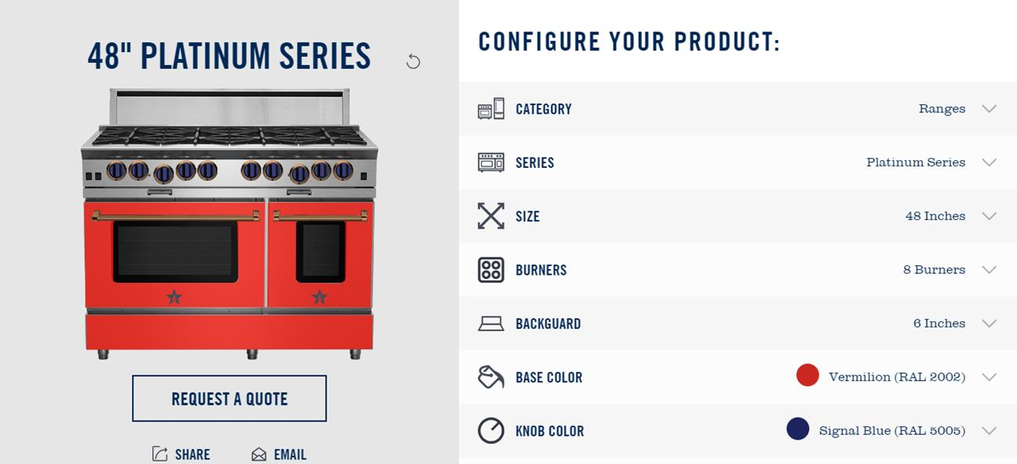
Try it all with our Build Your Own BlueStar® Tool
http://www.bluestarcooking.com/inspiration/build-your-own/

Slide 21



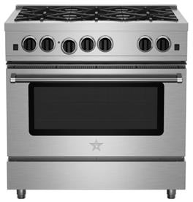
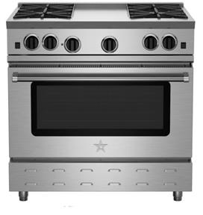
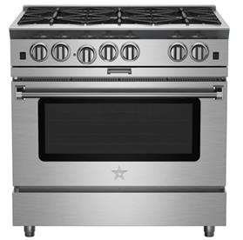
Freestanding Ranges
Culinary Series
Nova Series
Platinum Series
15,000 BTU Open Burners
21,000 BTU Sealed Burners
Limited customization
Stainless steel only
24” up to 36”
30” starting at $3,499
22,000 BTU Burners
Open Burner Design
Integrated Cooking Features
Swing Door Options
750+ Colors & Finishes
24” up to 60” sizes
30” starting at $4,799
25,000 BTU Burners
Open Burner Design
Interchangeable Griddle/Charboiler
PowR Oven Technology
750+ Colors & Finishes
24” up to 60” sizes
30” starting at $6,195

Slide 22
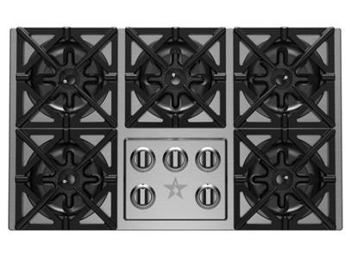

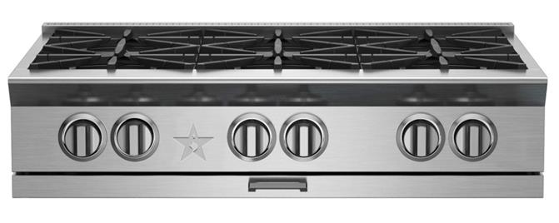
Cooktops / Rangetops
Drop-In Cooktops (30” & 36”)
Induction Cooktop (36”)
Rangetops (24” – 60”)

Slide 23
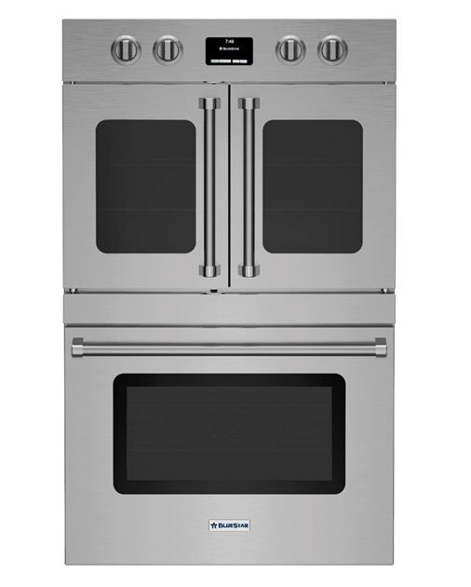
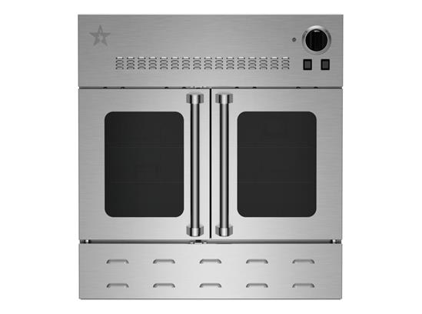
Wall Ovens
Gas Wall Ovens (24” – 36”)
Electric Wall Ovens (30”)

Slide 24
Ventilation Overview

Slide 25
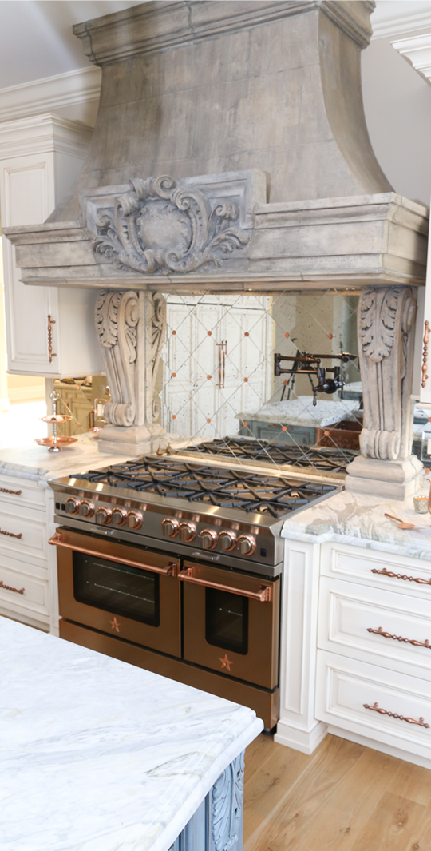
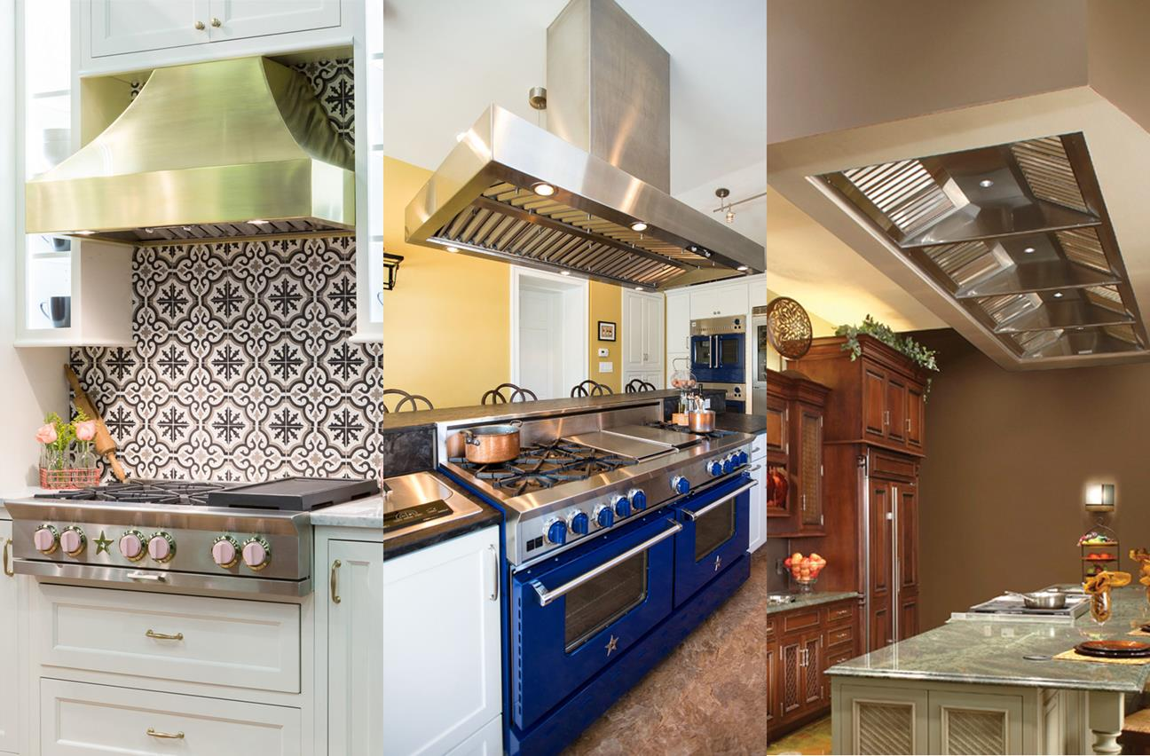
Wall Hoods
Island Hoods
Liners

Slide 26


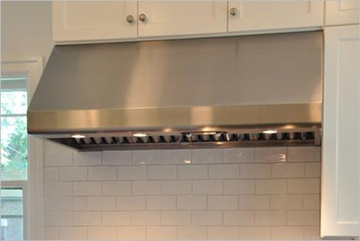
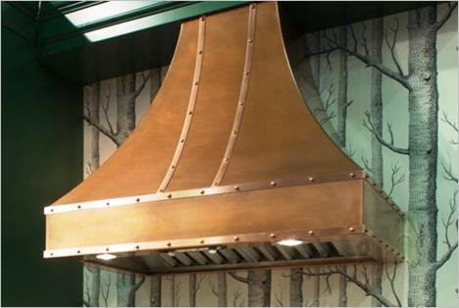
Full Offering of Standard and Custom Ventilation Lines
Available in stainless steel or over 750+ colors and finishes
Sizes available: 24” up to 66”
In-hood, In-line or Remote blower options
Available in stainless steel or over 750+ colors and finishes
10 Luxury Metal Finishes such as Brushed Brass, Brushed Copper, European Black Steel and Mirrored Stainless Steel
Custom banding, rivets and towel bars available
Custom size and shapes available
Sizes available: 24” up to 110”
In-hood, In-line or Remote blower options

Slide 27
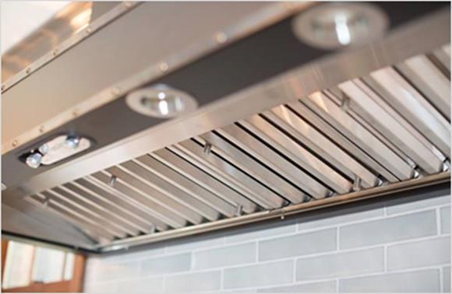
Professional-grade Construction and Performance
Constructed with commercial-grade, 18 gauge 300 stainless steel
Handcrafted seamless design
Durable stainless steel baffle filter system
  Superior grease extraction and dishwasher-safe
Variable light control
3-speed fan control
Convenient top or rear discharge (available in most models)

Slide 28
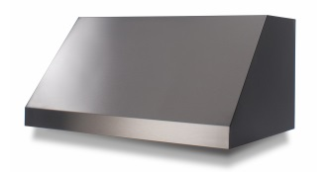
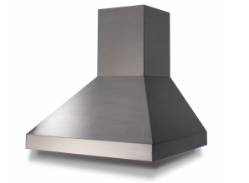
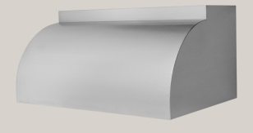

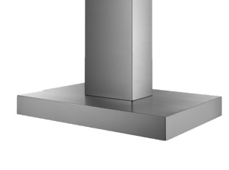
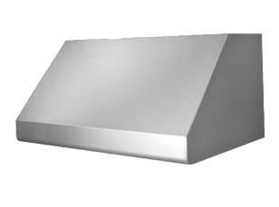




BlueStar: Standard Hoods
Wall
Hoods
Proline
Pyramid
Bonanza
Santa Fe
Manhattan
Incline
Hampton
Low Profile & Low Profile Recirculating
Metal Liner
Professional Liner
Island
Hoods
Hampton
Manhattan

Slide 29



Prizer Hoods: Standard Hoods

Slide 30

Prizer Hoods: Designer Hoods

Slide 31
Refrigeration Overview

Slide 32


Introducing NEW Built-In Refrigeration
Product at a Glance:
36” Built-In Bottom Freezer Refrigerator
Commercial-Style Design and Performance
Available in Stainless Steel and 750+ Colors plus 10 metal trims
Designed and developed by BlueStar in Cedar Rapids, Iowa
UMRP: $9,850

Slide 33


Slide 34

Commercial Styling
Durable and Hygienic Stainless Steel Interiors
Dramatic, Ramp-On LED Lighting
Heavy-duty, one piece construction with tighter sealed doors
Intuitive, OLED touch screen control with advanced features like Door Open Alarm and Max Ice
Commercial-style, articulating hinge

Slide 35

Chef Level Performance
Next generation food preservation capabilities:
Dual compressors / evaporators to provide optimal temp control, extend shelf-life and reduce odors
  Fresh foods stay fresher longer with chilled, humid air; Frozen foods thrive in dryer frigid air – No cross contamination of odors (e.g. fishy ice)

Slide 36

Chef Level Performance
Unique features for the discerning home chef:
    Oversized capacity (22.4 c ft total; 16.7 cft fridge; 5.7 cft freezer)
    Fully extending tray that fits commercial size sheet pan (in fridge and freezer)
    Extra-large, fully extending storage and freezer drawers with soft-close glides
    Adjustable and removable shelves and bins
    Automatic ice maker with Max Ice feature
    Water filtration system
    Nano-glass technology contains spills quickly

Slide 37

Build Your Own Custom Refrigerator
http://www.bluestarcooking.com/inspiration/build-your-own/

Slide 38
Quality and Reliability
      Top tier design and development team
      Over 150 years combined industry experience
      Rigorous Performance and Quality Testing
      Temperature stability testing
      Software functionality
      Structures (e.g. door swing, shelf load)
      100% Production Line testing
      Nationwide Field Testing program
      Detailed in-market testing for performance testing and sustainability
      Quality Components
      Leveraging quality parts from established suppliers

Slide 39
Customer Service and Warranty Coverage
Iron-Clad Warranty:
Full 2 year, Full 5 year sealed system, Limited 12 year sealed system
Smart Design:
Major components are easily accessible to service technician (located in standard locations)
Superior Service and Support:
Dedicated customer service team
Experienced servicer network trained by BlueStar field service training team

Slide 40


Refrigeration Overview
OLED Touchscreen Control:
Crisp, clear OLED display is easy to use and offers advanced options like Max Ice, Door Alarm & Sabbath Mode
Unmatched Customization:
Shelves and bins can easily be changed to fit any need. 750+ color and finish combinations and 10 metal trim finishes.
Oversized Capacity:
Features an astounding 22.4 cu ft of capacity.
Fits Full-Size Restaurant Sheet Pan:
Both the fridge and freezer can accommodate 18” x 26” sheet pans
Dramatic Theater LED Lighting:
Soft bright light is evenly distributed throughout the refrigerator, eliminating shadows and reflections.
Durable Stainless Steel & Glass Interiors:
No plastic – instead, 304 grade stainless steel interiors and stainless steel and glass shelves and drawers

