Slide 1
AXOR FinishPlus
&
AXOR Signature

Slide 2
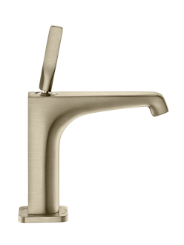


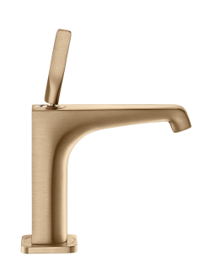

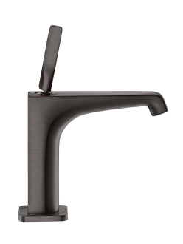
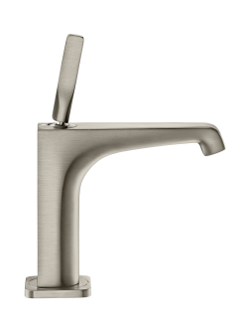
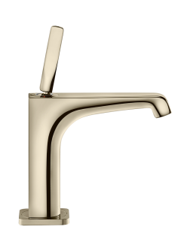



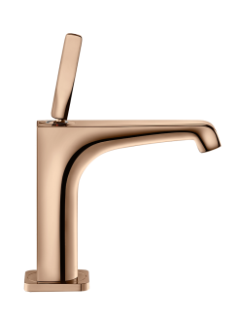
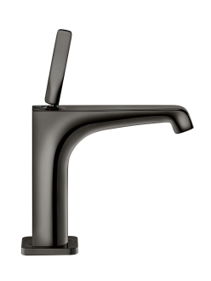
AXOR FinishPlus - PVD Special Finishes
Now Available on Select Products
Brushed
Nickel
Brushed
Brass
Brushed
Gold Optic
Brushed
Bronze
Brushed
Red Gold
Brushed
Black Chrome
Steel Optik
Polished
Nickel
Polished
Brass
Polished
Gold Optic
Polished
Bronze
Polished
Red Gold
Polished
Black Chrome

Slide 3
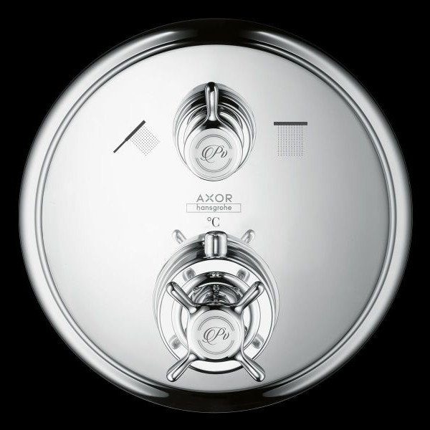
AXOR Signature - Laser Etching & Pad Printing
Custom Laser Markings
We have many premade laser markings that can be applied in place of or in addition to our standard markings.
Note: Some products will have size/placement limitations.

Slide 4
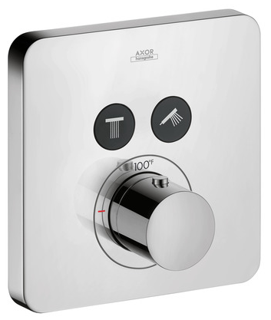
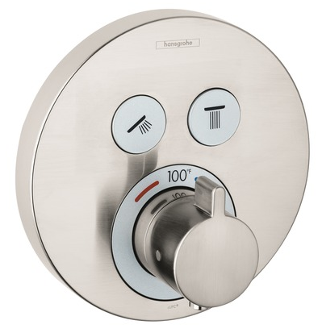
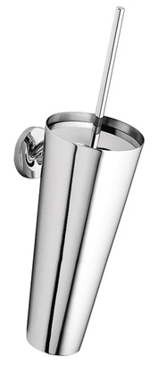
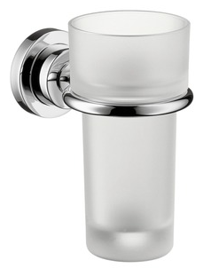
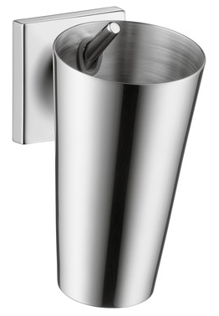
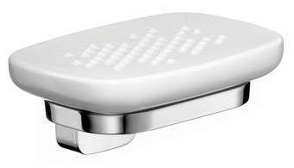
Other Customizations
Material Exceptions
Some articles contain components that cannot receive PVD finishes including:
Select shower buttons
- Axor will remain black
- hansgrohe will remain silver
- Temperature ring will also remain silver
for hansgrohe ShowerSelect trims
Porcelain and glass components included with bath accessory collections
Interior of receptacles and tumblers including toilet brush holders

Slide 5
Minimum Order Quantities
AXOR Products:
There is no minimum order quantity on AXOR-branded products.
Single piece orders are welcome.
hansgrohe Products:
The minimum order quantity is 30 on hansgrohe-branded products, with the exception of the hansgrohe-branded products included in the AXOR price book.
The 2017 AXOR price book will include a limited assortment of hansgrohe-branded WaterSense approved showerheads and handshowers available in the
new special finishes.

Slide 6
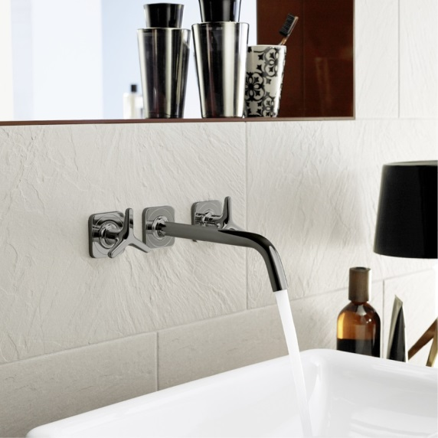
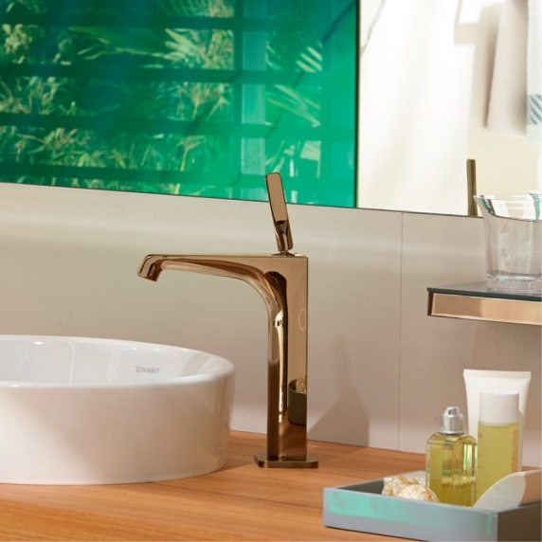
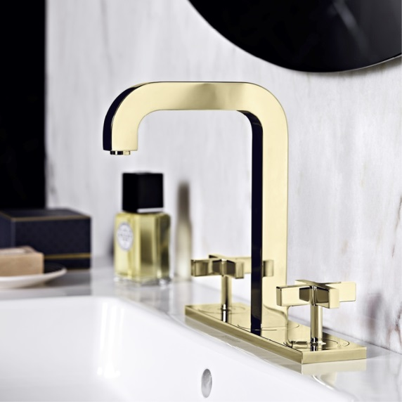
Pricing – AXOR FinishPlus
(PVD Special Finishes)
Standard orders: There is a 50% upcharge on the chrome article list price for custom finishes on quantities of 1-29 pieces. Regular tier discount applies
Projects: The Global Projects team will quote each job individually for a minimum quantity of 30 pieces per part number

Slide 7
Pricing – AXOR Signature
Special Markings (Laser Etch and Pad Print)
Due to the variety of laser and pad printing images and options available, each AXOR Signature request will be quoted individually.
This applies to both Trade and Project requests.
Please submit inquiries and quote requests to
custom-us@hansgrohe.com for more information.

Slide 8
Inquiry and Order Process - Simplified
Customer submits inquiries and orders for special finish and custom markings to custom-us@hansgrohe.com
Hansgrohe sales team and production review the request to confirm feasibility, and to provide cost confirmation and estimated lead time
Customer submits their order, receives confirmation, and submits the required and signed order acknowledgment forms
The order is produced to meet the customer’s specification, and ships within the quoted lead time

Slide 9
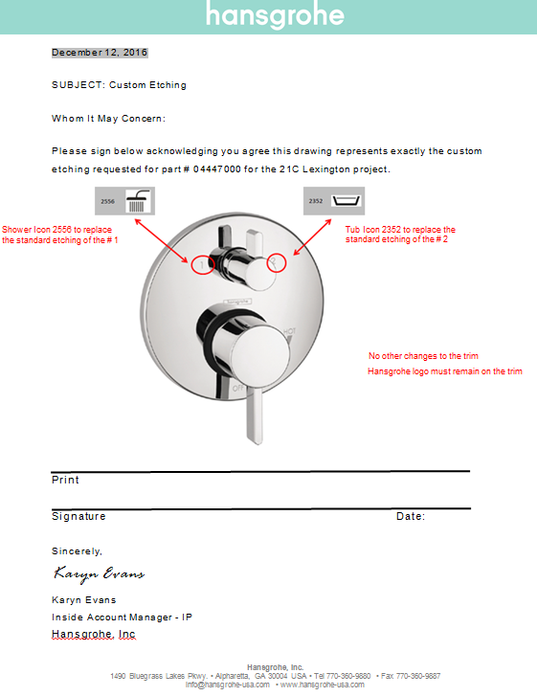
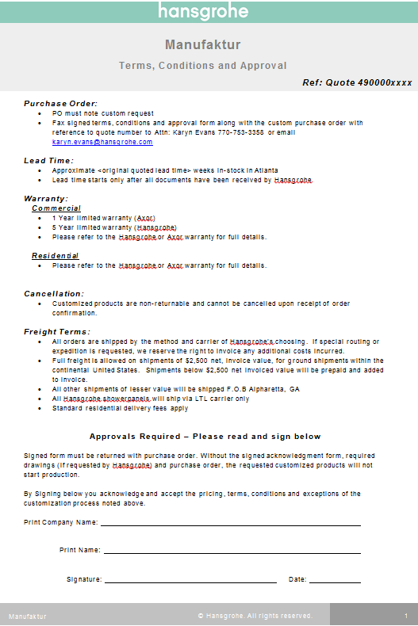
Order Process
Custom
Approval Form:
Order Terms & Conditions Acknowledgement:

Slide 10
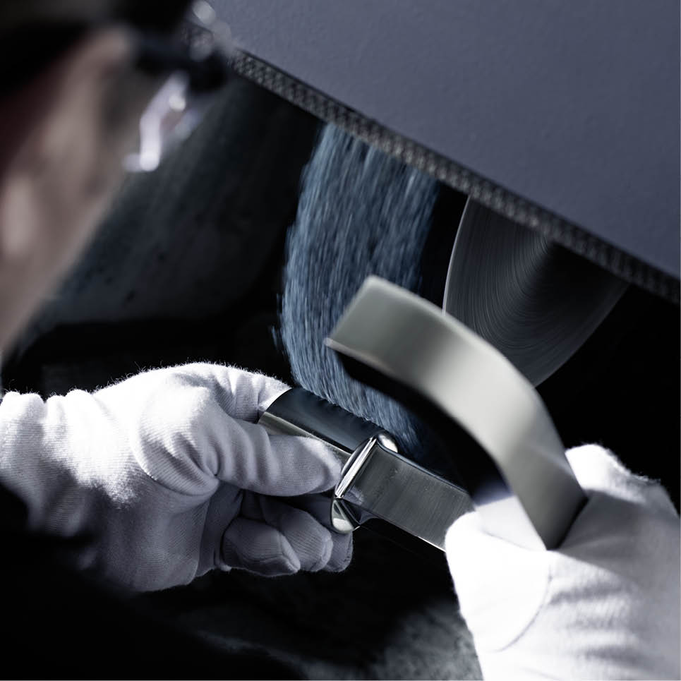
Order Process
Single orders will be 12-14 weeks from order confirmation.
Job orders will be quoted individually.
Batch releases are possible.
Large project sample requests should allow for a 8 week delivery time.
The quoted times account for production time from plants outside of the USA + transportation time to HG USA + delivery to the customer.
For jobs composed entirely of products produced in US01, the delivery time may be significantly faster.
Personal Use Orders: we will not offer a personal use discount for special finishes. The customer should order at their standard, trade discount.

Slide 11
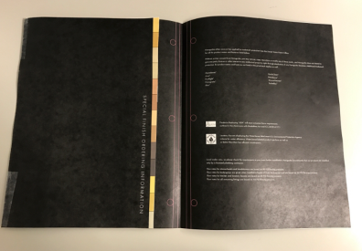
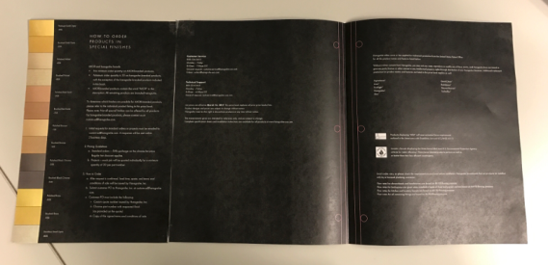
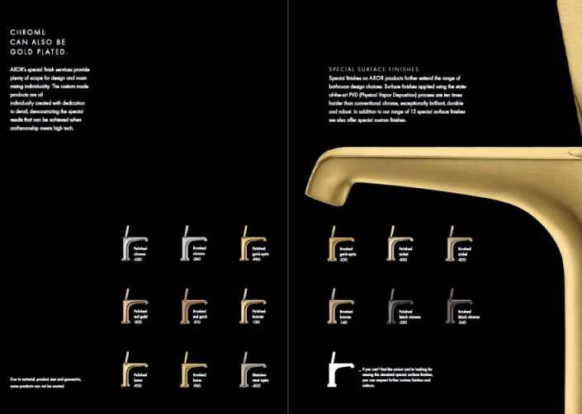
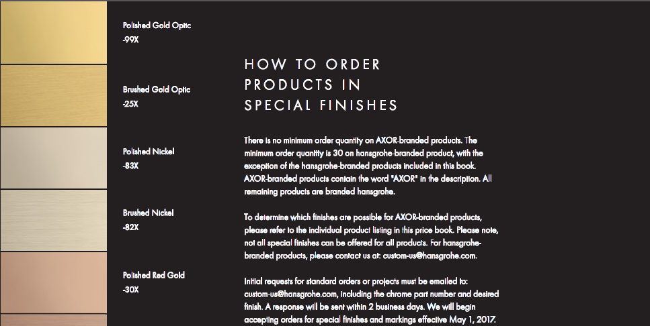
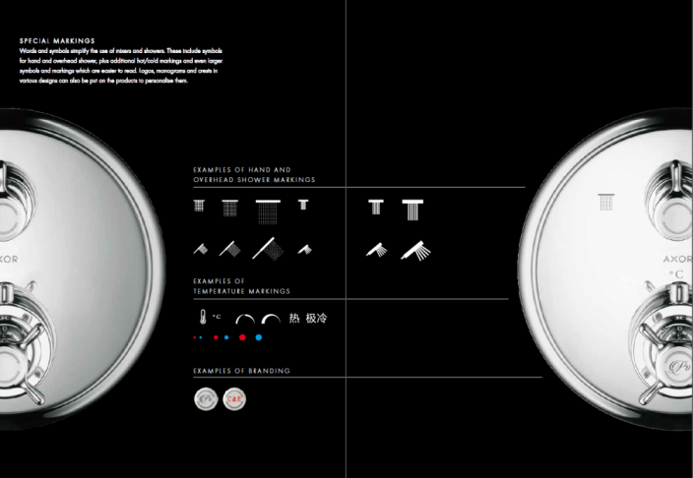
AXOR Price Book Integration:
Inside Cover & Intro

Slide 12
Display Order Information
Axor
Buy 1 piece or more for stock of regular finished items at standard discount,
customer may also order 1 piece of same item for display purposes @ .25 display multiplier off Special Finishes List Price
Order must be pre-approved by Hansgrohe RSM
Customer PO should be placed as follows:
* Line 1: 1 + pieces (stock order)
* Line 2: 1 piece (display order) @ display multiplier of .25
Please email order to: custom-us@hansgrohe.com

Slide 13
Display Order Information
AXOR
AXOR Citterio E Single-Hole Dummy Faucet on Acrylic
AXOR Citterio E single-hole dummy faucet on acrylic available
in all 13 AXOR FinishPlus finishes
List price: $ 500 (across all finishes)
Customer may purchase dummy faucet at @ .25 display multiplier
No pre-approval needed
Please email order to: custom-us@hansgrohe.com
No additional dummies/mock-ups available in AXOR FinishPlus
Order may be subject to extended lead-time

Slide 14
Display Order Information
AXOR
AXOR Citterio E Single-Hole Dummy Faucet on Acrylic
Polished Gold Optic #36118990
Brushed Gold Optic #36118250
Polished Nickel #36118830
Brushed Nickel #36118820
Polished Red Gold #36118300
Brushed Red Gold #36118310
Polished Bronze #36118130
Brushed Bronze #36118140
Polished Black Chrome #36118330
Brushed Black Chrome #36118340
Polished Brass #36118930
Brushed Brass #36118950
Stainless Steel Optic #36118800

Slide 15
Display Order Information
hansgrohe
Regular Finished Goods
Customer must order minimum 30 pieces (same SKU) required for processing (stock**) at regular trade discount
Customer may order 1 additional product at no charge for display purposes
(same SKU as stock order)
Customer PO should be placed as follows:
* Line 1: 30 + pieces (stock order)
* Line 2: 1 piece (display order), second line item will be keyed at no charge
No charge display product only eligible for initial stock order
No pre-approval needed
Please email order to: custom-us@hansgrohe.com
No dummies/mock-ups available for hansgrohe-branded products
in special finishes
**Project Pricing does not apply to Trade stock orders

Slide 16
Axor FinishPlus and Axor Signature
Questions?
Please contact custom-us@hansgrohe.com

