Slide 1
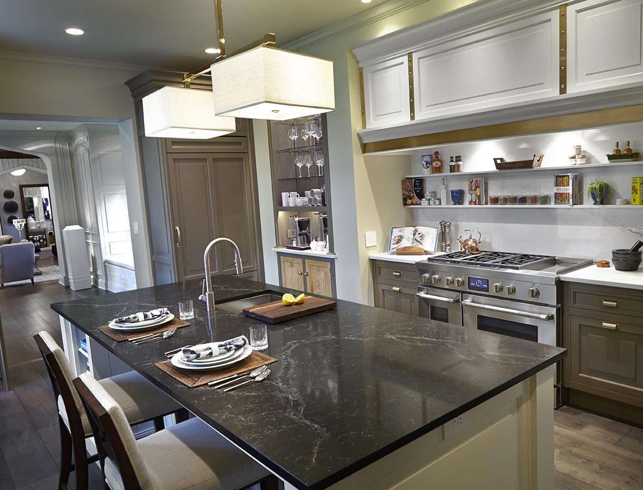

SELL-IN TOOL KIT:
Built-in/Countertop Convection Microwave

Slide 2
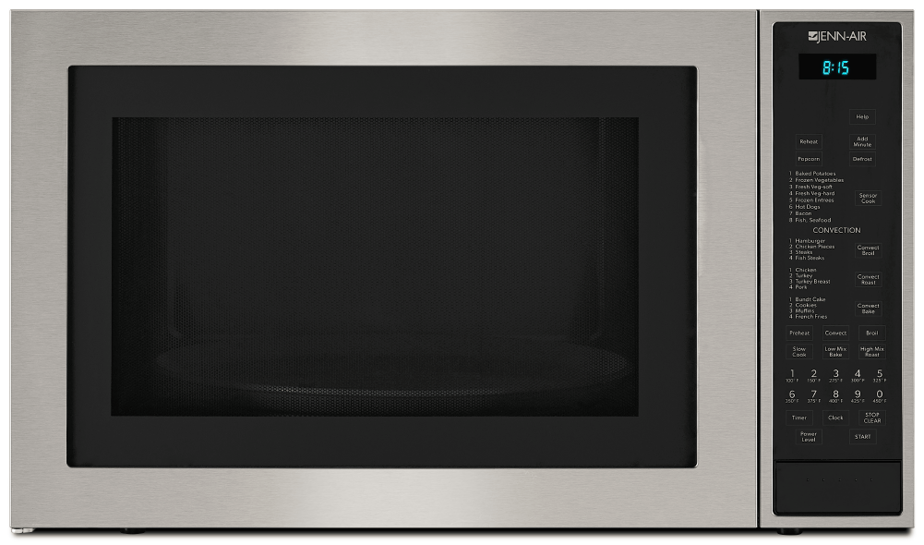
BUILT-IN/COUNTERTOP CONVECTION MICROWAVE
JMC3415ES
Euro-Style
Luxury Sensorial Quality
Brushed Stainless Steel Trim
Black Glass viewing window
Styling compatible with Euro and Pro contemporary kitchens
Built-In Oven Compatible
Tested for installation above warming drawers and the New Minerva Single Wall Ovens
Build-In Ready for Flush or Traditional Styling
Optional kits allow installations to match cabinet decor - whether style is flush mounting or traditional mounting -
both available in 27” and 30” width
Open To Ship: NOW
OTHER ADVANTAGES:
900 Watt MICROWAVE power
1450 Watt CONVECTION power
White-LED display
Interactive, sealed control panel
8 programed sensor cook settings, 12 convection auto settings for broil, roast, bake
Ceramic turntable (dishwasher-proof)
2-tier broil and bake racks
1.5 cu ft stainless steel interior
Countertop ready or can be installed as built-in (with kits)
Optional trim kits include all ductwork, trim, fasteners
UL and CSA Listed

Slide 3
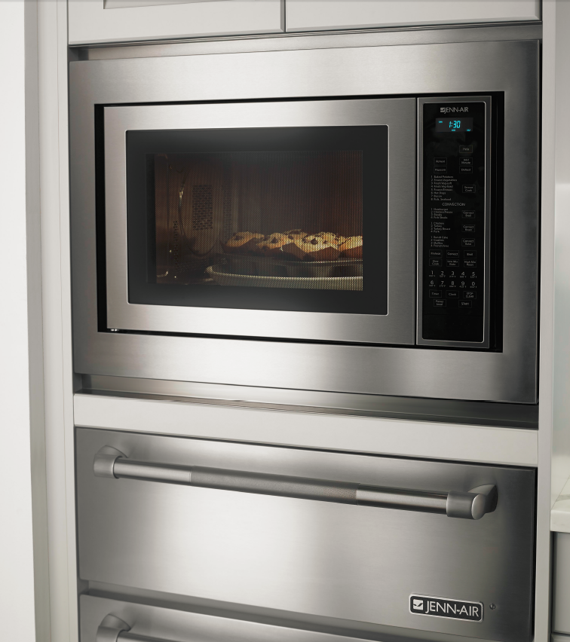
SUITABLE
Fits with Stainless Steel, Euro or Pro
May, 2016 | Confidential

Slide 4


CONSUMABLES AND ACCESSORIES
Installation Kits and other items:
Trim Kit for Flush Cabinet Install, 30” (MKC4150ES)
Trim Kit for Flush Cabinet Install, 27” (MKC4157ES)
Trim Kit for Traditional/Standard Cabinet Install, 30” (MKC3150ES)
Trim Kit for Traditional/Standard Cabinet Install, 27” (MKC3157ES )
Affresh Stainless Steel Cleaner (W10355016)

Slide 5
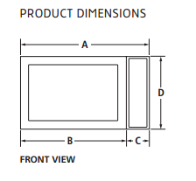
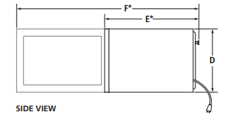
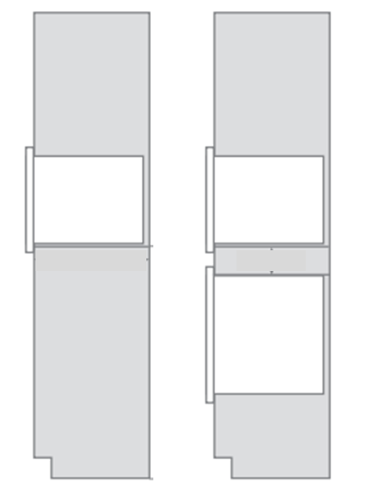
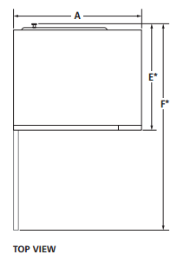
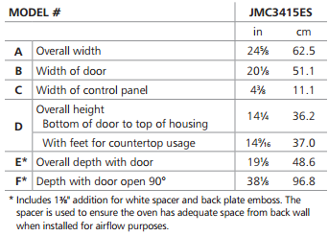
MICROWAVE DIMENSIONS
JMC3415ES
BUILT-IN MICROWAVE
BUILT-IN MICROWAVE ABOVE BUILT-IN WALL OVEN
Dimensions shown are for showroom planning purposes only. Please refer to Dimension Guides and Installation Manuals for additional details for final installation applications.

Slide 6
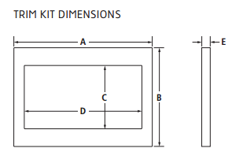
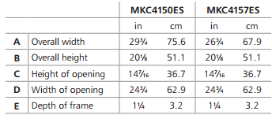
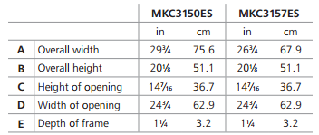
TRIM KIT DIMENSIONS
Trim Kits for JMC3415ES
VENTING REQUIREMENTS: If microwave oven is built in, a trim kit is required for proper ventilation
Flush Cabinet Installation | MKC4150ES 30” wide kit* | MKC4157ES 27” wide kit*
Width of cabinet opening | 30 1/8” | 27 1/8”
Height of cabinet opening | 22 5/8” | 22 5/8”
Projection from face of cabinet frame installed | 0” | 0”
Traditional / Standard Cabinet Installation | MKC3150ES 30” wide kit* | MKC3157ES 27” wide kit*
Width of cabinet opening | 29 3/8” | 26 3/8”
Height of cabinet opening | 18 15/16” | 18 15/16”
Projection from face of cabinet frame installed | 1 1/4” | 1 1/4”
*Dimensions shown are for showroom planning purposes only. Please refer to Dimension Guides and Installation Manuals for additional details for final installation applications.

Slide 7
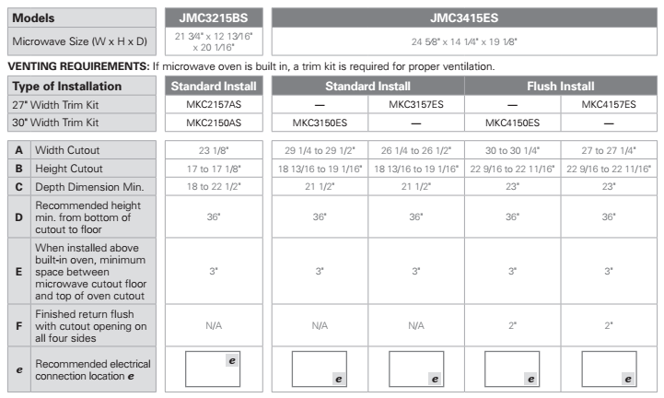
INSTALLATION DIMENSIONS
Comparing JMC3215BS to JMC3415ES
Dimensions shown are for showroom planning purposes only. Please refer to Dimension Guides and Installation Manuals for additional details for final installation applications.

Slide 8
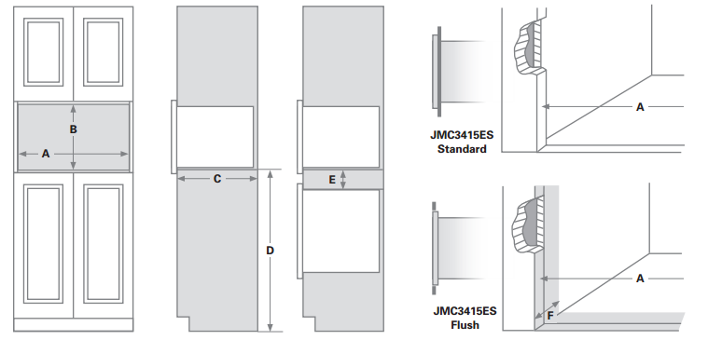
INSTALLATION DIMENSIONS
Comparing JMC3215BS to JMC3415ES
Dimensions shown are for showroom planning purposes only. Please refer to Dimension Guides and Installation Manuals for additional details for final installation applications.

