Slide 1
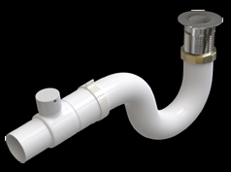
K 40- Innovation in overflows
Allows tubs to be ordered without overflow hole for extremely clean look!
Available for most V+A tubs noted as NO (no overflow), please check price book.
See page 112 of catalog for more info.

Slide 2

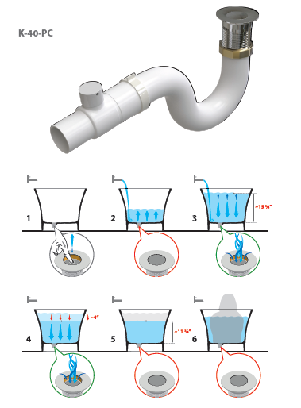
KIT 40 “INTELLI-WASTE”
KIT 40 “Intelli-waste”
The K-40 “intelli-waste” bath drain is a technical masterpiece.
Neatly hidden underneath its plug lies a highly calibrated mechanism which automatically opens if water exceeds approx. 15 ¾” in depth.
Eliminates the need for an unsightly overflow pipe
Is revolutionary emptying performance of up to 9 ½ gallons per minute offers real world flood protection – and total peace of mind.
Once the tap is turned off, the intelli-waste allows the bath to empty to approximately 11 ¾” and then automatically reseals, allowing the bather to enjoy a deep soak.
Pending IAPMO Approval.
Certified to UNI EN-274-1:2004 and 274-2:2004.
Works with all Victoria + Albert baths excluding Cabrits and Pescadero.
Finishes: Polished Chrome, Brushed Nickel.

