Slide 1

Dyad
A New Suite of Bathroom Accessories by

Slide 2
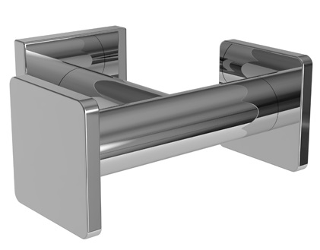
The Inspiration
Dyad is a new perspective on contemporary accessories. A dyad is the pairing of elements that are often at odds or conflicting. Dyad combines round posts and square rosettes & finials, contrasting yet complementing forms, which combine to create a modern alternative to the typical uniformity of minimalist design.

Slide 3
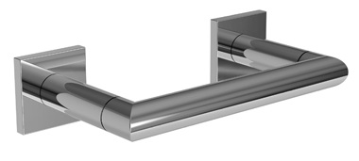
Products & Finishes
Eighteen top level items
All items available in Polished Chrome (PC), Satin Nickel (SN) and Polished Nickel (PN).
Two pricing groups:
  Group 1: PC
  Group 2: SN & PN

Slide 4
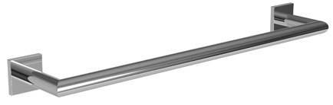
Towel Bars
Part | Description | Group 1 | Group 2
5302 | 18" Towel Bar | $150 | $180
5303 | 24" Towel Bar | $177 | $212
Launches April 2016

Slide 5
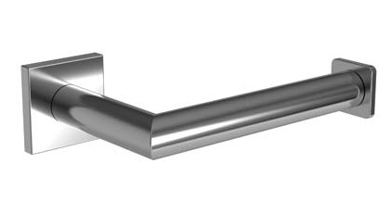
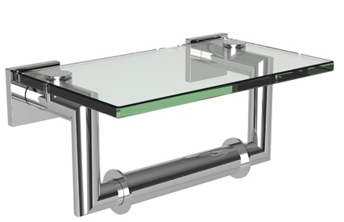
Toilet Tissue Holders
Part | Description | Group 1 | Group 2
5308 | Double Post Toilet Tissue Holder with Pivoting arm | $168 | $212
5306 | Open Toilet Tissue Holder | $144 | $171
5309 | Double Open Toilet Tissue Holder | $152 | $190
5327 | Double Post Toilet Tissue Holder with Cover | $221 | $278
Launches April 2016

Slide 6
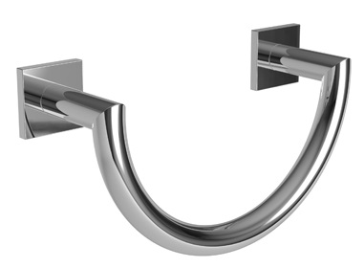
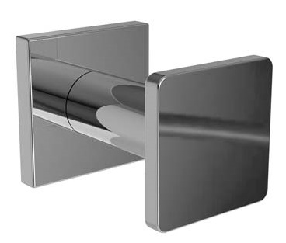
Towel Ring & Hooks
Part | Description | Group 1 | Group 2
5305 | Towel Ring | $209 | $251
5310 | Single Robe Hook | $52 | $62
5310D | Double Robe Hook | $106 | $122
Launches April 2016

Slide 7
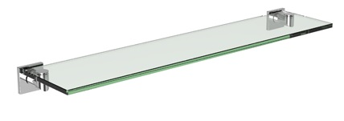
Shelves
Part | Description | Group 1 | Group 2
5334T-24 | 24" Shelf | $223 | $274
524B | Hotel Shelf Mounting Kit | $95 | $114
5334T-24 features tempered glass.
524B is compatible with XX40, XX43 & XX43S Hotel Shelf Frames.
Order (1) Mounting Kit plus (1) Frame to make a complete hotel shelf.
24” Shelf Launches April 2016
Hotel Shelf Mounting Kit Launches July 2016

Slide 8
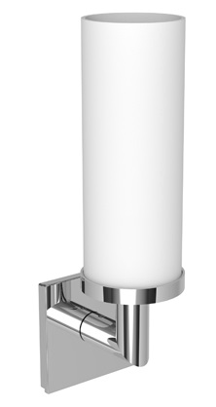
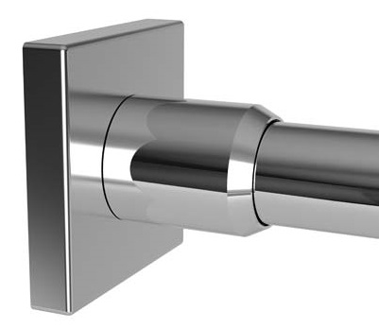
Light & Shower Rod Brackets
Part | Description | Group 1 | Group 2
5381 | Single Light | $346 | $416
Part | Description | Group 1 | Group 2
5239B | Shower Rod Brackets | $106 | $127
Lights are UL listed for damp locations.
Shade: Satin Etched, Cased Opal Glass (3681-G-O).
Bulb: A19 incandescent, 100 watt maximum.
Order (1) Bracket Pair plus (1) 1139R-6 Shower Rod to make a complete unit. 6' Straight Rods should be trimmed for use in smaller openings.
Launches April 2016
Launches July 2016

Slide 9
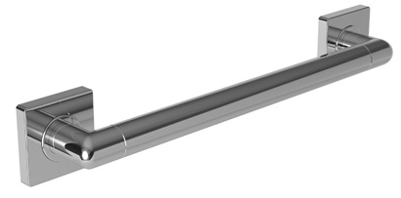
Grab Bars
Part | Description | Group 1 | Group 2
5261 | 16" Grab Bar | $324 | $388
5262 | 18" Grab Bar | $332 | $399
5263 | 24" Grab Bar | $355 | $425
5265 | 36" Grab Bar | $449 | $539
5266 | 42" Grab Bar | $513 | $615
Launches July 2016

Slide 10
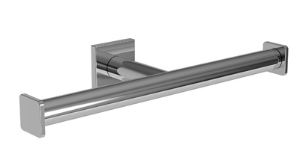
Product Quality
Workmanship – Hand finished, precision brass products
Products are backed by a limited lifetime warranty against defects in material and workmanship
Solid brass construction delivers beauty and long-lasting quality finishing process
GINGER accessories utilize concealed screws to maintain design beauty

Slide 11
Display Options
Size | Orientation | Placement | List
24" x 18" | Horizontal | Wall Only | $2,491
24" x 30" | Vertical | Wall & Kiosks | $2,732
36" x 30" | Horizontal | Wall & Kiosks | $3,978
36" x 60" | Vertical | Wall & Kiosks | $4,811

Slide 12
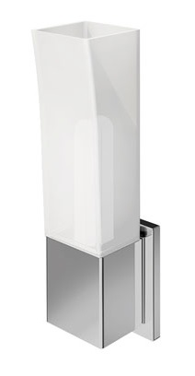
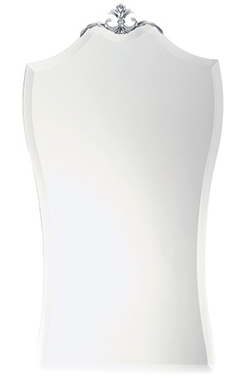
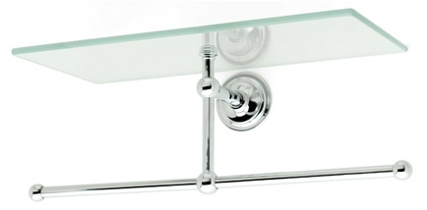
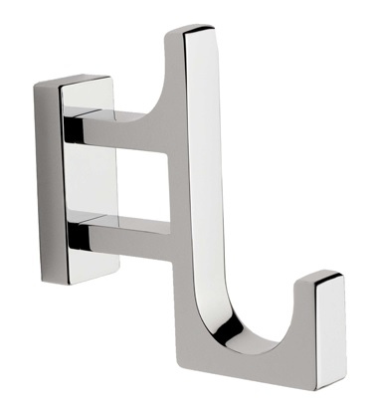
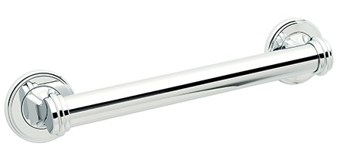
Brasstech, Your Preferred Partner
One PO Program – Order GINGER, Newport Brass and Brasstech products on one PO.
Auto RMA Program – Generate RMA numbers automatically at mybrasstech.com
Technical Support – Customer Service technical team
has more than 100 years of industry experience
ReadyShip Program – 95%+ on-time delivery performance on more than 2,800 of our best selling products
Redesigned, easy-to-use websites
Marketing Support – Brasstech invests more than
$1 million annually to support our showroom partners with merchandising materials, advertising, display, and literature
Sales Support – Our network of District Managers, Regional Managers, and Sales Representative Organizations are always available to serve your needs.

