Slide 1





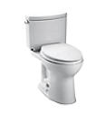
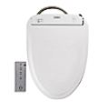
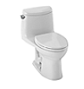




Earn money for each sale!
Double Cyclone Toilets
Neorest Line
Washlet Line
Contact Mary Beth Beno for all parameters of spiff at #330-655-9220 or Marybeth@uscrep.com
Promotion Starts March 19th & ends June 30th, 2015

Slide 2

Money will be paid out for invoiced orders only. Please provide Mary Beth with documentation pertaining to the sale.
This offer does not apply to “job work” or “project work” sales.
Payout parameters subject to change at the discretion of TOTO USA.
Promotion Starts March 19 & ends June 30th, 2015.

