Slide 1


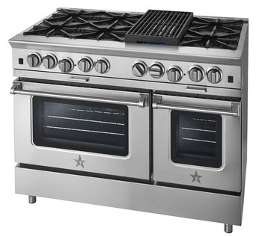
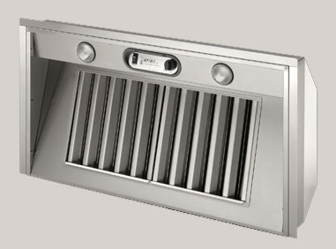
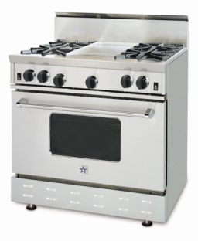
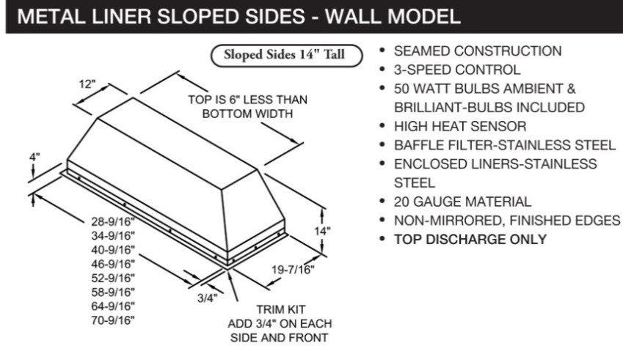
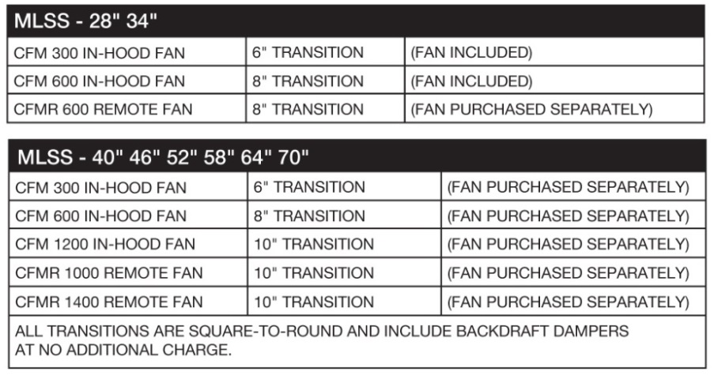
Bundle & Save
up to $400*
On a Prizer Hoods® metal liner when combined with a BlueStar® range or rangetop
Option 1:
Save $400 when combining a 48” or 60” BlueStar range or rangetop with a Prizer Hoods MLSS Liner
MLSS Retail: $837*
* Blower sold separately
Option 2:
Save $250 when combining a 24”, 30” or 36” BlueStar range or rangetop with a Prizer Hoods MLSS Liner
MLSS Retail: $749**
** Blower included

